Slide 1
Coursera capstone ibm applied data science capstone
Opening a New Shopping Mall In Kuala Lumpur, Malaysia

Slide 2
Business problem
Location of the shopping mall is one of the most important decisions that will determine whether the mall will be a success or failure
Objective: Analyze locations in the city of Kuala Lumpur, selecting the best place for a new shopping mall
Business Question
In the city of Kuala Lumpur, Malaysia, if a property developer were looking to open a new shopping mall, where would you recommend that they open it

Slide 3
Data
Data Required
List of neighborhoods in Kuala Lumpur
Latitude and longitude coordinates of each neighborhood
Venue data, in particular data for shopping malls
Sources of data
Wikipedia page listing all Kuala Lumpur neighborhoods
https://en.wikipedia.org/wiki/Category:Suburbs_in_Kuala_Lumpur
Geocoder package for latitude and longitude coordinates
Foursquare API for venue data

Slide 4
methodology
Web scraping the Wikipedia page for the neighborhood list
Obtain latitude and longitude coordinates using Geocoder
Use Foursquare API to obtain the venue data
Group the data by neighborhood, taking the mean of the frequency of occurrence of each venue category
Filter venue category by shopping mall
Perform clustering on the data by using k-means clustering
Visualize the clusters in a map using Folium

Slide 5

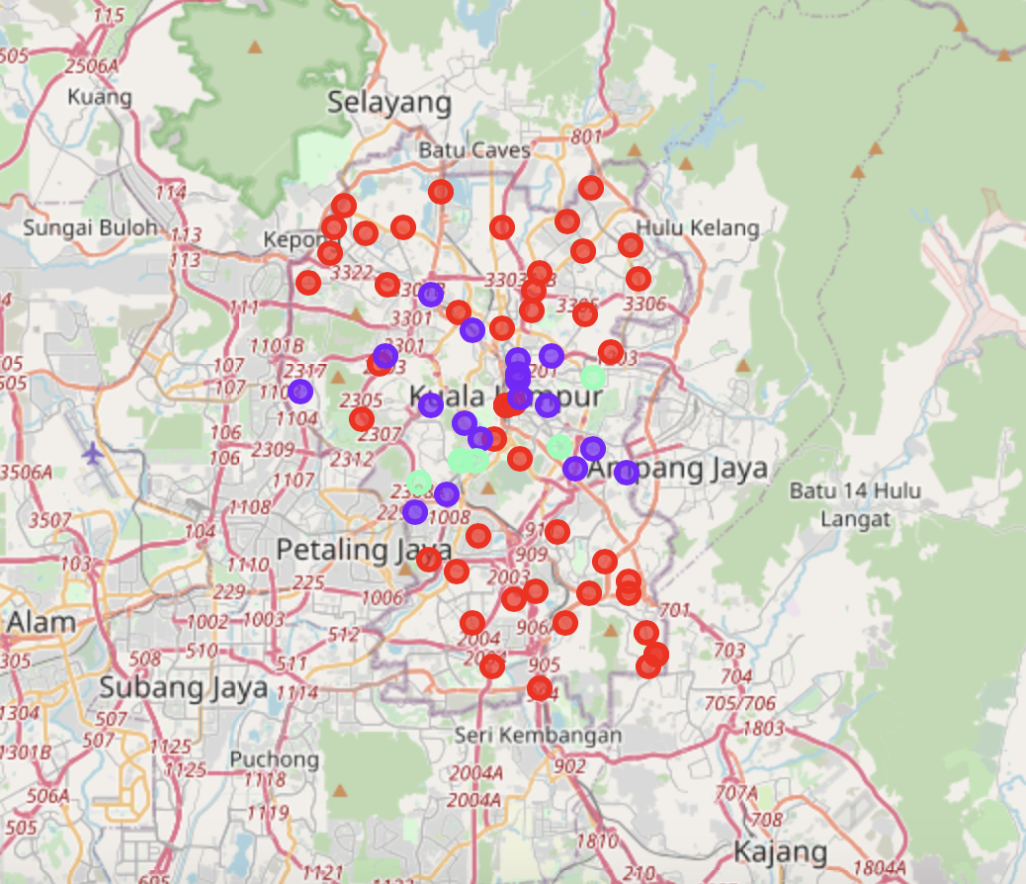
Results
Categorized the neighborhoods into three clusters
Cluster 0: Neighborhoods with moderate number of shopping malls
Cluster 1: Neighborhoods with low number of shopping malls
Cluster 2: Neighborhoods with a high concentration of shopping malls

Slide 6
Discussion
Most of the shopping malls are concentrated in the central area of the city
Cluster 2 has the highest number with cluster 0 having a moderate number
Cluster 1 neighborhoods have a very low number of shopping malls
Oversupply of shopping malls is mostly happening in the central area of the city, with the suburb area offering very few shopping malls

Slide 7
Recommendations
Open new shopping malls in neighborhoods in cluster 1
Cluster 0 can also be targeted for new shopping malls, if developers offer unique selling propositions to stand out from the competition
Avoid cluster 2, which already has a high concentration of shopping malls and intense competition

Slide 8
Conclusion
Answer to the business question: The neighborhoods in cluster 1 are preferred for the opening of a new shopping mall
Findings of this project will help the relevant stakeholders to capitalize on the opportunities of high potential locations while avoiding overcrowded areas in their decision to open a new shopping mall

