Slide 1
Presentation Slides (Day 3) - Extended Edition
Instructions: You can copy and generate the PPTX file to present to the Kong evaluators.

Slide 2
Slide 1: Title Slide
Title: Kong Konnect & AI Gateway Implementation Subtitle: Case 1: Global Fintech Bank Presenter: [Your Name] - Solutions Architect

Slide 3
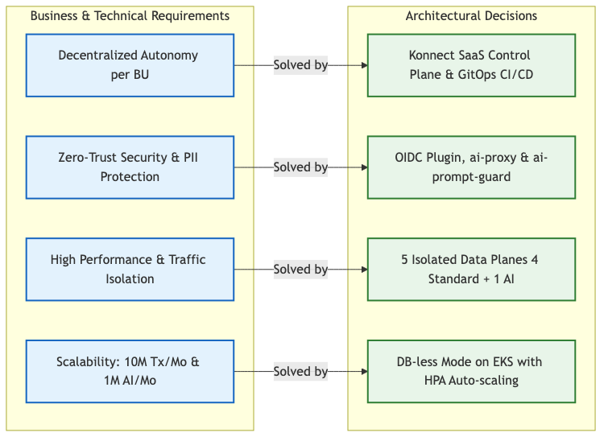
Slide 2: Phase 1 - Discovery and Requirements Mapping
The Client’s Challenge: The bank had monolithic architectures and silos, affecting Time to Market and security in the adoption of new technologies.
Silos and Bottlenecks: Credit Cards, Loans, and Personal Banking teams blocked by central infrastructure.
Performance: High latency in core systems under traffic spikes.
Security and AI: Need to adopt LLMs without risk of sensitive data leakage (PII).
Developer Experience: B2B partner onboarding extremely slow.

Slide 4
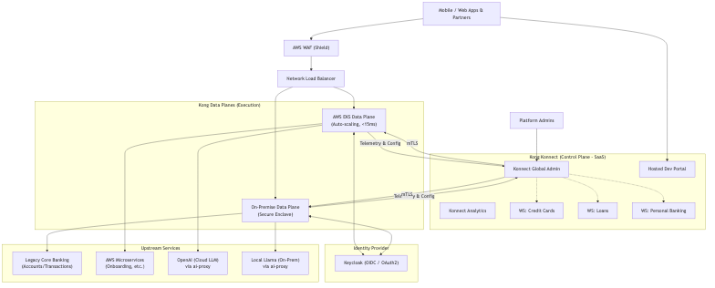
Slide 3: Phase 2 - Architecture and Design (Blueprint)
Hybrid Architecture Optimized for Fintech:
We decided to separate the control plane (Konnect) from the data plane (EKS), guaranteeing isolation, PCI-DSS compliance, and ultra-low latency.
Control Plane in Konnect (SaaS): Centralized governance (Single Pane of Glass) and strict RBAC.
5 Dedicated Data Planes (EKS):
  4 Transactional Data Planes for isolation between BUs (Cards, Loans, Core, Personal).
  1 Dedicated AI Data Plane (kong-ai-gateway) to separate token-intensive compute workloads.

Slide 5
Slide 4: Phase 3 - Security and Traffic Implementation
API-level Governance without touching code:
Rate Limiting: Implemented in the Cards ecosystem to protect legacy APIs against request spikes (Returning 429 Too Many Requests).
OpenID Connect (OIDC): Native integration with the bank’s Identity Provider (Keycloak) for strict validation of Bearer tokens.
Proxy-Cache: Caching frequent responses to reduce latency of overloaded microservices.

Slide 6
Slide 5: Phase 4 - Secure Artificial Intelligence (AI Gateway)
Protecting Bank data and controlling costs:
Semantic Routing (UI): Native semantic routing. Developers just consume /ai/chat/chat/completions without touching OpenAI credentials.
AI Prompt Guard: Instant Regular Expressions (RegEx) blocking. If the payload contains credit card formats, the request is blocked before reaching the LLM.
Costs and Chargeback: Exact traceability of token consumption (Ingress and Egress) for each Business Unit.

Slide 7
Slide 6: Phase 5 - Operations and Observability (APIOps)
100% Automation and Centralized Telemetry:
APIOps (decK): Pipeline based on a GitOps Monorepo. Declarative deployment from Swagger/OAS using the deck CLI.
OpenTelemetry: Global OTel plugin integration.
Signoz (Backend): Traces, Logs, and Metrics visualized in real-time without aggressively instrumenting the backend applications.

Slide 8
Slide 7: Live Demonstration
Architecture Flow in Action:
APIOps: Automated deployment and validation of APIs (verify_day2_configurations.sh).
Security and Traffic: Successful OIDC requests and rate limit checks (Rate Limiting).
AI in Action: Successful OpenAI consumption and real-time blocking of a credit card by the ai-prompt-guard.
Total Visibility: Massive traffic generation (generate_traffic.sh) and live trace monitoring in Signoz.

Slide 9
Slide 8: Next Steps (Roadmap)
The future of the Bank’s API Platform:
Kong Operator: Evolution towards native Kubernetes ingress traffic in the EKS cluster using the modern Gateway API.
Kong Mesh: Service Mesh (mTLS) implementation to guarantee internal Zero-Trust security between core microservices.
Custom Plugins (Go/Rust): Building high-speed plugins for highly specific business logic (e.g., ISO8583 protocol transformations).

Slide 10
End of slides.

