Slide 1
ViT-alia (Malaria Detection using Vision Transformers)
CS5105-MachineLearning
CS22B1093 ROHAN G
CS22B1095 R SAI CHARISH
CS22B1096 T PRATYEK

Slide 2
ViTalia - Malaria Detection using Vision Transformers (ViT)
Malaria:
Malaria remains one of the most prevalent and deadly infectious diseases in the world, particularly in developing regions like sub-Saharan Africa, Southeast Asia, and parts of South America. According to the World Health Organization (WHO), malaria accounted for an estimated 241 million cases and over 627,000 deaths in 2021 alone. The impact is especially severe on children under the age of five and pregnant women, making early and accurate diagnosis a critical factor in reducing mortality rates.
Traditional methods for diagnosing malaria involve manual examination of Giemsa-stained blood smears under a microscope. This process, although effective, is labor-intensive, time-consuming, and requires highly skilled technicians. In many regions where malaria is most prevalent, access to such skilled personnel and medical facilitiesis limited. As a result, delays in diagnosis can lead to worsening patient outcomes, including severe complications and death.
The need for a more scalable, rapid, and accurate solution is what motivated us to focus on automating malaria diagnosis using cutting-edge machine learning techniques. By leveraging deep learning models, we can provide faster, reliable, and efficient diagnostic tools that can be deployed in remote and resource-limited areas. Our project aims to bridge the gap between the need for early detection and the availability of diagnostic resources, ultimately contributing to global efforts in controlling and eradicating malaria.

Slide 3
Importance of Medical Imaging
Medical Imaging
Medical imaging plays a pivotal role in modern healthcare by enabling non-invasive diagnosis of diseases through the analysis of visual data such as X-rays, MRIs, and microscopy slides. In the context of malaria diagnosis, thin blood smear microscopy is considered the gold standard due to its high sensitivity and specificity
By utilizing medical imaging combined with artificial intelligence (AI) techniques, we can automate the detection of malaria parasites in blood smear images. Deep learning models, especially Vision Transformers, excel in analyzing complex image data by capturing intricate patterns and features that might be missed by the human eye.
In our project, we chose medical imaging as the foundation because it allows for accurate, non-invasive diagnosis while significantly reducing the time and resources required for analysis. This approach aligns with our goal of leveraging technology to improve healthcare outcomes and provide scalable solutions where they are needed most.

Slide 4
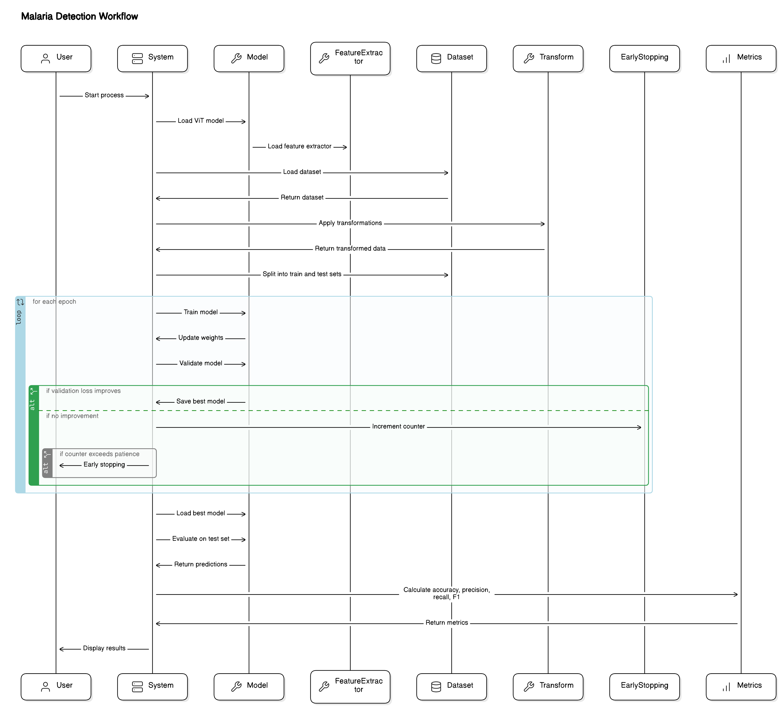
Work Flow Diagram
User Initiates the Process
System Setup
Dataset Loading
Feature Extraction and Transformation
Data Splitting
Model Training
Validation and Early Stopping
Model Evaluation
Metrics Calculation
Results Display

Slide 5
Traditional CNN
Convolutional Neural Networks (CNNs) have revolutionized the field of medical imaging by enabling automated analysis of visual data such as blood smear images, X-rays, and MRIs. In the context of malaria detection, CNNs provide a powerful tool to auto- mate the identification of infected cells, reducing the reliance on manual microscopy.
Dataset Preparation for CNN
The dataset used for malaria detection comprises cell images categorized into two classes: infected and uninfected. To prepare the dataset for training, we used the ‘ImageDataGenerator‘ class to perform data augmentation and split the dataset into training and validation sets. The images were resized to 128x128 pixels to standardize input dimensions.
The dataset was divided into training (80%) and validation (20%) sets.
Data augmentation techniques such as rescaling, rotation, and zoom were applied to enhance the diversity of the training data.
The training set contained approximately 22,048 images, while the validation set consisted of around 5,510 images.

Slide 6
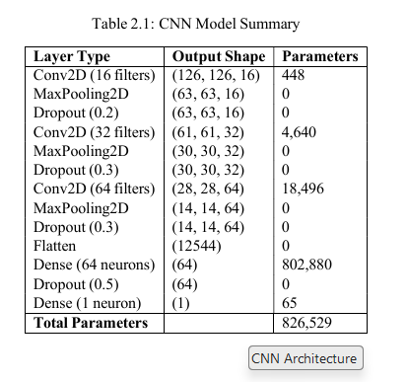
CNN Architecture
Convolutional Layers: The model begins with three convolutional layers using ReLU activation. The first layer has 16 filters, the second has 32 filters, and the third has 64 filters, each followed by max pooling and dropout to prevent overfitting.
Flattening Layer: Converts the 2D matrix output from the convolutional layers into a 1D vector.
Fully Connected Layers: Includes a dense layer with 64 neurons, followed by a dropout layer, and a final output layer with a sigmoid activation function for binary classification.

Slide 7
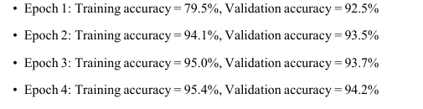
Training and Evaluation of CNN
The model was compiled using the Adam optimizer and binary cross-entropy as the loss function. Early stopping was applied to halt training if the validation loss did not improve for two consecutive epochs. The model achieved an accuracy of approximately 94% on the validation set after four epochs.
The CNN model developed in this project demonstrates a high level of accuracy in detecting malaria-infected cells. By automating the diagnostic process, we can significantly reduce the time and resources needed for malaria screening, especially in resource-limited settings.
Conclusion

Slide 8
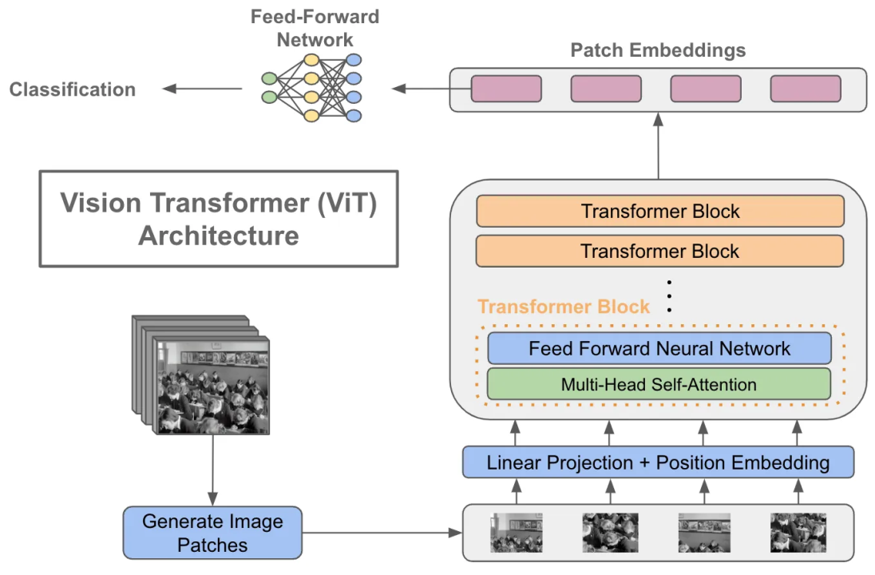
Non-Pre Trained Vision Transformers(ViT’s)
Introduction to Vision Transformers
Vision Transformers (ViTs) are a groundbreaking architecture that adapts the concept of transformers, originally developed for natural language processing, to the domain of computer vision. Unlike traditional convolutional neural networks (CNNs), which rely on convolutional layers to capture spatial features, ViTs utilize self-attention mechanisms to process image patches as sequences.
The main advantage of Vision Transformers is their ability to model long-range dependencies and relationships in images more effectively than CNNs. This capability makes ViTs particularly well-suited for tasks that involve complex spatial patterns, such as the detection of malaria parasites in blood smear images.

Slide 9
Vision Transformer Architecture
The architecture of a Vision Transformer consists of several key components:
Patch Embedding Layer: The input image is divided into smaller patches (e.g., 16x16 pixels). Each patch is flattened into a 1D vector and passed through a linear layer to create patch embeddings.
Positional Encoding: Since transformers do not inherently understand spatial information, positional encodings are added to the patch embeddings to retain spatial structure.
Transformer Encoder Layers: The core of the ViT model comprises multiple transformer encoder layers. Each layer consists of self-attention mechanisms and feed-forward neural networks with residual connections.
Classification Head: The output from the encoder layers is passed to a classifi- cation head, which predicts the class label (e.g., malaria-infected or uninfected).

Slide 10
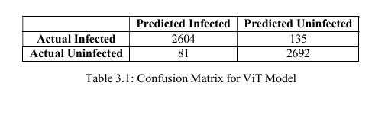
Results and Analysis
The model achieved high accuracy in classifying malaria-infected cells:
Accuracy: 96.08%
Precision: 95.22%
Recall: 97.08%
F1 Score: 96.14%
The non-pretrained Vision Transformer model demonstrated high accuracy in classifying malaria-infected cells. By training the model from scratch, we achieved a high level of performance, making it a viable solution for automated malaria diagnosis.
Conclusion

Slide 11
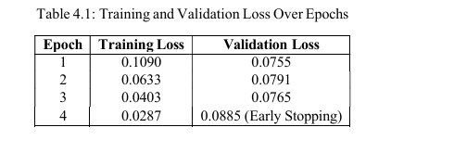
Pre-Trained Vision Transformers
Training of Pre-Trained ViT :
The Vision Transformer model was trained for a maximum of 15 epochs using the Adam optimizer and cross-entropy loss function. Early stopping was implemented to halt training if validation loss did not improve for 3 consecutive epochs.
Learning Rate: 2 × 10−5
Loss Function: Cross-entropy loss.
Optimizer: Adam optimizer.
Early Stopping: Triggered after 3 epochs of no improvement in validation loss.
Model Checkpointing: The best model was saved based on the lowest validation loss.

Slide 12
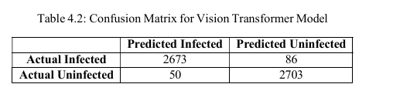
Evaluation of Pre-Trained ViT
The model was evaluated using accuracy, precision, recall, and F1-score. The best model, saved during training, was loaded for evaluation on the test set.
Accuracy: 97.53%
Precision: 96.92%
Recall: 98.18%
F1 Score: 97.55%
The Vision Transformer model trained on malaria cell images demonstrated superior performance compared to traditional methods, achieving over 97% accuracy. The use of transformers for image classification offers a promising approach to automating malaria diagnosis, particularly in resource-limited settings where rapid and accurate diagnosis is critical.
Conclusion

Slide 13
Comparison of Vision Transformers: ViT vs. Swin Transformer
Swin Transformer: Overview and Architecture
The Swin Transformer introduces a hierarchical structure that processes images in a non-overlapping window-based fashion, making it more efficient in handling high- resolution images compared to the ViT. This design enables the Swin Transformer to capture both local and global contexts effectively.
• Model: Swin Transformer with a configuration for binary classification
• Learning Rate: 2 × 10−5
• Loss Function: Cross-entropy loss
• Optimizer: Adam optimizer
• Epochs: 5 epochs
• Batch Size: 16

Slide 14
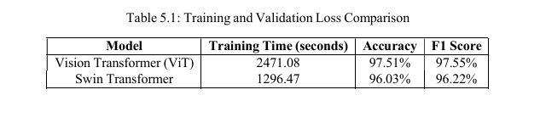
Training and Evaluation of Swin Transformer
The training process for both ViT and Swin Transformer models was conducted for 5 epochs. The evaluation metrics included accuracy, precision, recall, and F1-score.
• ViT: Provides superior accuracy but requires longer training times due to its reliance on global self-attention mechanisms.
• Swin Transformer: Offers competitive accuracy with significantly reduced training time, making it more efficient for resource-constrained environments.
ViT vs. Swin Transformer

Slide 15
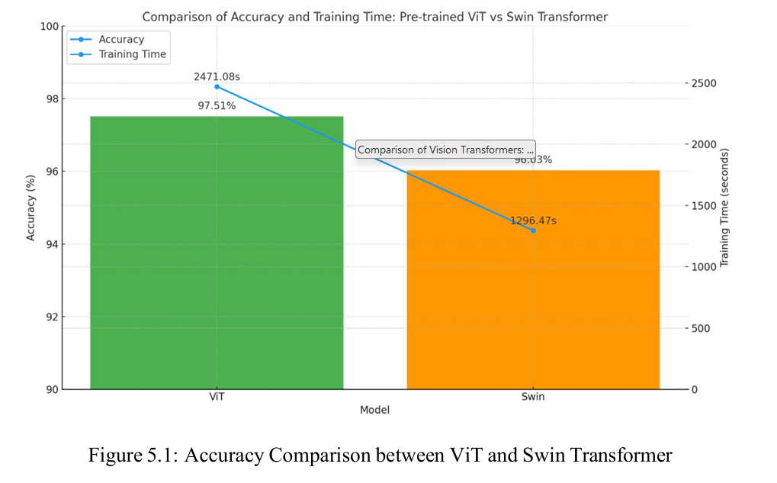
Conclusion of ViT v/s Swin
Both the Vision Transformer and Swin Transformer offer unique advantages for malaria detection.
While ViT excels in terms of accuracy, Swin Transformer provides a more efficient solution with faster training times.
The choice between the two models ultimately depends on the specific requirements of the deployment environment, such as the availability of computational resources and the need for real-time analysis.

Slide 16
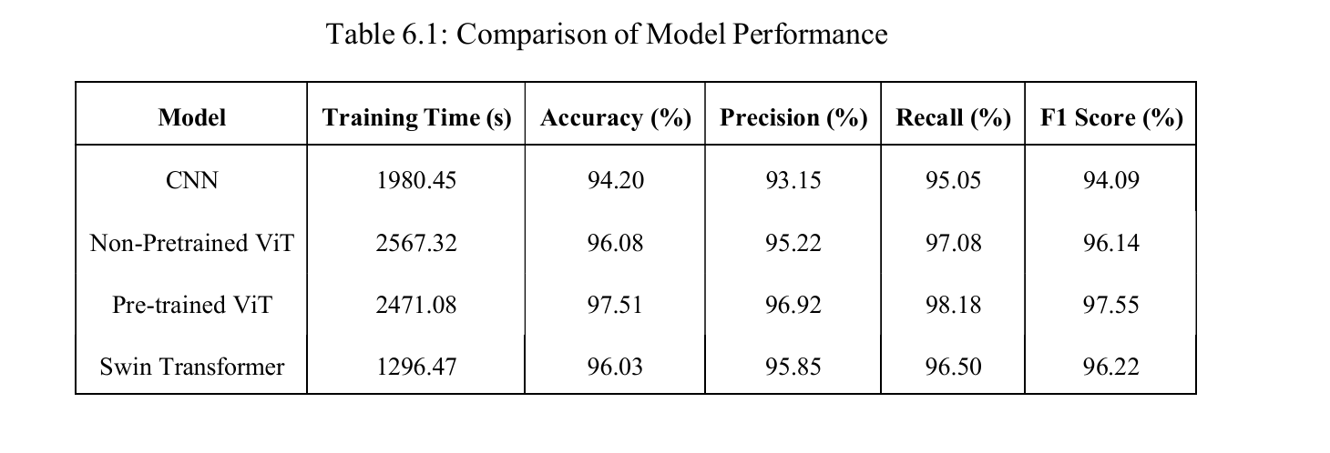
Results Comparison and Future Scope
Results:

Slide 17
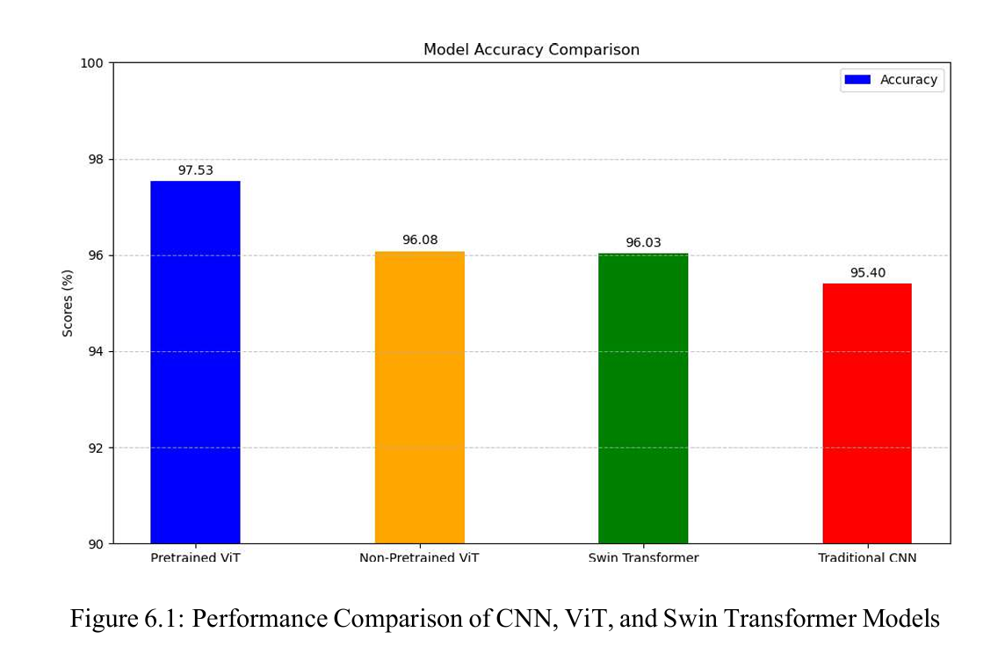
Model Accuracy Comparison

Slide 18
Scalability
The scalability of this project depends on the deployment environment and computational resources available. The models can be scaled and optimized for different levels of hardware infrastructure:
Edge Devices: For environments with limited resources, the Swin Transformer can be an ideal candidate due to its efficient use of computational power and faster training times.
Cloud Deployment: The Pre-trained ViT model can be deployed in cloud environments where computational resources are abundant. This model ensures high accuracy, making it suitable for large-scale screening in hospitals and research labs.
Hybrid Approach: A combination of both models can be used, where initial screening is performed using the Swin Transformer on edge devices, and cases flagged for further analysis are sent to cloud servers for detailed diagnosis using the Pre-trained ViT model.

Slide 19
Future Scope
There is significant potential to expand this project beyond its current scope. Future enhancements could focus on the following areas:
Data Expansion and Augmentation Techniques: Expanding the dataset with more diverse images and employing advanced data augmentation techniques such as rotation, flipping, and color variation can improve model robustness and gen- eralization, especially for detecting rare malaria cases or various parasite species.
Integration with Mobile Applications: Developing a mobile-based application for malaria detection could make the solution more accessible, especially in re- mote areas.
Model Optimization: Further research into model pruning and quantization can help reduce the model size and speed up inference times, making it more suitable for deployment on low-power devices.
Real-time Diagnostics: By leveraging streaming data from digital microscopes, the system can be expanded to perform real-time diagnostics, allowing healthcare professionals to receive instant feedback.
Generalization to Other Diseases: The framework can be extended to detect other diseases, such as tuberculosis or COVID-19, using similar approaches with minimal changes to the model architecture.
Explainability in AI Models: Implementing explainable AI techniques to high- light which parts of the blood smear images were critical in the decision-making process, increasing trust among healthcare providers.

Slide 20
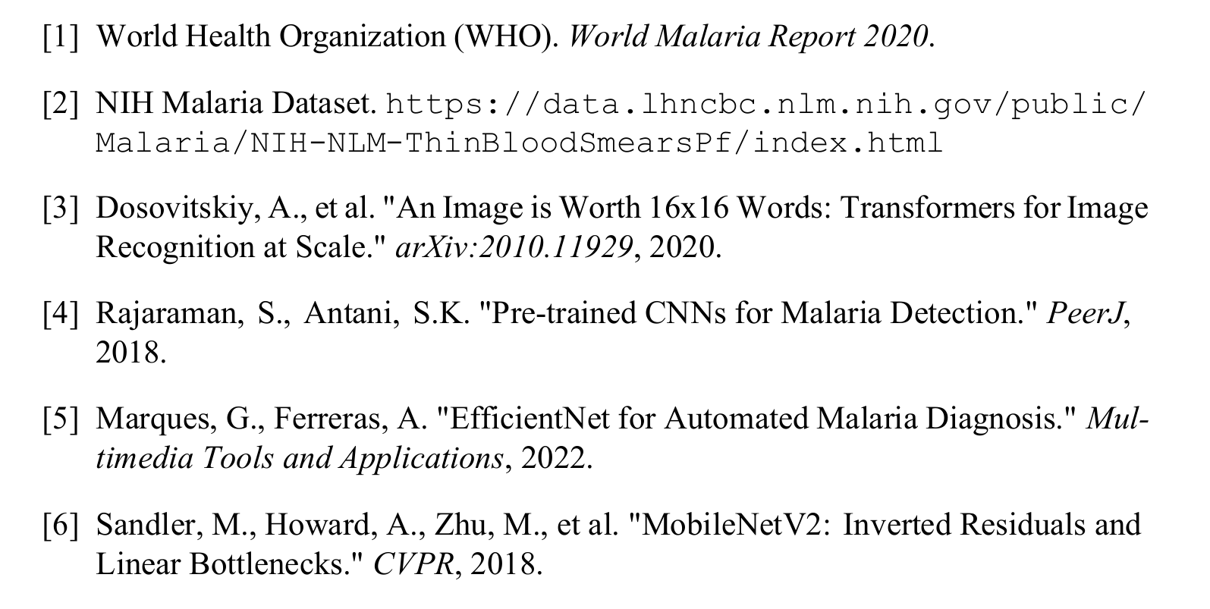
References

