Slide 1
Tele-Call Predictor (Predict the success of Bank Telemarketing)
CS3006-Intoduction to Data Science For Engineers(IDSE)
CS22B1093 ROHAN G
CS22B1095 R SAI CHARISH
Instructor – PREETH R

Slide 2
EDA - Predict the Success of Bank telemarketing
A short intro to EDA:
Exploratory Data Analysis refers to the critical process of performing initial investigations on data so as to discover patterns, to spot anomalies, to test hypothesis and to check assumptions with the help of summary statistics and graphical representations.
It is a good practice to understand the data first and try to gather as many insights from it.
Data Set: https://www.kaggle.com/competitions/predicting-bank-telemarketing/data
Data Columns: 15 columns + 1 output column(for success prediction)
[cont date,age,job,marital,education,default,balance,housing,loan,contact,duration,campaign,pdays,previous,poutcome]
Two Categories of Data:
Structured Data Types
Ex: csv file, excel file, database file
Unstructured Data Types
Ex: Images, Videos, Audio

Slide 3
Description of Columns of the dataset
The dataset contains 39,211 entries and 16 columns, with information about individuals and their interactions with a bank's marketing campaign. Here’s a brief overview of each column:
last contact date: The date of the last contact with the individual.
age: Age of the individual (ranging from 18 to 95).
job: Occupation; has some missing values.
marital: Marital status (e.g., married, single).
education: Education level, with some missing values.
default: Whether the individual has credit in default.
balance: Account balance, ranging from negative values to over 100,000.
housing: Whether the individual has a housing loan.
loan: Whether the individual has a personal loan.
contact: Type of contact communication, missing in some cases.
duration: Duration of the last contact (in seconds), with some instances of zero values.
campaign: Number of contacts during the campaign.
pdays: Days since the individual was last contacted (or -1 if never contacted).
previous: Number of contacts before the campaign.
poutcome: Outcome of the previous marketing campaign (many missing values).
target: Target variable, indicating the success of the campaign ("yes" or "no").

Slide 4
Structured Data Types
Categorical – This is any data that isn’t a number.
Ordinal- have set of order [ex: education(Primary, Secondary, tertiary)]
Binary – have only two values [ex: default, housing, loan(yes/no responses)]
Nominal – no set of order [ex: job, martial, contact, poutcome]
Numerical – Data inform of numbers
Continuous – numbers that don’t have a logical end to them
Discrete – have a logical end to them [ex: age, balance, duration, campaign, pdays, previous]

Slide 5
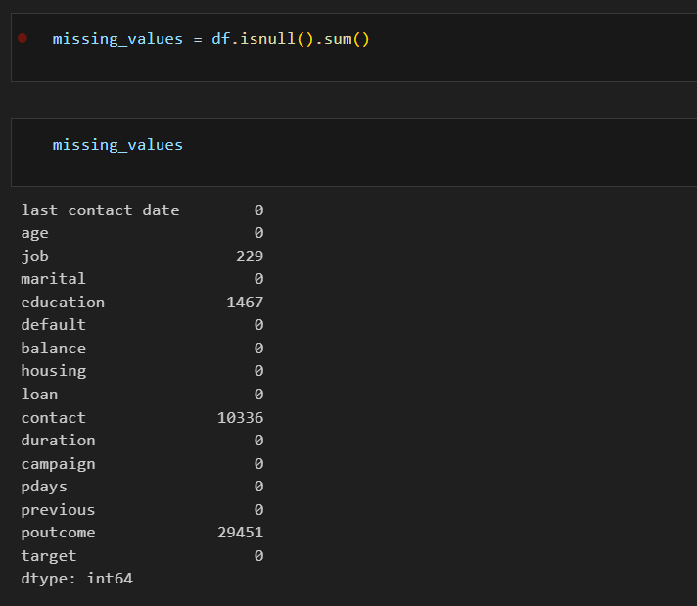
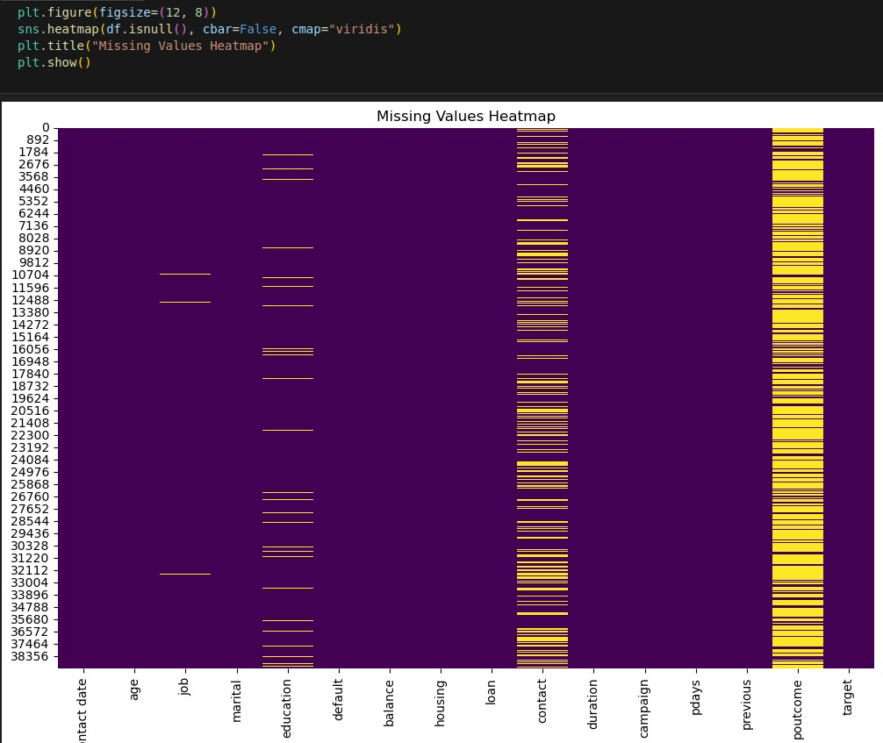

EDA - Predict the Success of Bank telemarketing
Data Cleaning
Finding out the NULL Values in the columns of the dataset
Plotting the NULL Values of columns using HEATMAP
Replacing the NULL Values with “UNKNOWN”
The above dataset has :
NULL values in these following columns and the number of NULL values that are present in the dataset are given below.
Columns | No.of NULL Values
Job | 229
Education | 1467
Contact | 10336
Poutcome | 29451

Slide 6
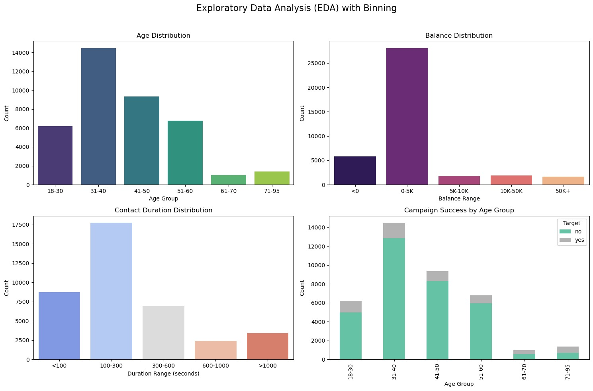
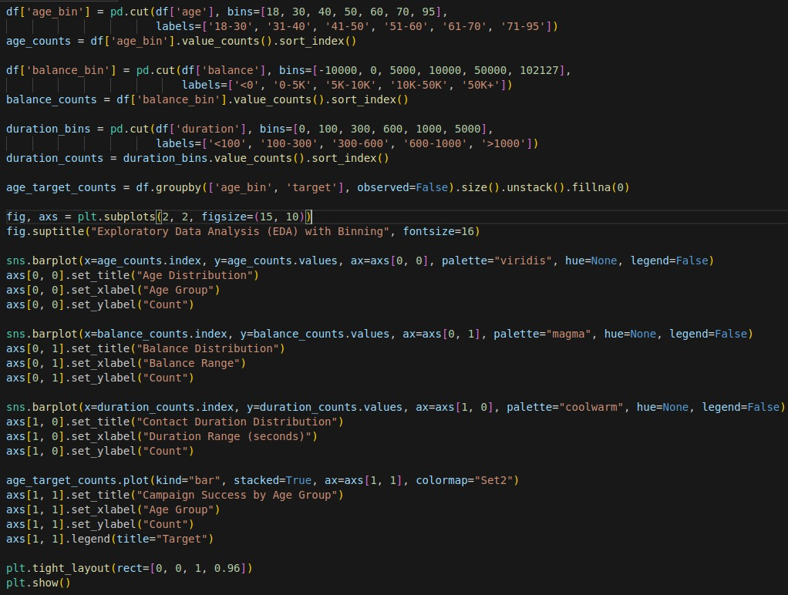
EDA -Binning
Binning is a data preprocessing technique where we group continuous variables into discrete categories or "bins." This approach helps us better understand data distribution and highlights patterns that may not be immediately visible with raw values.
Binning Analysis:
Age: Grouped into six age brackets (18-95). Most clients were in the 31-50 range, indicating middle-aged clients are the campaign's main target.
Balance: Segmented into five financial ranges. Majority had balances between $0 and $5,000, highlighting diverse financial profiles.
Contact Duration: Divided into five intervals. Most calls lasted under 600 seconds, with longer calls possibly linked to higher success.
Campaign Success by Age Group: Success was highest among the 31-50 age group, showing targeted age brackets respond well.

Slide 7
Univariate v/s Bivariate v/s Multivariate
Aspect | Univariate Analysis | Bivariate Analysis | Multivariate Analysis
Definition | Analyzes one variable at a time | Examines relationship between two variables | Studies relationships among three or more variables
Purpose | Describes single-variable distribution | Identifies associations or correlations | Explores complex interactions
Techniques | Histograms, bar charts, box plots | Scatter plots, correlation coefficients | Regression, clustering, factor analysis
Data Complexity | Simple | Moderate | High
Insights | Central tendency, spread | Trends, correlations, causal links | Multi-variable influences and predictions
Visualization | Single-axis plots | 2D plots (scatter, line) | 3D plots, heatmaps, multivariable models
Example Question | "What is the average age?" | "Is age related to income?" | "How do age, income, and education impact spending?"
Application | Descriptive stats, data summarization | Cause-effect analysis, correlation | Complex modeling, predictive analytics

Slide 8
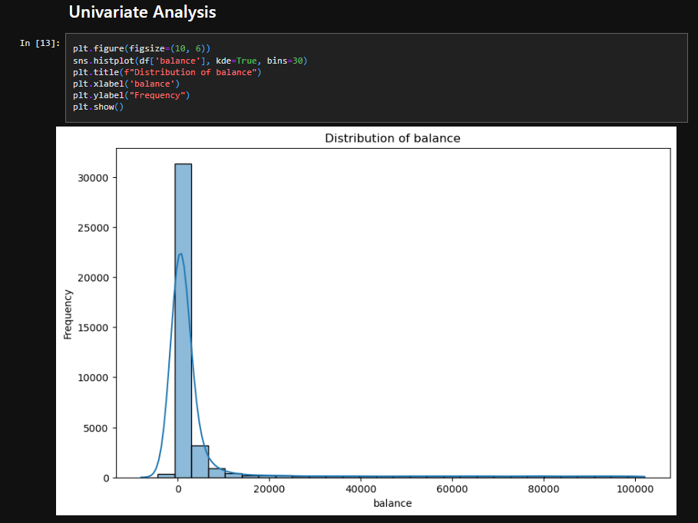
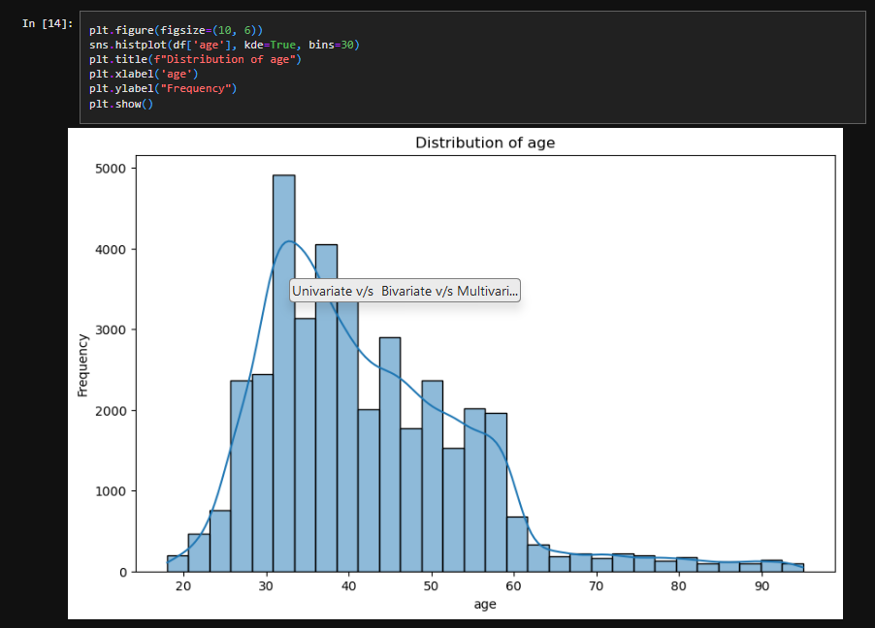
Univariate Analysis
This univariate analysis of `balance` shows how frequently different balance values occur, with the histogram and KDE curve revealing the data's shape. The peak indicates the most common balance range, while the spread shows variability. If skewed, it hints that balances tend to be higher or lower, helping us understand typical balance patterns and possible outliers.
This univariate analysis of `age` shows the frequency of different age groups. The histogram and KDE curve reveal the age distribution shape, with peaks indicating common age ranges. The spread reflects age diversity, while any skewness suggests whether the population leans younger or older, helping us identify typical and less common ages in the dataset.

Slide 9
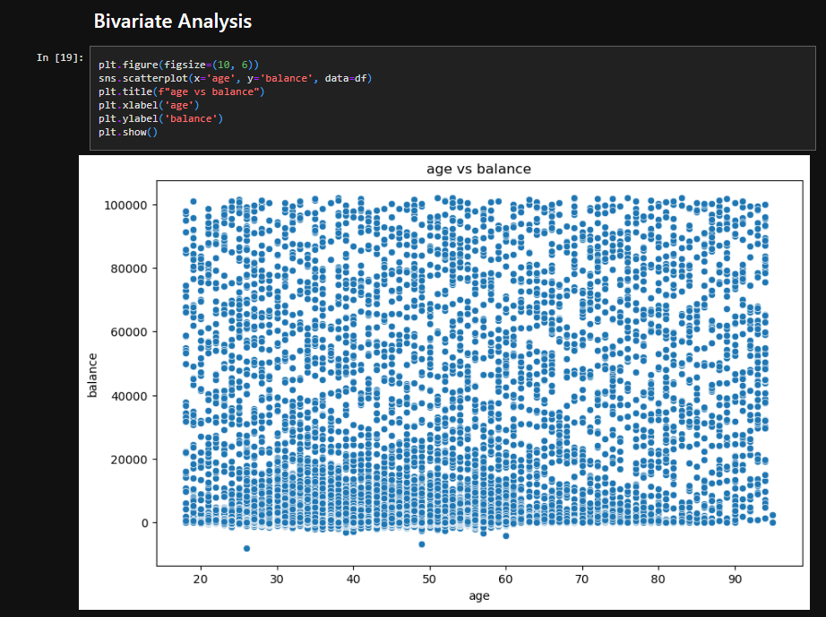
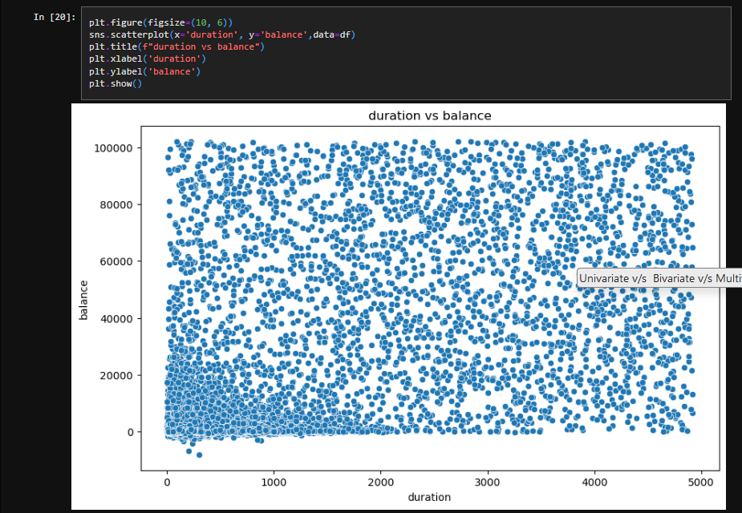
Bivariate Analysis
This scatter plot of `age` vs. `balance` shows the relationship between age and account balance. Each point represents a person's age and balance, with any visible trend or clustering suggesting patterns, like whether certain age groups tend to have higher or lower balances. Outliers or gaps may indicate unusual age-balance combinations.
This scatter plot of `duration` vs. `balance` highlights the relationship between call duration and account balance. Each point shows an individual's call duration and balance, with any patterns or trends indicating if longer calls relate to higher or lower balances. Outliers may represent unusually high or low balances for specific call durations.

Slide 10
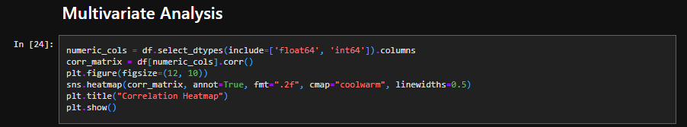
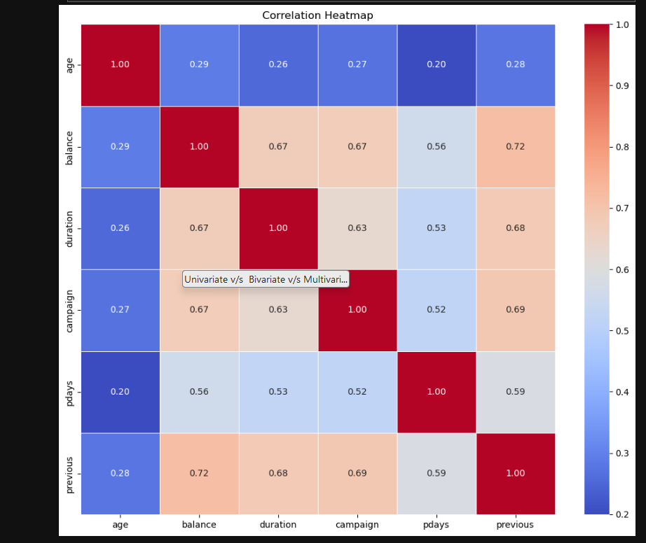
Multivariate Analysis
CORRELATION HEATMAP
Correlation Heatmap: Visualizes the relationships between numerical variables.
Color Scale: Colors indicate correlation strength and direction; warmer colors show positive, cooler colors show negative correlations.
Annotations: Each cell shows the correlation coefficient, highlighting specific variable pairs with strong correlations.
Diagonal: The diagonal is always 1, as each variable is perfectly correlated with itself.
Insights: Helps identify which variables are strongly related (positively or negatively), guiding feature selection and deeper analysis.

Slide 11
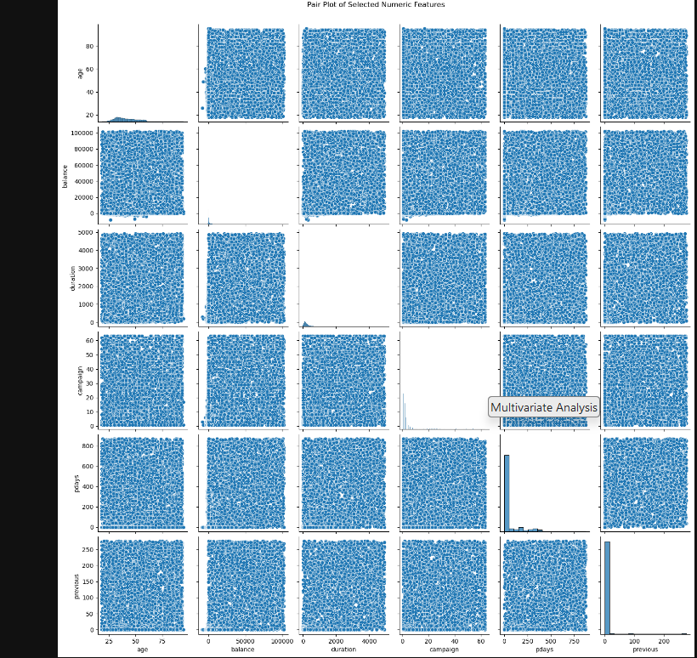

Multivariate Analysis
PAIR PLOT OF SELECTED NUMERIC FEATURES
Insights from the above steps
Age: The age distribution is left-skewed, with most clients in older brackets (31-50+). Targeting younger age groups could diversify engagement.
Balance: Majority have moderate to high balances; the campaign could focus on premium services, while low-balance clients may represent a distinct segment.
Contact Duration: Long calls dominate, indicating good client engagement. Maintaining engagement length is key; analyzing short calls might offer improvement insights.
Campaign Success by Age Group: Higher success is noted among older clients. Expanding effective strategies for younger groups could enhance overall results.
Implications for Predictive Modeling: Skewed features like balance and duration might benefit from transformations (e.g., log or square-root) to improve model performance.

Slide 12
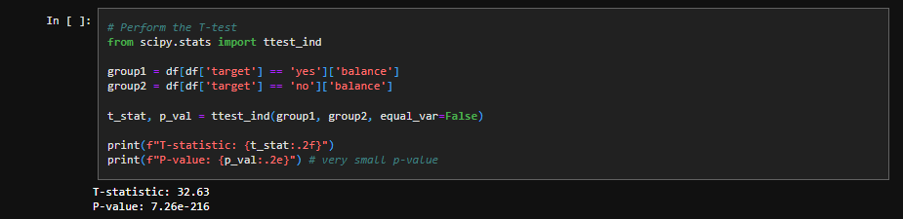
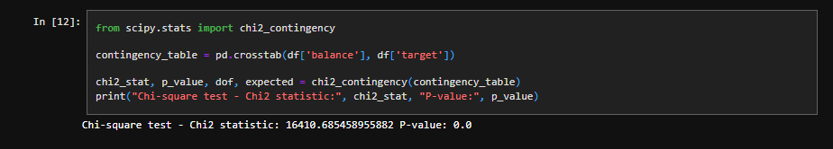
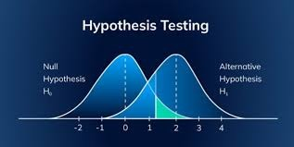
Hypothesis Testing
Testing Balance Influence on Campaign Success
Null Hypothesis (H₀): Customers’ average balance does not differ significantly between those who participated in the campaign successfully and those who didn’t.
Alternative Hypothesis (H₁): There is a significant difference in the average balance between customers who participated successfully and those who didn’t.
Test Type
Two-sample t-test (independent)
Reason
Since balance is a continuous variable, a t-test can assess whether there is a significant difference in the mean balance for customers who had campaign success vs. those who didn’t.
Campaign Success and Customer Balances
Null Hypothesis (H₀): Balance and campaign success are independent of each other.
Alternative Hypothesis (H₁): There is an association between balance and campaign success.
Test Type
Chi-square test of independence (if balance is categorized, e.g., low, medium, high)
Logistic regression (if predicting the probability of campaign success based on continuous balance values)
Reason
If balance is divided into categories, the chi-square test can reveal if there's an association between balance levels and campaign success. Logistic regression would be suitable if the goal is to predict the likelihood of success based on the balance.

Slide 13
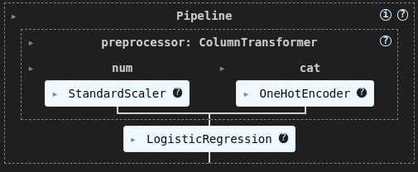
Data Transformation
Data Normalization :
Numeric Transformer: The code uses Pipeline to define a numeric transformer that includes a StandardScaler.
StandardScaler: StandardScaler rescales each numeric feature (like age, balance, etc.) to have a mean of 0 and a standard deviation of 1.
Pipeline Structure: This pipeline (numeric_transformer) is applied only to numeric columns.
Purpose: By standardizing, each numeric feature has a consistent scale, making them comparable for model training.
Usage in ColumnTransformer: This normalization is applied within ColumnTransformer, ensuring only numeric columns are transformed.
One-Hot Encoding :
Categorical Transformer: A Pipeline is defined for categorical features, using OneHotEncoder.
OneHotEncoder: Converts each category in features like job, marital, etc., into multiple binary columns (1 per unique category).
Handle Unknown: The parameter handle_unknown='ignore' ensures unseen categories at test time won’t cause errors.
Purpose: This transformation enables the model to interpret categorical features by converting them into numeric form.
Usage in ColumnTransformer: The ColumnTransformer applies this one-hot encoding only to the specified categorical columns.

Slide 14
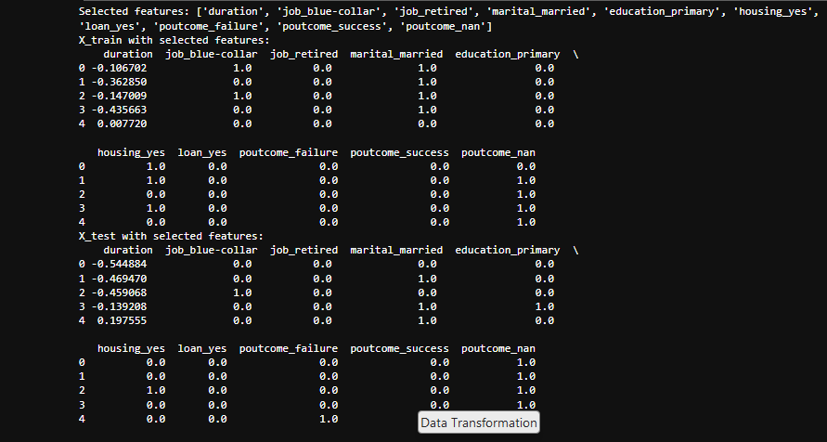
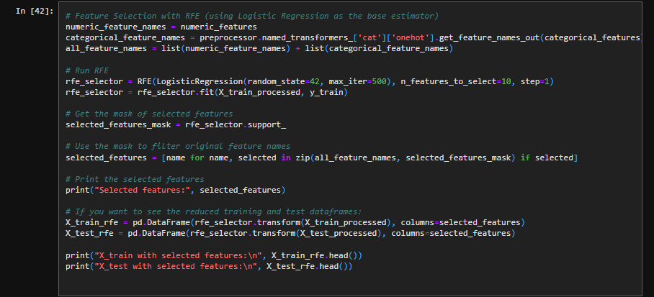
Data Reduction
RECURSIVE FEATURE ELIMINATION (RFE)
1. RFE Setup: Implements Recursive Feature Elimination (RFE) using Logistic Regression to identify the top 10 most important features.
2. Feature Selection: Fits RFE on `X_train_processed` and `y_train`, creating a mask to mark selected features.
3. Selected Features: Filters feature names based on the RFE mask, identifying the most relevant features for the model.
4. Data Reduction: Transforms `X_train_processed` and `X_test_processed` to retain only the selected features.
5. Result Preview: Displays the first few rows of the reduced `X_train` and `X_test` DataFrames, containing only the selected features for training and testing.

Slide 15
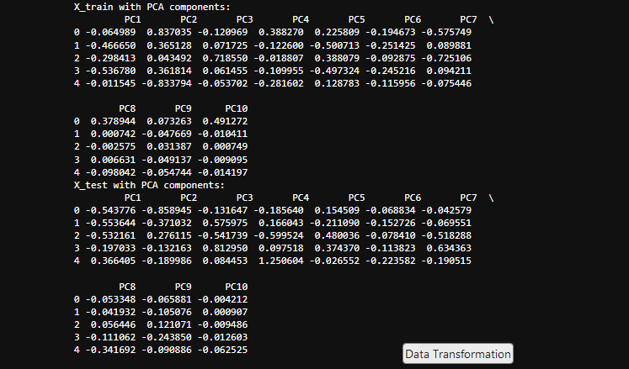
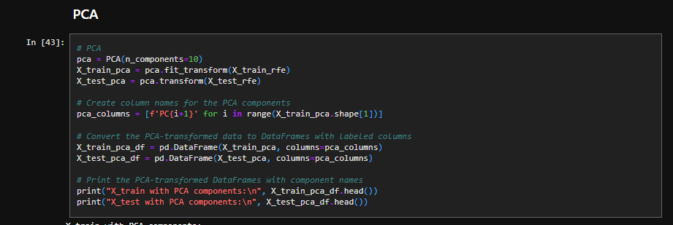
Data Reduction
PRINCIPAL COMPONENT ANALYSIS(PCA)
PCA Transformation: Applies Principal Component Analysis (PCA) to reduce features to 10 principal components, capturing most of the variance.
Fitting and Transforming: Fits PCA on X_train_rfe (training data) and transforms both X_train_rfe and X_test_rfe to lower-dimensional representations.
Component Naming: Creates column names (PC1, PC2, etc.) for each principal component to label the transformed data.
DataFrames for PCA Data: Converts the transformed training and test data into DataFrames with meaningful column labels for easier interpretation.
Result Preview: Displays the first few rows of X_train and X_test with PCA components, showing the reduced, transformed data structure.

Slide 16
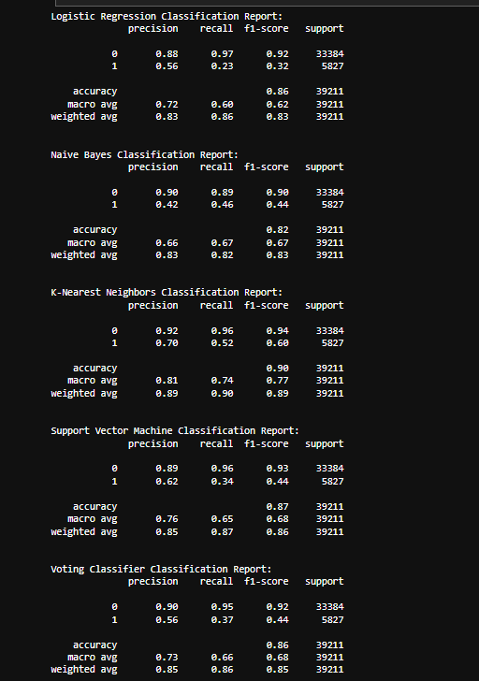
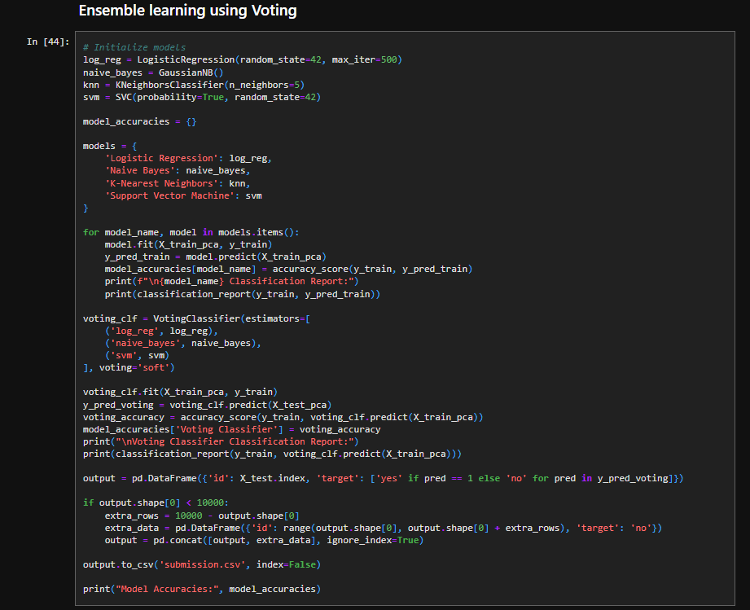
ML MODEL
ENSEMBLE LEARNING USING VOTING

Slide 17
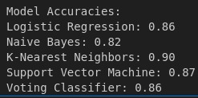
ML MODEL
Model Initialization: Logistic Regression, Naive Bayes, K-Nearest Neighbors, and Support Vector Machine models are initialized for training.
Training and Evaluation: Each model is trained on the PCA-transformed training set, and accuracy scores are recorded.
Classification Reports: Detailed reports provide insights into model performance on training data, including precision, recall, and F1 scores.
Voting Classifier: A soft voting classifier combines predictions from Logistic Regression, Naive Bayes, and SVM, aiming for a more robust prediction.
Voting Classifier Performance: The voting classifier's accuracy is calculated, providing an additional comparison to individual model accuracies.
Prediction on Test Set: The voting classifier predicts outcomes on the test set, with predictions formatted as 'yes' or 'no'.
Output Formatting: Results are saved in submission.csv, including a unique 'id' and target prediction.
Accuracy Summary: The dictionary model_accuracies summarizes the performance of each individual model and the voting classifier.
Conclusion: This pipeline evaluates multiple models, optimizes with a voting approach, and outputs results in a format suitable for submission.
ENSEMBLE LEARNING USING VOTING

