Slide 1
Linux Patching Automation
Author: Run Zhang
Date: Oct 25 2019

Slide 2
Purpose
Linux operating system patching is crucial part of operating system life cycle. The process is repetitive, time consuming and at the same time error prone.
We need solution to manage the whole patching cycle programmatically to increase efficiency, speed, manageability with all the proper authorizing, auditing and logging capabilities imbedded into the code.
The answer to this is end to end automation of entire work flow of patching multiple Linux servers in parallel.

Slide 3
Summary
The patching automation function is part of the menu driven automation tool (IPUB) that cover 4 major related areas of Linux administration – Inventory, patch, upgrade and build.
Daemon less agent package for client side automation for less over head, ease of management and when host is not reachable from automation platform.
Language(s): python/perl/yml/SQL
Infrastructure: satellite 6, Ansible Engine

Slide 4
What is automated?
The tool was 128 bit password protected
Menu driven from automation server
Automated inventory check
Automated pre patching verification
Automation post patching verification and report
Automated back up system configuration before and after patching
Process multiple servers concurrently through the entire work flow
Automated updating repository before patching
Automated check file systems sizes before patching
Automated resolve repository issue

Slide 5
What’s automated? (continue …)
Automated clean up out of dated kernel
Automated patch and reboot
Automated Dry run option
Automated applying Exelon security baseline after successful patching
Automated sync with current root password after successful patching
Automated logging on both client and server side
Automated auditing the work based on ticket# and staff email
Automated generating consolidation reports based on ticket# and staff email
Automated option to email the reports to the staff for record keeping
Automated rpm based daemon-less agent for servers that are not reachable from automation server

Slide 6
High level diagram
IPUB client
Red Hat Satellite
IPUB Inventory DB
IPUB application logic based on python
IPUB client
Menu driven IPUB interface
IPUB client
IPUB application logic based on yml
IPUB client
IPUB client

Slide 7
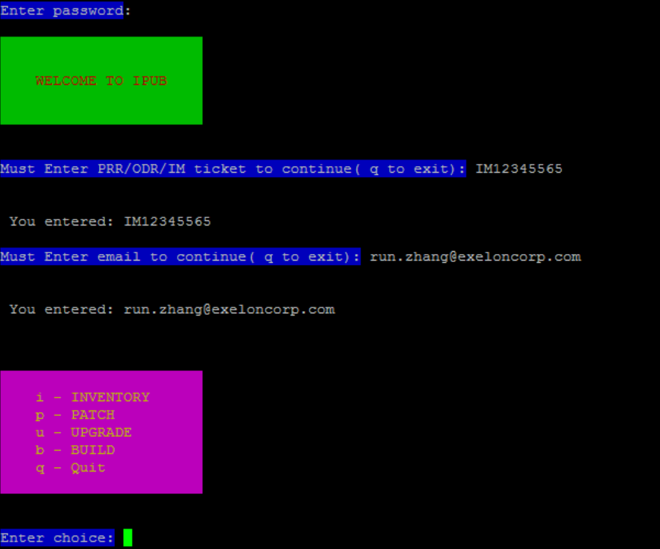
User interface
ANSI console based

Slide 8
Future development
Web / desktop version of the IPUB interface
Patching automatically according to preset schedule
Automatically fix post patching failure item(s)
High availability of the automation platform

Slide 9
Questions
Questions?

