Slide 1
CS 4476/6476 Project 3
张如山 Rushan Zhang
rzhang662@gatech.edu
rzhang662
903849603
Discussed with Shuangyue Cheng (email: katcheng@gatech.edu)

Slide 2
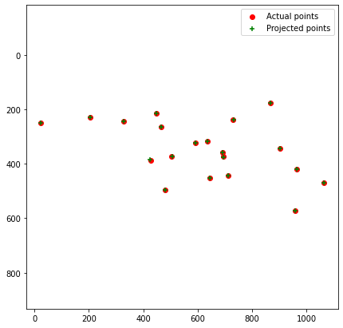
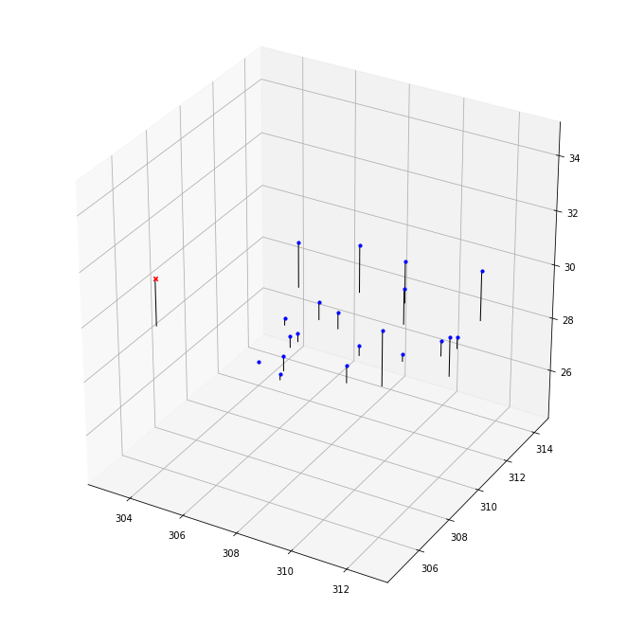
Part 1: Projection matrix
[insert visualization of projected 3D points and actual 2D points for the CCB image we provided here]
[insert visualization of camera center for the CCB image here]

Slide 3
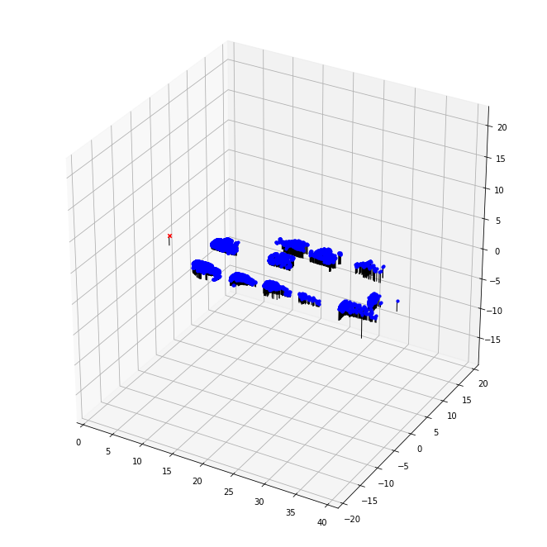
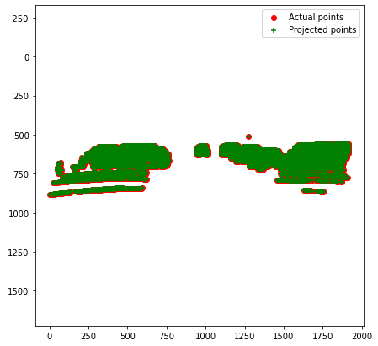
Part 1: Projection matrix
[insert visualization of projected 3D points and actual 2D points for the Argoverse image we provided here]
[insert visualization of camera center for the Argoverse image here]

Slide 4
Part 1: Projection matrix
[What two quantities does the camera matrix relate?]
3d locations of the real world (World coordinate) and the 2d coordinates (Image coordinate) of those locations in the image taken by the camera.
[What quantities can the camera matrix be decomposed into?]
Into 2 matrices. The intrinsic matrix K and the extrinsic matrix [R|T].
R corresponds to the rotation matrix, while T corresponds to the translation matrix.
[List any 3 factors that affect the camera projection matrix.]
The camera optical center
The location and orientation (angle) of the camera
The image aspect ratio
The camera focal length

Slide 5
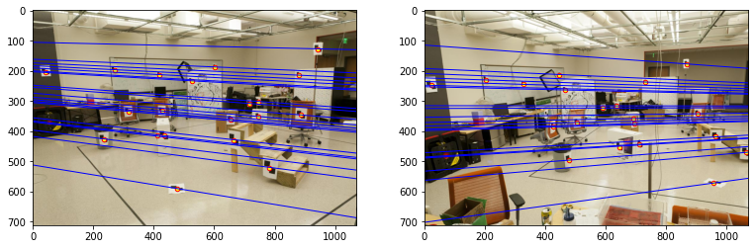
Part 2: Fundamental matrix
[insert visualization of epipolar lines on the CCB image pair]

Slide 6
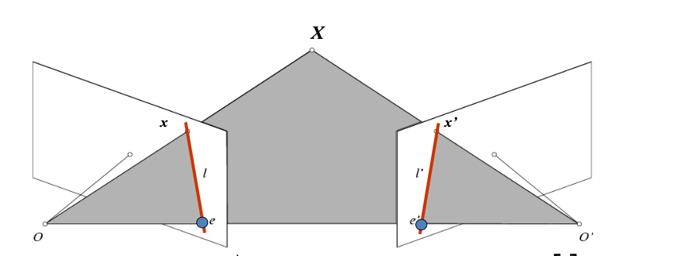
Part 2: Fundamental matrix
[Why is it that points in one image are projected by the fundamental matrix onto epipolar lines in the other image?]
The fundamental matrix F has the property:
x^T F x’ = 0 — (2.1)
Therefore, for any point x in the first image, points x’ on the epipolar line in the other satisfy equation (2.1). Therefore, the epipolar line is:
l’ = F^T x, where l’^T x’ = 0
Similarly, for any point x’ in the second image, its epipolar point in the first image is:
I = F x’, where l^T x = 0
[What happens to the epipoles and epipolar lines when you take two images where the camera centers are within the images? Why?]
All the epipolar lines in the second image intersects at the camera centers of first image in the second image. This is because, the epipolar lines of the first image, in the 3D space, are 3D rays from point O, passing through the pixel in the first image. Since they are originated from point O in the 3D space, there projection on the second image should intersect at point O (camera centre).
The epipole in the second image is at the first camera in the second image. This is because, in the graph above, we can see that the epipole e’ is the intersection of the baseline and the second image plane. Since O, e, e’, O are all on the baseline, their projection on the images are the same.
Similar for the first image.

Slide 7
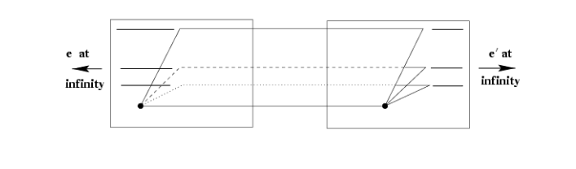
Part 2: Fundamental matrix
[What does it mean when your epipolar lines are all horizontal across the two images?]
It means that the two imahe planes are parallel
[Why is the fundamental matrix defined up to a scale?
This is because its definition x^T F x’ = 0 is homogeneous (i.e. scaling F with any scaler a will not change x^T F x’ ).
[Why is the fundamental matrix rank 2?]
E = [t]_x R, where [t]_x is Skew- symmetric matrix, which is rank 2, R is full rank.
Therefore, E is rank 2.
F = K^-T E K’^-1, where K and K’ are full rank.
Therefore, F is rank 2.
(An easier explanation is that Fe’=0 and F^Te=0. Therefore, all epipolar lines converges to the epipole. Therefore, F is not full rank, F is rank 2.)

Slide 8
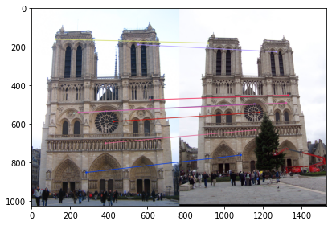
Part 3: RANSAC
[insert visualization of correspondences on Notre Dame after RANSAC]

Slide 9
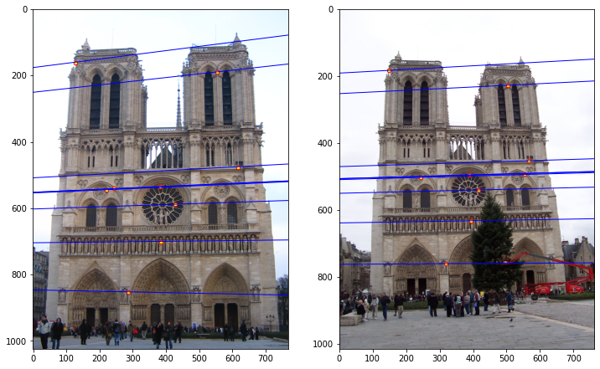
Part 3: RANSAC
[insert visualization of epipolar lines on the Notre Dame image pair]

Slide 10
Part 3: RANSAC
[How many RANSAC iterations would we need to find the fundamental matrix with 99.9% certainty from your Mt. Rushmore and Notre Dame SIFT results assuming that they had a 90% point correspondence accuracy if there are 9 points?]
14
[One might imagine that if we had more than 9 point correspondences, it would be better to use more of them to solve for the fundamental matrix. Investigate this by finding the # of RANSAC iterations you would need to run with 18 points.]
42
[If our dataset had a lower point correspondence accuracy, say 70%, what is the minimum # of iterations needed to find the fundamental matrix with 99.9% certainty?]
4238 with 18 points
167 with 9 points

Slide 11
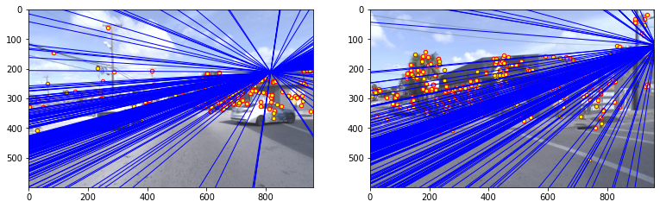
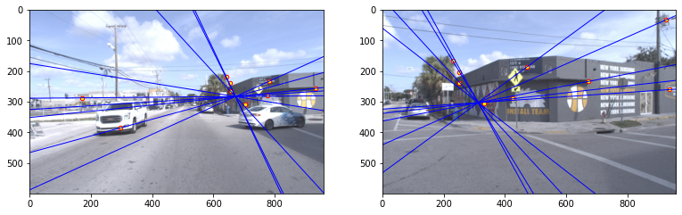
Part 4: Performance comparison
[insert visualization of epipolar lines on the Argoverse image pair using the linear method]
[insert visualization of epipolar lines on the Argoverse image pair using RANSAC]
(sample size = 9)

Slide 12
Part 4: Performance comparison
[Describe the different performance of the two methods.]
RANSAC works much better on real images than the linear method when there are lots of falsely matched points (noise). (The epipolar seems more accurate, and the epipolar lines seems to make more sense)
[Why do these differences appear?]
Because there are lots of outliers in this image pair (there are some cars that are in image a but not in image b, and vice versa), which will disturb the least-square method. RANSAC, which will try to find the best matching pairs by random sampling, is more robust to noise.
[Which one should be more robust in real applications? Why?]
RANSAC is more robust, because in most cases, real cameras are not calibrated. Besides, the objects in real images may change. Therefore, there are lots of outliers. RANSAC, which will try to find the best matching pairs by random sampling, is more robust to noise.

Slide 13
Part 5: Visual odometry
[How can we use our code from part 2 and part 3 to determine the “ego-motion” of a camera attached to a robot (i.e., motion of the robot)?]
The VO problem requires us to solve both the rotational matrix and the translational matrix. We can use image at t = i and image at t = i+1 to calculate the fundamental matrix, and from the fundamental matrix, together with the intrinsic matrix K we can calculate the essential matrix. Together with the points in the previous and current image, we can calculate the rotational and translational motion between previous position and current position.
[In addition to the fundamental matrix, what additional camera information is required to recover the ego-motion?]
The intrinsic matrix K. (Because we have to recover the essential matrix)

Slide 14
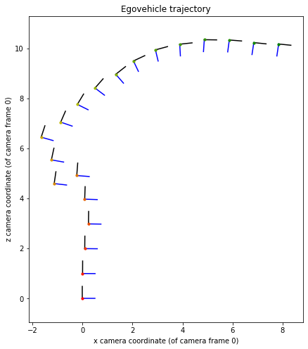
Part 5: Visual odometry
[Attach a plot of the camera’s trajectory through time]

Slide 15
Part 6: Panorama Stitching
[Please add a README style documentation here for your implementation of panorama stitching with: description of what you implemented, instructions on how to replicate the results in clear steps that can be followed by course staff. Failure to replicate results by following this documentation will result in point penalties on this question of the assignment.]

Slide 16
Part 6: Panorama Stitching
[Insert visualizations of your stitched panorama here along with the 2 images you used to stitch this panorama (there should be 3 images in this slide)].

Slide 17
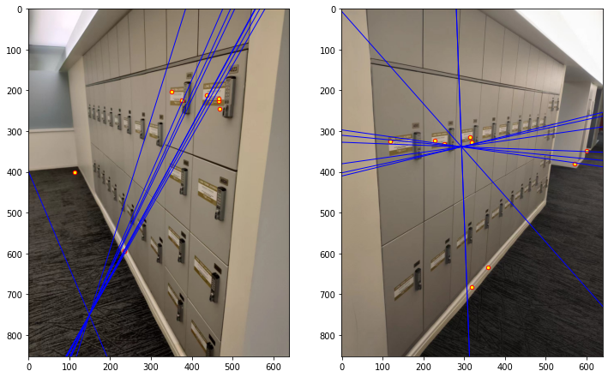
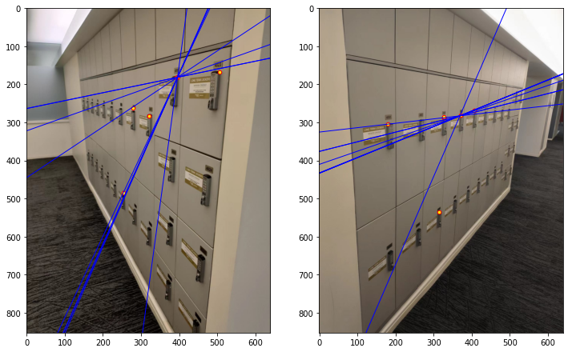
Additional
I decided to use another local descriptor besides SIFT (something more recent, check out deep learning-based options) and evaluate the performance difference between the two.
The feature descriptor I use is ORB (Oriented FAST and Rotated BRIEF):
Rublee, E., Rabaud, V., Konolige, K., & Bradski, G. (2011, November). ORB: An efficient alternative to SIFT or SURF. In 2011 International conference on computer vision (pp. 2564-2571). Ieee.
See readme.txt
Results:
L: SIFT; R: ORB

