Slide 1
CS 4476/6476 Project 4
Rushan Zhang
rzhang662@gatech.edu
rzhangbq@ust.hk
rzhang662
903849603
Discussed with Shuangyue Cheng (email: katcheng@gatech.edu)

Slide 2
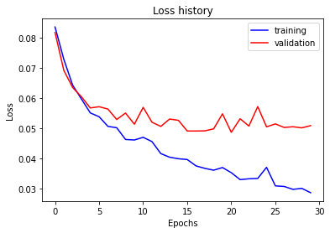
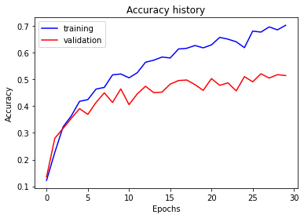
Part 1: SimpleNet
[Insert loss plot for SimpleNet here]
Final training accuracy:0.7028475711892798
Final validation accuracy:0.5146666666666667
[Insert accuracy plot for SimpleNet here]

Slide 3
Part 2: SimpleNetFinal
Add each of the following (keeping the changes as you move to the next row):
 | Training accuracy | Validation accuracy
SimpleNet | 0.7028475711892798 | 0.5146666666666667
Jittering (I also added RandomHorizontalFlip here) | 0.6914572864321608 | 0.3220000000000000
Zero-centering & variance-normalization | 0.7651591289782245 | 0.6100000000000000
Dropout regularization | 0.7232830820770519 | 0.5880000000000000
Making network "deep" | 0.7822445561139029 | 0.6206666666666667
Batch normalization | 0.7822445561139029 | 0.6826666666666666

Slide 4
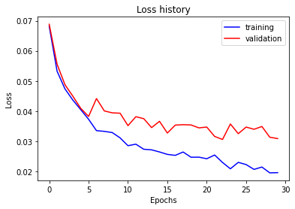
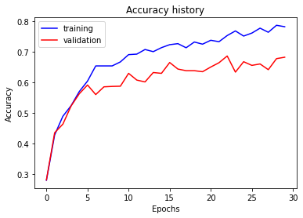
Part 2: SimpleNetFinal
[Insert loss plot for SimpleNetFinal here]
Final training accuracy:0.7822445561139029
Final validation accuracy:0.6826666666666666
[Insert accuracy plot for SimpleNetFinal here]

Slide 5
Part 2: SimpleNetFinal
[Name 10 different possible transformations for data augmentation.]
Normalization: transforms.Normalize
Horizontal flip: transforms.RandomHorizontalFlip
Vertical flip:transforms.RandomVerticalFlip
Color jittering:transforms.ColorJitter
Random rotation:
transforms.RandomRotation
Gaussian blurring:
transforms.GaussianBlur
Random erasing: transforms.RandomErasing
Random cropping and resize: transforms.RandomResizedCrop
Random perspective transformation: transforms.RandomPerspective
Randomly transform image into grayscale: transforms.RandomGrayscale
Random affine transformation:
transforms.RandomAffine
[What is the desired variance after each layer? Why would that be helpful?]
1
Forcing the variance to be the same (1) helps make the distribution of the outputs (and inputs) of each layer to be the same. In this way, the components of the gradients from each layer would not vary too much in magnitude (avoiding poor conditioning) during training.
Furthermore, rescaling the network to variance = 1 and mean=0 can also avoid internal covariate shift, which could make activation functions like sigmoid or ReLU ineffective.

Slide 6
Part 2: SimpleNetFinal
[What distribution is dropout usually sampled from?]
Bernoulli distribution
(from Dropout — PyTorch 1.13 documentation)
[How many parameters does your base SimpleNet model have? How many parameters does your SimpleNetFinal model have?]
SimpleNet: 56895
SimpleNetFinal: 69320
[What is the effect of batch norm after a conv layer with a bias?]
If the conv layer originally has a bias (say, if the output of the conv z = g(w, x) + b, where w is the weights, x is the input and b is the bias), then since we subtract the mean in the batch norm (i.e. we make the mean of the output of the batch norm to be 0), the bias b is cancelled out.

Slide 7
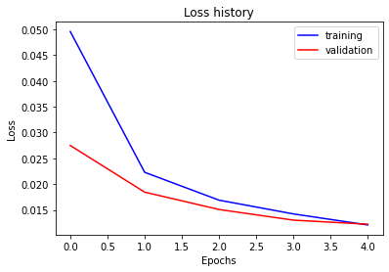
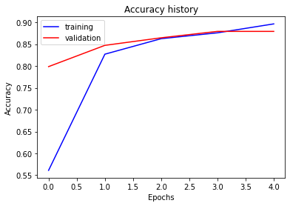
Part 3: ResNet
[Insert loss plot here]
Final training accuracy: 0.8964824120603015
Final validation accuracy: 0.8793333333333333
[Insert accuracy plot here]

Slide 8
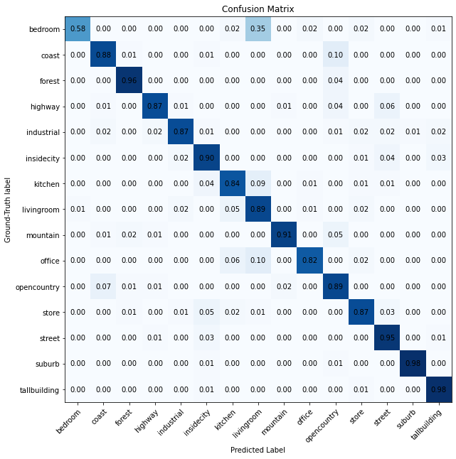
Part 3: ResNet
[Insert visualization of confusion matrix obtained from your final ResNet model.]

Slide 9
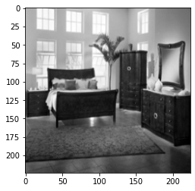
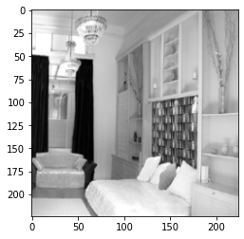
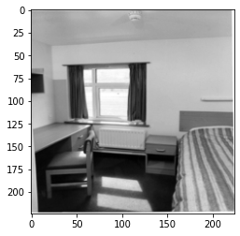
Part 3: ResNet
[Insert visualizations of 3 misclassified images from the most misclassified class according to your confusion matrix. Explain why this may have occurred.]
Target: Bedroom; Predicted as: Living room; Kitchen; Office
Why? Sometimes, the bedroom may be bright, spacious (like living room), having lots of closets (like kitchen) or contains a table (like an office). In this way, the bedroom could be easily misinterpreted as other types of room.

Slide 10
Part 3: ResNet
[What does fine-tuning a network mean?]
This concept is the opposite of “training from scratch”.
Fine-tuning a network means that we obtain a pre-trained model (e.g. pre-trained ResNet), change some of the model structure to fit our application, and then train the network using our own dataset so that the network works well on our application.
[Why do we want to "freeze" the conv layers and some of the linear layers from a pre-trained ResNet? Why can we do this?]
Why want?
Because the ResNet model is very deep and has millions of parameters, so training it from scratch (i.e. updating all the parameters) will take too long.
Why can?
Because the ResNet model we obtained is a pre-trained model, its previous layers are already pretrained. Therefore, we just need to change its fully-connected layers and train this part so that it works well on our own application.

Slide 11
Part 4: Multi-label Scene Attributes
[Insert loss plot here]
Final training accuracy:
Final validation accuracy:
[Insert accuracy plot here]

Slide 12
Part 4: Multi-label Scene Attributes
[Insert visualization of accuracy table obtained from your final MultilabelResNet model.]

Slide 13
Part 4: Multi-label Scene Attributes
[List 3 changes that you made in the network compared to the one in part 3.]
[Is the loss function of the ResNet model from part 3 appropriate for this problem? Why or why not?]

Slide 14
Part 4: Multi-label Scene Attributes
[Explain a problem that one needs to be wary of with multilabel classification. HINT: consider the purpose of visualizing your results with the accuracy table. You might want to do some data exploration here.]

