Slide 1
CS 4476 Project 5
Rushan Zhang
rzhang662@gatech.edu
rzhangbq@ust.hk
rzhang662
903849603
Discussed with Shuangyue Cheng (email: katcheng@gatech.edu)

Slide 2
Parts 4 & 5: mIoU of different models
Add each of the following (keeping the changes as you move to the next row):
# at epoch=10
 | Training mIoU | Validation mIoU
Simple Segmentation Net (no pretrained weights) | 0.0673 | 0.0582
ImageNet-Pretrained backbone | 0.3114 | 0.2979
Data augmentation | 0.1780 | 0.2227
ImageNet-Pretrained PSPNet w/ Data Aug. without PPM | 0.4321 | 0.4517
PSPNet with PPM | 0.4149 | 0.4019
PSPNet with auxiliary loss | 0.4223 | 0.4189

Slide 3
Parts 4 & 5: Per class IoUs
Report your model’s IoU for the 11 Camvid classes (you can find the order they are listed in at dataset_lists/camvid-11/camvid-11_names.txt): (Val results)
Epoch=10
Class Index | Class name | Simple Segmentation Net Class IoU | PSPNet Class IoU
0 | Building | 0.4785 | 0.8150
1 | Tree | 0.7712 | 0.7712
2 | Sky | 0.6636 | 0.8028
3 | Car | 0.0000 | 0.3832
4 | SignSymbol | 0.0000 | 0.0000
5 | Road | 0.5365 | 0.8852
6 | Pedestrian | 0.0000 | 0.0004
7 | Fence | 0.0000 | 0.3213
8 | Column_Pole | 0.0000 | 0.0000
9 | Sidewalk | 0.0000 | 0.6290
10 | Bicyclist | 0.0000 | 0.0000

Slide 4
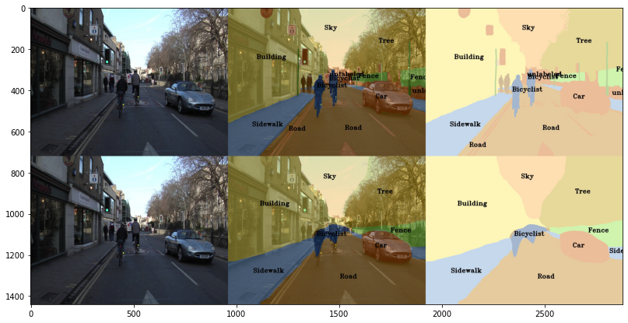
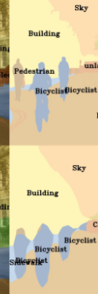
Parts 4 & 5: Most difficult classes
[Which classes have the lowest mIoU? Why might they be the most difficult? Provide an example RGB image from Camvid that illustrates your point]
Column pole, sign symbol, pedestrian and bicyclist.
Column pole and sign symbol:
Very small or thin, hard to
distinguish from background.
Pedestrian and bicyclist:
These two are very similar,
hard to distinguish between these
two.

Slide 5
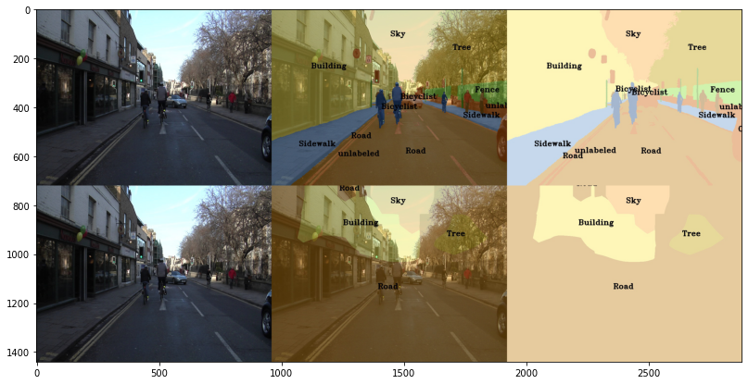
Part 4: Simple segmentation net qualitative results
[Paste a figure of the generated semantic segmentation from Colab. It should be a 2x3 grid, with ground truth on the top row, and your predictions on the bottom row.]
Epoch=10

Slide 6
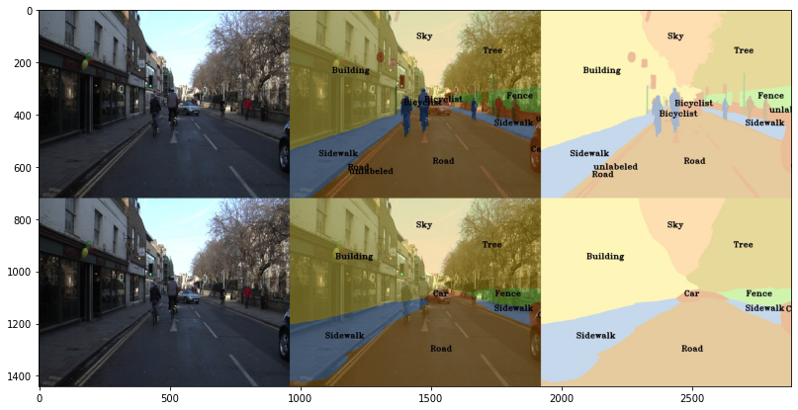
Part 5: PSPNet qualitative results
[Paste a figure of the generated semantic segmentation from Colab. It should be a 2x3 grid, with ground truth on the top row, and your predictions on the bottom row.]
Epoch=10

Slide 7
Part 6: Transfer Learning
Report your model’s IoU for the Kitti Dataset.
 | mIoU | mAcc/ | allAcc
Train result
Val result
Class Index | Class name | iou | accuracy
0 | Road
1 | Not_Road

Slide 8
Part 6: Transfer Learning
Compare the training loss generated when training on Kitti dataset and Camvid dataset. Which decreases at a faster rate? If Camvid or Kitti training loss decreases at a faster rate than the other, why do you think this happened? Or, if the loss decreases at a similar rate, why do you think that is so?

