Slide 1
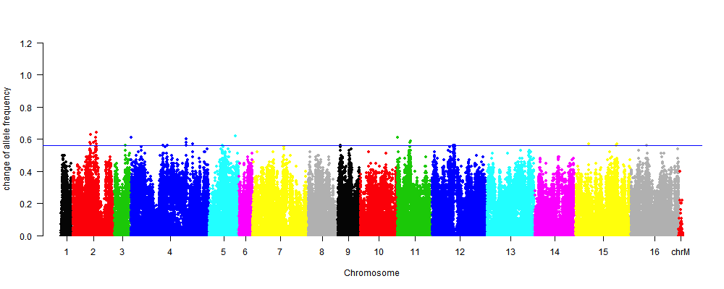
Notes:
Rep 1

Slide 2
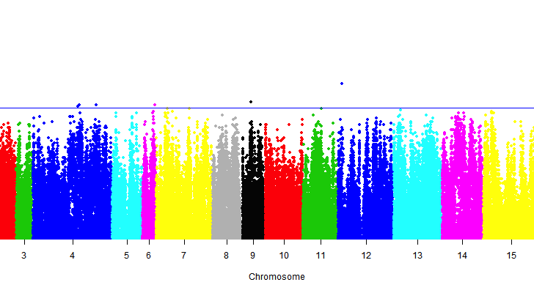
Notes:
Rep 2

Slide 3
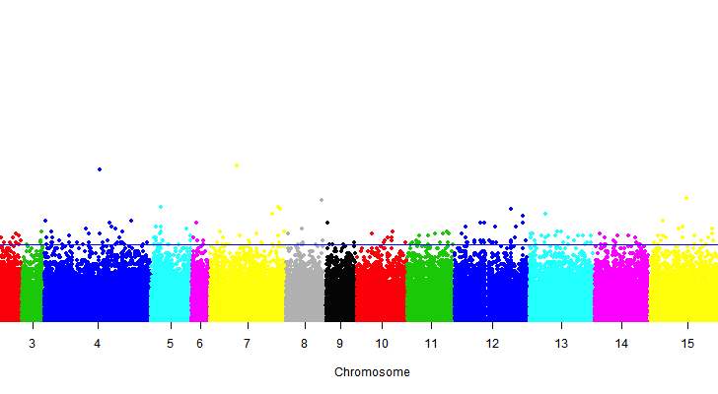
Notes:
Rep 3

Slide 4
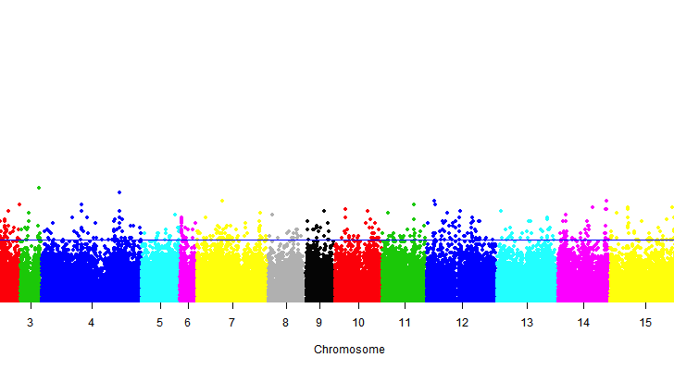
Notes:
Rep 5

Slide 5
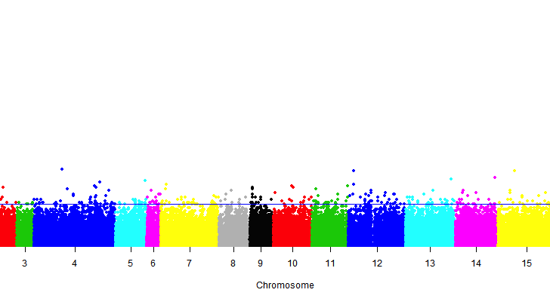
Notes:
Rep 7

Slide 6
