Slide 1
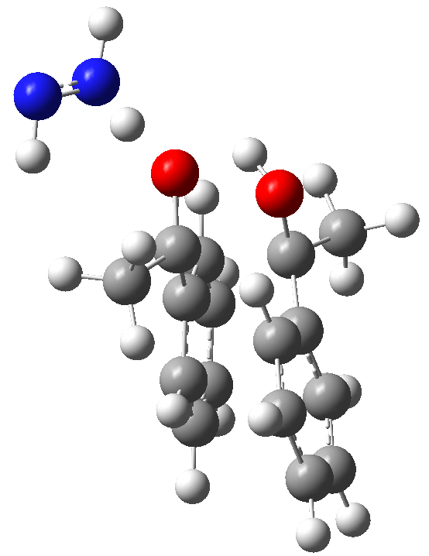
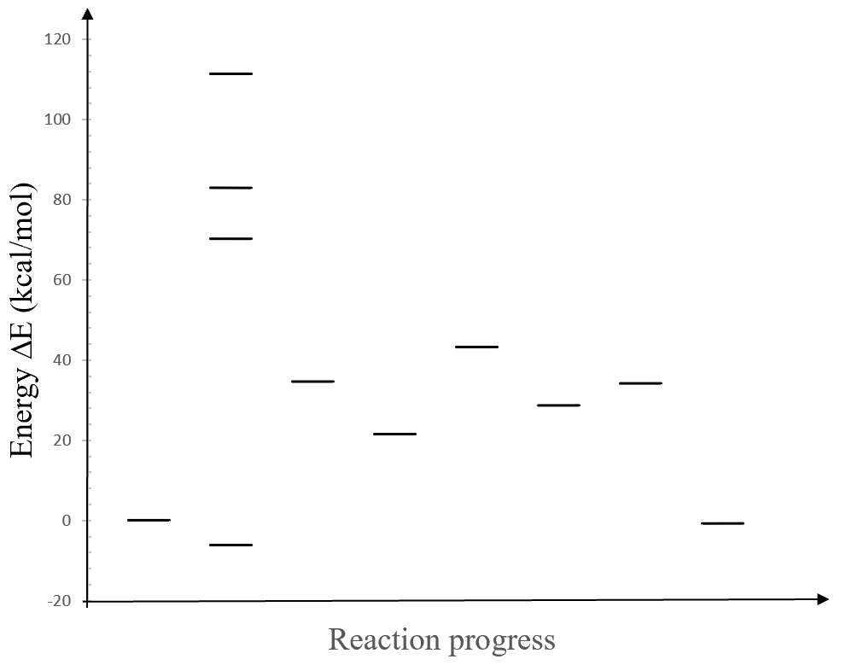



ground and excited states
Transition State
(TS)
$$S_{hν}$$
??
ISC
$$S_{1}$$
89
$$T_{o}$$
77
Use the same format to label states as shown for state 1a+2:
The energy label above the bar round to the nearest integer
do not use our A..BH2 abbreviation, use molecular numbers defined for each ChemDraw structure (read the article). Zihang must tell you which numbers to use.
Do not use ΔE for reactions to label the state energy.
Use ACS style for ChemDraw structures
All Gview structure must be on separate figures, not in PowerPoint.
The free energy diagram must have the same exactly format as the energy diagram, do not use curvy lines.
On the free energy diagram, label excitation energy with ΔE as shown here to distinguish it from ΔG.
Create axis labels in PowerPoint, use the same font type (Times new roman?) for tick labels.
Apply all this to the free energy diagram as well.
ΔE (kcal/mol)
-36
ΔE=??
(24?? nm)
+22
-15
-13
+6
3a+??
-35
0
1a+2
-6
3a+H₂+N₂
??
Reaction progress

Slide 2
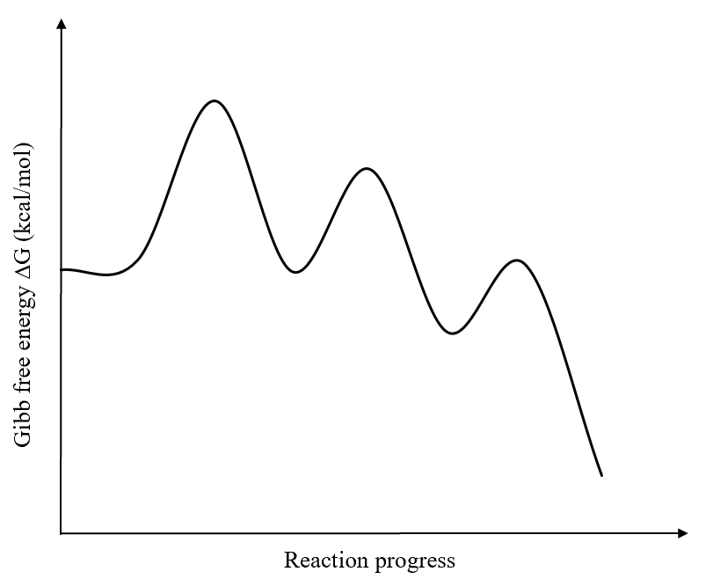






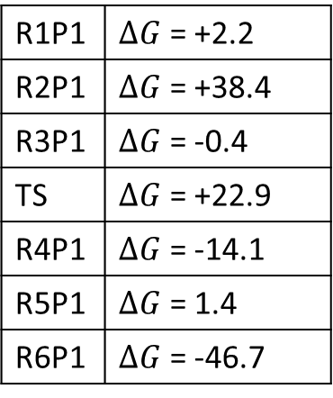
Gibb free energy diagram, path 1
R1P1 | $ΔG$ = +2.2
R2P1 | $ΔG$ = +38.4
R3P1 | $ΔG$ = -0.4
TS | $ΔG$ = +22.9
R4P1 | $ΔG$ = -14.1
R5P1 | $ΔG$ = 1.4
R6P1 | $ΔG$ = -46.7
Excited State
A…$BH_{2}$
TS
$${\left[\text{AH}\text{−}\text{BH}\text{…}\text{A}\right]}^{\text{ǂ} }$$
+40.6
+25.1
AHAH + B
+3.6
+2.2
Reactants
A…$BH_{2}$
AH..BH..A
-1.8
A + $BH_{2}$ 0.0
AH-AH..B
-57.1
$$ΔG<0$$
-11.9
Products
AHAH + $H_{2}$ + $N_{2}$

Slide 3
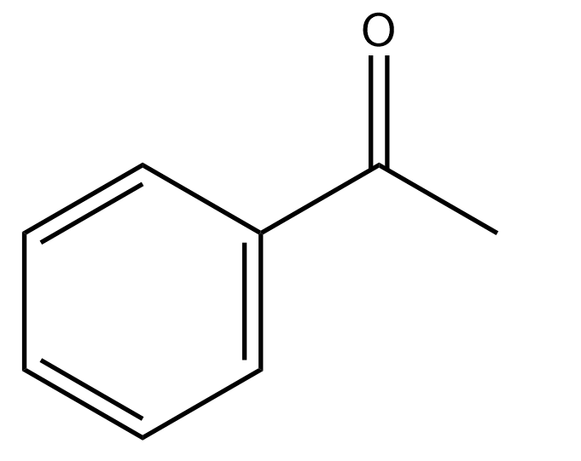

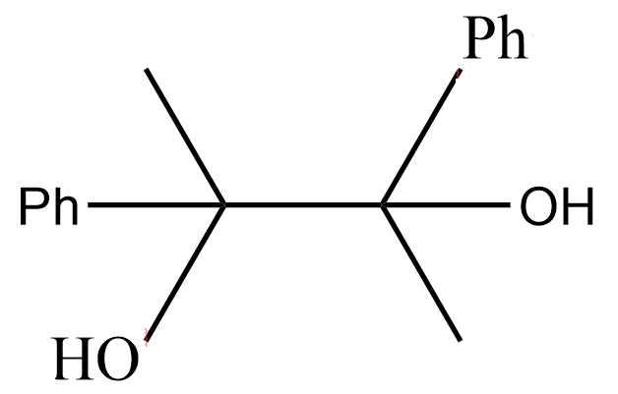

Slide 4
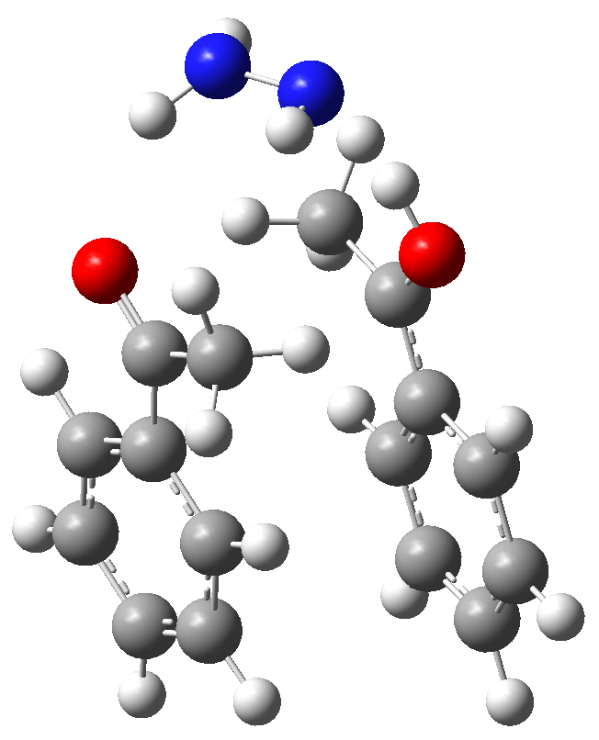
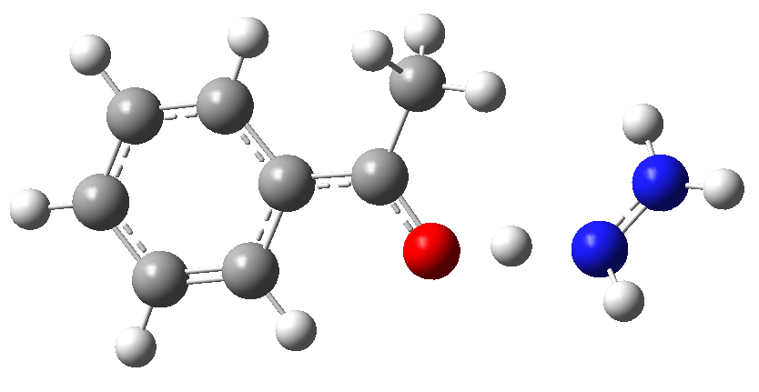
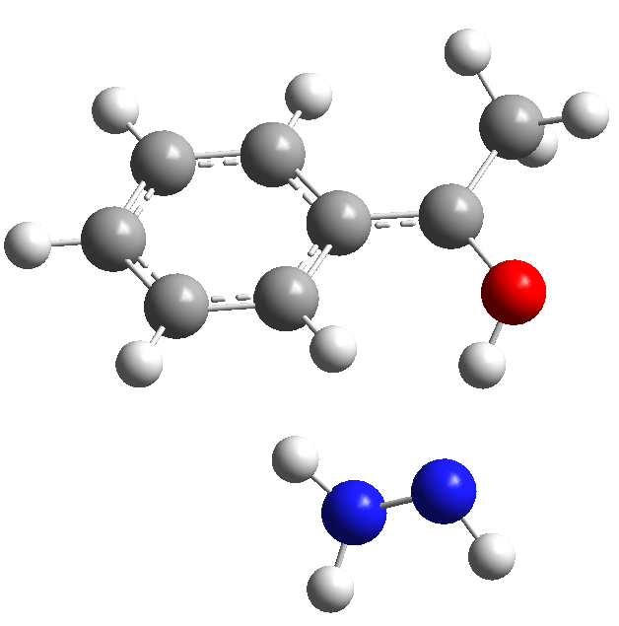
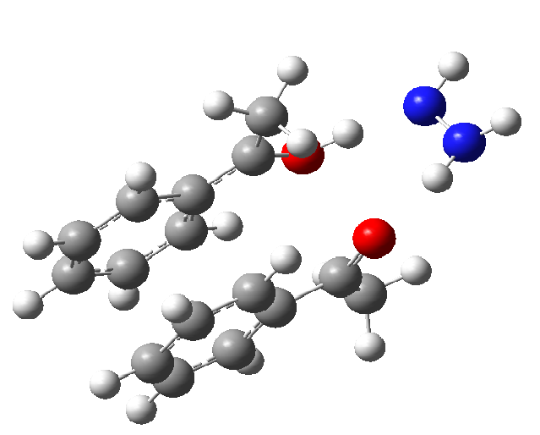
A…H…BH- SU
AHBH-1st H transfer-path 1
A..AH..BH (AABH-final scan)
AHBH + A

Slide 5
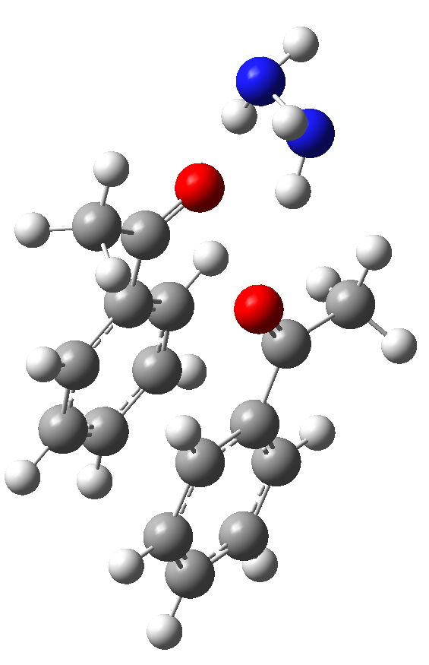
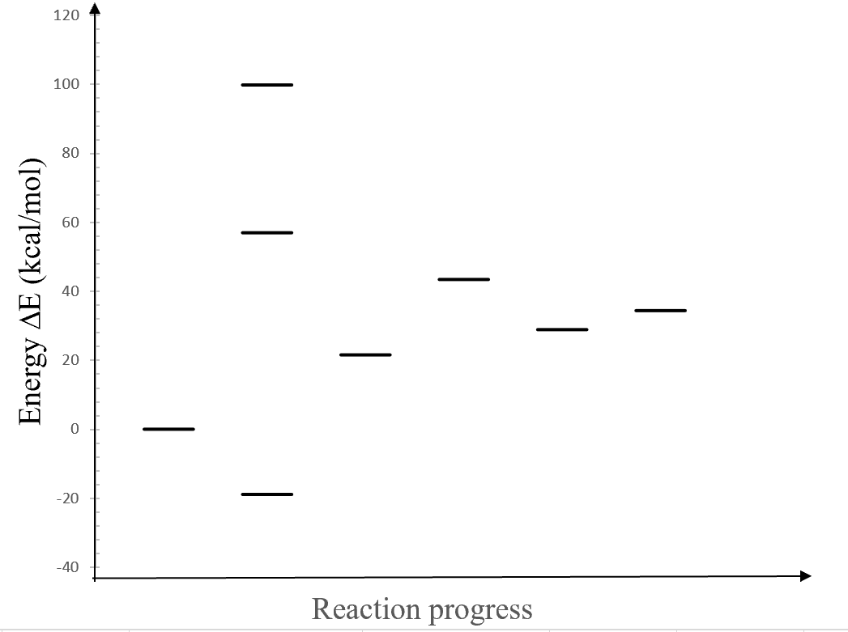






Reactants (3 pieces)
Energy diagram, path 2
Excited State
A...$BH_{2}$...A
+118.7
TS
AH-$BH$...A
-14.5
AHAH + $B$
+21.9
+5.5
AH..BH..A
AH-AH....$B$
+75.8
A + $BH_{2}$ + A
+40.5
-18.9
A…$BH_{2}$...A

Slide 6
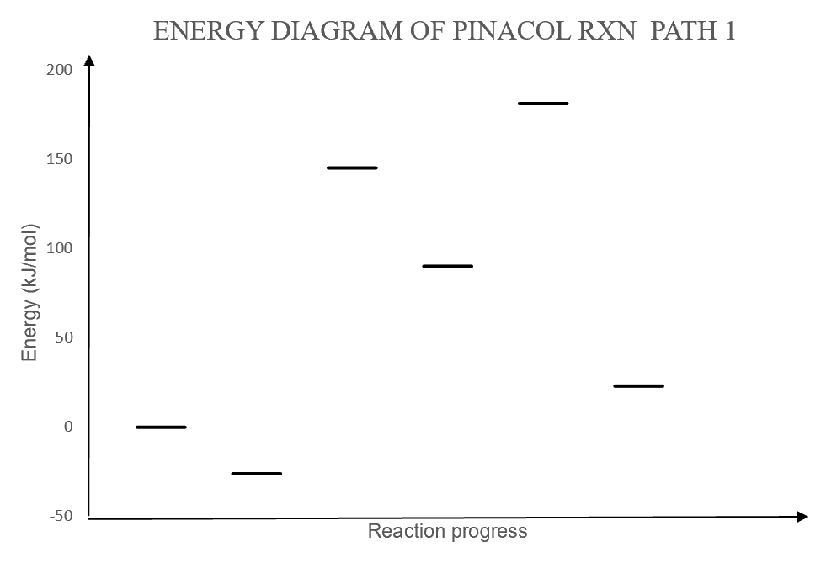

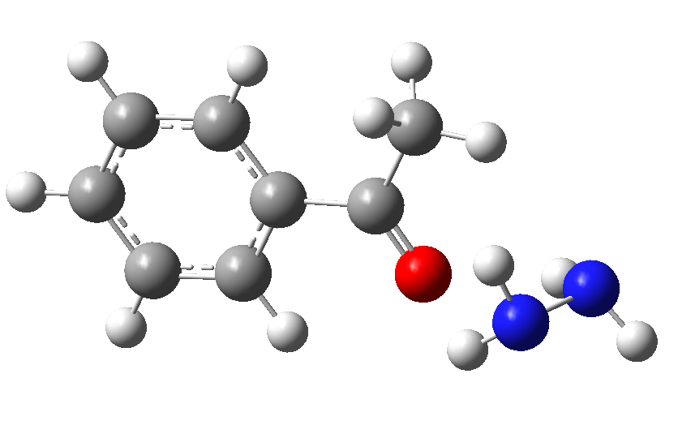


INITIAL DRAFT
AH-AH…B
AH… $BH$
-55
-158
AH…BH + A
171
A + $BH_{2}$
23
AHAH + B
-26
A…$BH_{2}$

