Slide 1
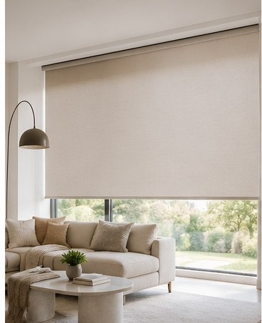

COMPANY PROFILE
Window Fashion Experience Since 1982
DESIGN • QUALITY • SERVICE

Slide 2
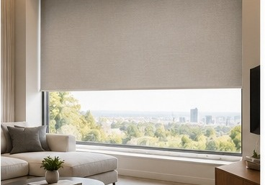
01 / ABOUT ACCENT
Window Fashion Experience Since 1982
Accent Blinds brings stylish window covering solutions to homes and workplaces.
1982
Established in Sydney, Australia.
Over 40 years of experience in window fashion.
DESIGN • QUALITY • SERVICE
ACCENT BLINDS | COMPANY PROFILE
2

Slide 3
02 / OUR APPROACH
Where Design Meets Function
Window coverings tailored to light control, privacy, design, and comfort.
01
02
03
DESIGN
QUALITY
SERVICE
Styles and textures to complement your interior.
Product choices focused on appearance and functionality.
Consultation, professional installation, and after-sales support.
ACCENT BLINDS | COMPANY PROFILE
3

Slide 4
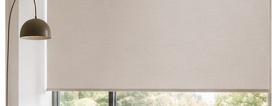
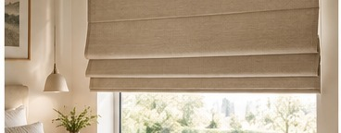
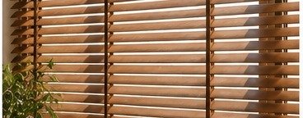
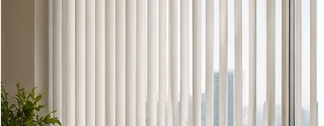
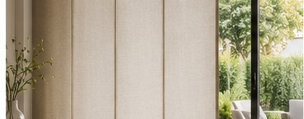

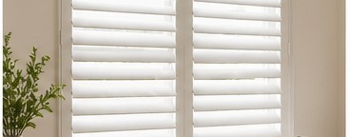
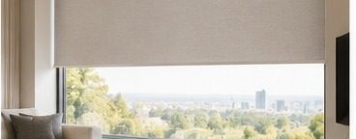
03 / PRODUCT COLLECTION
Find the Right Solution for Every Window
Product categories featured on the Accent Blinds website.
Roller Blinds
Roman Blinds
Venetian Blinds
Vertical Blinds
Minimalist, practical and versatile.
Soft fabric folds for an elegant finish.
Adjustable light and privacy control.
Ideal for wide windows and openings.
Panel Glides
Cellular Shades
Pvc Shutter
Motorised Blinds
Smooth panels for larger openings.
Honeycomb design helps improve insulation.
Timeless style with a clean finish.
Timeless style with a clean finish.
ACCENT BLINDS | COMPANY PROFILE
4

Slide 5
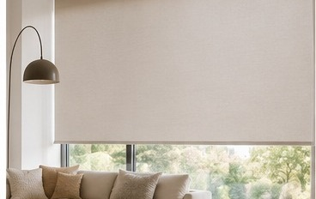
04 / PRODUCT SPOTLIGHT
Roller Blinds
Simple, elegant, versatile, practical, and functional.
CLEAN • FLEXIBLE • TIMELESS
A Minimalist Look
Designed to complement a wide range of interiors. Accent lists manual, dual, linked, motorised, and cassette operating options.
Ideal for: living rooms, bedrooms, and offices
ACCENT BLINDS | COMPANY PROFILE
5

Slide 6
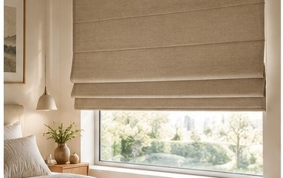
05 / PRODUCT SPOTLIGHT
Roman Blinds
Soft fabric folds create a decorative, refined look.
CLASSIC • SEWLESS • VILLA
Three Styles, One Collection
Classic features traditional stitching; Sewless uses slim aluminium extrusions for a clean look; Villa adds wooden sticks for a relaxed, natural finish.
ACCENT BLINDS | COMPANY PROFILE
6

Slide 7
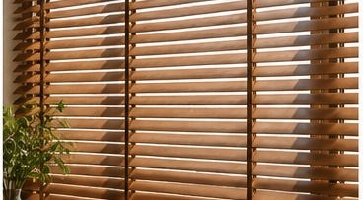
06 / PRODUCT SPOTLIGHT
Venetian Blinds
Adjustable slats offer control over daylight and privacy.
01 / VENETIAN
02 / VENETIAN
03 / VENETIAN
Timber Venetian
Econo Venetian
Aluminium Slimline
Natural warmth with a range of wood finishes.
A durable, economical synthetic alternative.
Lightweight, easy to clean, with 25 mm slats.
Note: sizes and options are subject to Accent product availability.
ACCENT BLINDS | COMPANY PROFILE
7

Slide 8
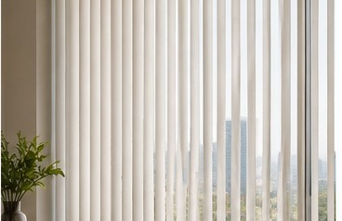
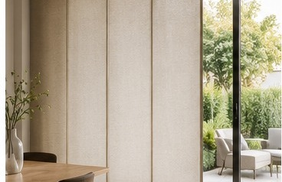
07 / PRODUCT SPOTLIGHT
For Wide Windows and Larger Openings
Vertical lines and fabric panels create a clean, contemporary look.
VERTICAL BLINDS
PANEL GLIDES
Fabric vanes help manage light and heat.
Fabric panels for large windows and doors.
ACCENT BLINDS | COMPANY PROFILE
8

Slide 9


08 / PRODUCT SPOTLIGHT
Texture, Comfort, and Character
Distinctive features paired with thoughtful design.
CELLULAR SHADES
PVC SHUTTER
Honeycomb cells help with insulation and light control.
A classic look with a focus on function and durability.
ACCENT BLINDS | COMPANY PROFILE
9

Slide 10
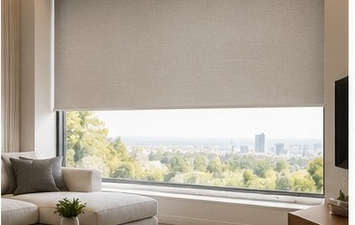
09 / PRODUCT FEATURE
Motorisation for Added Convenience
Motorised operation is available on selected products.
SMARTER DAILY ROUTINE
Everyday Convenience
Ask the Accent team which motorisation options suit your chosen product and space.
ACCENT BLINDS | COMPANY PROFILE
10

Slide 11
10 / BENEFITS
Comfort You Can Feel Every Day
Choose the features that best fit each room.
LIGHT CONTROL
PRIVACY
THERMAL COMFORT
Adjust the amount of natural daylight.
Help maintain privacy.
Cellular Shades trap air within their honeycomb structure.
DESAIN INTERIOR
PENGOPERASIAN
PERAWATAN
Complete the space with colour, texture, and form.
Choose manual operation or motorisation on selected products.
Get usage and care guidance from the installation team.
ACCENT BLINDS | COMPANY PROFILE
11

Slide 12




11 / SPACES
Solutions for Different Spaces
Illustrative visuals showing how window coverings may work in different spaces.
RESIDENTIAL
HOSPITALITY
Living rooms and bedrooms
Guest rooms and lounges
OFFICE
LARGE OPENINGS
Workspaces and meeting rooms
Glass doors and wide openings
ACCENT BLINDS | COMPANY PROFILE
12

Slide 13
12 / OUR SERVICE
From Consultation to Installation
A guided process to help customers choose the right solution.
01
02
03
04
CONSULTATION
PRODUCT SELECTION
INSTALASI
AFTER-SALES
Discuss your needs, functionality, and interior style.
Select product type, material, colour, and operation.
Professional and efficient installation.
Usage guidance, care advice, and ongoing support.
ACCENT BLINDS | COMPANY PROFILE
13

Slide 14
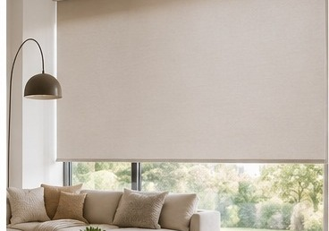
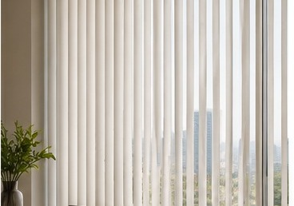
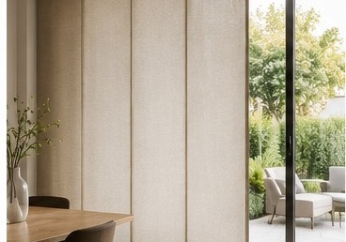
13 / PROJECT PORTFOLIO
Completed Project Portfolio
Showcase completed installations using your own project photos and approved project details.
TEMPLATE NOTE: The images above are sample visuals, not completed Accent Blinds projects. Replace them with your own project photos.
Project names, clients, locations, dates, and installed products must be completed using company records. The public website reviewed does not list named projects.
ACCENT BLINDS | COMPANY PROFILE
14

Slide 15
14 / PROJECT LIST
Completed Project List
Editable template — enter completed projects only. Replace each field with your approved project information.
PROJECT 01
[Project / Client Name]
PROJECT 02
[Project / Client Name]
[City • Completion Year]
[City • Completion Year]
[Product Installed • Area]
[Product Installed • Area]
PROJECT 03
[Project / Client Name]
PROJECT 04
[Project / Client Name]
[City • Completion Year]
[City • Completion Year]
[Product Installed • Area]
[Product Installed • Area]
PROJECT 05
[Project / Client Name]
PROJECT 06
[Project / Client Name]
[City • Completion Year]
[City • Completion Year]
[Product Installed • Area]
[Product Installed • Area]
ACCENT BLINDS | COMPANY PROFILE
15

Slide 16
15 / CASE STUDY
Completed Project Profile
Editable project template — duplicate this slide for each completed project.
INSERT PROJECT PHOTO HERE
Replace this box with your completed installation photo
[PROJECT 01 NAME / CLIENT]
Project Overview
[Building / room / client requirement]
Products Installed
[Blind type, material, colour, control system]
Project Details
[Impact on function, light control, or aesthetics]
ACCENT BLINDS | COMPANY PROFILE
16

Slide 17
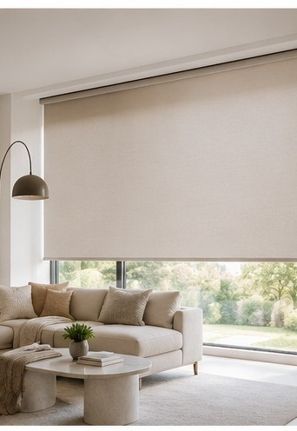
LET'S CREATE A BETTER SPACE
Let’s create a
space you’ll love.
ACCENT BLINDS
Ruko De Mansion #D9, Alam Sutera
021-22630219 • 0821 1426 8322
cs@accentblinds.id
Monday–Friday | 8:30 AM–5:00 PM
accentblinds.id
ACCENT BLINDS | COMPANY PROFILE
17

Slide 18
16 / NOTES
Sources & Visual Usage
Notes to review before sharing this presentation externally.
PRIMARY SOURCE
Official website: https://accentblinds.id/
Product, brand, service, and contact information is based on public pages from Accent Blinds.
Product visuals in this presentation are conceptual illustrations, not official catalogue photos or verified Accent Blinds project photography.
Before sharing with clients, replace project templates with approved project names and photography.
ACCENT BLINDS | COMPANY PROFILE
18

Slide 19
15 / CASE STUDY
Completed Project Profile
Editable project template — duplicate this slide for each completed project.
INSERT PROJECT PHOTO HERE
Replace this box with your completed installation photo
[PROJECT 02 NAME / CLIENT]
Project Overview
[Building / room / client requirement]
Products Installed
[Blind type, material, colour, control system]
Project Details
[Impact on function, light control, or aesthetics]
ACCENT BLINDS | COMPANY PROFILE
19

Slide 20
15 / CASE STUDY
Completed Project Profile
Editable project template — duplicate this slide for each completed project.
INSERT PROJECT PHOTO HERE
Replace this box with your completed installation photo
[PROJECT 03 NAME / CLIENT]
Project Overview
[Building / room / client requirement]
Products Installed
[Blind type, material, colour, control system]
Project Details
[Impact on function, light control, or aesthetics]
ACCENT BLINDS | COMPANY PROFILE
20

Slide 21
15 / CASE STUDY
Completed Project Profile
Editable project template — duplicate this slide for each completed project.
INSERT PROJECT PHOTO HERE
Replace this box with your completed installation photo
[PROJECT 04 NAME / CLIENT]
Project Overview
[Building / room / client requirement]
Products Installed
[Blind type, material, colour, control system]
Project Details
[Impact on function, light control, or aesthetics]
ACCENT BLINDS | COMPANY PROFILE
21

Slide 22
15 / CASE STUDY
Completed Project Profile
Editable project template — duplicate this slide for each completed project.
INSERT PROJECT PHOTO HERE
Replace this box with your completed installation photo
[PROJECT 05 NAME / CLIENT]
Project Overview
[Building / room / client requirement]
Products Installed
[Blind type, material, colour, control system]
Project Details
[Impact on function, light control, or aesthetics]
ACCENT BLINDS | COMPANY PROFILE
22

Slide 23
15 / CASE STUDY
Completed Project Profile
Editable project template — duplicate this slide for each completed project.
INSERT PROJECT PHOTO HERE
Replace this box with your completed installation photo
[PROJECT 06 NAME / CLIENT]
Project Overview
[Building / room / client requirement]
Products Installed
[Blind type, material, colour, control system]
Project Details
[Impact on function, light control, or aesthetics]
ACCENT BLINDS | COMPANY PROFILE
23

