Slide 1
Microsoft Graph Data Connect
Introducing Microsoft Graph data connect & configuring your Office 365 tenant

Slide 2

Microsoft Graph Data Connect
What is Microsoft Graph data connect?
What types of scenarios does Microsoft Graph data connect enable?
Configuring your Office 365 tenant to enable Microsoft Graph data connect

Slide 3
What are customers trying to do?
Better CRM
Security and Fraud
Optimize Your Organization​
Build & Integrate Intelligent Workflows with O365​
Mine your org network for a customer introduction
Opportunity health assessment​
Detect fraud with productivity and communication data
Mine communication for interaction patterns with users outside the organization
Find an expert​
Automate knowledge base creation​
Understand resource utilization within your organization
Case management
Questions & answers bot
Support ticket management
Analytics
AI and ML
Index and Search

Slide 4
Challenging scenarios with the Microsoft Graph
Today’s most interesting data-driven applications
require reasoning & analysis over massive datasets
built by extracting data from Office 365 via Microsoft Graph APIs
Microsoft Graph is optimized for simple, real-time, entity centric queries, not:
Data Access in bulk - requires expensive engineering
Data Privacy is at risk - given the current all-or-nothing consent models
Data Security & Data Governance - entirely up to the experience author

Slide 5
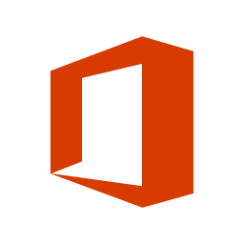
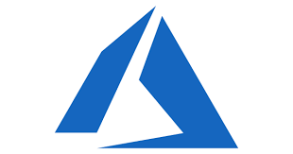





Microsoft Graph Data Connect
Apply defined data controls
Securely extend Office 365 data to Azure
Enable big data and machine learning
Data at scale
Office 365
Azure
Customer data
Granular consent
Product data
Security & Governance
Industry data
Customer’s MS Cloud

Slide 6
What is Microsoft Graph Data Connect?
Creates a new model for data access & hosting applications within the customer’s control
Allows developers to build intelligent applications and experiences using Office 365 data & Azure resources
Application access to customer data requires explicit customer approval
Microsoft Graph remains the best approach for enabling end-user task centric apps

Slide 7
Benefits to Enterprise Customers
Granular access to only the specific datasets/fields required for developer app
Customer gets to review the specific fields and any exclusions
Data is stored, processed, accessed within the customer Azure tenancy
Only data the customer explicitly approves is shared with the application developer
Data policy promises hold true at all times
Policies like encryption, auditing, etc. are in place when data moves from Office 365 into Azure
Developer app is “managed” with no effort from the customer
Deployed, scaled, updated, with minimal customer intervention

Slide 8
Benefits to Developers & ISVs
Application logic runs within Azure’s customer sandbox
Developer doesn’t need to be trusted with/liable for hosting data
Data layout optimized for analytics applications
Focus on building value rather than coercing user-mode APIs into analytics scenarios
Azure data services and tools
Leverage the full stack ‘better together’ tooling that Azure + VS + O365 provides
1-click install for your app through marketplace or service catalog (internal distribution)
Easy to manage/scale/update even in the customer’s tenancy

Slide 9
Comparing Microsoft Graph APIs & Microsoft Graph Data Connect
 | Graph APIs | Graph data connect
Access scope | Single use / entire tenant | Many users / groups
Access pattern | Real time | Recurrent schedule
Data operations | Operates on data master | Operates on cache of the data
Data protection | Data is protected while in Microsoft 365 | Data protection is extended to the cache of data in your Azure subscription
User consent | Self; resource types | None
Admin consent | Entire organization; resource types | Select groups of users; resource types & properties; excludes users
Access tools | RESTful web queries | Azure Data Factory

Slide 10
Graph Data Connect - Enabling Scenarios
Data resides in Office 365
Azure Data Factory extracts data via Graph data connect
Graph data connect enforces only approved requests for data
Extracted data is stored in Azure:
Azure Blob Storage
Azure Data Lake
Create solutions that leverage the data in Azure

Slide 11
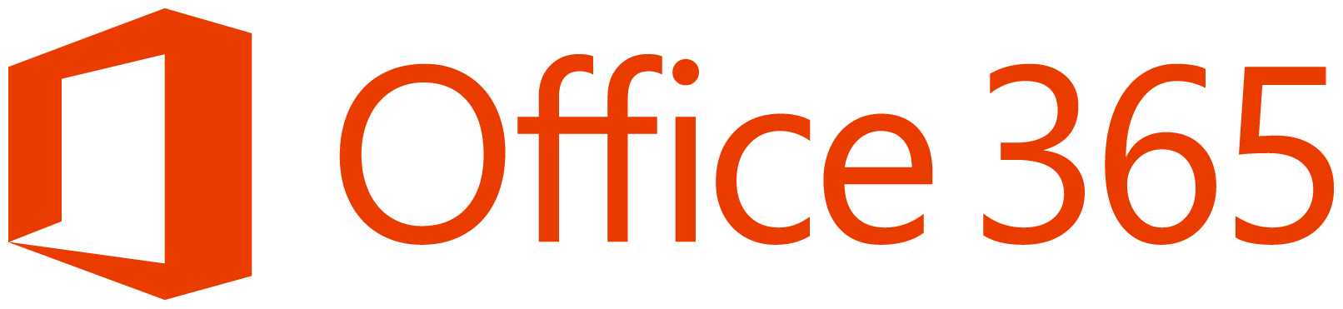

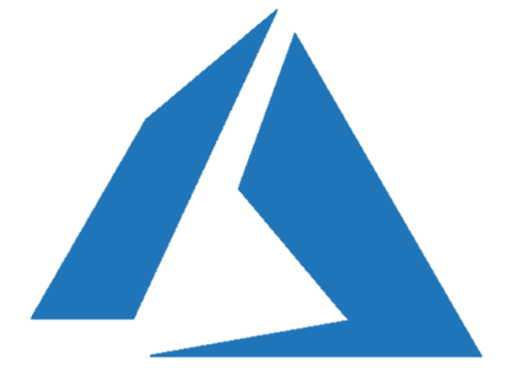
Insight examples for organizations
Build a better CRM. Connect your organizational network for a customer introduction.
Engage your customers
Transform products
Build & integrate intelligent workflows with Office 365 for your business and industry.​ Leverage knowledge to improve legal case management.
Your Data +
Workplace Analytics
Azure
Connect employees with the best expert. Abstract trends to automate knowledge management.
Optimize your organization​
Streamline operations
Detect fraud with productivity and communication data.
Connect interaction patterns with users outside the organization.

Slide 12
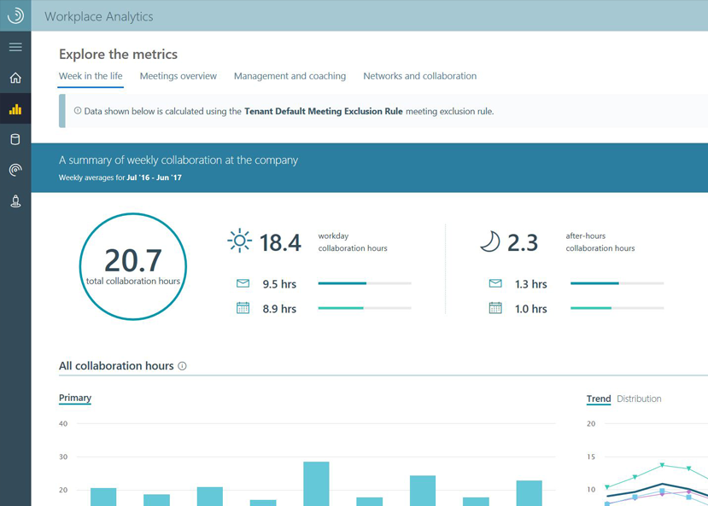
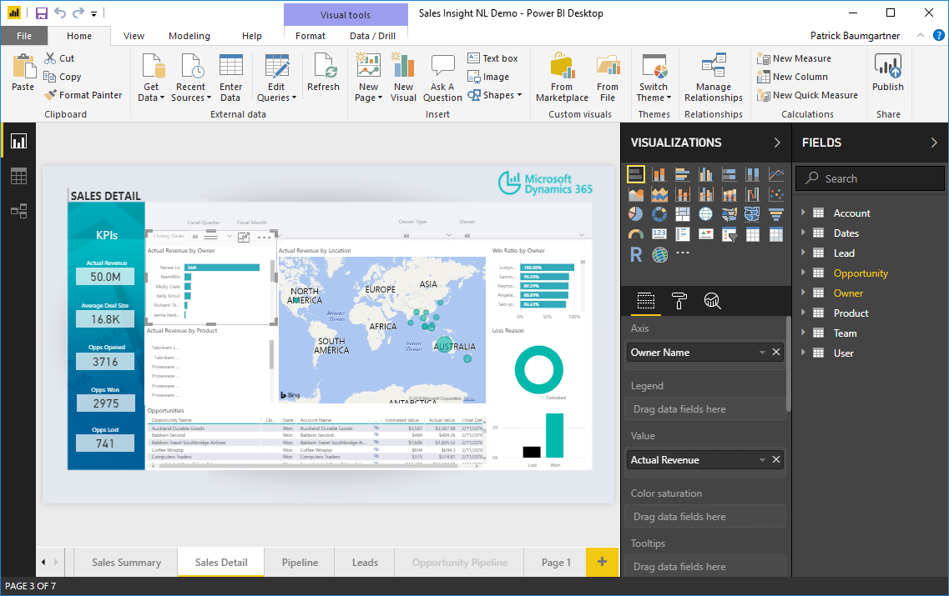
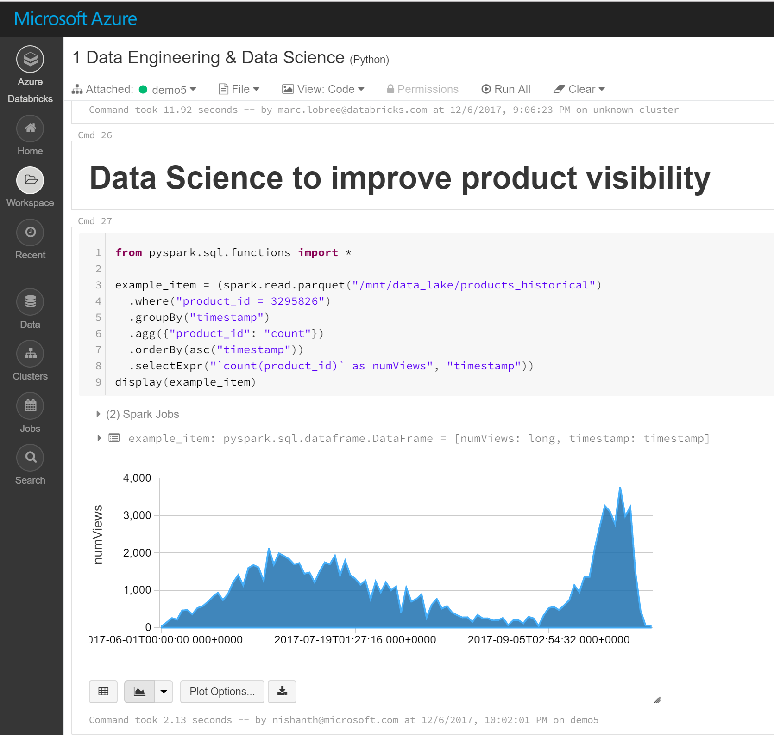


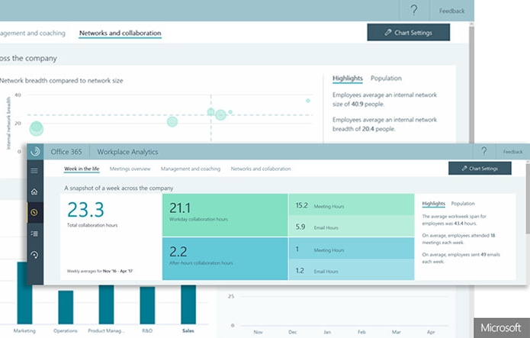
Create insight applications in the Enterprise
Anyone can develop custom insights using key organizational data
Decision makers
Business analysts
Developers
Workplace Analytics
Create self-service customization
Harness full AI tool suites and frameworks
Insights apps
Unlock valuable insights in hours

Slide 13
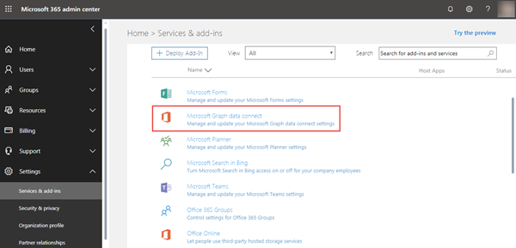
Configuring Office 365 & Microsoft Azure
Office 365 Requirements:
Enable Graph Data Connect in your Office 365 tenant
Designate security group that can approve data extraction requests
Workplace Analytics licenses
Microsoft Azure Requirements:
Minimum of two (2) users
One with global administrator role assigned
Azure Active Directory application

Slide 14
Demo Configuring Your Office 365 Environment

Slide 15

Summary
What is Microsoft Graph data connect?
What types of scenarios does Microsoft Graph data connect enable?
Configuring your Office 365 tenant to enable Microsoft Graph data connect

Slide 16
Reading further
Microsoft Graph
https://graph.microsoft.com

Slide 17
Thank you.

