Slide 1
Microsoft Graph Data Connect
Extract Office 365 data with Graph data connect

Slide 2

Extract Office 365 data with Microsoft Graph Data Connect
Create a data sink where extracted data will go
Create Azure Data Factory pipeline
Approve data request

Slide 3
Graph Data Connect - Enabling Scenarios
Data resides in Office 365
Azure Data Factory extracts data via Graph data connect
Graph data connect enforces only approved requests for data
Extracted data is stored in Azure:
Azure Blob Storage
Azure Data Lake
Etc.
Create solutions that leverage the data in Azure

Slide 4
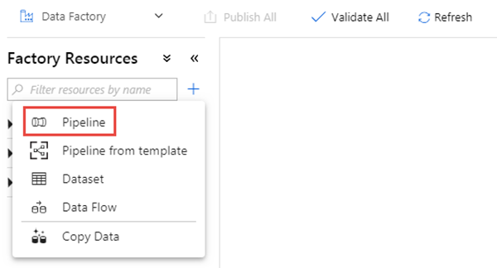
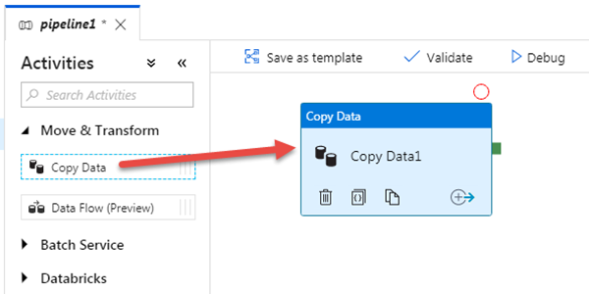
Extracting Data with Azure Data Factory
Azure Data Factory pipelines used to extract data from Office 365 to an Azure storage option
Use the Office 365 Connector
Create a pipeline and add the Copy Data activity

Slide 5
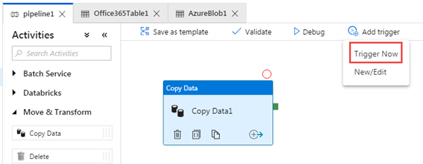
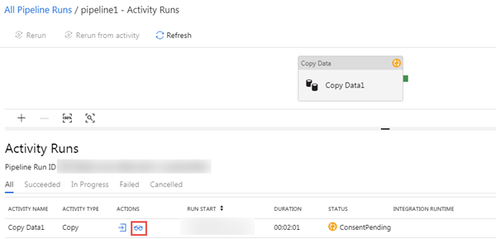
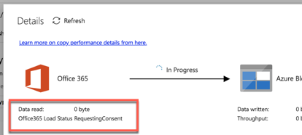
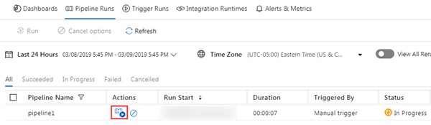
Run the Azure Data Factory Pipeline
Trigger the pipeline to run after validating & publishing
Monitor status if it is pending approval request
Notes:
Can approve via PowerShell or Admin UX:
https://portal.office.com/adminportal/home#/Settings/PrivilegedAccess

Slide 6
Approving Data Requests
Use Exchange Online PowerShell to check and approve data access requests
Must login to EOL PowerShell with an account that meets the following requirements:
Member of the designated approvers group
Has multi-factor authentication enabled
Is not the same user who initiated the request
Alternatively approve via Microsoft 365 Admin Center:
https://portal.office.com/adminportal/home#/Settings/PrivilegedAccess

Slide 7
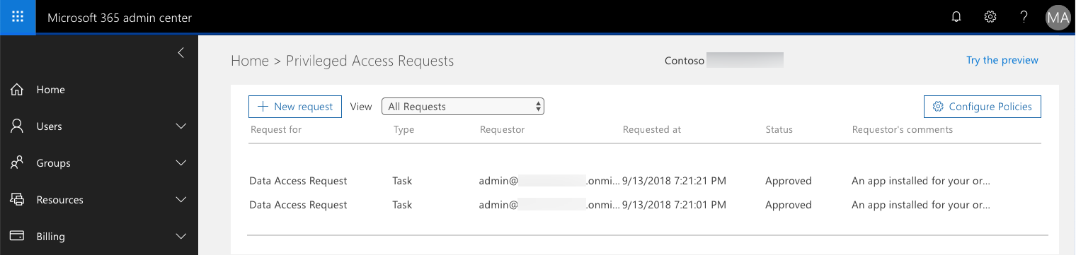
Approving Data Requests via Microsoft 365 Admin Center

Slide 8
Connect to Exchange Online
# login
$UserCredential = Get-Credential
# create new EOL remote session
$Session = New-PSSession
-ConfigurationName Microsoft.Exchange
-ConnectionUri https://ps.protection.outlook.com/powershell-liveid/
-Credential $UserCredential -Authentication Basic –AllowRedirection
# load the EOL session Import-PSSession $Session –DisableNameChecking
# alternative connection to EOL
Connect-EXOPSession

Slide 9
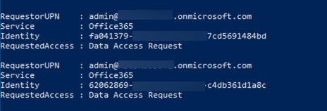
List Pending Data Access Requests
Get-ElevatedAccessRequest
| where {$_.RequestStatus -eq 'Pending’}
| select RequestorUPN, Service, Identity, RequestedAccess
| fl

Slide 10
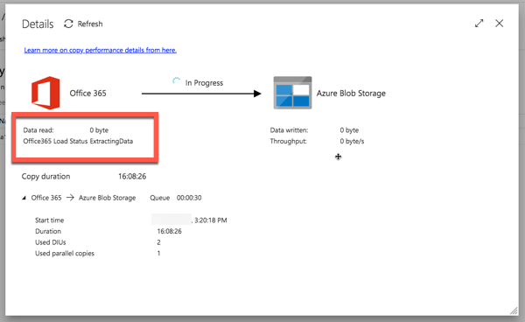
Approve Pending Requests
Approve-ElevatedAccessRequest
-RequestId fa041379-0000-0000-0000-7cd5691484bd
-Comment 'approval request granted'

Slide 11
Demo Extracting data from Office 365 via Graph data connect

Slide 12

Summary
Create a data sink where extracted data will go
Create Azure Data Factory pipeline
Approve data request

Slide 13
Reading further
Microsoft Graph
https://graph.microsoft.com
Azure Data Factory
https://azure.microsoft.com/services/data-factory

Slide 14
Thank you.

