Slide 1
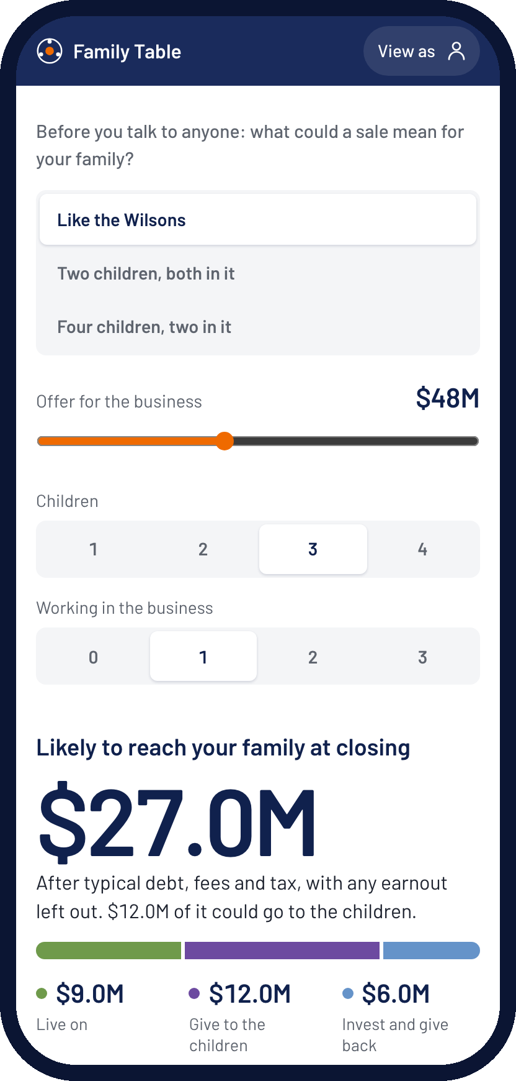
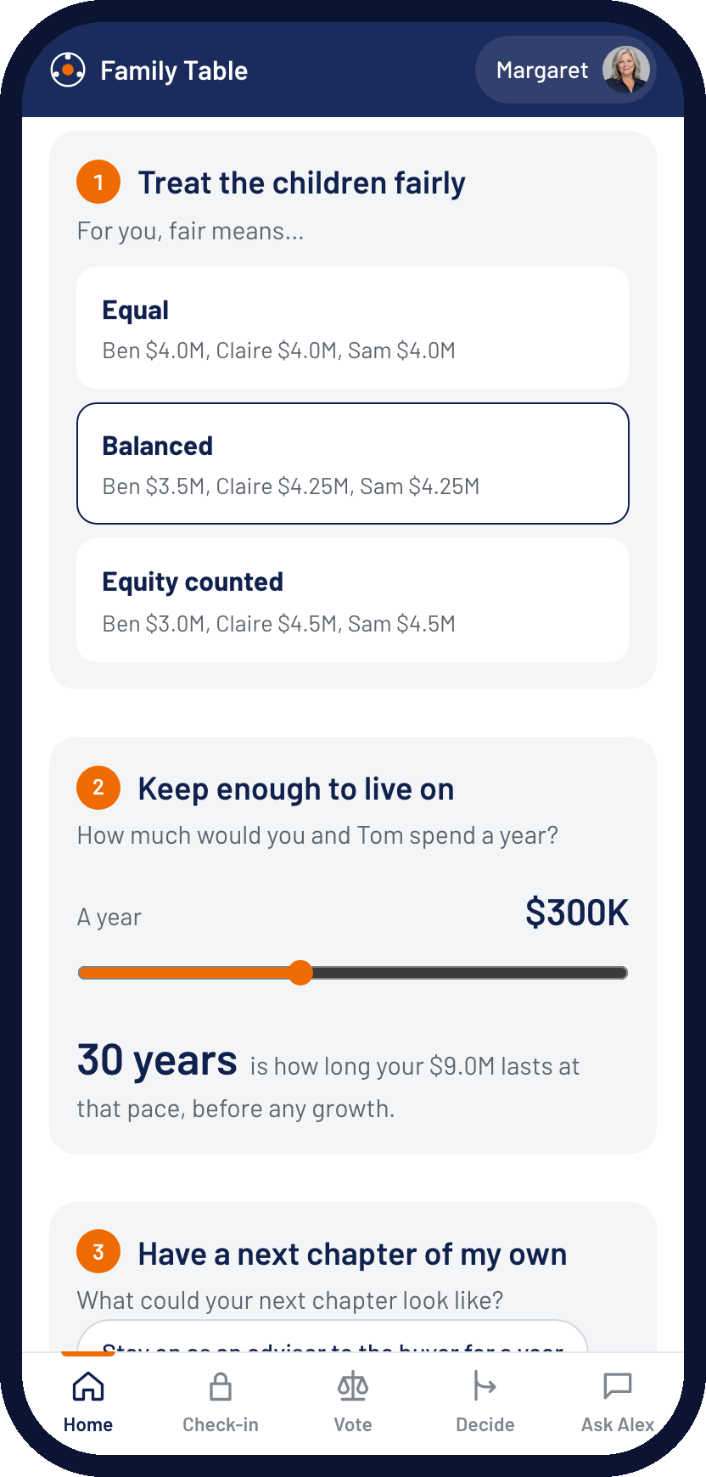
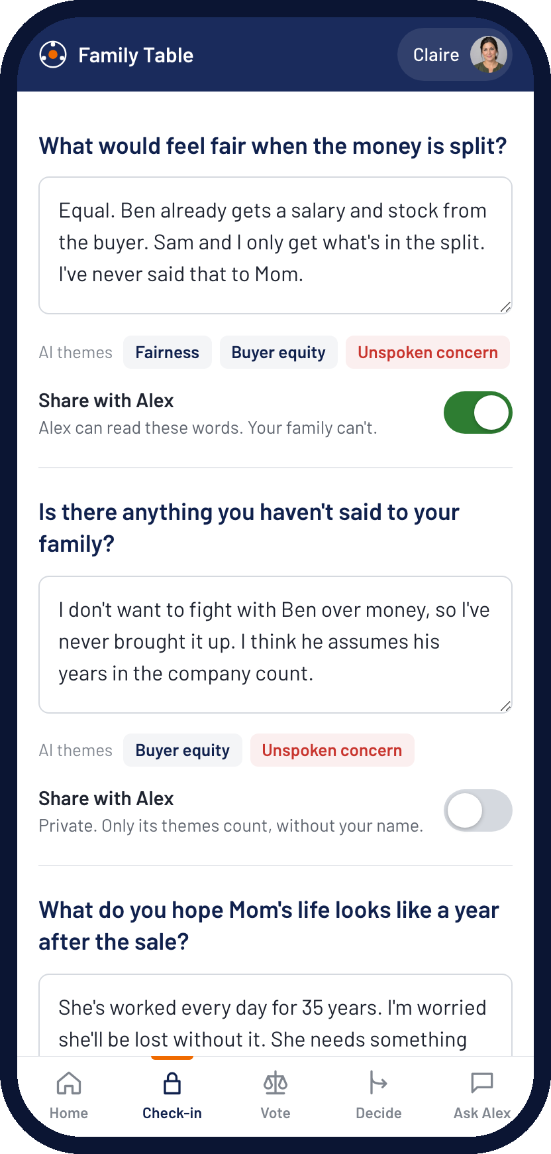
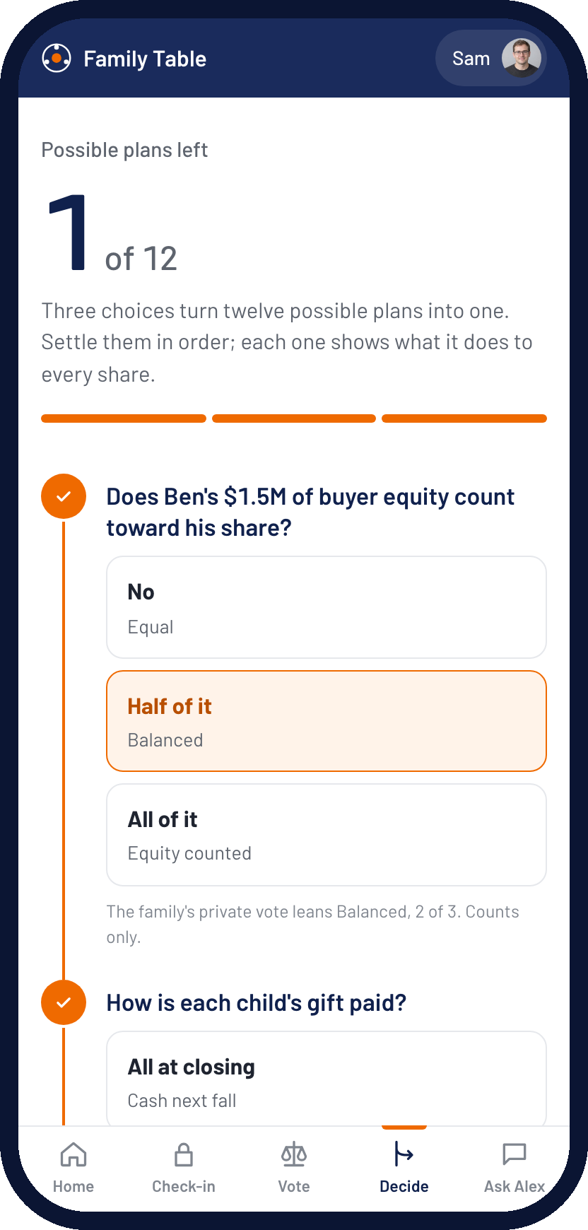
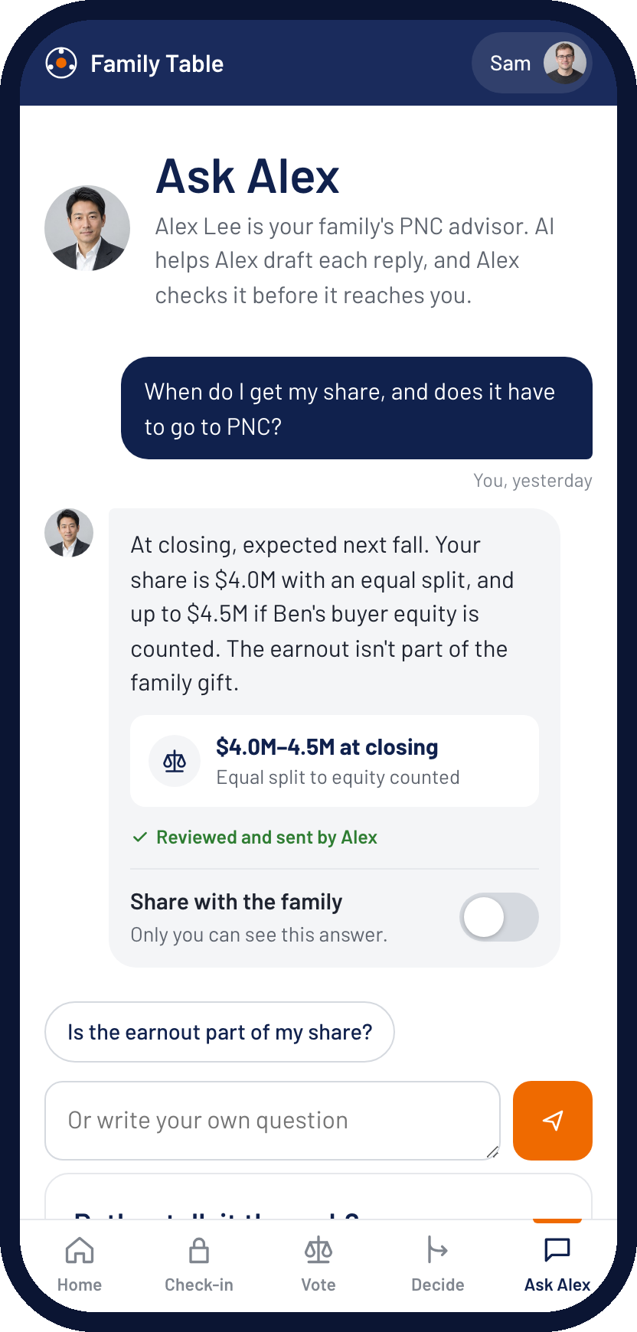
AI Client & Family Experience
Two quick steps to start, then the core journey where the family decides: Align, Allocate, Activate
Explore
Onboard
Core journey
Align
Allocate
Activate
See what a sale could mean
Confirm facts, sharpen goals
Speak in private
Vote, then 12 plans to 1
Ask a person, not a bot
Before talking to anyone: the likely amount at closing, and two ways to split it.
PNC fills in what it knows. Margaret ranks three goals and says what fair means.
Claire writes what she's never said, then chooses what Alex may read.
Each child's number under every split, a private vote, and a decision tree.
Questions go to Alex. The reply carries its numbers; a call is one tap away.
AI: none; fixed ratios do the math.
AI: prefills from PNC records.
AI: NLP tags themes in her own vault.
AI: explains; formulas do every number.
AI: drafts; Alex checks before it's sent.
WHAT THE FAMILY GETS
Clarity: their own number, not a guess. Fairness: a private voice, without a fight at dinner. Confidence: every answer is checked by a person before it reaches them.
Source: Family Table prototype (mobile). The Wilson family, portraits and figures are fictional; AI steps are simulated, formulas are real.
Notes:
Five moments on the family side, all on a phone. Explore and Onboard are the lead-in; the core journey, where the family actually decides, is Align, Allocate and Activate. Before Margaret ever talks to PNC, the preview shows what a sale could mean for a family like hers. Once she joins, PNC has already filled in the facts; she ranks her goals and says what fair means to her. Claire checks in privately: natural-language processing tags themes, and she decides what Alex may read. Each child sees their own number under every split, votes privately, and a decision tree narrows 12 possible plans to one. Questions go to Alex, not a chatbot: the AI drafts, Alex checks and sends. This answers Margaret's friction: a guided portal, not a dense dashboard, and no direct confrontation at the dinner table.

Slide 2
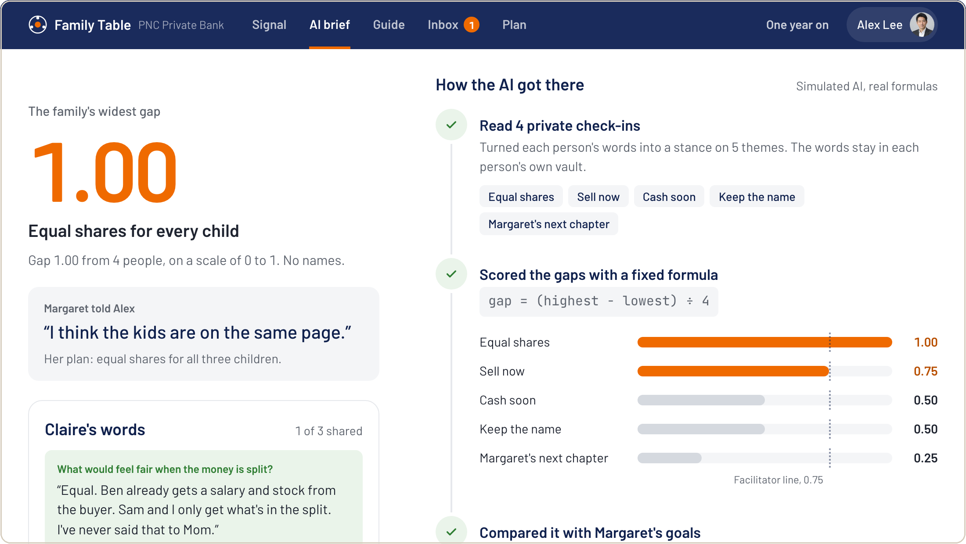
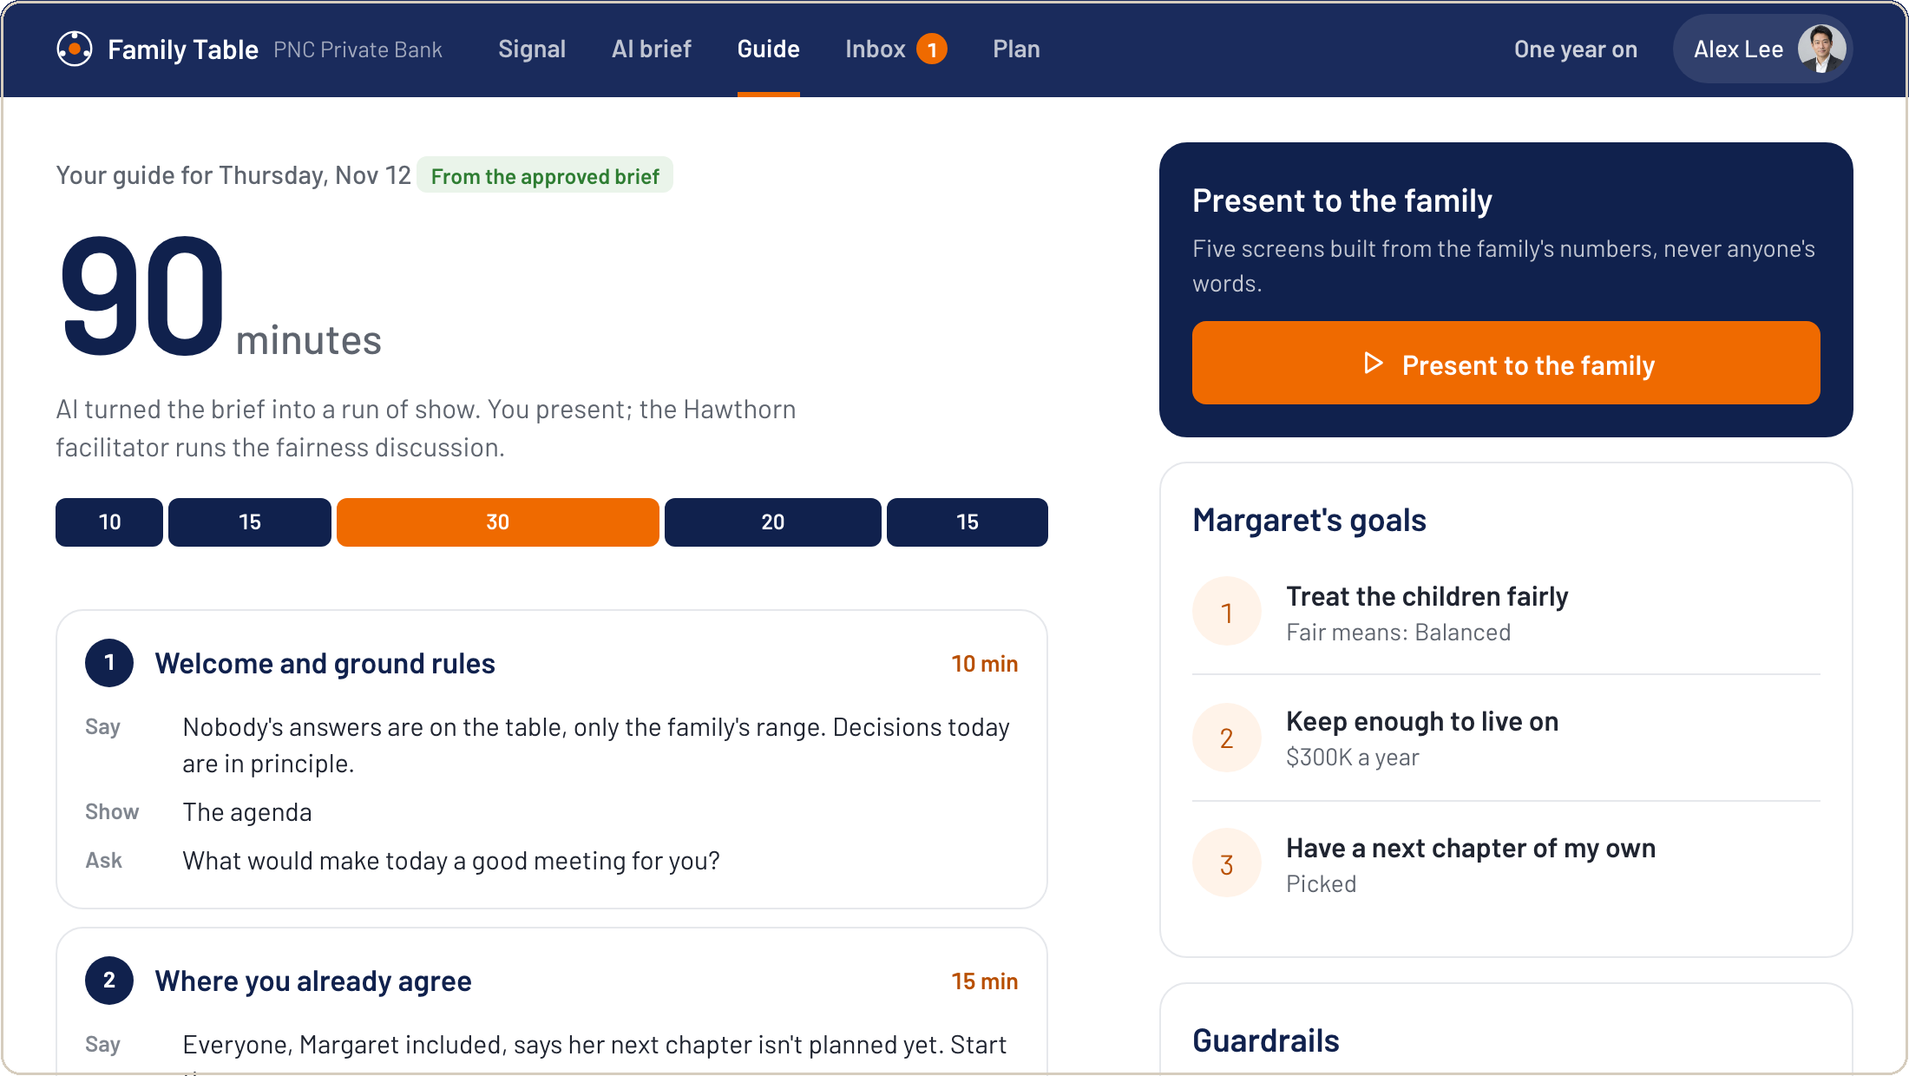
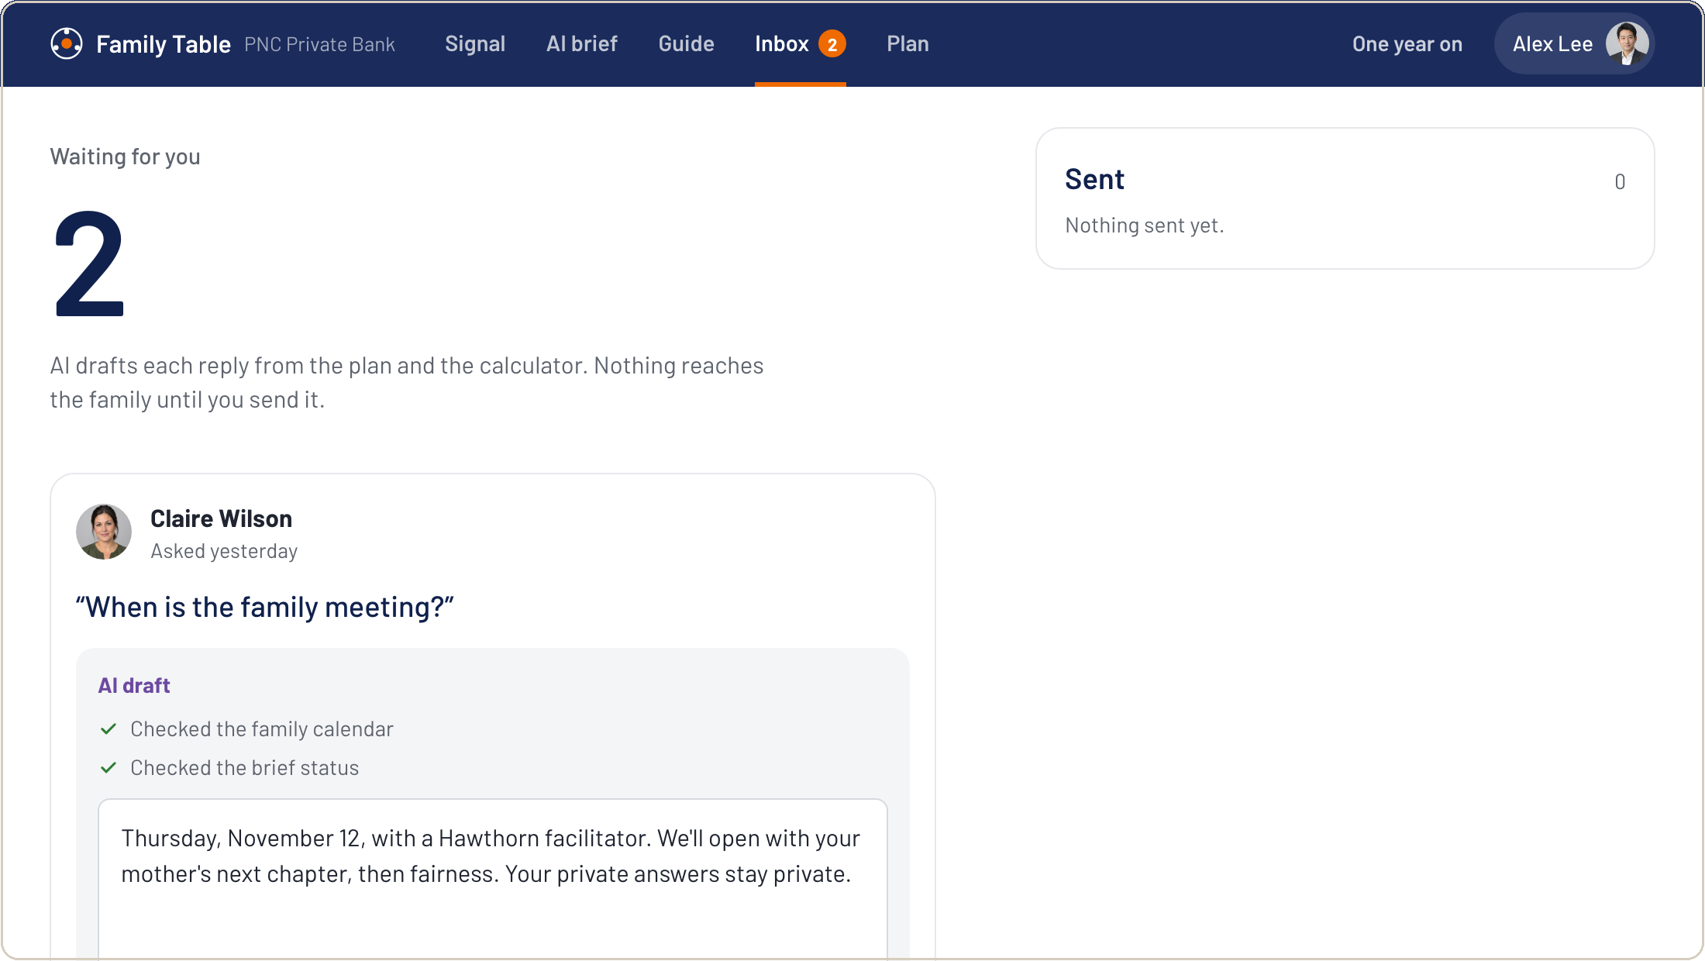
AI Advisor Workbench
Alex sees the sale a year early, then AI does the reading in each core stage and Alex makes every call
Stage | AI tool | What the AI does | What Alex decides
Explore | Sale signal | Machine learning scores business-account activity: 81 out of 100, 12–18 months before closing, with its reasons. | Whether and when to call Margaret.
Align | Family brief | NLP turns four private check-ins into themes; a fixed formula scores the gaps (fairness 1.00); Document AI flags the 2012 will. | Approves the brief. Books a Hawthorn facilitator when a gap passes 0.75.
Allocate | Meeting guide and options | Turns the brief into a 90-minute run of show and five presenting screens; explains each split, every number from the calculator. | What to present. The facilitator leads the fairness talk; the family decides in principle.
Activate | Inbox and specialists | Drafts each reply from the plan; routes tasks to five specialist teams; flags $8.0–9.0M heading to heirs who bank elsewhere. | Edits and sends every reply. Introduces PNC to Claire and Sam, with Margaret's agreement.
AI brief: every AI step is shown, then Alex approves
Meeting guide and inbox: AI drafts the run of show and each reply; Alex presents and sends
ADVISOR RULE
AI reads, scores, drafts and routes. Alex reviews every output before any client action, and sees the family's gaps, never anyone's words.
Source: Family Table prototype. Scores, family data and figures are fictional; the signal model is a hypothesis to validate on PNC data.
Notes:
The advisor side, stage by stage: the signal in Explore, then one AI tool for each core stage, Align, Allocate and Activate. Each row says what the AI does and what Alex decides, because the rule is that Alex reviews every output before any client action. The signal comes from PNC's own business-account data, a year before closing. The brief is the core insight: Margaret told Alex the kids are on the same page, but the family's widest gap is fairness. Alex sees it as a range, with no names. The AI then turns the brief into a 90-minute meeting guide with screens to present, drafts replies to the family that Alex sends, and routes tasks to five specialist teams. It also flags the $8 to 9 million heading to two heirs who bank elsewhere. This answers Alex's friction: hearing only the founder, undocumented concerns, and capabilities spread across business units.

Slide 3
Added Value: The Secret Sauce & Core Innovation
Three assets only PNC can combine, and what they are worth to the family and to PNC
Machine learning
NLP + fixed formula
Consent ledger
A signal PNC already holds
Private-by-default family intelligence
One household graph
PNC banks the operating company. Payments to M&A advisers, audited-financials requests and early paydowns flag a sale 12–18 months ahead.
Natural-language processing turns each member's private words into themes inside their own vault. A fixed formula scores where the family disagrees.
Business, owners, spouse, heirs, trusts and accounts in one consented map, under one roof with Business Banking, the Private Bank and Hawthorn IFS.
Powers Explore
Powers Align and Allocate
Powers Activate and Continue
Hard to copy: Outside wealth managers see the money only after it moves.
Hard to copy: Honest answers given in private can't be bought, scraped or rebuilt.
Hard to copy: Heirs become PNC relationships before any money moves.
For the family
For PNC, in the Wilson case
• The fairness gap surfaces before the letter of intent, not after closing
• Every child sees their own number under every option
• A facilitator steps in when the gap is wide
$27.0M
3 → 5
$8.5M
~$216K
proceeds stay at closing
family relationships at PNC
reaches the next generation at PNC
a year in fees, at an illustrative 0.8%
CORE INNOVATION
A consented family-intelligence layer on PNC's own commercial signal. AI reads and explains, formulas do the money, and the advisor decides, seeing how far apart the family is, never anyone's words, and only when 3 or more take part.
Sources: Cerulli Associates (2019), 13% of adult children use their parents' advisor. Wilson figures are fictional; the fee is an illustrative 0.8% blended rate, to validate with PNC.
Notes:
Generative AI and alerts are easy to copy; these three assets are not. First, timing: PNC banks the operating company, so its own account data can flag a sale a year before closing, while outside wealth managers see the money only after it moves. Second, private-by-default family intelligence: natural-language processing turns each member's private words into themes inside their own vault, a fixed formula scores the gaps, and Alex sees the size of a disagreement, never the words, and only when at least three people take part. Honest answers given in private are data no competitor can buy or scrape. Third, one household graph links the business to every heir, so the next generation meets PNC before the money moves. The added value: for the family, the fairness question surfaces before the letter of intent. For PNC, in the Wilson case, $27.0M stays, relationships grow from three to five, $8.5M reaches the next generation at PNC, and the fees are about $216K a year at an illustrative 0.8%.

