Slide 1

Twitter Dashboard
Demonstration and Discussion
Zheng Sun, Kevin Wu, Alex Leung
24 Jump Street
Symantec, ZK 14357

Slide 2
Agenda
1
Describe the application
Demonstrate functionalities
2
Discuss expansions
3
Question and answer session

Slide 3
Step 1a: Describe the application
You make and release a product.
How do others feel about it?
OR
Good?
Bad?

Slide 4
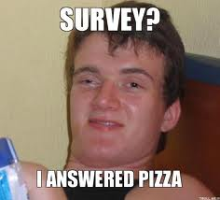
Step 1a: Describe the application
How do you get through their feels?
OR
Social Network?
Survey?
Which one saves more time?
Shows more honesty?
Makes fewer people feel annoying?

Slide 5
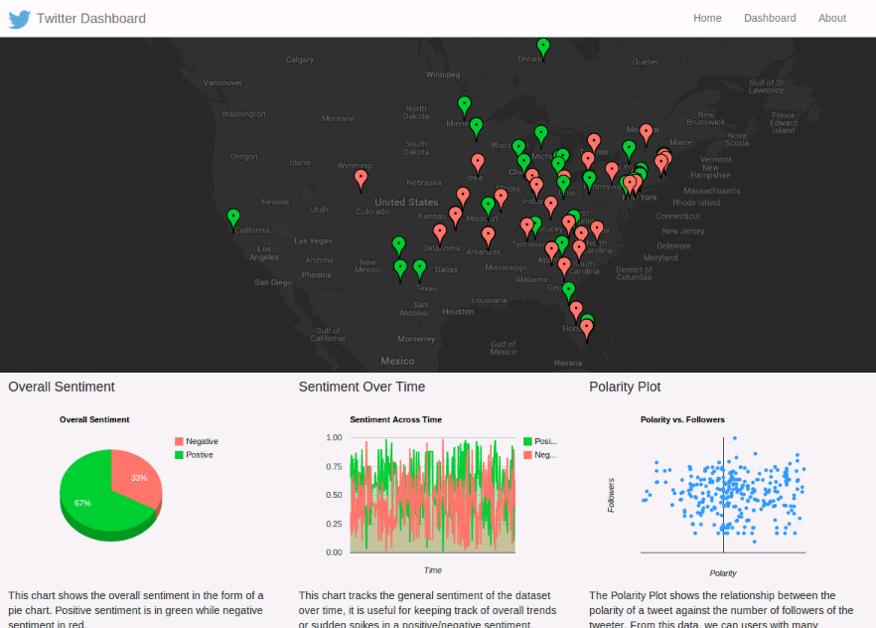
Step 1a: Describe the application
Here it comes!
Which gives you an image about how people say of your products

Slide 6
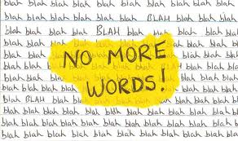
Step 1b: Demonstration
So let’s talk more about our application…
Alright, let’s demo the application then…

Slide 7
Step 1b: Demonstration
Few things to show:
1. Implementation overview
2. Search Term
3. Map
4. Charts

Slide 8
Step 2: Expansions

Slide 9
Step 3: Q&A Session
Want to raise your hands?

