Slide 1
What is the Bridge Design Pattern?
Decouple an abstraction from its implementation so that the two can vary independently
The Bridge Pattern is very poorly explained
Everyone seems to explain it differently
Progressively adding functionality while separating out major differences using abstract classes

Slide 2
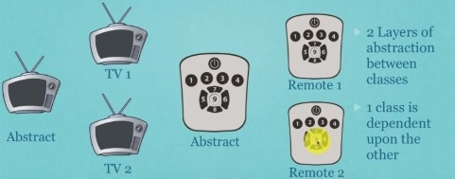
What is the Bridge Design Pattern?

Slide 3
What is the Bridge Design Pattern?
When you want to be able to change both the abstractions(abstract classes) and concrete classes independently
When you want to the first abstract class to define rules (Abstract TV)
The concrete class adds additional rules (Concrete TV)
An abstract class has a reference to the device and it defines abstract methods that will be defined (Abstract Remote)
The Concrete Remote defines the abstract methods required

