Slide 1
What is the Abstract Factory Pattern?
It is like a factory, but everything is encapsulated
  The method that orders the object
  The factories that build the object
  The final objects
  The final objects contain objects that use the Strategy Pattern
    Composition: Object class files are objects

Slide 2
What can you do with an Abstract Factory?
Allows you to create families of related objects without specifying a concrete class
Use when you have many objects that can be added, or changed dynamically during runtime
You can model anything you can imagine and have those objects interact through common interfaces
The Bad: Things can get complicated

Slide 3

Factory Makes One of Many Classes
Name
Speed
damage
Factory
UFO
Rocket
Boss UFO
Name
Speed
damage
There are no concrete classes!
Name
Speed
damage

Slide 4
Factory Design Pattern
Allows you to create objects without specifying the exact class of object that will be created.
Make a UFO
EnemyShipTesting.java <Store>
public static void main(String[] args) {
// Create the factory object
EnemyShipFactory shipFactory
new EnemyShipFactory()
// Enemy ship object
EnemyShip theEnemy = null;
Scanner userInput = new Scanner(Systen.in);
System.out.print(‘What type of ship? (U/R/S)’;
if (userInput.hasNextLine()) {
String typeOfShip = userInput.nextLine();
theEnemy = shipFactory.makeEnemyShip(typeOfShip);
if (theEnemy != null)
doStuffenemy(theEnemy);
else
System.out.print
(“Please enter U,R or S next time’);
}
    Factory
    UFO
    Rocket
    Boss UFO
EnemyShipFactory.java <Factory>
public EnemyShip makeEnemyShip
(String newShipType)
{
EnemyShip newShip = null
if (newShipType.equals(“U”))
return new UFOEnemyShip();
else if (newShipType equals(“R))
return new RocketEnemyShip();
else if (newShipType equals(“S”))
return new BigUFOEnemyShip();
else return null
}
    Name
    Speed
    Damage
EnemyShip.java <Abstract Class>
public abstract class EnemyShip
{
private String name;
private double speed;
private double damage;
public string getName() {return name}
public void setName(String newName)
{name = newName}
public double getDamage() { return
amtDamage;}
public void setDamage(double newDamage)
{ amtDamage = newDamage;}
}
  BigUFOEnemyShip
public class bigUFOEnemyship extends EnemyShip {
public BigUFOEnemyShip() {
setName(“Big UFO Enemy Ship”);
setDamage(40.0);
setSpeed(10.0);
}
}
  UFOEnemyShip
public class UFOEnemyship extends EnemyShip {
public UFOEnemyShip() {
setName(“UFO Enemy Ship”);
setDamage(20.0);
setSpeed(20.0);
}
}

Slide 5
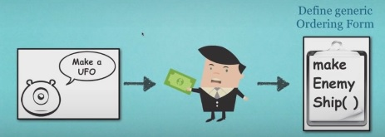
Simplify the Abstract Factory

Slide 6


Connect the Generic Order form to a Specific Factory
Define generic Ordering Form
Define the different types of UFOs that can be built
Define a UFO factory and attach it to the to be built UFO
Give the UFOs a name

Slide 7

Define the Classes that Implement the Interface
What makes a UFO a UFO? <abstract>
Define what every UFO must be able to do to be considered a UFO

Slide 8


Define the Factories Specific to Each UFO
Define what factory makes each specific type of UFO
Each UFO will have different guns and engines
A factory can make may types of UFOs as long as they have a Weapon & Engine

Slide 9

Specific Factories Output Generic Ships
Each factory outputs an object that still has all of the parts that every ship must include
This abstract ship class is used to create specific ships

Slide 10
Every Ship Takes Advantage of Polymorphism
Each ship belongs to the same abstract class to take advantage of polymorphism
A UFO is still a Space Ship

Slide 11
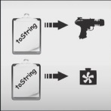
Each Ship is Made Up of Parts that are Defined in an Interface
Each ship is made up of parts
Each part has the same abstract class to take advantage of composition

Slide 12
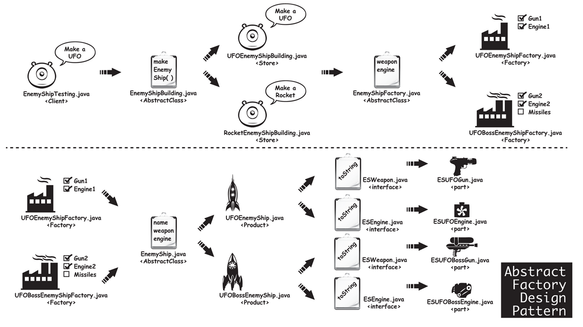
Abstract Factory Design Pattern

