Slide 1
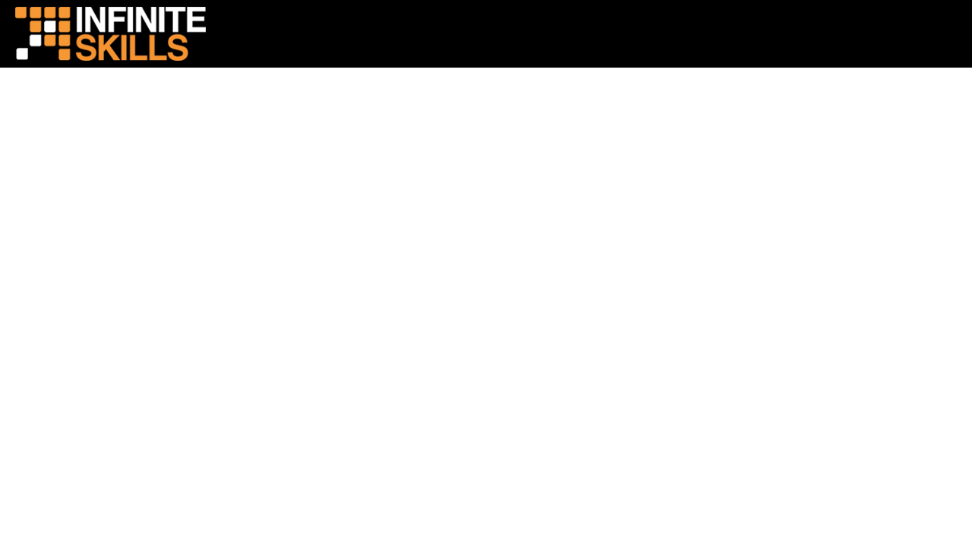
MVC Pattern

Slide 2
Agenda
Model
View
Controller
Our progress

Slide 3
Model

Slide 4
The Model
Object classes
Separate functionality from GUI
Handle Business logic

Slide 5
View

Slide 6
The View
HTML – not so good
JSP -- better
JSP + Client Scripts and Styles – even better
User interaction to communicate with controller

Slide 7
Controller

Slide 8
The Controller
Application Logic
Makes calls to models, sets information in session, uses context variables, init params, and attributes.
Responds to requests from the views, Sends information to the views

Slide 9
Our progress

Slide 10
Our Current Status
Too much going on in servlets
Move business logic to Models.
Need a better way to show information and interact with the GUI than plain HTML

Slide 11
Conclusion

Slide 12
Wrap Up
MVC is an important pattern for development
Using MVC allows for easier maintenance and scaling of web applications
We have some learning to do to get to the full power of MVC

