Slide 1

Oracle11g:
PL/SQL Programming
Chapter 1
Introduction to PL/SQL

Slide 2
Chapter Objectives
After completing this lesson, you should be able to understand:
  PL/SQL and application programming
  Application models
  How to locate Oracle resources
  SQL and PL/SQL tools
  The databases used in this book
  SQL SELECT statement and data manipulation syntax
Oracle11g: PL/SQL Programming

Slide 3
Procedural Languages
Programming languages allow actions of the end user to be converted to computer instructions
Procedural languages allow the inclusion of logic processes
PL/SQL is a procedural language, SQL is not a procedural language
Oracle11g: PL/SQL Programming

Slide 4
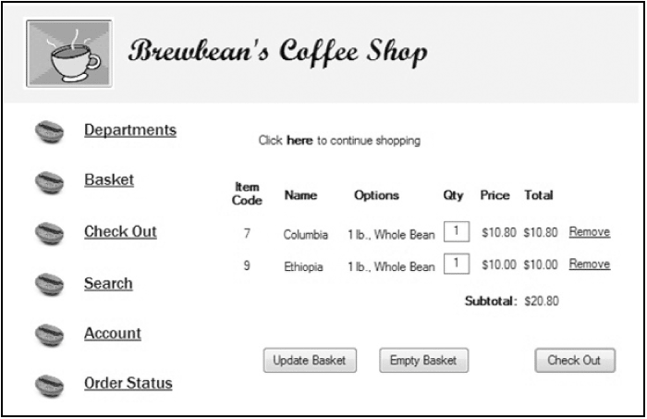
Application Programming
Example application screen
Oracle11g: PL/SQL Programming

Slide 5
Brewbean’s Application
Processing needed to support the shopping cart check out button
  Verify quantities are > 0
  Calculate shipping cost
  Calculate taxes
  Check/update product inventory
  Check shopper profile for credit card information
Oracle11g: PL/SQL Programming

Slide 6
The PL/SQL Language
Proprietary Oracle language
Tightly integrated with SQL
Can increase performance by grouping statements into blocks of code
Portable to any Oracle platform
Used within many Oracle tools
Stored program units can increase security
Oracle11g: PL/SQL Programming

Slide 7
Application Models
Three main components
  User interface or screens
  Program logic (brains behind the screens)
  Database
Most models are based on a two- or three-tier structure
Oracle11g: PL/SQL Programming

Slide 8
Two-tier Model
Commonly referred to as client/server
Parts of the processing occur both on the user’s computer and the database server
Named or stored program units are blocks of PL/SQL code saved in the Oracle database to provide server-side processing
Oracle11g: PL/SQL Programming

Slide 9
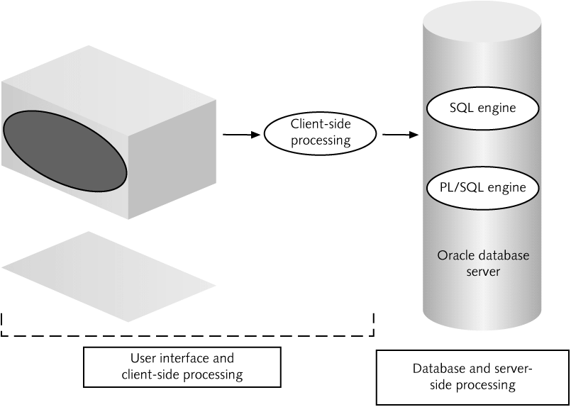
Two-tier Diagram
Oracle11g: PL/SQL Programming

Slide 10
Three-tier Model
Thin client with no code loaded on the user machine (browser access)
Middle tier is the application server – Forms server for Oracle
Last tier is the database server
Processing load is on the middle and last tier
Maintenance is simplified
Oracle11g: PL/SQL Programming

Slide 11
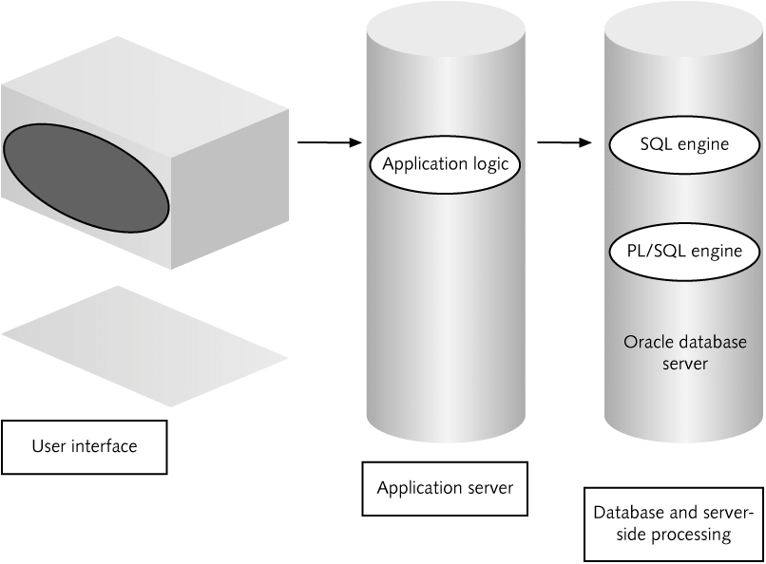
Three-tier Diagram
Oracle11g: PL/SQL Programming

Slide 12
Oracle Documentation
Oracle Technology Network (OTN): otn.oracle.com
  Documentation
  Sample Code
  Discussion Forums
User Web sites: PL/SQL Obsession
Oracle11g: PL/SQL Programming

Slide 13
SQL & PL/SQL Tools
SQL*Plus
SQL Developer
  Appendix B
Other software introduced in appendices
  TOAD
  SQL Navigator
Oracle11g: PL/SQL Programming

Slide 14
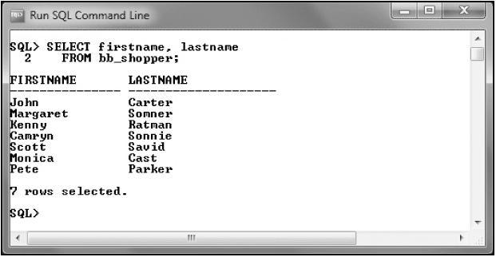
SQL*Plus Client Interface
Oracle11g: PL/SQL Programming

Slide 15
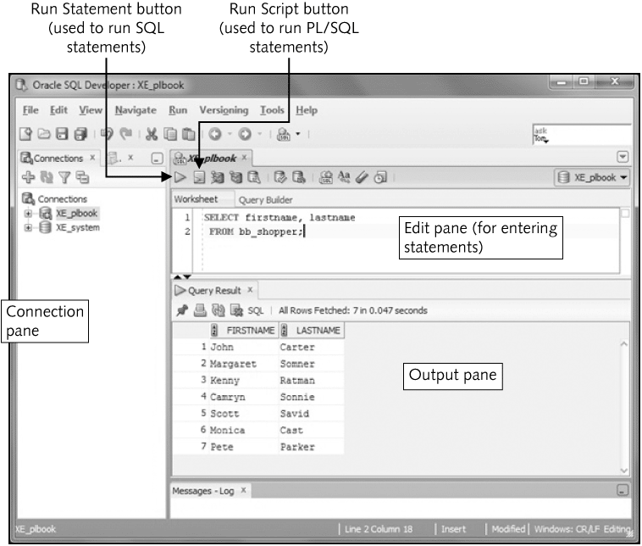
SQL Developer
Oracle11g: PL/SQL Programming

Slide 16
Databases Used
Brewbean’s Company
  In text examples
  Assignments
DoGood Donor
  Assignments
More Movie Rentals
  Case Projects
Oracle11g: PL/SQL Programming

Slide 17
The Brewbean’s Company
Retails coffee and brewing equipment via the Internet, phone, and stores
Used in chapter explanations, examples, and exercises
Databases create script provided for each chapter
Oracle11g: PL/SQL Programming

Slide 18
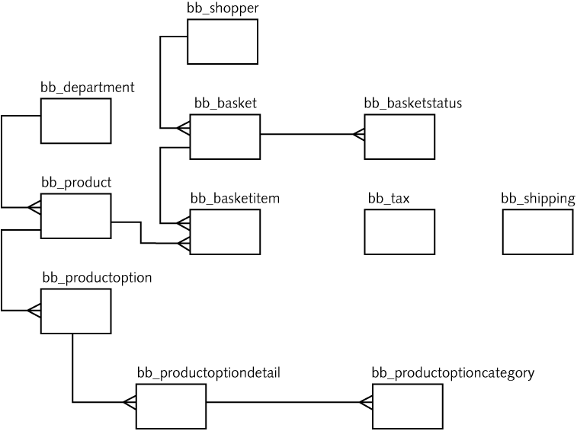
ERD for Brewbean’s DB
Oracle11g: PL/SQL Programming

Slide 19
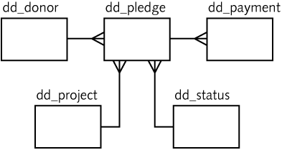
DoGood Donor ERD
Track donation, pledges, and payments
Oracle11g: PL/SQL Programming

Slide 20
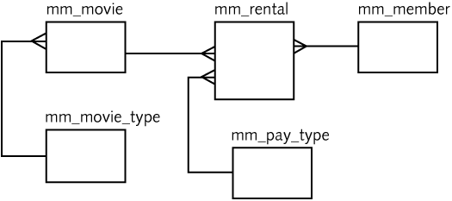
More Movies ERD
Movie rental company used in an ongoing case study
Oracle11g: PL/SQL Programming

Slide 21
SQL Query Syntax
SELECT <columns>
FROM <tables, views>
WHERE <conditions>
GROUP BY <columns>
HAVING <aggregation conditions>
ORDER BY <columns>;
Oracle11g: PL/SQL Programming

Slide 22
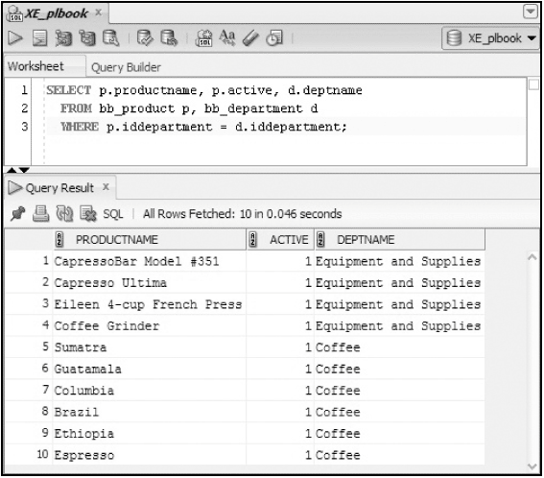
Traditional Join
Oracle11g: PL/SQL Programming

Slide 23
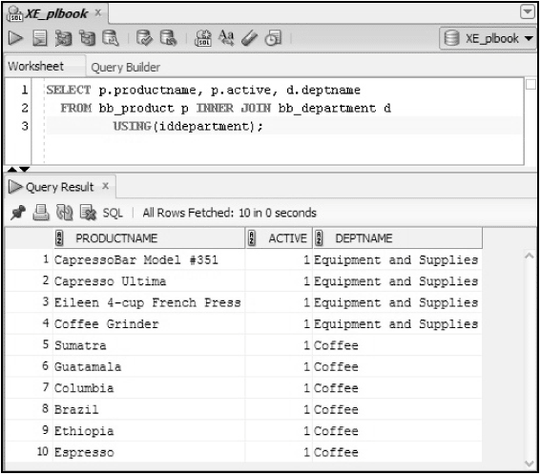
ANSI Join
Oracle11g: PL/SQL Programming

Slide 24
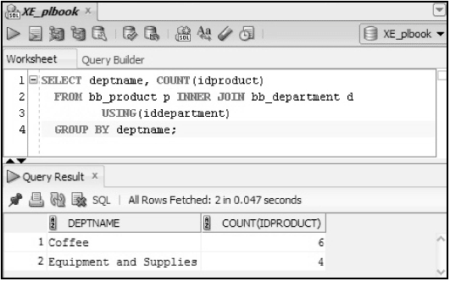
Aggregate function
Oracle11g: PL/SQL Programming

Slide 25
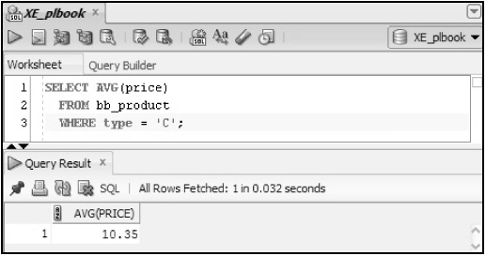
WHERE clause filter
Oracle11g: PL/SQL Programming

Slide 26
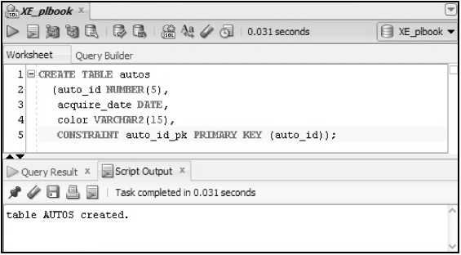
Creating Tables
Oracle11g: PL/SQL Programming

Slide 27
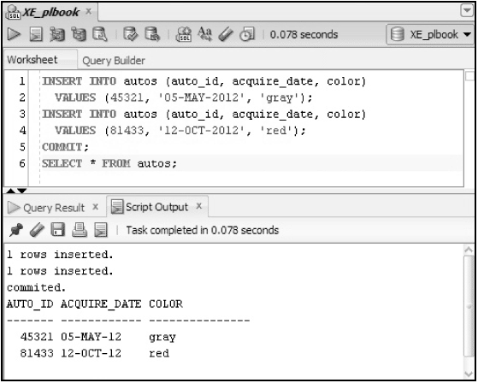
DML - Insert
Oracle11g: PL/SQL Programming

Slide 28
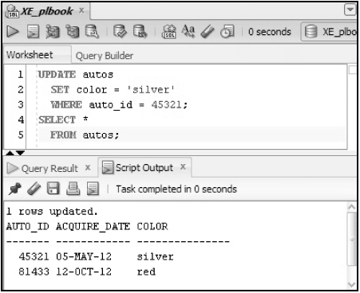
DML - Update
Oracle11g: PL/SQL Programming

Slide 29
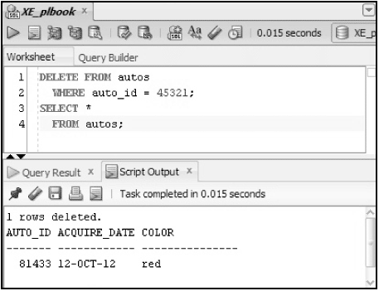
DML - Delete
Oracle11g: PL/SQL Programming

Slide 30
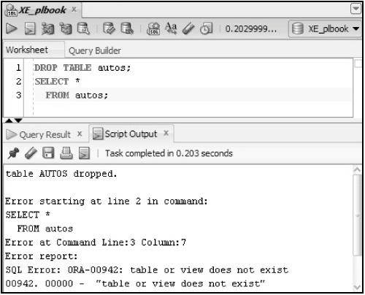
Drop Table
Oracle11g: PL/SQL Programming

Slide 31
Review to prepare
Review SQL statement syntax
Explore the Brewbean’s database
Oracle11g: PL/SQL Programming

