Slide 1

Oracle11g:
PL/SQL Programming
Chapter 3
Handling Data in
PL/SQL Blocks

Slide 2
Chapter Objectives
After completing this lesson, you should be able to understand:
  SQL queries in PL/SQL
  The %TYPE attribute
  Expanding block processing to include queries and control structures
  Embedding DML statements in PL/SQL
Oracle11g: PL/SQL Programming

Slide 3
Chapter Objectives (continued)
After completing this lesson, you should be able to understand (continued):
  Using record variables
  Creating collections
  Bulk processing basics
  GOTO statement
Oracle11g: PL/SQL Programming

Slide 4
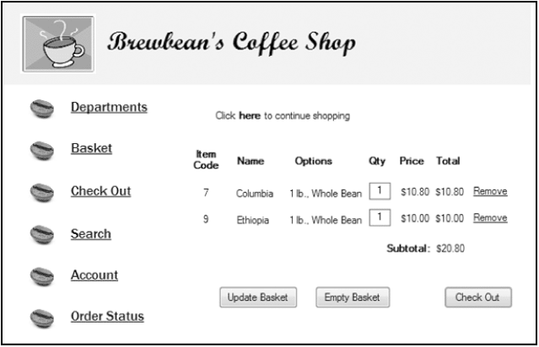
Brewbean’s Challenge
Consider actions needed upon check out
Oracle11g: PL/SQL Programming

Slide 5
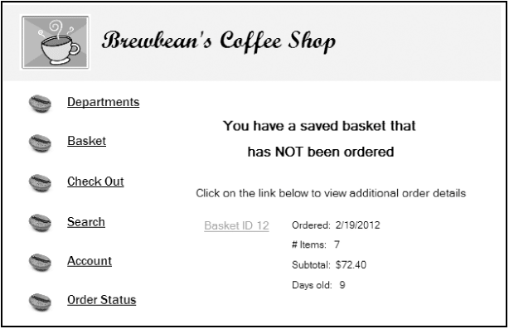
Include SQL within a Block
Data query needs to identify if the customer has a saved basket
Oracle11g: PL/SQL Programming

Slide 6
Include SQL within a Block (continued)
SQL statements can be embedded into the executable area of a PL/SQL block
SELECT statements are embedded to query needed data
An INTO clause is added to a SELECT statement to move data retrieved into variables
Oracle11g: PL/SQL Programming

Slide 7
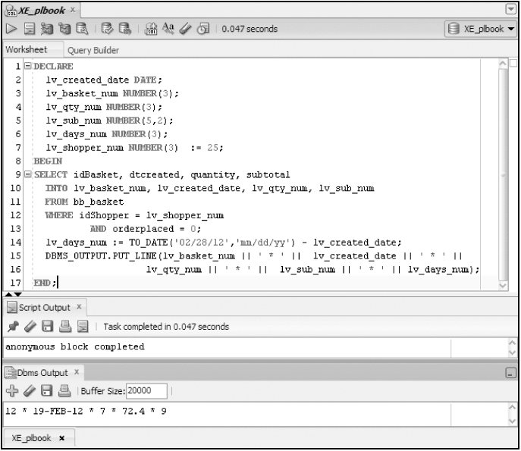
Include SQL within a Block (continued)
SQL
Query – add
INTO clause
Assignment Statement
Oracle11g: PL/SQL Programming

Slide 8
Executing a Block with Errors
Common Errors
  Use = rather than :=
  Not declaring a variable
  Misspelling a variable name
  Not ending a statement with ;
  No data returned from a SELECT statement
Oracle11g: PL/SQL Programming

Slide 9
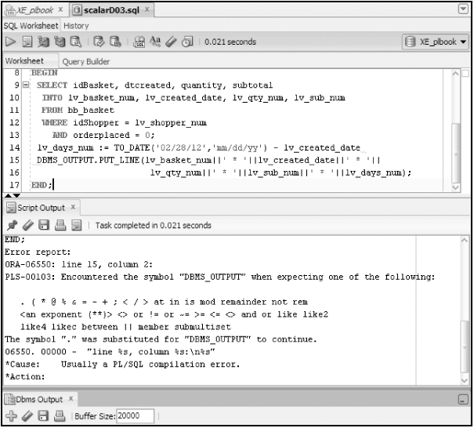
Executing a Block with Errors (continued)
Not closing a statement with ;
Oracle11g: PL/SQL Programming

Slide 10
%TYPE Attribute
Use in variable declaration to provide data type based on a table column
Ideal for declaring variables that will hold data from the database
Minimizes maintenance by avoiding program changes to reflect database column changes
Called an anchored data type
lv_basket_num bb_basket.idBasket%TYPE;
Oracle11g: PL/SQL Programming

Slide 11
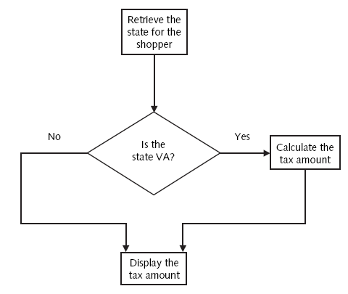
Data Retrieval with Decision Structures
Oracle11g: PL/SQL Programming

Slide 12
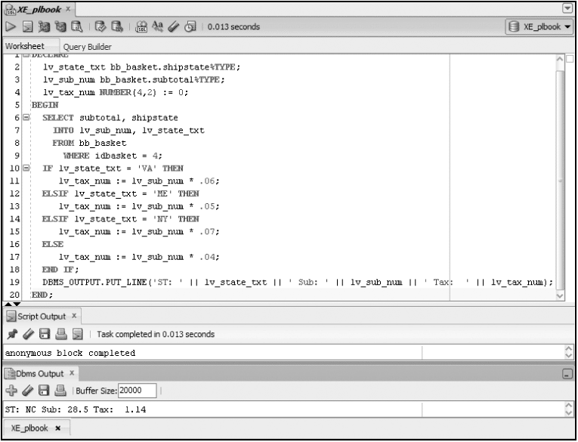
IF Statement Example
Oracle11g: PL/SQL Programming

Slide 13
Including DML
DML statements can be embedded into PL/SQL blocks to accomplish data changes
DML includes INSERT, UPDATE, and DELETE statements
Oracle11g: PL/SQL Programming

Slide 14
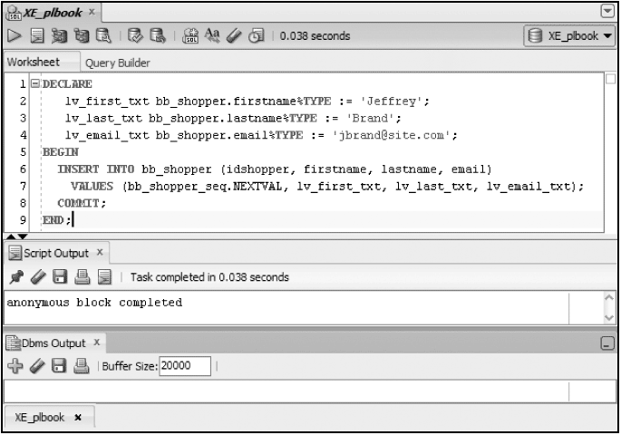
Including DML (continued)
Add a new shopper - INSERT
Oracle11g: PL/SQL Programming

Slide 15
Record variables
Stores multiple values of different data types as one unit
Record – can hold one row of data
Oracle11g: PL/SQL Programming

Slide 16
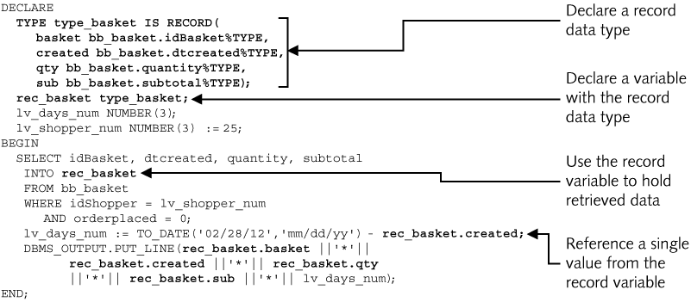
Record Data Type
Oracle11g: PL/SQL Programming

Slide 17
%ROWTYPE Attribute
Create record structure based on table structure
DECLARE
rec_shopper bb_shopper%ROWTYPE;
BEGIN
SELECT *
INTO rec_shopper
FROM bb_shopper
WHERE idshopper = 25;
DBMS_OUTPUT.PUT_LINE(rec_shopper.lastname);
DBMS_OUTPUT.PUT_LINE(rec_shopper.address);
DBMS_OUTPUT.PUT_LINE(rec_shopper.email);
END;
Oracle11g: PL/SQL Programming

Slide 18
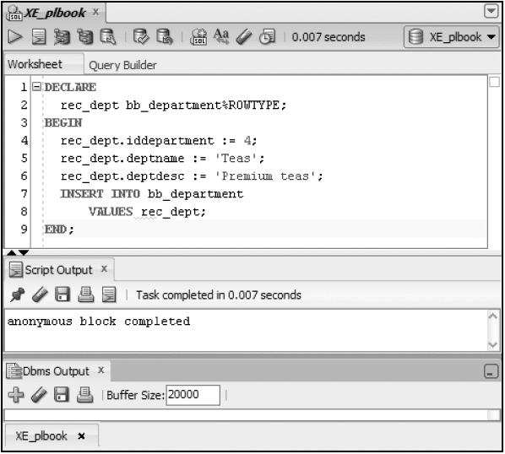
INSERT Using Record
Oracle11g: PL/SQL Programming

Slide 19
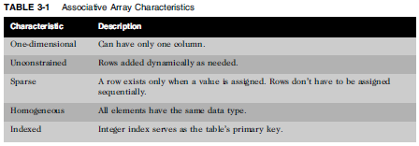
Collections
Store multiple values of the same data type
Similar to arrays in other languages
Associative Array– handle many rows of one field
Oracle11g: PL/SQL Programming

Slide 20
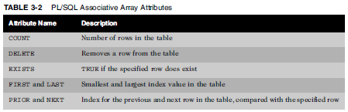
Associative Array Attributes
Oracle11g: PL/SQL Programming

Slide 21
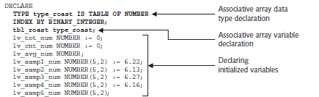
Associative Array Example
Oracle11g: PL/SQL Programming

Slide 22
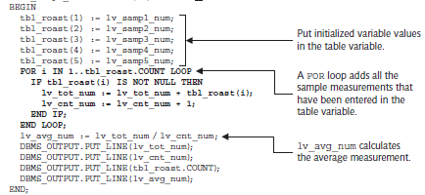
Example (continued)
Oracle11g: PL/SQL Programming

Slide 23
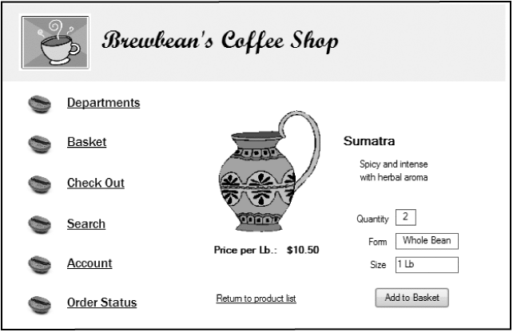
Table of Records
Contains one or more records
Handle shopping basket data
Oracle11g: PL/SQL Programming

Slide 24
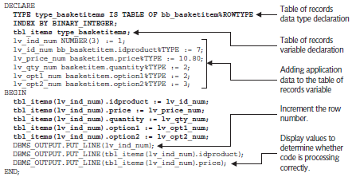
Table of Records
Oracle11g: PL/SQL Programming

Slide 25
Bulk Processing
Improve performance & add capabilities
Reduces context switching
Groups SQL actions for processing
BULK COLLECT and FORALL statements
More examples in Chapter 4
Oracle11g: PL/SQL Programming

Slide 26
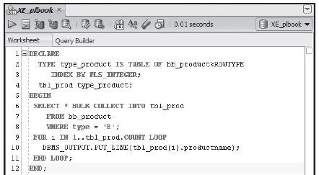
Bulk Processing
Enables loading multi-row query directly to table of record variable
Oracle11g: PL/SQL Programming

Slide 27
GOTO Statement
Jumping control that instructs the program to move to another area of code to continue processing
Most developers discourage the use of GOTO as it complicates the flow of execution
Oracle11g: PL/SQL Programming

Slide 28
Summary
SQL queries and DML statements can be embedded into a block
An INTO clause must be added to a SELECT
The %TYPE attribute is used to use a column data type
Composite data types can hold multiple values in a single variable
A record can hold a row of data
A table of records can hold multiple rows of data
Oracle11g: PL/SQL Programming

Slide 29
Summary (continued)
The %ROWTYPE attribute can be used to declare a data type based on a table’s structure
An associative array is a collection of same type data
Bulk processing groups SQL statements for processing to improve performance
The GOTO statement enables execution to jump to specific portions of code
Oracle11g: PL/SQL Programming

