Slide 1

Oracle11g:
PL/SQL Programming
Chapter 4
Cursors and
Exception Handling

Slide 2
Chapter Objectives
After completing this lesson, you should be able to understand:
  Manipulating data with cursors
  Using bulk-processing features
  Managing errors with exception handlers
  Addressing exception-handling issues, such as RAISE_APPLICATION_ERROR and propagation
  Documenting code with comments
Oracle11g: PL/SQL Programming

Slide 3
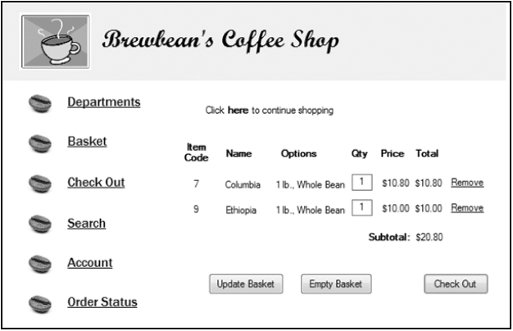
Brewbean’s Challenge
Processing multiple data rows
Oracle11g: PL/SQL Programming

Slide 4
Cursors
Work area in which SQL statement is processed
Implicit cursor – declared automatically for DML and SELECT statements
Explicit cursor – declared and managed programmatically to handle a set of rows returned by a SELECT statement
Cursor variable – reference or pointer to a work area or cursor
Oracle11g: PL/SQL Programming

Slide 5
Cursor Attributes
Attribute Name
Data
type
Description
%ROWCOUNT
Number
Number of rows affected by the SQL statement
%FOUND
Boolean
TRUE if at least one row is affected by the SQL statement, otherwise FALSE
%NOTFOUND
Boolean
TRUE if no rows are affected by the SQL statement, otherwise FALSE
Oracle11g: PL/SQL Programming

Slide 6
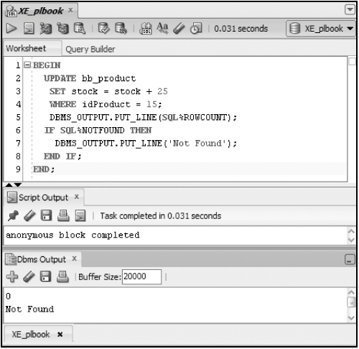
Implicit Cursor
Oracle11g: PL/SQL Programming

Slide 7
Explicit Cursor
Step
Step Activity
Activity Description
1
DECLARE
Creates a named cursor identified by a SELECT statement. The SELECT statement does not include an INTO clause. Values in the cursor are moved to PL/SQL variables with the FETCH step.
2
OPEN
Processes the query and creates the active set of rows available in the cursor.
3
FETCH
Retrieves a row from the cursor into block variables. Each consecutive FETCH issued will retrieve the next row in the cursor until all rows have been retrieved.
4
CLOSE
Clears the active set of rows and frees the memory area used for the cursor.
Oracle11g: PL/SQL Programming

Slide 8
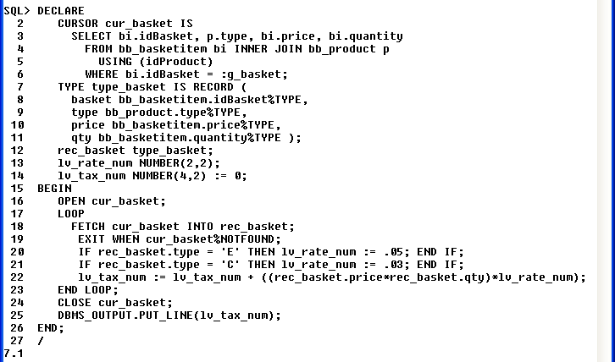
Explicit Cursor Example
Declare cursor
Declare record type
and variable
Open cursor
Fetch a row from the cursor
Check if row returned from fetch
Close cursor
Calculate tax amount
Oracle11g: PL/SQL Programming

Slide 9
Cursor FOR Loop
Handles tasks automatically for processing each row returned by a cursor (record declaration, fetch, ending loop)
Use FOR UPDATE and WHERE CURRENT OF clauses for record locking
Oracle11g: PL/SQL Programming

Slide 10
Cursor FOR Loop Example
DECLARE
CURSOR cur_prod IS
SELECT type, price
FROM bb_product
WHERE active = 1
FOR UPDATE NOWAIT;
lv_sale bb_product.saleprice%TYPE;
BEGIN
FOR rec_prod IN cur_prod LOOP
IF rec_prod.type = 'C' THEN lv_sale := rec_prod.price * .9;
ELSIF rec_prod.type = 'E' THEN lv_sale := rec_prod.price * .95;
END IF;
UPDATE bb_product
SET saleprice = lv_sale
WHERE CURRENT OF cur_prod;
END LOOP;
COMMIT;
END;
Oracle11g: PL/SQL Programming

Slide 11
Cursors with Parameters
Use parameters to make dynamic
Parameters are values passed to the cursor when it is opened
Enables the cursor to retrieve different data based on the input values
Oracle11g: PL/SQL Programming

Slide 12
Cursors with Parameters
DECLARE
CURSOR cur_order (p_basket NUMBER) IS
SELECT idBasket, idProduct, price, quantity
FROM bb_basketitem
WHERE idBasket = p_basket;
lv_bask1_num bb_basket.idbasket%TYPE := 6;
lv_bask2_num bb_basket.idbasket%TYPE := 10;
BEGIN
FOR rec_order IN cur_order(lv_bask1_num) LOOP
DBMS_OUTPUT.PUT_LINE(rec_order.idBasket || ' - ' ||
rec_order.idProduct || ' - ' || rec_order.price);
END LOOP;
FOR rec_order IN cur_order(lv_bask2_num) LOOP
DBMS_OUTPUT.PUT_LINE(rec_order.idBasket || ' - ' ||
rec_order.idProduct || ' - ' || rec_order.price);
END LOOP;
END;
Oracle11g: PL/SQL Programming

Slide 13
Cursor Variable
More efficiently handles data returned by query by returning a pointer to the work area rather than the actual result set
The same cursor variable can be used for different query statements
Oracle11g: PL/SQL Programming

Slide 14
Cursor Variable Example
DECLARE
cv_prod SYS_REFCURSOR;
rec_item bb_basketitem%ROWTYPE;
rec_status bb_basketstatus%ROWTYPE;
lv_input1_num NUMBER(2) := 2;
lv_input2_num NUMBER(2) := 3;
BEGIN
IF lv_input1_num = 1 THEN
OPEN cv_prod FOR SELECT * FROM bb_basketitem
WHERE idBasket = lv_input2_num;
LOOP
FETCH cv_prod INTO rec_item;
EXIT WHEN cv_prod%NOTFOUND;
DBMS_OUTPUT.PUT_LINE(rec_item.idProduct);
END LOOP;
Oracle11g: PL/SQL Programming

Slide 15
Example (continued)
ELSIF lv_input1_num = 2 THEN
OPEN cv_prod FOR SELECT * FROM bb_basketstatus
WHERE idBasket = lv_input2_num;
LOOP
FETCH cv_prod INTO rec_status;
EXIT WHEN cv_prod%NOTFOUND;
DBMS_OUTPUT.PUT_LINE(rec_status.idStage || ' - '
|| rec_status.dtstage);
END LOOP;
END IF;
END;
Oracle11g: PL/SQL Programming

Slide 16
Bulk-processing
Improve performance of multirow queries and DML statements
Processes groups of rows without context switching between the SQL and PL/SQL processing engine
Use in FETCH with LIMIT clause
FORALL option with DML activity
Oracle11g: PL/SQL Programming

Slide 17
Bulk-processing (Query)
DECLARE
CURSOR cur_item IS
SELECT *
FROM bb_basketitem;
TYPE type_item IS TABLE OF cur_item%ROWTYPE
INDEX BY PLS_INTEGER;
tbl_item type_item;
BEGIN
OPEN cur_item;
LOOP
FETCH cur_item BULK COLLECT INTO tbl_item LIMIT 1000;
FOR i IN 1..tbl_item.COUNT LOOP
DBMS_OUTPUT.PUT_LINE(tbl_item(i).idBasketitem || ' -'
|| tbl_item(i).idProduct);
END LOOP;
EXIT WHEN cur_item%NOTFOUND;
END LOOP;
CLOSE cur_item;
END;
Oracle11g: PL/SQL Programming

Slide 18
Bulk-processing (DML)
DECLARE
TYPE emp_type IS TABLE OF NUMBER INDEX
BY BINARY_INTEGER;
emp_tbl emp_type;
BEGIN
SELECT empID
BULK COLLECT INTO emp_tbl
FROM employees
WHERE classtype = '100';
FORALL i IN d_emp_tbl.FIRST .. emp_tbl.LAST
UPDATE employees
SET raise = salary * .06
WHERE empID = emp_tbl(i);
COMMIT;
END;
Oracle11g: PL/SQL Programming

Slide 19
Exception Handlers
Used to capture error conditions and handle the processing to allow the application to continue
Placed in the EXCEPTION section of a PL/SQL block
Two types of errors
    Oracle errors (Predefined and Non-Predefined)
    User-defined errors
RAISE_APPLICATION_ERROR
Oracle11g: PL/SQL Programming

Slide 20
Predefined Oracle Errors
Exception Name
Description
NO_DATA_FOUND
A SELECT statement in a PL/SQL block retrieves no rows or a nonexistent row of an index-by table is referenced
TOO_MANY_ROWS
A SELECT statement in a PL/SQL block retrieves more than one row
CASE_NOT_FOUND
No WHEN clause in the CASE statement is processed
ZERO_DIVIDE
Attempted division by zero
DUP_VAL_ON_INDEX
Attempted violation of a unique or primary key column constraint
Oracle11g: PL/SQL Programming

Slide 21
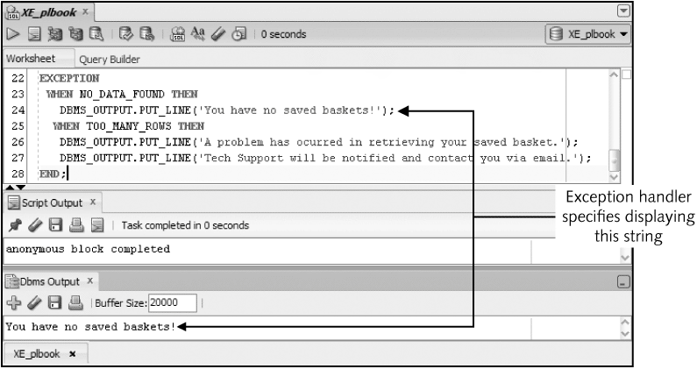
Predefined Error Example
Oracle11g: PL/SQL Programming

Slide 22
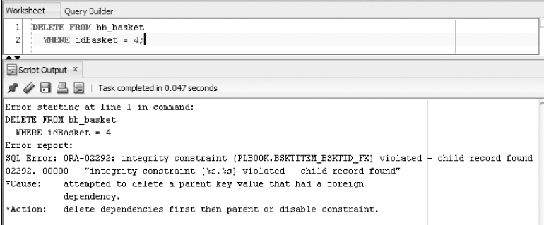
Undefined Error
Identify possible errors for statements in a block
Oracle11g: PL/SQL Programming

Slide 23
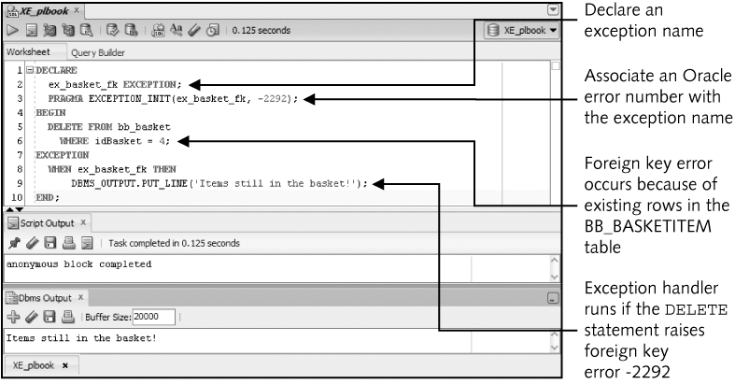
Handler Added
Oracle11g: PL/SQL Programming

Slide 24
User-Defined Exception
No system error is raised
Raise errors to enforce business rules
Once error is raised, the remaining statements in the executable sections are not executed
Processing moves to the exception area of the block
Oracle11g: PL/SQL Programming

Slide 25
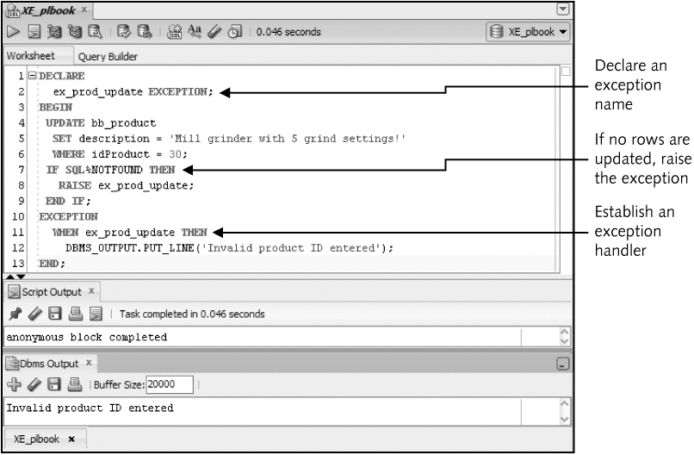
User-Defined Exception Example
Oracle11g: PL/SQL Programming

Slide 26
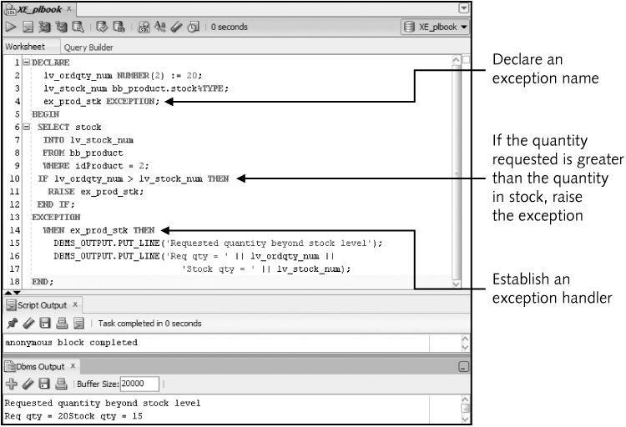
User-Defined Exception Example
Oracle11g: PL/SQL Programming

Slide 27
Additional Exception Concepts
WHEN OTHERS – traps all errors not specifically addressed by an exception handler and used for handling unanticipated errors
SQLCODE and SQLERRM – functions used to identify the error code and message, especially in application, testing to identify unanticipated errors
Oracle11g: PL/SQL Programming

Slide 28
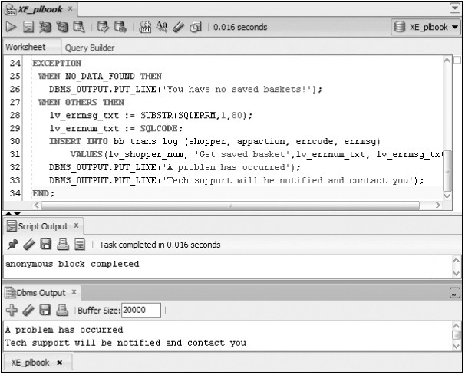
Example
Oracle11g: PL/SQL Programming

Slide 29
Exception Propagation
Exception handling in nested blocks
Exception raised in a block will first look for handler in the exception section of that block, if no handler found, execution will move to the exception section of the enclosing block
Error in DECLARE section propagates directly to exception section of the enclosing block
Error in exception handler propagates to exception section of the enclosing block
Oracle11g: PL/SQL Programming

Slide 30
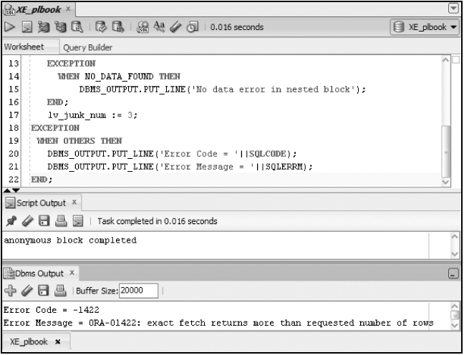
Exception Propagation
Oracle11g: PL/SQL Programming

Slide 31
Commenting Code
Add comments within code to identify code purpose and processing steps
Use /* */ to enclose a multiline comment
Use -- to add a single or partial line comment
Oracle11g: PL/SQL Programming

Slide 32
Comment Examples
DECLARE
ex_prod_update EXCEPTION; --For UPDATE of no rows exception
BEGIN
/* This block is used to update product descriptions
Constructed to support the Prod_desc.frm app screen
Exception raised if no rows updated */
UPDATE bb_product
SET description = 'Mill grinder with 5 grind settings!'
WHERE idProduct = 30;
--Check if any rows updated
IF SQL%NOTFOUND THEN
RAISE ex_prod_update;
END IF;
EXCEPTION
WHEN ex_prod_update THEN
DBMS_OUTPUT.PUT_LINE('Invalid product id entered');
END;
Oracle11g: PL/SQL Programming

Slide 33
Summary
Implicit cursors are automatically created for SQL statements
Explicit cursors are declared
Cursors allow the processing of a group of rows
CURSOR FOR Loops simplify cursor coding
Parameters make cursors more dynamic
A REF CURSOR acts like a pointer
BULK processing options can improve performance for queries and DML activity
Oracle11g: PL/SQL Programming

Slide 34
Summary (continued)
Add error handlers in the EXCEPTION area to manage Oracle and user-defined errors
Exception propagation is the flow of error handling processing
Use comments in code for documentation
Oracle11g: PL/SQL Programming

