Slide 1

Oracle11g :
PL/SQL Programming
Chapter 6
Functions

Slide 2
Chapter Objectives
After completing this lesson, you should be able to understand:
  Functions
  Creating a stored function
  Using OUT parameters in functions
  Including multiple RETURN statements in a function
  Using a RETURN statement in a procedure
  Using constraints of actual and formal parameters
Oracle11g: PL/SQL Programming

Slide 3
Chapter Objectives (continued)
After completing this lesson, you should be able to understand (continued):
  Understanding and controlling how parameter values are passed
  Working with function purity levels
  Additional program unit options
  Referencing the data dictionary for program units
  Deleting program units
Oracle11g: PL/SQL Programming

Slide 4
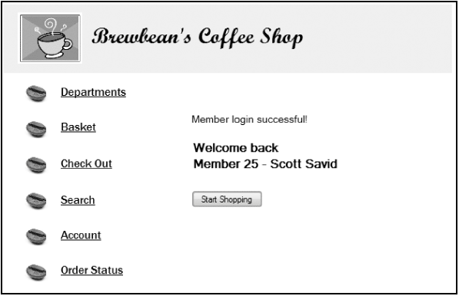
Brewbean’s Challenge
Need program module to check a user login
Oracle11g: PL/SQL Programming

Slide 5
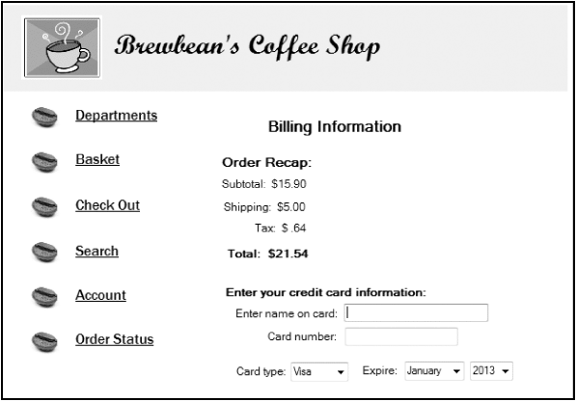
Brewbean’s Challenge (continued)
Need program module to calculate shipping cost based on the number
of items in the basket
Oracle11g: PL/SQL Programming

Slide 6
Introduction to Functions
A function is similar to a procedure in that it can accomplish a task and retrieve/return values
A function is part of an expression, not an entire statement such as a procedure
Can be used in both PL/SQL and SQL statements
Same as Oracle-supplied functions (ROUND, TO_CHAR)
Contains a RETURN statement
Oracle11g: PL/SQL Programming

Slide 7
Example of Oracle-Supplied Function
SQL
SELECT idProduct, price, ROUND(price, 0)
FROM bb_product
WHERE idProduct < 4;
PL/SQL
  DECLARE
  v_amt1 number(5,2);
  v_amt2 number(3,0);
  BEGIN
  v_amt1 := 32.50;
  v_amt2 := ROUND(v_amt1,0);
  DBMS_OUTPUT.PUT_LINE(v_amt2);
  END;
Oracle11g: PL/SQL Programming

Slide 8
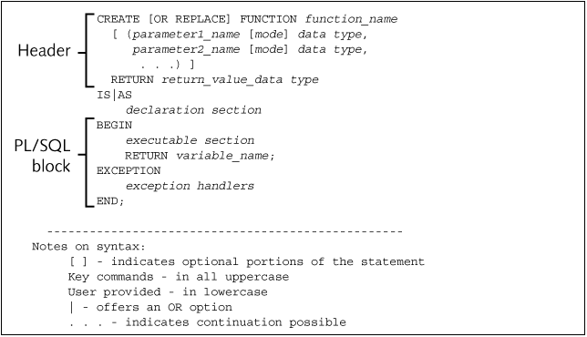
Function Create Statement
Oracle11g: PL/SQL Programming

Slide 9
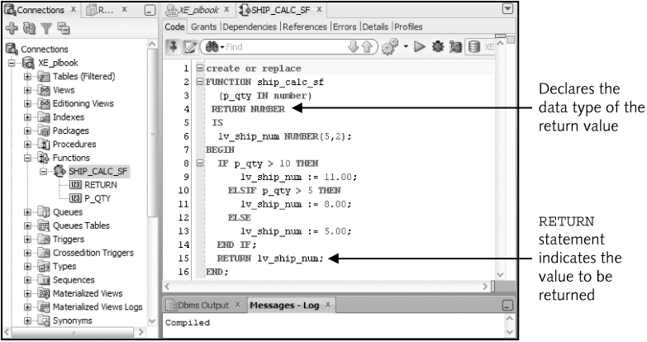
Function Example
Oracle11g: PL/SQL Programming

Slide 10
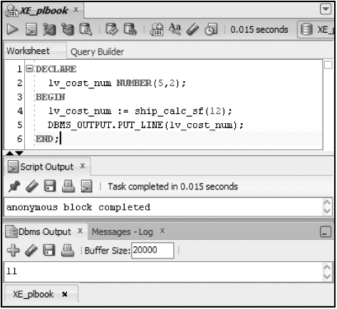
Invoking a Function from a Block
An assignment statement is used – a function RETURNS a value!
Oracle11g: PL/SQL Programming

Slide 11
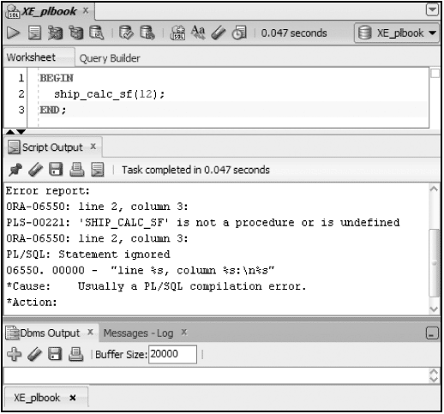
Attempt to Invoke Stand-alone
Oracle11g: PL/SQL Programming

Slide 12
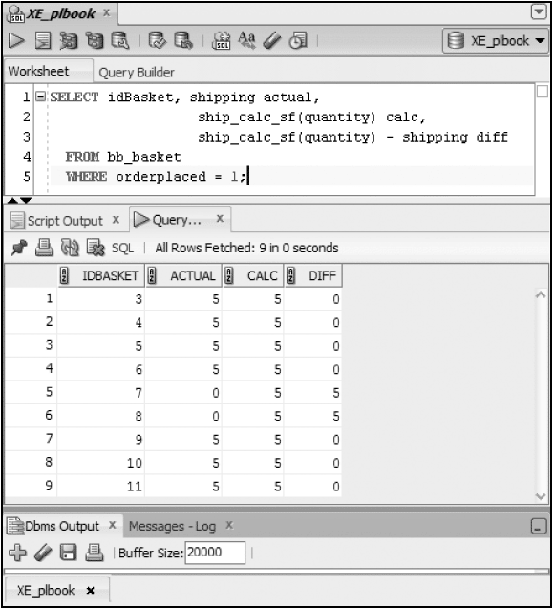
Use Function in SQL
Oracle11g: PL/SQL Programming

Slide 13
Brewbean’s Member Display
CREATE OR REPLACE FUNCTION memfmt1_sf
(p_id IN NUMBER,
p_first IN VARCHAR2,
p_last IN VARCHAR2)
RETURN VARCHAR2
IS
lv_mem_txt VARCHAR2(35);
BEGIN
lv_mem_txt := 'Member ' || p_id || ' - ' || p_first
|| ' ' || p_last;
RETURN lv_mem_txt;
END;
Oracle11g: PL/SQL Programming

Slide 14
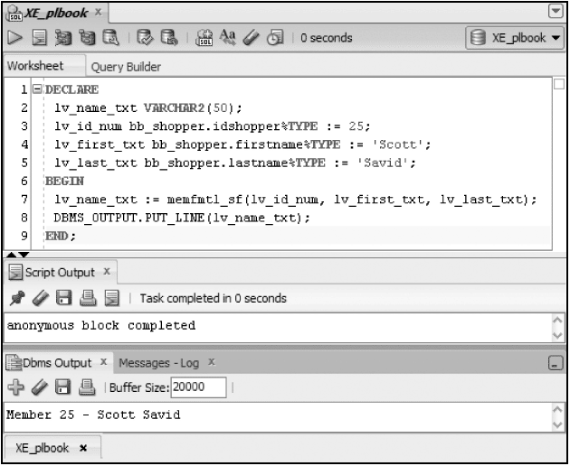
Member Display Test
Oracle11g: PL/SQL Programming

Slide 15
Using OUT Mode in a Function
OUT parameters are not typically used in functions, as:
  Mixing OUT and RETURN values can lead to confusion
  It prohibits the function from being used in SQL
Oracle11g: PL/SQL Programming

Slide 16
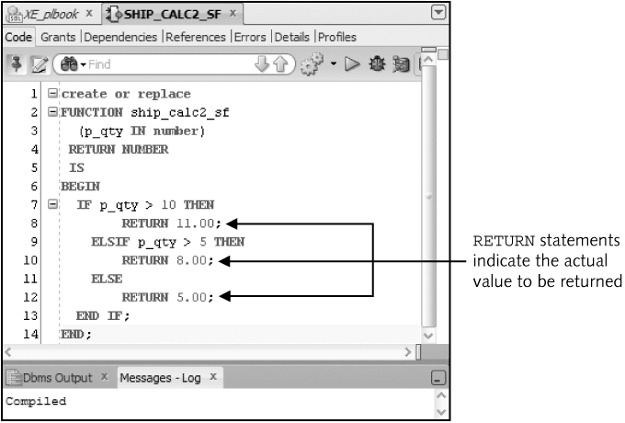
Multiple RETURN Statements
Note: Only one RETURN statement can execute
Oracle11g: PL/SQL Programming

Slide 17
RETURN Statement in a Procedure
Different purpose than a RETURN statement in a function
Used to change flow of execution
Stops processing in that block and moves to the next statement after the procedure call
Stand-alone statement with no arguments
Oracle11g: PL/SQL Programming

Slide 18
Parameter Constraints
Formal parameters – included in a program unit
Actual parameters – arguments used in a program unit call
Argument for an OUT parameter must be a variable to hold the value returned
Actual parameters determine the size of the formal parameters
Oracle11g: PL/SQL Programming

Slide 19
Passing Parameter Values
Two techniques used to pass values between actual and formal parameters:
  Passed by Reference – create pointer to
  value in the actual parameter
  Passed by Value – copies value from
  actual to formal parameter
Pass by value is the default
Use a compiler hint to use pass by reference
Oracle11g: PL/SQL Programming

Slide 20
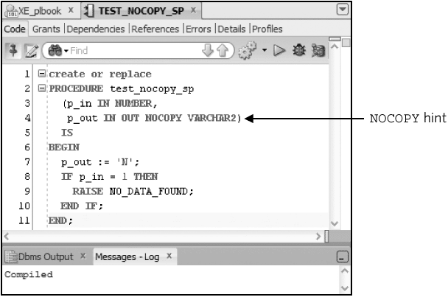
Pass by Reference
Oracle11g: PL/SQL Programming

Slide 21
Purity Levels
Restrictions on functions used in SQL
  Functions cannot modify any tables in Oracle8 and prior versions
    Beginning with Oracle8i, the function cannot modify a table used in the SQL statement that calls the function; however, it may alter other tables if called from a non-select statement
  If used in a remote or parallel operation, no reading or writing of packaged variables allowed
  If used in a SELECT, VALUES, or SET clause, the function can write values to packaged variables; otherwise, it is not allowed
Oracle11g: PL/SQL Programming

Slide 22
Purity Levels (continued)
Restrictions on functions used in SQL (continued)
  Functions cannot be used in a check constraint or as a default value of a table column
  If the function calls other subprograms, the subprograms cannot break these rules
  Must be a stored database object (or in a stored package)
  Can use only IN parameters
  Must be a row function (not a group function)
Oracle11g: PL/SQL Programming

Slide 23
Purity Levels (continued)
Restrictions on functions used in SQL (continued)
  Formal parameter data types must use database data types (no PL/SQL data types such as BOOLEAN are permitted)
  Return data types must be a database data type
  Must not issue transaction control statements to end the current transaction prior to execution
  Cannot issue ALTER SESSION or ALTER SYSTEM commands
Oracle11g: PL/SQL Programming

Slide 24
Purity Levels (continued)
Level Acronym
Level Name
Level Description
WNDS
Writes No Database State
Function does not modify any database tables (No DML)
RNDS
Reads No Database State
Function does not read any tables (No select)
WNPS
Writes No Package State
Function does not modify any packaged variables (packaged variables are variables declared in a package specification; they are discussed in detail in Chapter 6)
RNPS
Reads No Package State
Function does not read any packaged variables
Oracle11g: PL/SQL Programming

Slide 25
Purity Levels Test
Function that updates table bb_test1
CREATE OR REPLACE FUNCTION fct_test1_sf
(p_num IN NUMBER)
RETURN NUMBER
IS
BEGIN
UPDATE bb_test1
SET col1 = p_num;
RETURN p_num;
END;
Oracle11g: PL/SQL Programming

Slide 26
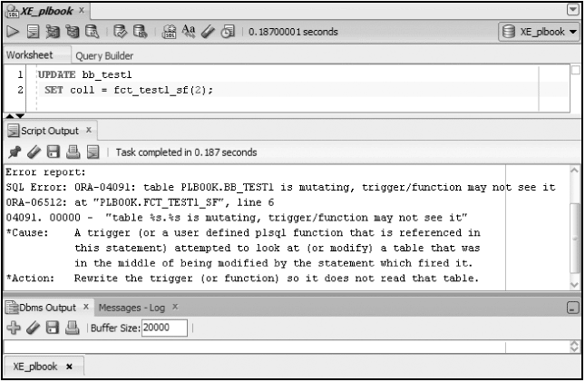
Purity Levels Test
Oracle11g: PL/SQL Programming

Slide 27
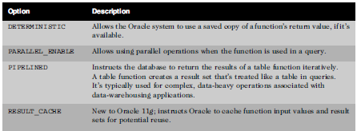
Additional Options
Oracle11g: PL/SQL Programming

Slide 28
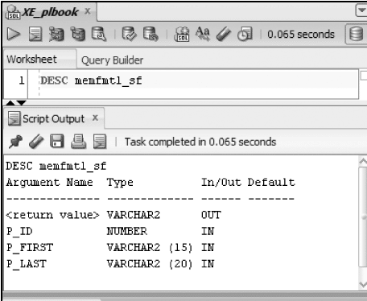
Data Dictionary Information
DESCRIBE identifies parameters and return value data type
Oracle11g: PL/SQL Programming

Slide 29
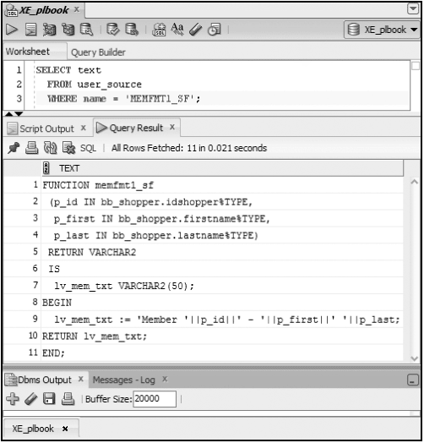
Data Dictionary Information (continued)
View source code using USER_SOURCE
Oracle11g: PL/SQL Programming

Slide 30
Delete Functions
DROP FUNCTION function_name;
Oracle11g: PL/SQL Programming

Slide 31
Summary
Functions can be used in PL/SQL and SQL statements
A function is part of an expression
Functions include parameters and must return a value
OUT parameter rarely used
Pass parameter values by value or reference
Multiple RETURN statements can be included and only one is executed
Oracle11g: PL/SQL Programming

Slide 32
Summary (continued)
Actual versus formal parameters
  Formal parameters – included in a program unit
  Actual parameters – arguments used in a program unit call
Purity levels refer to rules for functions to be used in SQL statements
Options are available for improving performance such as PARALLEL_ENABLE
DESCRIBE and USER_SOURCE view
DROP command removed a function
Oracle11g: PL/SQL Programming

