Slide 1

Oracle11g:
PL/SQL Programming
Chapter 8
Dependencies, Privileges and Compilation

Slide 2
Chapter Objectives
After completing this lesson, you should be able to understand:
  Direct and indirect dependencies
  Data dictionary information on dependencies
  Using the dependency tree utility
  The unique nature of package dependencies
Oracle11g: PL/SQL Programming

Slide 3
Chapter Objectives (continued)
After completing this lesson, you should be able to understand (continued):
  Remote object dependency actions
  Avoiding recompilation errors
  Granting program unit privileges
  PL/SQL compiler parameters and features
Oracle11g: PL/SQL Programming

Slide 4
Program Unit Dependencies
Relationships or dependencies determine the validity of any program unit after modifications to database objects that the program unit references
This validity determines the need for recompilation
A procedure calls a function
  The procedure is a dependent object and the function is the referenced object
Oracle11g: PL/SQL Programming

Slide 5
Brewbean’s Challenge
Need to take any steps possible to make the execution more efficient
Users have been hitting some unexpected errors related to recent modifications to the database and program units
In this light, need to review database dependencies and their impact
Oracle11g: PL/SQL Programming

Slide 6
Local Dependency Activity
Status of program unit can be checked using USER_OBJECTS
When a referenced object is modified, the status of the dependent object changes to INVALID
INVALID status indicates need for recompilation
ALTER COMPILE command used to recompile a program unit
Oracle11g: PL/SQL Programming

Slide 7
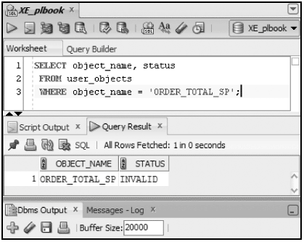
Object Status
Oracle11g: PL/SQL Programming

Slide 8
Automatic Recompilation
Upon execution of a program unit with an INVALID status, the system will automatically recompile
Drawbacks
  Recompilation of dependent objects tests the changes to the referenced objects, which could raise errors at run time
  Recompilation processing occurs during run time
Oracle11g: PL/SQL Programming

Slide 9
Direct & Indirect Dependencies
Direct – a procedure calls a function
Indirect – a procedure calls a procedure which calls a function
  The dependency between the first procedure and the function is indirect
Indirect dependencies have same affect as direct dependencies
Oracle11g: PL/SQL Programming

Slide 10
Data Dictionary
USER_DEPENDENCIES identify direct dependencies
Use WHERE clause on name column to analyze a particular object
DBA_DEPENDENCIES will identify direct dependencies of objects in all schemas
Oracle11g: PL/SQL Programming

Slide 11
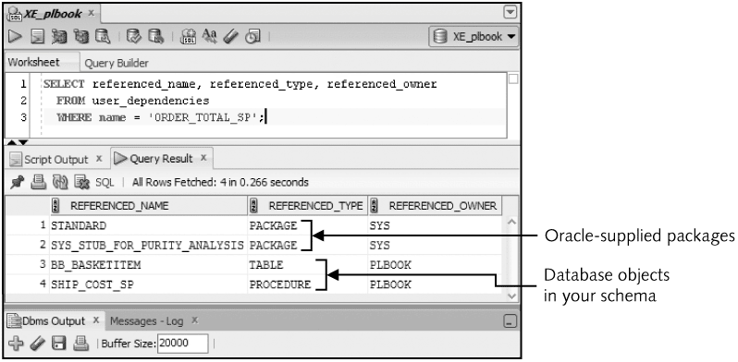
Data Dictionary
Oracle11g: PL/SQL Programming

Slide 12
Dependency Tree Utility
Mechanism to map direct and indirect dependencies
Execute utldtree.sql script once to set up the feature
Deptree_fill procedure used to analyze an object
Two views
  Deptree: numeric scheme
  Ideptree: indented scheme
Oracle11g: PL/SQL Programming

Slide 13
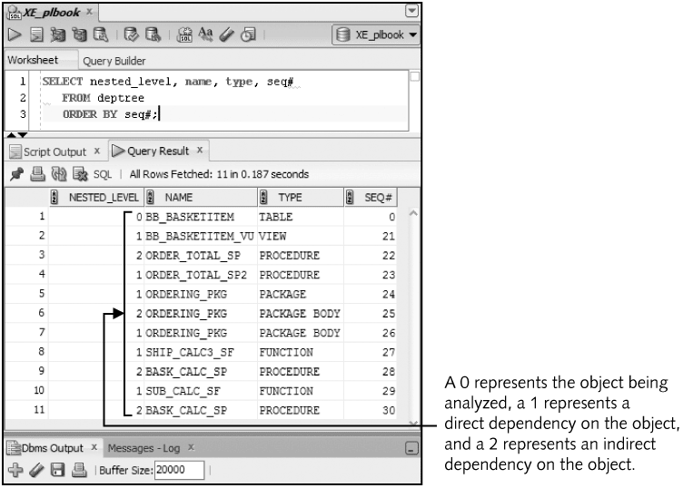
Dependency Tree Utility
Oracle11g: PL/SQL Programming

Slide 14
Package Dependencies
Modifications to package specification will change status of dependent objects
Modifications to only the package body do NOT change status of dependent objects
Separation of code in packages
  Minimizes recompilation needs
  Dependent objects to be developed prior to the package body being created
Oracle11g: PL/SQL Programming

Slide 15
Remote Object Dependencies
Database links are used to connect to other Oracle databases
Links allow calls to objects in other databases
  These objects are called remote objects
When remote objects are modified, local dependent objects are not initially flagged as INVALID
Remote dependencies are not checked until run time
Oracle11g: PL/SQL Programming

Slide 16
Remote Invalidation Methods
Timestamp: compares the last date of modification of dependent and referenced objects
Signature: compares the parameter modes, data types, and order
Timestamp is the default method
Databases in different time zones generate unnecessary recompilation using the timestamp method
Oracle11g: PL/SQL Programming

Slide 17
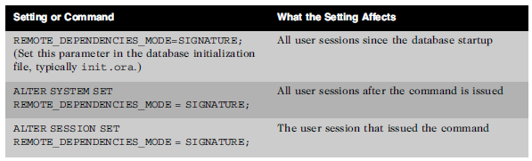
Signature Mode
Oracle11g: PL/SQL Programming

Slide 18
Avoiding Recompilation Errors
Use %TYPE and %ROWTYPE attributes
Use the ‘*’ notation in queries to select all columns
Use a column list in INSERT statements
Oracle11g: PL/SQL Programming

Slide 19
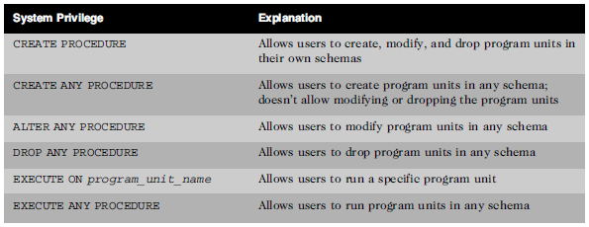
Program Unit Privileges
Oracle11g: PL/SQL Programming

Slide 20
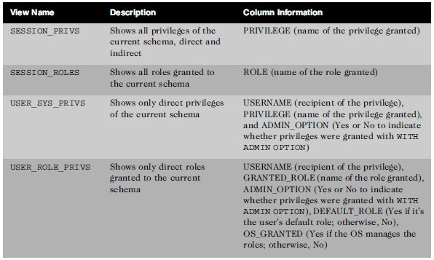
Privileges - Data Dictionary
Oracle11g: PL/SQL Programming

Slide 21
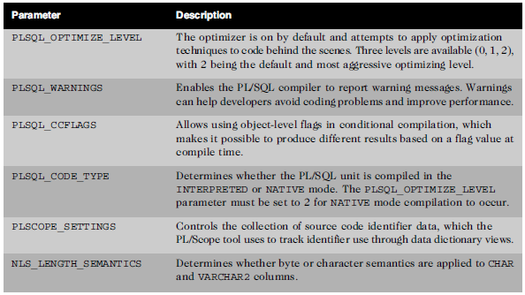
PL/SQL Compilation
Oracle11g: PL/SQL Programming

Slide 22
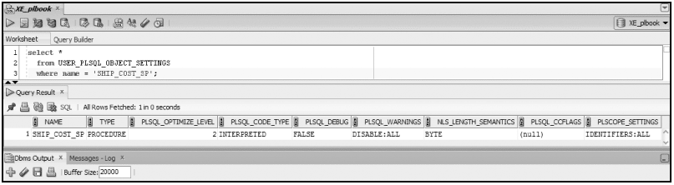
Compilation Parameters
Oracle11g: PL/SQL Programming

Slide 23

Parameter Settings
Oracle11g: PL/SQL Programming

Slide 24
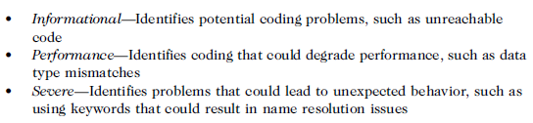

Compiler Warnings
Assists to identify coding problems for code that successfully compiles
Warning messages use number ranges
Oracle11g: PL/SQL Programming

Slide 25
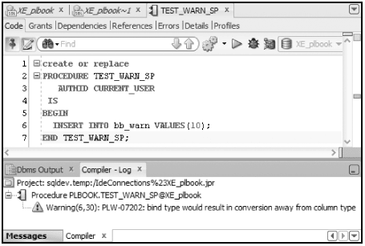
Compiler Warnings
Oracle11g: PL/SQL Programming

Slide 26
Conditional Compilation
Enables tailoring code based on compiler
directives
Create code that can be used in a variety of
Oracle versions but still take advantage of
version-specific features
Oracle11g: PL/SQL Programming

Slide 27
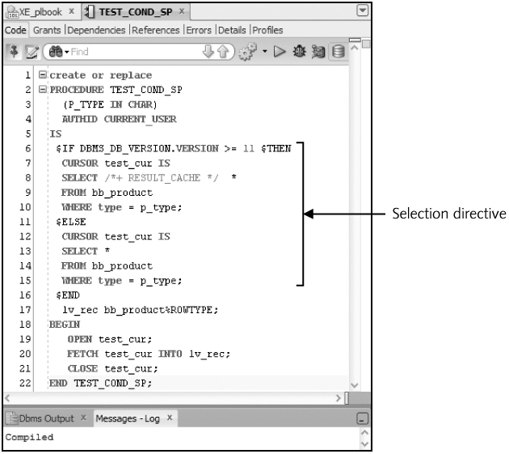
Conditional Compilation
Oracle11g: PL/SQL Programming

Slide 28

Conditional Compilation
Confirm the resulting code after evaluating
compiler conditions
Oracle11g: PL/SQL Programming

Slide 29
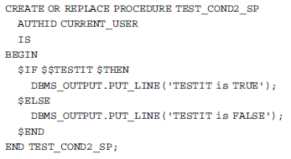
Compilation Flag
Oracle11g: PL/SQL Programming

Slide 30
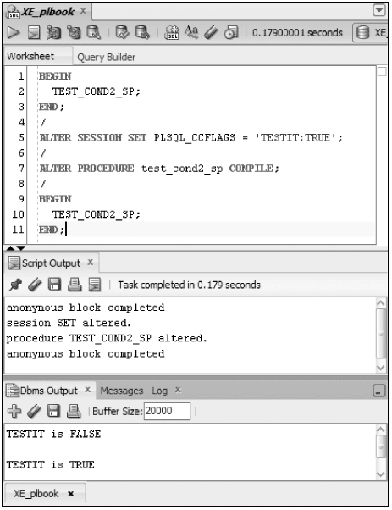
Compilation Flag
Oracle11g: PL/SQL Programming

Slide 31
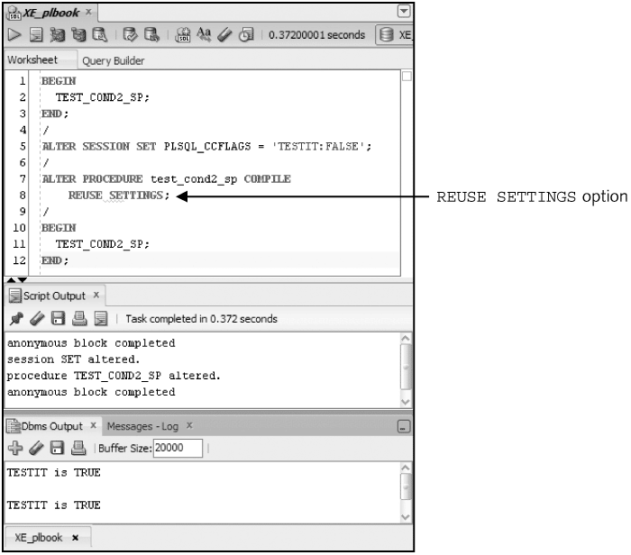
Compilation Flag
Oracle11g: PL/SQL Programming

Slide 32
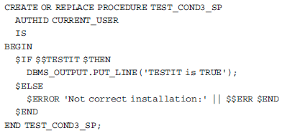
Error Directive
Oracle11g: PL/SQL Programming

Slide 33
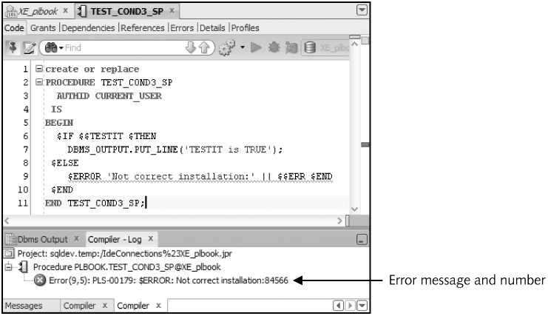
Error Directive
Oracle11g: PL/SQL Programming

Slide 34
Summary
Program unit status changes when referenced object is modified
INVALID status indicates a need for recompilation
Direct and indirect dependencies both affect status
Dependency tree utility allows mapping of both direct and indirect dependencies
Oracle11g: PL/SQL Programming

Slide 35
Summary (continued)
Packages minimize recompilation needs
Remote dependencies do not update status until run time
Appropriate privileges needed to create and use program units
Compiler parameters can affect how program units are compiled
Conditional compilation enables the tailoring of program unit code
Oracle11g: PL/SQL Programming

