Slide 1

Oracle11g:
PL/SQL Programming
Chapter 10
Oracle-Supplied Packages,
Dynamic SQL, and Hiding
Source Code

Slide 2
Objectives
After completing this lesson, you should be able to understand:
  Generating output via packages
  Including large objects in the Oracle database
  Using communication packages
  Using important built-in packages
  Exploring dynamic SQL and PL/SQL
  Hiding PL/SQL source code
Oracle11g: PL/SQL Programming

Slide 3
Brewbean’s Challenge
Credit card verification
Real-time messages
E-mail generation
Import external file data
Include image files in the database
Schedule program execution
Oracle11g: PL/SQL Programming

Slide 4
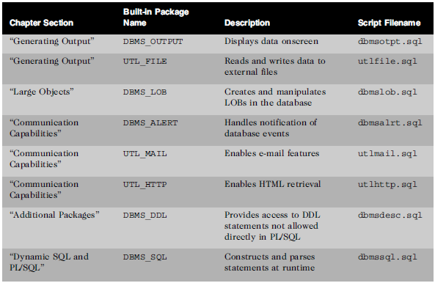
Built-in Packages
Oracle11g: PL/SQL Programming

Slide 5
Generating Output
Built-in Package Name
Description
Script Filename
DBMS_OUTPUT
Displays data to the screen
dbmsotpt.sql
UTL_FILE
Read and write data to external files
utlfile.sql
Oracle11g: PL/SQL Programming

Slide 6
DBMS_OUTPUT
Displays data from within PL/SQL code
Used heavily for debugging
Enable DBMS_OUTPUT in SQL Developer
The PUT procedure continues to place data on the same output line
The PUT_LINE procedure will start a new line
Oracle11g: PL/SQL Programming

Slide 7
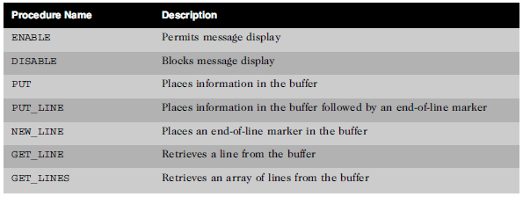
DBMS_OUTPUT
Oracle11g: PL/SQL Programming

Slide 8
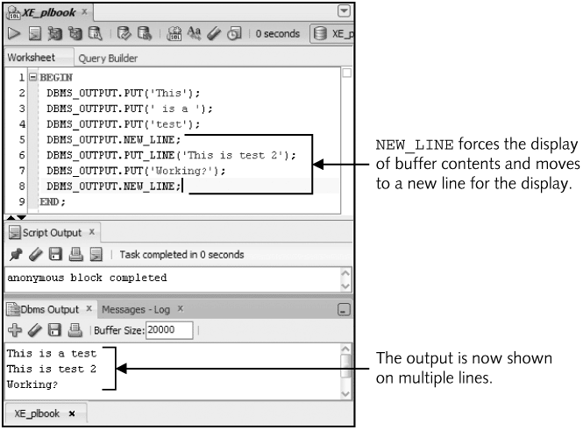
DBMS_OUTPUT Example
Oracle11g: PL/SQL Programming

Slide 9
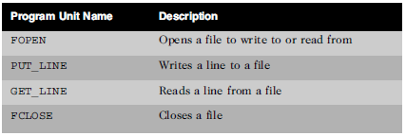
UTL_FILE
Enables reading and writing text data to operating system files (import and export data)
Oracle11g: PL/SQL Programming

Slide 10
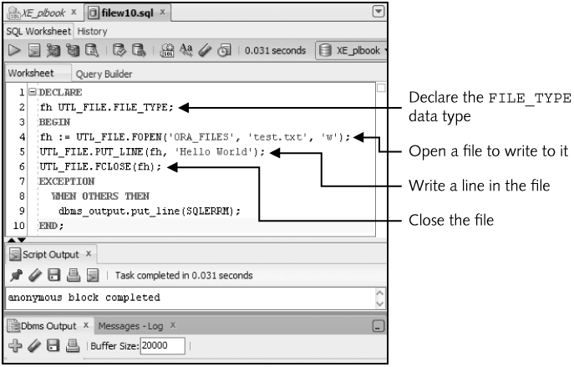
UTL_FILE Example - Write
Oracle11g: PL/SQL Programming

Slide 11
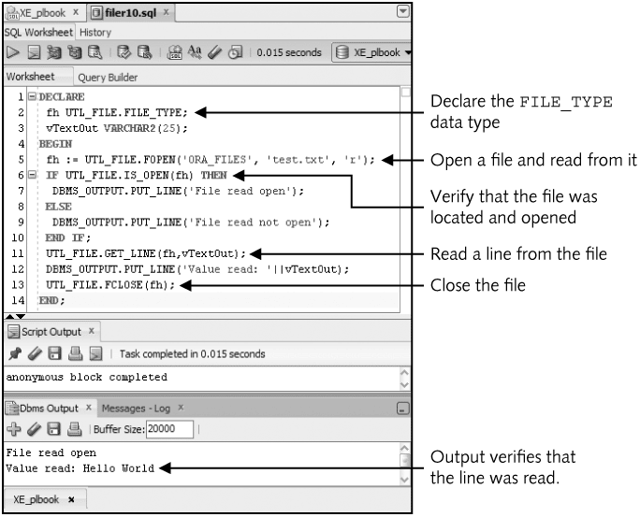
UTL_FILE Example - Read
Oracle11g: PL/SQL Programming

Slide 12
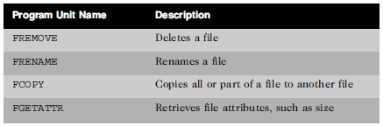
UTL_FILE
Other file management procedures
Oracle11g: PL/SQL Programming

Slide 13
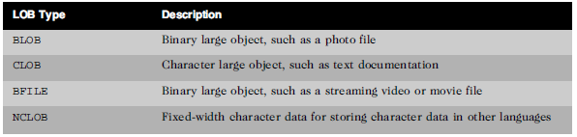
Large Objects (LOBs)
Handle media such as images, video segments, and large documents
Oracle11g: PL/SQL Programming

Slide 14
LOBs
Enable the storage of large objects as columns in a database table
Can hold up to 4GB of data
Multiple LOB columns allowed
All except BFILE are stored internally in the database
A LOB column contains pointer to actual LOB data
Oracle11g: PL/SQL Programming

Slide 15
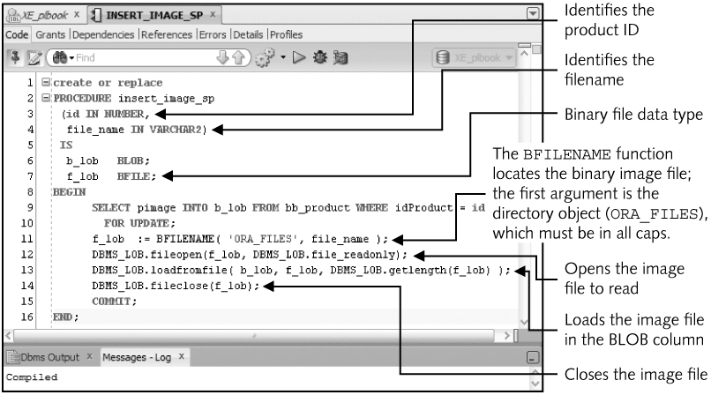
DBMS_LOB Example
Oracle11g: PL/SQL Programming

Slide 16
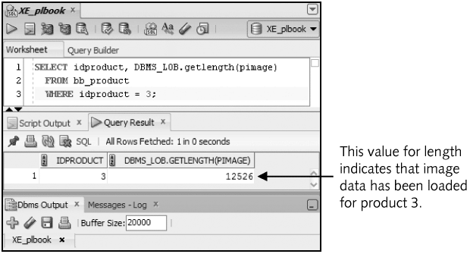
DBMS_LOB Example
Oracle11g: PL/SQL Programming

Slide 17
DBMS_ALERT
Allows real-time messages or alerts to be sent to users upon a particular event
Accomplished in a database trigger to be associated with an event
An example use is online auctions
Process includes: register an alert name, set when alert should signal, and identify users that should be recipients
Oracle11g: PL/SQL Programming

Slide 18
DBMS_ALERT Example
Register name
DBMS_ALERT.REGISTER(‘new_bid’);
Fire signal in database trigger
DBMS_ALERT.SIGNAL(‘new_bid’, TO_CHAR(:new.bid));
Register recipient
DBMS_ALERT.WAITONE(‘new_bid’, v_msg,
v_status, 600);
Oracle11g: PL/SQL Programming

Slide 19
UTL_MAIL
Simplifies sending e-mail via a PL/SQL block
Introduced in Oracle10g
Scripts must be executed to set up the package
SMTP server must be defined on the system
Starting with Oracle11g, system administrator must create an access control list (ACL)
Oracle11g: PL/SQL Programming

Slide 20
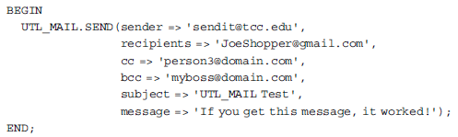
UTL_MAIL Example
Oracle11g: PL/SQL Programming

Slide 21
UTL_HTTP
Used to analyze HTML source of Web pages
Makes Hypertext Transfer Protocol (HTTP) calls from within PL/SQL
REQUEST_PIECES function will retrieve the HTML source of a specified URL in 2,000 byte segments
Oracle11g: PL/SQL Programming

Slide 22
DBMS_DDL
Allows access to two specific DDL statements:
  ALTER_COMPILE
  ANALYZE_OBJECT
Oracle11g: PL/SQL Programming

Slide 23
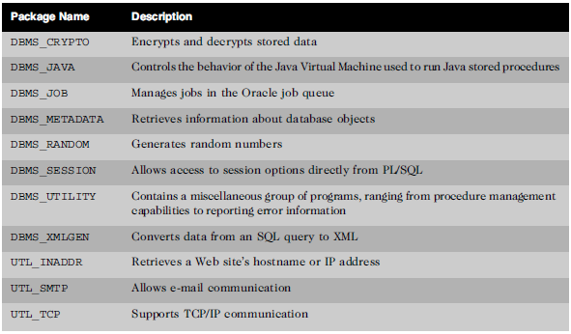
Exploring More
Oracle11g: PL/SQL Programming

Slide 24
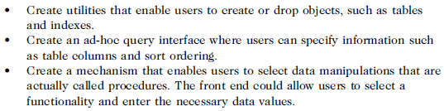
Dynamic SQL
Two mechanisms available
  DBMS_SQL package
  Native dynamic SQL
Oracle11g: PL/SQL Programming

Slide 25
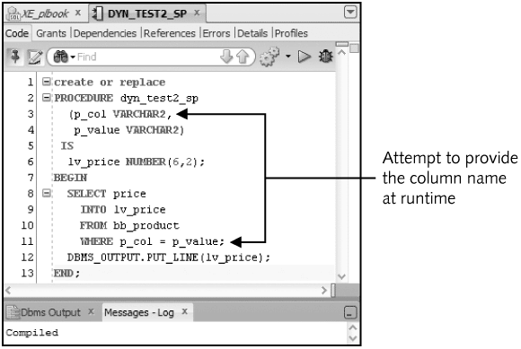
Dynamic SQL
Oracle11g: PL/SQL Programming

Slide 26
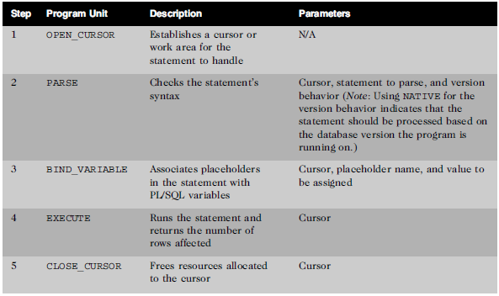
DBMS_SQL - DML
Oracle11g: PL/SQL Programming

Slide 27
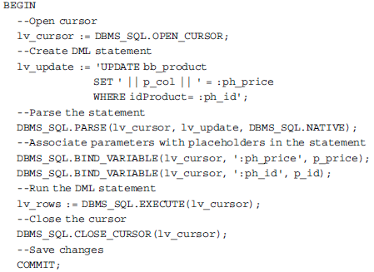
DBMS_SQL - DML
Oracle11g: PL/SQL Programming

Slide 28
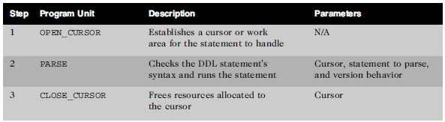
DBMS_SQL - DDL
Oracle11g: PL/SQL Programming

Slide 29
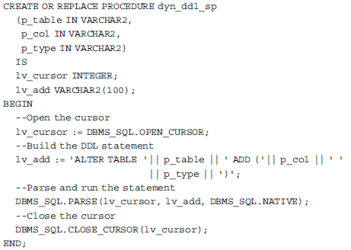
DBMS_SQL - DDL
Oracle11g: PL/SQL Programming

Slide 30
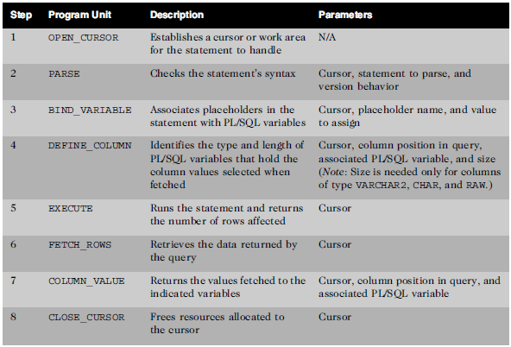
DBMS_SQL - Queries
Oracle11g: PL/SQL Programming

Slide 31
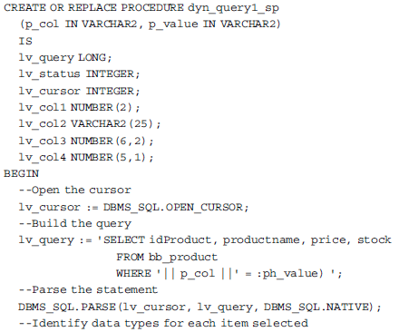
DBMS_SQL - Queries
Oracle11g: PL/SQL Programming

Slide 32
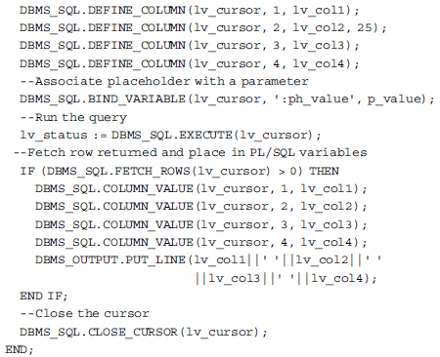
DBMS_SQL - Queries
Oracle11g: PL/SQL Programming

Slide 33
Native Dynamic SQL
Simpler coding
More efficient processing
Limited capabilities compared to DBMS_SQL package
Two methods
  EXECUTE IMMEDIATE
  OPEN FOR
Oracle11g: PL/SQL Programming

Slide 34
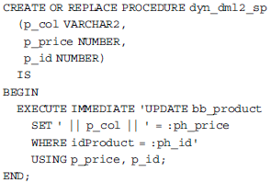
Native Dynamic SQL - DML
Oracle11g: PL/SQL Programming

Slide 35
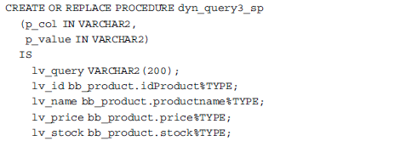
Native Dynamic SQL - Query
Oracle11g: PL/SQL Programming

Slide 36
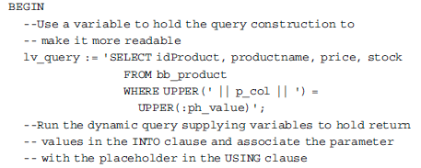
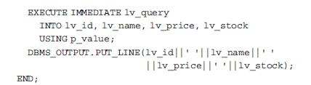
Native Dynamic SQL - Query
Oracle11g: PL/SQL Programming

Slide 37
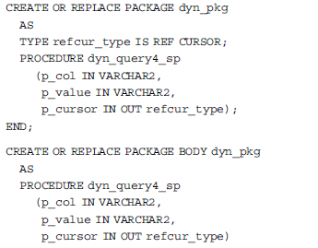
Native Dynamic SQL – Open For
Oracle11g: PL/SQL Programming

Slide 38
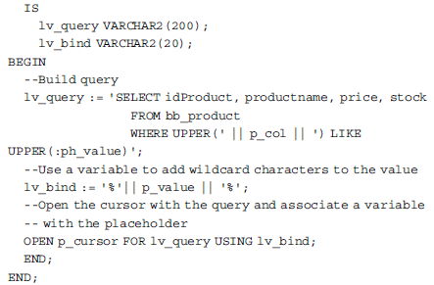
Native Dynamic SQL – Open For
Oracle11g: PL/SQL Programming

Slide 39

DBMS_SQL VS. Native Dynamic SQL
Using Native Dynamic SQL when
Oracle11g: PL/SQL Programming

Slide 40
Hiding Source Code
Obfuscating and wrapping refer to hiding PL/SQL code
Protect source code
Two methods
  Wrap utility
  DBMS_DDL package
Oracle11g: PL/SQL Programming

Slide 41
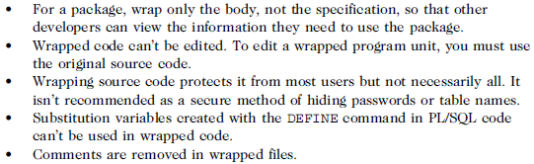
Hiding Source Code Tips
Oracle11g: PL/SQL Programming

Slide 42
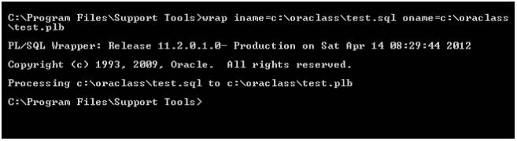
Wrap Utility
Oracle11g: PL/SQL Programming

Slide 43
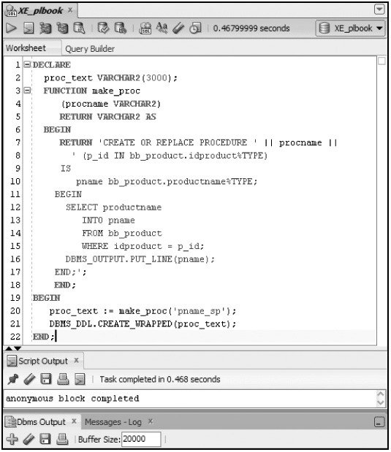
DBMS_DDL CREATE_WRAPPED
Oracle11g: PL/SQL Programming

Slide 44
Summary
Oracle-supplied packages are pre-built packages to address common processing needs
DBMS_OUTPUT allows data display
UTL_FILE enables reading and writing to text files
DBMS_LOB manages LOBs
DBMS_ALERT enables event notification
UTL_MAIL creates emails
Oracle11g: PL/SQL Programming

Slide 45
Summary (continued)
UTL_HTTP enables HTML source retrieval
DBMS_DDL enables the COMPILE and ANALYZE commands to be processed within PL/SQL
Dynamic SQL allows identifiers and DDL statements to process within PL/SQL
DBMS_SQL package and native dynamic SQL are two mechanisms providing dynamic SQL capabilities
Oracle11g: PL/SQL Programming

Slide 46
Summary (continued)
Native dynamic SQL is simpler to code and executes more efficiently
Two methods of hiding source code: wrap utility and DBMS_DDL package
Oracle11g: PL/SQL Programming

