Slide 1



Presentation on:
Building a Library for Matrix Calculation

Slide 2


Team Member
Yitian Chen, 11813211, department of mathematics
Yuwen Wu, 11813219, department of physics
Zhenyu Ren, 11812214, department of EE

Slide 3
Presentation Outline
Introduction
Methods Definition
Testing Results
Highlights
Difficulties and Future Work

Slide 4
Introduction
Matrix is an important concept introduced in linear algebra. Matrix calculation is widely used in many practical applications, including image processing, machine learning and deep learning.
In this project, we do not rely on any existing libraries, instead building a matrix calculation library, which providing serial methods like basic calculation, eigenvalues and eigenvectors, reshape and slicing, and convolution which widely used in image processing (Computer vision).

Slide 5
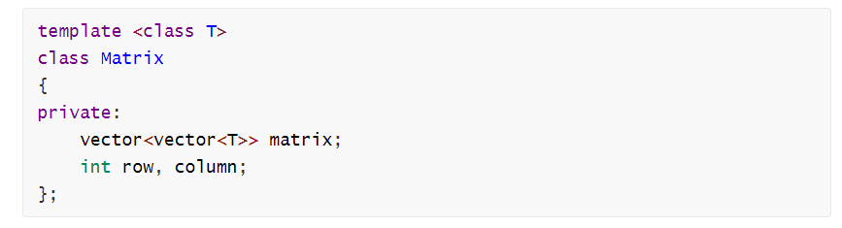
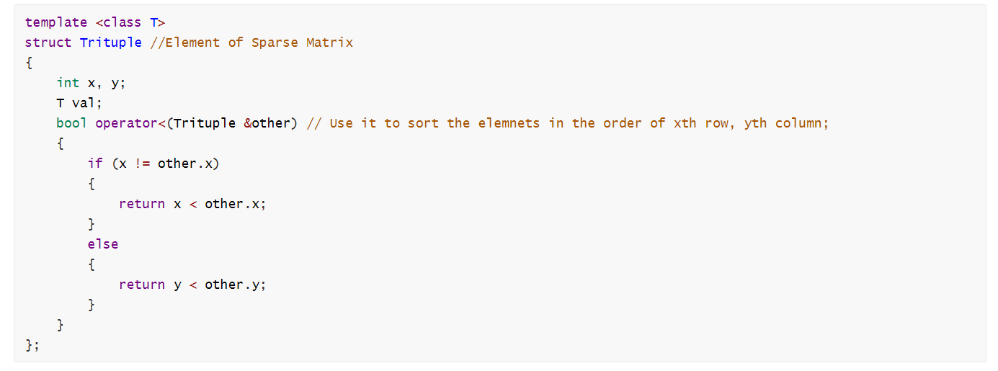
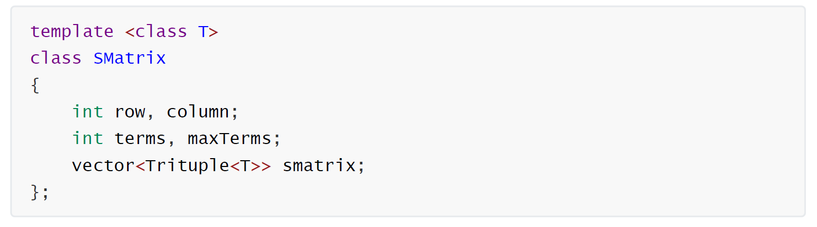
Methods Definition
Two classes and one struct are defined, ‘Matrix’, ‘Trituple’ and ‘Smatrix’. All support all kinds of data.
For class ‘Matrix’, all the methods required are implemented, For class ‘Smatrix’, we implement
the methods of addition, insertion, automatic sorting in the constructor and after insertion.
We provide the methods of transformations between classes ‘Matrix’ and ‘Smatrix’ using the constructors
and between class ‘Matrix’ and ‘cv::mat’

Slide 6
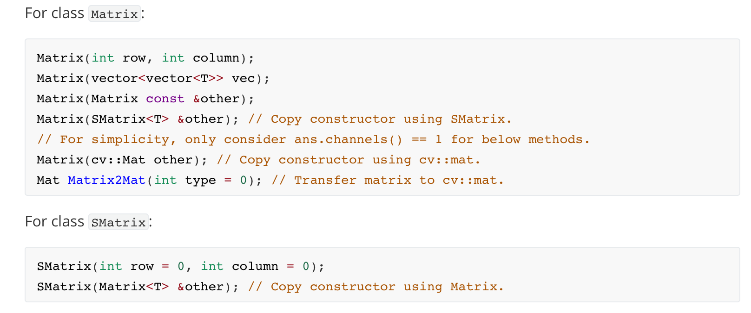
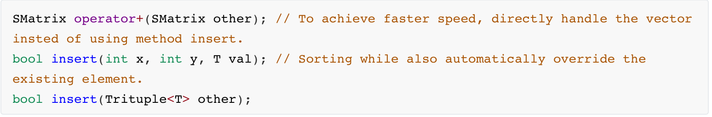
Methods Definition

Slide 7
Methods Definition
Matrix and vector arithmetic are supported. (+, -, *, .*, /, , transposition, conjugation)
Descriptive statistics are supported. (max. min. sum, average, all supporting axis-specific and slicing.)
Calculating eigenvalues and eigenvectors are supported.
Calculating traces, inverse and determinant are supported.
For both classes, override the operator << to show the matrix.
Methods all of above are well defined with comprehensive exception handling.

Slide 8
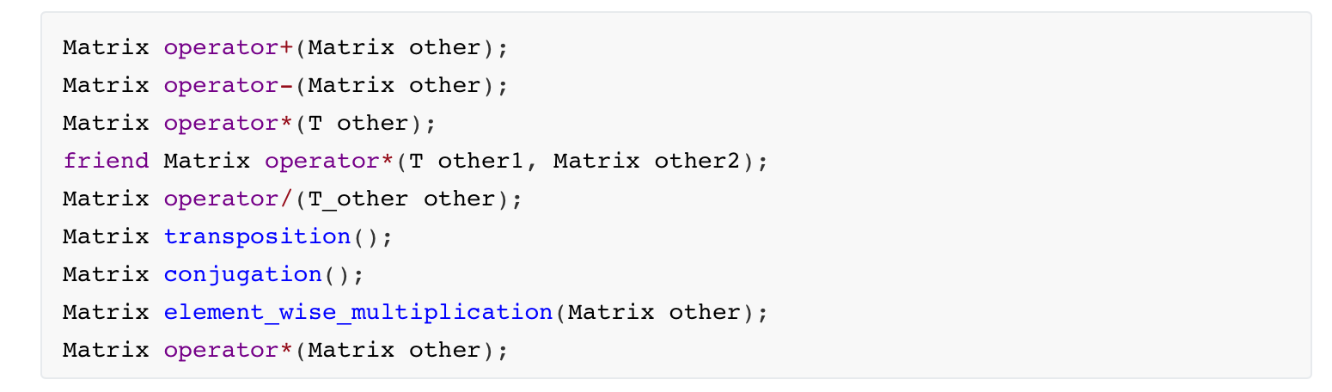
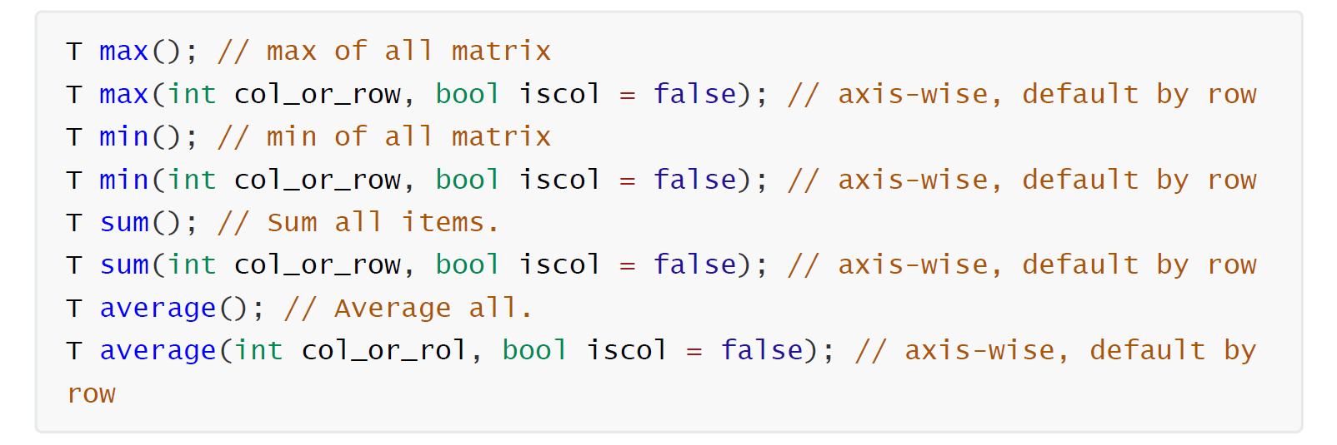
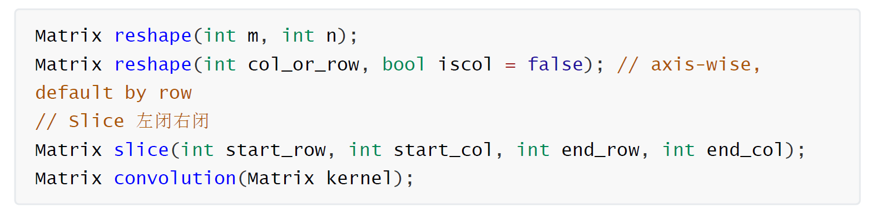
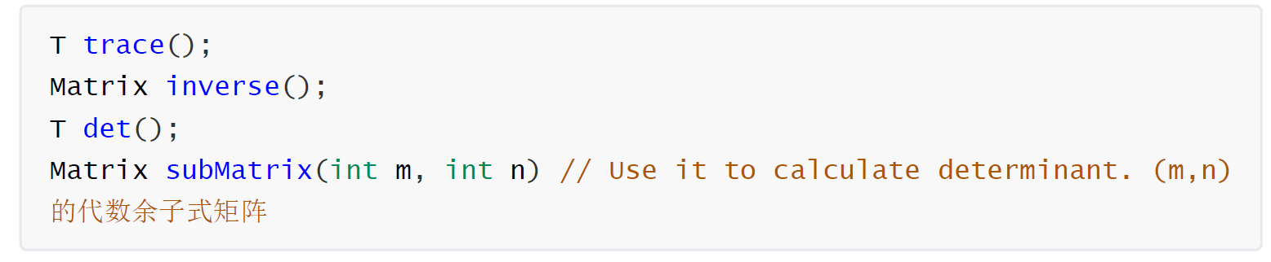
Methods Definition

Slide 9
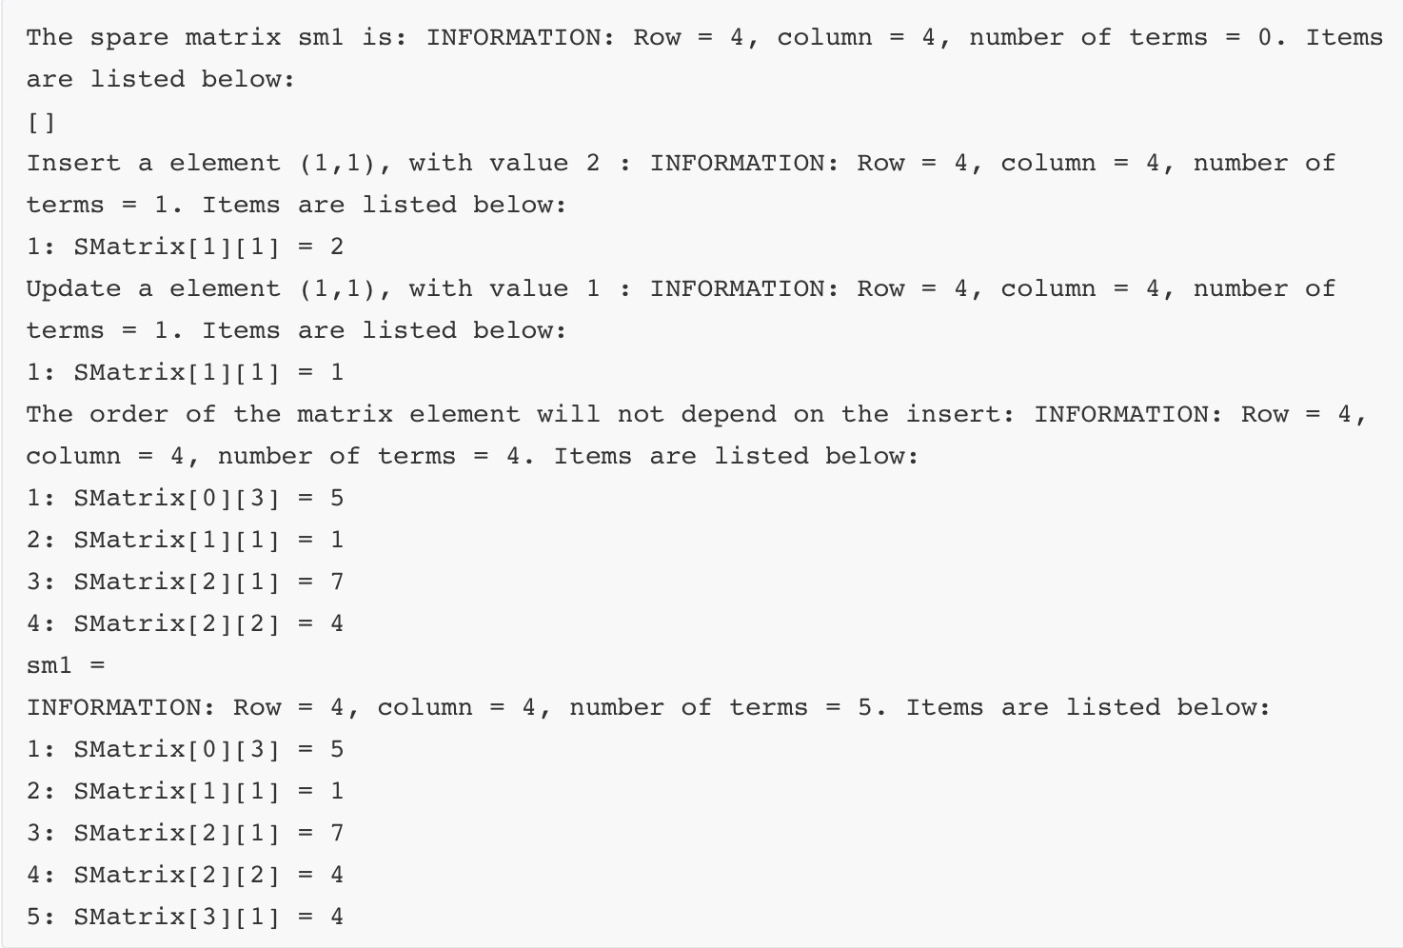
Testing Result
Sparse Matrix Demo:
Using method insert to declare a ‘Smatrix ’:(The sparse matrix is automatic sorting by the indexes of the matrix.)

Slide 10
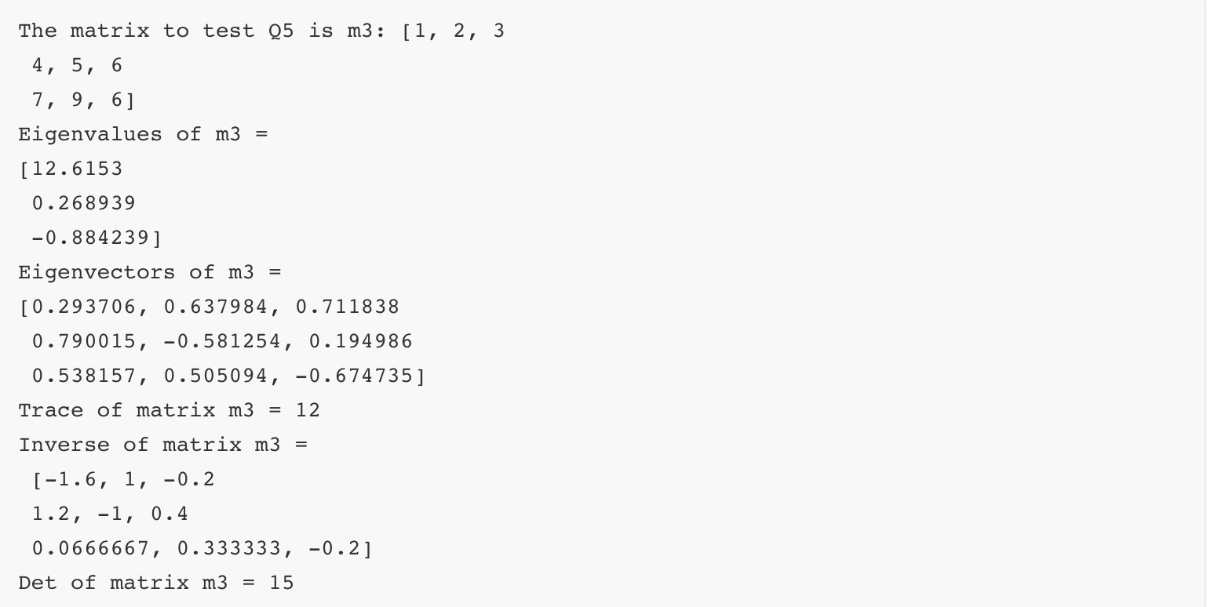
Testing Result
Eigenvalues, Eigenvector, traces, inverse, determinant
Please refer to our report to see more details. (Other functions, transformation between cv::mat, Matrix, SMatrix…)

Slide 11
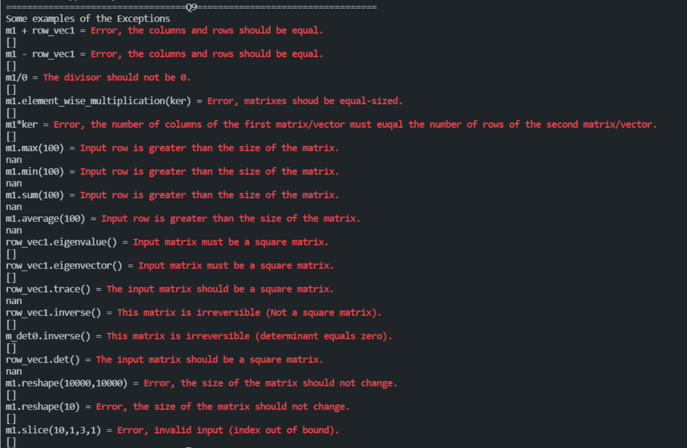
Testing Result
Exceptions Handling

Slide 12
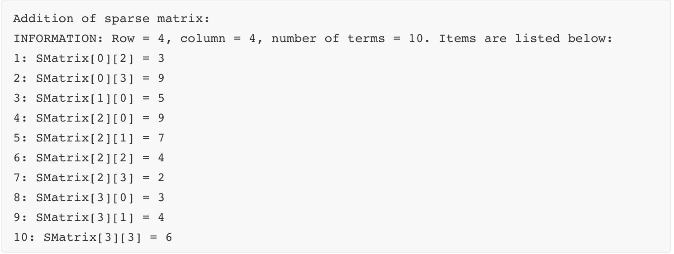
Highlights
Using method insert to declare a ‘Smatrix’, support transformation between sparse and dense matrices, addition of sparse matrix.

Slide 13
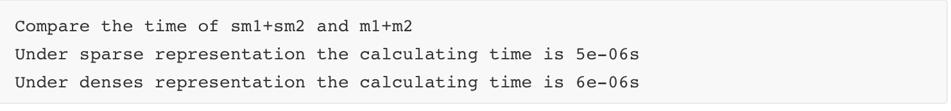
Highlights
Able to compare the calculation time of dense and sparse matrices.
Our sparse representation behaves faster than dense matrix calculation.

Slide 14
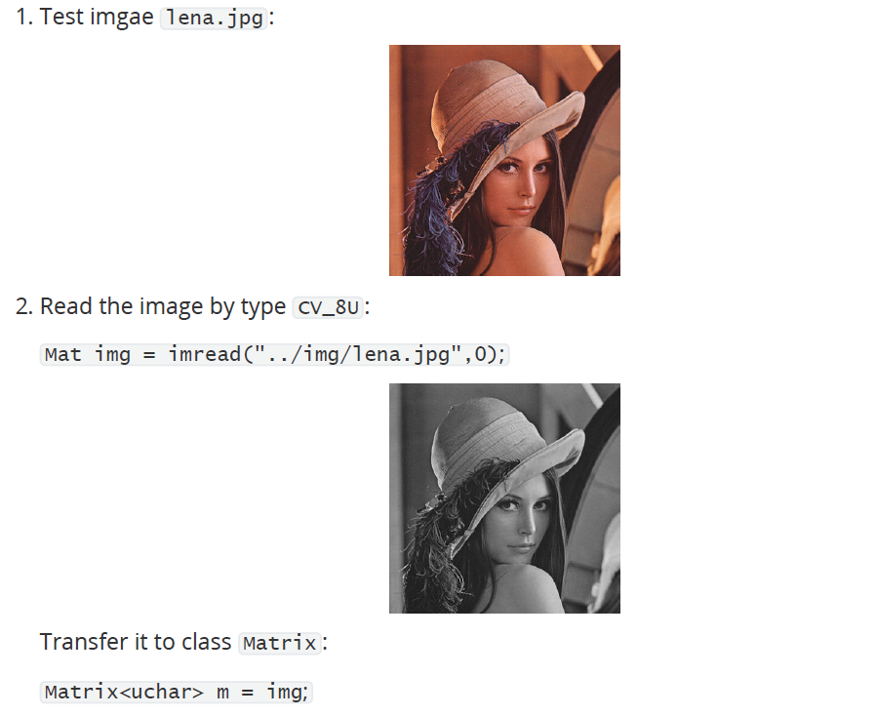
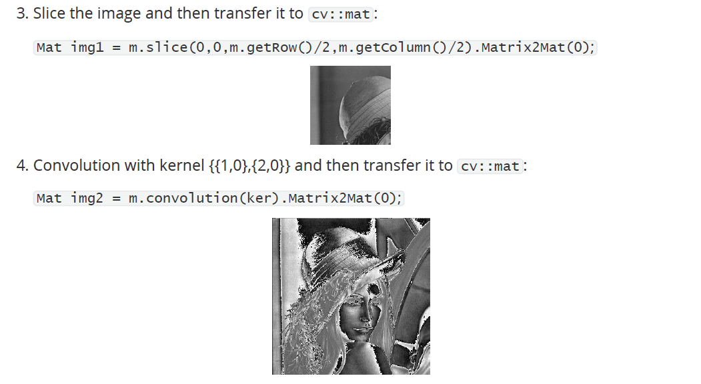
Highlights
Image processing test using our defined methods slice and convolution)

