Slide 1
Indoor and outdoor channel simulations using Winprop API.
Name: Ren Zhenyu
Date: 2021.7.12

Slide 2
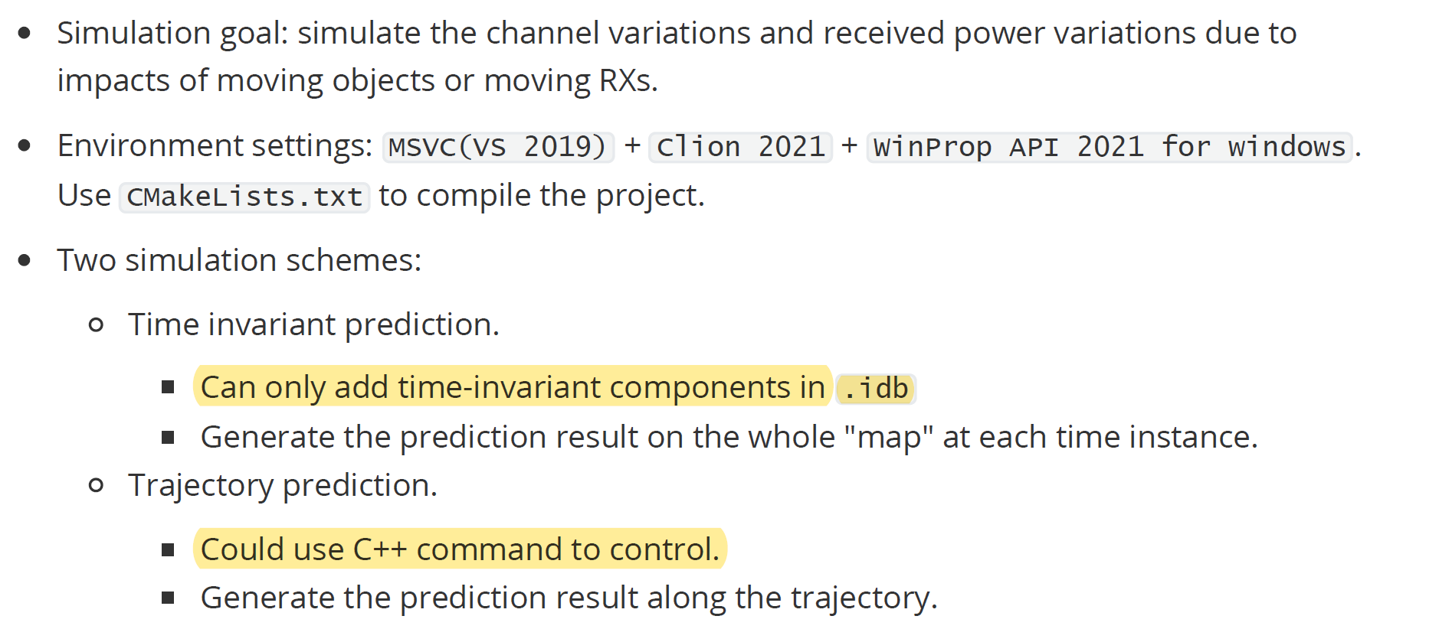
Overview
Simulation codes: https://github.com/rzy0901/testWinprop (private access now.)

Slide 3
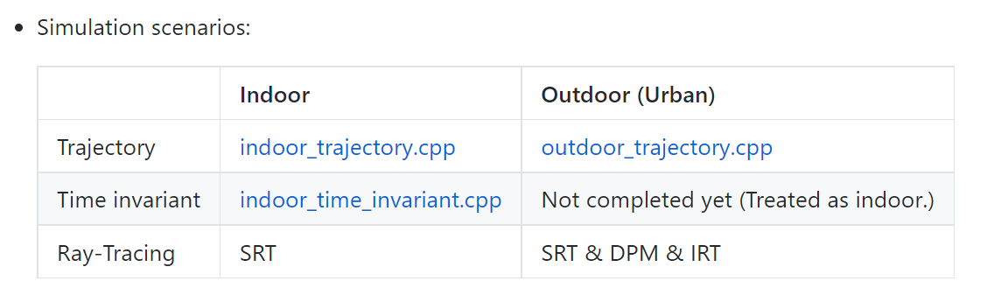
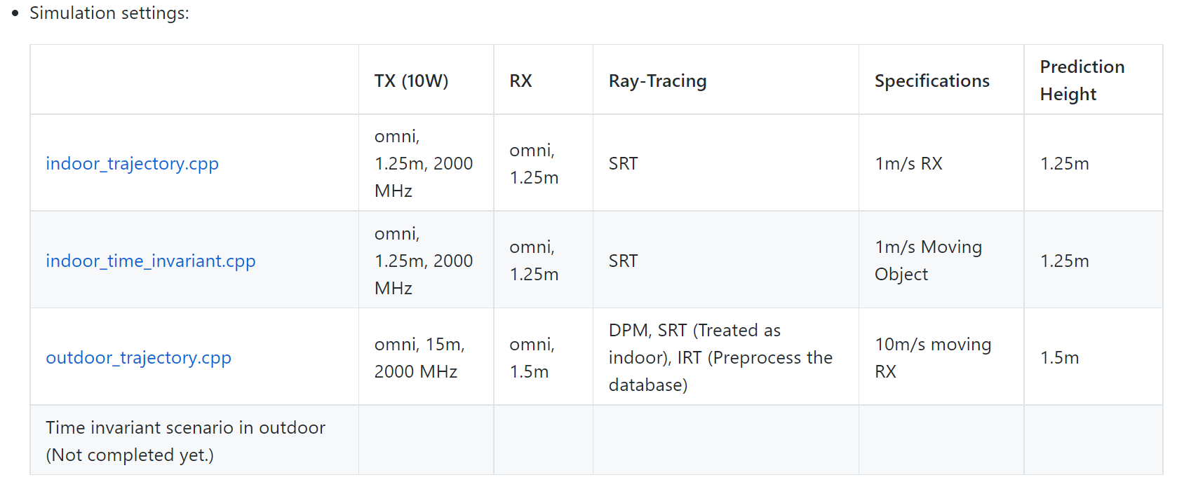
Simulation settings

Slide 4
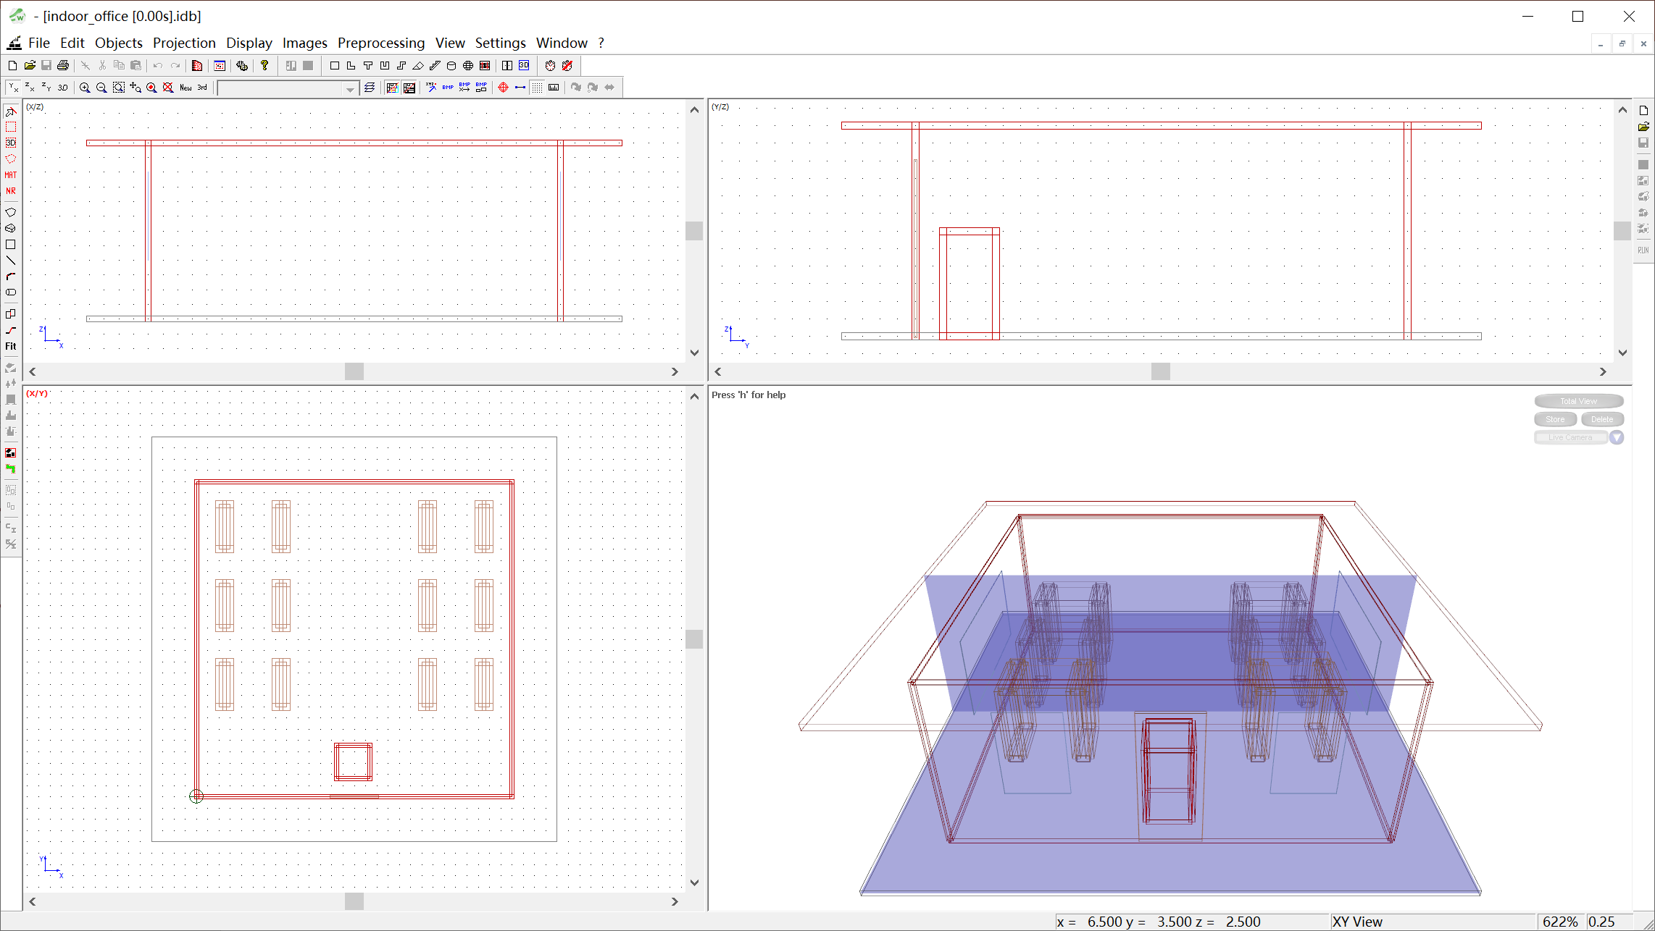
Simulation database: indoor_time_invariant.cpp
Object moving direction.(1m/s)

Slide 5
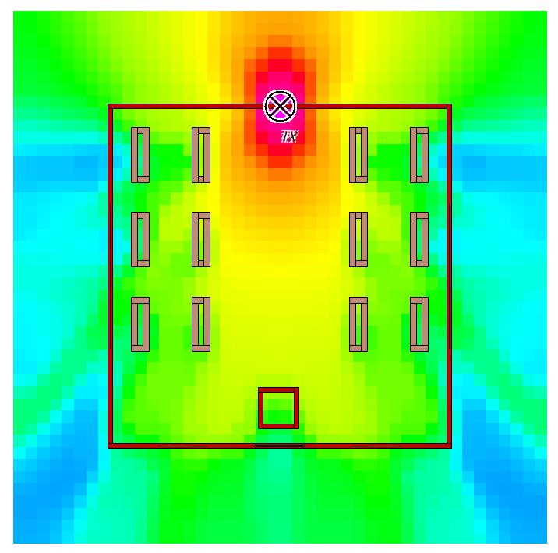
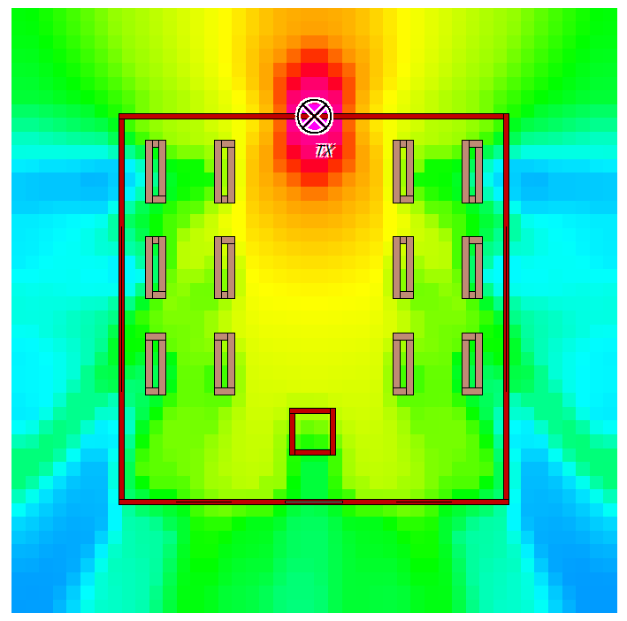
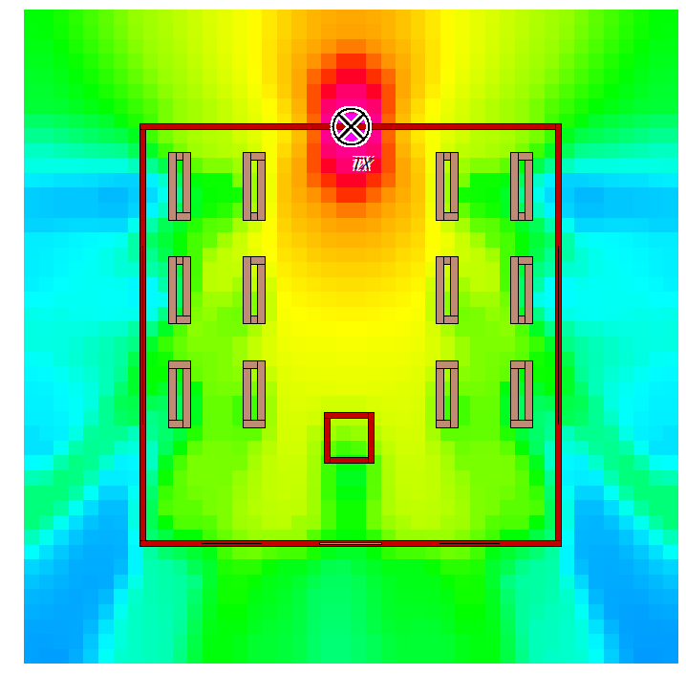
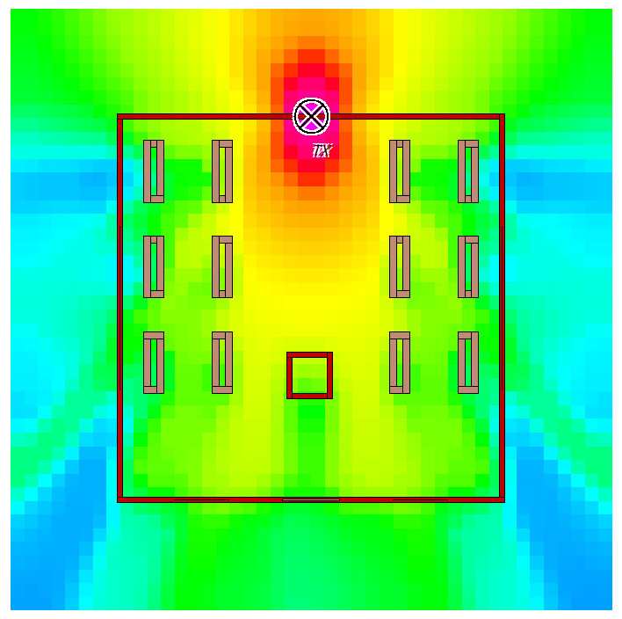
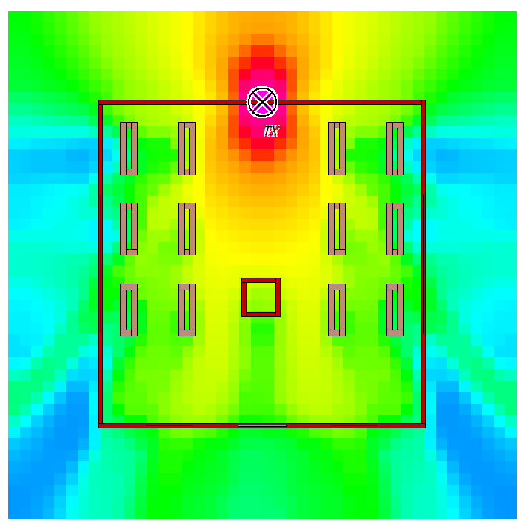
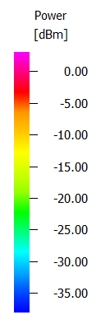
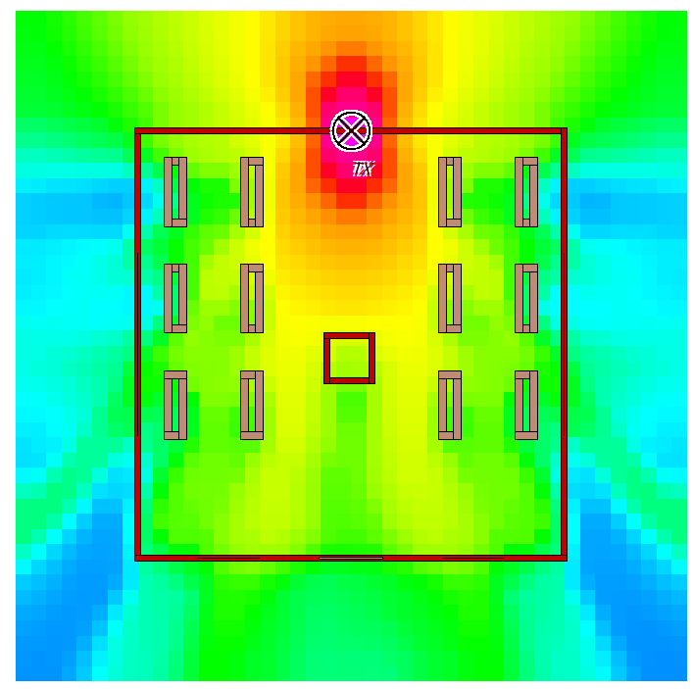
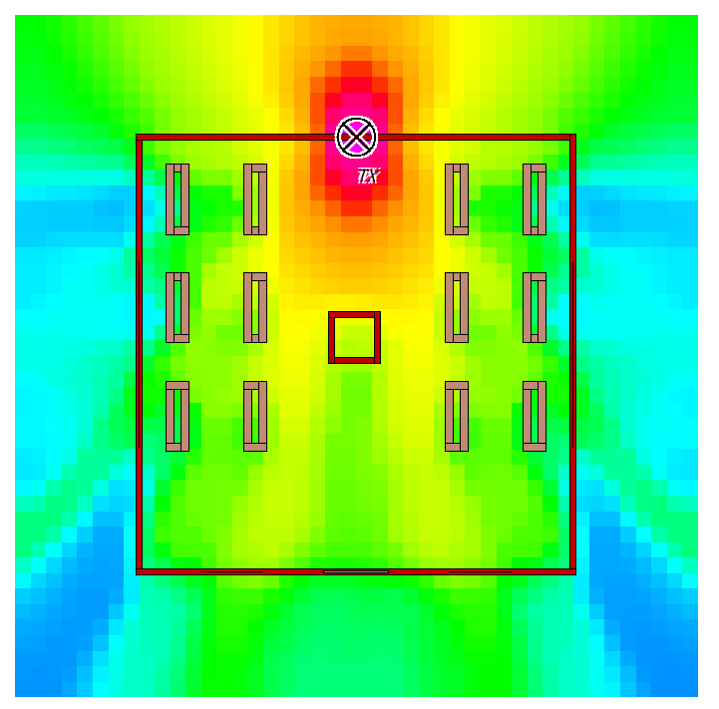
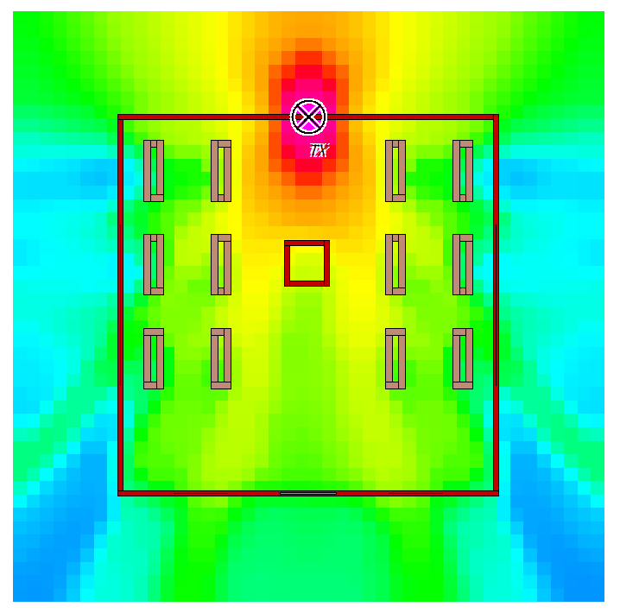
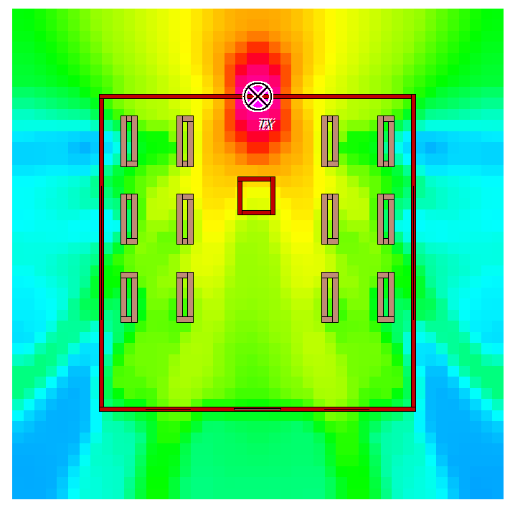
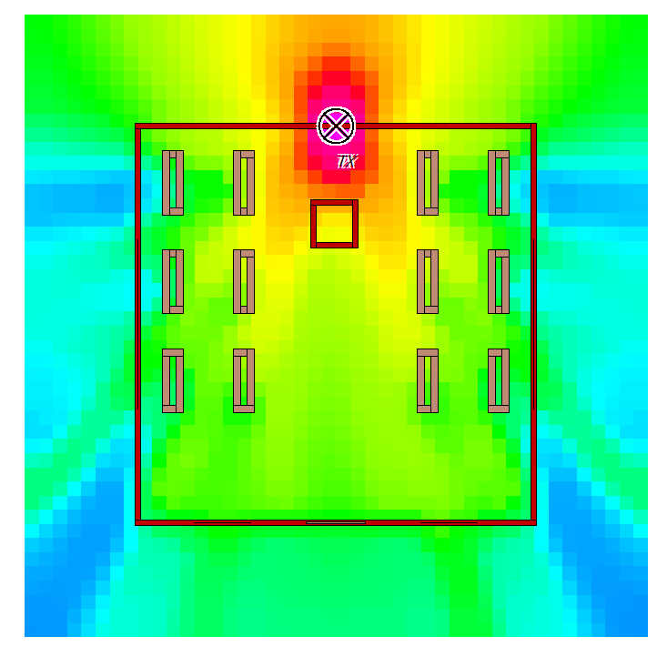
Result: indoor_time_invariant.cpp
0s
0.5s
1s
1.5s
2s
2.5s
3s
3.5s
4s
4.5s

Slide 6
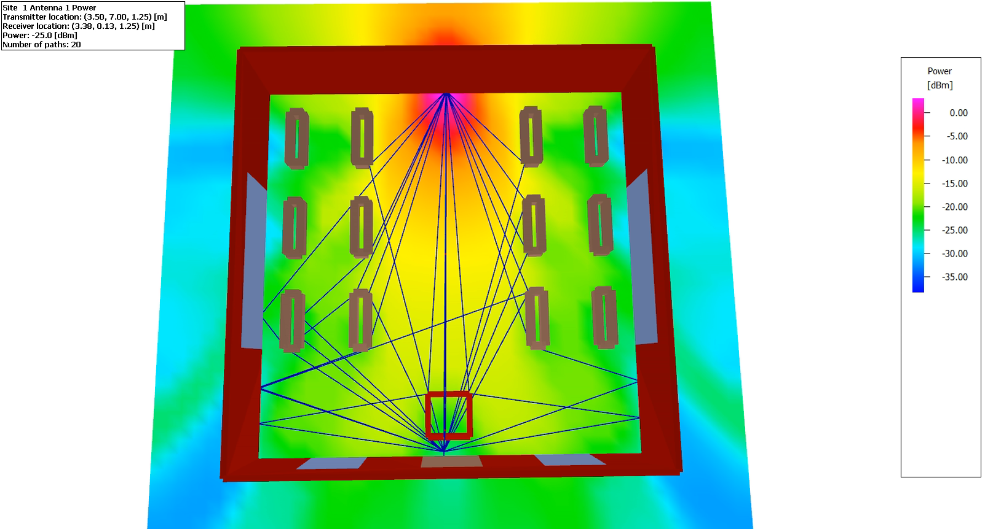
Result: indoor_time_invariant.cpp（ at pixel [3.5m:3.75m,0m:0.25m] ）

Slide 7
CIR at pixel [3.5m:3.75m,0m:0.25m]
Resolution here: 0.25m
Time step: 0s: 0.05s : 0.5s
Time step: 0s: 0.01s : 0.1s

Slide 8
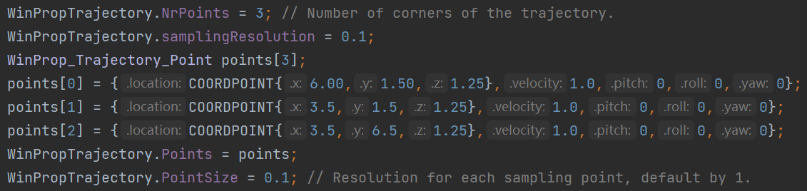
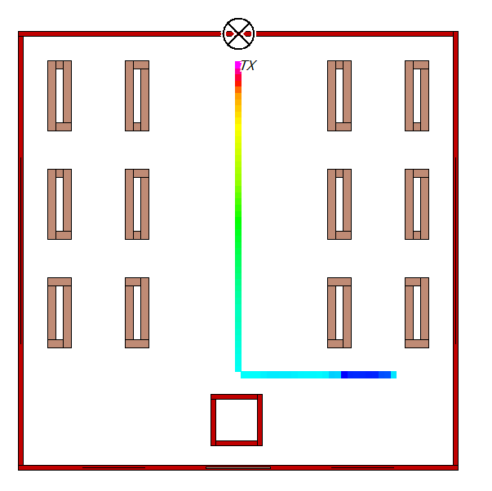
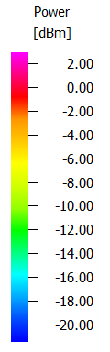
Result: indoor_trajectory.cpp
No object moving here. Only consider the mobility of RX.
Trajectory could be defined by locations of corners and velocity using C++ command. (Multiple RXs are also supported.)
RX moving trajectory.(1m/s)

Slide 9
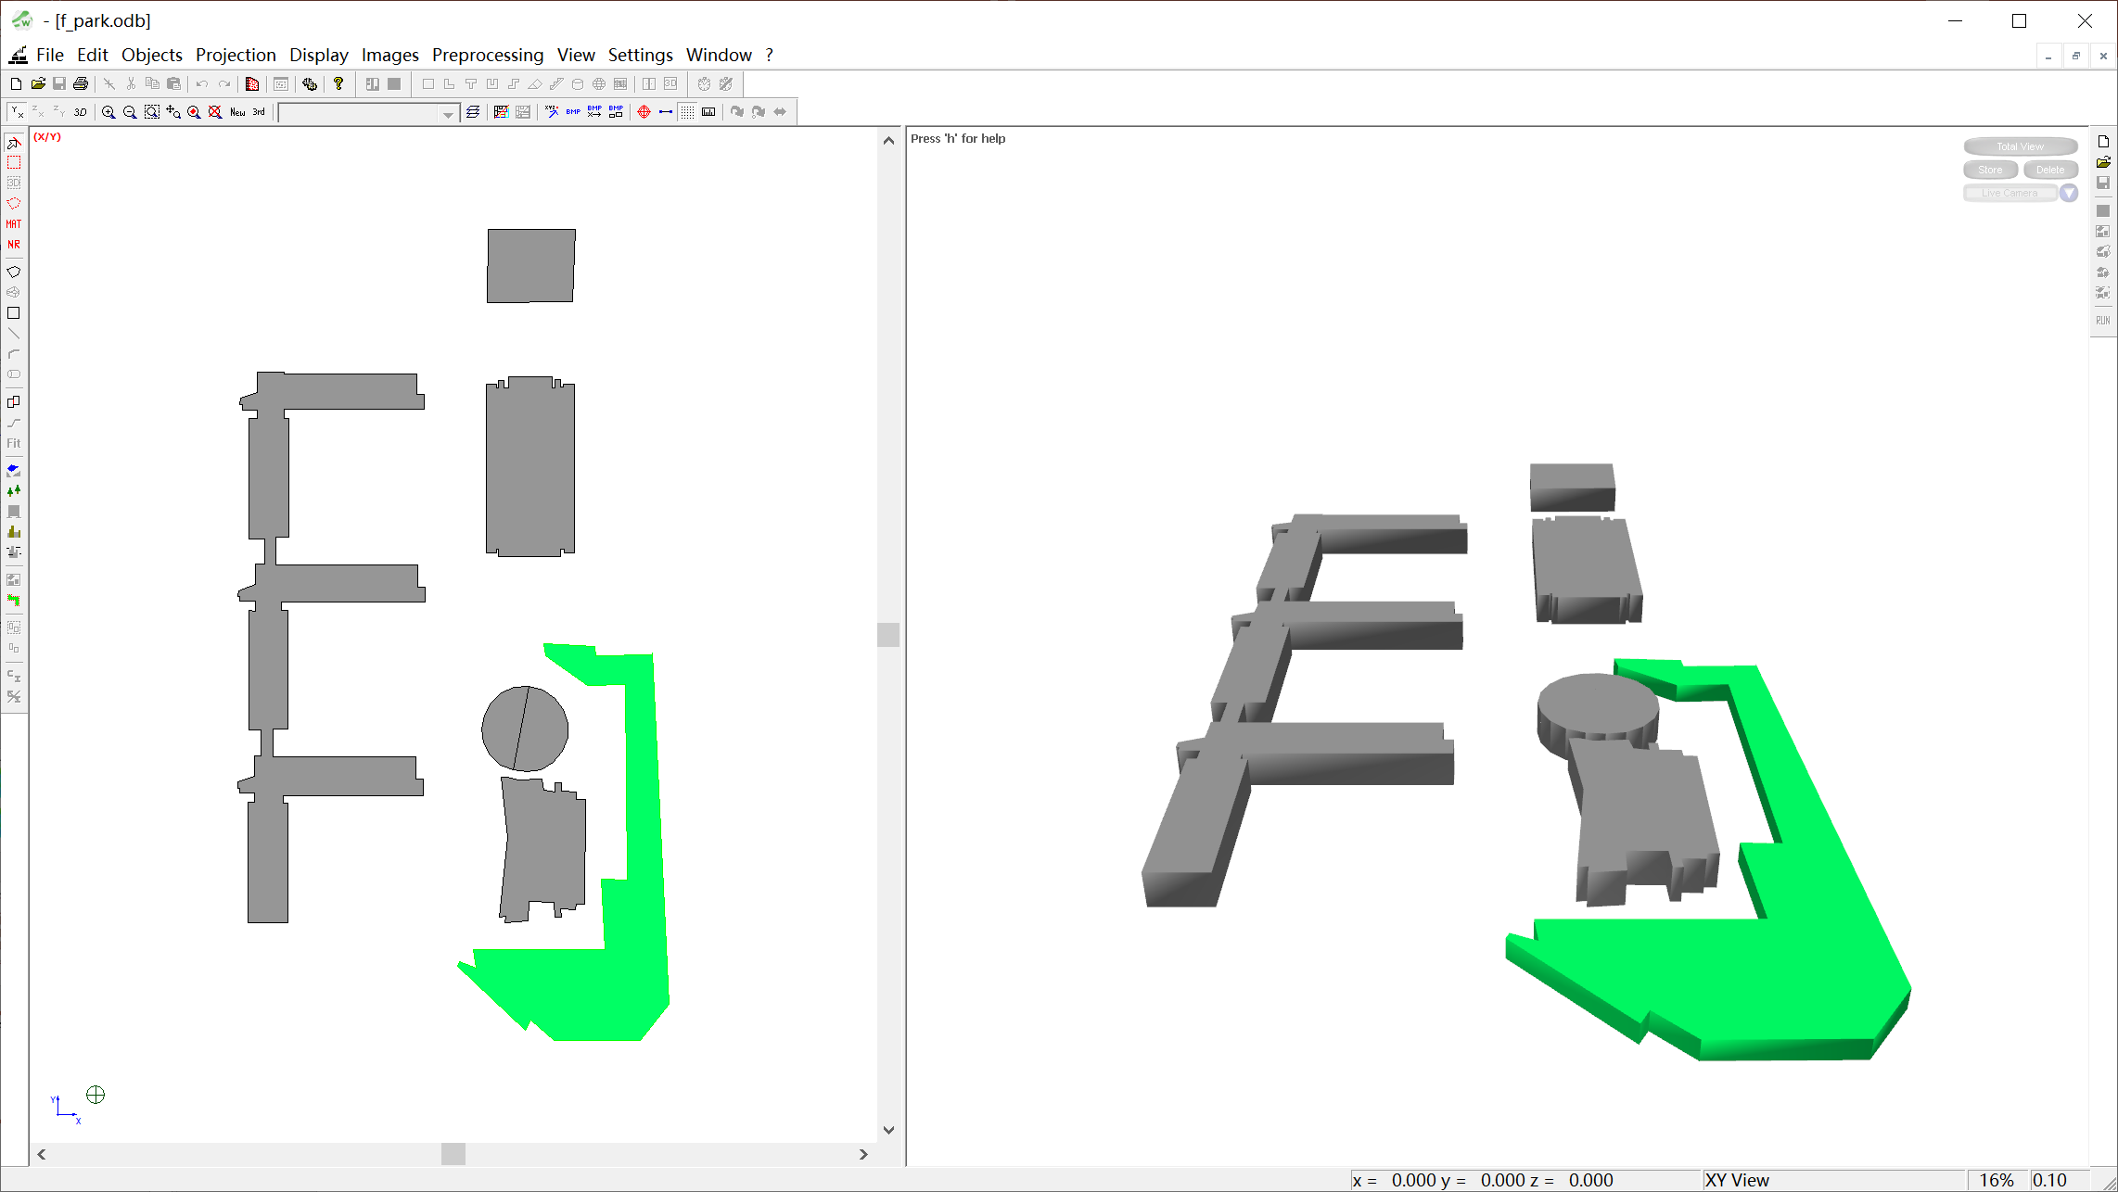
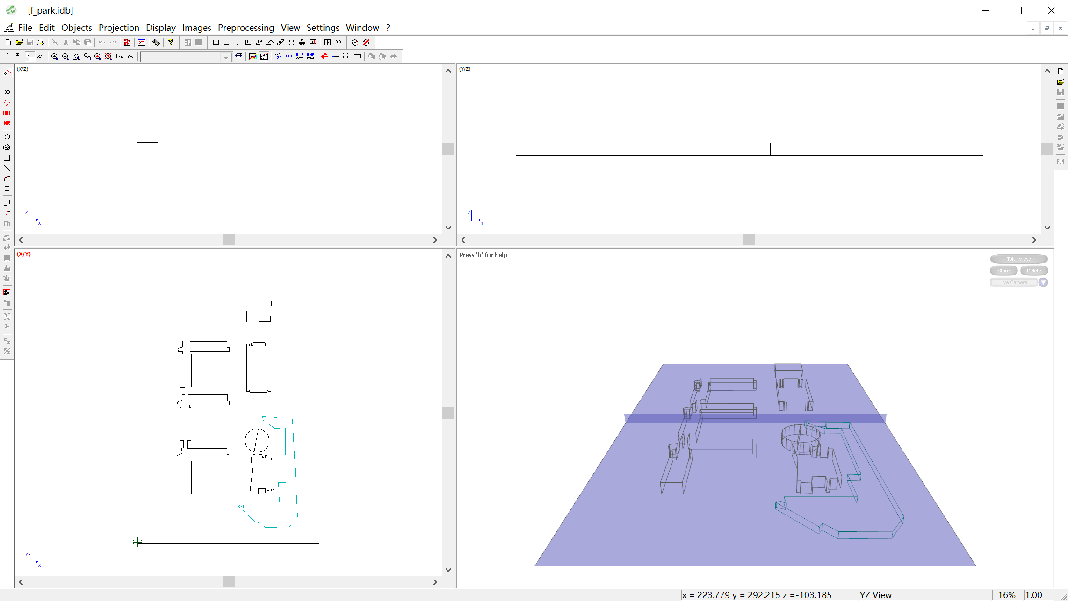

Simulation database: outdoor_trajectory.cpp
export
f_park.odb (outdoor database)
f_park.idb (indoor database)
preprocess
Three Ray-Tracing method:
DPM
f_park.odb
IRT
f_park.oib
SRT
f_park.idb
f_park.oib (preprocesed outdoor database)

Slide 10
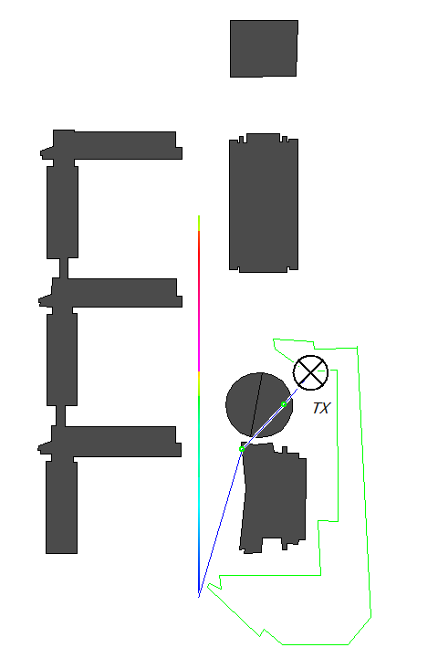
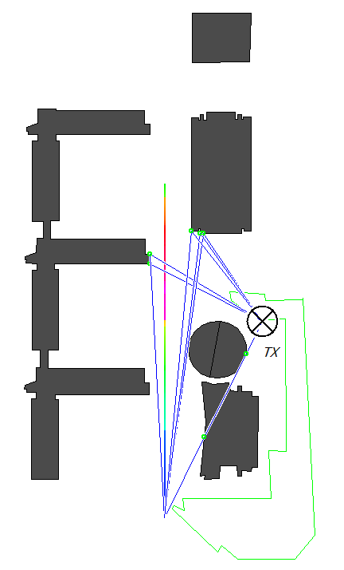
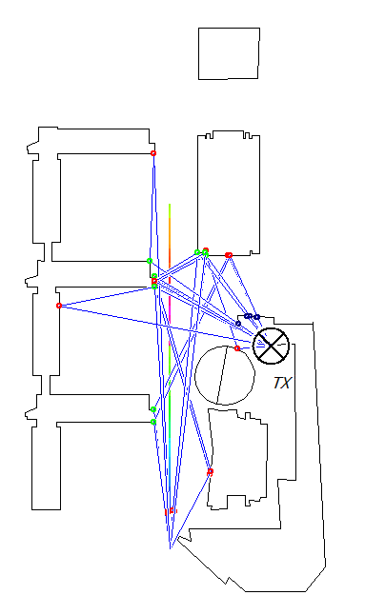
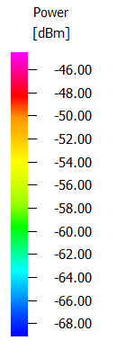
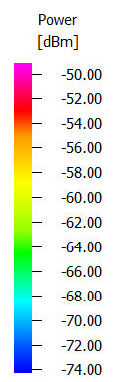
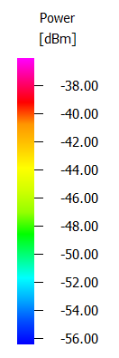
Result: outdoor_trajectory.cpp
RX moves from the South to the North with speed 10m/s.
DPM
(1 path predicted at start point)
IRT
(5 paths predicted at start point)
SRT
(19 paths predicted at start point)

Slide 11
Result: outdoor_trajectory.cpp (cont.)
Accuracy:
SRT > DPM > IRT.

Slide 12
Remaining problems.
Time-invariant scenario in outdoor (urban) database.
Winprop does not support time-invariant simulations in outdoor database.
Winprop just support trajectory simulations in outdoor database.
One possible alternative approach:
Treat the outdoor scenario as indoor.
Add directional antenna to RX.
Material settings.
Physical properties of materials in this project are defined at 2000 MHz.
It is required to calculate these physical properties again at 60 GHz.
Design specific indoor models for cars and working humans rather than using a simple box.

Slide 13
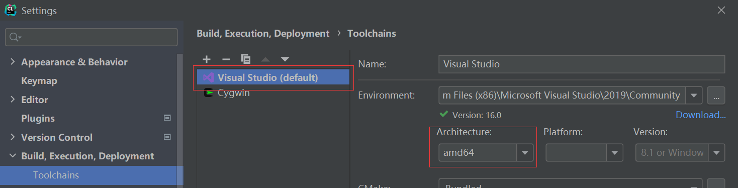
Appendix: C++ environment settings.
Do not use C++ environment in Linux or virtual machines. (can not compile winprop API)
Approach 1: install VS2019 directly. (Most straightforward but not recommended.)
poor portability: all the codes must be placed at a specific folder.
Use absolute path to include header files. (Not compatible with CMakeLists.txt.)
Approach 2: use VS2019 to set the Clion.
Download feko2021 or feko2020.
Download VS2019 and Download Clion.
Add “%FEKO_HOME%/bin” to system environment variable “path”.
% FEKO_HOME % refers to the installation path of feko.
In Clion, enter File -> Settings-> Build, Execution, Deployment -> Toolchains, top the VS environment,
Then select architecture with 64 bit.
Use CMakeLists.txt to build the project.

