Slide 1
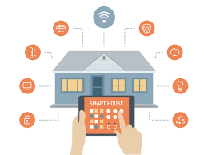
SMART HOME ENERGY MANAGEMENT SYSTEM
Presented By:
Team2
Team Lead - Jayanth
Technical Lead - Kavya
Developer Core- Dibya
Developer Supporting – Mounika
Tester/Quality Analyst – Swetha

Slide 2
The Smart Home Energy Management System addresses the growing challenge of rising energy consumption and inefficient resource utilization within modern households. As homes become increasingly equipped with electronic appliances and smart devices, monitoring and controlling overall power usage manually becomes complex and impractical.
The Smart Home Energy Management System is an intelligent Java-based solution engineered to enhance residential energy efficiency through automated control and data-driven decision-making.
The platform enables real-time monitoring of power usage, predictive appliance scheduling, and optimized resource utilization.
By integrating smart automation with user-centric insights, the system supports sustainable living while reducing operational energy costs.

Slide 3
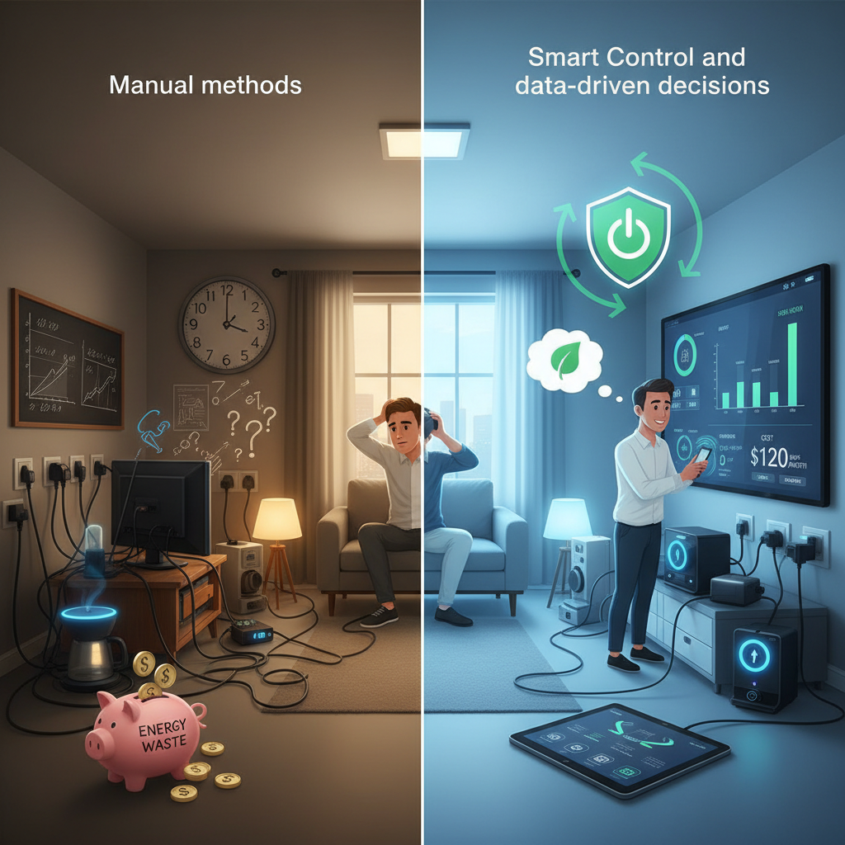
Existing Framework
Most households rely on manual control for operating electrical appliances.
Users have limited visibility into energy usage, including peak consumption times and appliance-wise breakdown.
Automation capabilities such as scheduling, load shifting, and energy optimization are generally unavailable.
Energy wastage occurs due to inefficient appliance usage or devices being left switched on.
Remote monitoring and smart control features are absent in traditional home energy systems.
Energy management decisions are reactive and user-driven, lacking data-driven or automated intelligence.

Slide 4
Solution Overview:
A Java-based Smart Home Energy Management System designed to optimize energy usage, automate device control, and provide intelligent consumption insights.
Functional Modules:
Authentication & Role Management🔐
Secure login and role-based access control.
Differentiated permissions for admin and user roles.
Device Management⚙️
Add, remove, and configure smart home devices.

Slide 5
Real-Time Energy Tracking📊
Live monitoring of appliance-level power consumption.
Analytics Dashboard📈
Visual reports, trends, and consumption summaries.
Data-driven insights to support energy optimization
Scheduling & Automation⏱
Smart rules based on time, usage patterns, or energy goals.

Slide 6
Tech Stack
Front End:Html/CSS/Bootstrap
Back End:
  Java 17 or higher →Stable version
  Spring Boot →Auto configures project and helps to build REST API
  JDBC → Connects java to database
  Hibernate → for ORM
  REST API → Enables easy communication
Data Base:
  MySql → table format and structured
IDE: IntelliJ

Slide 7
Four layer Approach
Controller Layer handles HTTP requests and user interactions.
Service Layer contains business logic and energy management rules.
Repository Layer manages database operations and data persistence.
Base Layer(Model) contains core entity and DAO classes that directly interact with the database.
Ex: Authcontroller
AuthService
AuthRepository
User classes……..

Slide 8
Authentication and Role Management
Smart Device Management
Energy Tracking
Analytics Dashboard
Scheduling and Automation
User Authentication
Role-Based Access Control
Forgot Password & Security Handling
OWNER / ADMIN: Full system access
GUEST: Limited Access
OWNER or ADMIN registers devices to their home.
Restricted access for GUEST users
Device controls based on roles
All actions are logged for energy tracking.
Timestamped usage logs
Current Device status
Device powerratings are used for reports
Viewed via dashboard
Energy consumption data is collected and stored with timestamps for accurate tracking.
Reports are available for download in CSV format.
The system allows users to define schedules for turning devices ON or OFF.
Rule-based automation reduces energy wastage by preventing unnecessary device operation.

Slide 9
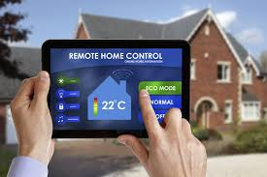
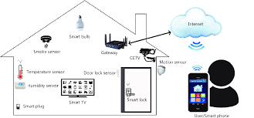
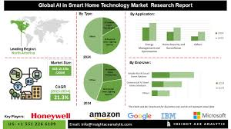
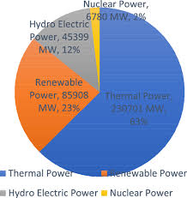
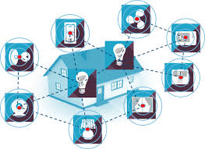
Real-World Scenarios:
Smart Home Energy Management is used in scenarios like:
Devices like water heaters or air conditioners can be scheduled to turn OFF automatically when not in use.
Lights and fans can be auto-disabled during daytime or when occupants are away.
Appliance-wise bar charts reveal energy-hungry devices, enabling users to take corrective action.
Automation minimizes human dependency, preventing energy wastage due to forgotten appliances

Slide 10
Advantages
Ensures secure access using JWT-based authentication.
Maintains accurate device state (ON/OFF) in real time.
Allows users to add and control smart devices easily.
Supports centralized control of all household appliances.
Modular and scalable four-layer architecture.
Secure, maintainable, and extensible system design.
Provides role-based authorization (OWNER, ADMIN, GUEST, MAINTENANCE WORKER)
Ready for future enhancements like IoT integration or AI-based optimization
Reduces manual effort and human dependency.

Slide 11
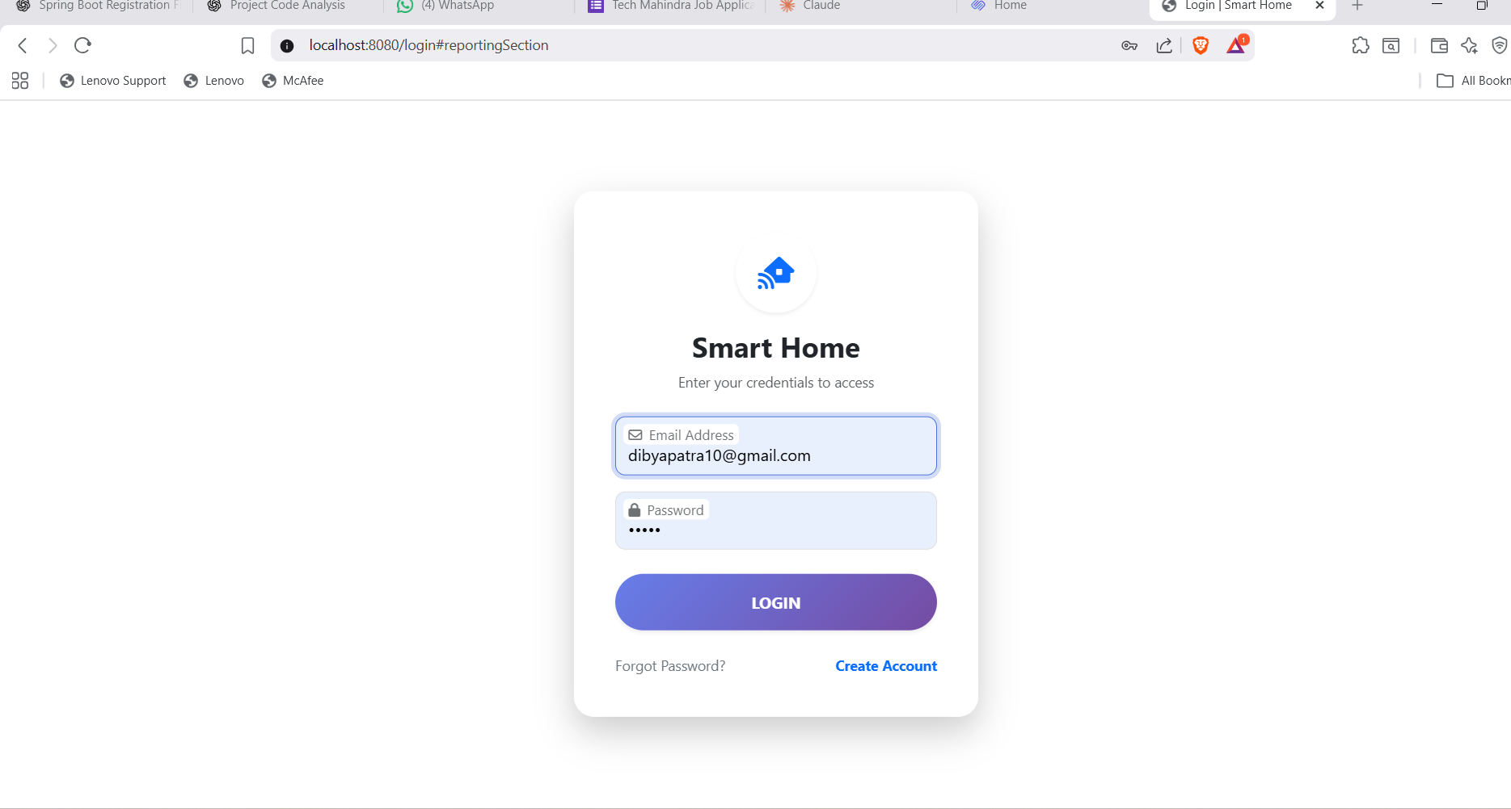
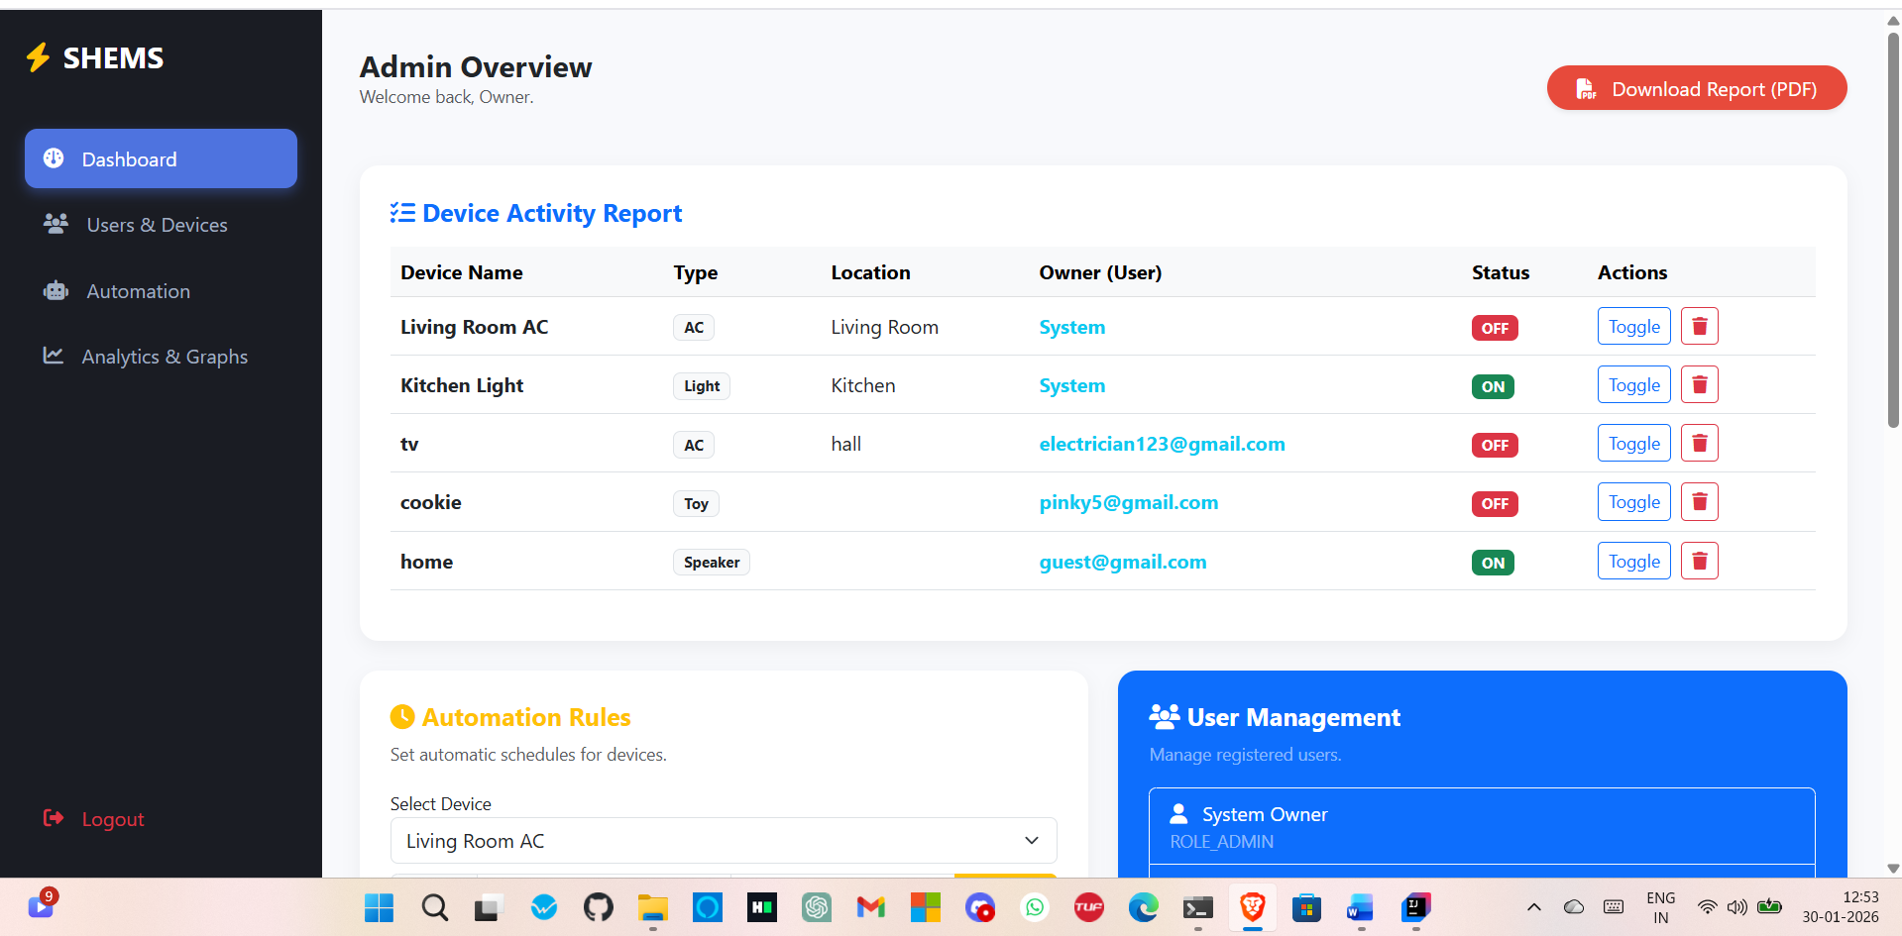
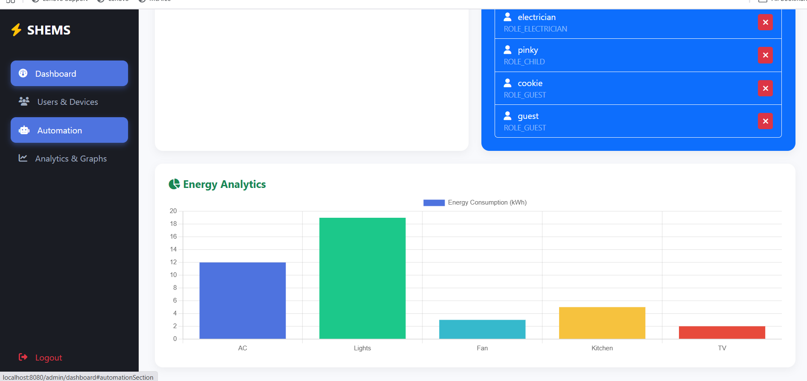
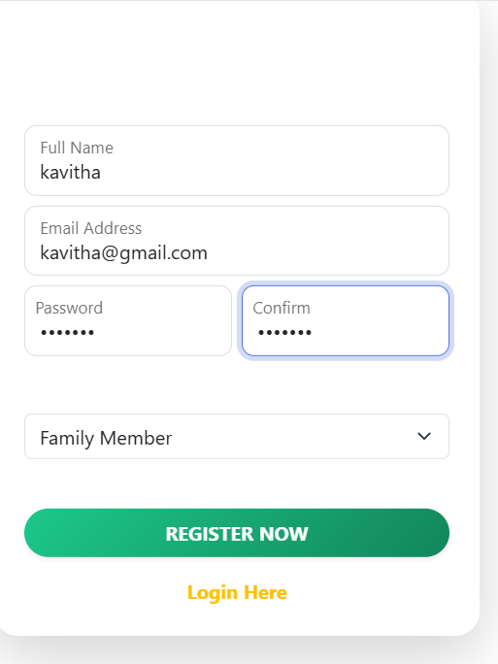
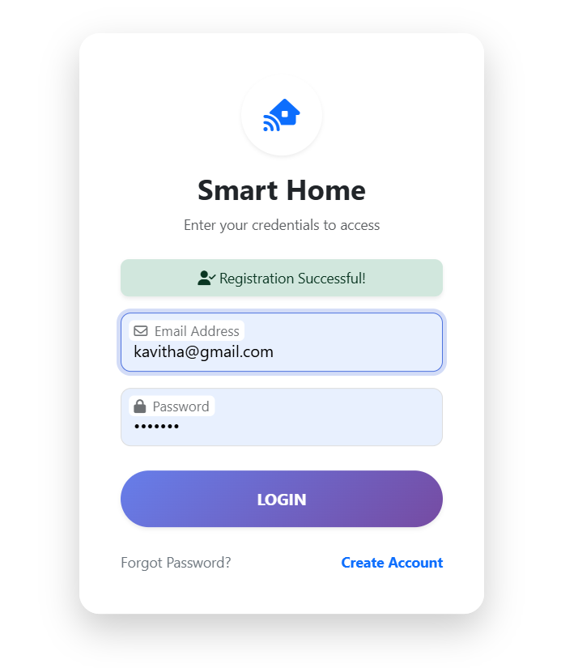
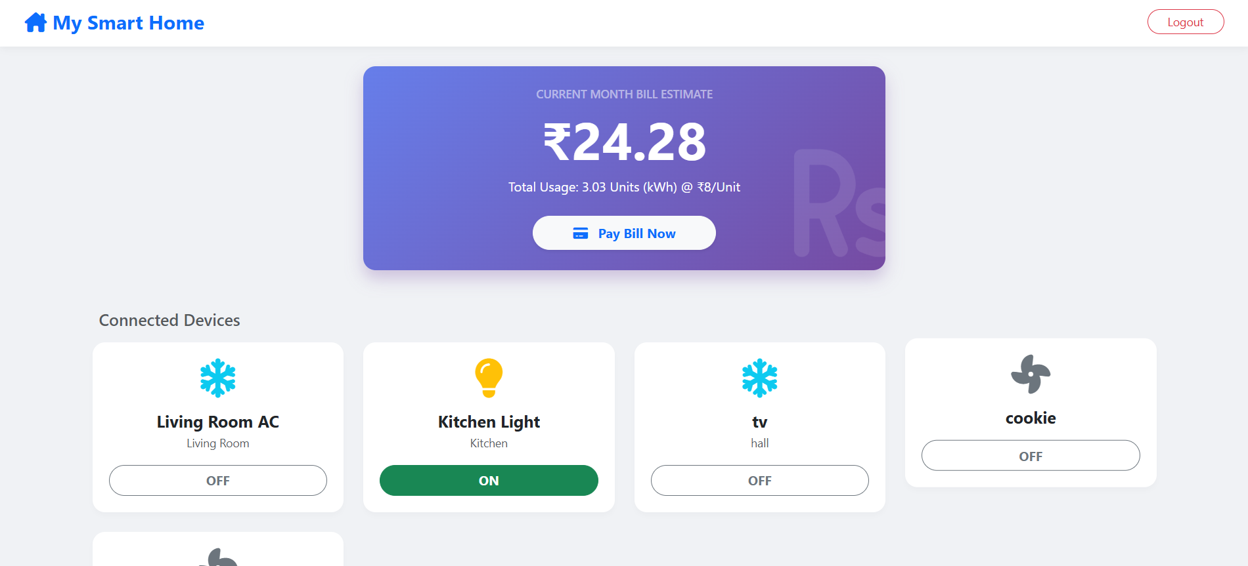

Slide 12
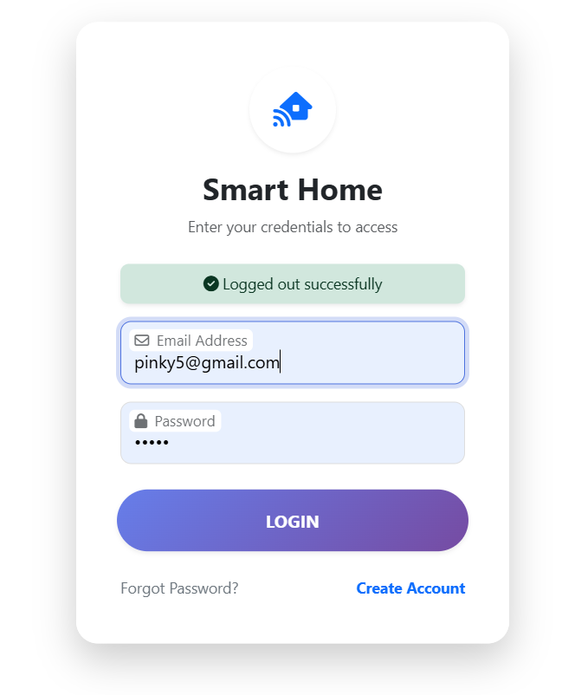
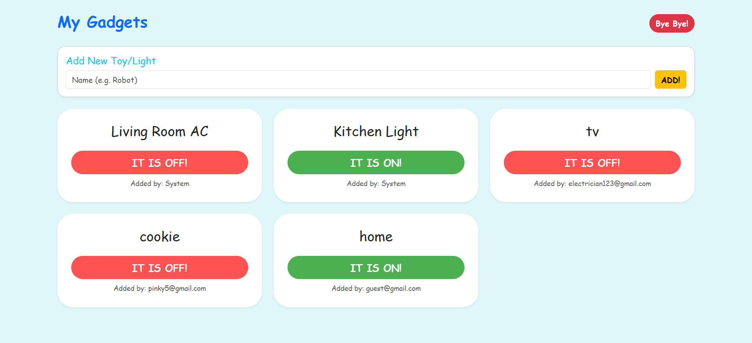
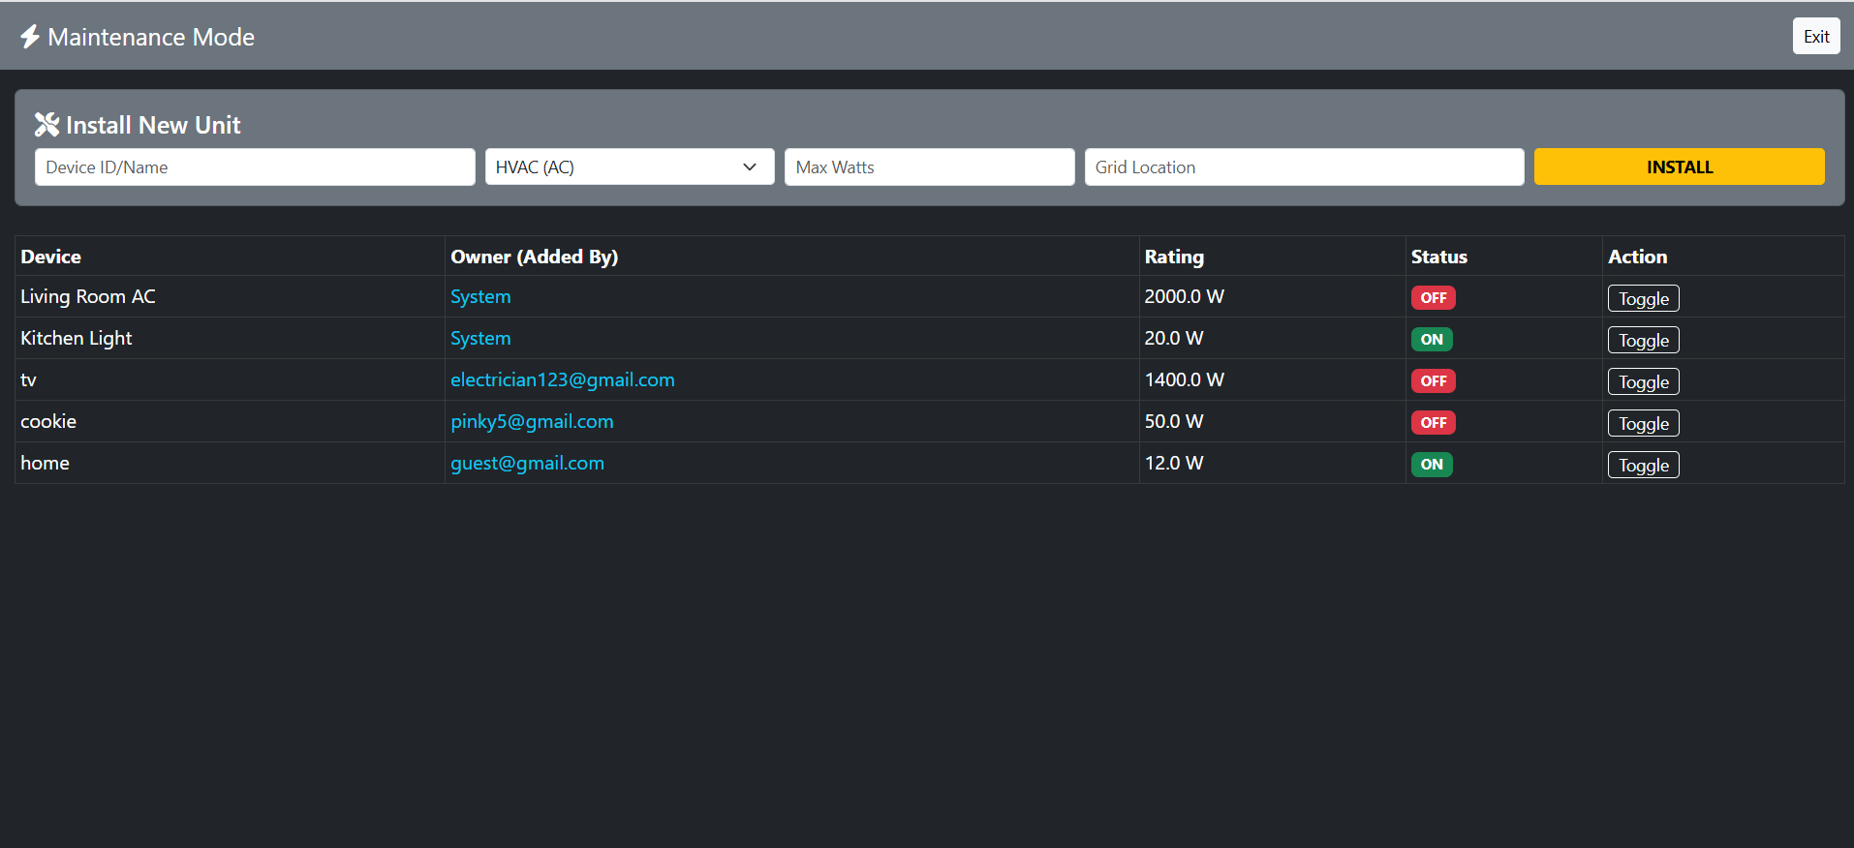

Slide 13
Conclusion
The Smart Home Energy Management System (SHEMS) provides a secure, intelligent, and automated approach to managing household energy consumption. By integrating role-based authentication, real-time energy tracking, analytics, and scheduling, the system transforms traditional manual energy control into a data-driven and efficient process.
Its modular architecture ensures scalability, maintainability, and future readiness, while automation and insights help reduce energy wastage, lower costs, and promote sustainable energy usage. Overall, SHEMS delivers a reliable and practical solution for modern smart home energy management.
Thank You

