Slide 1

Overview of Amudar.IO Projects
“Amudario Research” LLC
Contact details:
+998-97-3441136
Email: info@amudar.io
Web: amudar.io

Slide 2
Agenda
Our company – Amudar.IO Research
Our solutions in ecology
Use of weather stations in agriculture
Irrigation and land management
Plant protection from pests and diseases
Meteograms for tillage, spraying and sowing
Weather forecast for agricultural needs
Risk assessment based on historical records

Slide 3

What is Amudar.IO?
Amudar.IO was founded by three professors from Inha University in 2020 to help farmers in fighting pests using weather stations
Produced solutions in AgriTech and EcoTech:
Oxus-WS - agrometeorological stations
JayhunTrap – smart pheromone trap
GozanLink – greenhouse monitoring system
AirSense - air quality monitoring system

Slide 4
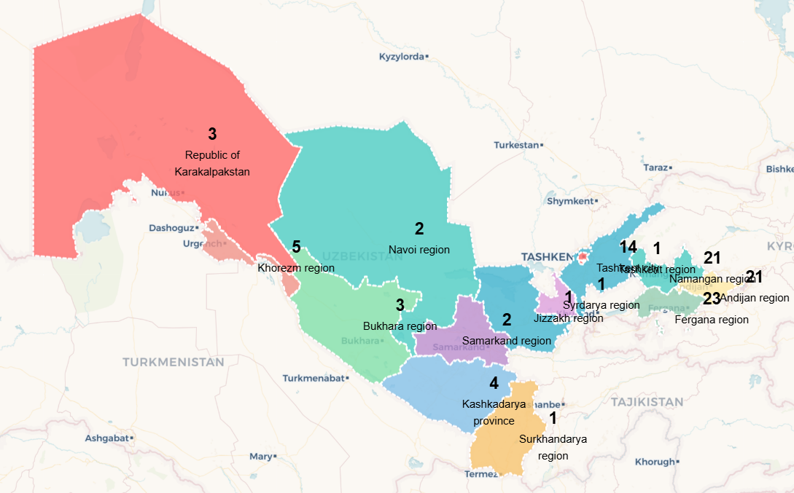
110+ weather stations across Uzbekistan
Solar powered, autonomous stations deployed nationwide since 2021 - largest agricultural monitoring network in Uzbekistan
Real-time monitoring of 8+ parameters with AI-powered pest/disease forecasting
Training programs provided to 100+ farmers and agricultural specialists
Crop loss prevention and reduction in pesticide use for farmers
Water conservation up to 30% irrigation water savings through precision scheduling

Slide 5














15+ successful joint projects
International Development Partners:
UNDP Projects - 55 agrometeorological stations + 12 smart pheromone traps deployed across Fergana Valley for climate resilience
IWMI Collaboration - 3 stations installed in Khorezm, Karakalpakstan, and Kazakhstan for transboundary water management
IFAD Partnership - 3 stations deployed in Andijan, Namangan, and Fergana for modern irrigation water management on 300 hectares
ICARDA Project - 4 soil monitoring stations with 48 sensors each for comprehensive soil analysis and research
Academic and Community Partners:
TIIAME University - 3 stations for soil monitoring in Tashkent, Khorezm, Bukhara, Karakalpakstan
Irrigators School – 12 stations with farmer training programs for sustainable water management practices
New Uzbekistan University – A professional weather station for promoting climate change research
Samarkand Marathon - Portable air quality monitoring for sports events across multiple cities

Slide 6
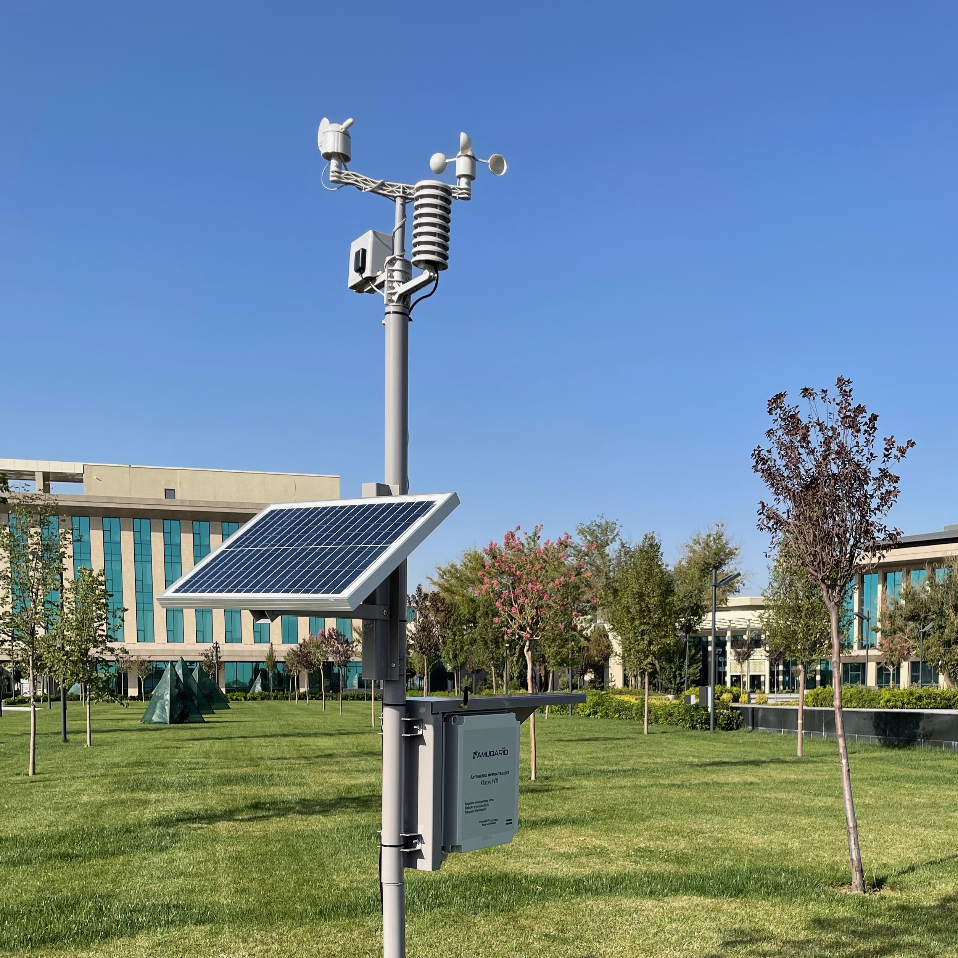
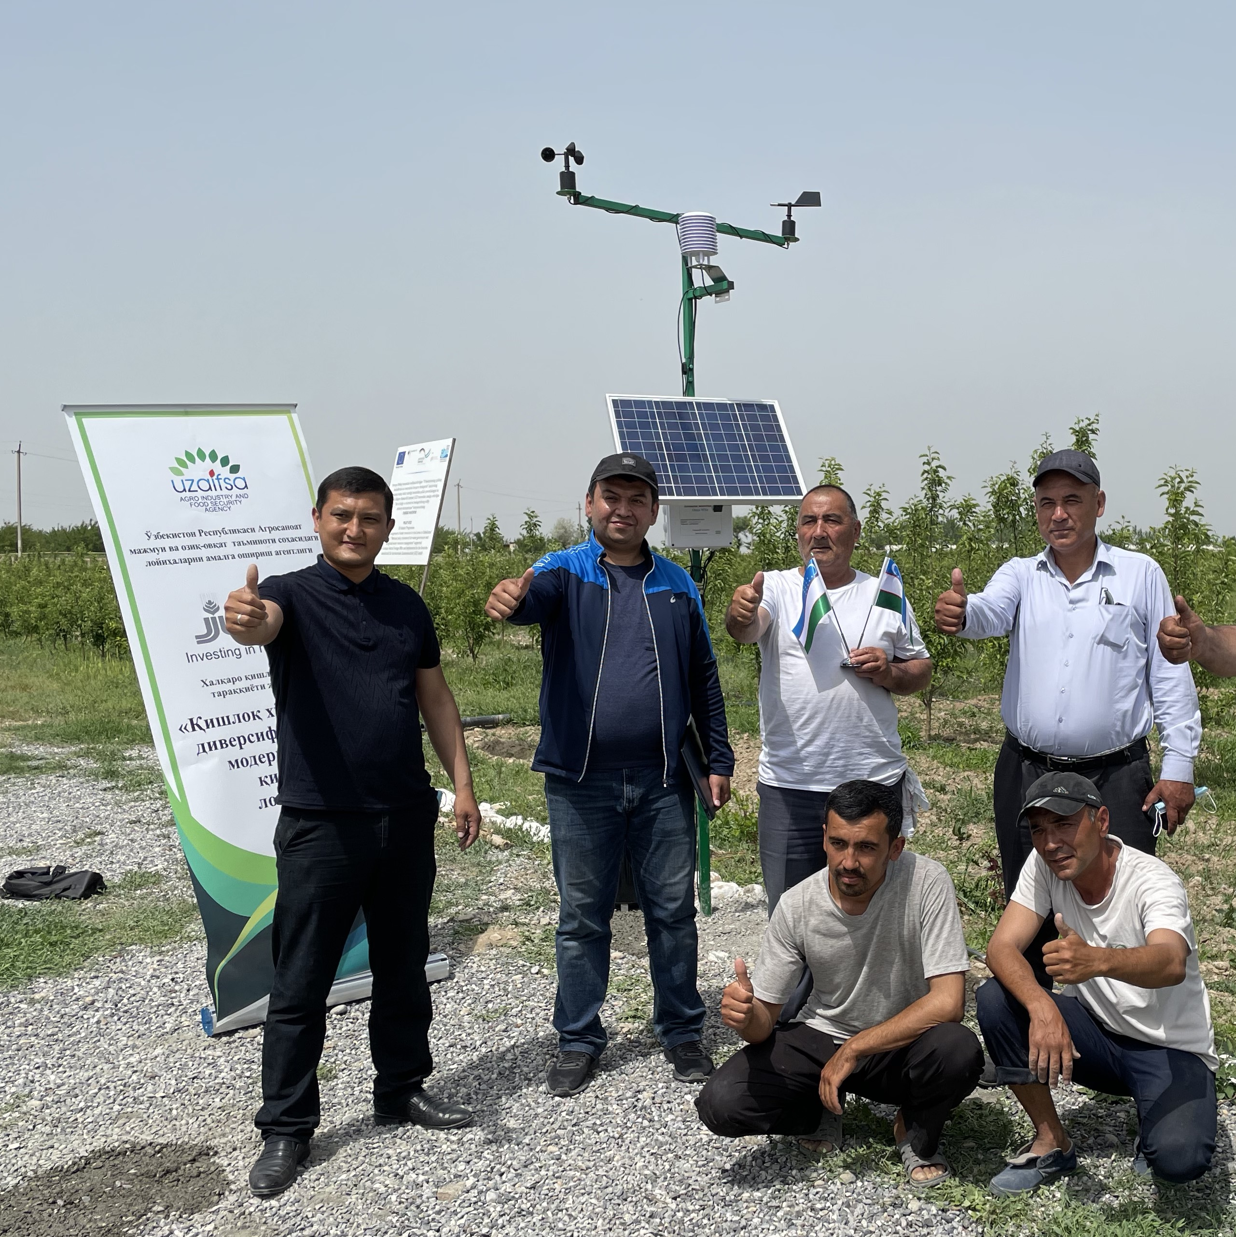
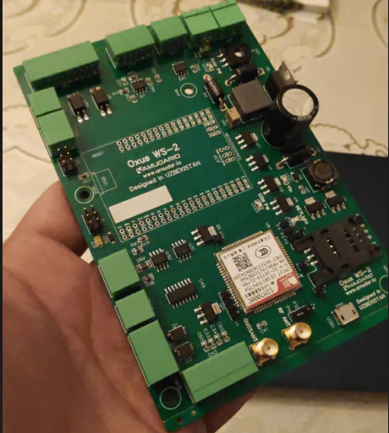
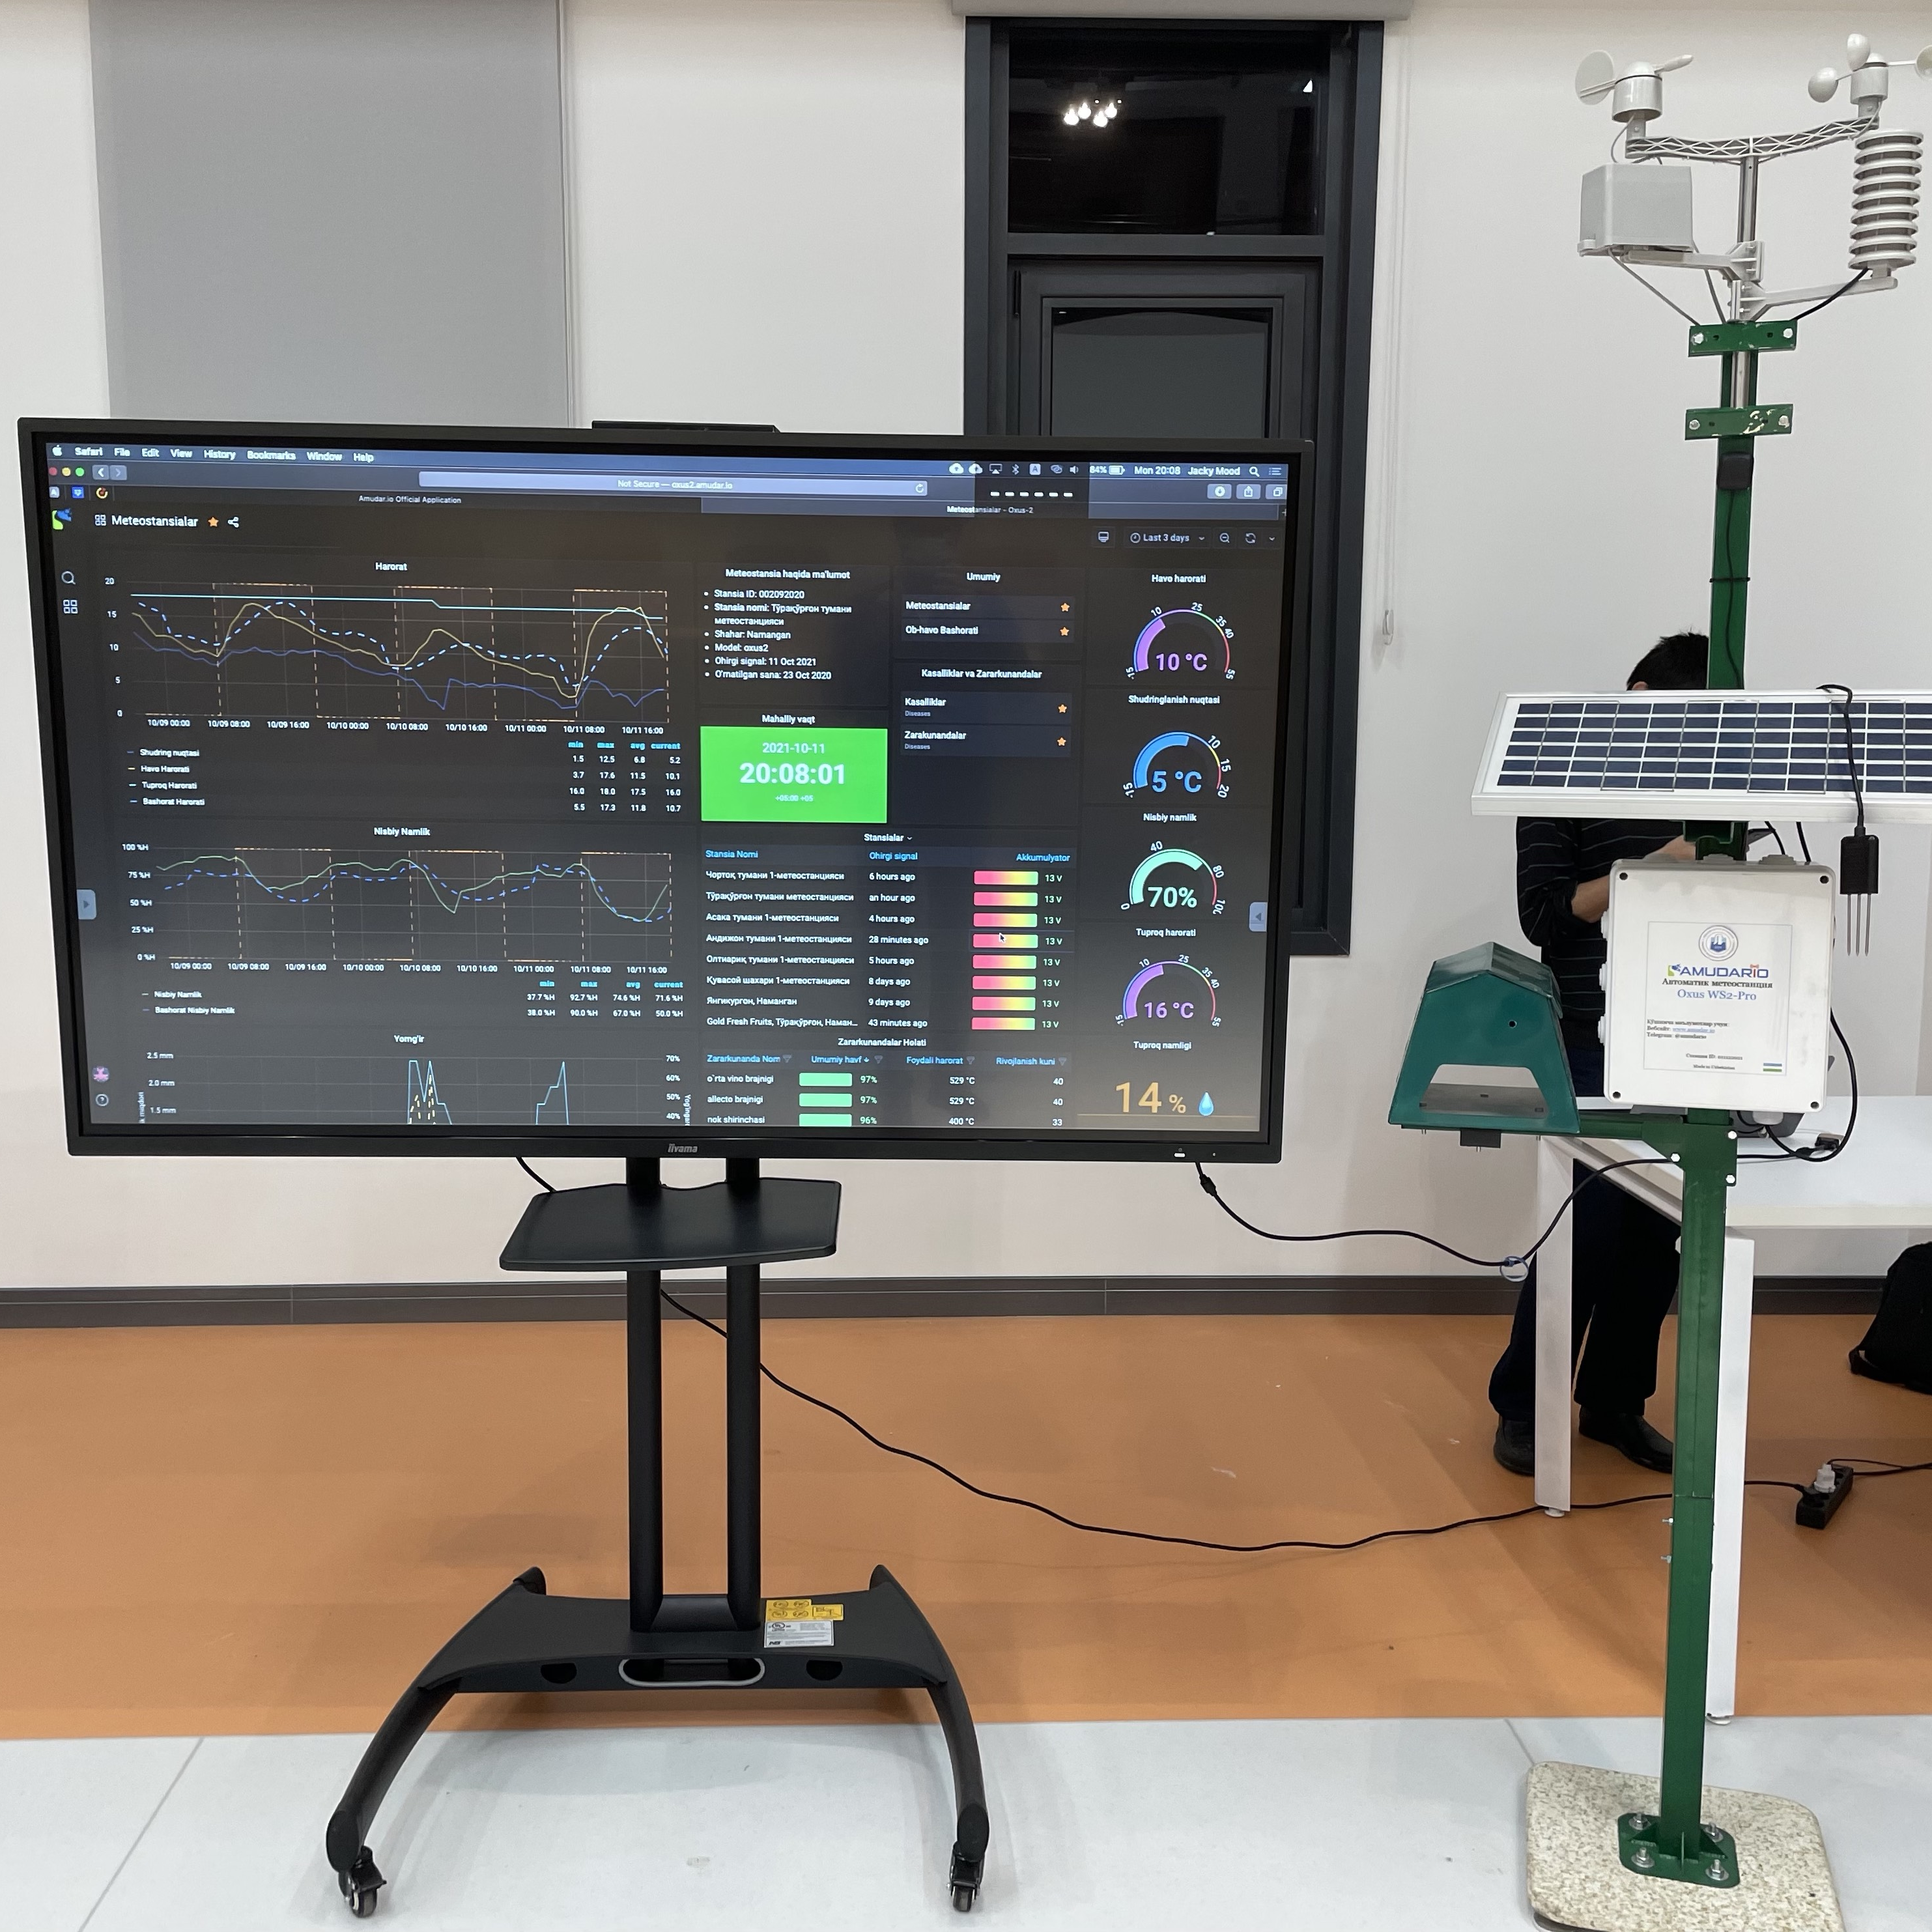
Designed and serviced in Uzbekistan
50% cost reduction compared to imported alternatives - from $2,300 to $1,300 per station
24/7 local technical support - immediate response and technical maintenance
Local pest database - 30+ diseases and pests specific to Uzbekistan agriculture
Uzbek language interface - accessible to local farmers without language barriers
Local job creation - 8+ skilled positions in engineering, programming, and agronomy enabling technology transfer

Slide 7
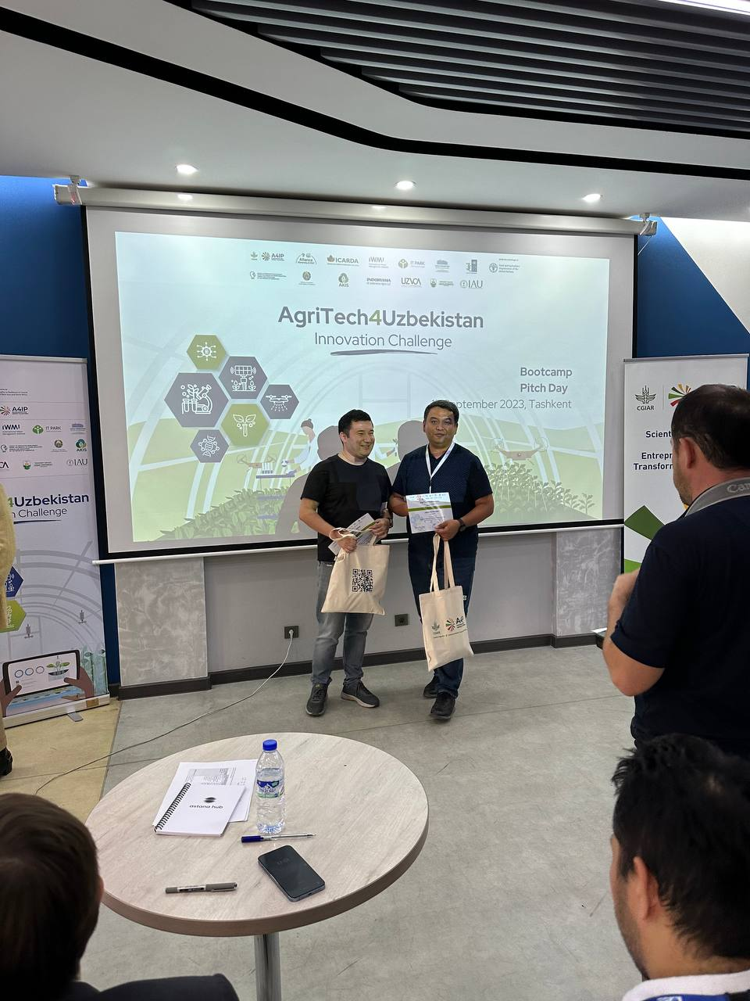
Winner of CGIAR’s AgriTech4Uzb
Selected as winner from 571 international applications spanning 78 countries competing for agricultural innovation in Central Asia
$15K equity-free grant - Awarded top prize for demonstrating sustainable business model, scaling plan, and strong connection with CGIAR science
Advanced through 3-month acceleration program

Slide 8
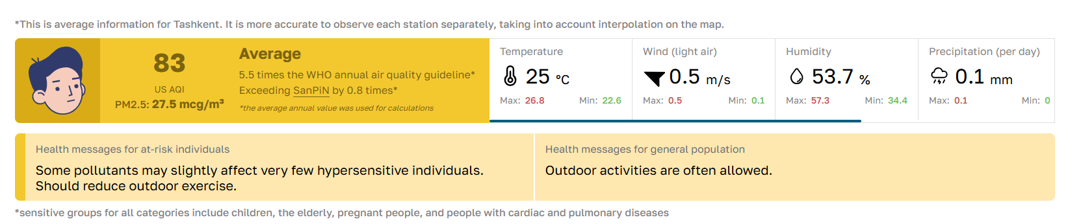
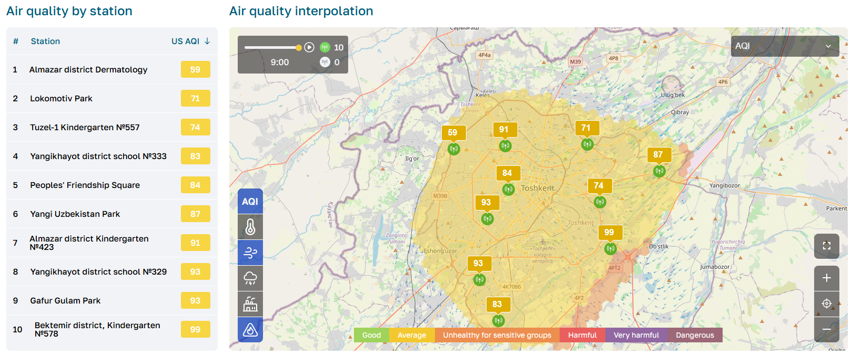
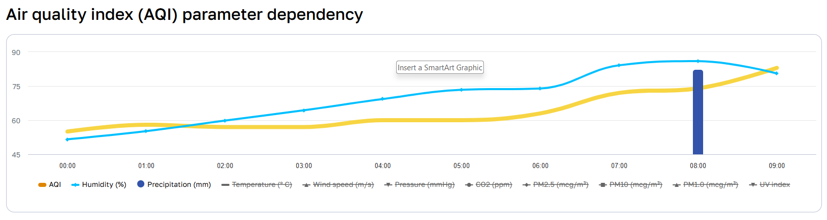
10 air quality monitoring stations on Air Tashkent Portal
air.tashkent.uz launched in 2022 by Tashkent Digital Development department providing real-time air quality monitoring for all citizens
It tracks PM1, PM2.5, PM10, CO2, meteorological data, plus registered fires and heating center locations affecting air quality
Continuously maintained by Amudar.IO for over 3 years

Slide 9
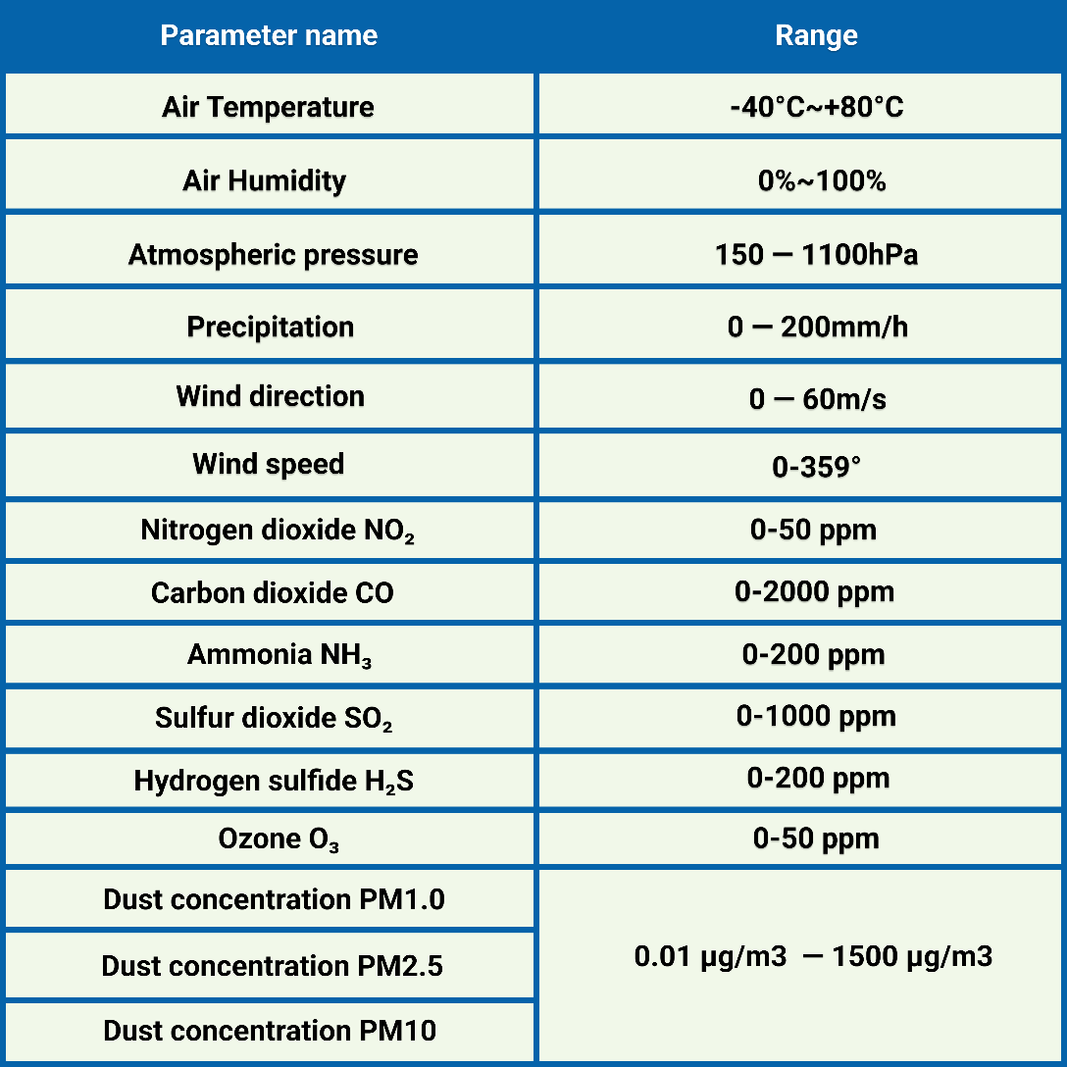
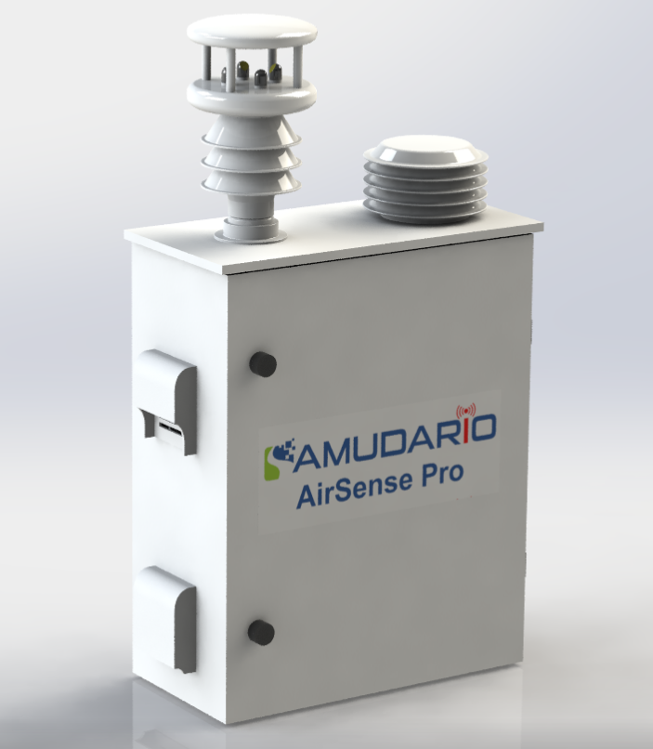
AirSense – air quality monitoring station

Slide 10
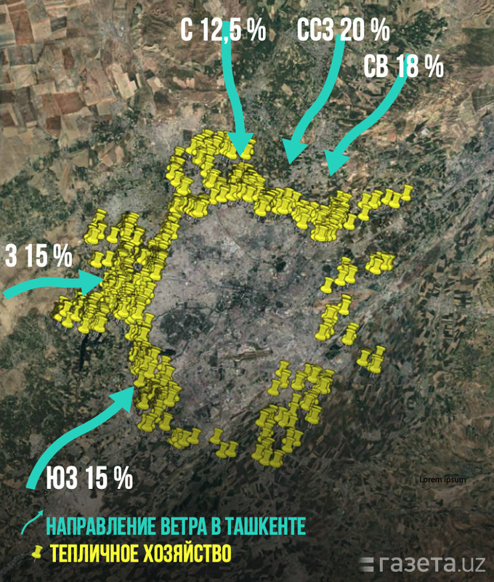
Coal-burning greenhouses are major air pollutants around Tashkent
631 greenhouses operating on 1,314 hectares around Tashkent, with 60% using coal as primary heating source, creating a "gray ring" instead of "green ring“
Greenhouse numbers increased 2.5x in past 5 years while coal consumption rose 22%
from 6.8 million tons in 2018
to 8.3+ million tons in 2022
Mass transition from gas to coal heating done without installing proper air filtration or energy saving systems

Slide 11
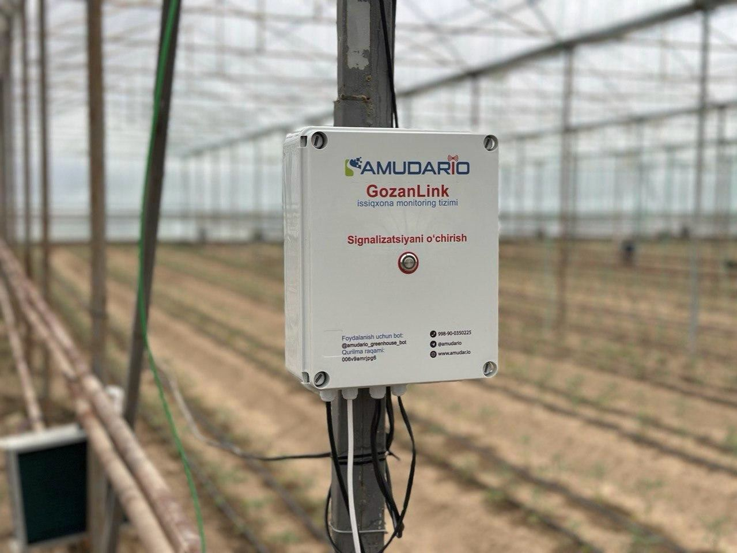
GozanLink – greenhouse monitoring system
Comprehensive greenhouse climate monitoring system
Combines indoor/outdoor climate sensors, soil monitoring, and energy usage tracking through mobile/web apps and on-site dashboard.
Reduces energy consumption by 18-30% through smart scheduling of the burner
Continuously informs the owner about emergency cases
Temperature drops and frosts
Humidity spikes
Strong winds
Power outages
Provides remote controlled alarm service for managing greenhouse personnel

Slide 12
Use of weather stations in agriculture

Slide 13




Key Issues of Agriculture in Uzbekistan
Climate change
Crop yield decline
Pests and diseases
Soil and water management
Quarantine checks in export
Weather data remains largely analog and inaccessible to farmers for decision-making
Unpredictable temperature and precipitation patterns threaten crop planning and yields
Farmers react to outbreaks instead of preventing them through early detection
Lack of real-time monitoring results in 60-80% crop damage before treatment begins
Excessive pesticide use prevents access to premium international markets
Residue testing failures block organic certification and higher-value exports
Salt accumulation and soil degradation go undetected without proper sensors
Irrigation scheduling relies on guesswork rather than actual soil moisture data
Inefficient water and fertilizer management leads to 20-30% productivity losses
Outdated farming practices fail to optimize resource allocation across growing seasons

Slide 14
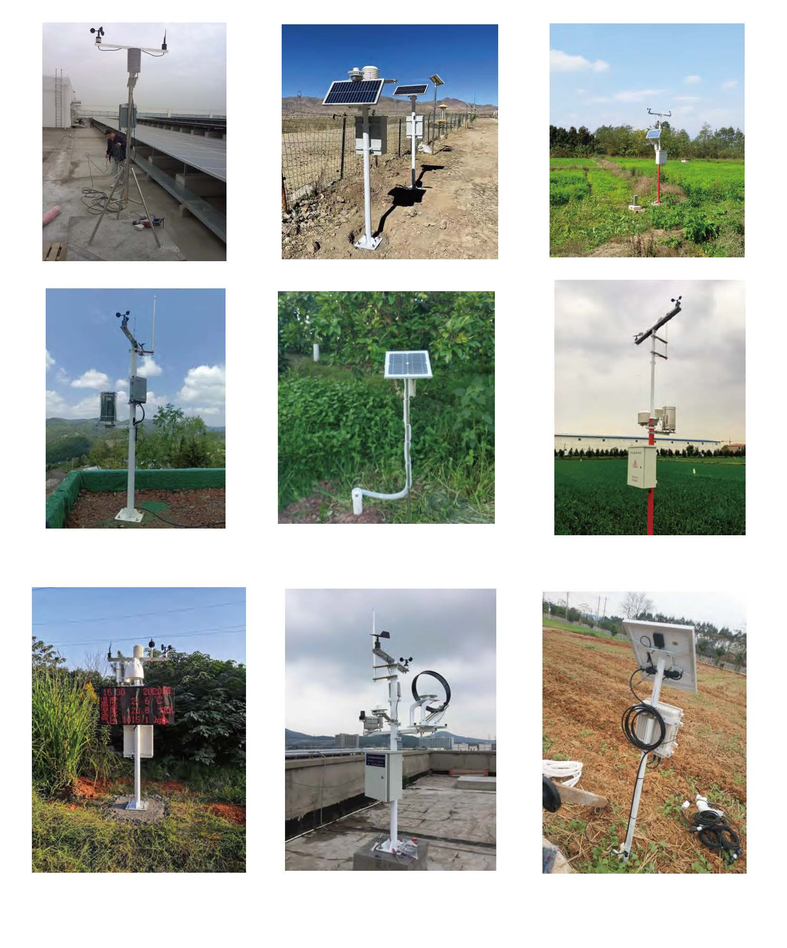
Why weather stations?
Irrigation systems
Greenhouse management
Prevention of pest spread
Disease prevention
Monitoring plant development
Field work planning
Farm management
Agrologistics

Slide 15
Economic benefits of weather stations
Impact on productivity
Increase crop yield by 15-30%
Reduce crop losses by 20-40%
Resource efficiency
Reduce water consumption by 20-30%
Increase fertilizer efficiency by 15-25%
Reduce labor costs by 10-20%
Expected savings per annum per hec:
Water savings: $500-1,500
Crop preservation: $2,000-5,000
Labor savings: $1,000-2,000
ROI – 1-2 years
Initial costs
Installation fee: $2,000-5,000
Yearly maintenance: $200-500
Coverage
Accuracy level: 95-98%
Coverage area: 10-50 hectares
Battery life: 1-2 years

Slide 16
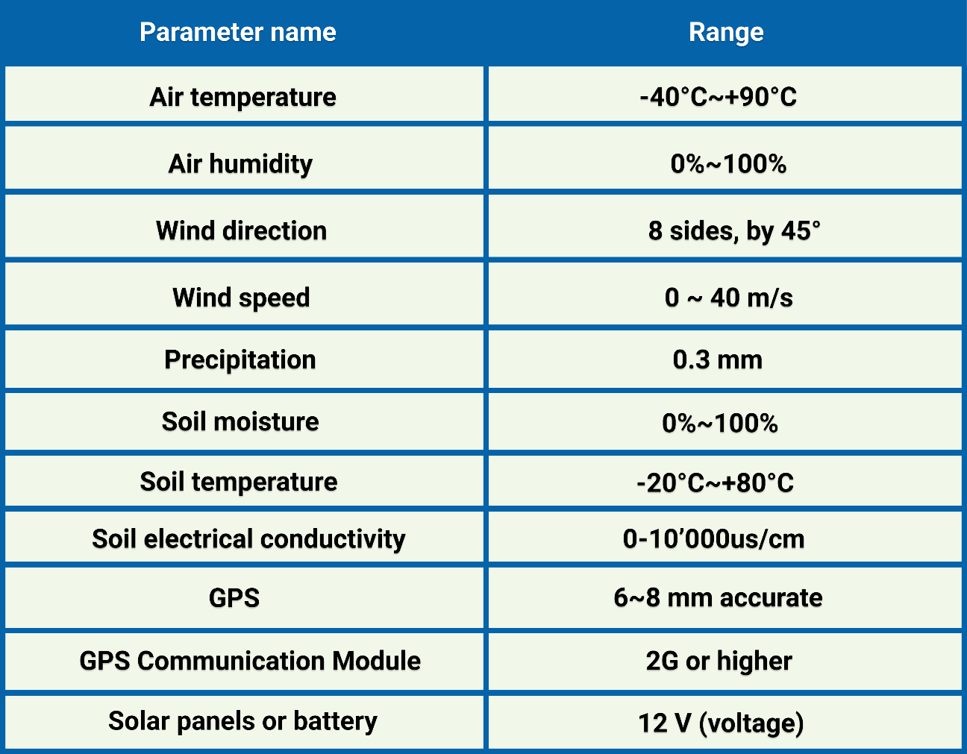
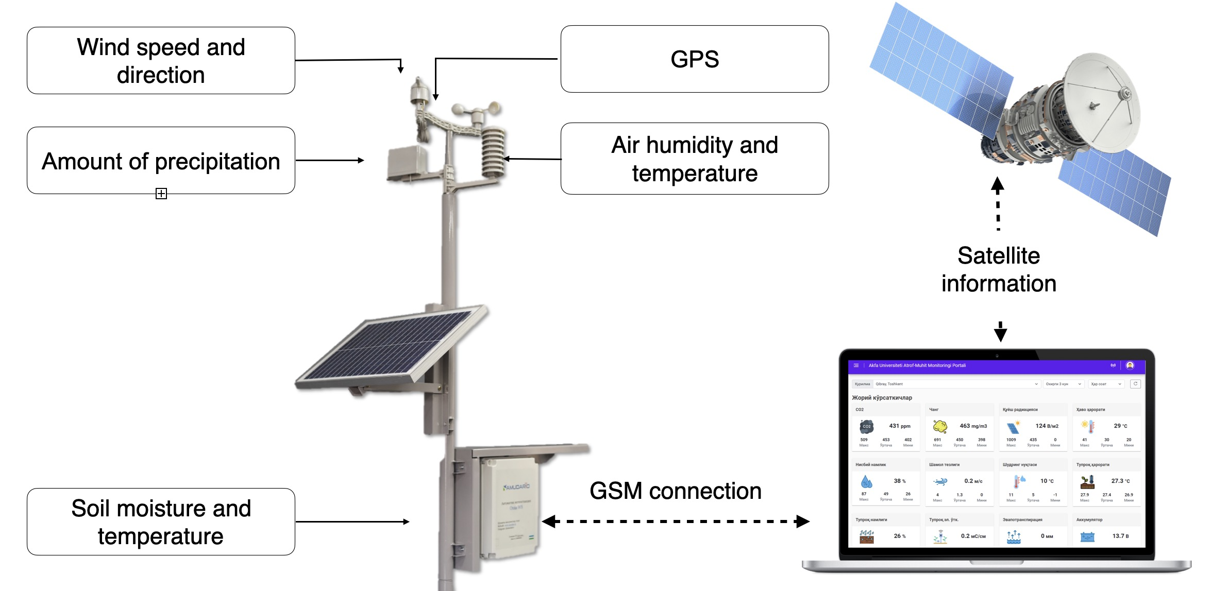
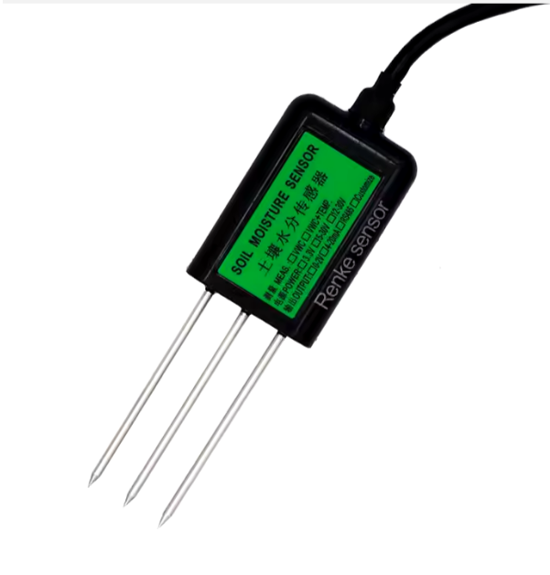
Oxus-WS Weather Station

Slide 17
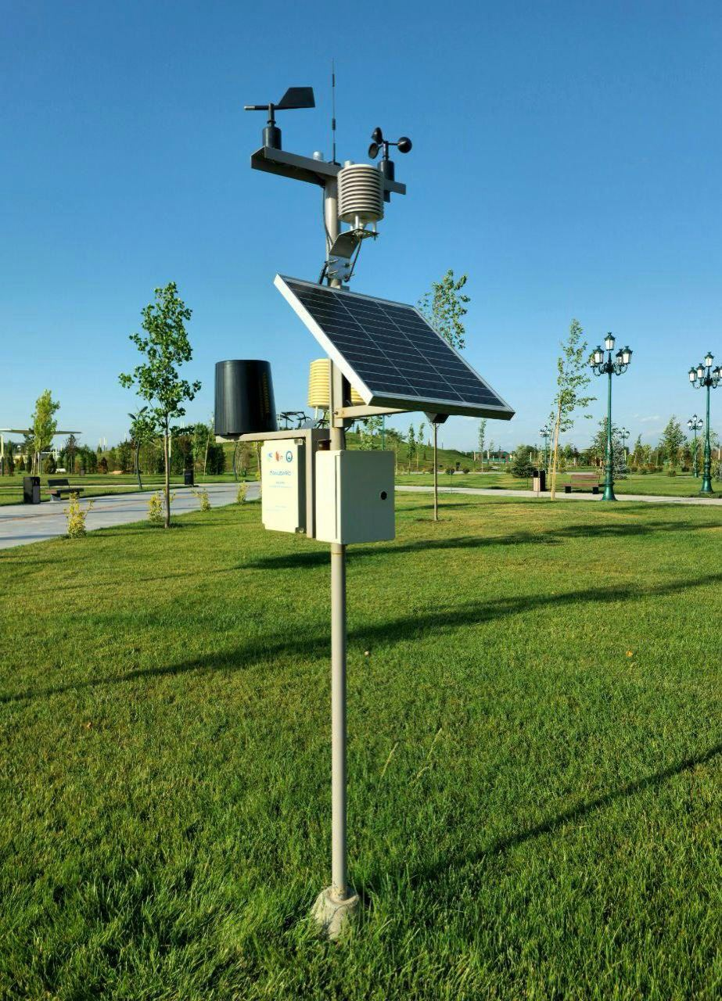
Key Features of Oxus-WS
Real-time data transmission
Uses GSM/GPRS network to automatically upload data to cloud servers for instant access from any location
Web-based monitoring platform
Accessible on any device with historical data, charts, and weather forecasts
Agricultural optimization features
30+ pest/disease risk alerts
Irrigation schedule for cotton and wheat
Spraying and sowing recommendations
Soil trafficability for tillage
Historical and forecasted data for risk assessment
Autonomous solar-powered operation
Fully self-sufficient with solar panel and battery backup, designed for remote agricultural locations without grid power and harsh climate

Slide 18
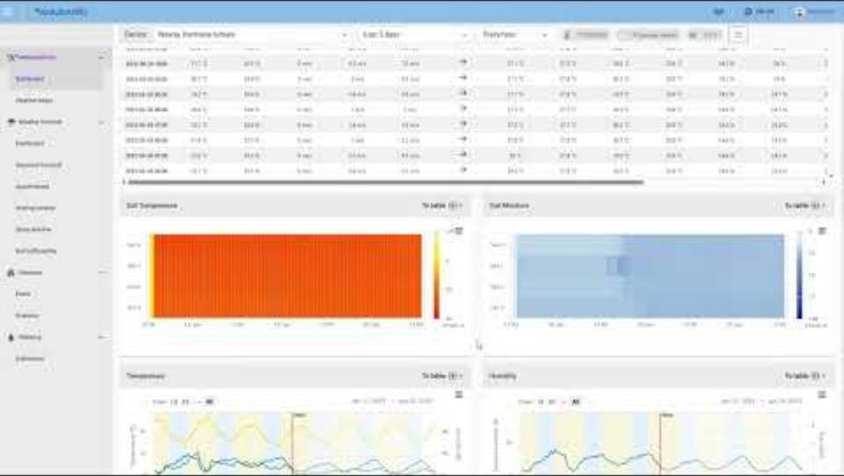
Glimpse into main dashboard
https://youtu.be/UrKmH4DhuYk

Slide 19
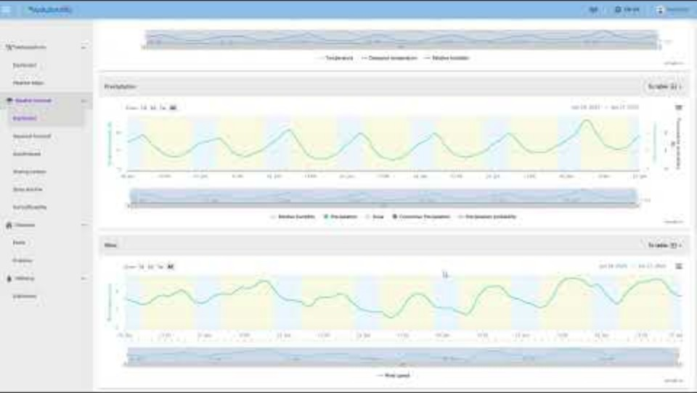
Professional agronomic forecast
https://youtu.be/LQNSkBgzp_A

Slide 20
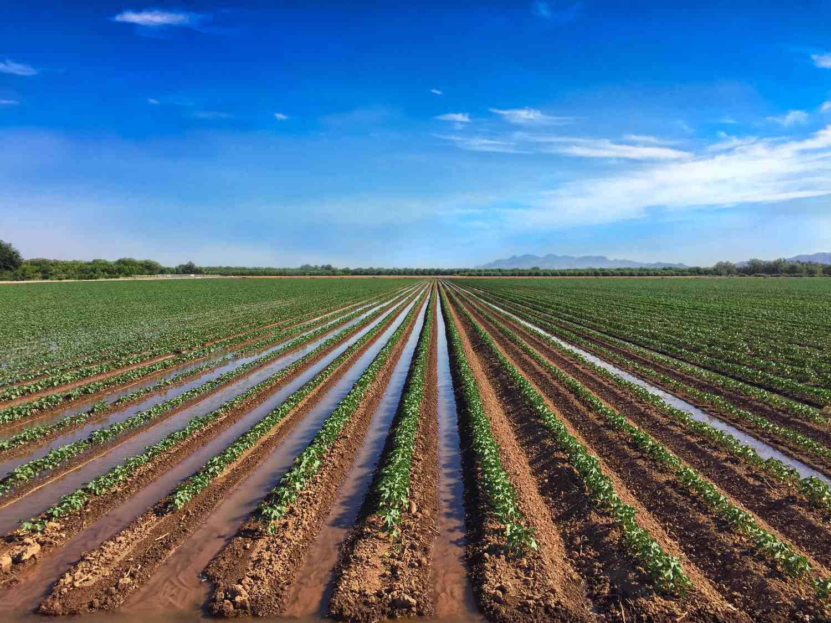
Irrigation Scheduling
Multi-depth soil sensors
Continuous monitoring of soil moisture, temperature, and electrical conductivity at various depths for comprehensive root zone analysis
Evapotranspiration calculations
Measures actual plant water loss to determine precise irrigation needs rather than guessing
Weather-integrated planning
Combines soil data with 7-day weather forecasts to prevent unnecessary watering before expected rainfall
Automated scheduling recommendations
System calculates optimal irrigation timing based on soil moisture levels, weather conditions, and crop requirements
20-30% water savings - Precision scheduling eliminates overwatering and reduces water waste compared to calendar-based irrigation

Slide 21
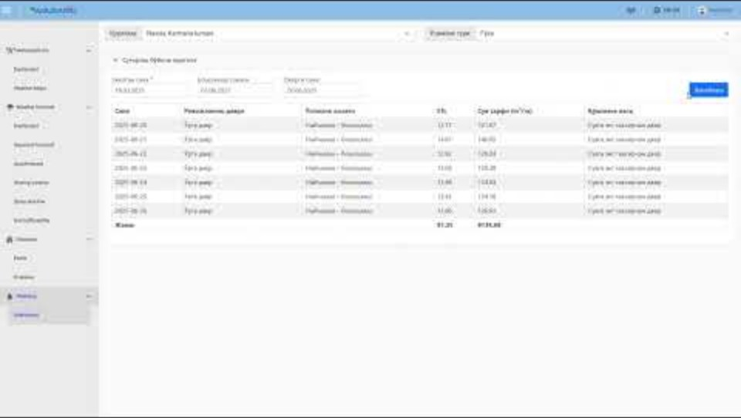
Irrigation scheduling calendar
https://youtu.be/5ZAHzCaoIX8

Slide 22
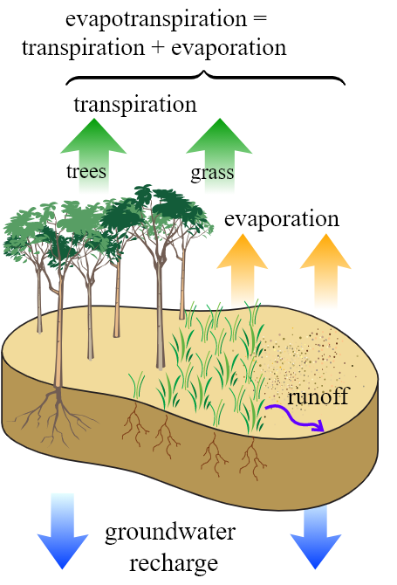
Daily Evapotranspiration
Evapotranspiration
The sum of water evaporation from soil surface (evaporation) and water evaporation from plants (transpiration)
Measured in mm/day like precipitation
In non-irrigated areas, equals precipitation amount
Types:
Potential (PET)
Maximum evaporation when sufficient water is available
Reference (ET₀)
Evapotranspiration for 12 cm grass
Crop-specific (ETc):
ETc = Kc * ET₀

Slide 23
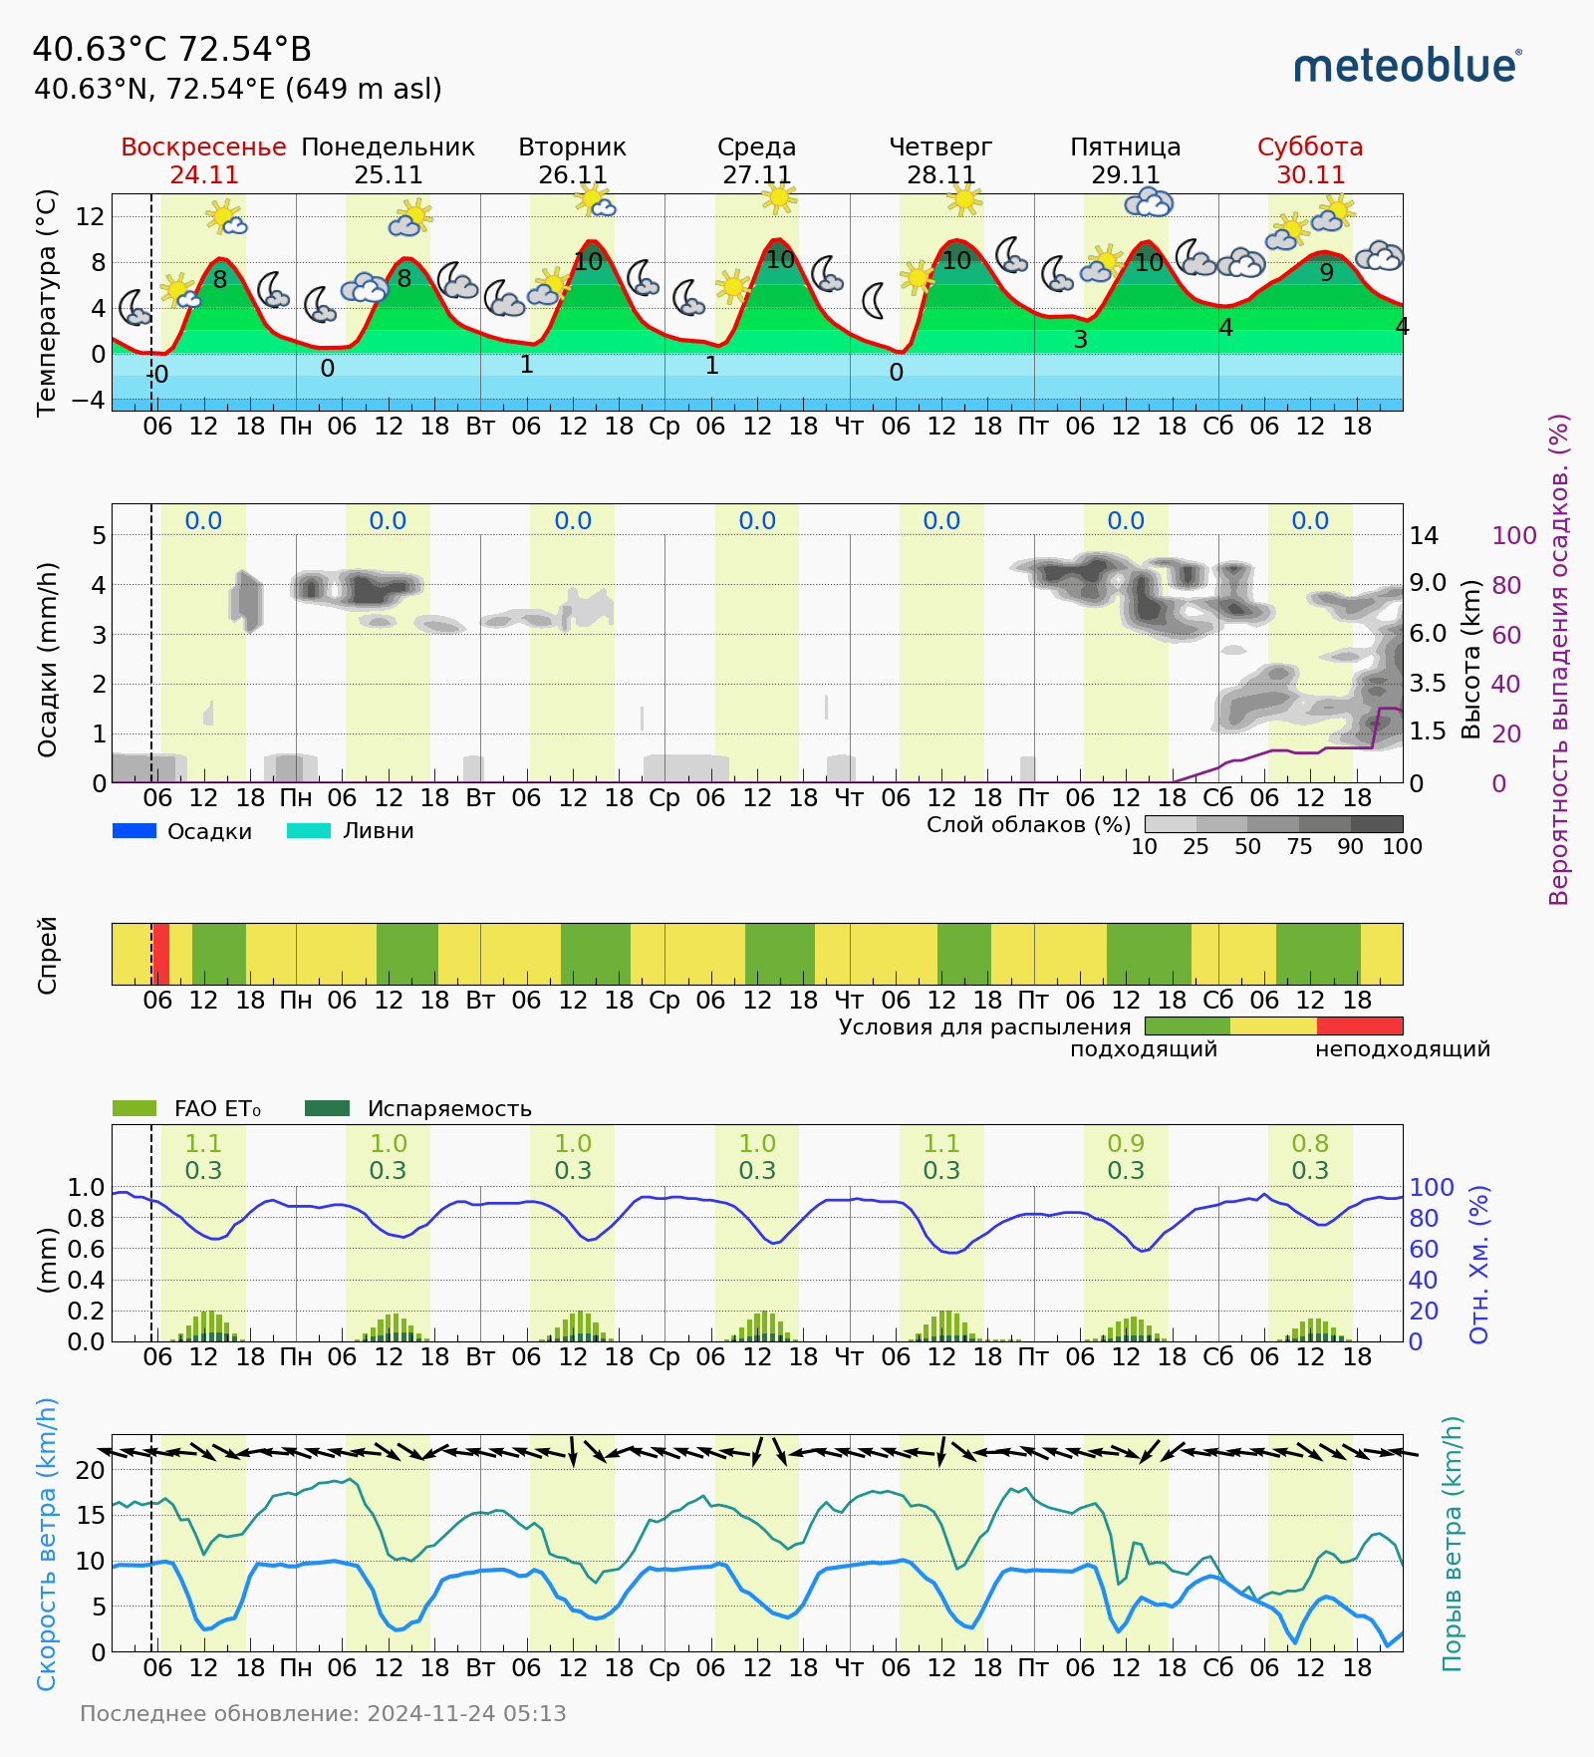
Forecasted Evapotranspiration
Precise irrigation scheduling
Daily ET₀ values (0.8-1.1 mm/day shown) combined with crop coefficients calculate exact water requirements, preventing over/under-watering and optimizing plant water stress management
Resource conservation
Accurate ET₀ measurements combined with precipitation forecasts can reduce irrigation water use by 25-30% while maintaining optimal crop growth conditions through precision water management

Slide 24
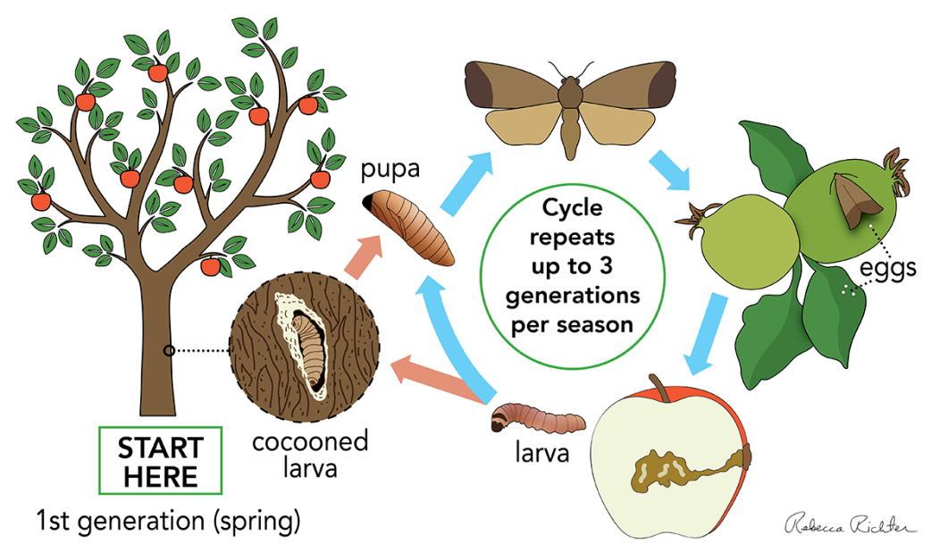
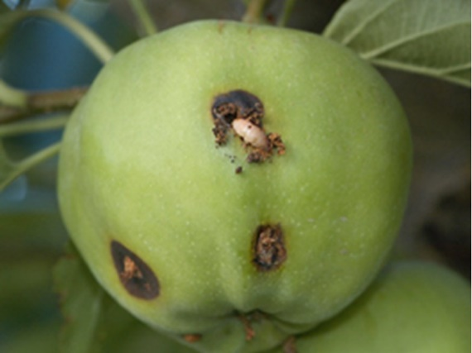
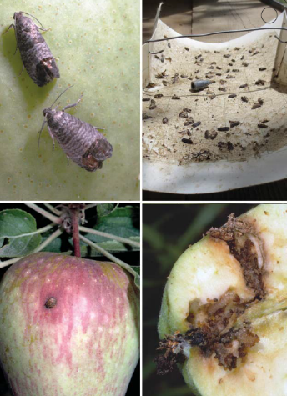
Integrated Pest Management
Weather-based prediction models
Agrometeorological stations provide temperature, humidity, and precipitation data to forecast pest development cycles and optimal timing for targeted treatments
Reduced chemical dependency
Precision timing and targeted application based on actual pest presence reduces pesticide use by 30-80% while maintaining crop protection effectiveness
Multi-modal monitoring approach
Combines automated weather data, pheromone trap monitoring and crop phenology tracking
Economic and environmental benefits
Prevents up to 80% of crop losses through early intervention while preserving beneficial insects, reducing chemical residues, and supporting export market requirements for pesticide-free produce

Slide 25
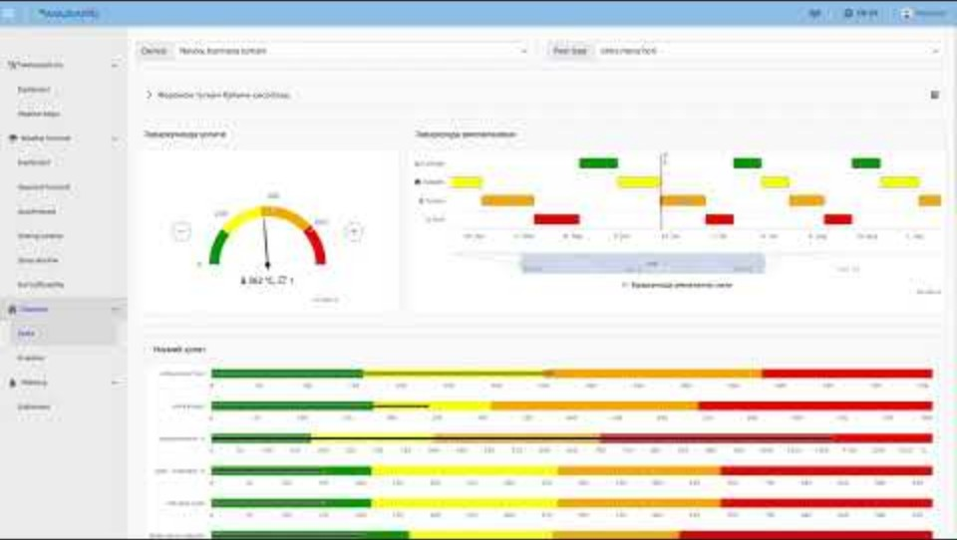
Pest Prediction Models
https://youtu.be/SYSbcg0IgA8

Slide 26
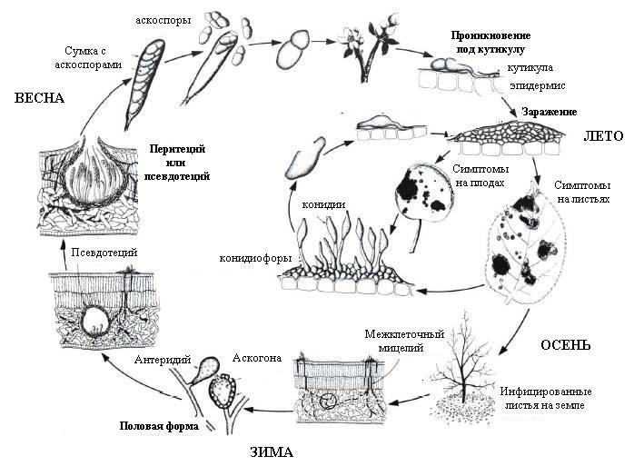
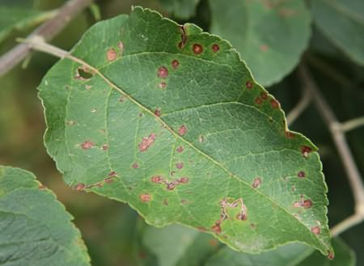

Plant Disease Management
Weather-based disease forecasting
Real-time monitoring of temperature, humidity, leaf wetness, and rainfall patterns enables prediction of disease-favorable conditions before symptoms appear
AI-powered risk assessment
Models predict the development probability of 30+ common agricultural diseases
Preventive intervention timing
Early warning alerts identify critical periods for fungicide application, allowing farmers to protect crops before disease establishment rather than treating existing infections
Cost reduction and plant protection
Prevents 60-80% of potential crop losses through early intervention while reducing fungicide costs by 25-40% via targeted applications only when disease conditions are favorable

Slide 27
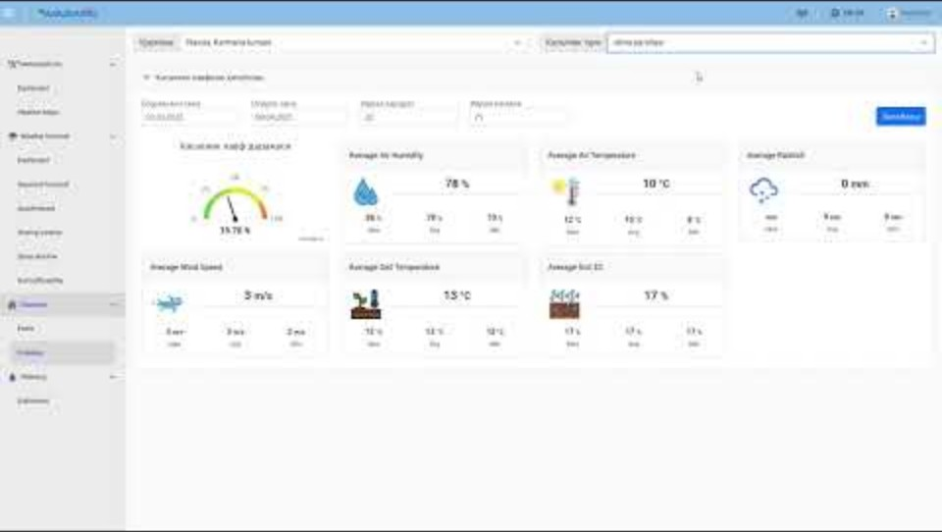
Plant Disease Models
https://youtu.be/xIlZHK1kdCY

Slide 28
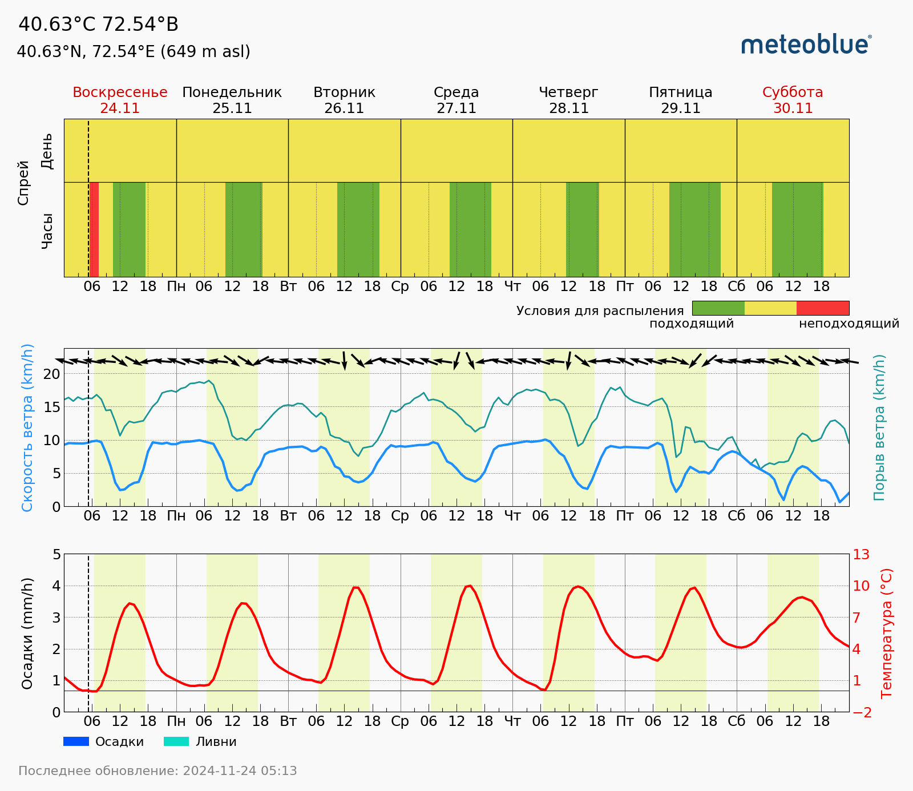
Spraying Windows
Optimal application timing
Green windows indicate ideal conditions with low wind speeds (<10 km/h), proper temperature ranges, and no precipitation for maximum pesticide effectiveness
Yellow and red periods indicate upcoming rain or adverse conditions that would wash away treatments
Chemical efficiency maximization
Spraying during favorable conditions ensures better droplet coverage and penetration, reducing product waste by 20-30%
Drift prevention
Real-time wind speed monitoring helps avoid applications during high-wind periods (red zones), preventing chemical drift to non-target areas and neighboring crops

Slide 29
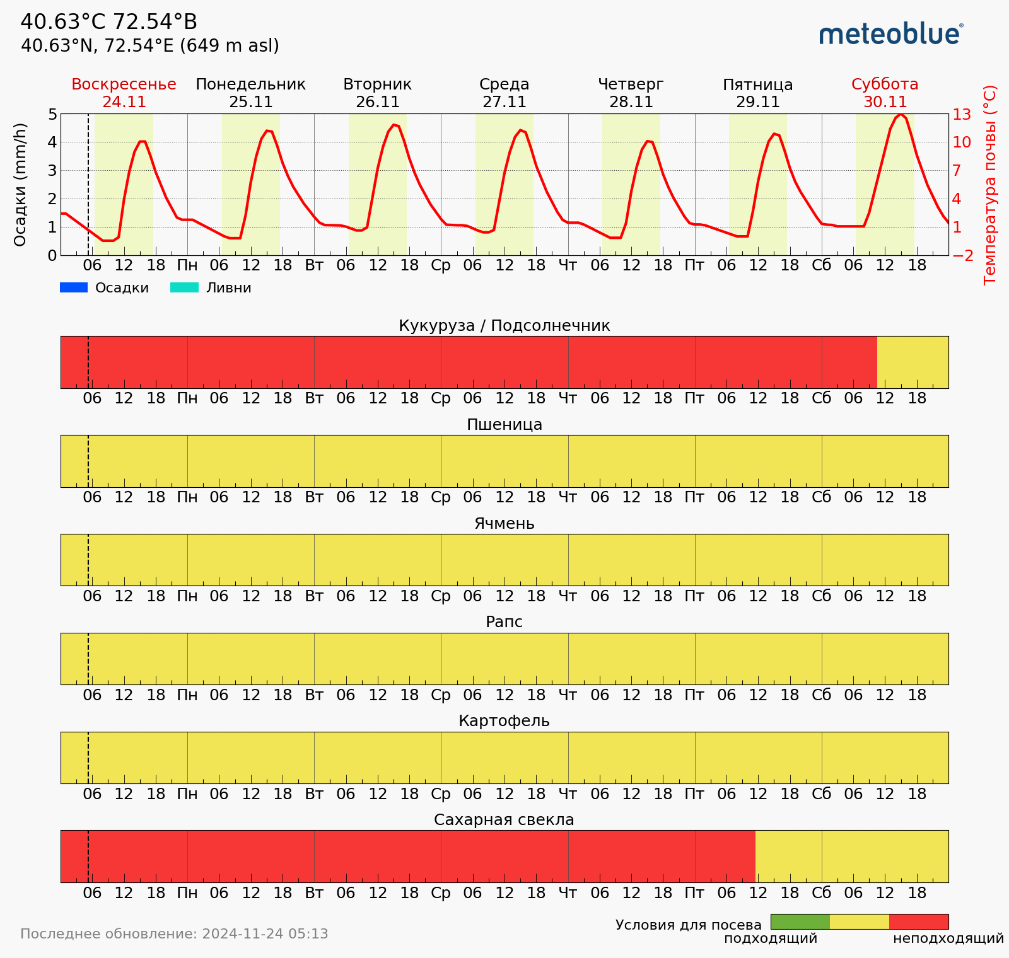
Sowing Windows
Crop-specific timing optimization
Color-coded windows show ideal sowing periods for each crop type (corn/sunflower, wheat, barley, rapeseed, potato, sugar beet) based on soil temperature and moisture conditions
Avoiding red/yellow periods prevents sowing in overly wet or cold soils that could lead to seed rot, poor emergence, or compaction damage
Germination success maximization
Green periods indicate optimal soil conditions for seed germination, reducing replanting costs
Proper timing based on weather forecasts can improve emergence rates by 15-25% and establish stronger plant stands that are more resilient to later stress conditions

Slide 30
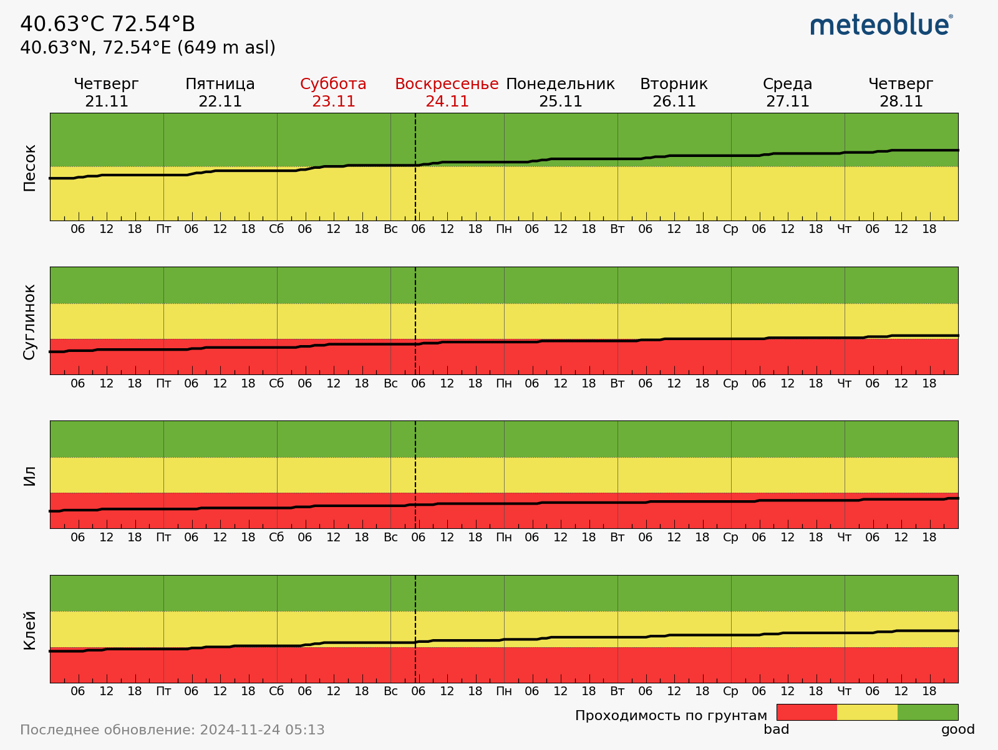
Soil Trafficability
Tillage timing
Color-coded conditions show optimal periods for heavy equipment operation on different soil types (sand, loam, silt, clay) to prevent compaction and rutting damage
Avoiding red/yellow periods prevents soil compaction damage that can reduce yields by 10-15% and persist for multiple growing seasons
Equipment protection and efficiency
Green windows indicate firm soil conditions that allow normal machinery operation without risk of getting stuck or requiring additional traction equipment
Proper timing eliminates costs associated with stuck equipment, extra fuel consumption, and potential machinery damage from operating in poor field conditions

Slide 31
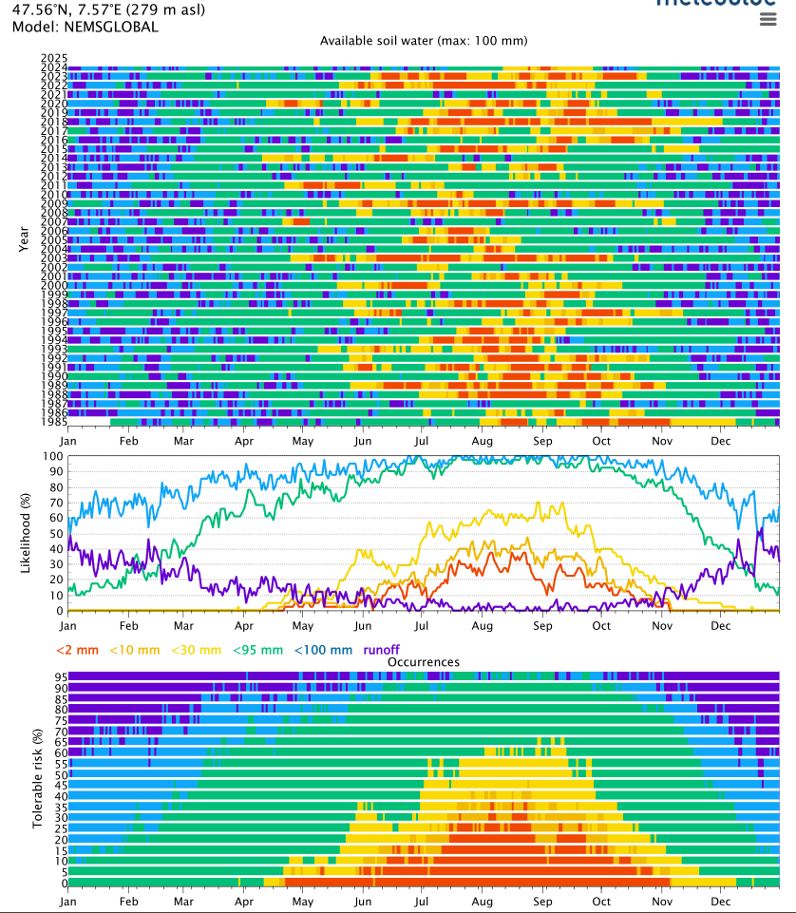
Risk assessment based on 40-year historical data
Extensive historical meteorological records combined with satellite data from meteoblue for the last 40 years enable:
long-term climate analysis,
seasonal pattern identification,
baseline establishment for agricultural planning
Risk-based insurance
Historical weather data supports crop insurance decisions and helps farmers plan risk mitigation strategies based on documented weather extremes

Slide 32
To summarize, weather stations can…
Estimate water consumption by calculating evapotranspiration
Save water by optimized irrigation scheduling
Protect plants from pests and diseases by modelling their development cycles
Save chemicals by finding optimal spraying windows
Maximize seed germination by choosing optimal sowing window
Prevent farm machinery from getting stuck in mud, or damaging tillers/ploughs
Save fuel by choosing optimal conditions for tillage
Assess risk employing the historical meteorological records of the site

Slide 33
Questions?
“Amudario Research” LLC
info@amudar.io
+998-97-3441136

