Slide 1

Note: The data and information in this document is reflective of a hypothetical situation and client. This document is to be used for KPMG Virtual Internship purposes only.
Sprocket Central Pty Ltd
Data analytics approach
[Division Name] - [Engagement Manager], [Senior Consultant], [Junior Consultant]

Slide 2
KPMG Data Analysis
Goal:
To recommend which of these 1000 new customers should be targeted to drive the most value for the organization.

Slide 3
Scope
Activity | Description
Ask | Asking SMART questions to understand the context of the project.
Prepare | Collecting and organizing the data for ease of access.
Process | Cleaning the data for accurate predictions.
Analyze | Performing sorting, filtering and statistics to analyze data.
Share | Sharing the insights to the client in the form of visualizations.
Act | Making recommendations for effective data driven decisions.

Slide 4
Ask
I try to understand the overall context of business requirements.
Used SMART strategy.
S - Specific
M - Measurable
A - Action oriented
R - Relevant
T - Time bound

Slide 5
Qns:
To determine who provides the most value, we need to know each new customer’s value.
But we don't have any prior transactions with the new customers.
So, how can we determine which customers to target?
Soln:
The common data between the old customers database and the new customers database are age, past_3_years_bike_related_purchases, job_title, job_industry_category, wealth_segment, owns_car, tenure, postcode, country, state.
So if we find which segment customers in the old customers list provides more value then based on that we can achieve our goal.

Slide 6
Causes | Effects
country | list_price past_3_years_bike_related_purchases tenure
state
wealth_segment
postcode
owns_car
job_industry_category
job_title

Slide 7
Prepare
What is the data?
How to collect it?
How much data do I need?
Whether ROCCC rule need to be applied?
Data security
Data organization and convention

Slide 8
Process
My checklist:
Change the entire columns into uppercase
Duplicates
Whitespace
Empty cells
Standardize the column formats
Outliers
Unmerge
Merge
Cross field validation
Change units of measurement

Slide 9
Change log
Transactions table:
Removed the rows where there are empty cells in the online_order column.
Removed the rows where there are empty cells in the brand column.
915 duplicate values found and removed.
Splitted transaction_date column into transaction _month and transaction_date columns.

Slide 10
Change log
New customer list table:
Removed the rows where there are empty cells in the DOB column.
Removed the rows where there are empty cells in the job_title column.
Removed the rows where there are n/a values in the job_industry_category column.
The word Argiculture was replaced with Agriculture in the job_industry_category_column.
The values in the postcode column are in the form of text so converted them into number format.
The values in the property value column are in the form of text so converted them into number format.
Merged the first name and second name column into a single column name.
The values in the column past_3_years_bike_related_purchases were in text format therefore converted them into number format.
Added a column age using datedif function.

Slide 11
Change log
Customer Demographic table:
Merged the first_name and second_name column into single column name.
Replaced M with male and F with female in the column gender.
The column DOB contained a wrong value 1843-12-21 therefore changed into 1943-12-21
Removed the rows where there are empty cells in the job_title column.
Removed the rows where there are n/a values in the job_industry_category column.
The word Argiculture was replaced with Agriculture in the job_industry_category_column.
Removed the rows where there are empty cells in the tenure column.

Slide 12
Change log
Customer address table:
Replaced NSW with New South Wales and VIC with Victoria in the state column.
Merged tables:
Merged customer demographic table, customer address table, transactions table into a single table called Old_Customer table
.
Categorization:
Categorized the age column into 10 categories like 20 - 29, 30 - 39 up to 90 - 99.

Slide 13
Analyze
Analyze using Excel.
Operations:
Organize
Filter
Sort
Getting feedback from others
Calculations (Pivot table)

Slide 14
Analyze
I have analyzed the following variables to derive insights.
wealth_segment : purchase_value
state : purchase_value
age _category : purchase_value
job_industry : purchase_value

Slide 15
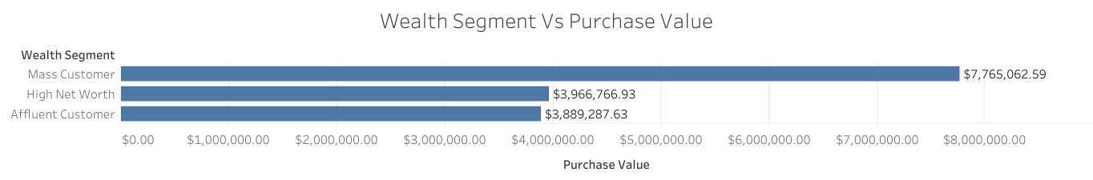


Slide 16
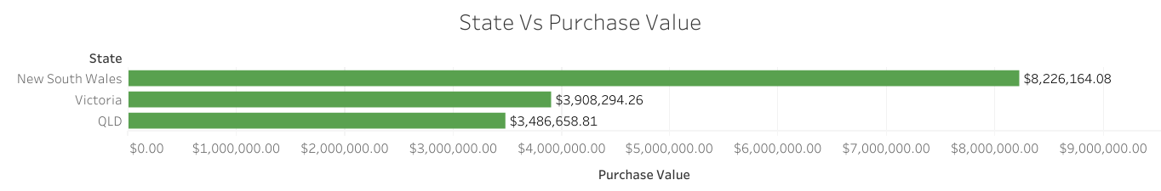

Slide 17
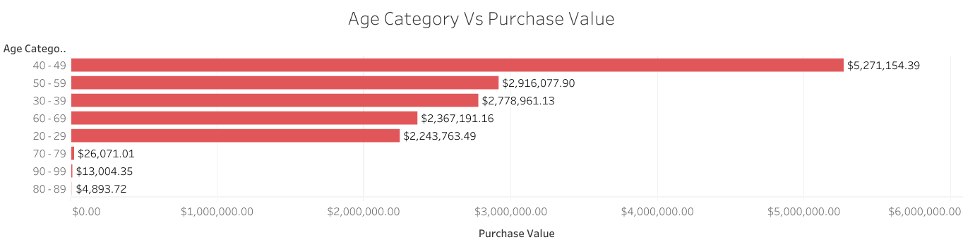

Slide 18
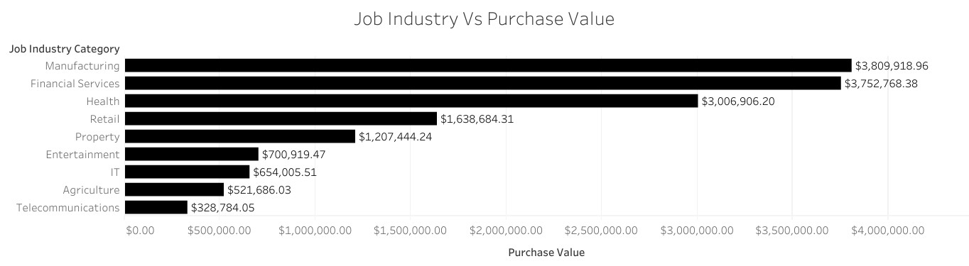

Slide 19
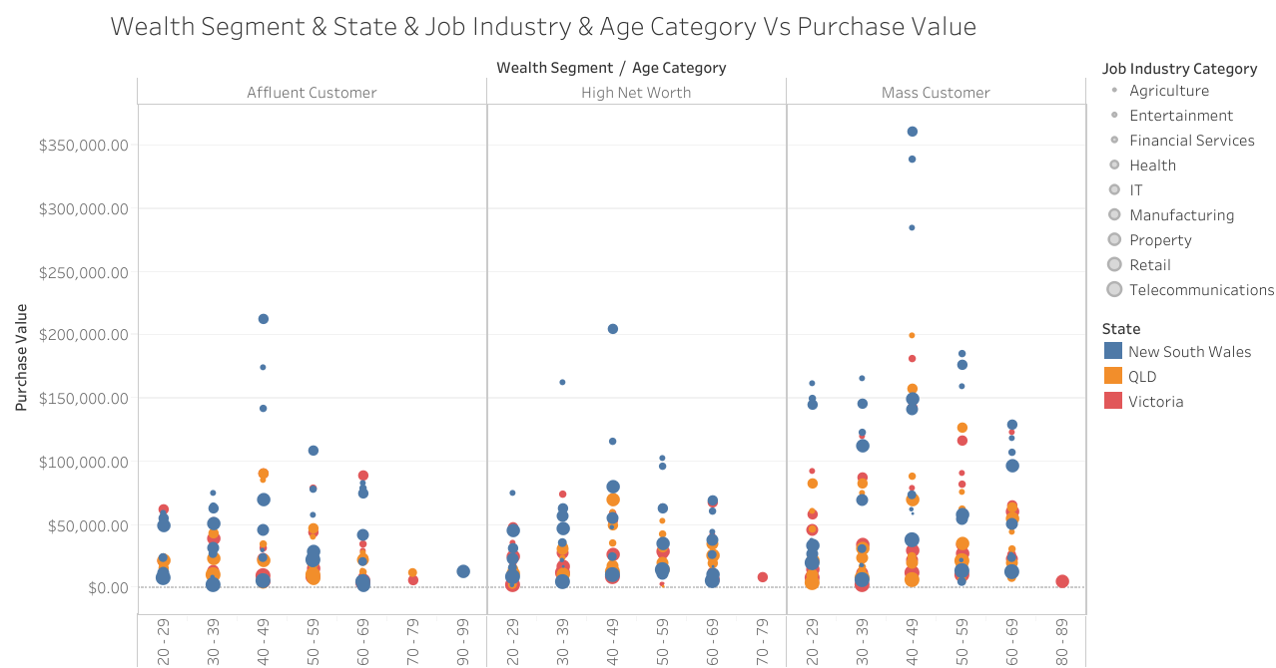

Slide 20
Conclusion
After analyzing the data, I have shortlisted the 1000 new customers based on the wealth_segment, age_category, state, job_industry and segregated them into 5 priorities.

Slide 21
Conclusion
Priority 1:
Mass Customer - 40 - 49 - NSW - Manufacturing
name | gender | past_3_years_bike_related_purchases | Age | Age Category | job_title | job_industry_category | wealth_segment | deceased_indicator | owns_car | tenure | address | postcode | Locality | state | country | property_valuation | Rank | Value
Martelle Tuppeny | Female | 52 | 42 | 40 - 49 | Marketing Assistant | Manufacturing | Mass Customer | N | No | 9 | 261 Grayhawk Way | 2226 |  | NSW | Australia | 10 | 54 | 1.38125
Ricki Dobrowski | Male | 13 | 48 | 40 - 49 | Civil Engineer | Manufacturing | Mass Customer | N | Yes | 9 | 8 Eggendart Pass | 2835 |  | NSW | Australia | 1 | 127 | 1.25
Harlin Mazin | Male | 34 | 49 | 40 - 49 | Computer Systems Analyst I | Manufacturing | Mass Customer | N | Yes | 13 | 735 Westridge Road | 2454 |  | NSW | Australia | 7 | 181 | 1.158125
Theresa Cowper | Female | 99 | 46 | 40 - 49 | Accountant III | Manufacturing | Mass Customer | N | No | 3 | 88 Mifflin Pass | 2529 |  | NSW | Australia | 10 | 271 | 1.06
Alexina Mabley | Female | 72 | 47 | 40 - 49 | Web Designer IV | Manufacturing | Mass Customer | N | Yes | 10 | 9 Rieder Junction | 2573 |  | NSW | Australia | 9 | 486 | 0.875
Katleen Arnoult | Female | 6 | 46 | 40 - 49 | VP Product Management | Manufacturing | Mass Customer | N | Yes | 13 | 540 Farragut Avenue | 2066 |  | NSW | Australia | 9 | 507 | 0.85
Ajay Worham | Female | 80 | 43 | 40 - 49 | Computer Systems Analyst I | Manufacturing | Mass Customer | N | Yes | 12 | 5 Homewood Road | 2800 |  | NSW | Australia | 6 | 606 | 0.765
Brendis Pineaux | Male | 12 | 45 | 40 - 49 | Mechanical Systems Engineer | Manufacturing | Mass Customer | N | No | 5 | 43030 Carberry Way | 2560 |  | NSW | Australia | 4 | 719 | 0.675
Shepperd Leonards | Male | 17 | 42 | 40 - 49 | Chemical Engineer | Manufacturing | Mass Customer | N | Yes | 5 | 38 Nobel Lane | 2147 |  | NSW | Australia | 9 | 733 | 0.6625

Slide 22
Conclusion
Priority 2:
Mass Customer - 40 - 49 - NSW - Health
name | gender | past_3_years_bike_related_purchases | Age | Age Category | job_title | job_industry_category | wealth_segment | deceased_indicator | owns_car | tenure | address | postcode | Locality | state | country | property_valuation | Rank | Value
Melba Spellacy | Female | 38 | 46 | 40 - 49 | VP Marketing | Health | Mass Customer | N | No | 4 | 0591 Anzinger Circle | 2232 |  | NSW | Australia | 10 | 14 | 1.59375
Patricia Everix | Female | 34 | 45 | 40 - 49 | Director of Sales | Health | Mass Customer | N | No | 19 | 91164 Washington Terrace | 2263 |  | NSW | Australia | 7 | 89 | 1.3125
Robert Corkill | Male | 55 | 47 | 40 - 49 | Clinical Specialist | Health | Mass Customer | N | No | 4 | 5612 Toban Point | 2227 |  | NSW | Australia | 10 | 166 | 1.175
Kort Disley | Male | 66 | 44 | 40 - 49 | Technical Writer | Health | Mass Customer | N | Yes | 7 | 76 Donald Trail | 2160 |  | NSW | Australia | 9 | 219 | 1.125
Gothart Artus | Male | 52 | 45 | 40 - 49 | Health Coach IV | Health | Mass Customer | N | Yes | 14 | 21824 Northridge Alley | 2117 |  | NSW | Australia | 10 | 231 | 1.105
Loleta Aberdalgy | Female | 45 | 42 | 40 - 49 | Occupational Therapist | Health | Mass Customer | N | No | 11 | 99 Westend Court | 2287 |  | NSW | Australia | 6 | 304 | 1.025
Katy Crooke | Female | 0 | 46 | 40 - 49 | Food Chemist | Health | Mass Customer | N | No | 13 | 67081 Burrows Center | 2111 |  | NSW | Australia | 12 | 546 | 0.823438
Selle Casper | Female | 98 | 45 | 40 - 49 | Social Worker | Health | Mass Customer | N | Yes | 10 | 34 Jay Hill | 2880 |  | NSW | Australia | 1 | 684 | 0.7
Therese Brotherhood | Female | 30 | 41 | 40 - 49 | Food Chemist | Health | Mass Customer | N | No | 10 | 25044 Bay Avenue | 2042 |  | NSW | Australia | 10 | 780 | 0.624219
Rosene Beckey | Female | 25 | 49 | 40 - 49 | Account Executive | Health | Mass Customer | N | Yes | 14 | 02463 Portage Center | 2107 |  | NSW | Australia | 11 | 801 | 0.597656
Darlleen Shalcras | Female | 77 | 42 | 40 - 49 | Health Coach I | Health | Mass Customer | N | No | 11 | 383 Graceland Avenue | 2010 |  | NSW | Australia | 10 | 801 | 0.597656
Randall Mason | Male | 95 | 48 | 40 - 49 | Product Engineer | Health | Mass Customer | N | Yes | 12 | 83497 Memorial Plaza | 2570 |  | NSW | Australia | 11 | 870 | 0.544
Jammie Seldner | Female | 42 | 48 | 40 - 49 | Human Resources Manager | Health | Mass Customer | N | Yes | 15 | 8 Saint Paul Junction | 2066 |  | NSW | Australia | 10 | 963 | 0.44

Slide 23
Conclusion
Priority 3:
Mass Customer - 40 - 49 - NSW - Financial Services
name | gender | past_3_years_bike_related_purchases | Age | Age Category | job_title | job_industry_category | wealth_segment | deceased_indicator | owns_car | tenure | address | postcode | Locality | state | country | property_valuation | Rank | Value
Rutledge Hallt | Male | 23 | 46 | 40 - 49 | Compensation Analyst | Financial Services | Mass Customer | N | No | 8 | 7 Nevada Crossing | 2620 |  | NSW | Australia | 7 | 6 | 1.671875
Daryl Pauncefort | Female | 12 | 44 | 40 - 49 | Community Outreach Specialist | Financial Services | Mass Customer | N | Yes | 12 | 0 Dexter Parkway | 2380 |  | NSW | Australia | 3 | 133 | 1.2375
Dorian Stollen | Male | 78 | 43 | 40 - 49 | Statistician I | Financial Services | Mass Customer | N | Yes | 18 | 72922 Cambridge Terrace | 2026 |  | NSW | Australia | 11 | 219 | 1.125
Sunny Christescu | Female | 90 | 48 | 40 - 49 | Cost Accountant | Financial Services | Mass Customer | N | No | 11 | 6668 Blue Bill Park Plaza | 2209 |  | NSW | Australia | 10 | 250 | 1.075
Inglebert Aspinal | Male | 4 | 49 | 40 - 49 | Financial Analyst | Financial Services | Mass Customer | N | No | 11 | 612 Annamark Center | 2176 |  | NSW | Australia | 8 | 507 | 0.85
Amabel | Female | 71 | 41 | 40 - 49 | Chief Design Engineer | Financial Services | Mass Customer | N | Yes | 9 | 3128 Mallory Pass | 2144 |  | NSW | Australia | 6 | 530 | 0.82875
Aldin Newsome | Male | 24 | 42 | 40 - 49 | Financial Analyst | Financial Services | Mass Customer | N | No | 17 | 058 Morningstar Center | 2127 |  | NSW | Australia | 9 | 648 | 0.725
Sinclair Wark | Male | 68 | 49 | 40 - 49 | Financial Analyst | Financial Services | Mass Customer | N | Yes | 11 | 44 Thompson Center | 2134 |  | NSW | Australia | 9 | 741 | 0.65875
Stephani Sidsaff | Female | 32 | 49 | 40 - 49 | Senior Quality Engineer | Financial Services | Mass Customer | N | Yes | 6 | 00 Southridge Avenue | 2036 |  | NSW | Australia | 11 | 755 | 0.64
Sonia Dunstall | Female | 0 | 47 | 40 - 49 | Accountant III | Financial Services | Mass Customer | N | No | 10 | 99 Park Meadow Hill | 2570 |  | NSW | Australia | 9 | 960 | 0.442

Slide 24
Conclusion
Priority 4:
Affluent Customer - 40 - 49 - NSW - Financial Services
name | gender | past_3_years_bike_related_purchases | Age | Age Category | job_title | job_industry_category | wealth_segment | deceased_indicator | owns_car | tenure | address | postcode | Locality | state | country | property_valuation | Rank | Value
Lacy Drance | Female | 27 | 45 | 40 - 49 | Graphic Designer | Manufacturing | Affluent Customer | N | Yes | 14 | 492 Waywood Lane | 2750 |  | NSW | Australia | 8 | 133 | 1.2375
Egon Ortells | Male | 35 | 47 | 40 - 49 | Structural Engineer | Manufacturing | Affluent Customer | N | No | 13 | 3 Sundown Hill | 2168 |  | NSW | Australia | 9 | 274 | 1.051875
Cherye Stanfield | Female | 0 | 42 | 40 - 49 | Environmental Tech | Manufacturing | Affluent Customer | N | No | 13 | 56766 Mariners Cove Place | 2256 |  | NSW | Australia | 9 | 797 | 0.6
Adria Van den Velde | Female | 39 | 45 | 40 - 49 | Nuclear Power Engineer | Manufacturing | Affluent Customer | N | Yes | 9 | 6030 Becker Plaza | 2261 |  | NSW | Australia | 7 | 810 | 0.5875
Kizzee Agget | Female | 98 | 46 | 40 - 49 | Statistician II | Manufacturing | Affluent Customer | N | No | 8 | 122 Marcy Park | 2213 |  | NSW | Australia | 10 | 930 | 0.478125

Slide 25
Conclusion
Priority 5:
High Net Worth Customer - 40 - 49 - NSW - Financial Services
name | gender | past_3_years_bike_related_purchases | Age | Age Category | job_title | job_industry_category | wealth_segment | deceased_indicator | owns_car | tenure | address | postcode | Locality | state | country | property_valuation | Rank | Value
Hasheem Groucock | Male | 98 | 48 | 40 - 49 | Budget/Accounting Analyst IV | Manufacturing | High Net Worth | N | Yes | 10 | 12351 Spenser Pass | 2034 |  | NSW | Australia | 12 | 72 | 1.35
Micheil Fleote | Male | 48 | 47 | 40 - 49 | Civil Engineer | Manufacturing | High Net Worth | N | No | 16 | 174 Lotheville Crossing | 2093 |  | NSW | Australia | 9 | 739 | 0.66

Slide 26
Thank you :)

