Slide 1
Forage_Virtual_Internship
File created on: 7/7/2023 1:31:17 PM

Slide 2
Forage Retail Analysis
Goal:
To provide retail and marketing insights to CEO and CMO in order to help them make effective data driven decisions.

Slide 3
Scope
Activity | Description
Ask | Asking SMART questions to understand the context of the project.
Prepare | Collecting and organizing the data for ease of access.
Process | Cleaning the data for accurate predictions.
Analyze | Performing sorting, filtering and statistics to analyze data.
Share | Sharing the insights to the client in the form of visualizations.
Act | Making recommendations for effective data driven decisions.

Slide 4
Ask
I try to understand the overall context of business requirements.
Used SMART strategy.
S - Specific
M - Measurable
A - Action oriented
R - Relevant
T - Time bound

Slide 5
CEO Metrics
Total revenue over year, over each month etc
Avg revenue
Gross margin
Profit margin

Slide 6
CMO Metrics
Customer retention rate
Customer Lifespan Value
Why CLV?
The longer the lifecycle or the more value a customer brings during that lifecycle, the more revenue a business earns. Therefore, tracking and improving CLV results in more revenue.
Customer Lifetime Value = (Customer Value * Average Customer Lifespan)
Customer Value = (Average Purchase Value * Average Number of Purchases)

Slide 7
Prepare
What is the data?
How to collect it?
How much data do I need?
Whether ROCCC rule need to be applied?
Data security
Data organization and convention

Slide 8
Process
My checklist:
Change the entire columns into uppercase
Duplicates
Whitespace
Empty cells
Standardize the column formats
Outliers
Unmerge
Merge
Cross field validation
Change units of measurement

Slide 9
Change log
Uppercase:
Converted all the text fields into uppercase.
Duplicates:
5268 duplicates found and removed.
536641 rows remained.
Empty cells:
Replaced most of the empty cells in the description column with their matching values.
107 rows were deleted as there are no descriptions for some stock codes.
Quantity with -ve values have been removed as they indicate returned orders.

Slide 10
Change log
Split:
Splitted the InvoiceDate column into a single column that contains only the date.
Remove:
Rows without customer Id has been removed.
Removed Unspecified countries.
Replaced RSA with South Africa as RSA means South Africa to locate in maps.

Slide 11
Analyze
Analyze using either Excel or SQL.
Operations:
Organize
Filter
Sort
Getting feedback from others
Calculations (Pivot table)

Slide 12
Visualize
Used McCandless method to create visualizations
Tried to create visualizations based on 5 second rule
Based on the questions asked, identified the right type of charts
For Example:
Trend analysis – line chart, scatter plot
Correlation – column graph, bar graph, stacked bar chart
Difference – map chart
Outliers – box and whisker plot etc.

Slide 13
First question
Time series of the revenue data for the year 2011 by each month
Seasonal trends
Why these trends occur?

Slide 14
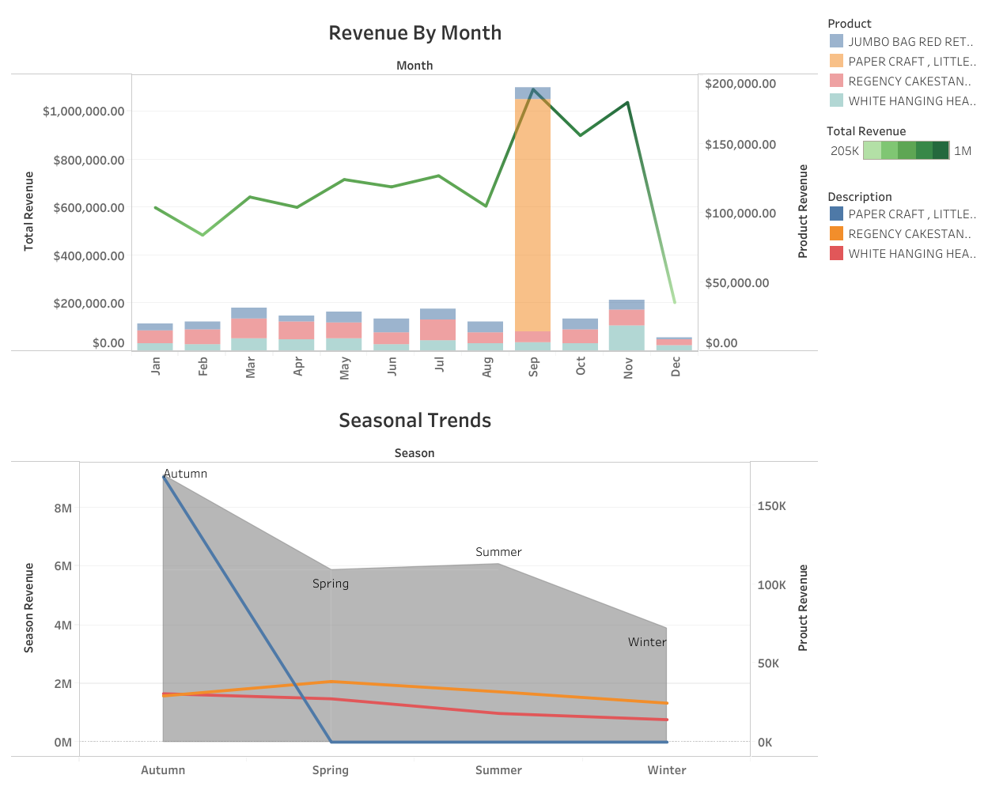


Slide 15
Second Question
Top 10 countries generating the highest revenue and the quantity sold excluding UK

Slide 16
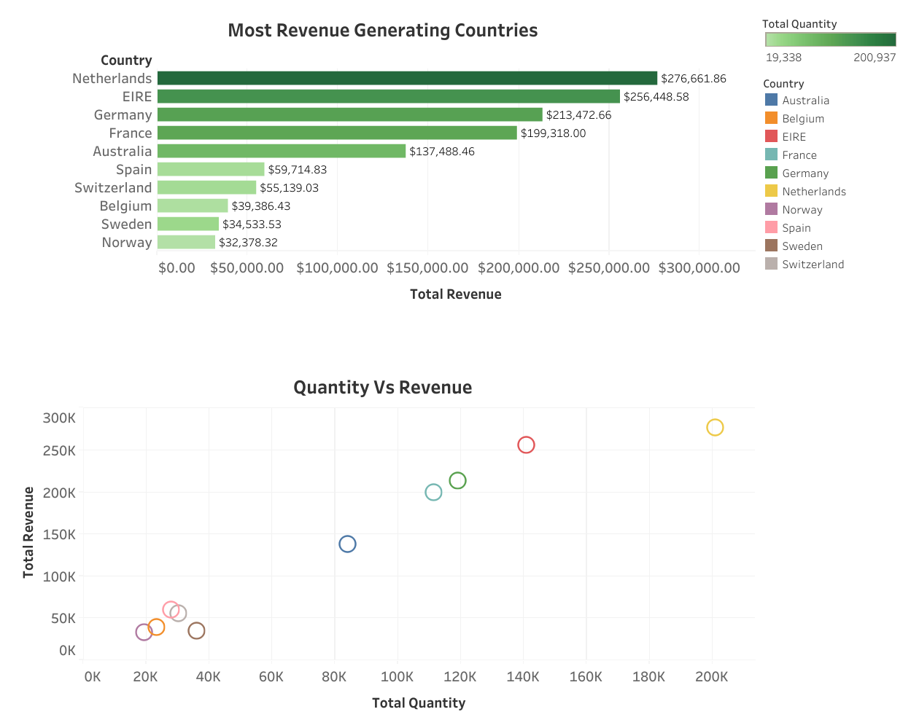

Slide 17
Third Question
Top 10 customers by revenue, the greatest revenue generating customer at the start and gradually declines to the lower revenue generating customers

Slide 18
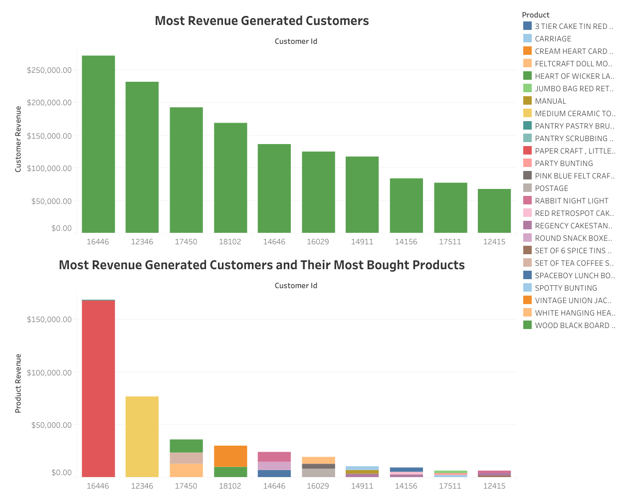

Slide 19
Fourth Question
Regions that have the greatest demand for their products excluding UK
Demand for our products

Slide 20
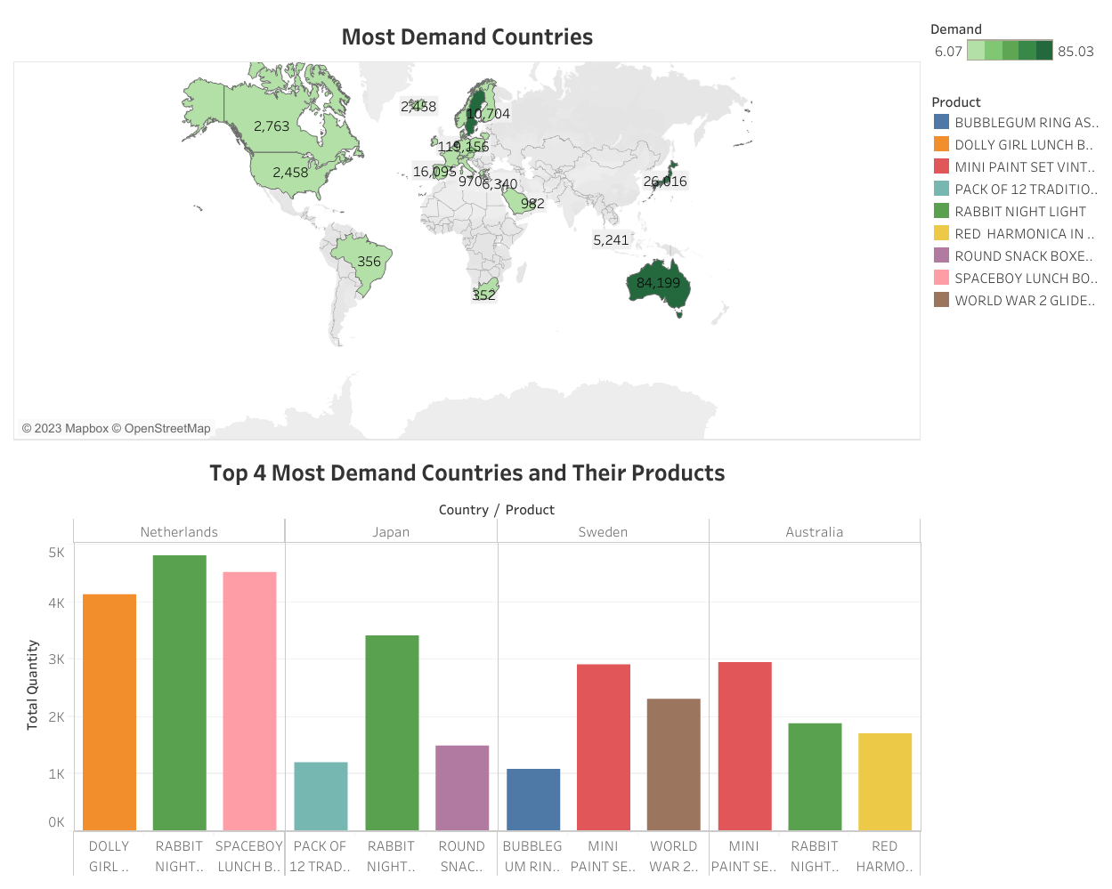

Slide 21
Conclusion
I suggest to store more papercraft little birdie product in the month of September.
I suggest to maintain the relationship with the most revenue generated customers based on the most bought products.
I suggest to try expand the market in Netherlands, Japan, Sweden, Australia as they are the most demanded countries.

Slide 22
Thank you :)

