Slide 1
Solar Power Forecasting
Using Deep
Neural Network

Slide 2
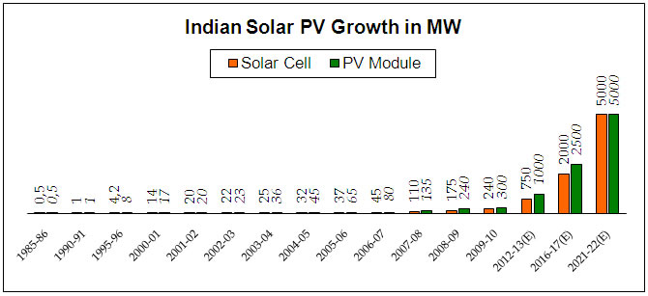
Growth of Solar Power in India
India expanded its solar-generation capacity 8 times from 2,650 MW on 26 May 2014 to over 20 GW as on 31 January 2018
The solar energy available in a single year exceeds the possible energy output of all of the fossil fuel energy reserves in India.
India has decided to phase out fossil-based energy generation and adopt green energy
As a result we have emerged as the second most attractive market for renewable energy equipment in the world.

Slide 3
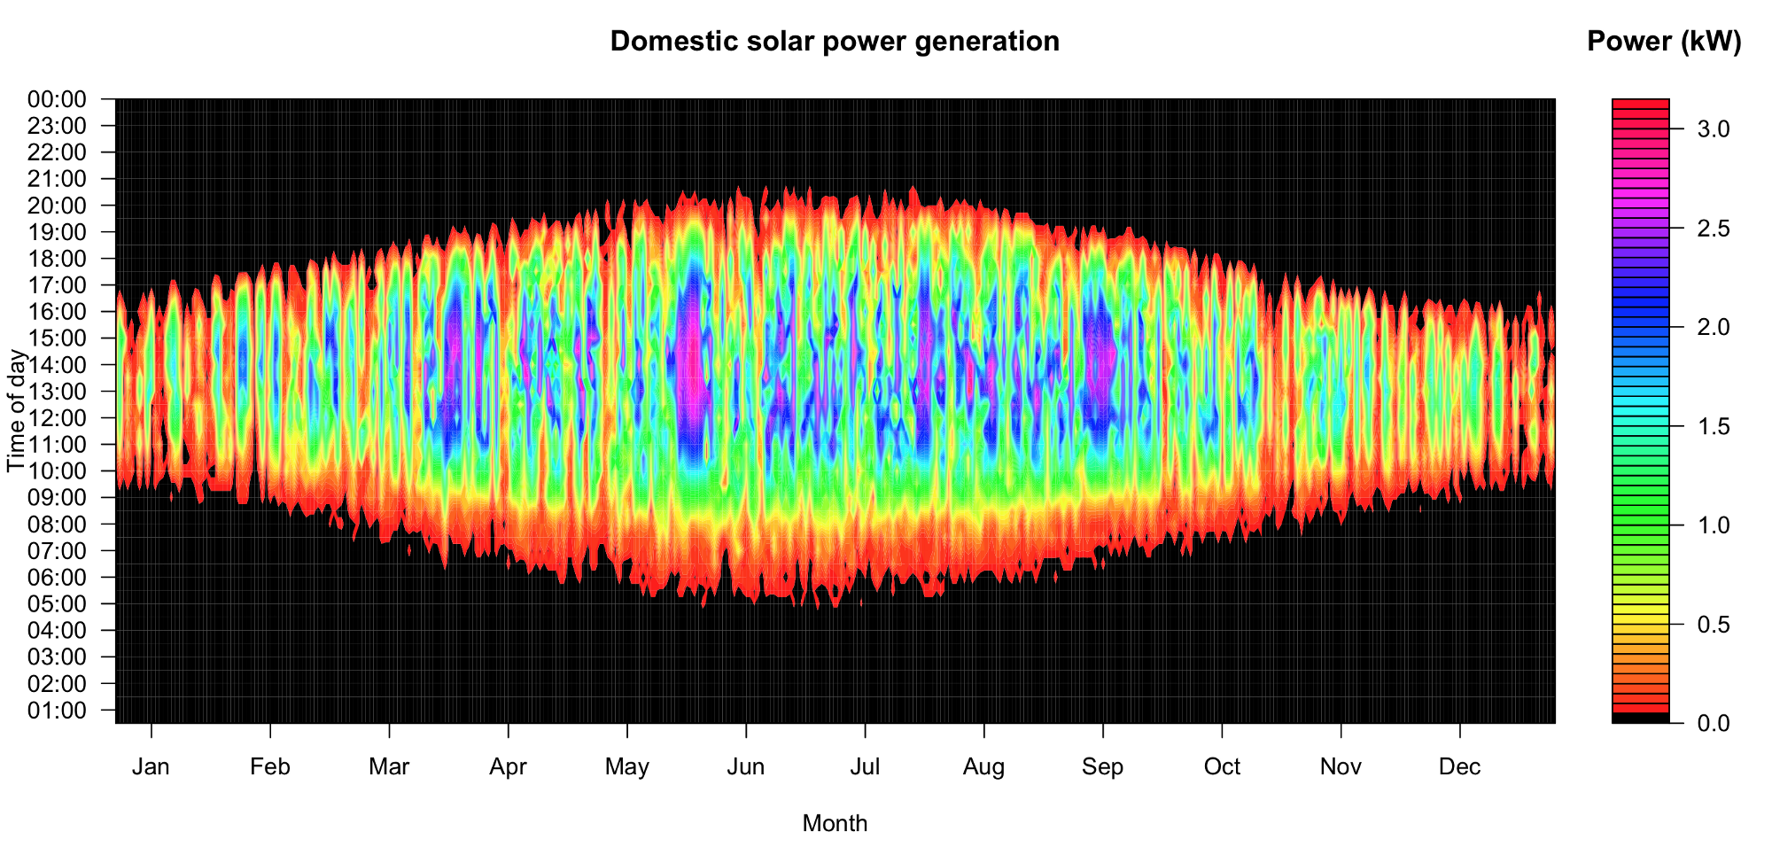
Problems with Solar Power
The energy produced by Solar Plants fluctuates with changing weather conditions
Photovoltaic energy generation directly depends on the amount of solar global irradiation.
This irradiation is variable over both short and long term intervals.
The long term part of the fluctuations are the seasonal cycle described by physical equations.
The short term uncertainty is due to the presence of clouds.
This inherent variability poses issues with grid reliability and the expenses associated with operating the solar units.

Slide 4
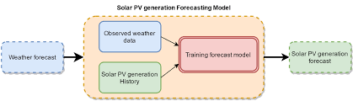
What is solar forecasting?
The solar power forecasting can be performed by several methods; the two big categories are the cloud imagery combined with physical models, and the machine learning models.
Machine learning is a subfield of computer science in which a model can solve problems which are impossible to be represented by explicit algorithms.
In global horizontal irradiance forecasting the models can be used in three different ways:
structural models which are based on other meteorological and geographical parameters
time-series models which only consider the historically observed data of solar irradiance as input features
hybrid models which consider both, solar irradiance
and other variables as exogenous variables.

Slide 5
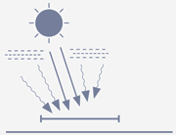
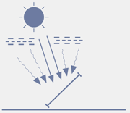
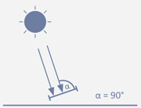
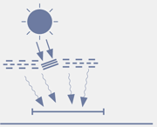

Types Of Radiation
Global Horizontal Irradiation
Global Tilted Irradiation
Direct Normal Irradiation
Diffuse Horizontal Irradiation
The total amount of direct and diffuse radiation received from above by a tilted surface.
Amount of solar radiation received per unit area by a surface that is always held perpendicular (or normal) to the rays coming direct from the sun.
Amount of radiation received per unit area by a surface that does not arrive on a direct path from the sun. It is a diffuse form of sunlight
The total amount of radiation received from above by a horizontal surface.

Slide 6
Past Work
The first step of our project was data collection by measurement.
For this purpose we used Pyranometer interfaced with Arduino UNO.
The Global Horizontal Irradiance(GHI) data was collected for a period of 15 days at an interval of 5 minutes with 12 Hours data per day
GHI was chosen as it is the easiest to measure and it also gives a good idea about the current irradiance level.

Slide 7
Continued...
The collected data in Arduino was logged into a computer. The analog output(0-5V) of Pyranometer was converted to digital format(0-1023) by the ADC of Arduino.This digital value was then converted to Irradiance value through appropriate conversion formulae.
Range of analog output- 0 to 5V
Range of digital output of Arduino-0 to 1023
Actual Pyranometer output range-0 to 1800 Watt/meter^2

Slide 8
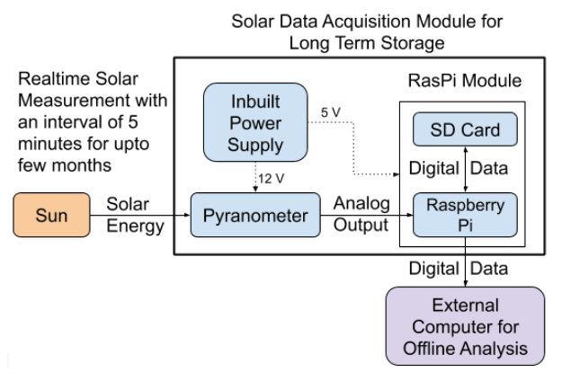
Solar GHI Measurement Block Diagram

Slide 9
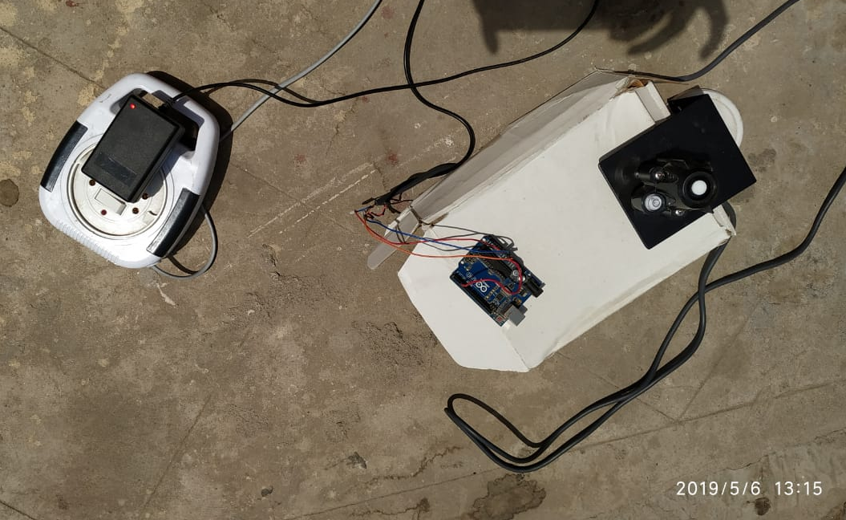
Solar GHI Measurement Setup

Slide 10
Goals
Predict the future solar output as closely as possible
Use as little data in the form of input as possible
The reason being
Difficult to obtain the extra measurements of weather etc.
More measurement = more measurement error
If only GHI can be used to predict GHI then it is best

Slide 11
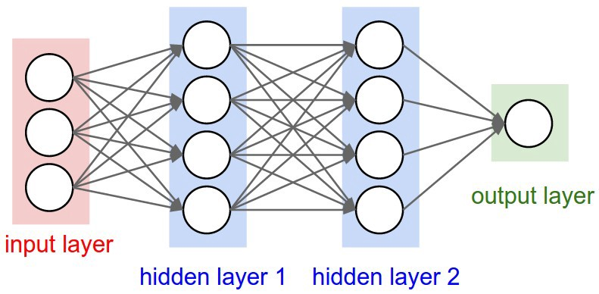
Deep Neural Network (DNN)
A deep neural network (DNN) is an artificial neural network (ANN) with multiple layers between the input and output layers. The DNN finds the correct mathematical manipulation to turn the input into the output, whether it be a linear relationship or a non-linear relationship.

Slide 12
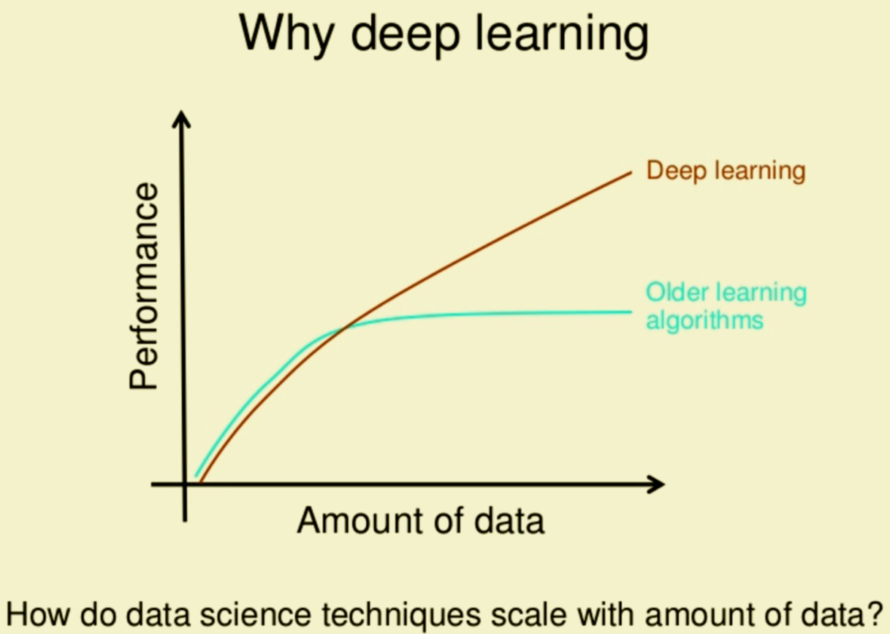
Why use DNN?
One of deep learning's main advantages over other machine learning algorithms is its capacity to execute feature engineering on it own. A deep learning algorithm will scan the data to search for features that correlate and combine them to enable faster learning without being explicitly told to do so.

Slide 13
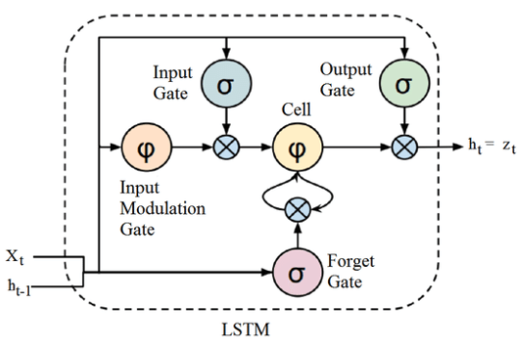
Long Short Term Memory (LSTM)
Long short-term memory (LSTM) is an artificial recurrent neural network (RNN) architecture used in the field of deep learning. Unlike standard feedforward neural networks, LSTM has feedback connections.

Slide 14
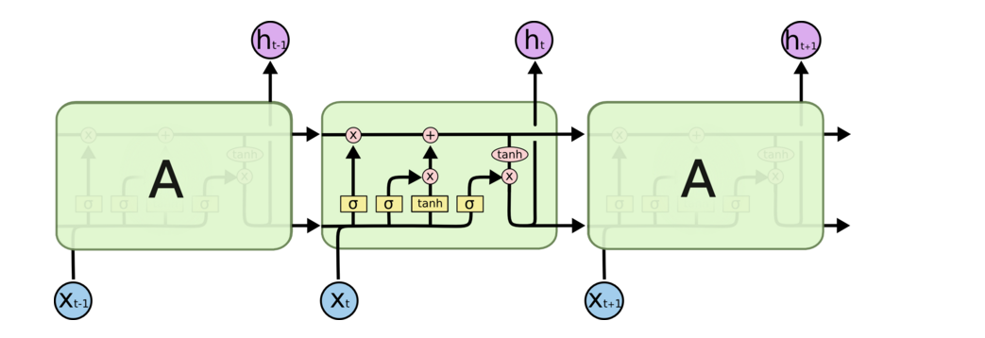
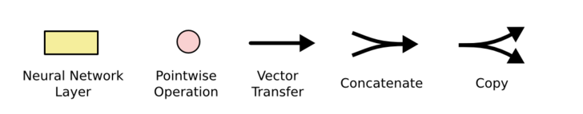
LSTM - Architecture
Decide what to forget
Decide what to add
σ: output in [0,1]
tanh: output in [-1,+1]

Slide 15
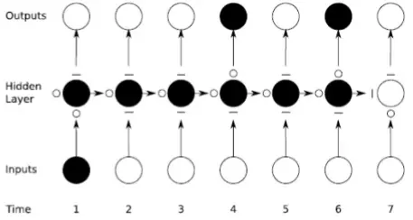
Why use LSTM?
LSTM allows the preservation of gradients. The memory cell remembers the first input as long as the forget gate is open and the input gate is closed.
The output gate provides finer control to switch the output layer on or off without altering the cell contents.

Slide 16
Time Step= 15 min
Used the nstep = 20 and nforward =6
Meaning: Using the history of previous 5 hours and predict the 1.5 hr in future
n-steps
in past
n-forward
in future
Past
Present
Future

Slide 17
Simple LSTM
Use only the GHI history to predict future GHI
Historical GHI data
LSTM

Slide 18
Two Stream
Use both GHI history and Atmospheric factors for predicting GHI
Historical GHI data
Temporal Stream(LSTM)
Temporal Stream(LSTM)
Current atmospheric data
Non Temporal Stream(DNN)

Slide 19
Decompose Stream -- New
Use only GHI history but decompose it into three components
Train seperate models over each individual component
Trend
Statistical Decompose
Seasonal
Summation
Residual

Slide 20
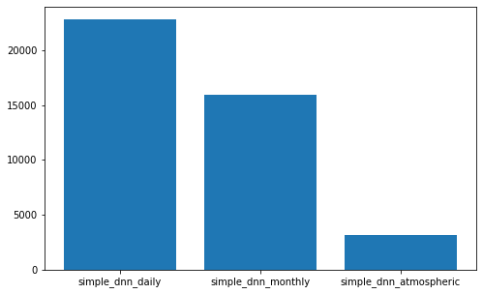
Comparison of DNN :
More features = Better Performance

Slide 21
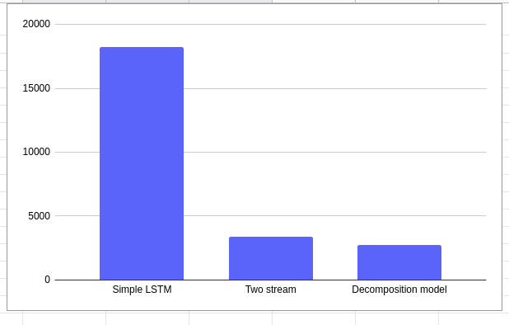
Comparison of LSTM :
Decomposition outperforms Two Stream

