Slide 1


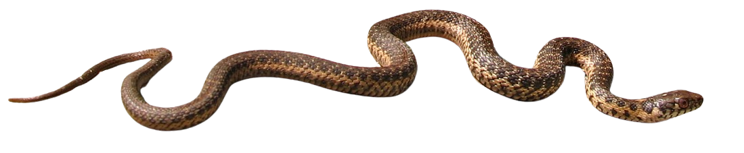
Assessing functional tradeoffs in toxin-resistant Sierra garter snakes (Thamnophis couchii)
Sage D Babish, Robert E del Carlo, Jessica S Reimche, Kelly E Robinson, Edmund D Brodie Jr., Edmund D Brodie III, Normand LeBlanc, Chris R Feldman
Image Source: Gary Nafis

Slide 2
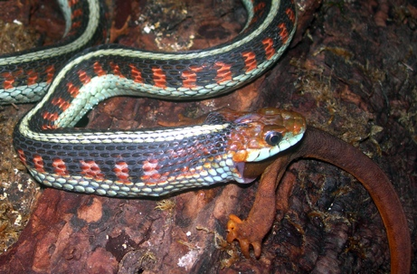
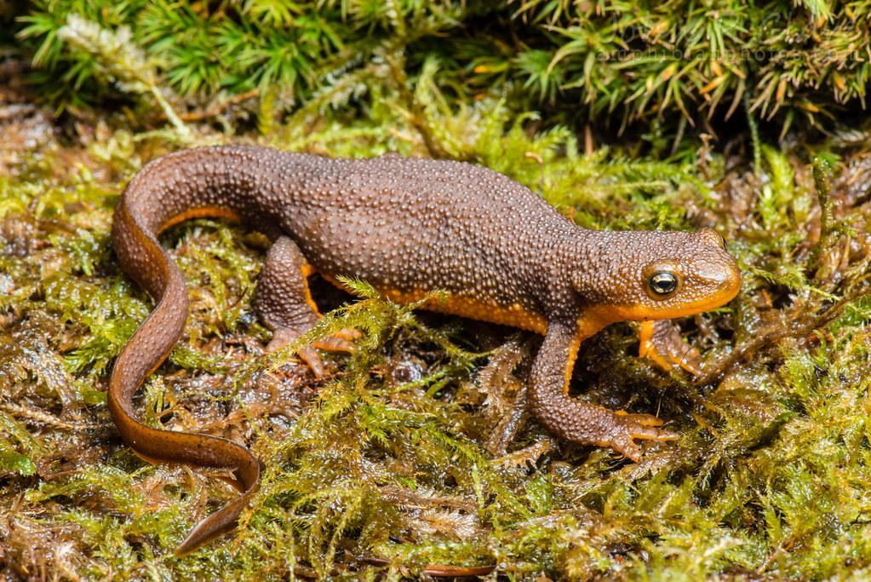
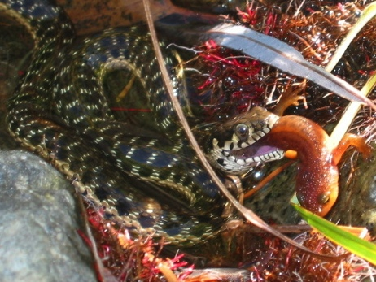
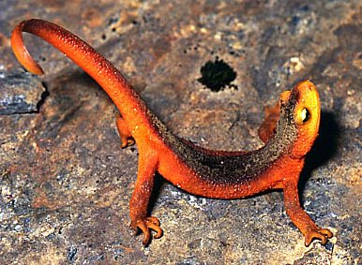
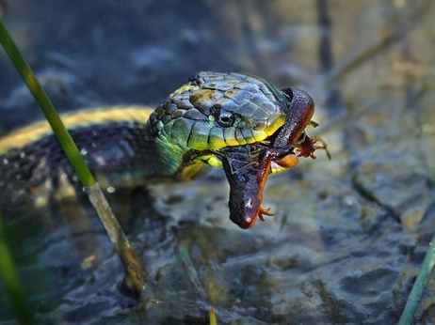
The Garter Snake-Newt Coevolutionary System
The Prey: Toxic Taricha Newts
The Predators: Toxin-Resistant Garter Snakes (Thamnophis)
Th. sirtalis
Ta. granulosa
Th. couchii
Ta. sierrae
Th. atratus
Brodie 1968; Feldman et al 2009; etc
Notes:
Say newts possess/contain ttx, not that they produce it

Slide 3
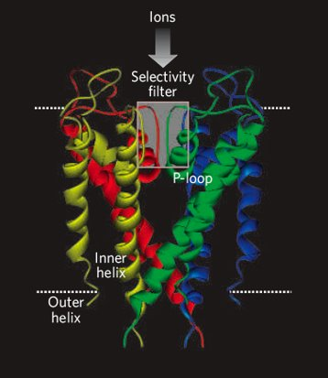
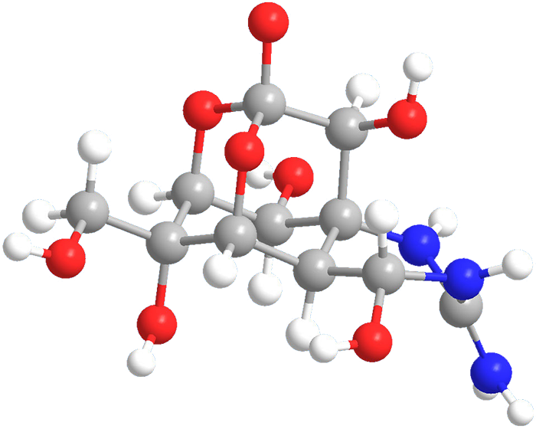
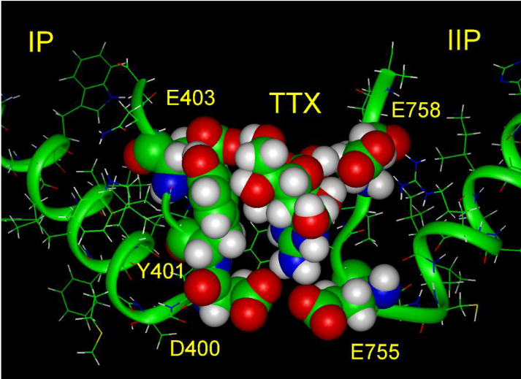
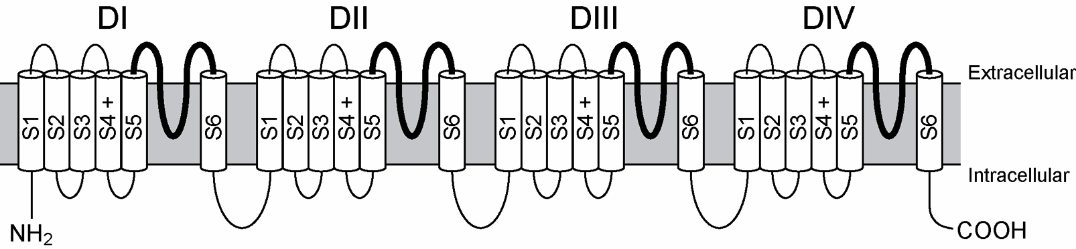
Tetrodotoxin: A Potent Anti-Predator Defense
Tetrodotoxin (TTX)
Sodium Channels (Nav Proteins)
American Chemical Society; Tikhonov and Zhorov 2005; Fozzard and Lipkind 2010
Notes:
Binding image from fozzard and lipkind 2010
Ttx image from acs

Slide 4
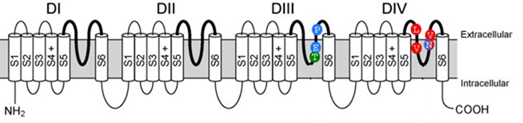
Mechanism of Resistance: Sodium Channel Mutations
Feldman et al 2012

Slide 5
The Resistance-Performance Trade-Off
Ability to Eat Newts
(Utilize Resources)
Sodium Channel
Performance
TTX Resistance

Slide 6
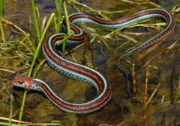
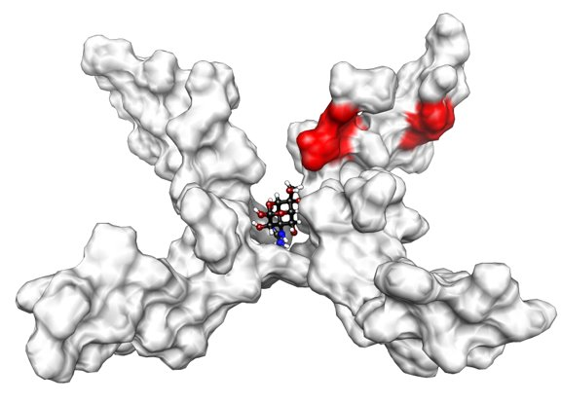
The Resistance-Performance Trade-Off
Ability to Eat Newts
(Utilize Resources)
Sodium Channel
Performance
Th. sirtalis
TTX Resistance
LVNV mutations carry performance trade-off
Feldman et al 2009; Lee et al 2011; Hague et al 2018; del Carlo et al 2024

Slide 7
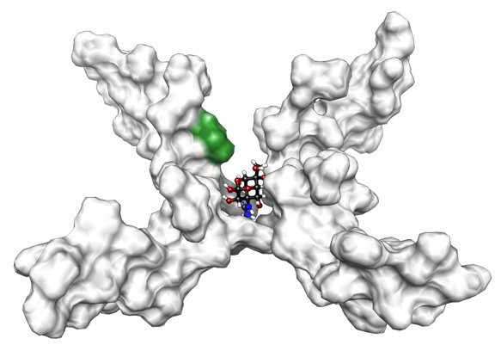
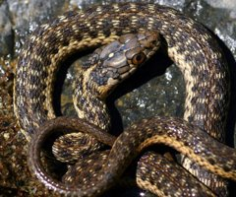
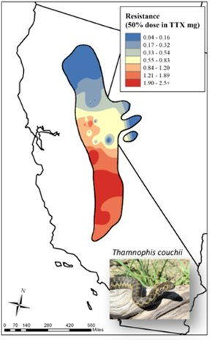
Study System: The Sierra garter snake (Thamnophis couchii)
Sympatric with Ta. sierrae and Ta. torosa
Fixed for M→T mutation in SCN4A
M→T mutation reduces TTX binding 15-fold
Same mutation found in TTX-bearing pufferfish and Taricha newts
Feldman et al 2012; Reimche et al 2022
Feldman et al 2009; Tikhonov and Zhorov 2005; Jost et al 2008; Hanifin and Gilley 2015

Slide 8
Research Questions
Do all TTX resistance-conferring mutations have pleiotropic effects/come with trade-offs?
How do these trade-offs influence the outcomes of coevolutionary interactions?

Slide 9
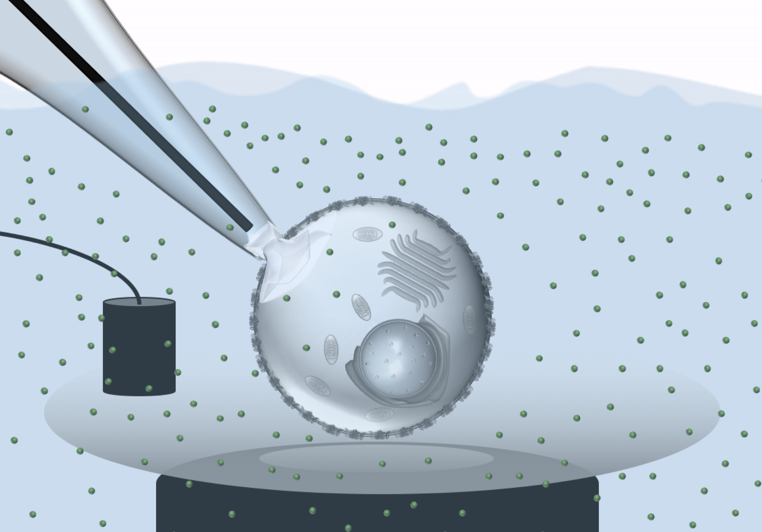
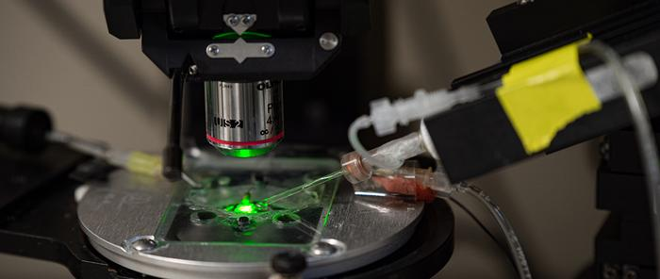
Approach 1: Assess sodium channel function with patch-clamp electrophysiology
Sodium Channel Currents
Steady-State Activation and
Inactivation of Channels
Current-Voltage
Relationship

Slide 10
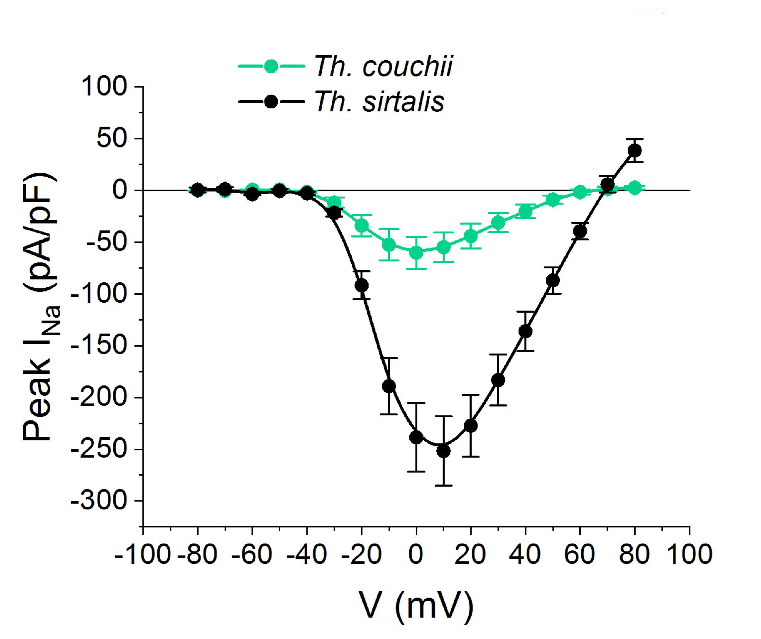
Cells with the Th. couchii M→T mutation produce weaker currents
Sodium currents produced by increasing voltages
Notes:
Na current recorded from each step of a voltage clamp step protocol

Slide 11
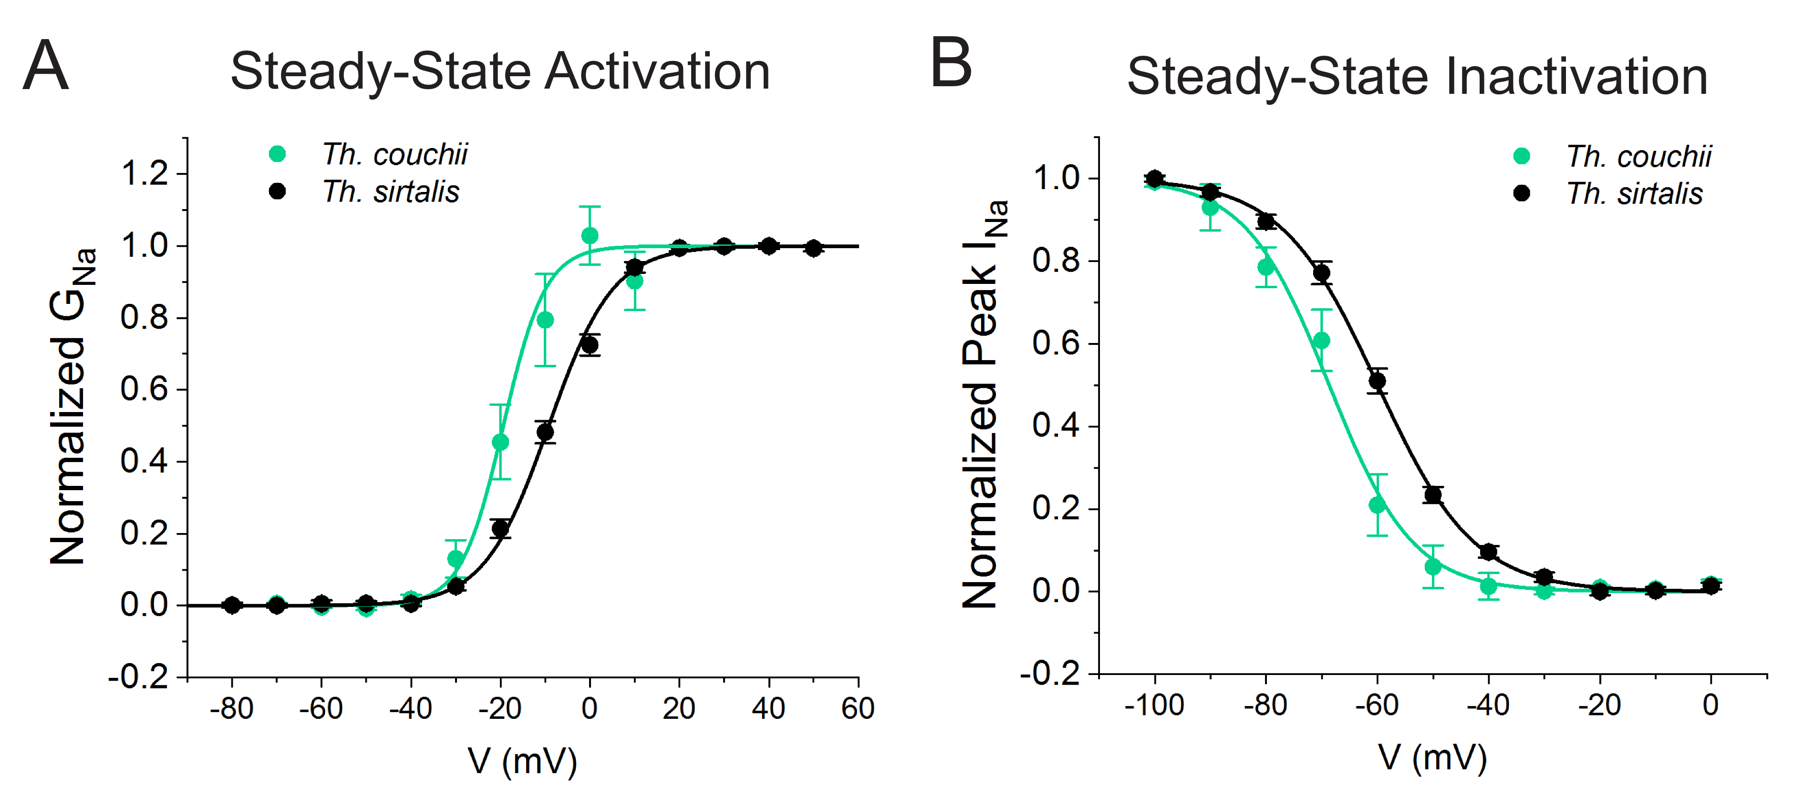
Sodium channels with the M→T mutation activate and deactivate more quickly than un-mutated sodium channels

Slide 12
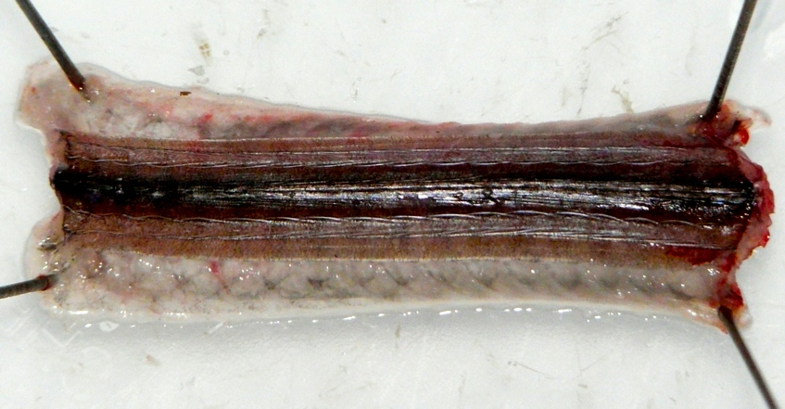
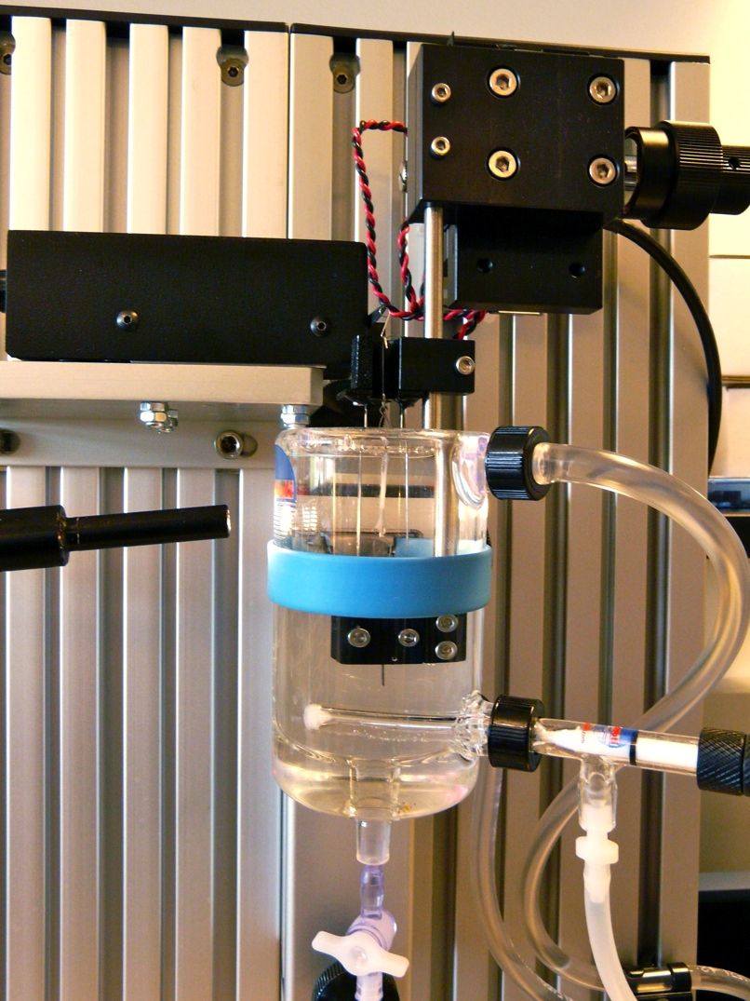
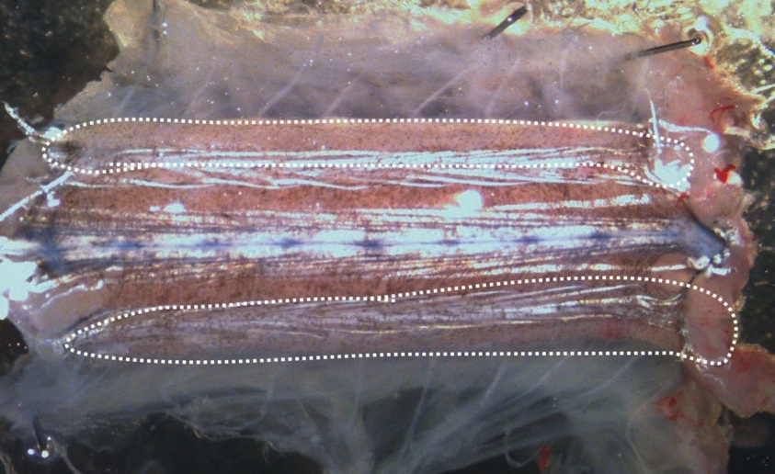
Approach 2: Assess skeletal muscle function with myography
Transient (quick) muscle contractions
Tetanic (sustained) muscle contractions
Muscle excitability (via rheobase experiments)

Slide 13
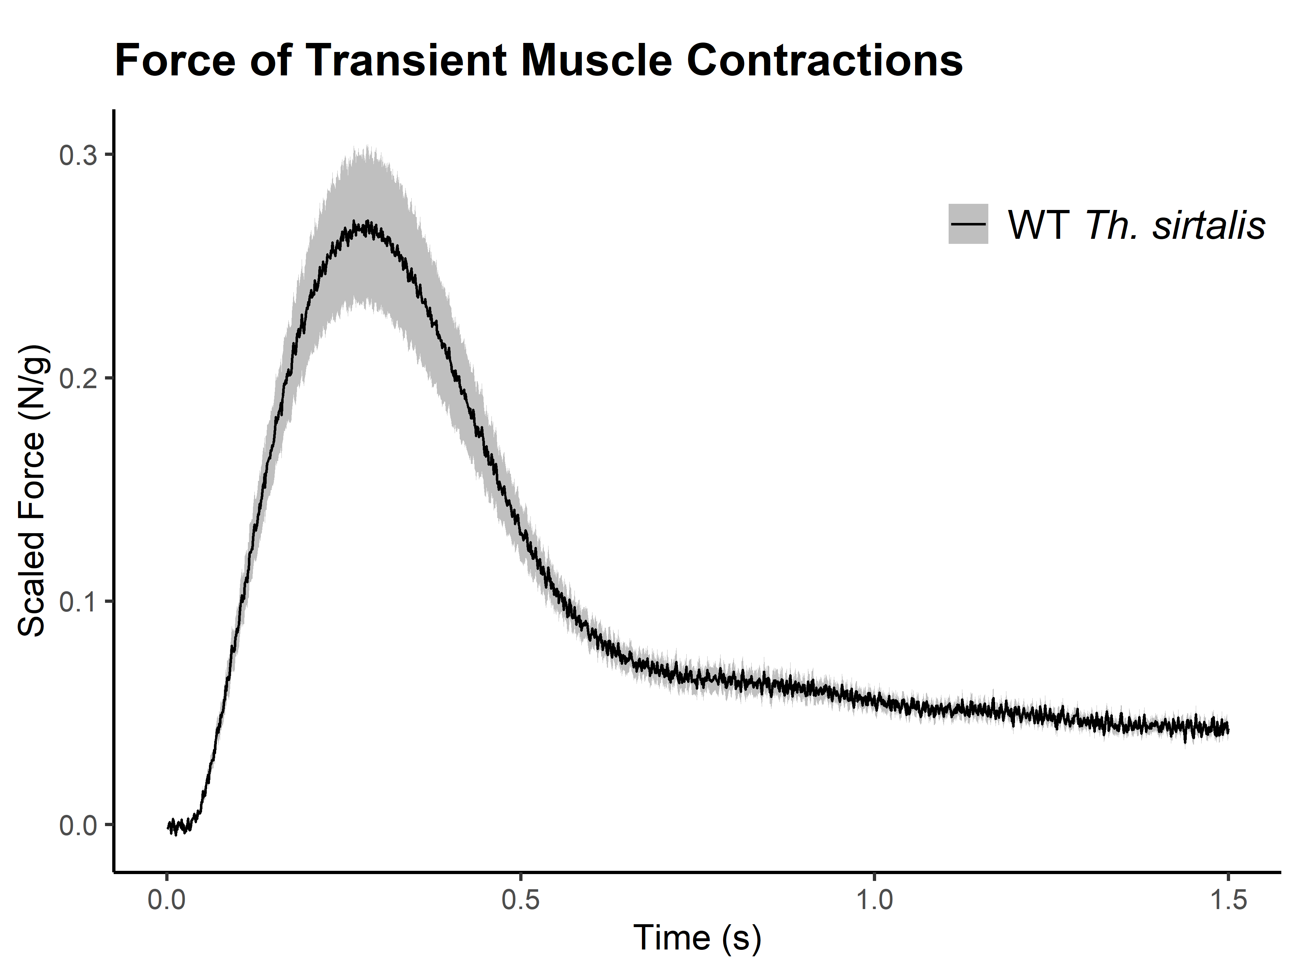

Slide 14
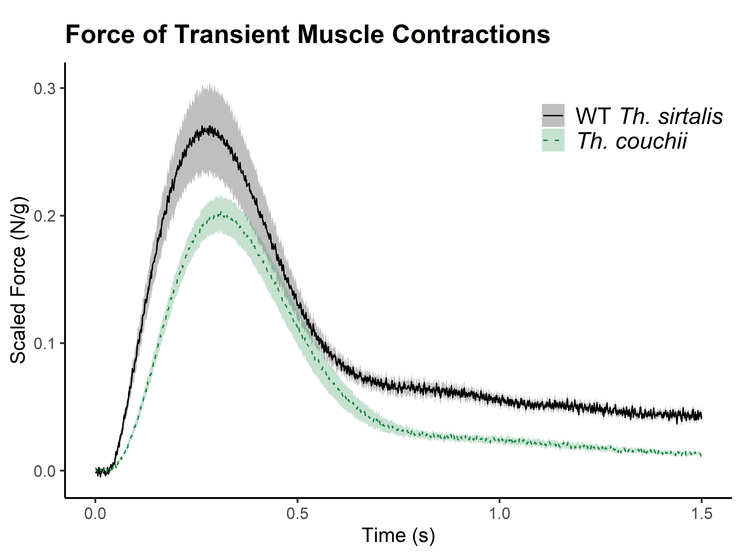

Slide 15
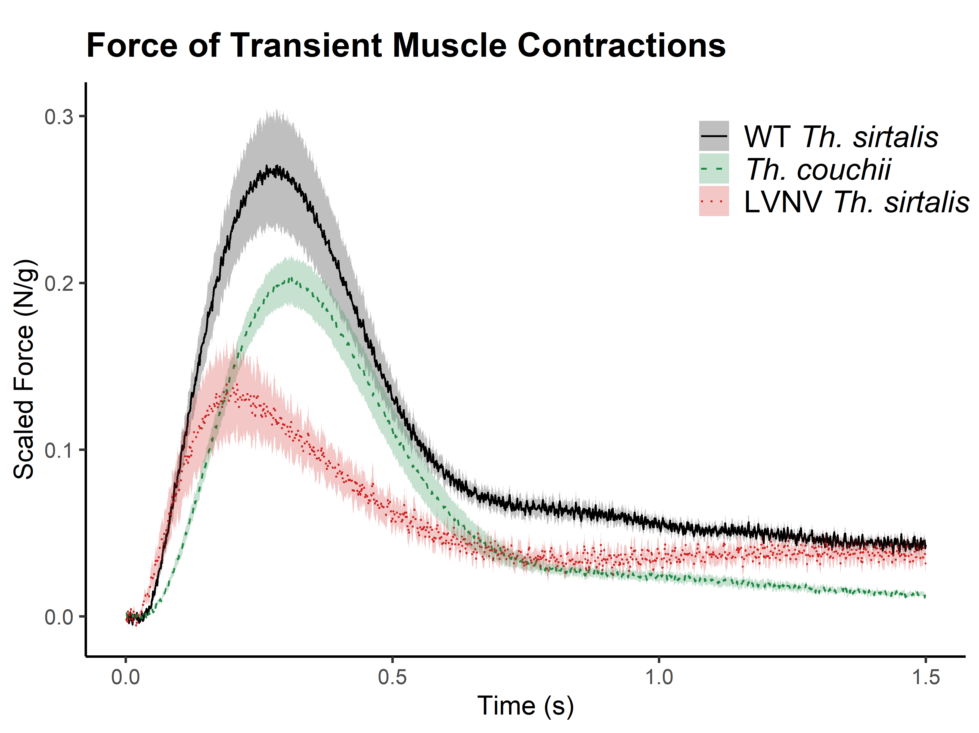

Slide 16
Th. couchii muscles produce slightly weaker, slower transient contractions than WT Th. sirtalis muscles

Slide 17
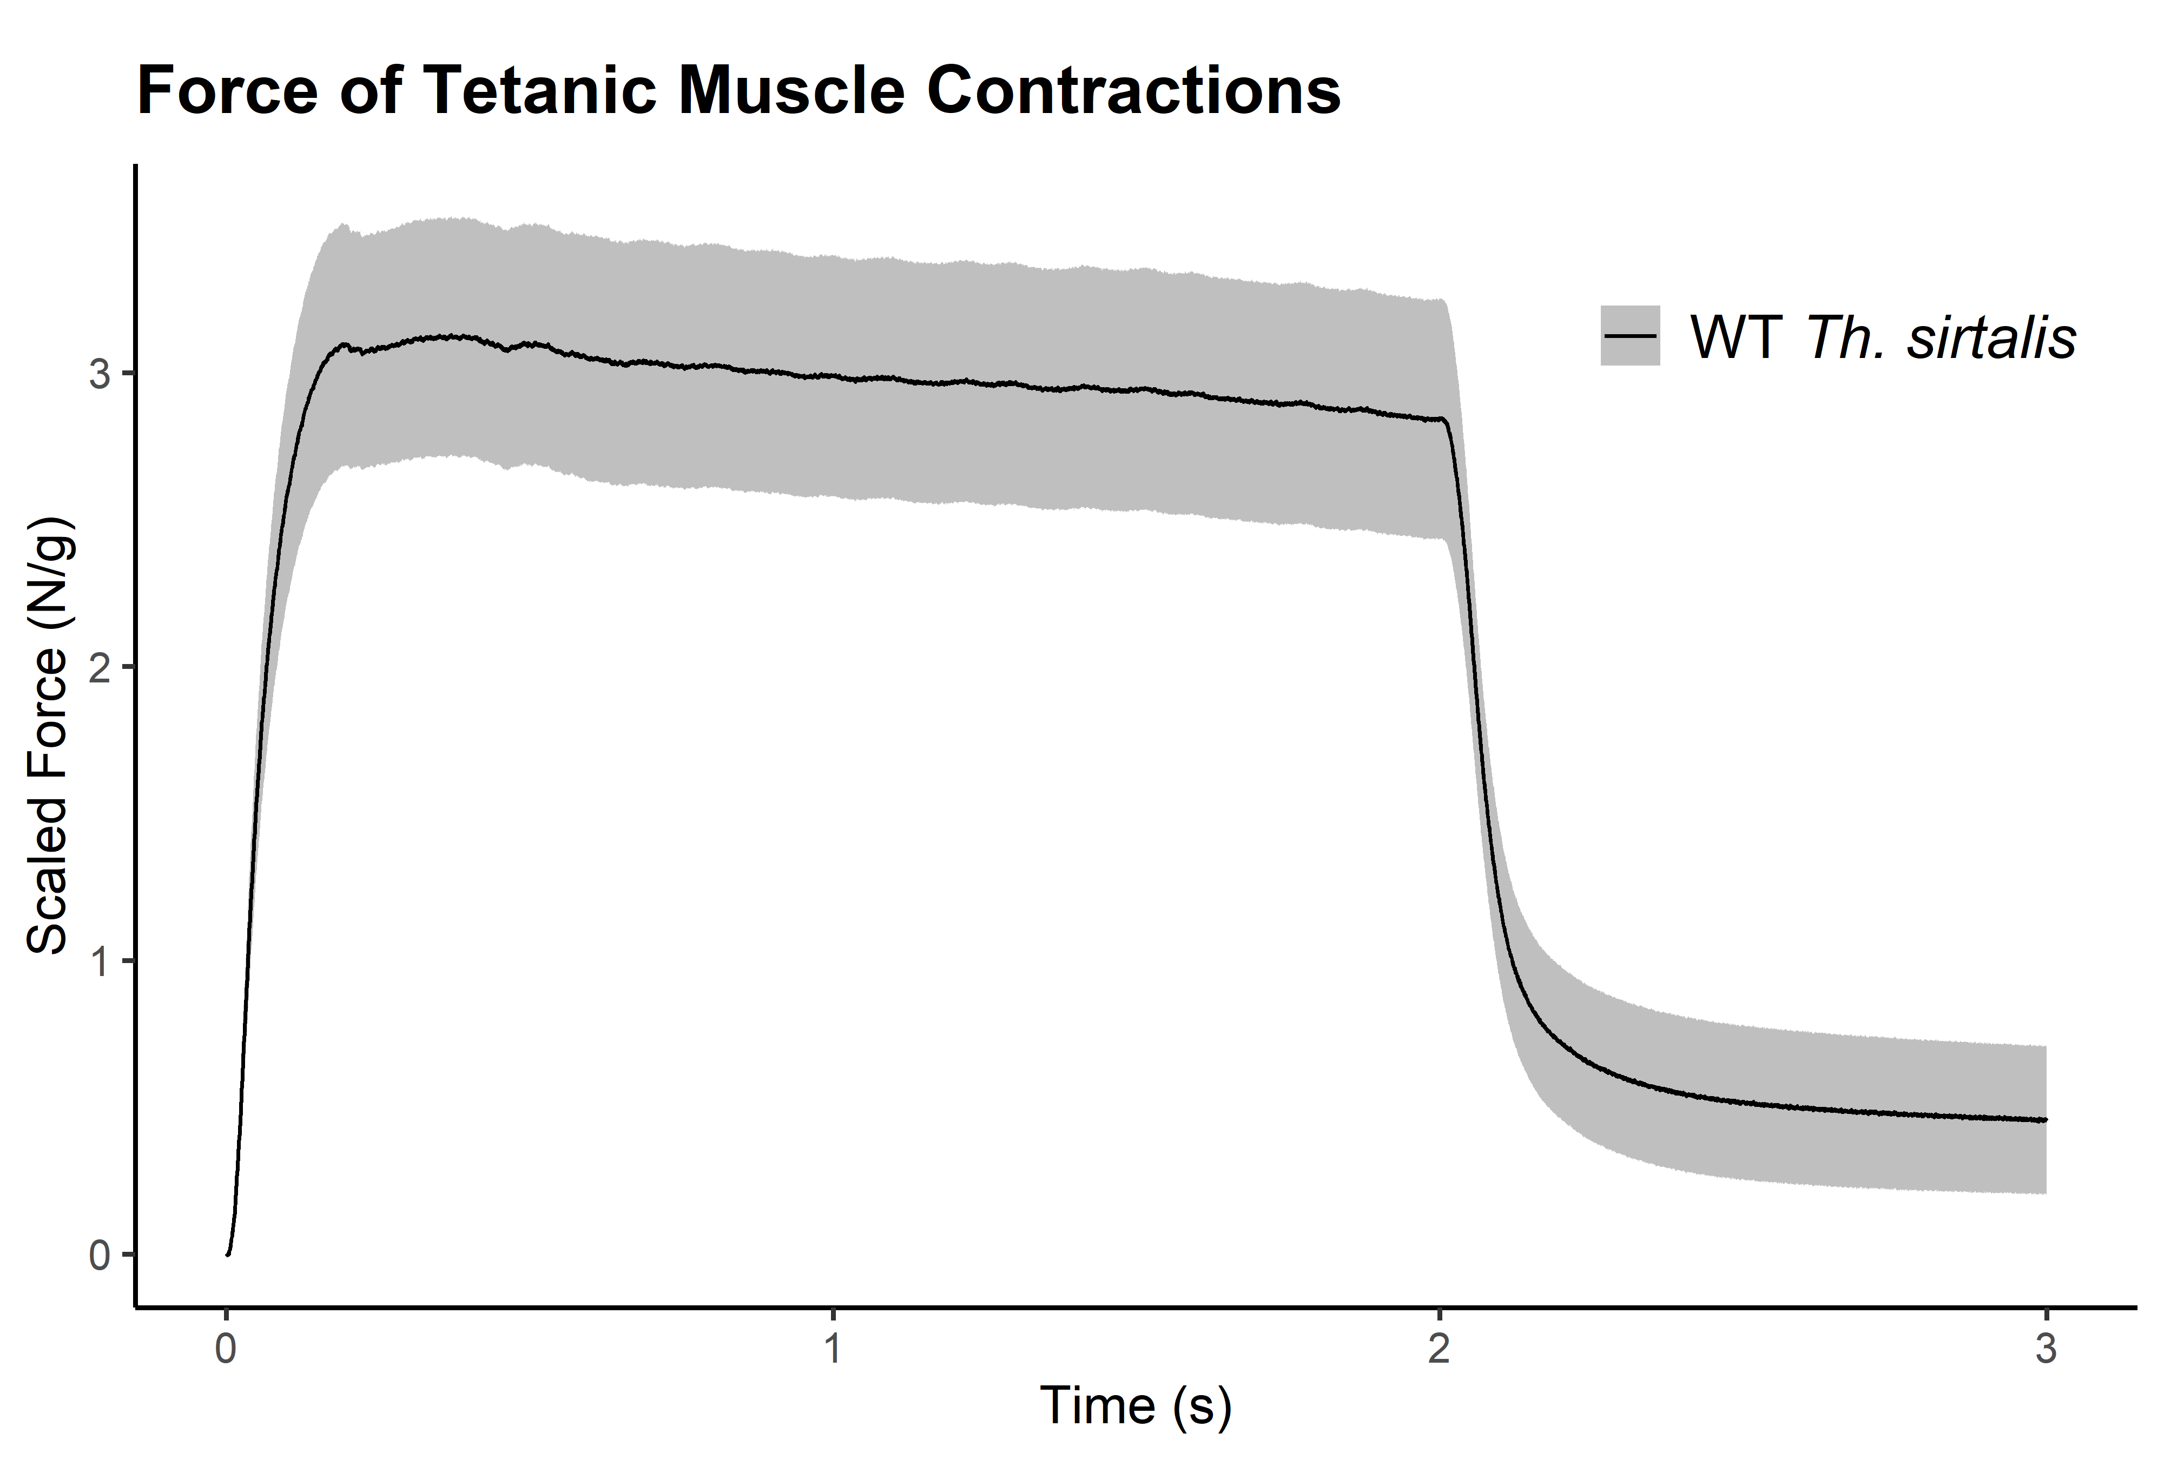

Slide 18
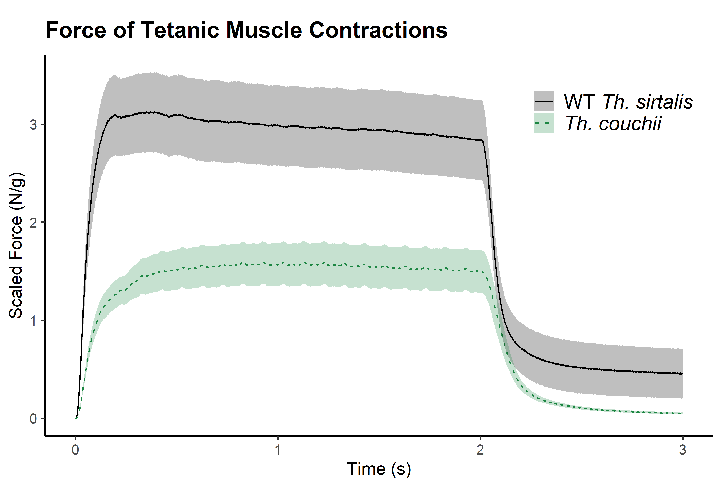

Slide 19
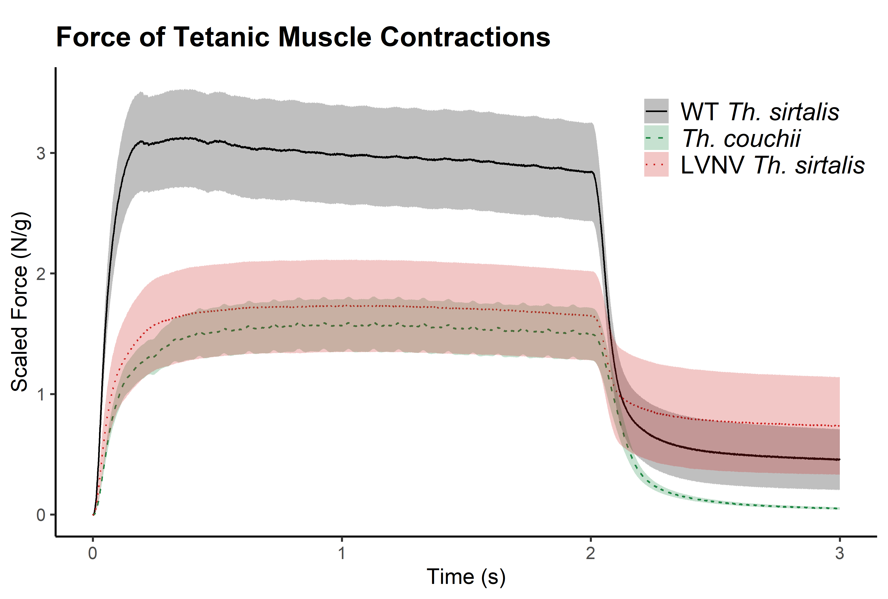

Slide 20
Th. couchii muscles produce much weaker tetanic contractions, comparable to LVNV Th. sirtalis muscles

Slide 21

Conclusions
TTX resistance-conferring mutations come with trade-offs
Supports theories about costs of specialized traits (Agrawal et al 2010; Futuyma and Moreno 1998)
Conflicts with theories that trade-offs should maintain polymorphisms, local adaptation (Futuyma and Moreno 1998; Bono et al 2017)
Ability to Eat Newts
(Utilize Resources)
Sodium Channel
Performance
TTX Resistance

Slide 22
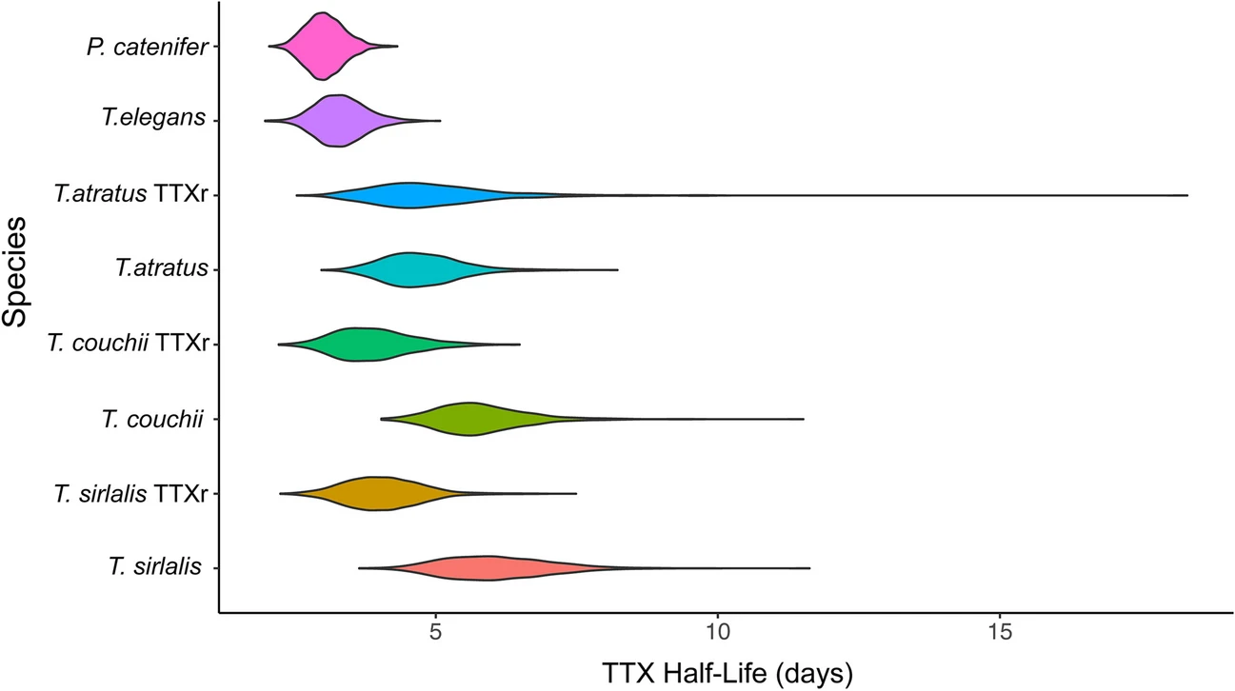
Future Directions
Further characterization of sodium channel function
Investigate other sources of TTX resistance
Robinson et al 2024

Slide 23

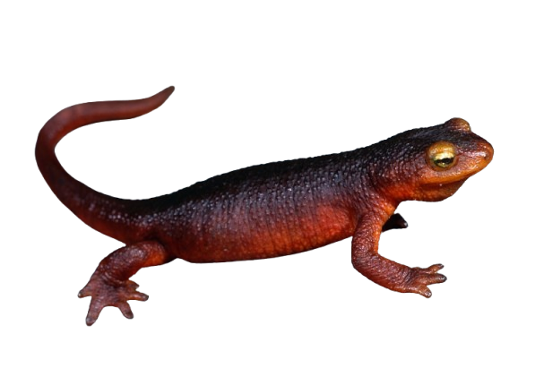


Sincere thanks to:
Funding:
NSF (to CRF & NL)
UNR
HL / SSAR / ASIH
Permits:
UNR IACUC
CA Fish & Wildlife
NV Div of Wildlife
Contact: sbabish@unr.edu
Live Animal Care:
Gabrielle Blaustein
Kenzie Wasley
Amber Durfee
Taylor Disbrow
Lab Aid:
Angelo Lippi
Janna Magana
Advice:
UNR Evol Doers
Field Collection:
Kevin Wiseman
Jens Vindum (CAS)
Photos:
Gary Nafis
Kevin Wiseman
Robert Hansen
Devon Picklum
Notes:
Lab:
Arielle Navarro
Angelo Lippi
Janna Magana

Slide 24
Extra/supplemental slides from this point on
:)

Slide 25
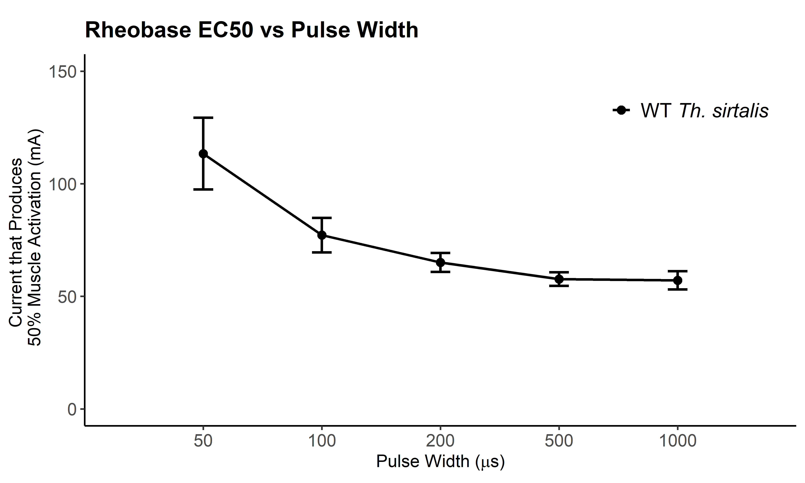

Slide 26
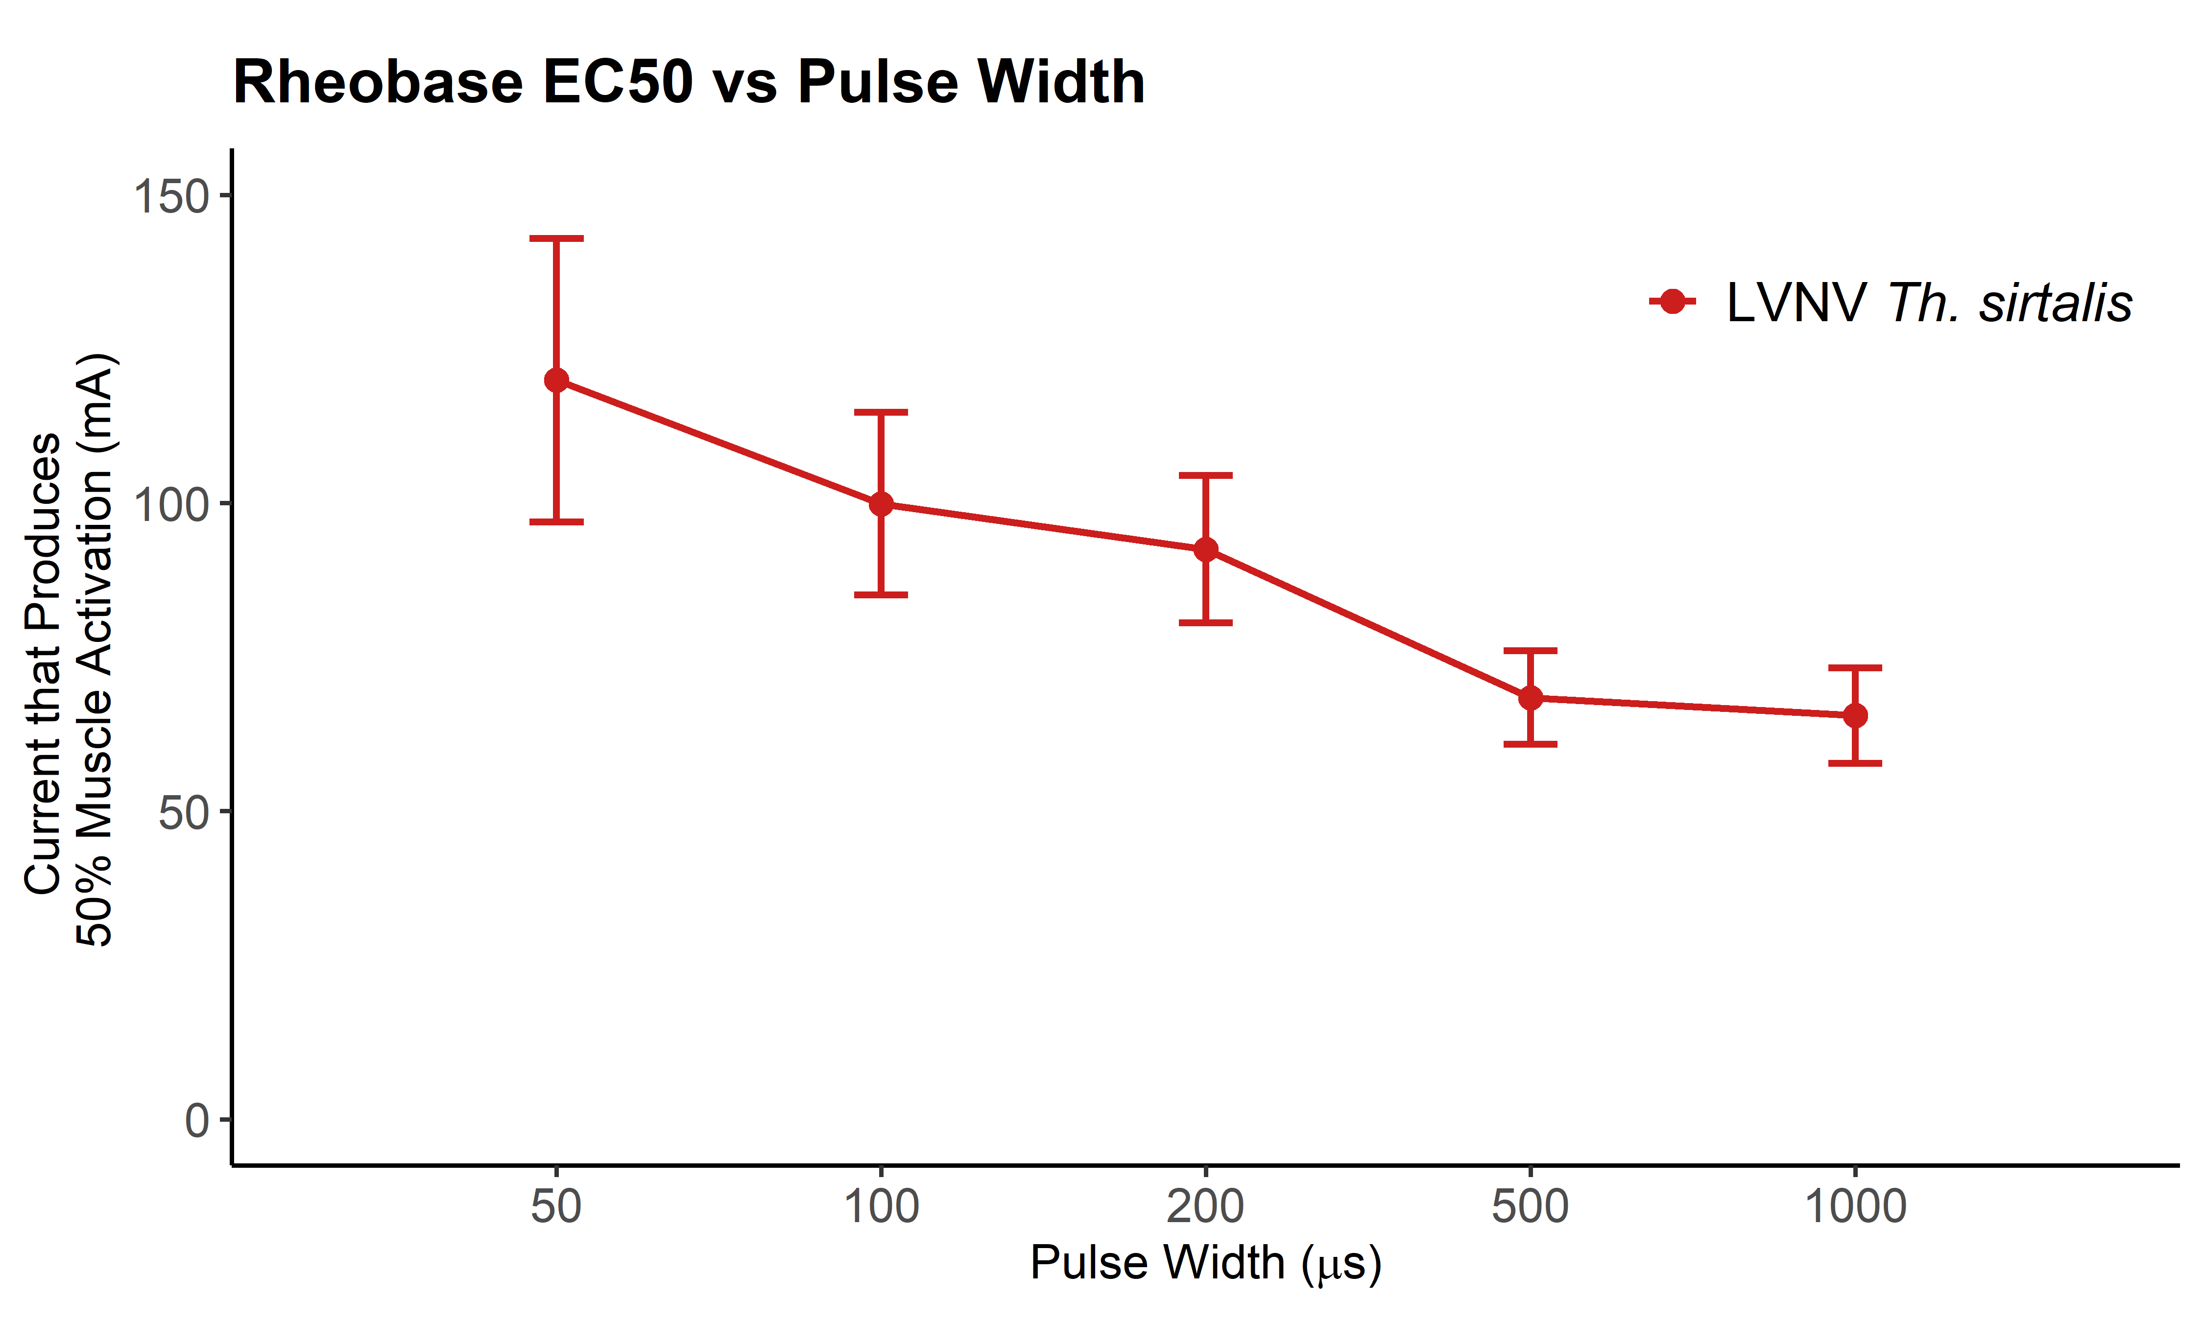
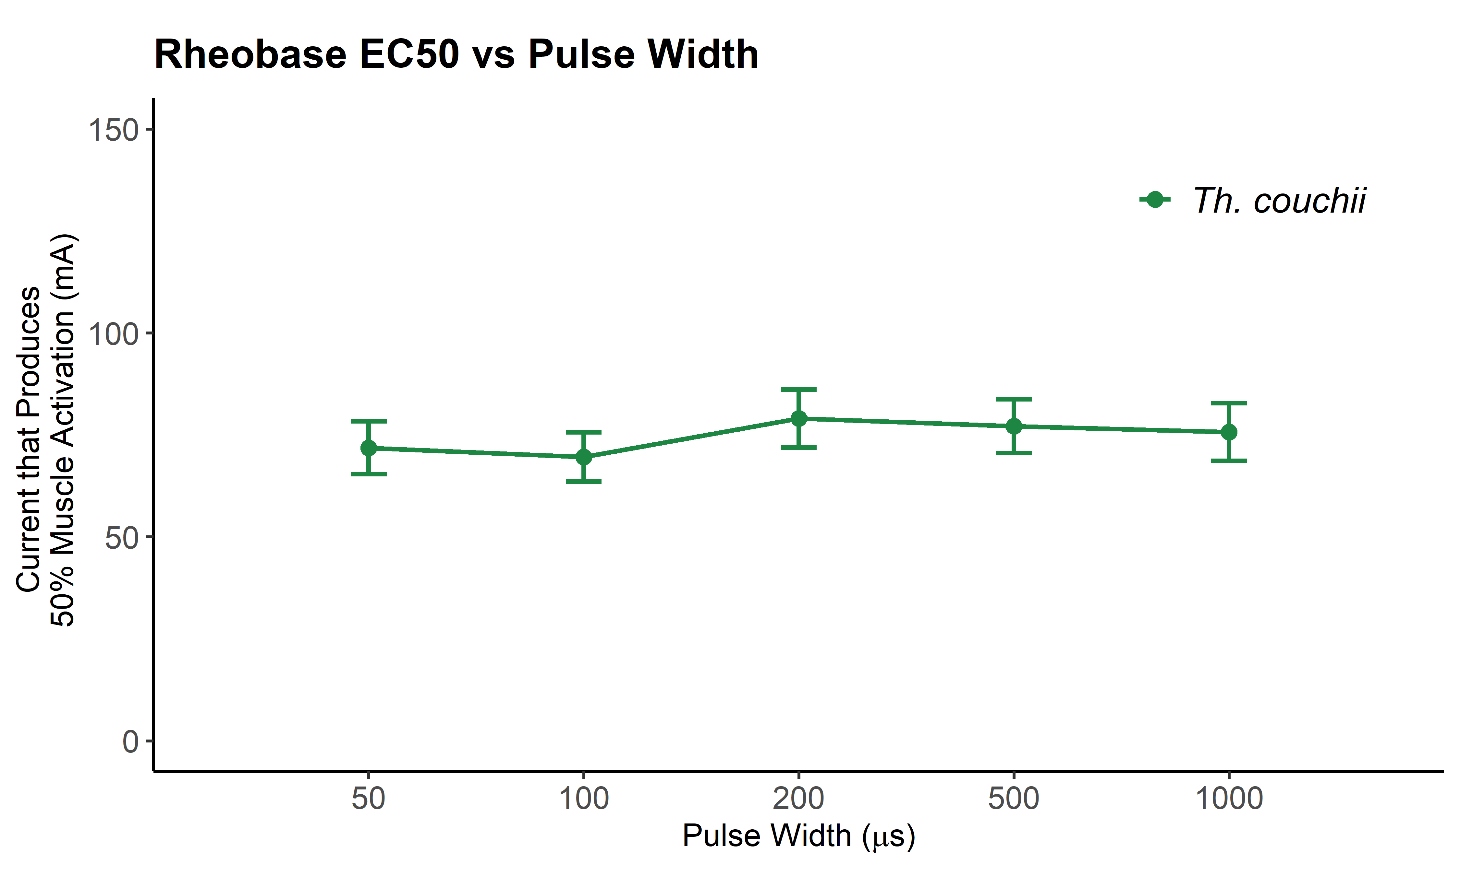

Slide 27
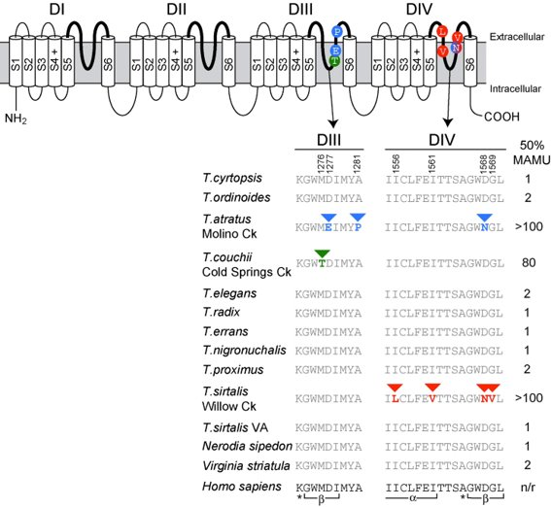
Feldman et al 2009

Slide 28
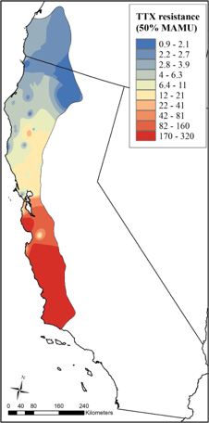
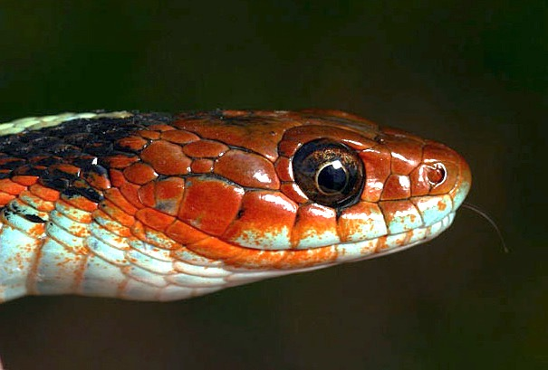
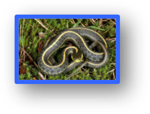
Geographic variation in TTX Resistance
Brodie et al 2002 Evolution​
Hague et al 2017 Evolution​
Gilbert et al 2023 Funct Ecol​

Slide 29
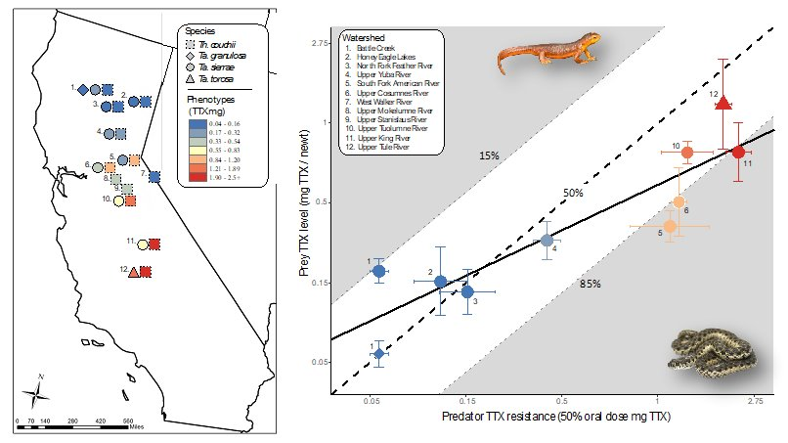
Newt-Snake Phenotype Matching
Reimche et al 2020

Slide 30
ANOVA Tables

Slide 31
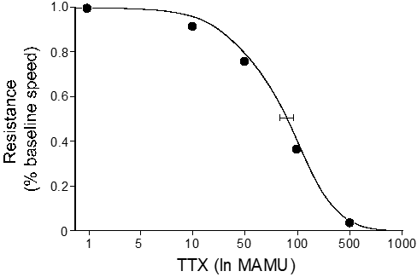
TTX resistance assay methods
Mouse Unit (MU)
0.2857μg TTX (20g Mus)
Mass Adjusted MU (MAMU)
mass (0.0143μg TTX / g)

