Slide 1
Machine Learning Security project
Project 1
PhD student: | Stefania Bello
GitHub link: | https://github.com/s-bello10/MLSec_Bello_S

Slide 2
Project description
Select five CIFAR-10 (ℓ∞) models from RobustBench and re-evaluate them using AutoAttack under different values of the radius epsilon (e.g., from 1/255 to 16/255, regularly spaced interval including the baseline 8/255), using a subset of 100-200 samples.
Compare the resulting robust accuracies and model rankings across these settings.
Evaluate the stability of model rankings across different epsilon values.
Identify cases where these changes lead to significant rank shifts and discuss what this reveals about the reliability of RobustBench leaderboards.

Slide 3
Selected models
Model ID | Architecture | RobustBench Ranking | Paper
Carmon2019Unlabeled | WideResNet-28-10 | 36 | Unlabeled Data Improves Adversarial Robustness
Sehwag2021Proxy_R18 | ResNet-18 | 59 | Robust Learning Meets Generative Models: Can Proxy Distributions Improve Adversarial Robustness?
Rebuffi2021Fixing_R18_ddpm | PreActResNet-18 | 53 | Fixing Data Augmentation to Improve Adversarial Robustness
Wang2023Better_WRN-28-10 | WideResNet-28-10 | 10 | Better Diffusion Models Further Improve Adversarial Training
Cui2023Decoupled_WRN-28-10 | WideResNet-28-10 | 9 | Decoupled Kullback-Leibler Divergence Loss

Slide 4
Experimental setup
Technical specifications
Parameters
CPU: 13th Gen Intel i9-13900HX
GPU: NVIDIA GeForce RTX 4070 Laptop GPU
Python 3.12.12
PyTorch 2.5.1 + PyTorch CUDA
Anaconda for virtual environment + Jupyter Notebook
Test subset size: 200
Epsilon values: 1/255, 4/255, 8/255, 12/255, 16/255
Batch size: 16
AutoAttack:
untargeted APGD-CE (no restarts)
targeted APGD-DLR (9 target classes)
targeted FAB (9 target classes)
Square Attack (5000 queries)
https://github.com/fra31/auto-attack

Slide 5
Results: clean accuracy
Model ID | Clean accuracy (%) (from RobustBench) | Clean accuracy (%) (on 200 test samples)
Carmon2019Unlabeled | 89.69 | 90.50
Sehwag2021Proxy_R18 | 84.59 | 87.00
Rebuffi2021Fixing_R18_ddpm | 83.53 | 85.50
Wang2023Better_WRN-28-10 | 92.44 | 92.50
Cui2023Decoupled_WRN-28-10 | 92.16 | 93.50
Our starting point

Slide 6
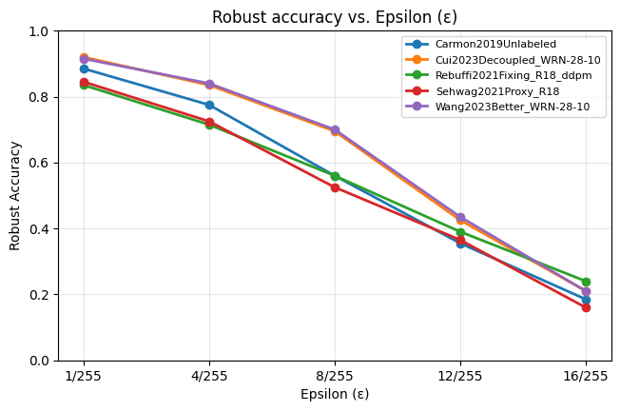
Results: robust accuracy
Robust accuracy dramatically drops for all models as ε increases, but some models degrade much faster than others:
  For smaller εs (e.g., 1/255 and 4/255), Wang2023Better_WRN-28-10 and Cui2023Decoupled_WRN-28-10 perform best;
  For larger εs (e.g., 12/255 and 16/255), Rebuffi2021Fixing_R18_ddpm becomes the most robust, while some top models at smaller ε fall behind;
These changes show that models' robustness strongly depends on εs and being robust against a specific ε doesn't make the model robust against other εs.
Model ID | Clean accuracy | 1/255 | 4/255 | 8/255 | 12/255 | 16/255
Carmon2019Unlabeled | 90.50% | 88.50% (↓2.00%) | 77.50% (↓13.00%) | 56.00% (↓34.50%) | 35.50% (↓55.00%) | 18.50% (↓72.00%)
Cui2023Decoupled_WRN-28-10 | 87.00% | 92.00% (↓1.50%) | 83.50% (↓10.00%) | 69.50% (↓24.00%) | 42.50% (↓51.00%) | 21.00% (↓72.50%)
Rebuffi2021Fixing_R18_ddpm | 85.50% | 83.50% (↓2.00%) | 71.50% (↓14.00%) | 56.00% (↓29.50%) | 39.00% (↓46.50%) | 24.00% (↓61.50%)
Sehwag2021Proxy_R18 | 92.50% | 84.50% (↓2.50%) | 72.50% (↓14.50%) | 52.50% (↓34.50%) | 36.50% (↓50.50%) | 16.00% (↓71.00%)
Wang2023Better_WRN-28-10 | 93.50% | 91.50% (↓1.00%) | 84.00% (↓8.50%) | 70.00% (↓22.50%) | 43.50% (↓49.00%) | 21.00% (↓71.50%)

Slide 7
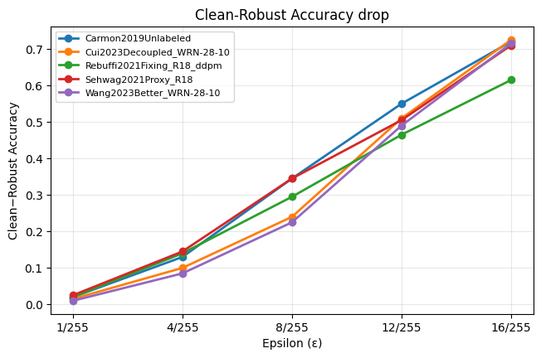
Results: robust accuracy drop
The clean-to-robust accuracy drop increases for all models as ε grows, but the size of the drop differs across models:
  For smaller εs (e.g., 1/255 or 8/255), Wang2023Better_WRN-28-10 and Cui2023Decoupled_WRN-28-10 show the smallest drops but, on larger εs, even their performance degrades;
  Rebuffi2021Fixing_R18_ddpm degrades more slowly at large ε, despite weaker performance at small εs;
  Models such as Carmon2019Unlabeled and Sehwag2021Proxy_R18 suffer larger accuracy drops, leading to lower rankings at higher ε values.
Model ID | Clean accuracy | 1/255 | 4/255 | 8/255 | 12/255 | 16/255
Carmon2019Unlabeled | 90.50% | 88.50% (↓2.00%) | 77.50% (↓13.00%) | 56.00% (↓34.50%) | 35.50% (↓55.00%) | 18.50% (↓72.00%)
Cui2023Decoupled_WRN-28-10 | 87.00% | 92.00% (↓1.50%) | 83.50% (↓10.00%) | 69.50% (↓24.00%) | 42.50% (↓51.00%) | 21.00% (↓72.50%)
Rebuffi2021Fixing_R18_ddpm | 85.50% | 83.50% (↓2.00%) | 71.50% (↓14.00%) | 56.00% (↓29.50%) | 39.00% (↓46.50%) | 24.00% (↓61.50%)
Sehwag2021Proxy_R18 | 92.50% | 84.50% (↓2.50%) | 72.50% (↓14.50%) | 52.50% (↓34.50%) | 36.50% (↓50.50%) | 16.00% (↓71.00%)
Wang2023Better_WRN-28-10 | 93.50% | 91.50% (↓1.00%) | 84.00% (↓8.50%) | 70.00% (↓22.50%) | 43.50% (↓49.00%) | 21.00% (↓71.50%)

Slide 8
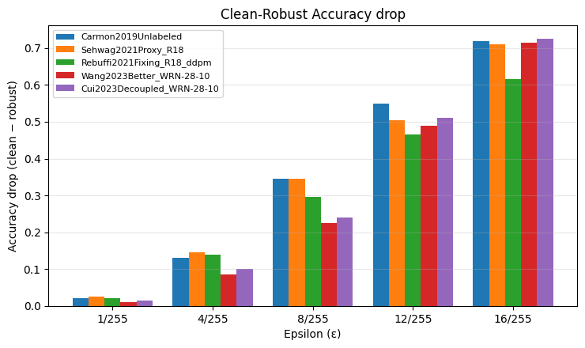
Results: robust accuracy drop
The same observations can be made if we observe the accuracy drop histogram
Model ID | Clean accuracy | 1/255 | 4/255 | 8/255 | 12/255 | 16/255
Carmon2019Unlabeled | 90.50% | 88.50% (↓2.00%) | 77.50% (↓13.00%) | 56.00% (↓34.50%) | 35.50% (↓55.00%) | 18.50% (↓72.00%)
Cui2023Decoupled_WRN-28-10 | 87.00% | 92.00% (↓1.50%) | 83.50% (↓10.00%) | 69.50% (↓24.00%) | 42.50% (↓51.00%) | 21.00% (↓72.50%)
Rebuffi2021Fixing_R18_ddpm | 85.50% | 83.50% (↓2.00%) | 71.50% (↓14.00%) | 56.00% (↓29.50%) | 39.00% (↓46.50%) | 24.00% (↓61.50%)
Sehwag2021Proxy_R18 | 92.50% | 84.50% (↓2.50%) | 72.50% (↓14.50%) | 52.50% (↓34.50%) | 36.50% (↓50.50%) | 16.00% (↓71.00%)
Wang2023Better_WRN-28-10 | 93.50% | 91.50% (↓1.00%) | 84.00% (↓8.50%) | 70.00% (↓22.50%) | 43.50% (↓49.00%) | 21.00% (↓71.50%)

Slide 9
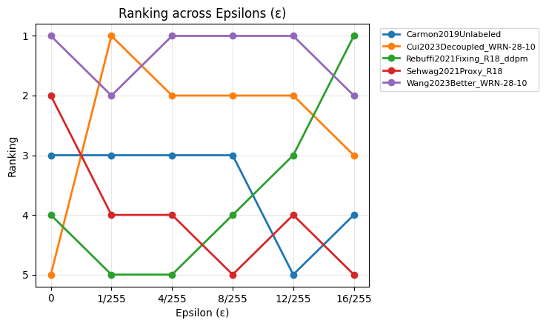
Results: ranking
Model rankings change noticeably as ε increases
Wang2023Better_WRN-28-10 and Cui2023Decoupled_WRN-28-10 show the most stable behaviour, staying within the top-2 and top-3 ranks, respectively, across all ε values;
Indeed, they rank 1st and 2nd at 8/255 (benchmark);
In contrast, Rebuffi2021Fixing_R18_ddpm is the most instable model, moving from last place at small ε to first place at large ε;
Overall, the results indicate that single-ε leaderboards mask important ranking shifts and that robustness should be evaluated across multiple ε values.
Model ID | Clean accuracy | Clean rank | 1/255 | 4/255 | 8/255 | 12/255 | 16/255
Carmon2019Unlabeled | 90.50% | 36 → 3 | 3 | 3 | 3 | 5 | 4
Cui2023Decoupled_WRN-28-10 | 87.00% | 59 → 5 | 1 | 2 | 2 | 2 | 3
Rebuffi2021Fixing_R18_ddpm | 85.50% | 53 → 4 | 5 | 5 | 4 | 3 | 1
Sehwag2021Proxy_R18 | 92.50% | 10 → 2 | 4 | 4 | 5 | 4 | 5
Wang2023Better_WRN-28-10 | 93.50% | 9 → 1 | 2 | 1 | 1 | 1 | 2

Slide 10
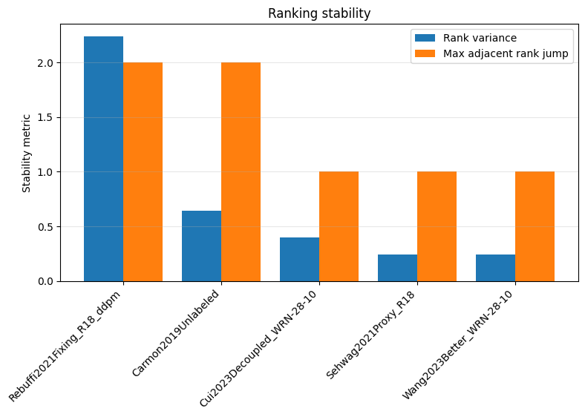
Results: ranking stability
Ranking stability can also be seen as rank variance: as a matter of fact, Wang2023Better_WRN-28-10 and Cui2023Decoupled_WRN-28-10 low variance hence more stability, with low rank variance and no large rank jumps across ε;
Rebuffi2021Fixing_R18_ddpm, with passed from 5 to 1, is the least stable model, showing both the highest rank variance and the largest rank jump;
Sehwag2021Proxy_R18 remains consistently in the lower ranks, showing moderate stability.
Carmon2019Unlabeled exhibits noticeable instability, with a larger rank variance and a two-position drop at higher ε.
Model ID | Clean accuracy | Clean rank | 1/255 | 4/255 | 8/255 | 12/255 | 16/255
Carmon2019Unlabeled | 90.50% | 36 → 3 | 3 | 3 | 3 | 5 | 4
Cui2023Decoupled_WRN-28-10 | 87.00% | 59 → 5 | 1 | 2 | 2 | 2 | 3
Rebuffi2021Fixing_R18_ddpm | 85.50% | 53 → 4 | 5 | 5 | 4 | 3 | 1
Sehwag2021Proxy_R18 | 92.50% | 10 → 2 | 4 | 4 | 5 | 4 | 5
Wang2023Better_WRN-28-10 | 93.50% | 9 → 1 | 2 | 1 | 1 | 1 | 2

Slide 11
Conclusions
Robust accuracy and model rankings change significantly as ε varies, showing that robustness is strongly ε-dependent;
Some models were more sensible to the increasing of ε;
Models ranked highest at the standard benchmark ε = 8/255 are not always the most robust at larger perturbation strengths;
Some models (e.g., Wang2023Better_WRN-28-10, Cui2023Decoupled_WRN-28-10) show relatively stable rankings, while others (Rebuffi2021Fixing_R18_ddpm) exhibit large rank shifts across ε;
RobustBench shows the robustness at ε = 8/255 (for these models) and doesn't represent a global notion of robustness: single-ε leaderboard positions can reflect optimization for a specific threat setting and can be quite misleading, as being robust against one ε (e.g., 8/255) doesn't imply absolute robustness → multi-ε analysis would be a better choice;
RobustBench leaderboards should therefore be interpreted as conditional rankings, valid only for the chosen ε and threat model.

Slide 12
THANK YOU FOR YOUR ATTENTION
Stefania Bello
 stefania.bello@unicampus.it - s.bello10@phd.uniba.it

