Slide 1
Welcome to the Slide Deck
Created by Sam Carter

Slide 2

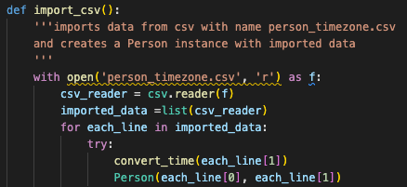

Idea of the Application and Packages Used
The application is designed to allow users to input people and their time zones into the app and view the current times for one or all people added. Will get into the technical side of the features in slides to come. The modules that are included in the application are:
Datetime – was used in the process of determining the current time and allowing pytz to convert
Pytz – this third-party package provided all of the time zones in the app along with the information about the time difference between.
Csv – was used in the process of importing and exporting the stored list of people to a CSV file.
Simple Term Menu – was used to create the menus all throughout the app. This was a great help when it came to pre-emptive error handling

Slide 3

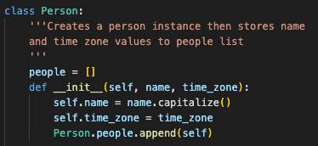
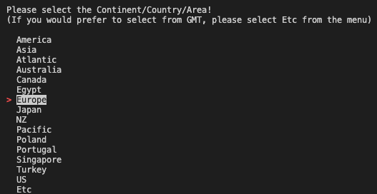
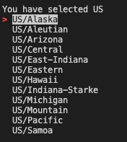
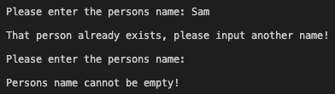
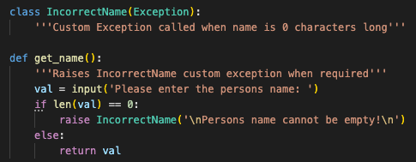
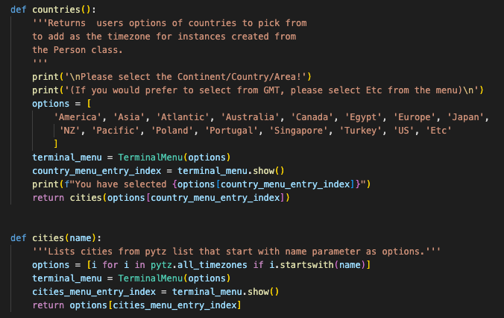

How it Ended Up – Feature 1 – Managing a person
Create, change time zone and delete user
Creates using a class method – Two arguments: name (input) and time zone (Lists created with simple term menu that drill down by continent/country/area.
Error Handling – checks for duplicate or empty name inputs and raises custom errors
Issues – PYTZ sorting of time zones – not always consistent

Slide 4




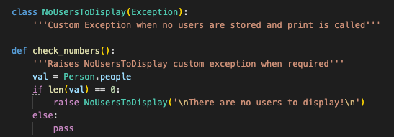
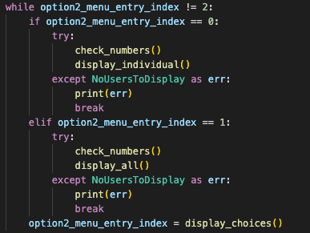
How it Ended Up – Feature 2 – Displaying the Times
View people from the list either individually or prints all people:
This feature also carries out the time zone conversion from a string to a formatted time:
Error Handling – checks if there are class instances in the list before displaying:

Slide 5
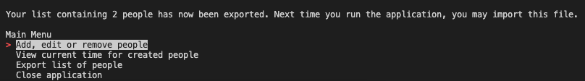

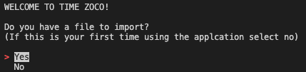

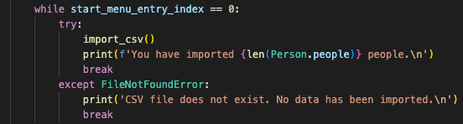
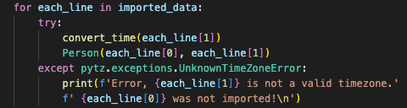
How it Ended Up – Feature 3 – Importing/Exporting CSV
Allows the user to export their list of people to a CSV file which can later be imported when the app next runs
Exporting is done from the main menu:
While user is given the option to import the CSV file when the app starts:
Error Handling – When importing files, the time zone data is checked to confirm it has a corresponding time zone in the pytz database. If an error is found, the user will be made aware of the failed import and the app will continue importing the other perople from the CSV
If CSV file does not exist and user tries to import, they will be made aware

Slide 6
Final Thoughts
Great learning experience!
Much better understanding of Python syntax and the format.

