Slide 1


Web Service Composition & YouRest
Koutli Maria - CERTH

Slide 2
Workflow of web service composition
WSC plug-in
Workflow of services
Register services in YouREST
Code generation
Create storyboards
Service Deployment

Slide 3
YouREST
A web directory for registering and exposing web services.
Contains external services registered by the user or RESTful web services produced by the S-CASE MDE and Web Service Composition plug-ins.
Supports WSDL, WADL and RAML descriptions.

Slide 4
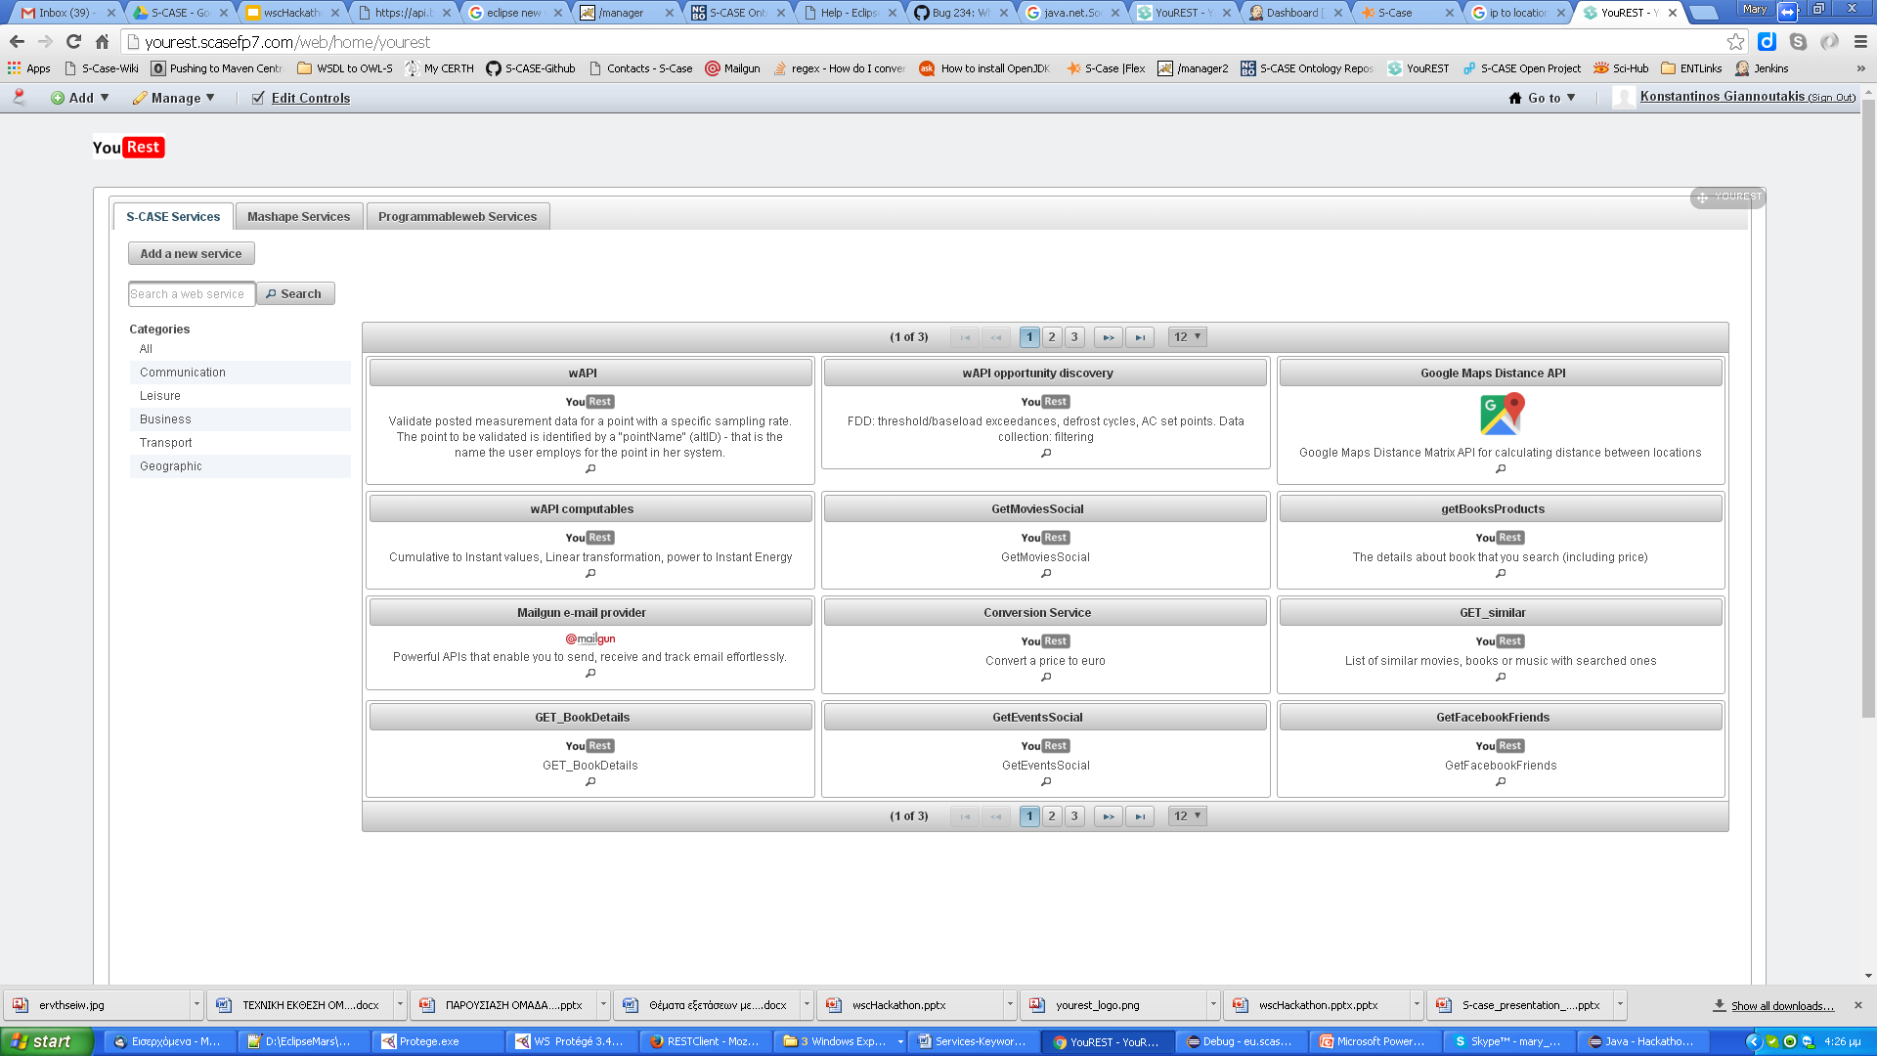
YouREST Interface

Slide 5
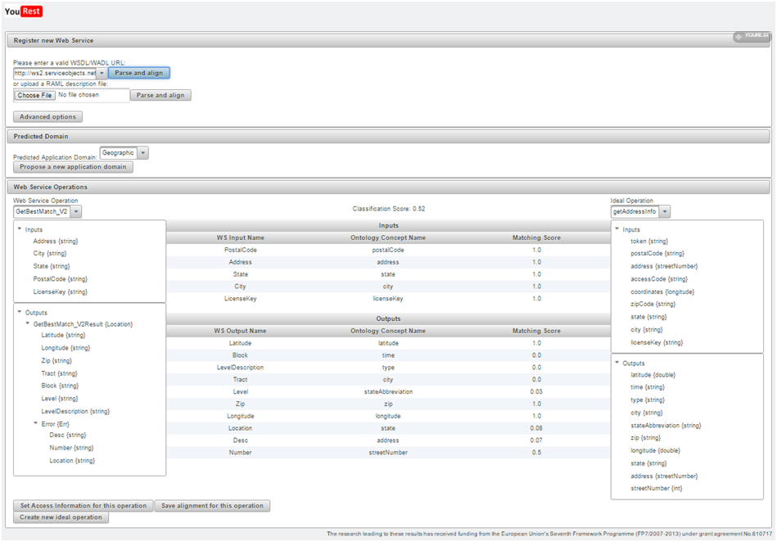
Web service registration on YouRest
Semantic annotation of web services.
Three-level categorization.

Slide 6
Web Service Composition plug-in
Concept:
Match storyboard actions with YouREST services.
Select services based on connectivity.
Replace inputs by services.

Slide 7
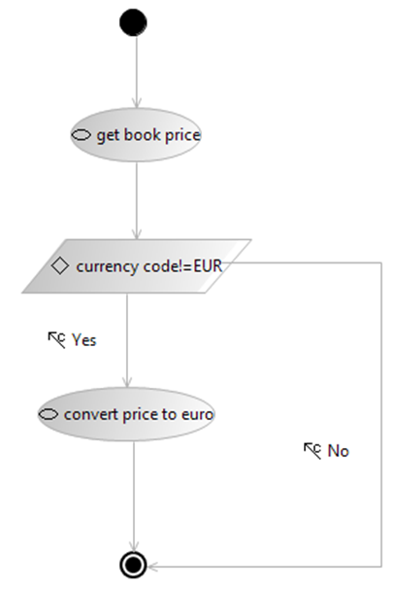
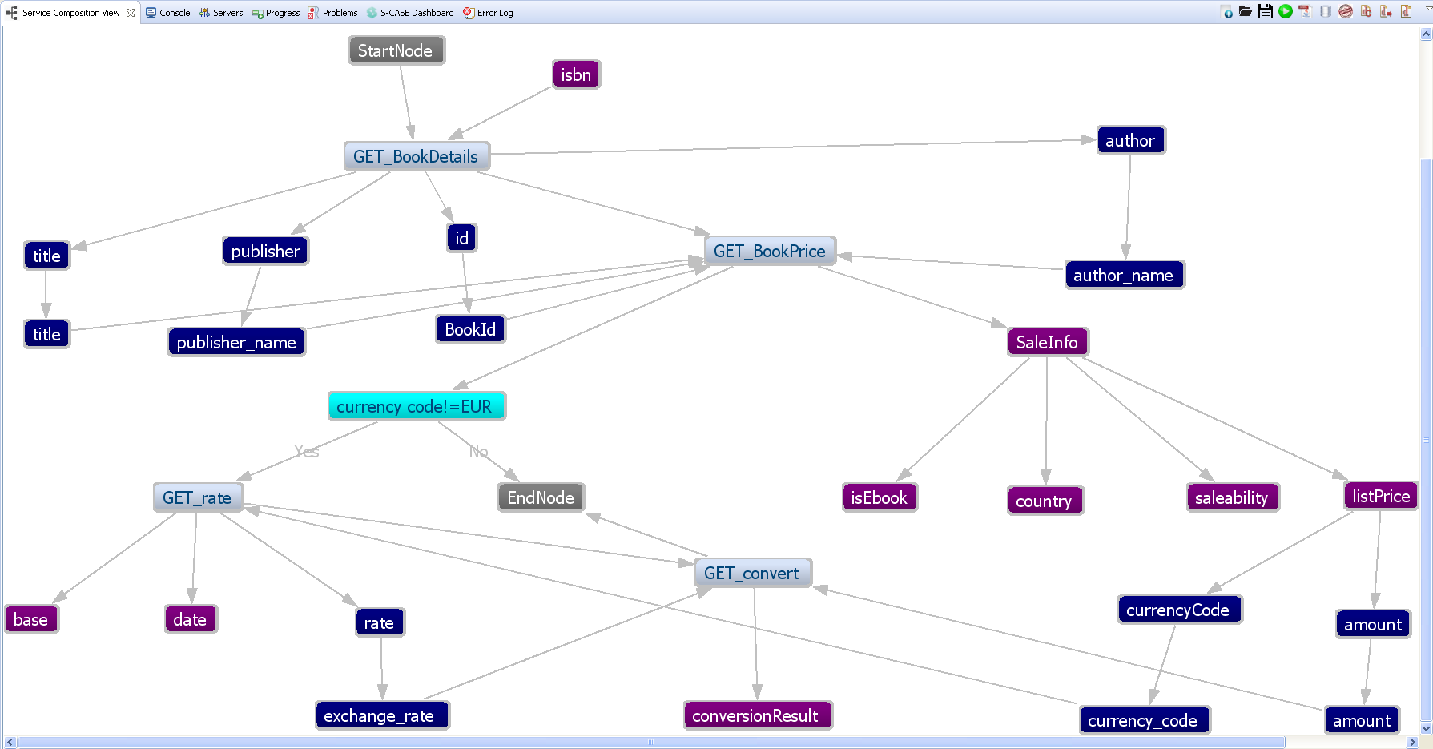
Import storyboards
Conversion of storyboard file to workflow of web services.

Slide 8

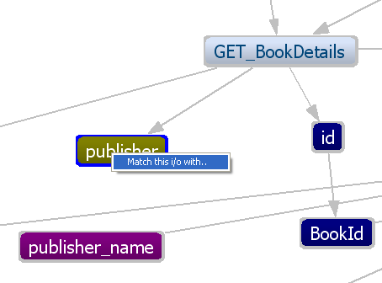
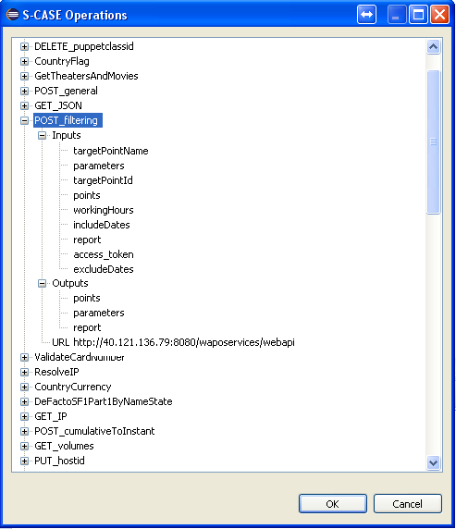
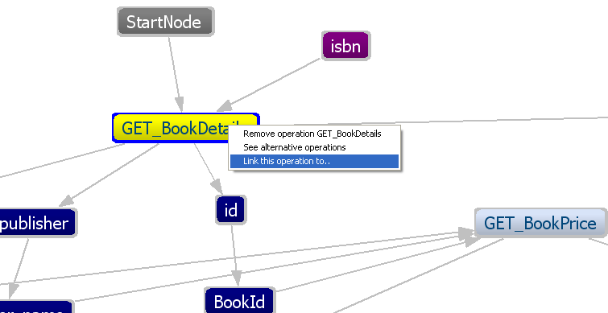
Manual composition
Add operations
Create conditions
Create matches between input/output values.
Create connections

Slide 9

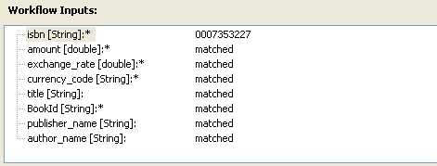
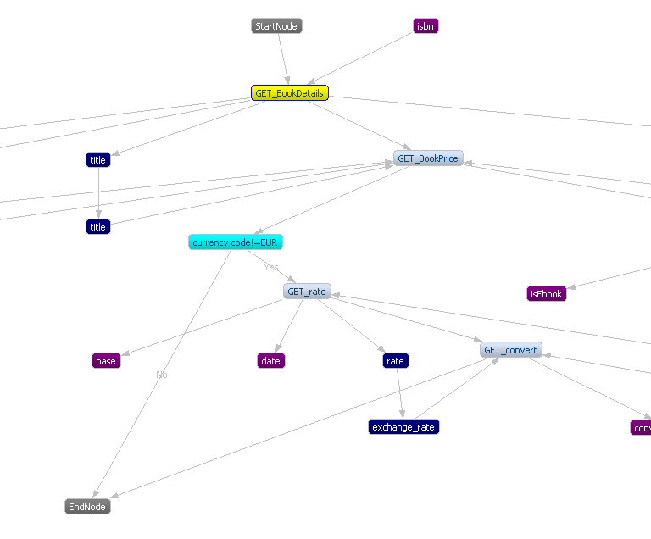
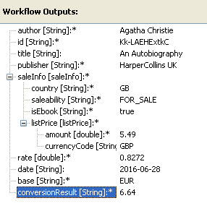
Execute the workflow
Invoke web services
Fill input values
Get output values

Slide 10

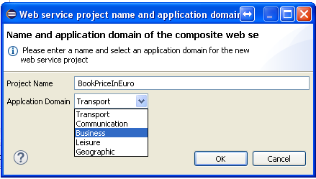
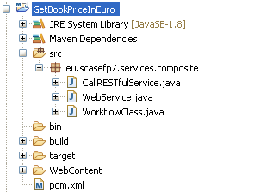
Generate composite web service
Java, Maven Dynamic web service.

Slide 11

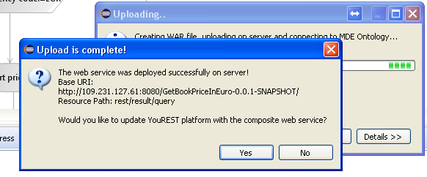
Web Service Deployment
Build project and create WAR file.
Deploy on server.
Register the web service in YouREST.

Slide 12
Thank you very much for your attention.

