Slide 1
Simulation of eye movement artefacts in EEG
Research Project - Maanik Marathe
Supervisors: Jun.-Prof. Dr. Benedikt Ehinger, Judith Schepers
Course: M.Sc. Information Technology, Faculty 5
12.03.2025

Slide 2
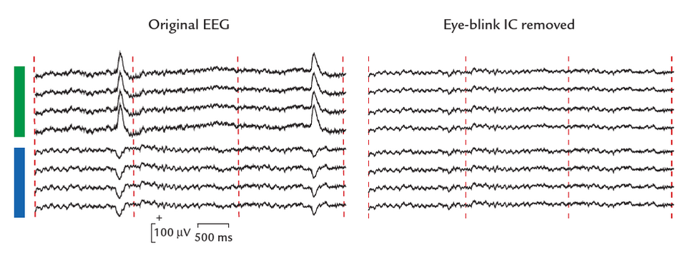
Motivation
Understanding the artefact
Make simulated data more similar to real EEG data
Improving analysis & artefact removal toolboxes
Eye blink artefact. Source: Hari, R., & Puce, A. (2017)
Notes:
Artefacts in EEG - Can be much larger than signal, difficult to remove by filtering or baselining
Simulate - but should be as close as possible to realistic data.

Slide 3
Research Questions 👀
What is the origin of the measured EEG potentials during eye movements, and how can we simulate these?
Does our simulation match recorded data? - qualitative: topoplot
Proof of concept: eye movements, pure horizontal and vertical.
Simpler to understand
Simulating blinks → future scope

Slide 4
Origin of potentials from eye movements
Eyeball - electrically charged.
Eyelid movements - modifying the effect from the eyeball.
Muscles - used to move the eyeball.
Our current focus is on the eyeball charges.

Slide 5
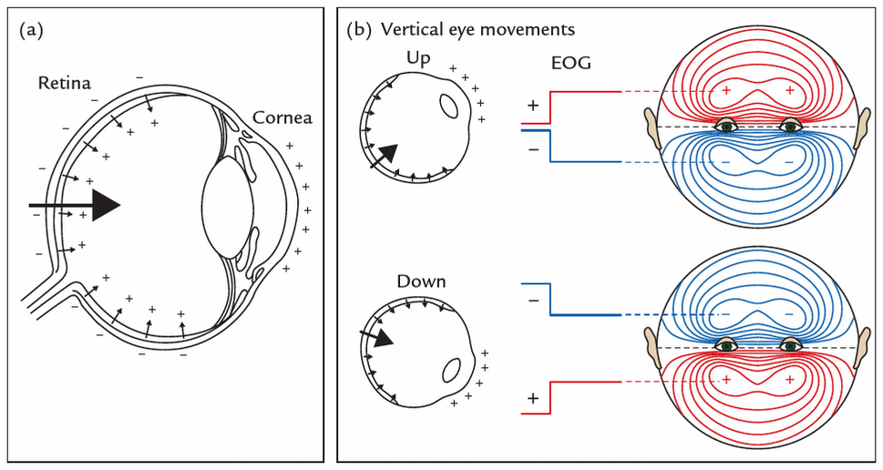
Eye structure
Potential difference across retina, cornea surfaces
Eye movement: charges’ physical locations change.
Electrodes closer to positive cornea measure higher voltage
Overall, “Corneo-retinal” dipole (CRD)
Source: Hari, R., & Puce, A. (2017)

Slide 6
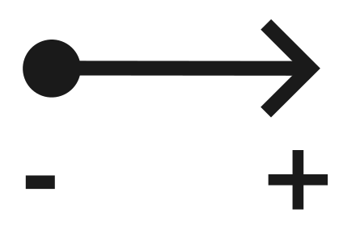
Representing the eye charges
Source dipole
Tiny current to represent an electrical potential difference.
Has a position and an orientation.
Orientation: by convention, from the negative end of the dipole to the positive end.
Notes:
((EEG is a difference signal))

Slide 7
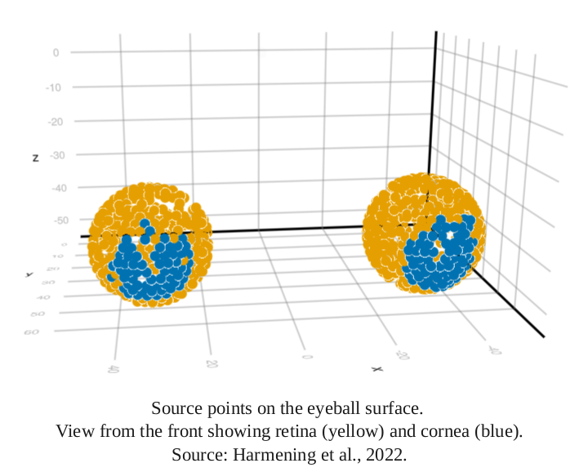
Concept: Head model
Head model - describes how the head conducts electric potentials.
Different tissue conductivities
“Lead field”: electric potential measured at the scalp
We use the HArtMuT head model (Harmening et al. 2022)
Eye model: source points on eye surface.

Slide 8
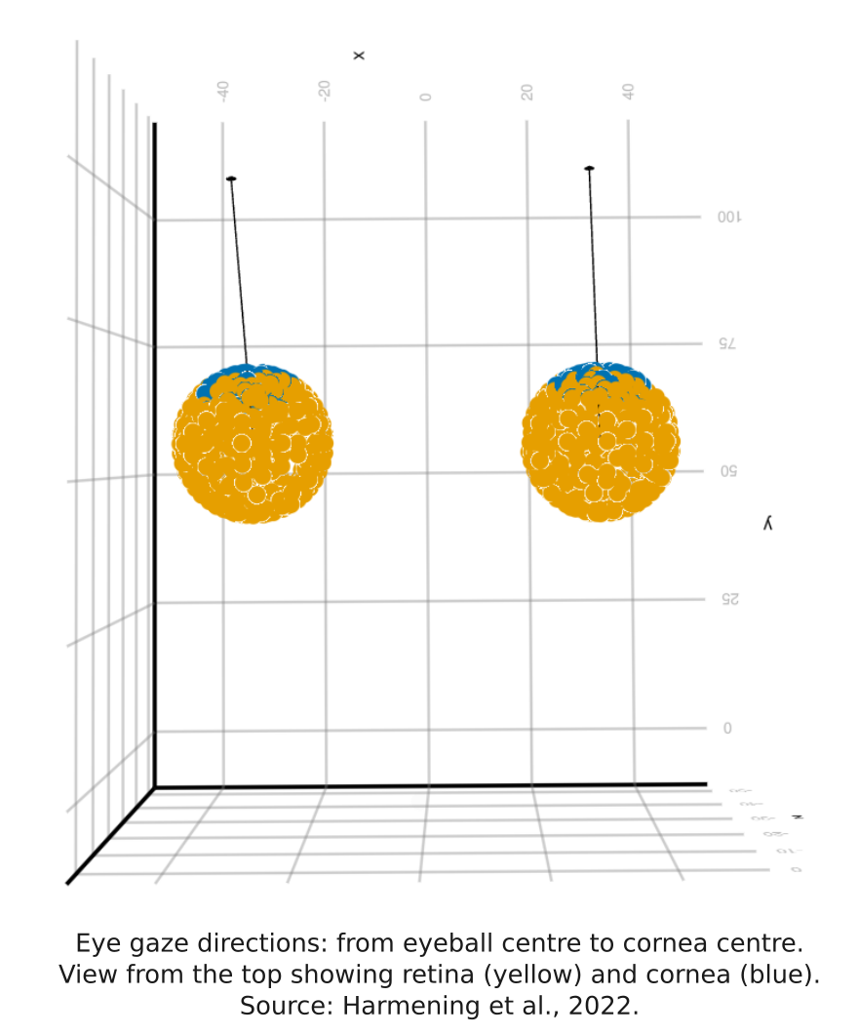
Concept: Gaze direction
“Gaze direction” vector:
From center of eye in the direction of viewed object, through the cornea.
‘Point’ the eye in a certain direction.

Slide 9
Back to the research questions 👀
What physically creates the measured EEG potentials during eye movements, and can we simulate this? - let’s try some simulations..
Simulation
Movement: from viewing point A to point B
Input: Gaze direction, Output: scalp topography
Topoplot: difference between end (B) and start (A)
What do we expect?
Positive near new cornea location
Negative near new retina location

Slide 10
Our assumptions
Perfectly spherical eye
Cornea symmetric around axis of gaze
Only rotation, no translation of the eye within its socket
Viewed target is very far away from subject - eye gaze directions are parallel.
Notes:
Eyes are not a separate tissue type with their own conductivity - considered as skin instead. (assumed in HArtMuT model)

Slide 11
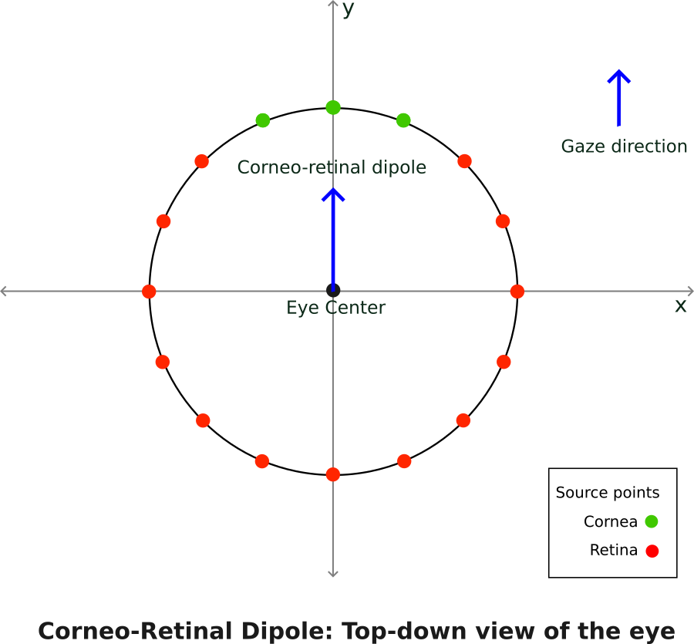
Corneo-retinal Dipole method
One source dipole per eye
Placed at the eye centre, oriented parallel to gaze direction.

Slide 12
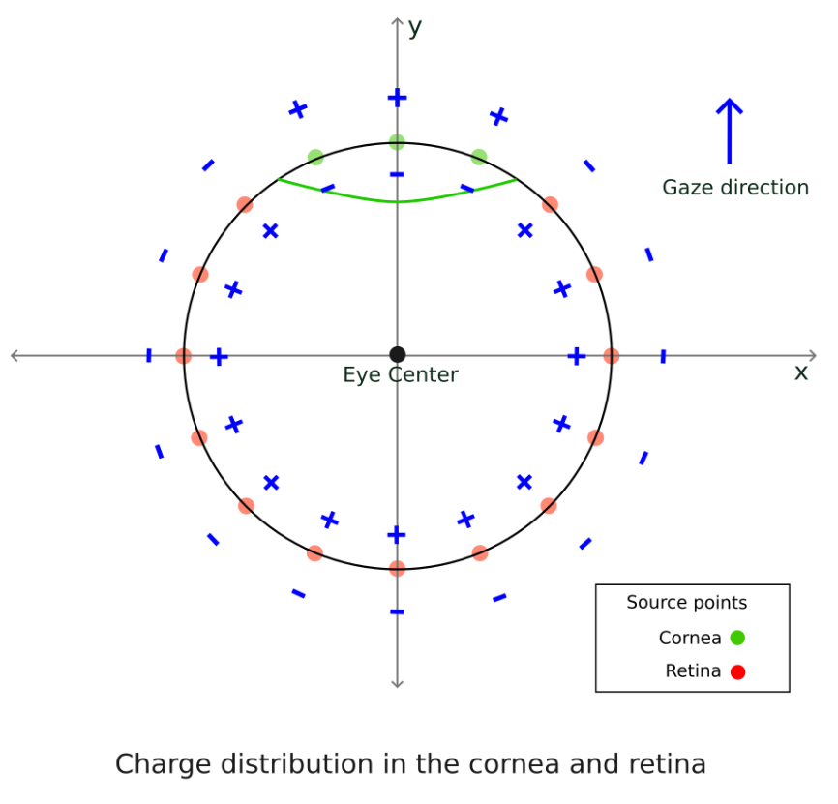
Ensemble method - our approach
Many source dipoles to represent the charges in the eye - closer to real-world
Why?
More control: specify exact gaze direction, simulate any gaze trajectory

Slide 13
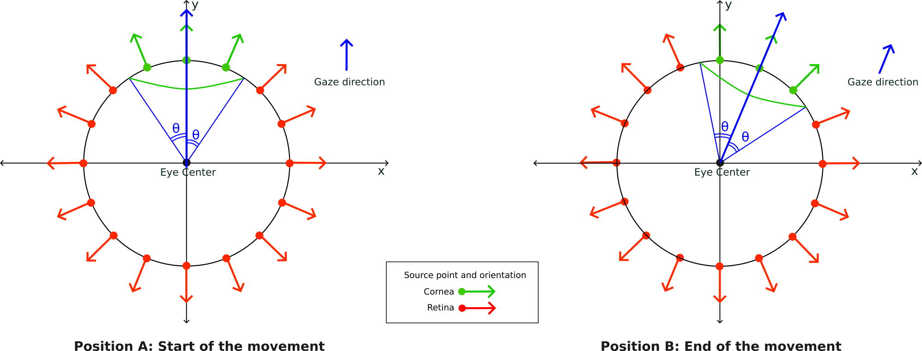
Ensemble method
Cornea always within a certain angle range away from gaze direction
use gaze direction and angle to find cornea

Slide 14
Simulation
Horizontal saccade: from centre (0°) to 15° to the left
Vertical saccade: from centre (0°) to 15° upwards
Real data:
Saccades of similar size from Gert et al. (2022)
Indicative plots: difficult to find pure horizontal/vertical saccades.

Slide 15
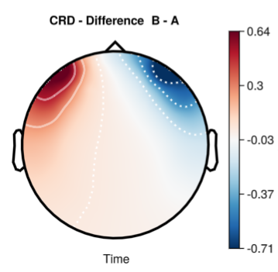
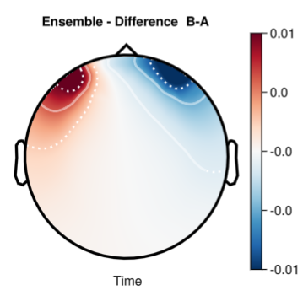
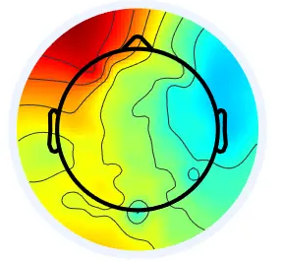
Results: Horizontal saccade
Real data: similar saccade
Real data plot: saccade starts slightly to the right of centre, amplitude 9.63°, includes slight vertical movement. Source: Gert et al. (2022)

Slide 16
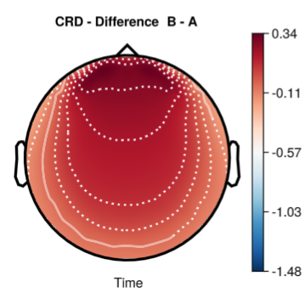
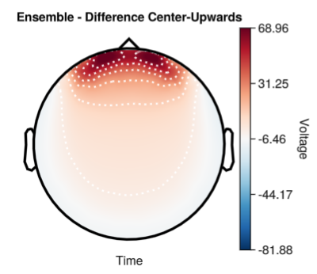
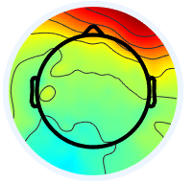
Results: Vertical saccade
Real data: similar saccade
Real data plot: saccade starts slightly below centre, amplitude 10.69°, also includes some left-right movement. Source: Gert et al. (2022)

Slide 17
Evaluation
Qualitatively - matches what we expected - more positive towards the left/upwards respectively.
Quantitatively - not evaluated at the moment.
Cannot yet compare magnitudes - some scaling required.
Electrode positions differ
Difficult to find purely horizontal saccades with this exact magnitude and starting point.

Slide 18
Back to the research questions 👀
What physically creates the measured EEG potentials during eye movements, and can we simulate this?
- Eyeball charges, eyelid, muscles;
- We simulated eyeball movement: (1) single dipole, (2) ensemble of dipoles.
Does our simulation match the real recorded data?
- Topography looks similar to expectations
- Need to explore further

Slide 19
Limitations
Current head model: eye tissue conductivity is still ‘skin’.
Only pure horizontal/vertical saccades simulated. (unlikely in real data)
Only the start and end positions; full trajectory not yet simulated.
Cornea and retina relative magnitude - also, debated whether the cornea contributes at all.
Not modelled here: accompanying eyelid motion, muscle activations.

Slide 20
Recap and Outlook
“Ensemble” method - charge distribution simulation - proof of concept
New head model - updated conductivities
Scaling - magnitudes for cornea & retina sources, and overall result
Eyelid movement simulation
Blinks - putting together eyelid movement and eye movement
Muscle movements
Package it up - UnfoldArtefacts.jl?

Slide 21
🕵️ Questions?

Slide 22
References
Hari, R., & Puce, A. (2017). Meg-eeg primer. Oxford University Press, Incorporated. https://ebookcentral.proquest.com/lib/uni-stuttgart/detail.action?docID=5746005.
Harmening, N., Klug, M., Gramann, K., & Miklody, D. (2022). HArtMuT—modeling eye and muscle contributors in neuroelectric imaging. Journal of Neural Engineering, 19(6), 066041–066041. https://doi.org/10.1088/1741-2552/aca8ce
https://www.learningeeg.com/

Slide 23
References
Gert, A. L., Ehinger, B. V., Timm, S., Kietzmann, T. C., & König, P. (2022). WildLab: A naturalistic free viewing experiment reveals previously unknown electroencephalography signatures of face processing. European Journal of Neuroscience, 56(11), 6022–6038. https://doi.org/10.1111/ejn.15824

