Slide 1
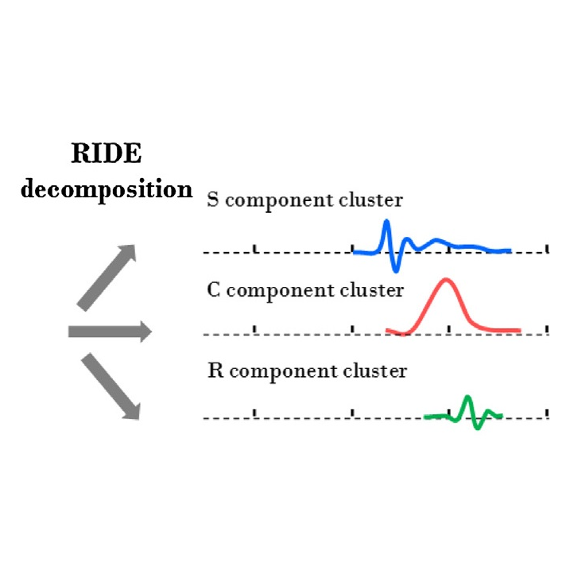
Implement the RIDE algorithm into the Unfold.jl toolbox
Master‘s Thesis Intro Talk
Notes:
TODO: Bild austauschen, evtl RIDE graph

Slide 2
About me
Till Prölß
Age: 26
Course of study: Software Engineering M.Sc.
Born and raised in Stuttgart/Remseck
Hobbies:
Video Games
Gym
Discussing Politics, Ethics, etc.
Conclusion
Notes:
TODO Hobbies
TODO Bild

Slide 3
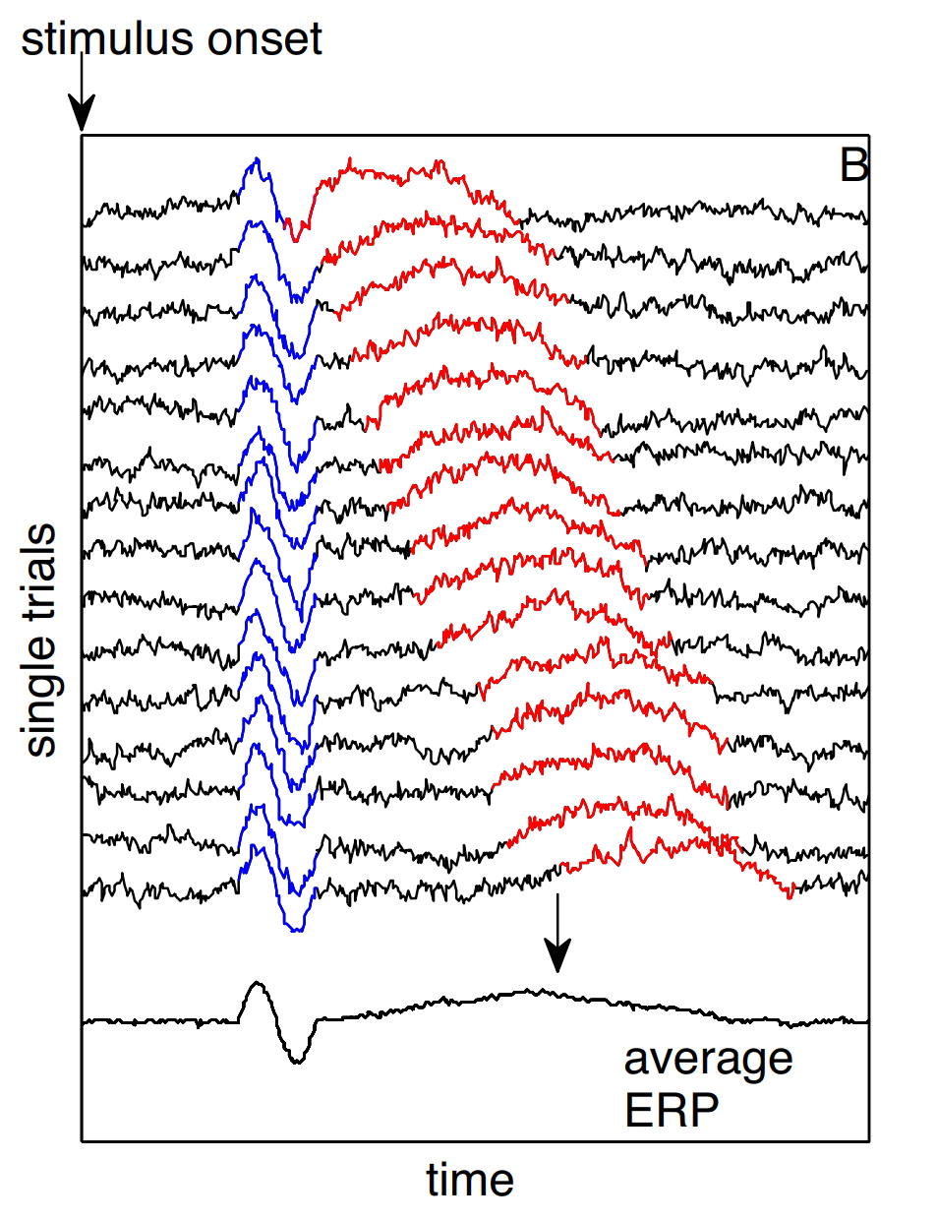
Introduction
Electroencephalogram (EEG) to gather data during an experiment
Event related potentials (ERP) to analyze EEG data and identify components
Problem with time jittered components
“Smearing” on the ERP
Adapted from [2]
Components with a variable latency cause smearing.
Notes:
Todo Bilder Captions (Quelle)
Explain every figure
Conclusions are optional

Slide 4
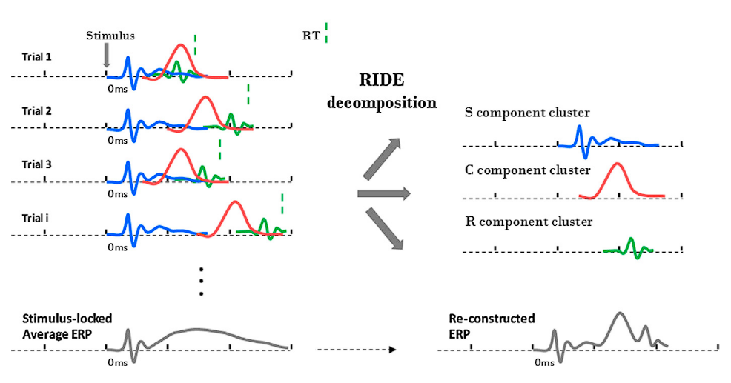
RIDE (Residue Iteration Decomposition)
Developed by Ouyang et al. [1, 2]
Analyzing EEGs
ERP component decomposition
Time jittered components
Three different component clusters
S: locked to stimulus onset
R: locked to response time
C: related to stimulus onset, but with variable latency
Found use in multiple Studies
Comparing ADD and ADHD Patients in a Flanker task [3]
Mapping the brain through event codes [4]
Adapted from [2]
Notes:
C cluster is related to the stimulus, but has a variable latency
TODO: Add component clusters as text
TODO: mention results of the mentioned papers
Figure erklären

Slide 5

Unfold
What is Unfold [5]
Julia toolbox for ERP analysis
Decomposition and Overlap correction through a regression- based method
In active development (last commit 3 days ago 23.09.24)
Used in a multitude of studies to
allow for less stringent experiment setups [6, 7]
understand reading [8] and dyslexia [9]
Reasons to include RIDE
Time jittered components
Easy comparison of RIDE and Unfold decomposition
Combination of time jittered components and covariate estimation
Conclusion
Notes:
TODO: Overlap correction
Shorten this. Only include unfold and unfoldsim

Slide 6
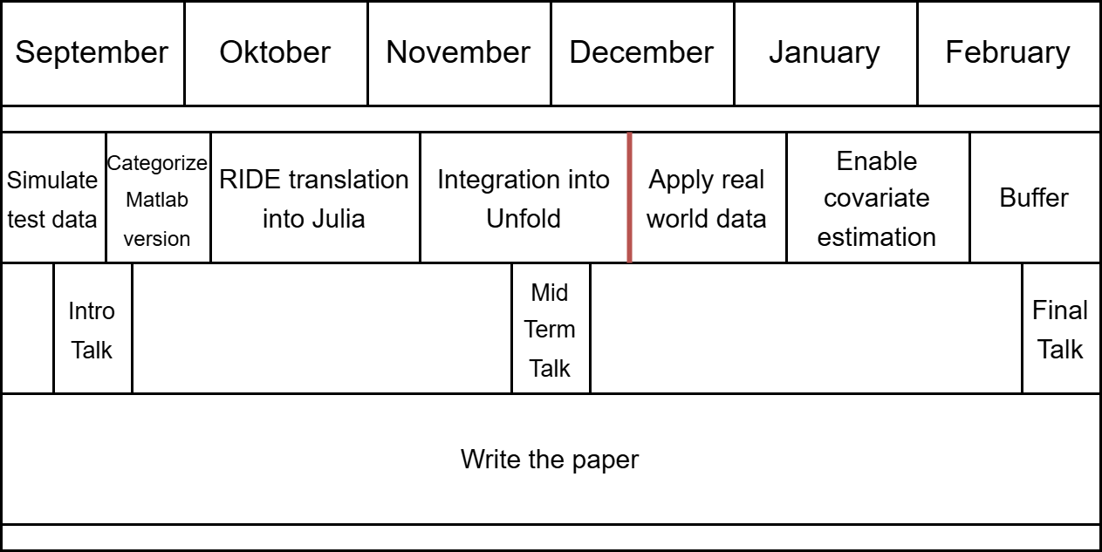
Schedule
Conclusion
Notes:
Simulate testdata using UnfoldSim
Categorize the existing matlab toolbox into individual modules
Run the matlab toolbox on the generated testdata
Collect intermediate results for each module
Reimplement RIDE in Julia, module by module
Write a unit test suite and documentation for each module
Enables simple progress tracking
Modifications are limited to refactoring to avoid breaking the algorithm
Replace the iterative step in RIDE
Unit test for correctness? Do results change?
Apply a real world dataset
Enable Covariate Estimation
Last Month reserved as buffer and to write the paper / presentation
TODO: Update Gant chart, include intro and midterm talk
TODO: Ride implementation in Julia
TODO: Implement Ride into Unfold (Formulierung überdenken)
TODO: Test covariate estimation

Slide 7
Sources
Ouyang, Guang, Grit Herzmann, Changsong Zhou, and Werner Sommer. "Residue iteration decomposition (RIDE): A new method to separate ERP components on the basis of latency variability in single trials." Psychophysiology 48, no. 12 (2011): 1631-1647.
Ouyang, Guang, Werner Sommer, and Changsong Zhou. "A toolbox for residue iteration decomposition (RIDE)—A method for the decomposition, reconstruction, and single trial analysis of event related potentials." Journal of neuroscience methods 250 (2015): 7-21.
Annet Bluschke et al. “Neuronal Intra-Individual Vari-ability Masks Response Selection Differences betweenADHD Subtypes—A Need to Change Perspectives”. In:Frontiers in Human Neuroscience 11 (June 28, 2017).Publisher: Frontiers. ISSN: 1662-5161. DOI: 10.3389/fnhum.2017.00329. URL: https://www.frontiersin.org/journals/human- neuroscience/articles/10.3389/fnhum.2017.00329/full (visited on 08/27/2024).
Witold X. Chmielewski, Moritz M¨uckschel, andChristian Beste. “Response selection codes in neuro-physiological data predict conjoint effects of controlledand automatic processes during response inhibition”.In: Human Brain Mapping 39.4 (2018). eprint:https://onlinelibrary.wiley.com/doi/pdf/10.1002/hbm.23974,pp. 1839–1849. ISSN: 1097-0193. DOI: 10.1002/hbm.23974. URL: https://onlinelibrary.wiley.com/doi/abs/10.1002/hbm.23974 (visited on 08/27/2024).
Benedikt V. Ehinger and Olaf Dimigen. “Unfold: an in-tegrated toolbox for overlap correction, non-linear mod-eling, and regression-based EEG analysis”. In: PeerJ7 (Oct. 24, 2019). Publisher: PeerJ Inc., e7838. ISSN:2167-8359. DOI: 10.7717/peerj.7838. URL: https://peerj.com/articles/7838 (visited on 08/27/2024).
Anna L Gert et al. “WildLab: A naturalistic free viewingexperiment reveals previously unknown EEG signaturesof face processing”. In: European Journal of Neuro-science (Sept. 16, 2022). MAG ID: 4296164644. DOI:10.1111/ejn.15824.
Yan Yan, Laurence T. Hunt, and Cameron D. Has-sall. “Reward positivity biases interval production in acontinuous timing task”. In: (July 7, 2023). MAG ID:4383499942. DOI: 10.1101/2023.07.06.548049.
Joshua Snell et al. “Parallel word reading revealed byfixation-related brain potentials”. In: 162 (May 1, 2023).MAG ID: 4322124135, pp. 1–11. DOI: 10.1016/j.cortex.2023.02.004.
Catherine Manning et al. “Visual Motion and Decision-Making in Dyslexia: Reduced Accumulation of Sen-sory Evidence and Related Neural Dynamics.” In: TheJournal of Neuroscience 42.1 (Jan. 5, 2022). MAG ID:4226134057, pp. 121–134. DOI: 10 . 1523 / jneurosci .1232-21.2021.
Conclusion

Slide 8
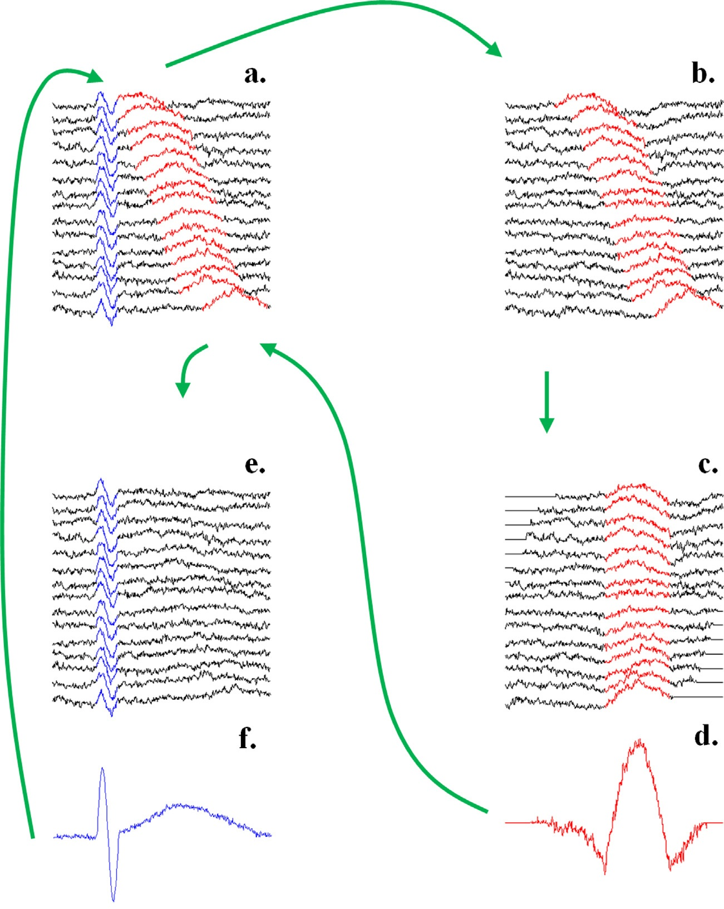
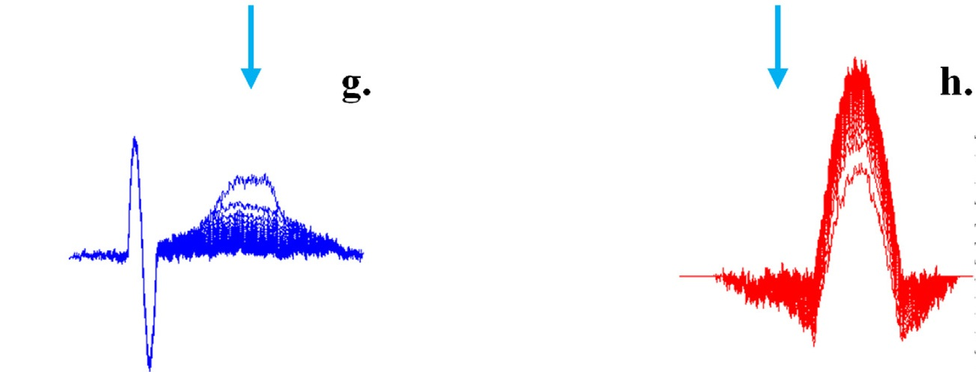
RIDE (Residue Iteration Decomposition)
Adapted from [2]
Conclusion

Slide 9
RIDE (Residue Iteration Decomposition)
“Fig. 2. Illustration of the decomposition module using two artificial sinusoidal components, S (blue) and R (red), for a single electrode. (a) Single trial ERPs from different trials with superimposed S, R, and noise. (b) Subtract S from single trials ERP (initially S is stimulus-locked ERP). (c) Align the residue according to the latency of R. (d) Obtain R as the median waveform from (c), for the first time. (e) Subtract R (obtained from (d)) from the single trials ERP. (f) Obtain S again as the median waveform of the residue in e. The route goes to (b) (where the new estimate of S is subtracted from the original single trials) and iterates. (g) and (h) For each iteration, the S and R components obtained from (f) and (d) move closer to the originally given (sinusoidal) waveforms and converge. Note that the plots in (d), (f), (g), and (h) use different scales than (a), (b), (e), and (c). (For interpretation of the references to color in this figure legend, the reader is referred to the web version of this article.)”
Adapted from [2]
Conclusion

