Slide 1
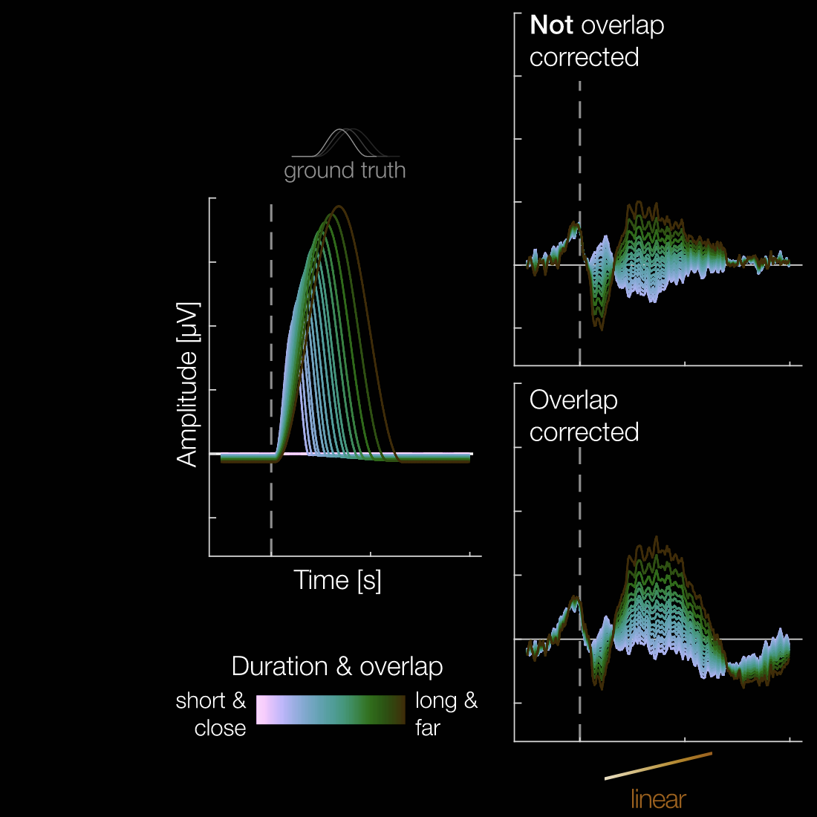
Effect of stimulus duration on event-related potentials during a rapid serial visual presentation task
Bachelor thesis final presentation

Slide 2
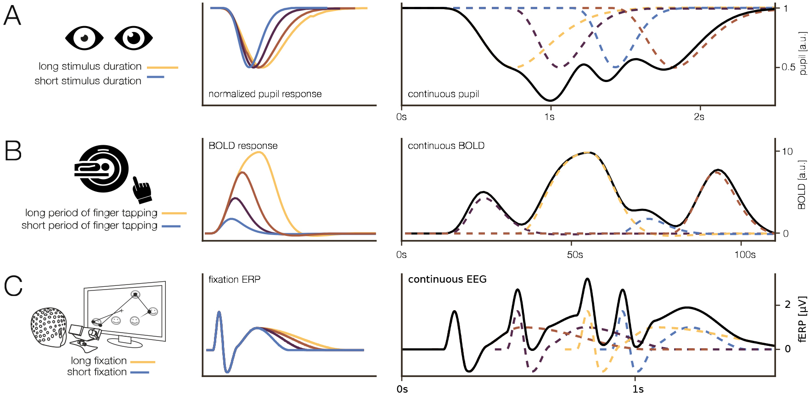
Motivation
Exemplary simulated duration effects in different modalities.
A: normalized pupil response (Snowden et al. 2016), B: BOLD response in fMRI (Glover 1999),
C: fixation ERP (Skukies et. al. 2025, data: Gert et. al. 2022)
Figure from “Brain responses vary in duration - modeling strategies and challenges.” by Skukies et. al., 2025, Imaging Neuroscience 2025; 3 IMAG.a.1003. CC-BY-NC-ND 4.0.
Notes:
Simulations, according to published effects
A: effect of stimulus duration on pupil response
Snowden et. al: Neutral and images eliciting ‚fear‘ images were presented for varying durations
B: BOLD response scales with period of finger tapping
Glover, 1999: Participants were asked to tap to a ceratain rythm by metronome
C: Fixation duration influences ERP
From René paper itself, fixation duration effect on fixation ERP

Slide 3
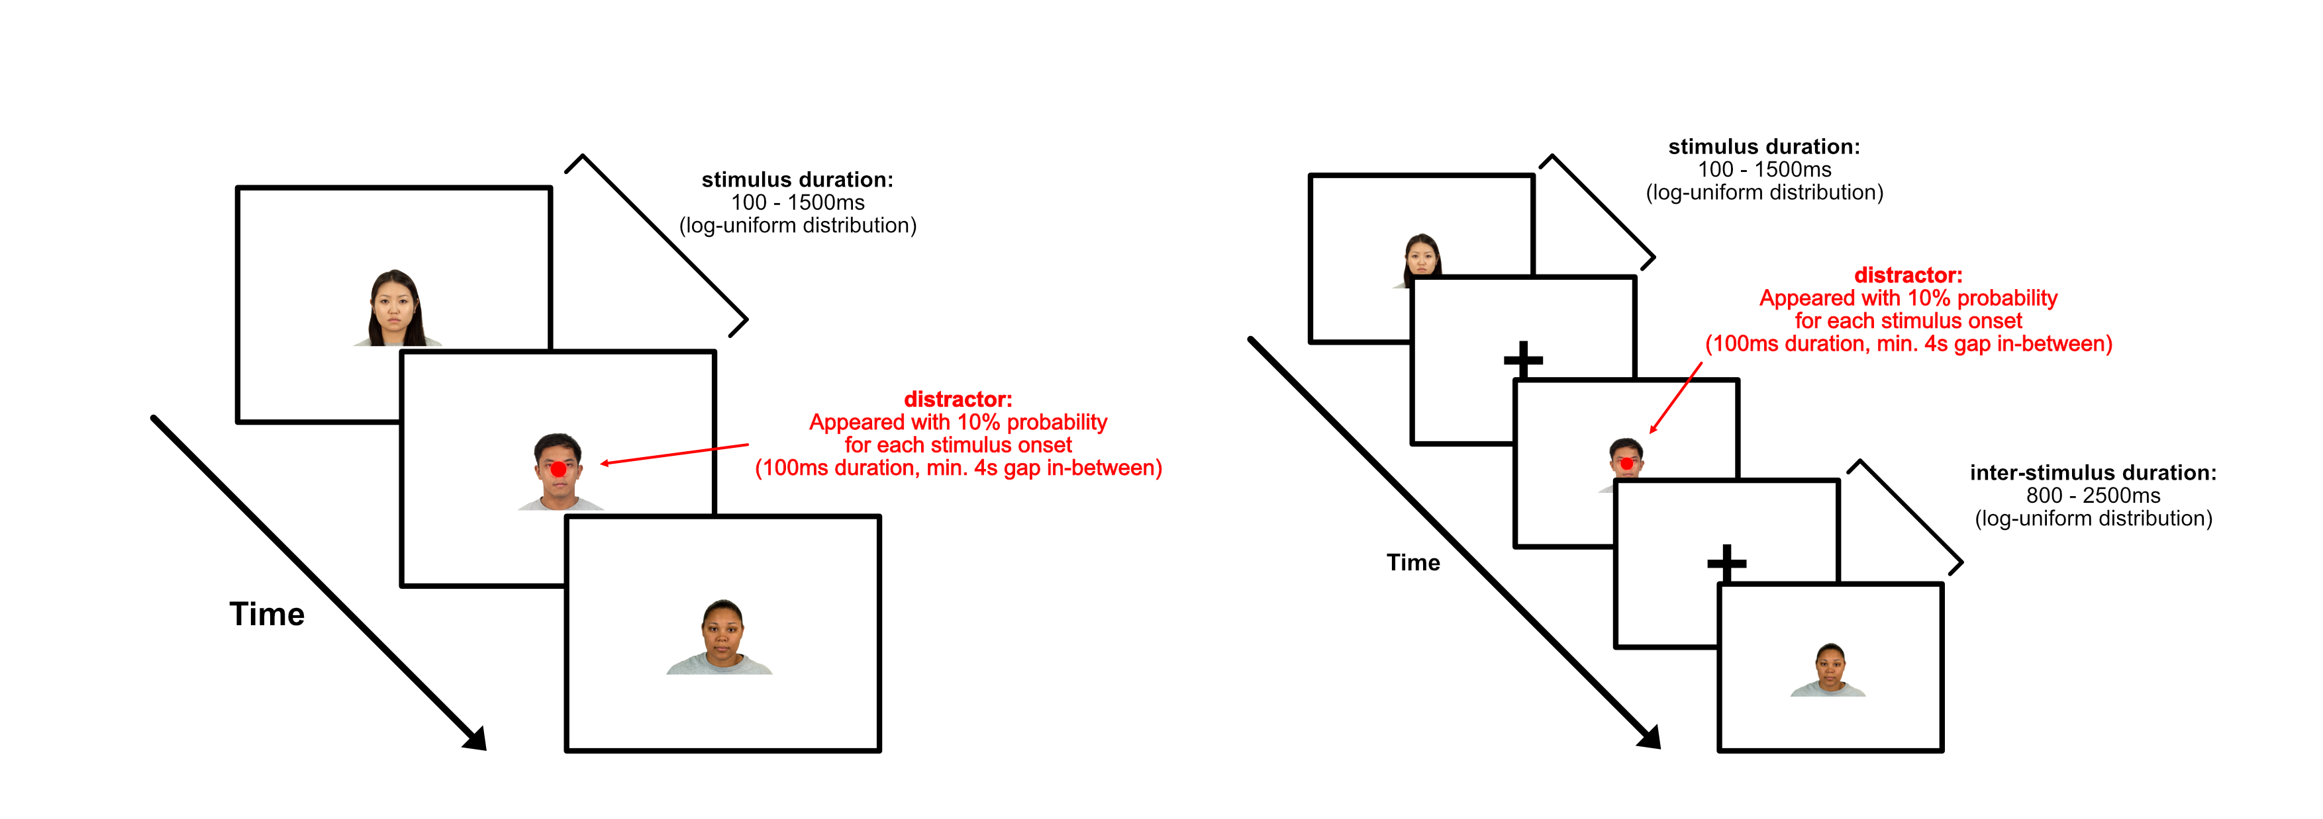
Study
Task
Trials without blanks in-between (no-blank condition)
Trials with blanks in-between (blank condition)
6 blocks (3 blank, 3 no-blank condition) with 120 images each were conducted per participant

Slide 4
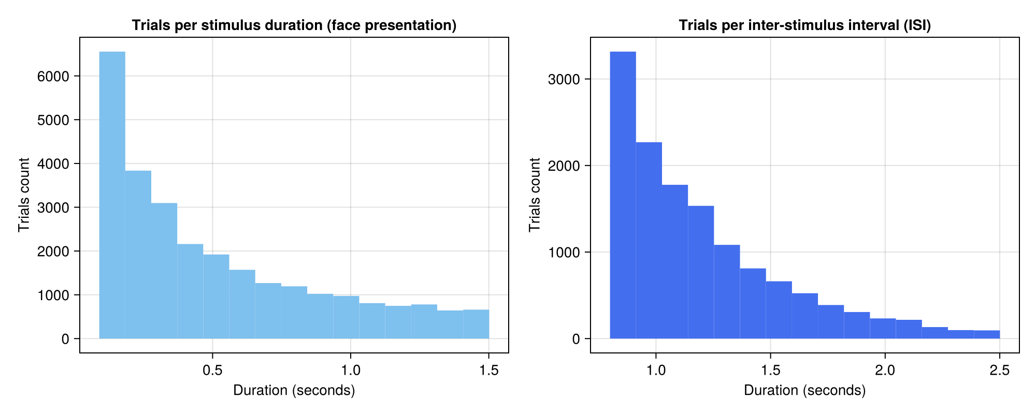
Study
Trial distributions
From blank and no-blank condition trials
From only blank condition trials

Slide 5

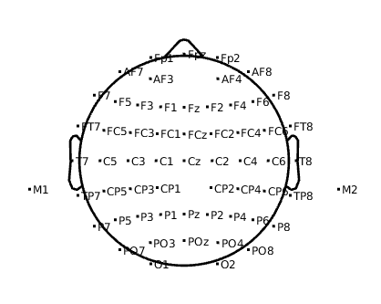

Study
Participants
38 participants (all right-handed)
14 female, 24 male
Age: 21 - 36 years (mean: 27.2)
EEG Recording
Conducted in SimTech building with usual hardware
Cap placed according to 10/5 system (60 scalp electrodes recorded)
Topoplot of recorded electrodes

Slide 6
Goals of thesis
Scientific Goal: Does the duration of face presentation influence the brain response?
Methodological Goals
Assess the application of deconvolution-based overlap correction in combination with stimulus duration modelling
Comparison of linear and non-linear modeling of stimulus duration effects
Investigate the influence of using ‘blanks‘ between stimuli (effect of ISIs)

Slide 7

Preprocessing
Downsample to 250Hz (initially 1000Hz recording)
Remove 50Hz line noise
Remove bad channels
Rereferencing
Remove large spikes
Independent Component Analysis (ICA)
Continuous ASR rejection
Interpolate bad channels
Apply 0.1Hz Highpass filter

Slide 8
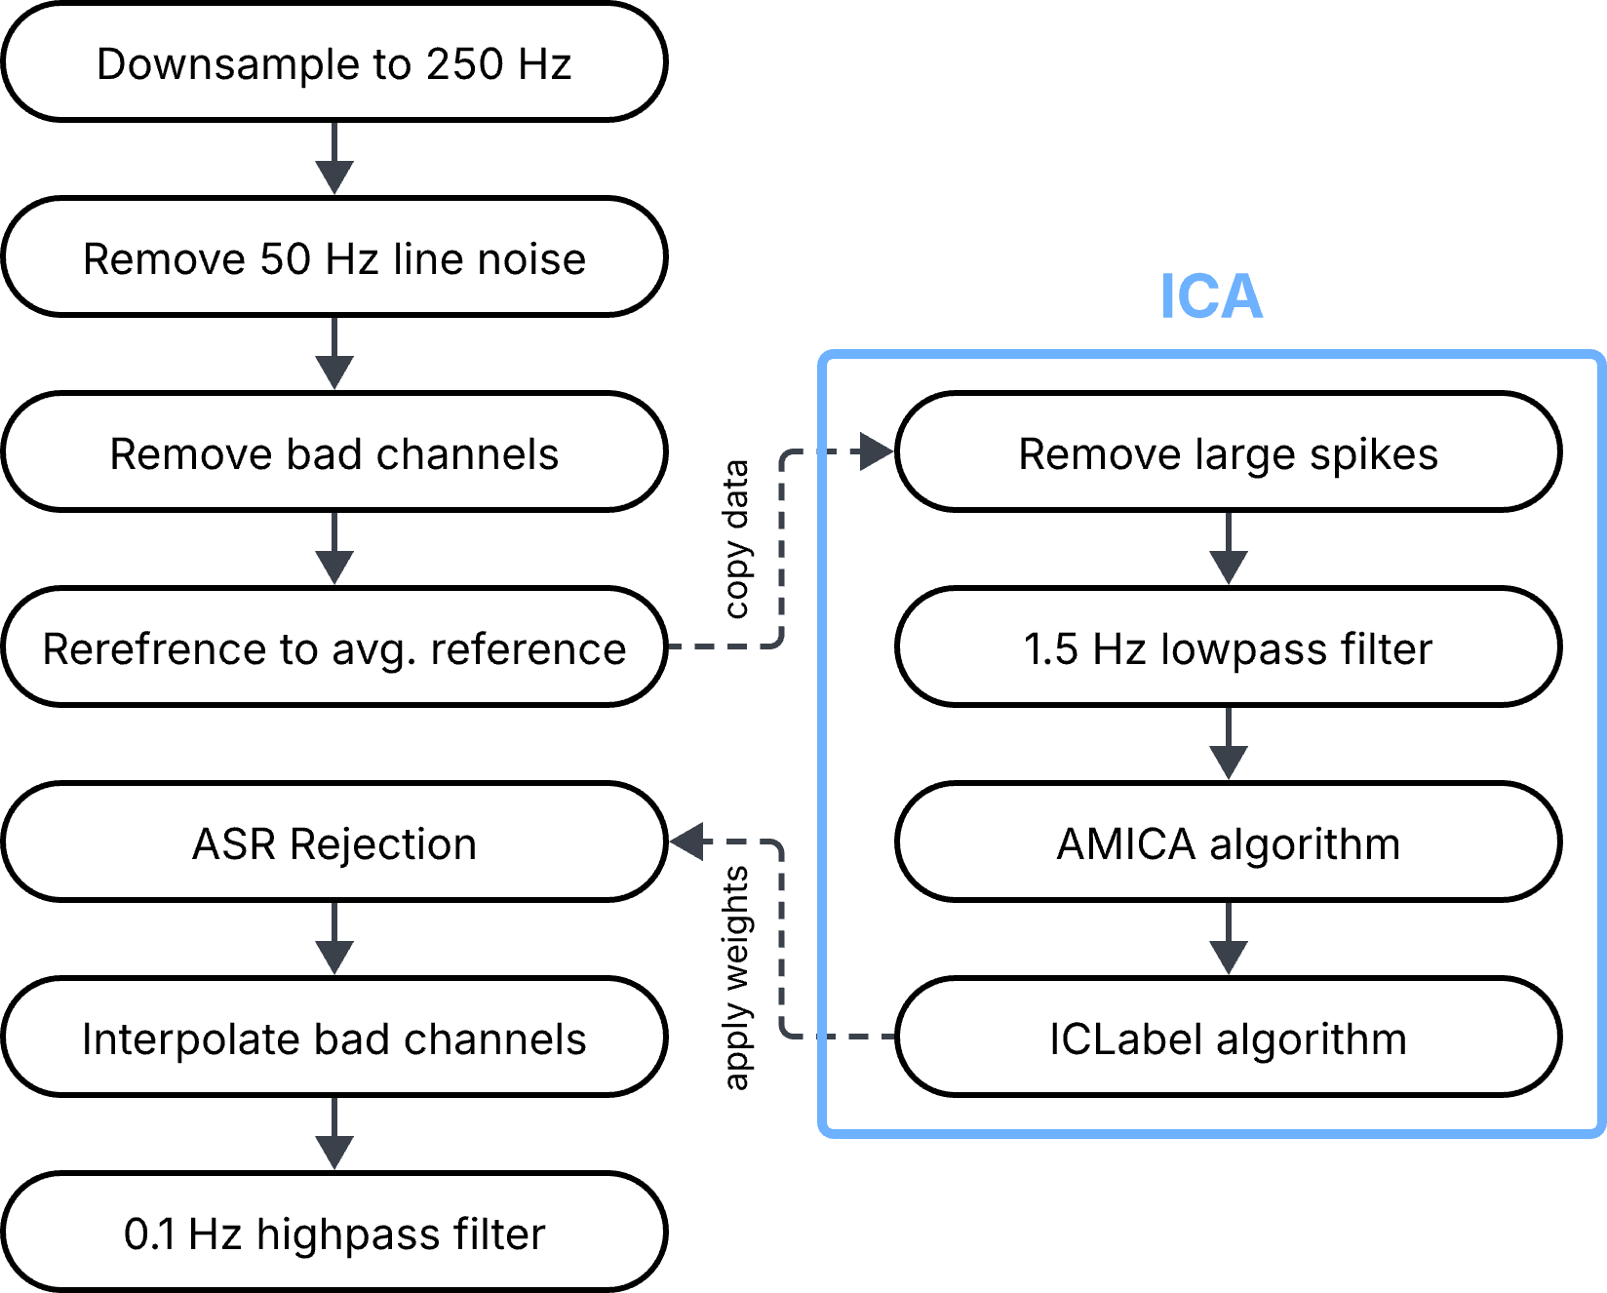
Preprocessing Pipeline
EEGLAB

Slide 9
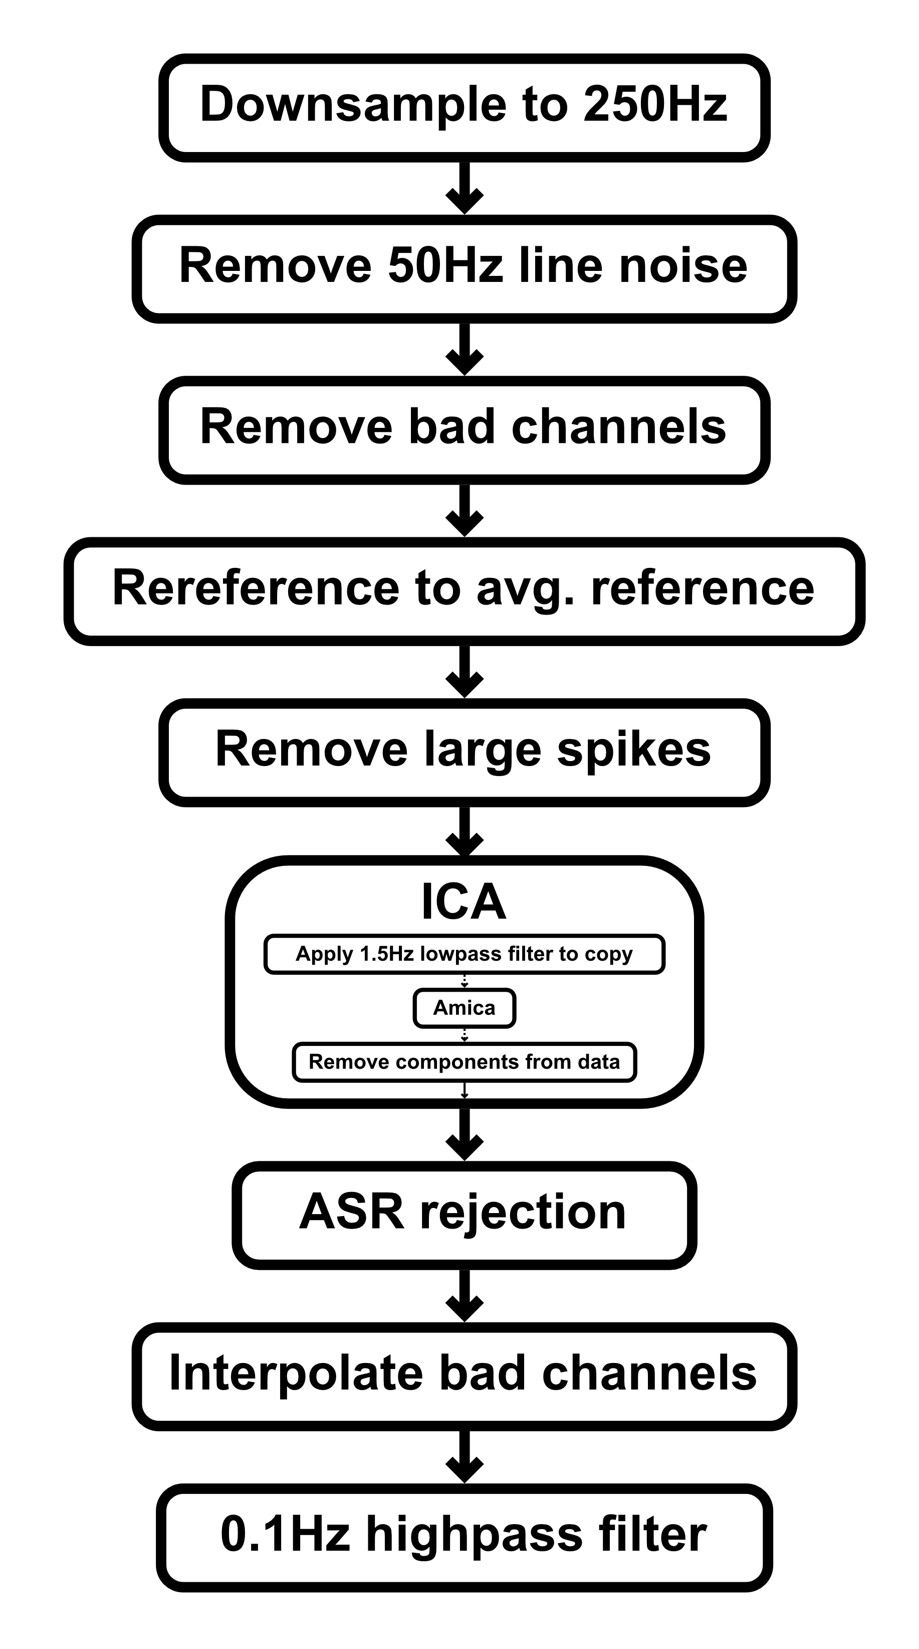
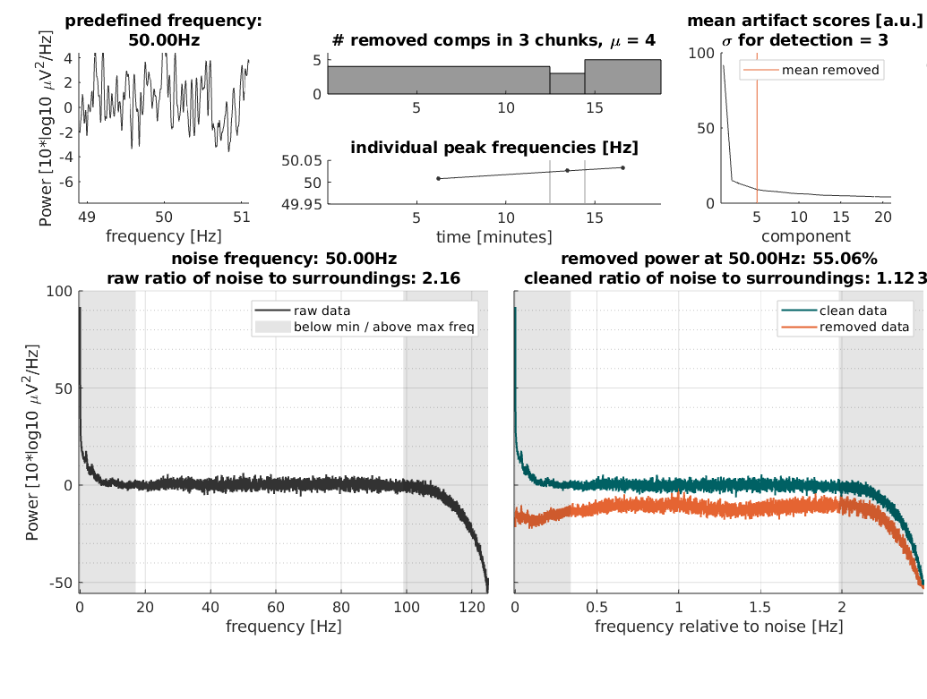
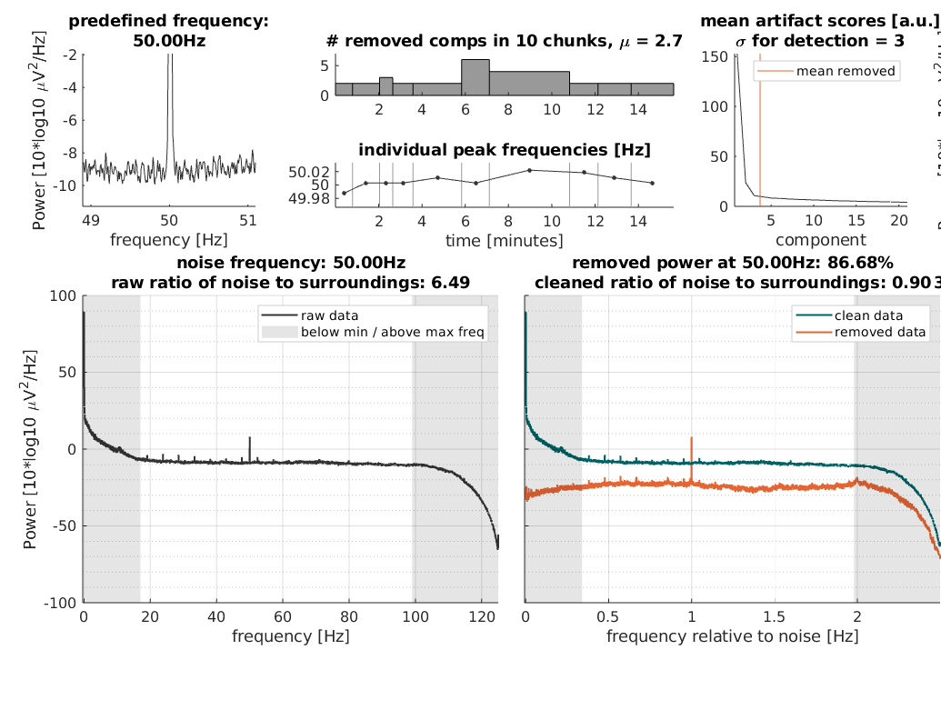
Preprocessing
Subject with noisy EEG data
Subject with tiny alpha peak and small spikes

Slide 10
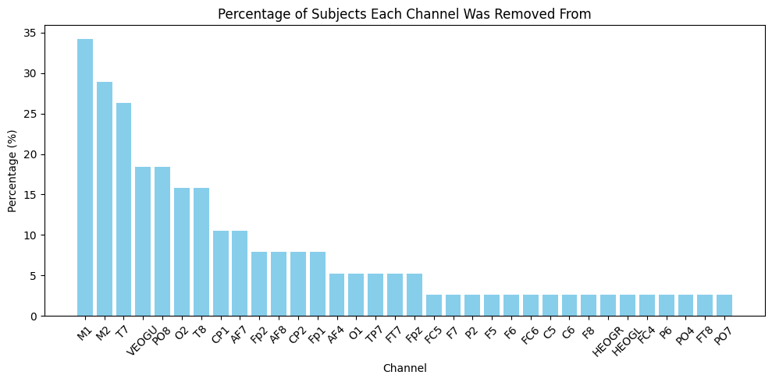
Preprocessing
Criteria: Flatline >5s, correlation <0.8 to robust reference, Line noise (>4 std)
Removed channels per subject on average: 3.03 ± 1.96 std
7 subjects where one of the channels of interest (visual cortex area) missing

Slide 11


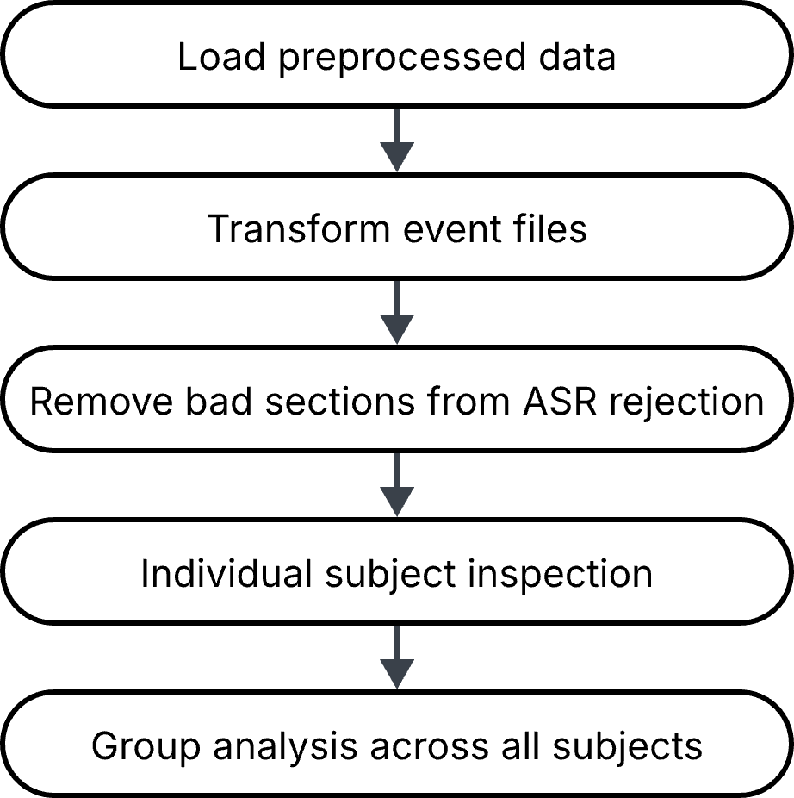

Analysis
Analyze Event-related potentials (ERP) of face images
Unfold.jl toolbox using regression ERP (rERP) framework
2 subjects (8, 25) were removed because their ERPs were faulty (36 remaining)

Slide 12
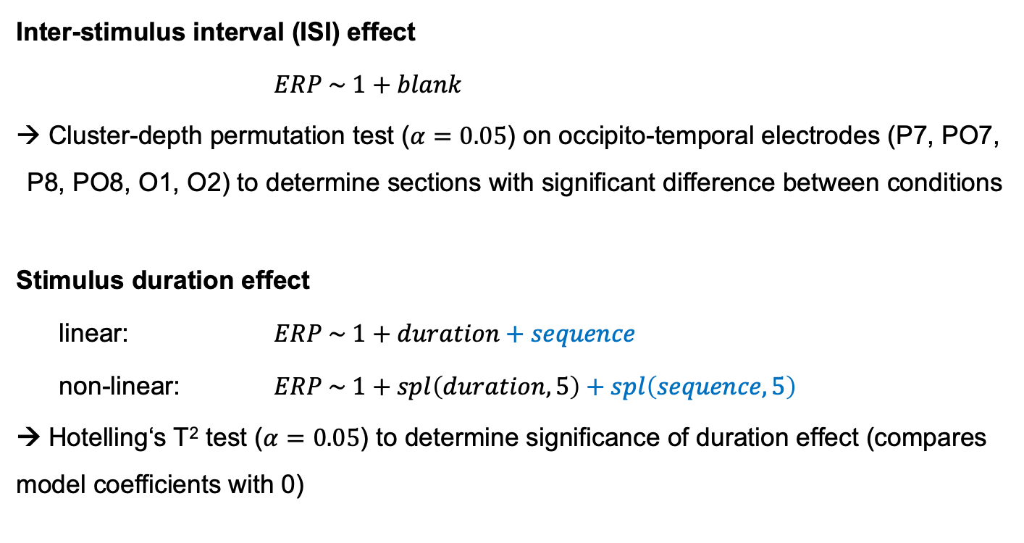
Mass univariate & Deconvolution models
Inter-stimulus interval (ISI) effect
$ERP \sim 1+blank$
Cluster-depth permutation test ($α=0.05$) on occipito-temporal electrodes (P7, PO7, P8, PO8, O1, O2) to determine sections with significant difference between conditions
Stimulus duration effect
linear: $ERP \sim 1+duration+sequence$
non-linear: $ERP \sim 1+spl\left(duration, 5\right)+spl\left(sequence, 5\right)$
→ Hotelling‘s T² test ($α=0.05$) to determine significance of duration effect (compares model coefficients with 0)
For additional analysis of habituation effect
Notes:
Cluster depth test
cluster threshold: 95th percentile of student t-distribution
5000 iterations
Hotellings t test
compares coefficients of covariate duration (1 when linear, 5 when non-linear)

Slide 13
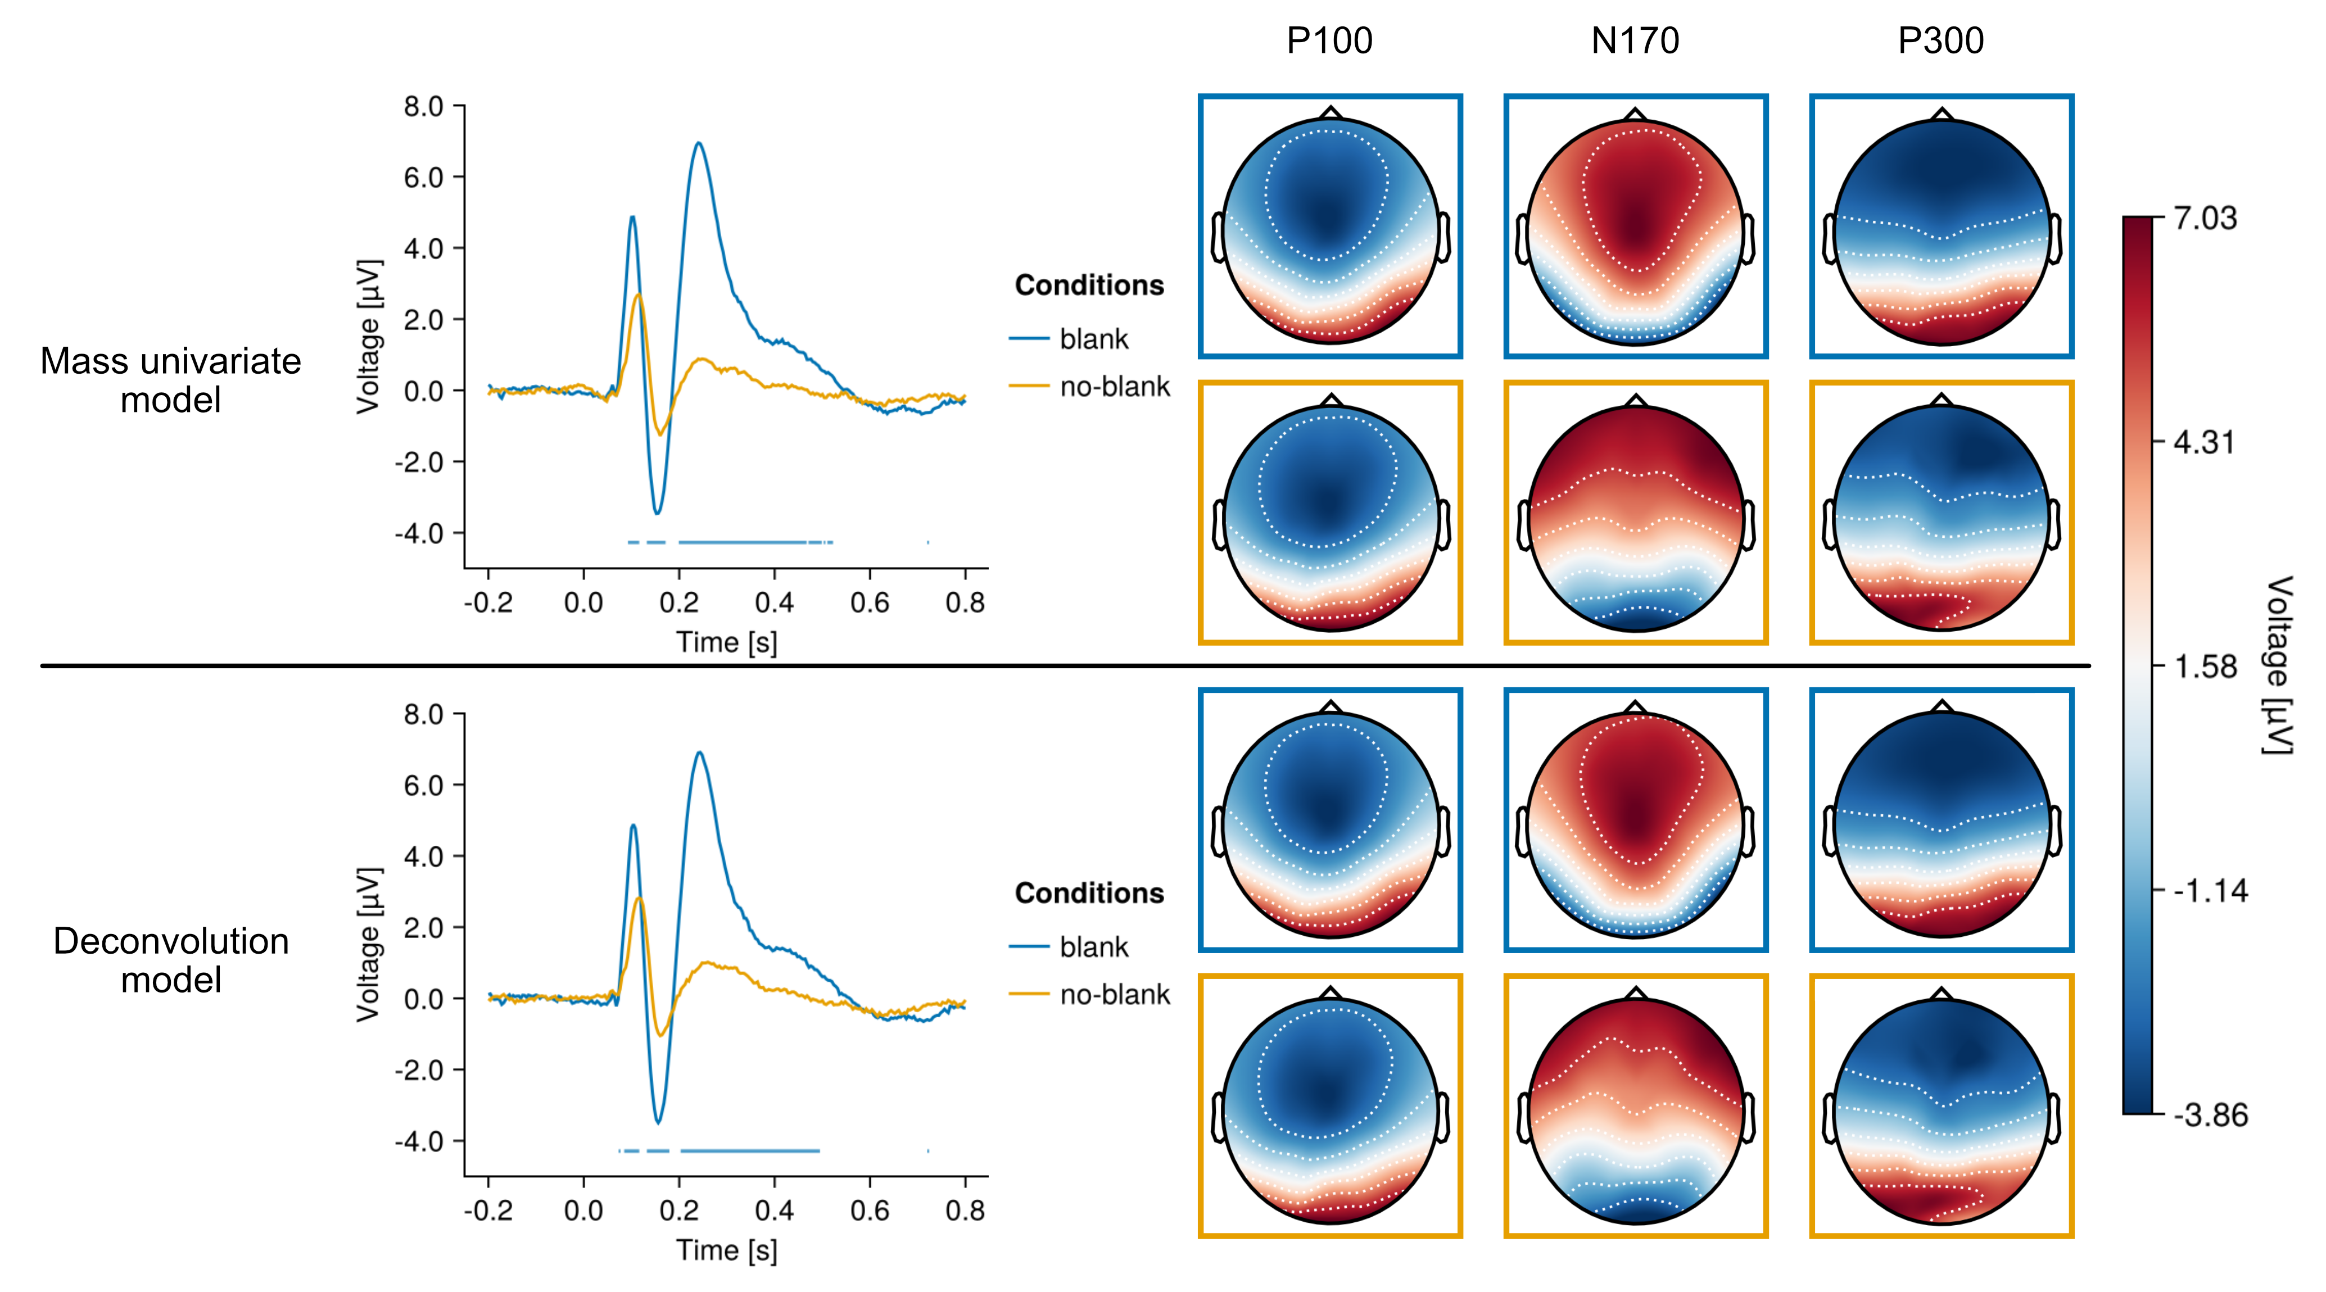
Inter-stimulus Interval (ISI) effect
Grand averaged ERPs (PO8 channel) with baseline correction
Notes:
Difference between conditions drastic in both models
P100, N170 more pronounced in blank condition
P300 shows most significant effect (almost no peak in blank condition
Topoplots: similar between conditions, only the N170 component more active in parietal region for no-blank condition

Slide 14
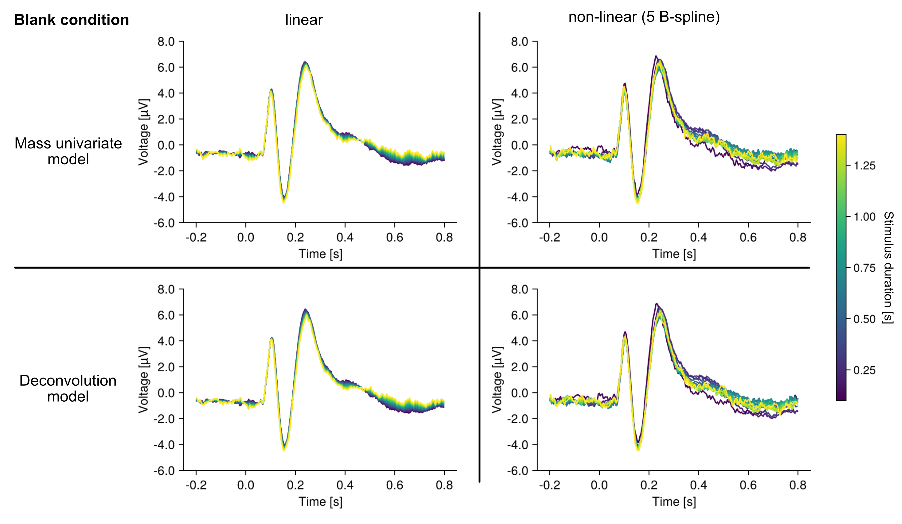
Stimulus duration effect
Grand averaged ERPs (PO8 channel)
Notes:
Mass univariate and deconvolution model almost identical
Expected, since littel overlap in blank condition
All models show no/little effect of amplitude of the components
Biggest effect in late stage of P300 component

Slide 15
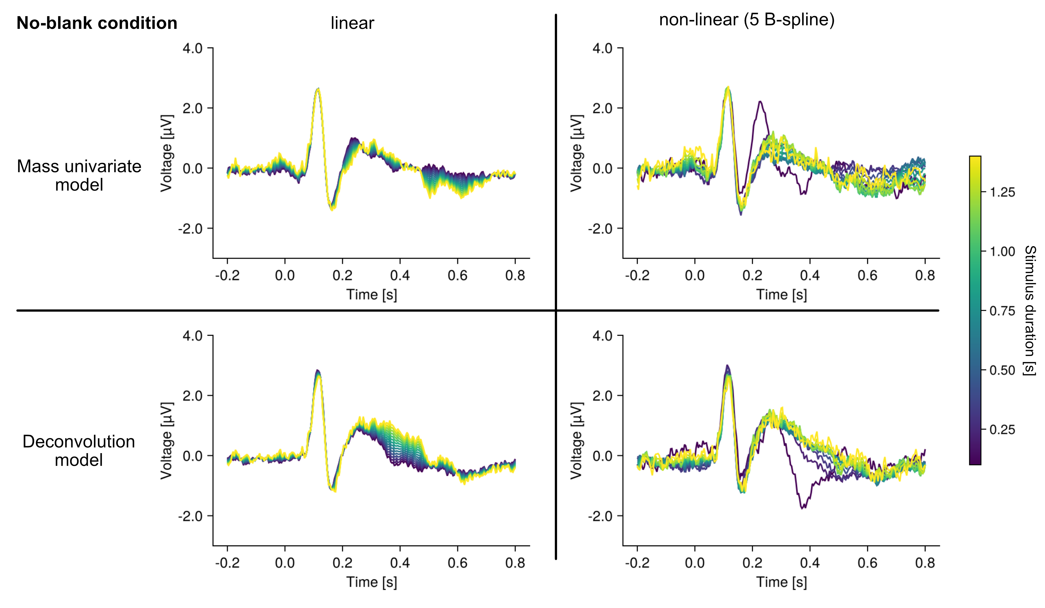
Stimulus duration effect
Grand averaged ERPs (PO8 channel)
Notes:
Much bigger difference between mu and deconv
Expected, since overlap present
Mass univariate, non-linear shows this strong peak before P300 for short stimulus durations
Results more questionable peak could be P100 from following stimulus
Deconvolution models: no significant effect on component peaks but on late stage of P300 (300-500 ms)

Slide 16
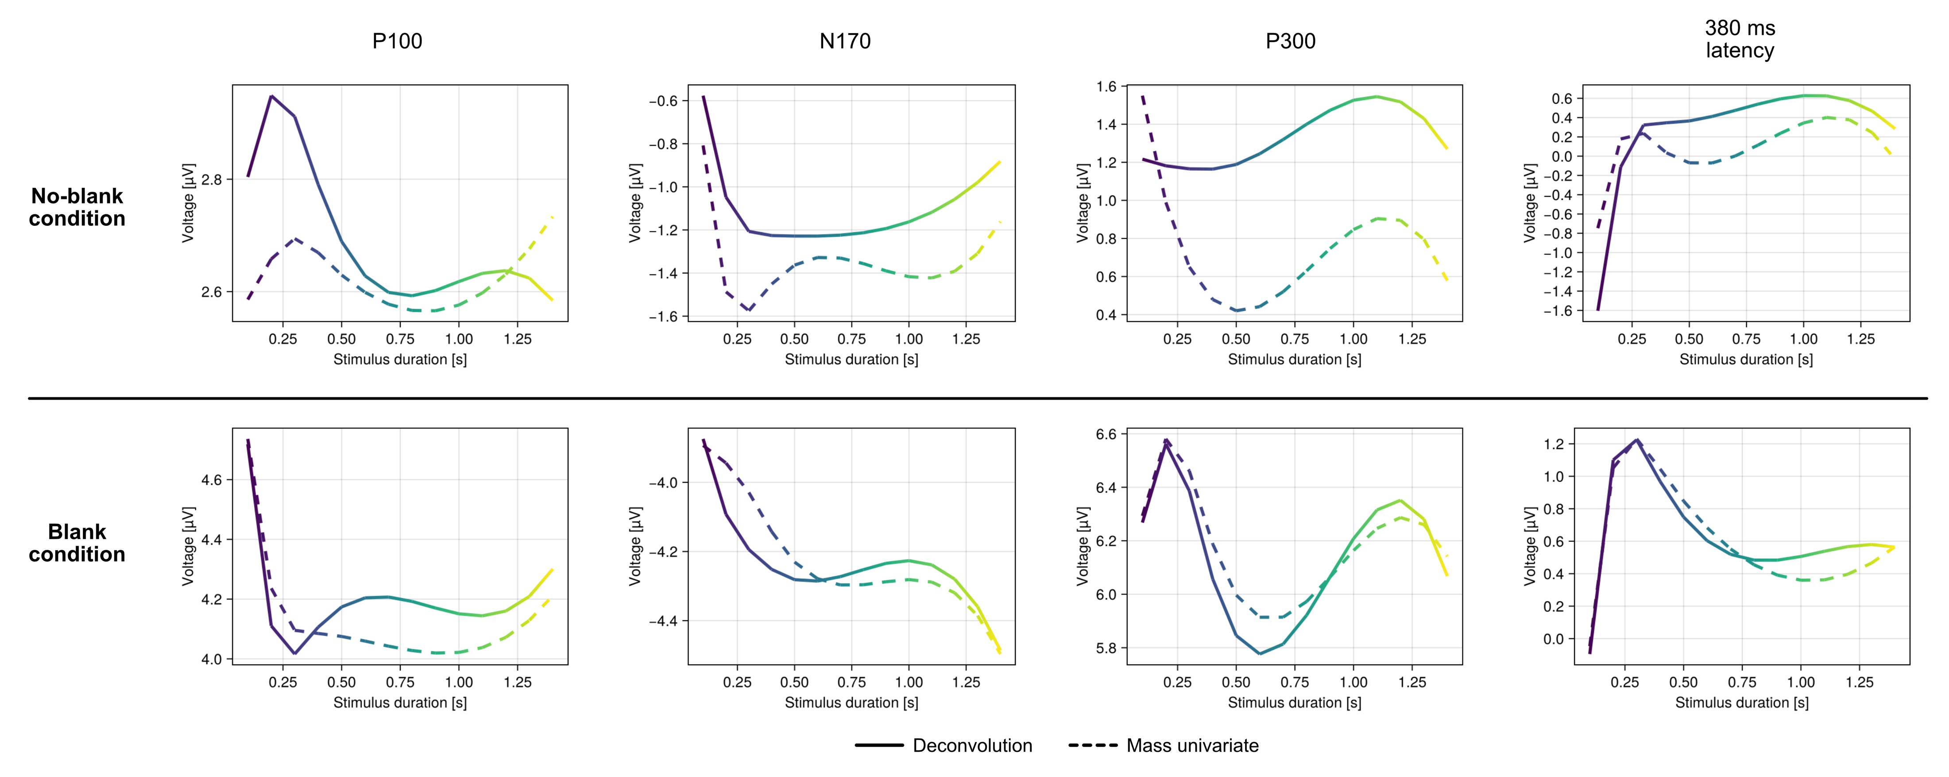
Stimulus duration effect
From grand averaged ERPs (PO8 channel)
Notes:
Blank condition: mu and deconv models very similar
No-blank: also similar but difference visible

Slide 17
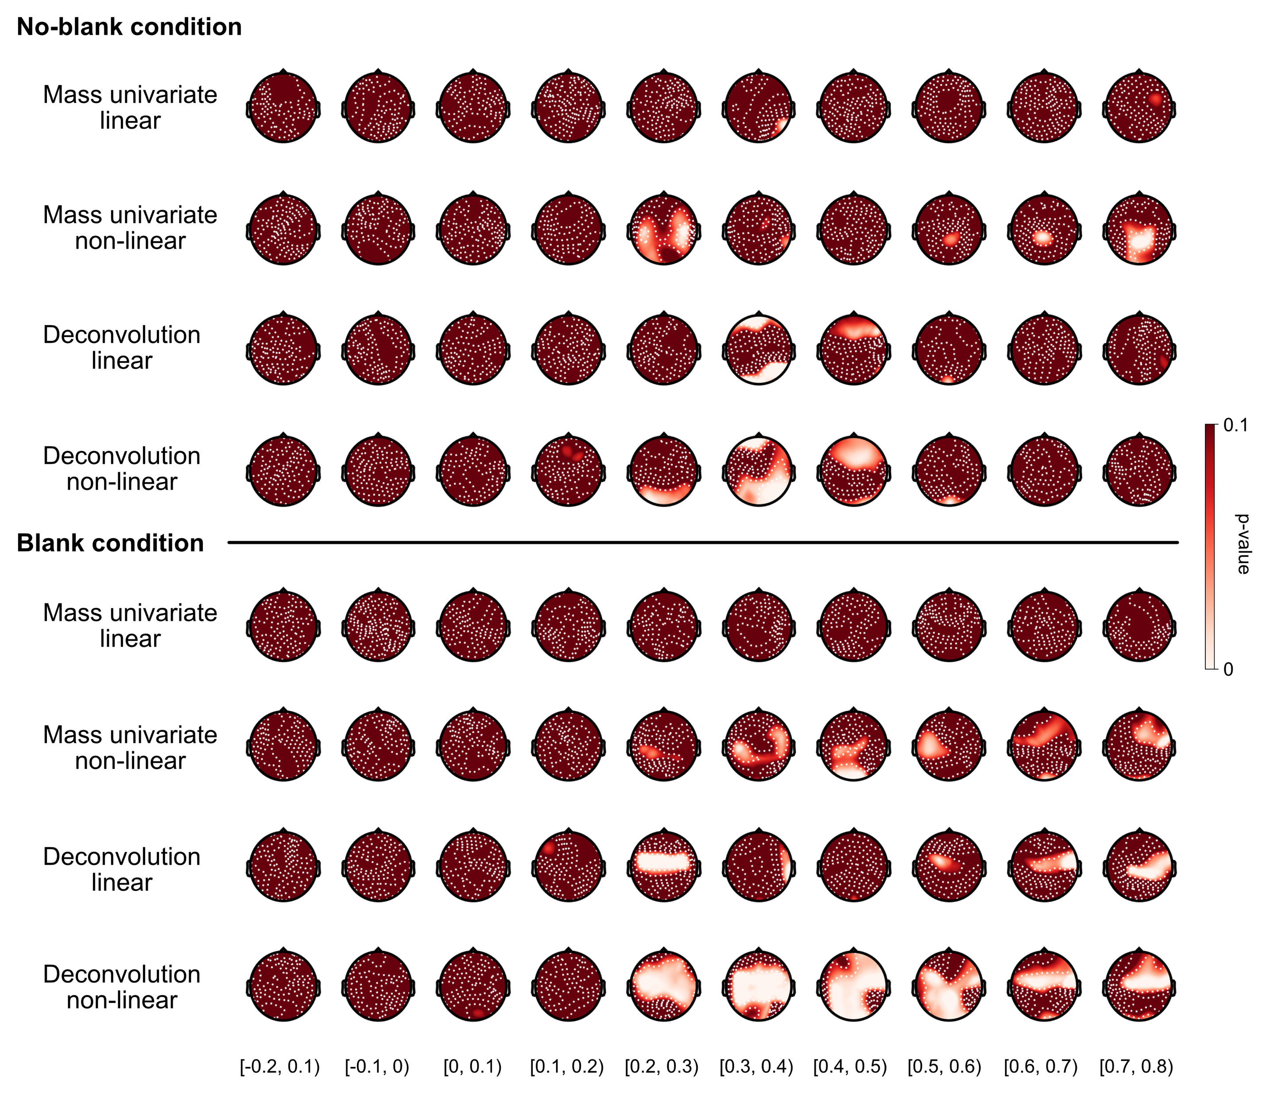
Hotelling‘s t² test results

Slide 18
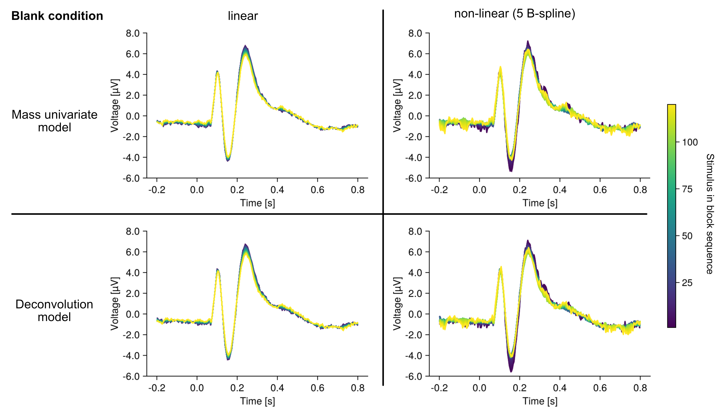
Habituation effect
Grand averaged ERPs (PO8 channel)

Slide 19
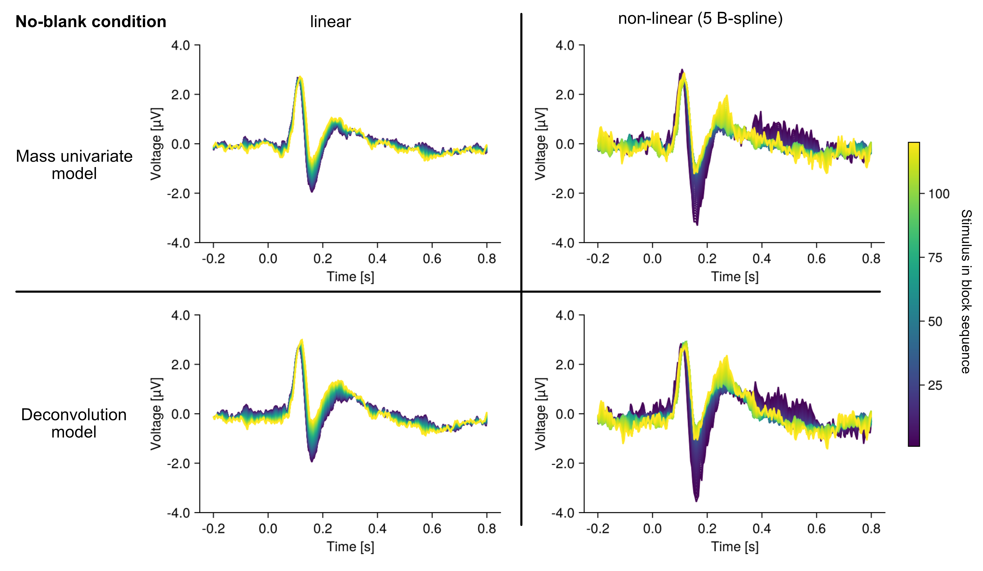
Habituation effect
Grand averaged ERPs (PO8 channel)

Slide 20
Results
ISIs have a significant impact on amplitude of ERP components
No significant effect of stimulus duration on ERP component peaks, but in late stage of P300 component
Applicability of deconvolution-based overlap correction in compination with duration modelling seems methodologically sound

Slide 21
Limitations
Why did two subjects (8, 25) have faulty data?
Lack of multiple comparison correction for Hotelling‘s T² test results
Applicability of baseline correction in RSVP paradigm
Usage of log-uniform distribution for stimulus duration and ISIs
Fewer trials with long durations (could affect model reliability)
Notes:
Hotelling‘s T test: Bonferroni, Benjamini-Hochberg

Slide 22
Future scope
Further research on duration effect needed, with adapatations of study design
→ uniform distribution of stimulus duration
→ increased task relevance of stimulus
Research on ISI effect (possibly also with focus on duration)
Habituation effect could also be of interest for further research

