Slide 1
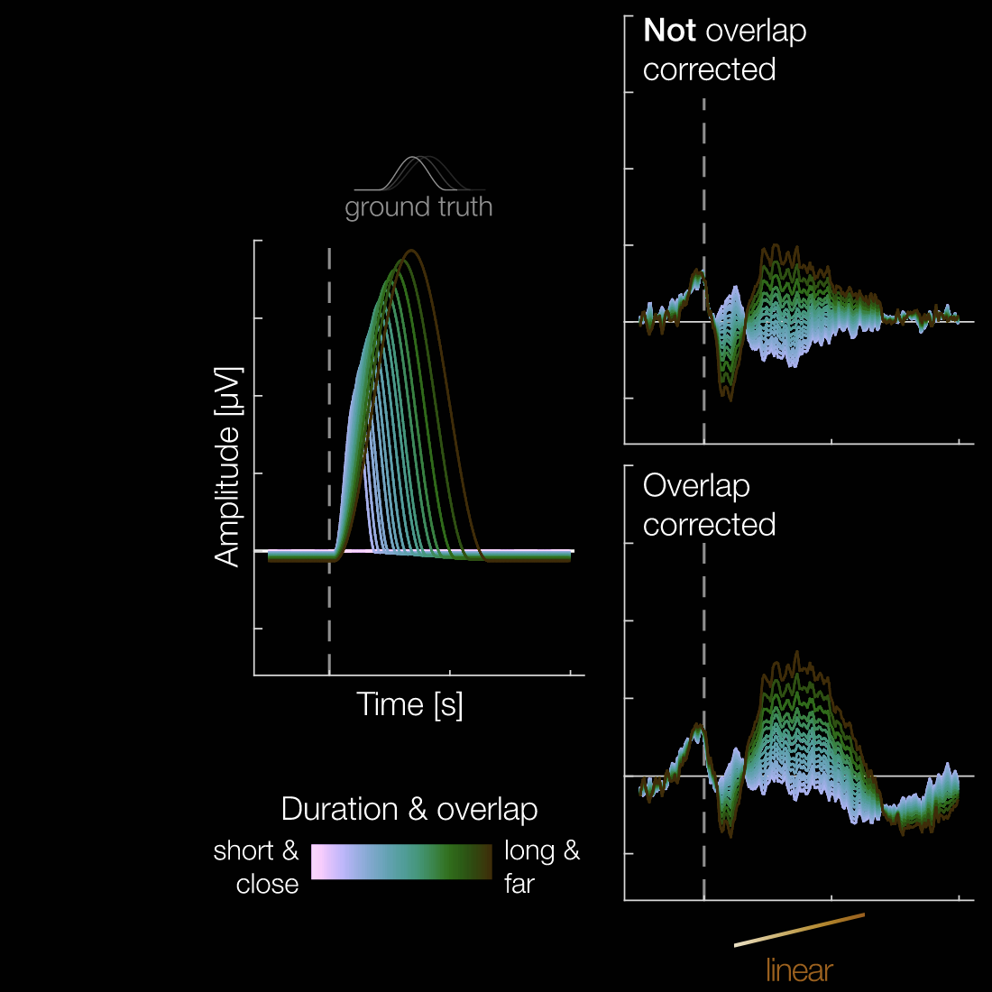
Effect of stimulus duration on event-related potentials during a rapid serial visual presentation task
Bachelor thesis midterm presentation

Slide 2
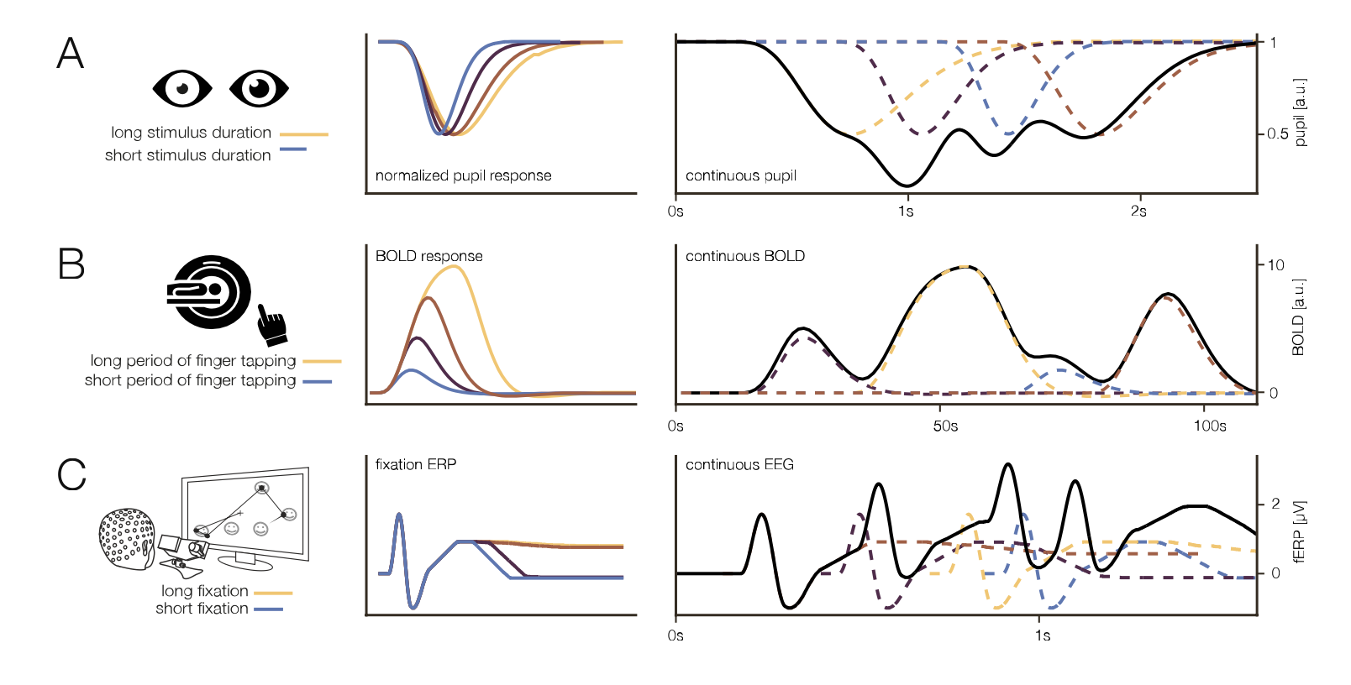
Motivation
Exemplary duration effects in different modalities.
A: normalized pupil response (Snowden et al. 2016), B: BOLD response in fMRI (Glover 1999),
C: fixation ERP (Skukies et. al. 2025, data: Gert et. al. 2022)
Figure from “Brain responses vary in duration - modeling strategies and challenges.” by Skukies et. al., 2025, bioRxiv. CC-BY-NC-ND 4.0.

Slide 3
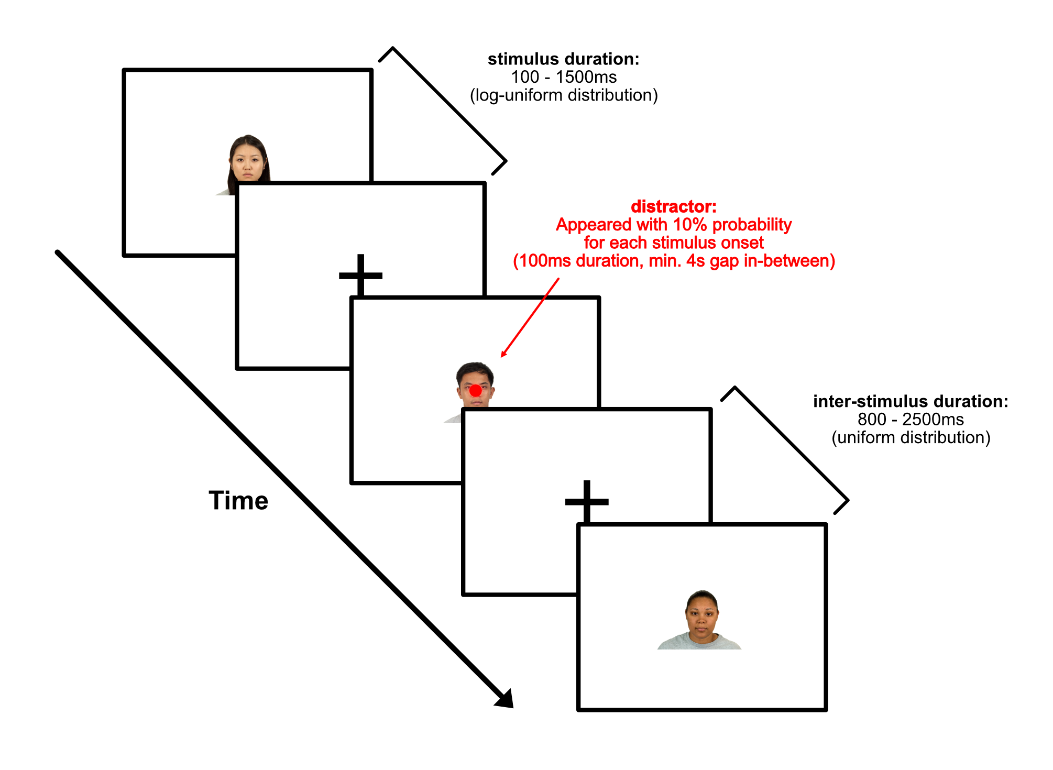
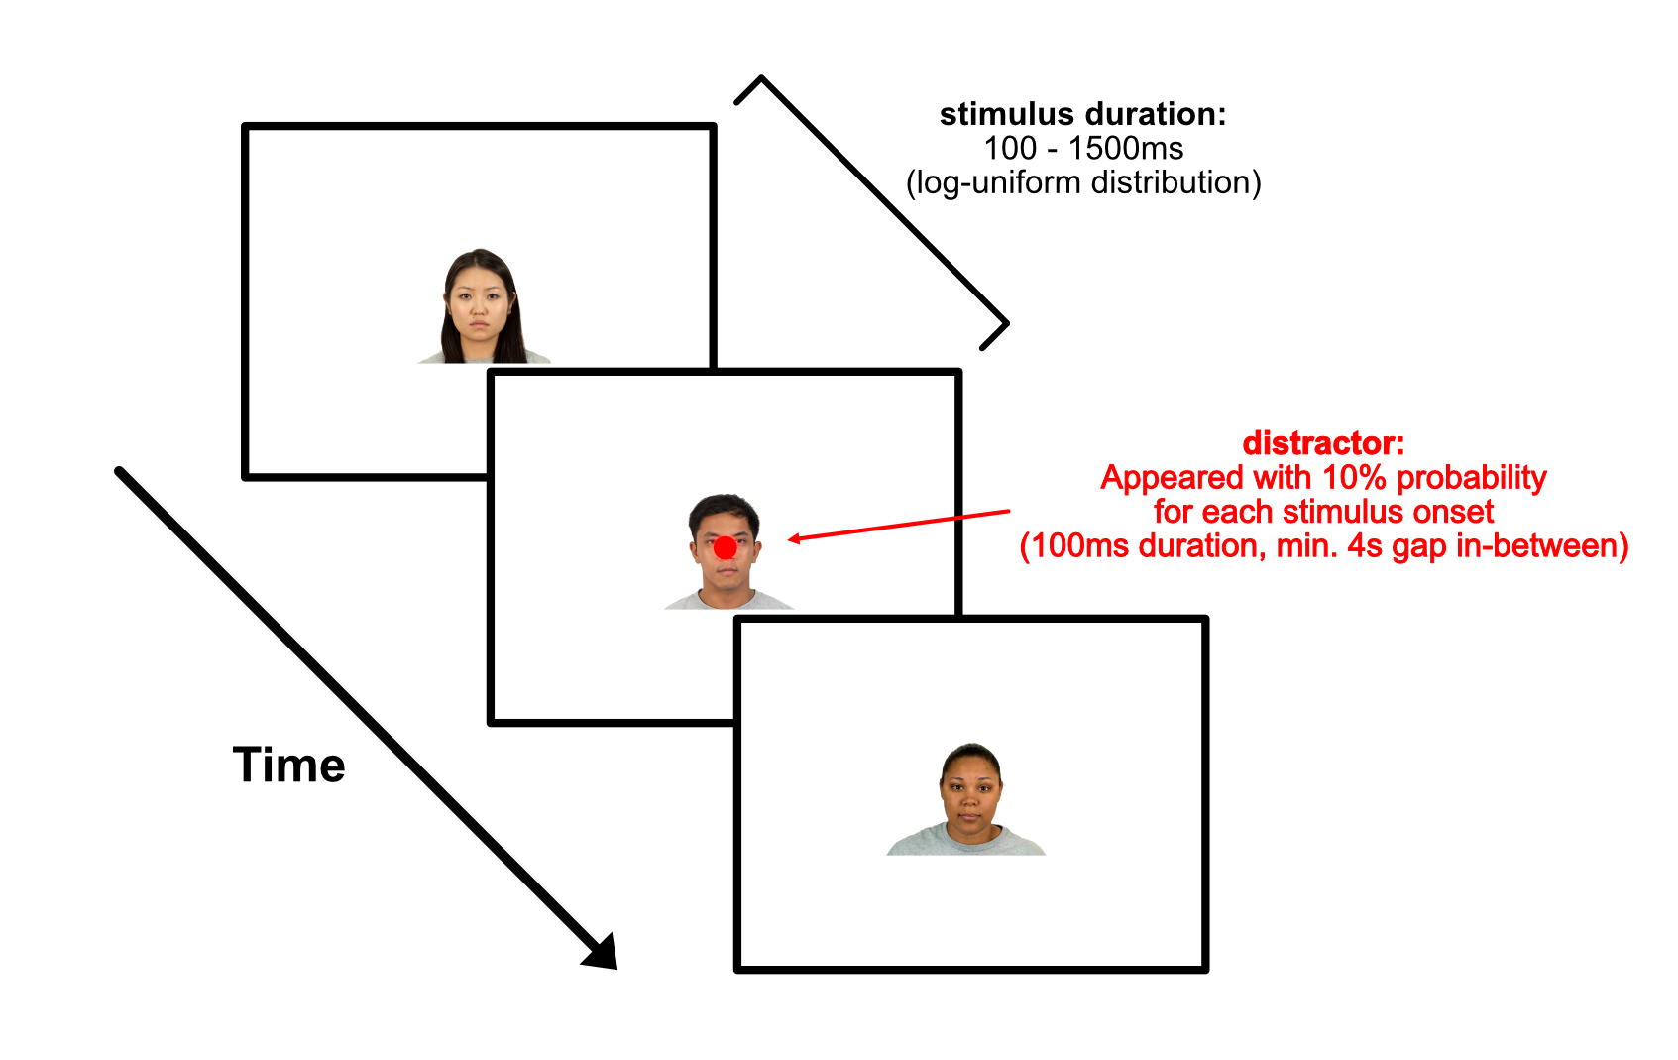
Study
Task
Trials without blanks in-between
Trials with blanks in-between
6 blocks (3 with blanks, 3 without blanks), with 120 images each were conducted per participant

Slide 4

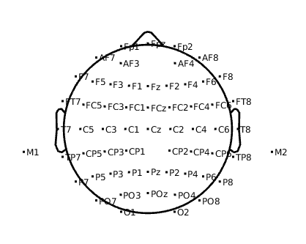
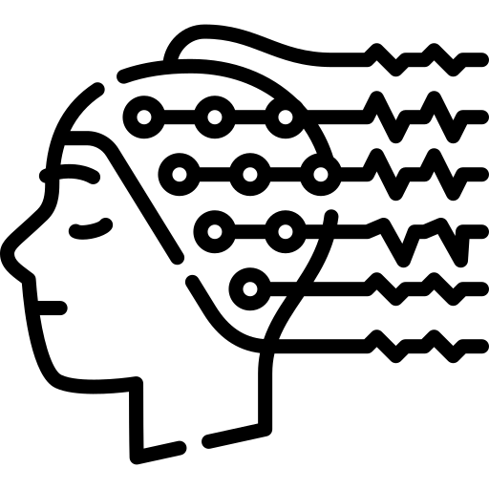
Study
Participants
38 participants (all right-handed)
14 female, 24 male
Age: 21 - 36 years (mean: 27.2)
EEG Recording
Conducted in SimTech building with usual hardware
Cap placed according to 10/5 system (60 scalp electrodes recorded)
Topoplot of recorded electrodes

Slide 5
Study
EEG Recording
Study was conducted in lab at SimTech building
Manufacturer: ANT Neuro (Netherlands)
eegoTM sports amplifier (EE-225)
waveguardTM original cap (CA-203.s1)
Cap placed according to 10/5 system (60 Ag/AgCl scalp electrodes recorded)
Conclusion

Slide 6

Study
Task
Consisted of 6 blocks, of 20 images each
Images of faces were presented in rapid succession
Duration between 100 – 1500ms sampled from log-uniform distribution
Blocks had blank (black-fixation cross) between faces (duration: 800ms – 2500ms) (equally distributed)
During image series a distractor (red dot) randomly popped up (fixed duration 100ms, 10% prob. For each stimOnset, min. 4s pause between)
→ subjects had to react with space-button press
Conclusion

Slide 7
Goals of thesis
Scientific Goal: Does the duration of face presentation influence the brain response?
Methodological Goals:
Investigate the application of deconvolution-based overlap correction in combination with stimulus duration modelling
Comparison of linear and non-linear modeling of stimulus duration effects
Assess the influence of using blanks between stimuli

Slide 8

Preprocessing
Downsample to 250Hz (initially 1000Hz recording)
Remove 50Hz line noise
Remove bad channels
Rereferencing
Remove large spikes
Independent Component Analysis (ICA)
Continuous ASR rejection
Interpolate bad channels
Apply 0.1Hz Highpass filter

Slide 9
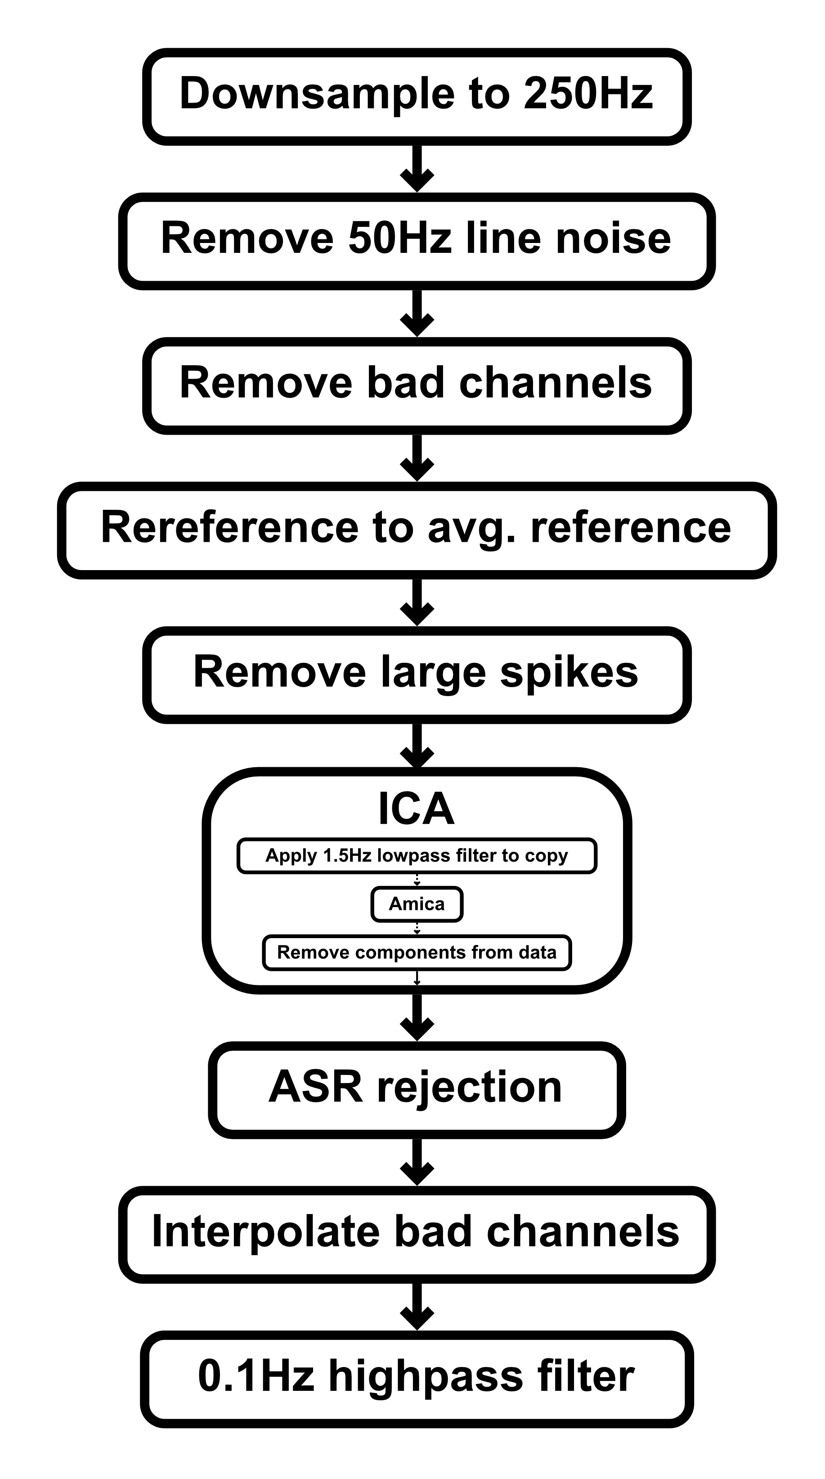
Preprocessing Pipeline
EEGLAB

Slide 10
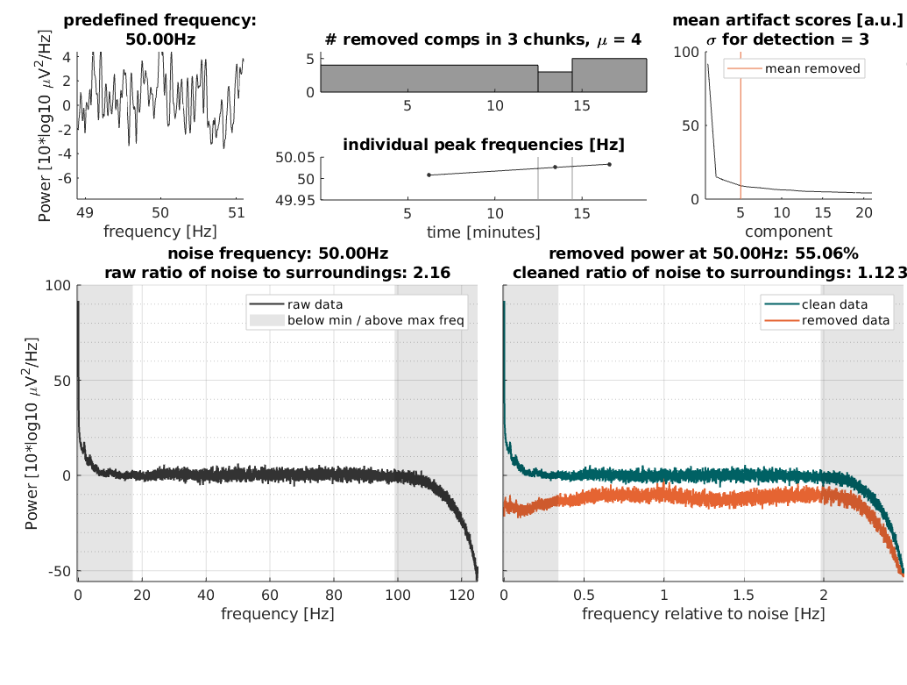
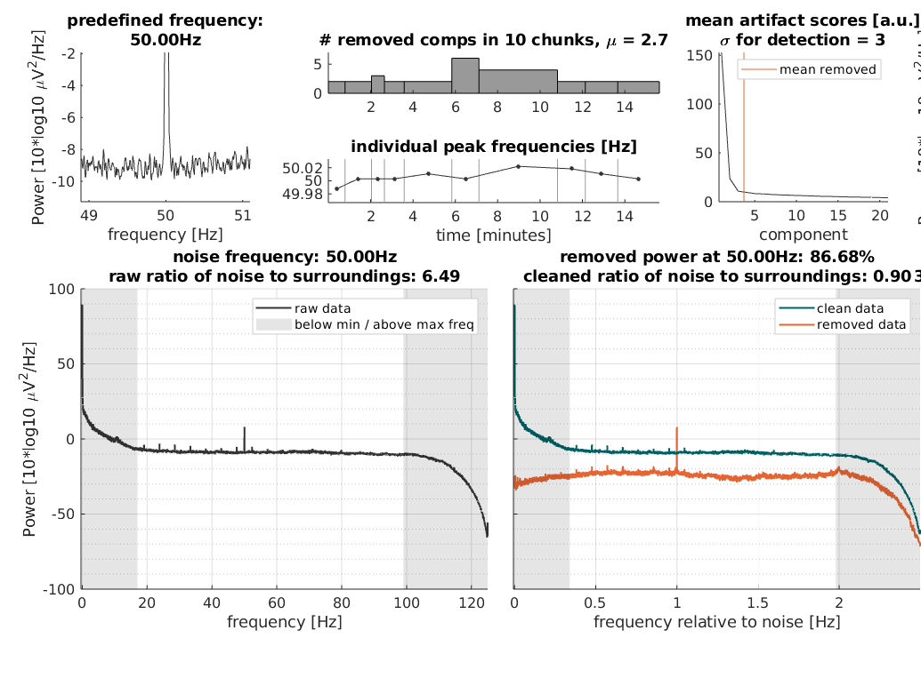
Preprocessing
Subject with noisy EEG data
Subject with tiny alpha peak and small spikes

Slide 11
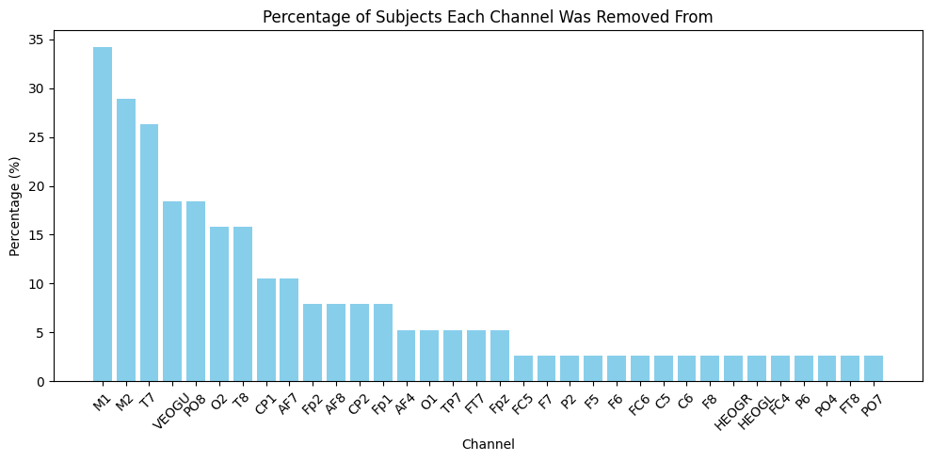
Preprocessing
Criteria: Flatline >5s, correlation <0.8 to robust reference, Line noise (>4 std)
Removed channels per subject on average: 3.03 ± 1.96 std
7 subjects where one of the channels of interest (visual cortex area) missing

Slide 12
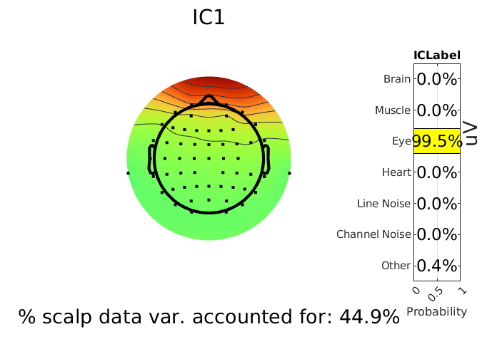
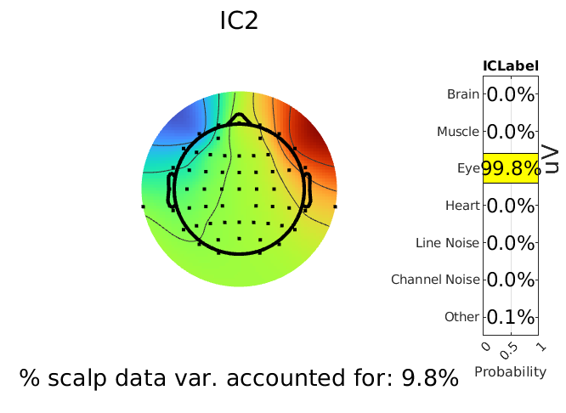
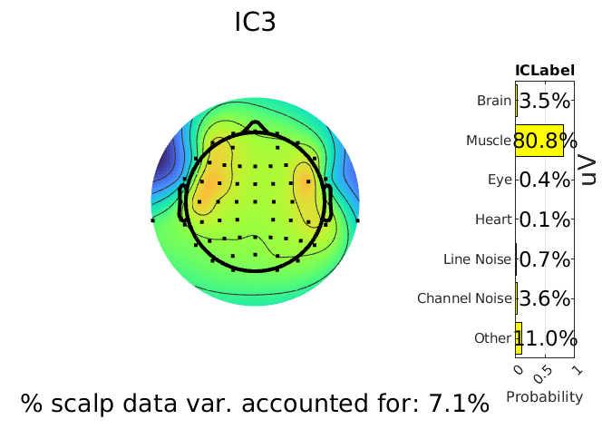
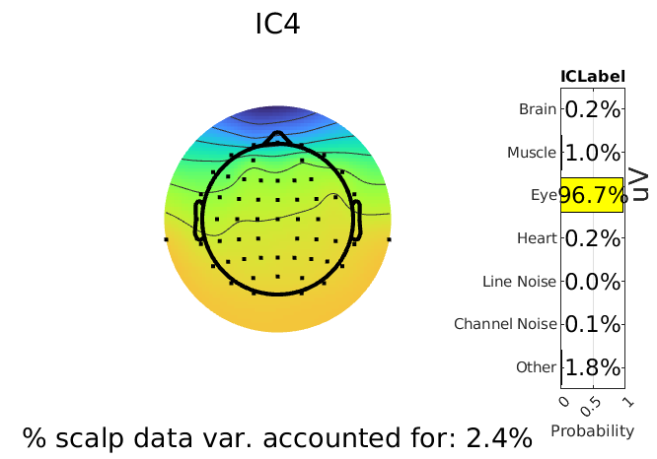
Preprocessing
ICLabel used for component labelling
Confidence threshold for removal >80% for non-brain components
Components removed on average: 18.55 ± 5.10 std
First 4 ICA components of subject with noisy data

Slide 13



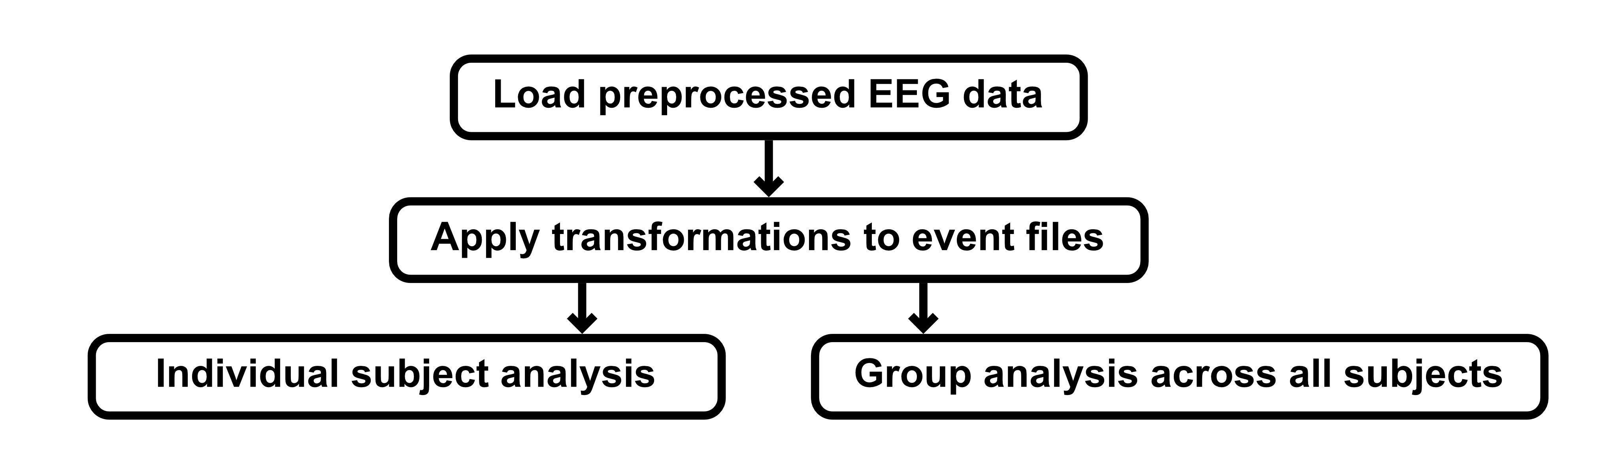
Analysis
Analyze Event-related potentials (ERP) of face stimuli
Conducted in Pluto notebook, julia language
Unfold.jl toolbox using regression ERP (rERP) framework

Slide 14
Analysis
Data Transformations
Indicator wether a blank was present before stimulus not directly captured in event files
→ Create ‘blank‘ column according to ‘value‘ column sequences
Stimulus duration values captured in sample count insted of miliseconds
Multiply duration values by 4 (because of sampling rate 250Hz)
Add columns showing transformation

Slide 15
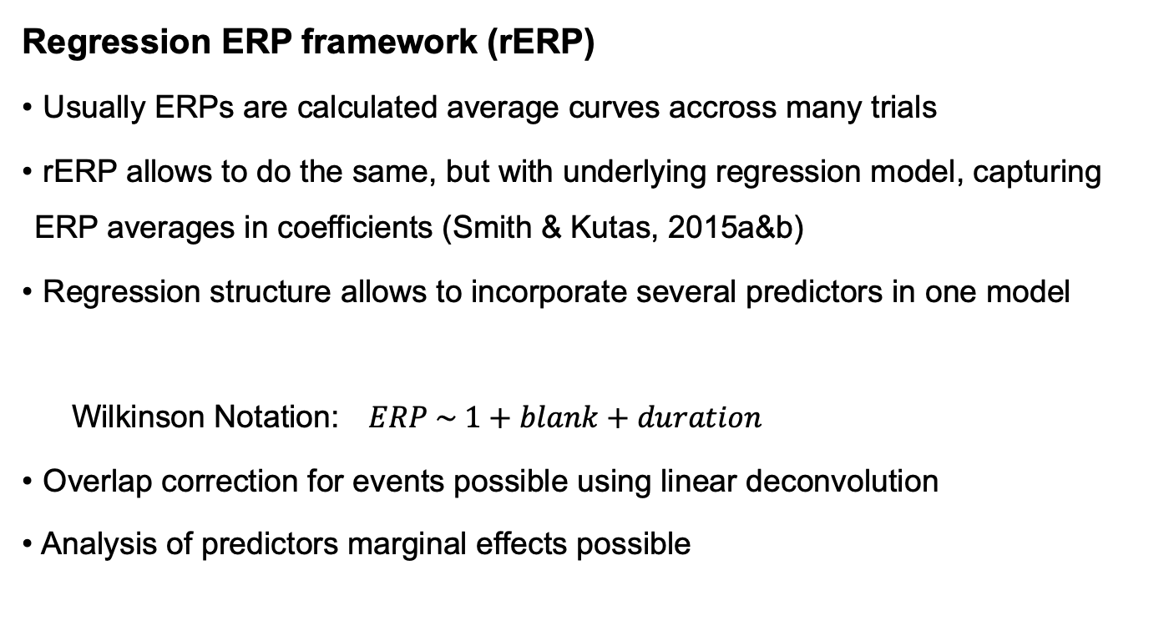
Analysis
Regression ERP framework (rERP)
Usually ERPs are calculated average curves accross many trials
rERP allows to do the same, but with underlying regression model, capturing ERP averages in coefficients (Smith & Kutas, 2015a&b)
Regression structure allows to incorporate several predictors in one model
Wilkinson Notation: $ERP \sim 1+blank+duration$
Overlap correction for events possible using linear deconvolution
Analysis of predictors marginal effects possible
categorical continuous

Slide 16
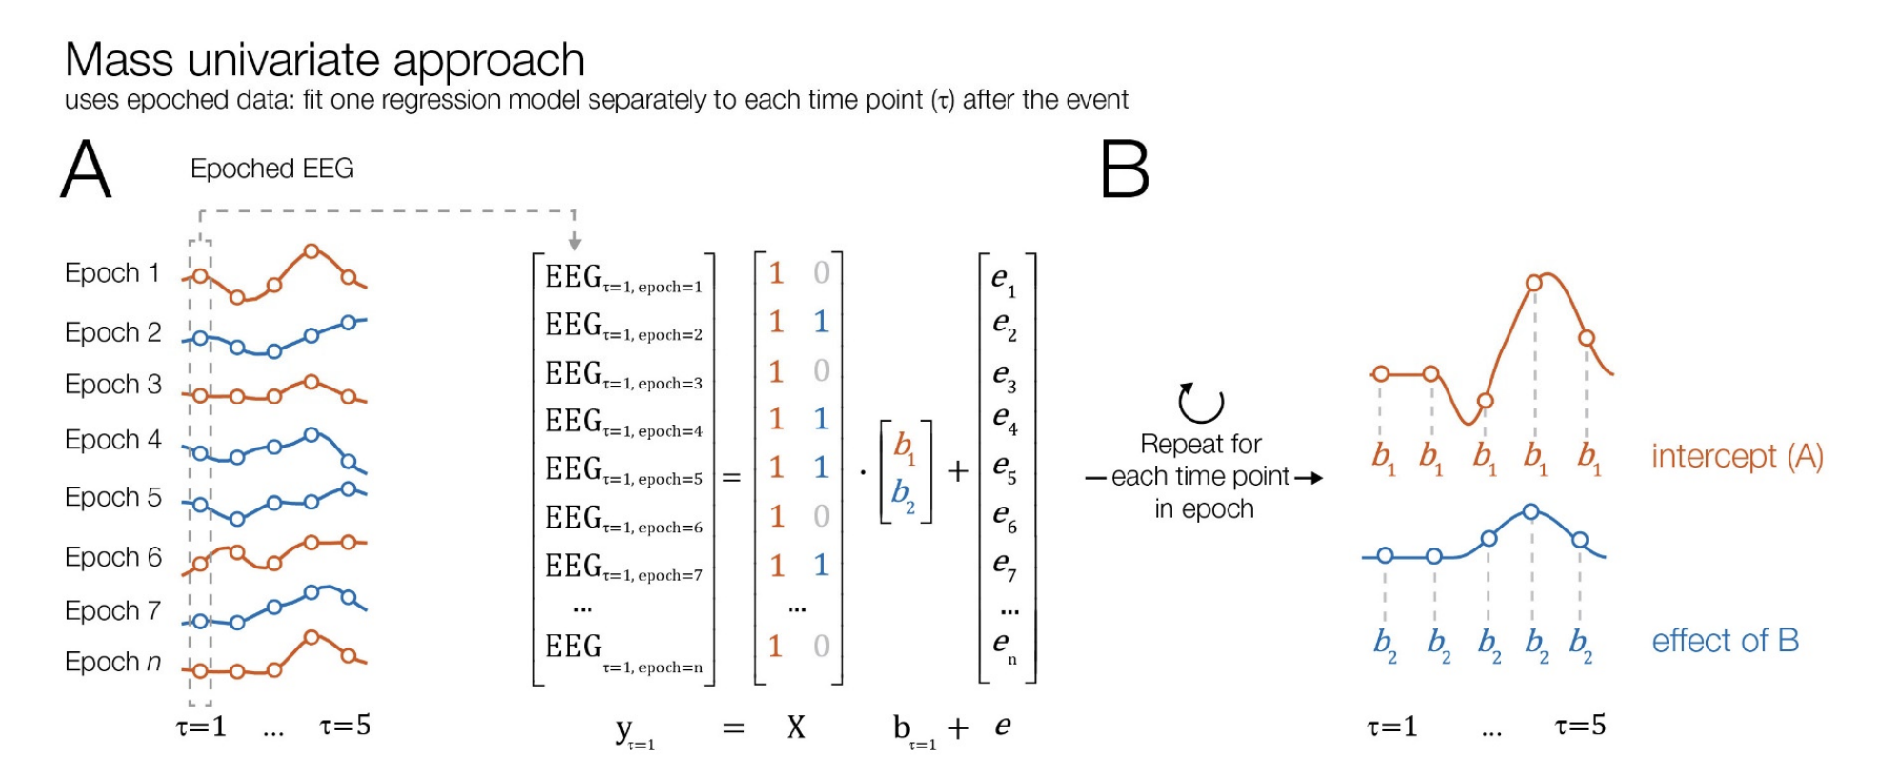
Analysis
Non-overlap corrected models (mass univariate analysis)
# Epoch data
data_epochs, times = Unfold.epoch(data = data, tbl = events, τ = (-0.2, 0.8), sfreq = 250);
# Run Unfold model (without overlap correction)
m_uv = fit(UnfoldModel, ["stimOnset" => (f, times)], events, data_epochs; eventcolumn="value");
Figure from “Analyzing combined eye-tracking/EEG experiments with (non)linear-deconvolution models.” by O. Dimigen and B. V. Ehinger, 2020, bioRxiv. CC-BY-NC-ND 4.0.

Slide 17
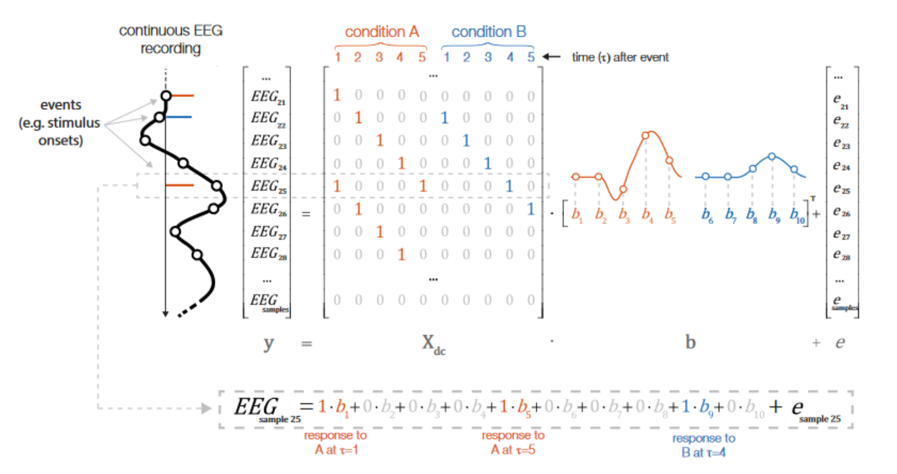
Analysis
Overlap corrected models (linear deconvolution)
# Define basis function (for overlap correction range)
basisfunction = firbasis(τ = (-0.2, 0.8), sfreq = 250)
# Fit Unfold model (with overlap correction)
m_oc = fit(UnfoldModel, ["stimOnset" => (f, basisfunction)], events, data; eventcolumn="value")
Figure from “Unfold: an integrated toolbox for overlap correction, nonlinear modelling, and regression-based EEG analysis” by B. V. Ehinger and O. Dimigen, 2019, PeerJ, 7, e7838. CC-BY 4.0.

Slide 18
Analysis
Marginal Effects
Analyze how a change of coviarate (blank, duration) affects the ERP
Compare linear and non-linear models for continuous covariate duration
GIF from Unfold.jl Documentation, https://unfoldtoolbox.github.io/UnfoldDocs/Unfold.jl/stable/ 2025

Slide 19
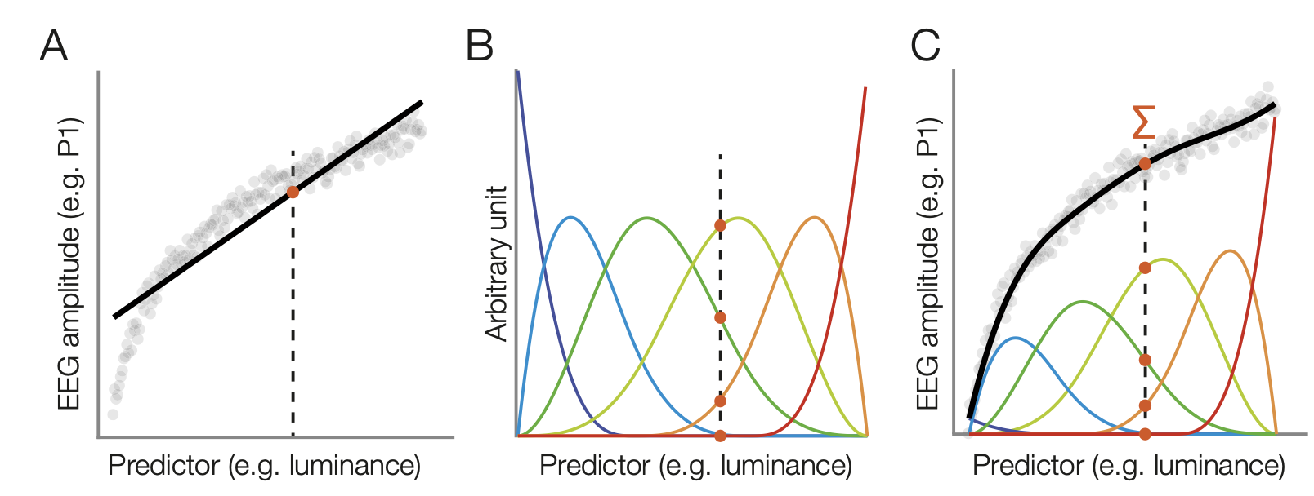
Analysis
Linear vs non-linear models
Definitions of formulas for models:
f = @formula 0 ~ 1 + blank + duration
f_5spl = @formula 0 ~ 1 + blank + spl(duration, 5)
linear
non-linear (5-splines)
Application of 6 b-splines to model continuous predictor luminance by B. V. Ehinger and O. Dimigen, 2019, PeerJ, 7, e7838. CC-BY 4.0.

Slide 20
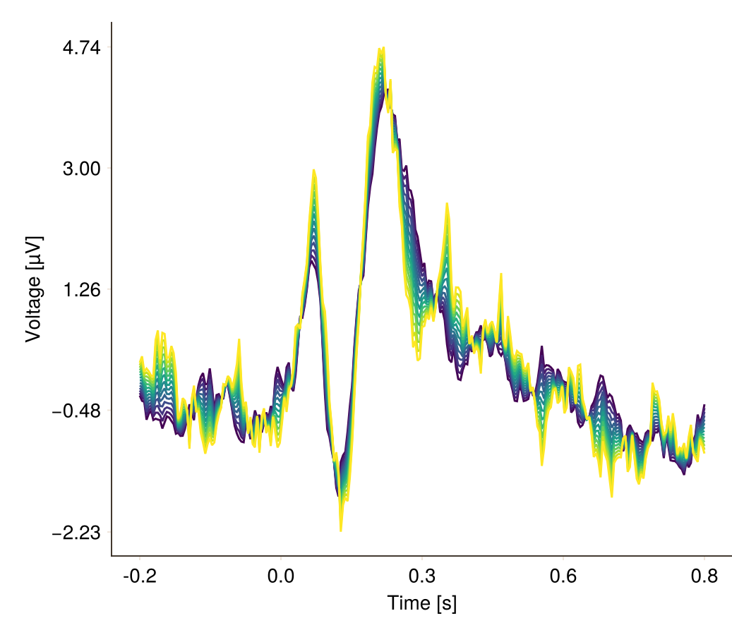
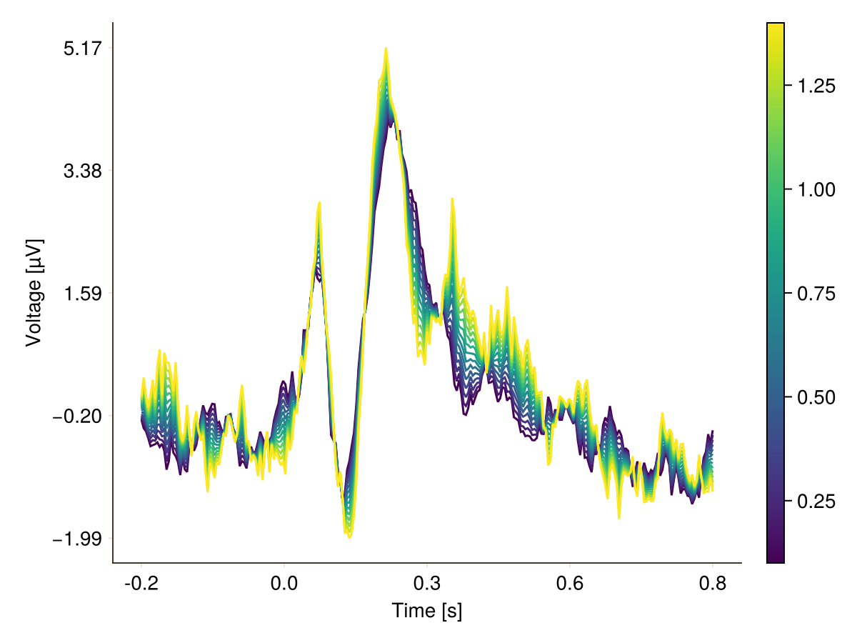
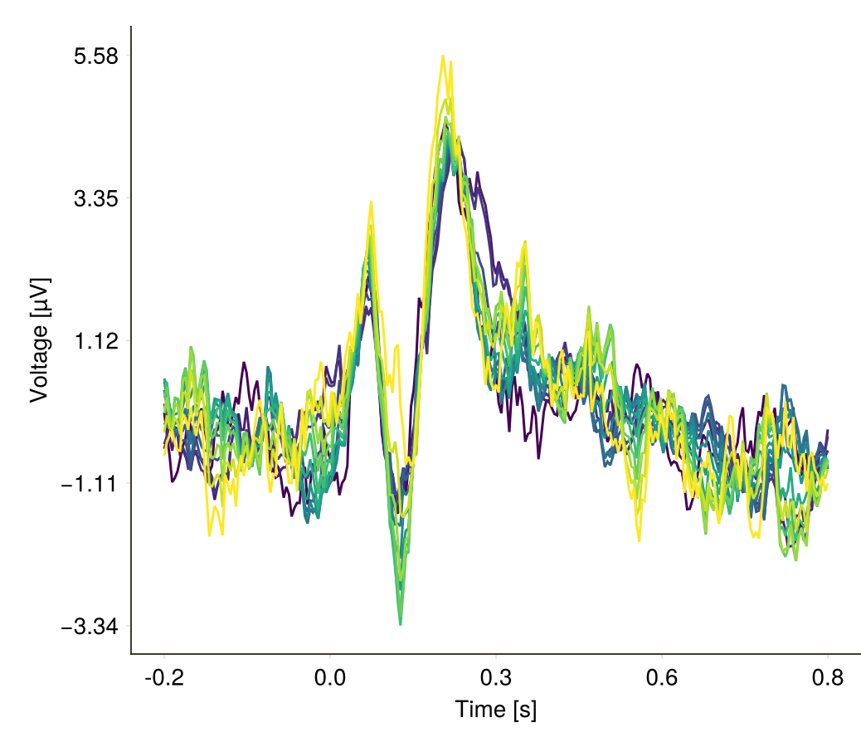
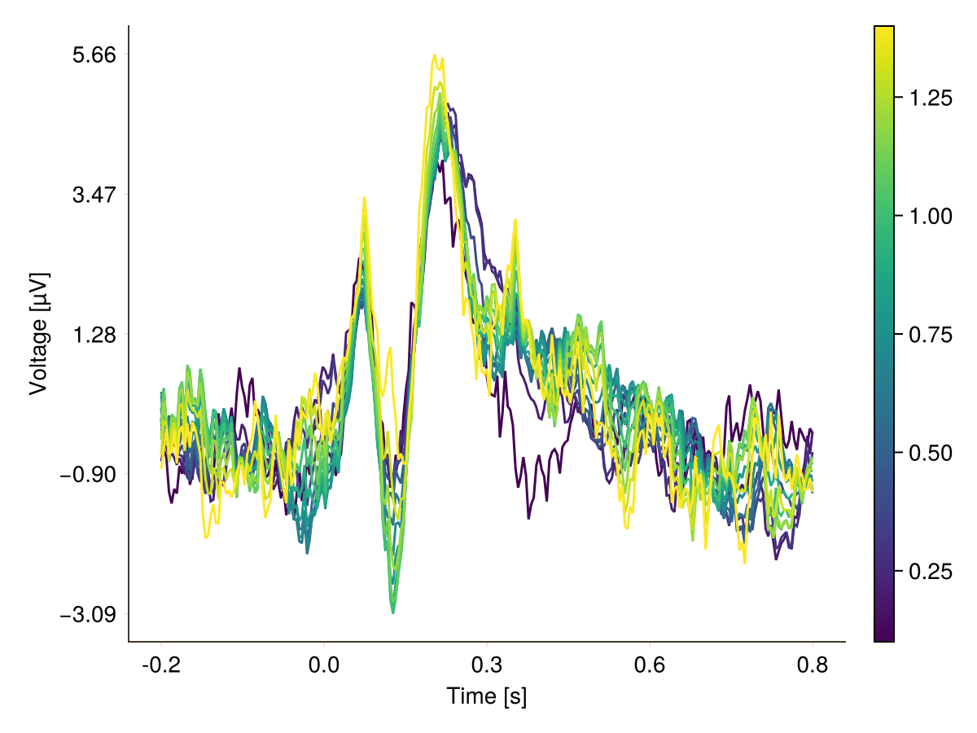
Effect of Duration
mass univariate
overlap corrected
linear
5-spline
PO8 electrode of subject with noisy data

Slide 21
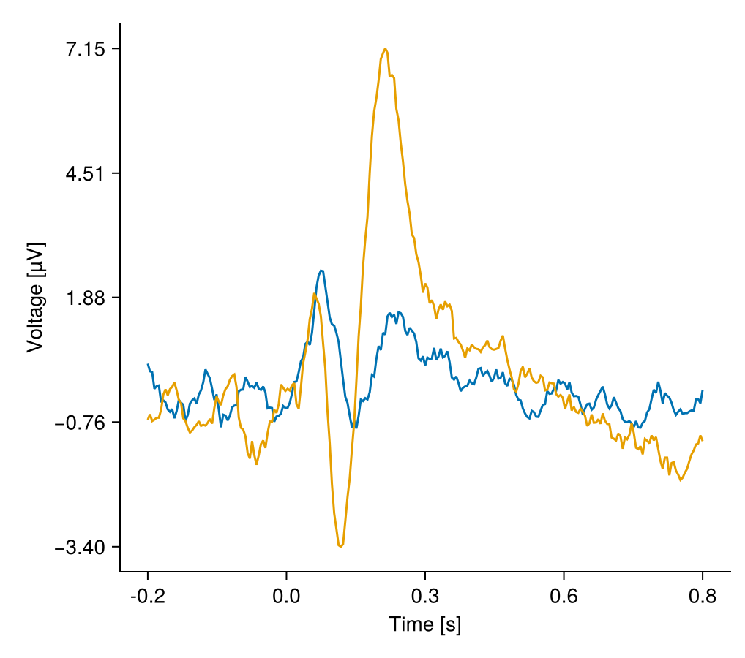
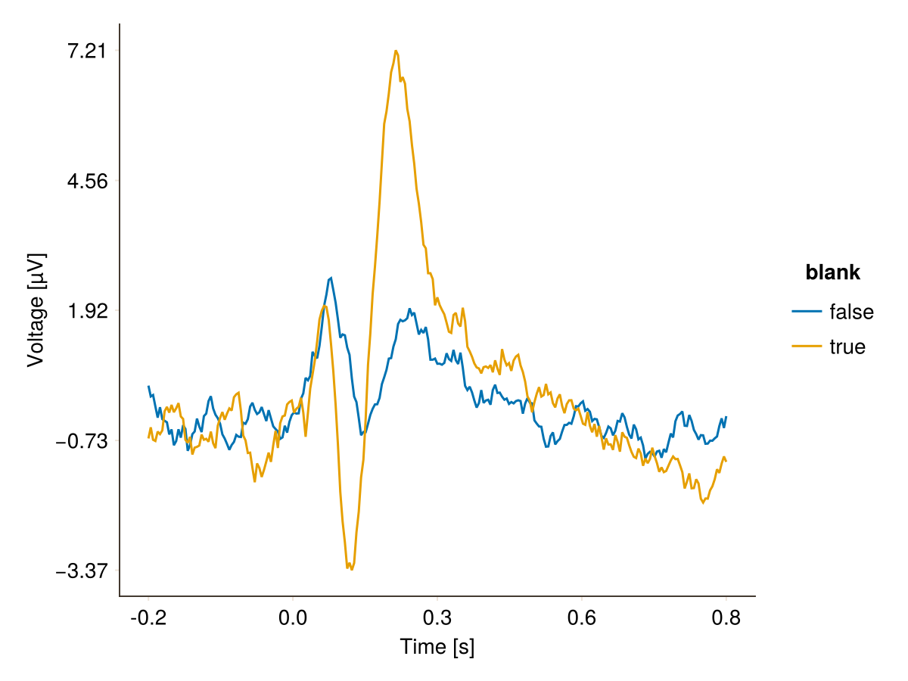
Effect of Blanks
mass univariate
overlap corrected
PO8 electrode of subject with noisy data

Slide 22
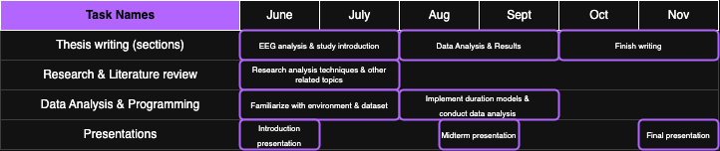
Outlook
Finish Group Analysis and apply statistical tests (Hotellings T-squared Test, Cluster permutation test)
Interpret results
Write up thesis

Slide 23
Open Questions
How to handle last stimulus in a block? (May the runout after stimulus offeset influence ERP)
How to deal with subjects that showed noisy data?
How to handle subjects where main channels and neighbouring channels for interpolation are missing

