Slide 1
Reimplementation of AMICA in Julia
Alexander
Lulkin

Slide 2
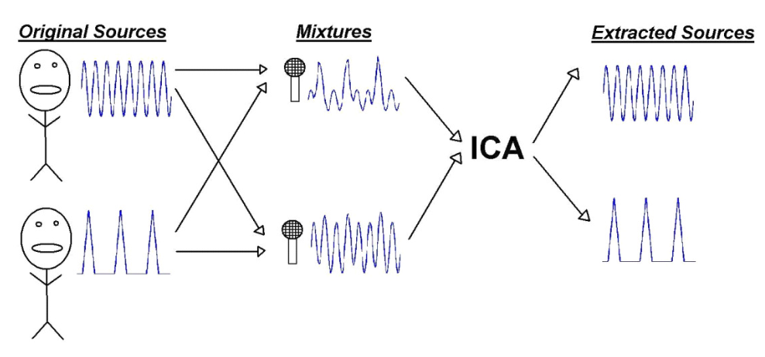
Blind Source Separation
Image source: „An Introduction to Independent Component Analysis: InfoMax and FastICA algorithms“ (Dominic Langlois et al., 2010)

Slide 3
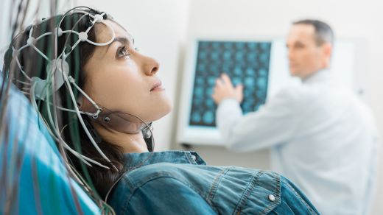
ICA in EEG
Identification of independent components
Noise reduction (muscle artifacts)
Various algorithms are in use (FastICA, Infomax, AMICA)
©iStock.com/yacobchuk

Slide 4
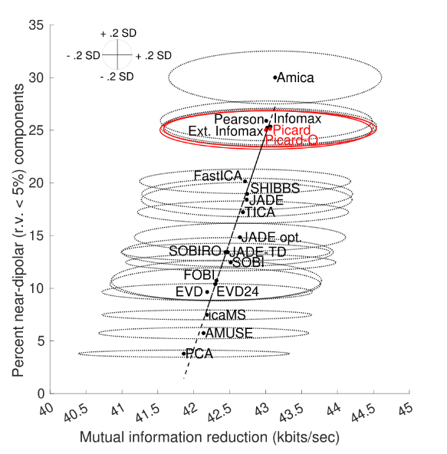
Different ICA Algorithms
Image source: “A Framework to Evaluate Independent Component Analysis applied to EEG signal: testing on the Picard algorithm” (Gwenevere Frank et al., 2022)

Slide 5
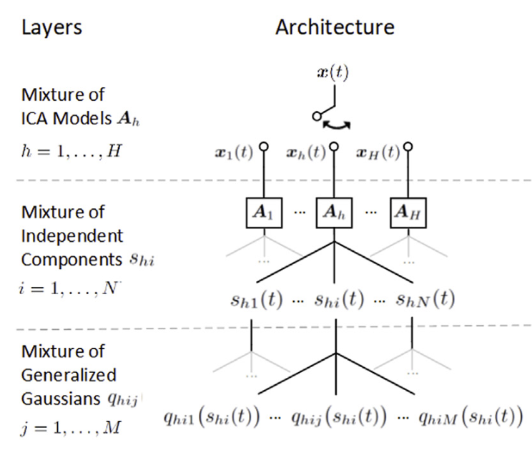
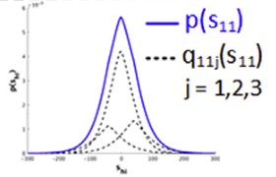
Adaptive Mixture Independent Component Analysis (AMICA)
Image source: „Modeling brain dynamic state changes with adaptive mixture independent component analysis “ (Sheng-Hsiou Hsu et al., 2018)

Slide 6
Current Problems
Two implementations: Fortran & Matlab
The former is hard to read, the latter has bad performance
Further development is not easy
Potential for optimization

Slide 7
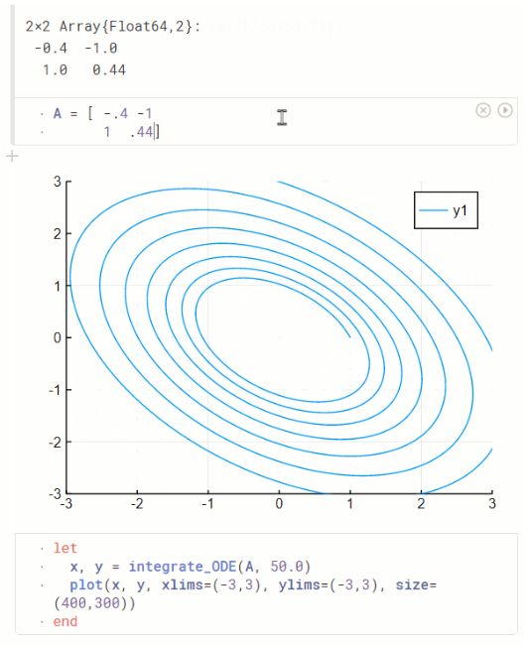
Why Julia?
Readable code
Modular structure
(Hopefully) Good performance
→ Further development will be easier
Image source: https://plutojl.org/

Slide 8
Mandatory Goals
Implementation of the adaptive source density models
Implementation of the ICA mixture model
Evaluation of the correctness of the algorithm
Measurement of the performance

Slide 9
Optional Goals
Replacing manual calculations of derivations
Evaluating different Automatic Rejection Schedules
Something will come up

Slide 10
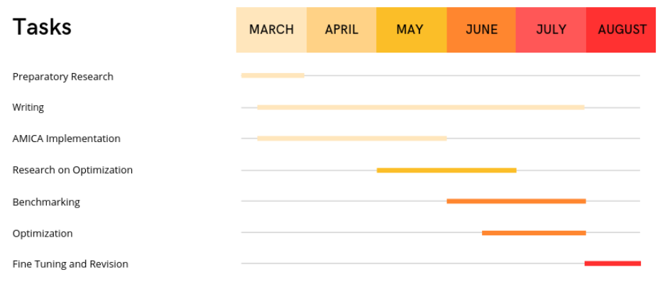
Project Schedule

Slide 11
Alexander Lulkin
e-mail:
st108415@stud.uni-stuttgart.de
Phone: +49 (0) 176 404-29089
University of Stuttgart

