Slide 1
Reimplementation of AMICA in Julia
Alexander
Lulkin

Slide 2
Motivation
AMICA is an algorithm which unmixes data
Two implementations: Fortran & Matlab
The former is hard to read, the latter has bad performance
Further development is not easy
Potential for optimization
→ Let‘s implement it in Julia
Notes:
And lets see if we can improve any of those
But first, a recap of the basics…

Slide 3
Blind Source Separation
Image source: „Independent component analysis: An introduction “ (A. Tharwat et al., 2021)
Notes:
-Mixture durch matrix dargestellt
ICA: finde matrix!

Slide 4

Independent Component Analysis
Model data as linear mixture:
Original sources are assumed to be not normally distributed
Mixtures of random variables tend towards the normal distribution
→ Recover sources by maximizing non-Gaussianity
Notes:
Independence assumption gilt nur in einem bestimmten zeitpunkt
-central limit theorem

Slide 5
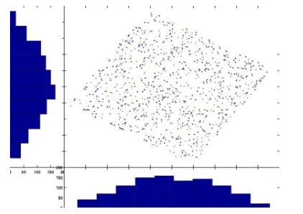
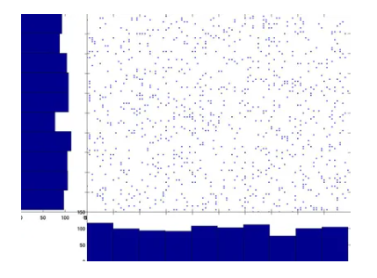
Independent Component Analysis
→
Image source: https://arnauddelorme.com/ica_for_dummies/

Slide 6
Data Preprocessing: Sphering and Mean Removal
Before performing ICA, the data should be prepared in two ways:
1. The data should be centered
Remove mean from each variable
Equalizes the weight of the different dimensions
2. The data should be whitened/sphered
Remove correlations by setting variance to 1
Notes:
Mean removal does not affect unmixing, means can be added back
Mean removal makes calculation easier
Whitening: allows for all dimensions to be weighted equally
Causing mixing matrix to be orthogonal
Varianz = streuung um mittelwert
Whitening is not enough to get independent components cause of rotation

Slide 7
ICA in EEG
Identification of independent components
Noise reduction (muscle artifacts)
Various algorithms are in use (FastICA, Infomax, AMICA)
Notes:
Überleitung: now ive mentioned this is about a certain ica…

Slide 8
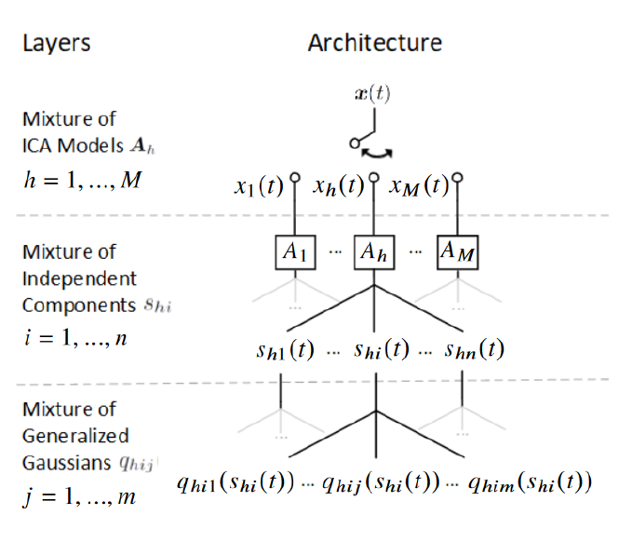
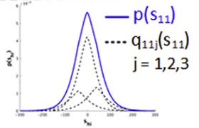
Adaptive Mixture Independent Component Analysis (AMICA)
Adapted from: „Modeling brain dynamic state changes with adaptive mixture independent component analysis “ (Sheng-Hsiou Hsu et al., 2018)
Notes:
Advantages gegenüber anderen:
Multiple models used to model different timesteps
Instead of regular GG: use Mixture to approximate probability density function

Slide 9
Expectation-maximization Algorithms (EM)
How to optimize a model?
Calculate likelihood function and maximize it
Expectation step: calculates likelihood estimate with current parameters
Maximization step: calculate new parameters to find better likelihood
Repeat until convergeance
Notes:
You dont know which parts of the model generated which parts of the data
Usually used when some data is missing

Slide 10


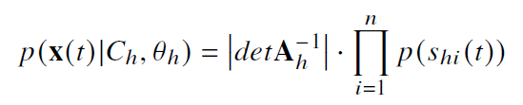
Likelihood Function
Probability of a model generating the data
Data:
Model Parameters:
Likelihood:
Notes:
h(t) = h (dominant model at time t)
This is what we want to maximize
C = sagt uns ob model aktiv ist
Determinante um skalierungseigenschaften der transformation zu berücksichtigen
p= probaility density function

Slide 11
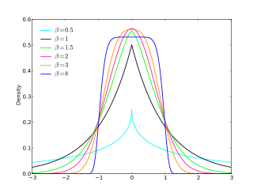

Generalized Gaussian
Image source: https://en.wikipedia.org/wiki/Generalized_normal_distribution
Notes:
Betas in image = rho in formula
Scale = more spread out, shape = sharp or round, location = shift
Γ(z) = ∫[0, ∞] t^(z-1) * e^(-t) dt
Rho = shape, beta = scale, mu = location (shift)
Gamma probably there to ensure proper probability distribution

Slide 12
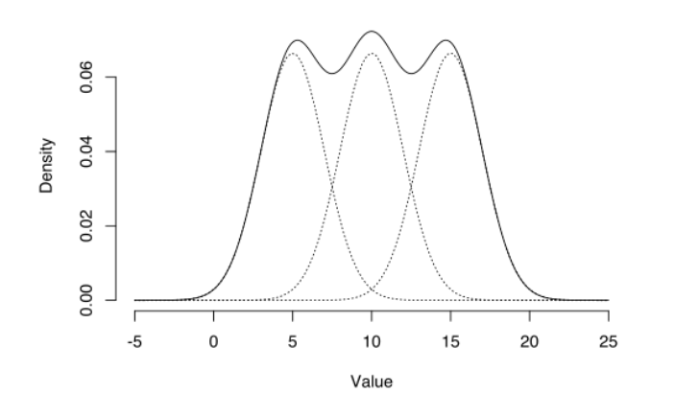
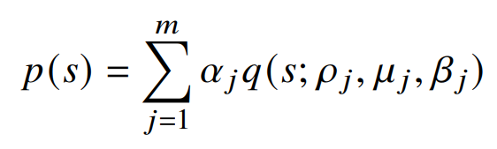
Gaussian Mixtures
Image source: https://www.statisticshowto.com/gaussian-mixture-model/
Notes:
Alpha = weights for gaussians

Slide 13
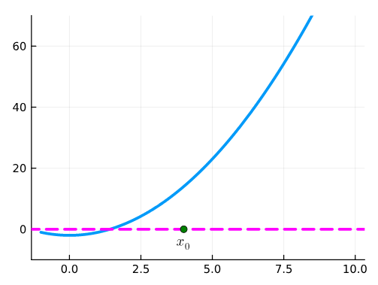
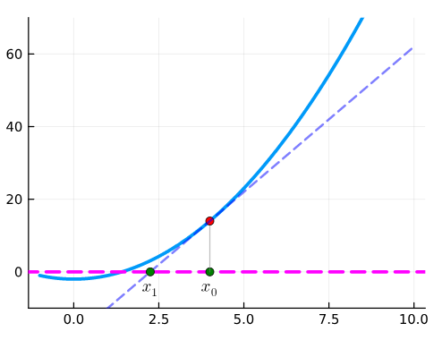
Newton Method
Newton method estimates the zeros of a function
Find zeros of derivative of likelihood function → find maximum
Image source: https://computationalthinking.mit.edu/Fall23/images_abstractions/newton_method/

Slide 14
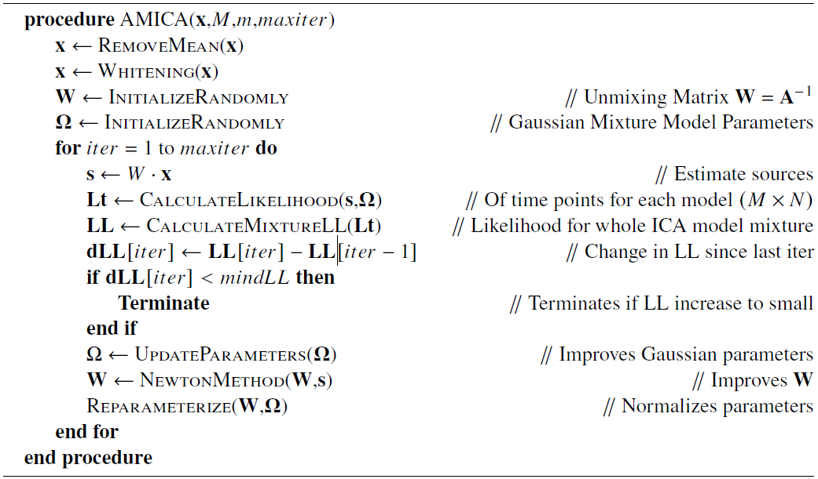
Amica Algorithm
Notes:
Eig. Summe von dLL damit nichts sofort abbricht wenn in einer iteration nicht gut -> lokalen minima entkommen
Was ist reparameterization?
Wie werden die GG parameters improved?

Slide 15
Implementation
Custom Data Types
Notes:
Z = Densities for each sample per gaussian

Slide 16
Implementation
Multiple Dispatch
Notes:
-Man muss nicht multi funktion nutzen wenn man keine der besonderen parameter braucht

Slide 17
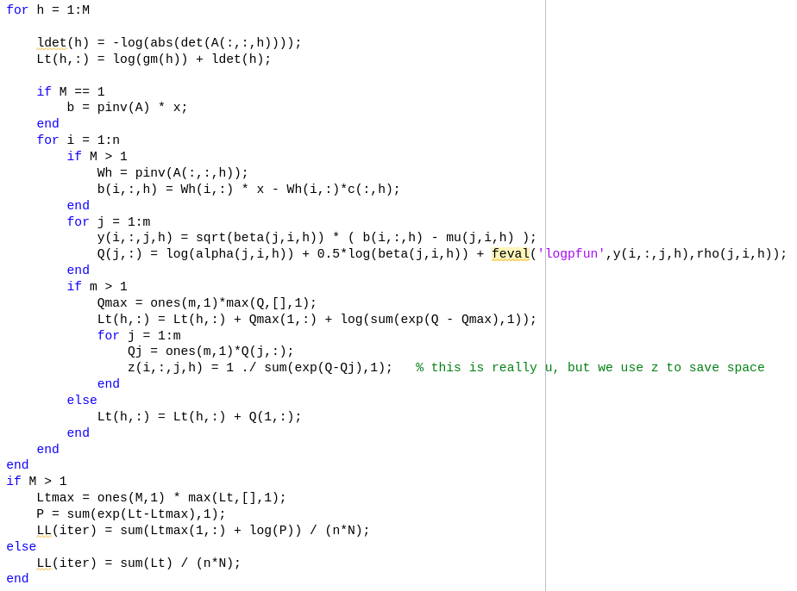
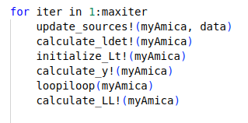
Implementation
Notes:
Whats in loopiloop?

Slide 18
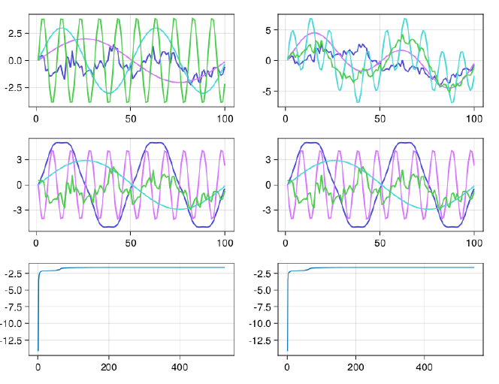
Correctness: MATLAB vs Julia
SingleModel
Original data Mixed data
Unmixed(Julia) Unmixed(ML)
LL (Julia) LL(ML)

Slide 19
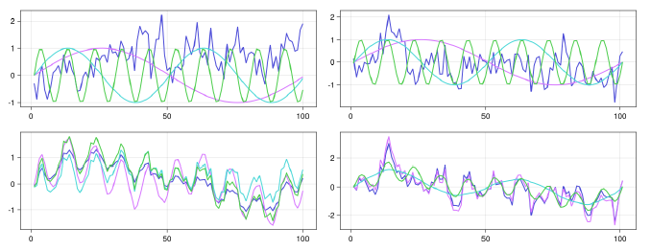
Correctness: MATLAB vs Julia
Data mixed with 2 mixing matrices
Original:
Mixed:

Slide 20
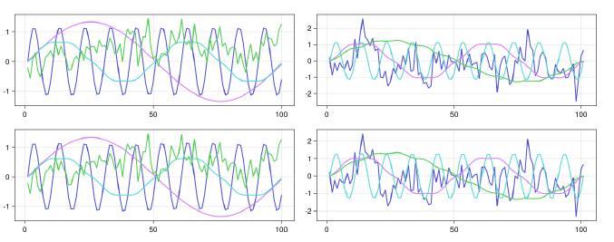
Correctness: MATLAB vs Julia
Data unmixed with 2 models
Julia:
MATLAB:

Slide 21
Evaluation: Correctness
Unmixing matrices applied in reverse
Unmixed with matrix 1: Unmixed with matrix 2:

Slide 22
Evaluation: Performance
Single Thread on EEG data
Notes:
EEG data set: 2 people were looking at visual stimuli
Sieht nur aus als ob ML und Julia nah beieinander weil Fortran so weit weg
Julia sogar etwas besser als ML
-bei fortran parameter nicht fixiert!

Slide 23
Evaluation: Performance
Multi Thread on EEG data
Notes:
Julia worst (weil kein multithreading support)
Überprüfen ob julia überhaupt speed up hatte (sollte)

Slide 24
Future Work
Optimization!
Still some Qs and us and zs in there
Some more clean up
Add more features (see Fortran implementation)
Notes:
Ideen für opti siehe text doku

Slide 25

Alexander Lulkin
e-mail
st108415@stud.uni-stuttgart.de
phone +49 (0) 176 404 29089
University of Stuttgart

