Slide 1
Reimplementation of AMICA in Julia
Alexander
Lulkin

Slide 2
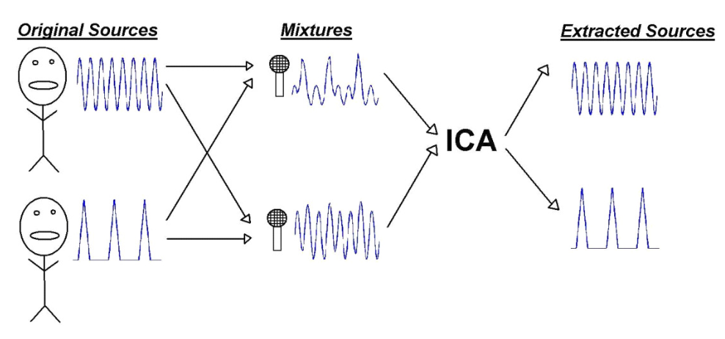
Blind Source Separation
Image source: „An Introduction to Independent Component Analysis: InfoMax and FastICA algorithms“ (Dominic Langlois et al., 2010)

Slide 3
ICA in EEG
Identification of independent components
Noise reduction (muscle artifacts)
Various algorithms are in use (FastICA, Infomax, AMICA)

Slide 4
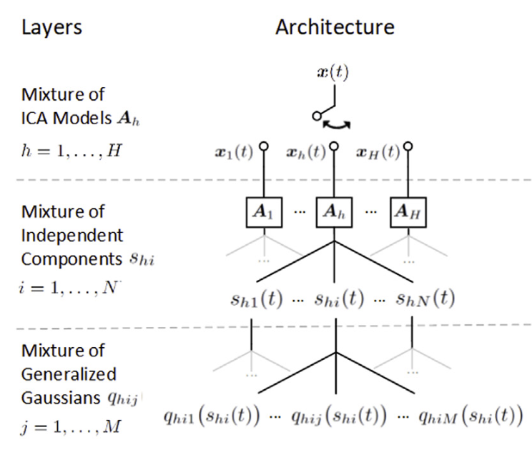
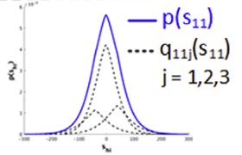
Adaptive Mixture Independent Component Analysis (AMICA)
Image source: „Modeling brain dynamic state changes with adaptive mixture independent component analysis “ (Sheng-Hsiou Hsu et al., 2018)
Notes:
Advantages gegenüber anderen:
Multiple models used to model different timesteps
Instead of regular GG: use Mixture to approximate probability density function

Slide 5
Motivation
Two implementations: Fortran & Matlab
The former is hard to read, the latter has bad performance
Further development is not easy
Potential for optimization

Slide 6
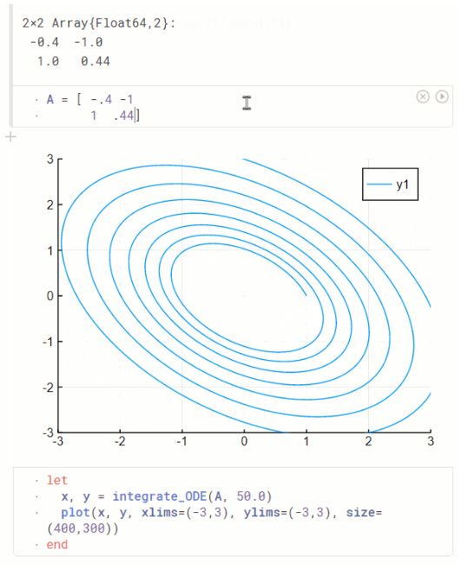
Why Julia? (Maybe delete)
Readable code
Modular structure
(Hopefully) Good performance
→ Further development will be easier
Image source: https://plutojl.org/

Slide 7
Expectation-maximization Algorithms (EM)
Goal: Find maximum likelihood
Expectation step: calculates likelihood estimate with current parameters
Maximization step: calculate new parameters to find better likelihood
Repeat until convergeance
Notes:
You dont know which parts of the model generated which parts of the data
Usually used when some data is missing

Slide 8
Amica Algorithm
Initialise parameters
for iter in maxiter
calculate likelihood
likelihood_diff = likelihood[iter] - likelihood[iter-1]
if likelihood_diff < minimum_likelihood_diff
terminate
else
calculate mixing_matrix
end
end
Notes:
Eig. Summe von dLL damit nichts sofort abbricht wenn in einer iteration nicht gut -> lokalen minima entkommen
Eig.

Slide 9
Amica Algorithm
initialise parameters
for iter in maxiter
calculate likelihood => Expectation
likelihood_diff = likelihood[iter] - likelihood[iter-1]
if likelihood_diff < minimum_likelihood_diff
terminate => Maximization
else
calculate mixing_matrix
end
end

Slide 10

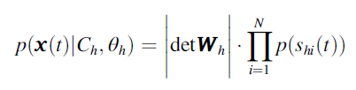
Some Math
Likelihood:
Notes:
h(t) = h (dominant model at time t)
C = bias! Constant component like wind
Determinante um skalierungseigenschaften der transformation zu berücksichtigen

Slide 11
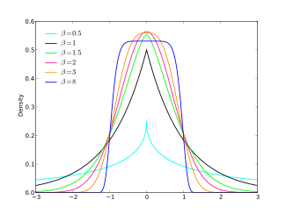

Generalized Gaussian
Image source: https://en.wikipedia.org/wiki/Generalized_normal_distribution
Notes:
Betas in image = rho in formula
Scale = more spread out, shape = sharp or round, location = shift
Γ(z) = ∫[0, ∞] t^(z-1) * e^(-t) dt
Rho = shape, beta = scale, mu = location (shift)
Gamma probably there to ensure proper probability distribution

Slide 12
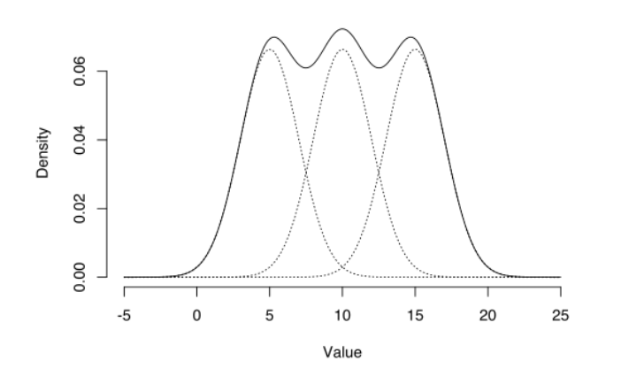
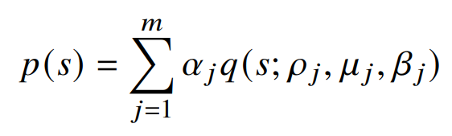
Gaussian Mixtures
Image source: https://www.statisticshowto.com/gaussian-mixture-model/
Notes:
Alpha = weights for gaussians

Slide 13

Let‘s combine it…

Slide 14
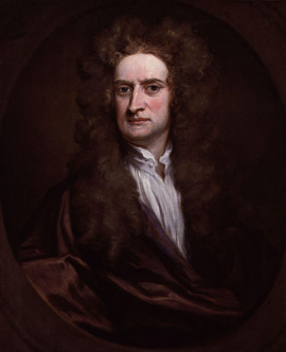
Newton Method
How do we maximize likelihood? With the help of Newton!
Newton method estimates the zeros of a function
Can be used to calculate maximum/minimum
Image source: https://de.wikipedia.org/wiki/Isaac_Newton

Slide 15
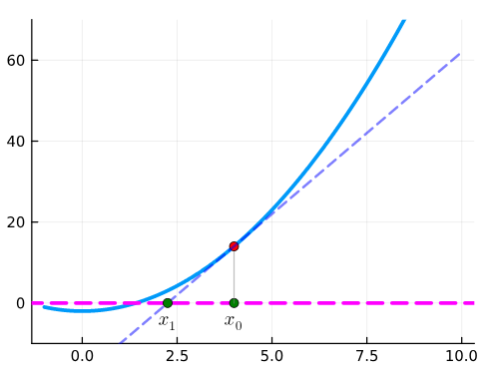
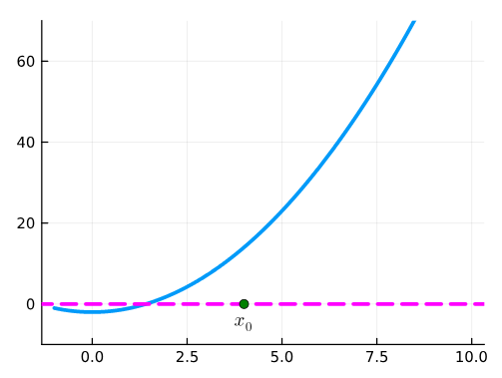
Newton Method
Image source: https://computationalthinking.mit.edu/Fall23/images_abstractions/newton_method/
Notes:
Startpunkt -> tangente ziehen -> nullpunkt von tangente = nächster punkt

Slide 16
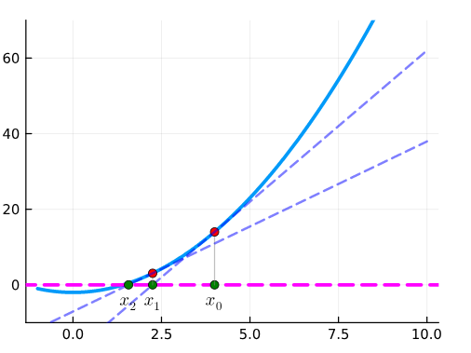
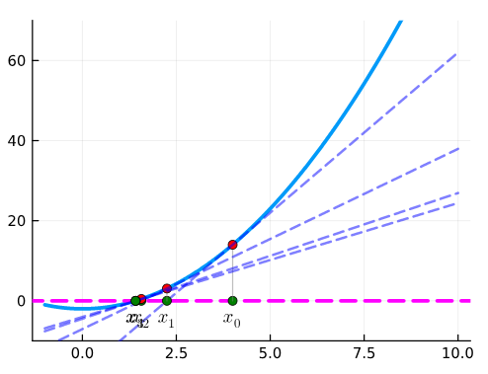
Newton Method
Image source: https://computationalthinking.mit.edu/Fall23/images_abstractions/newton_method/

Slide 17
Live Demonstration

Slide 18
Current challenges
Infinite Likelihood on actual EEG Data
Code could use some clean up (to put it mildly)
Gaussian Mixtures might be wrong (they might also be correct)
Results are slightly different (gets worse with more iterations)

Slide 19
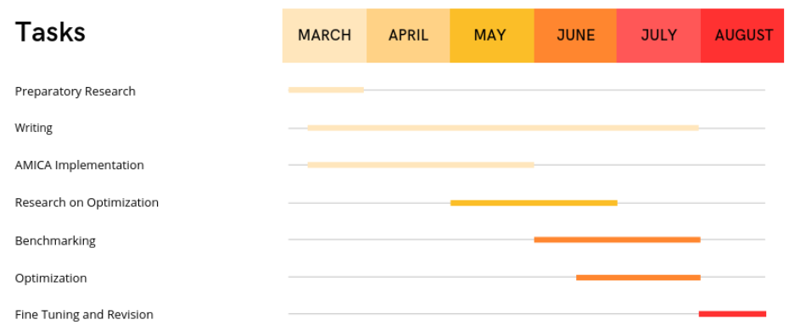
Project Schedule

Slide 20
Next steps
Fix critical bugs
Clean up code (break down functions, combine parameters into data types etc.)
Unit tests for functions
Enable modularity
Check Fortran implementation for more features
Compare performance

Slide 21

Alexander Lulkin
e-mail
st108415@stud.uni-stuttgart.de
phone +49 (0) 176 404 29089
University of Stuttgart

