Slide 1
Intro Talk Simulation of EEG-Activity Based on Sequential Sampling Models
M.Sc. Business Informatics Timo Zaoral

Slide 2
Table of Content
About Me
Introduction
Kelly et. al Model of neural activity in Julia
Goals
Schedule
Literature

Slide 3




About Me
Timo Zaoral
Born in 2000; Living in Mundelsheim
2019-2022
SOSE 2024
2022-Now
Working for TRUMPF
Notes:
DHBW Bachelor in Computer Science in Cooperation with TRUMPF
Working for TRUMPF since 2019
M.Sc. Business Informatics
Exchange Semester in Oslo SOSE 2024

Slide 4
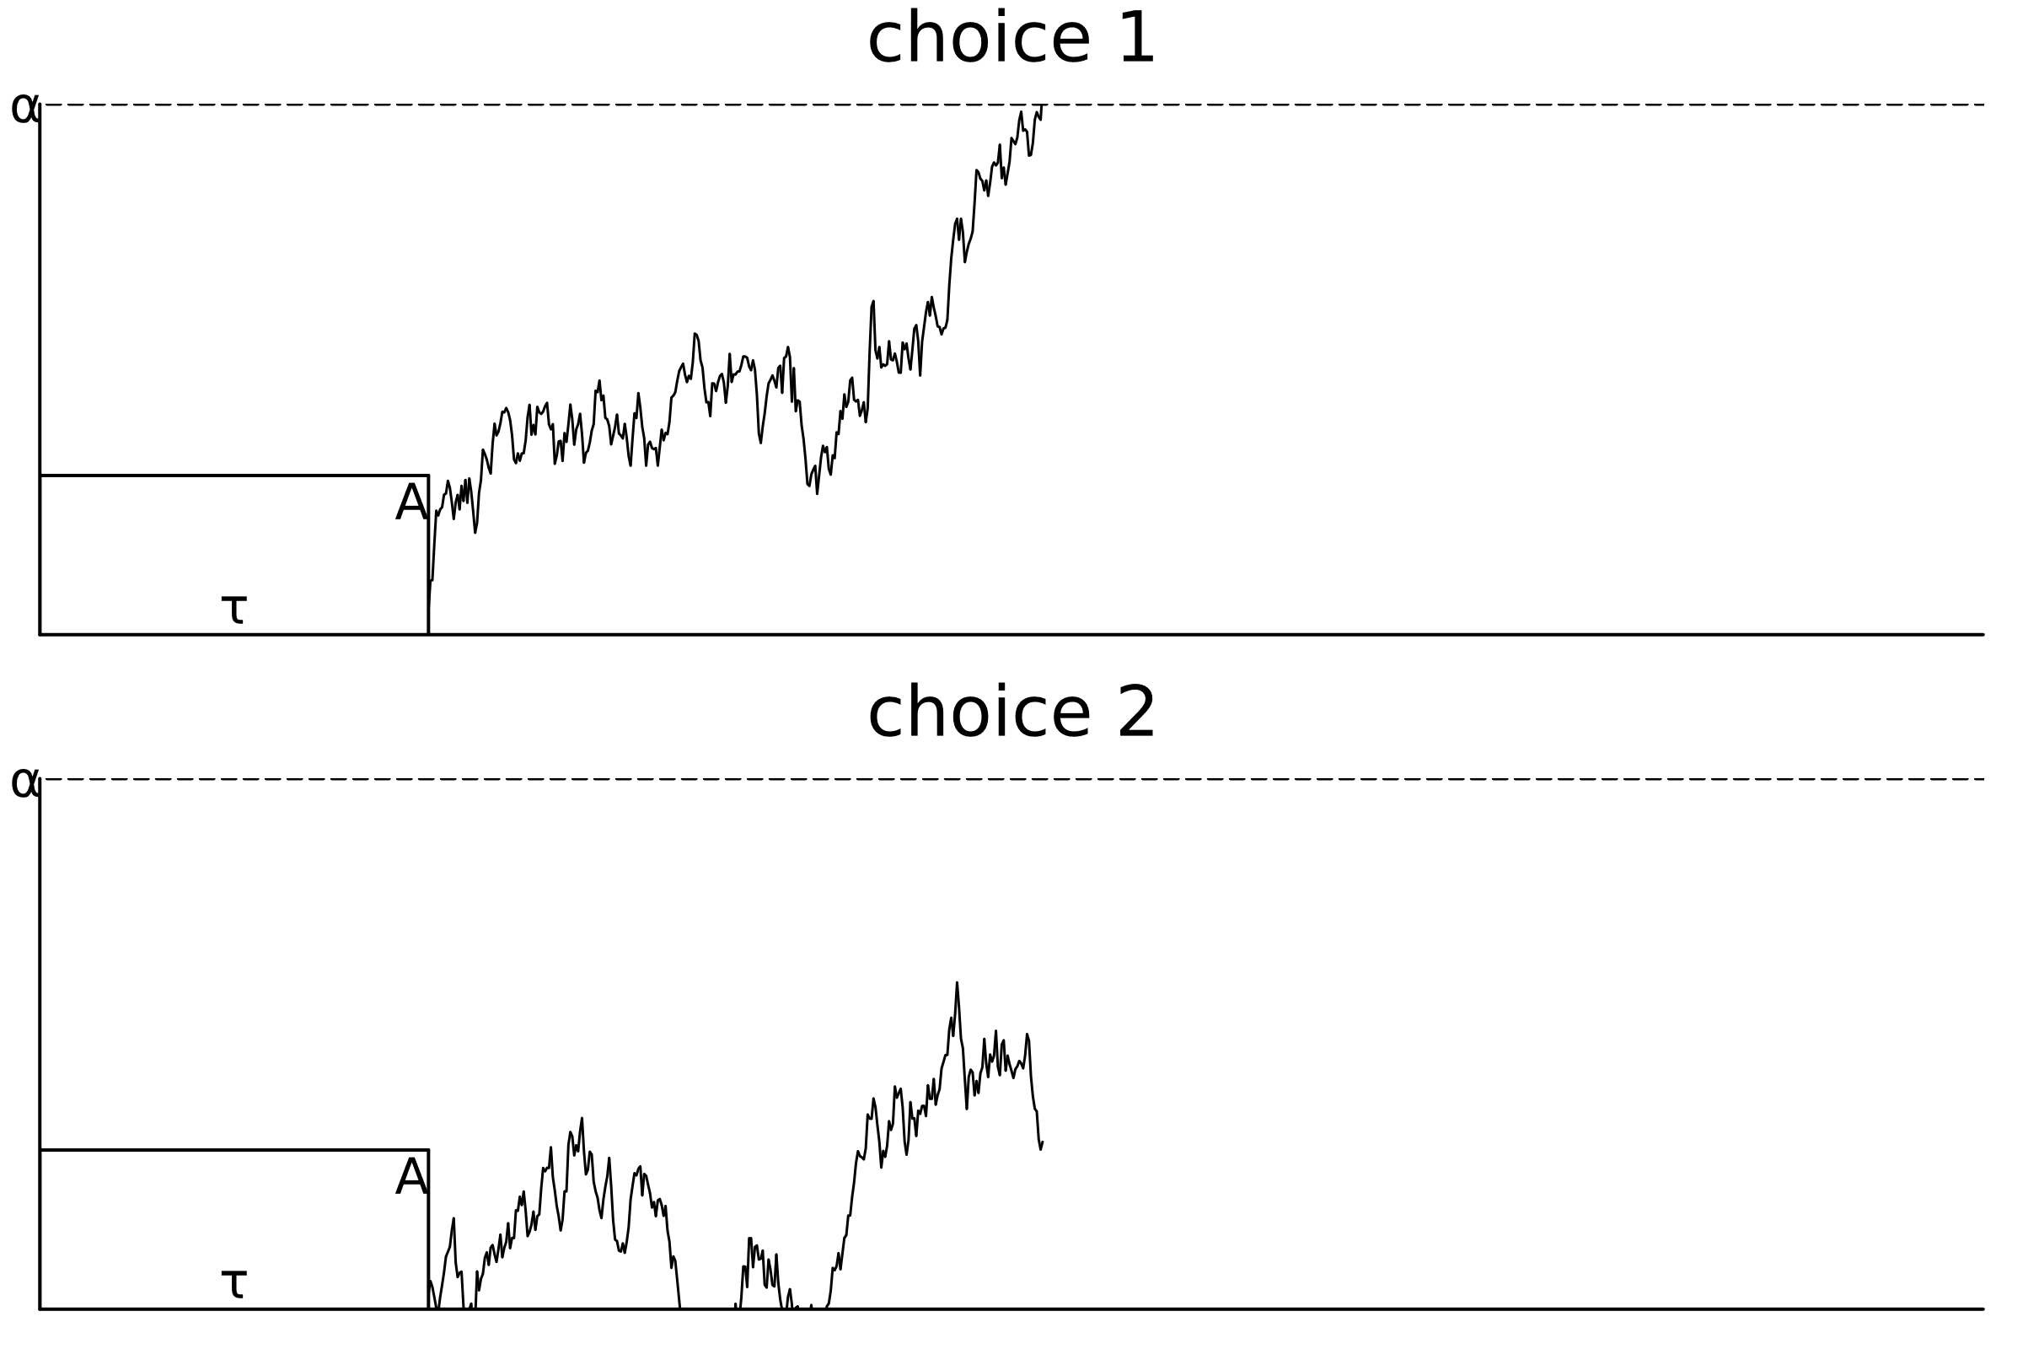
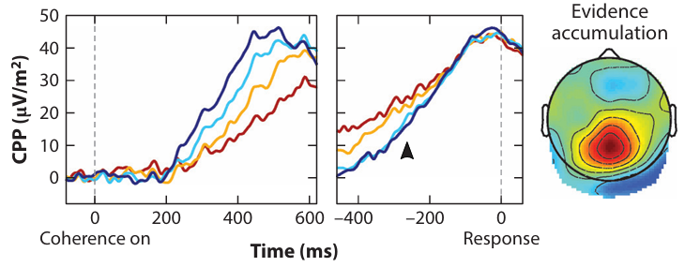
Kelly et. al Model of neural activity in Julia
Sequential sampling models (SSM) depict the decision-making process in the brain
Evidence-dependent structural dynamics of the component centroparietal positivity (CPP) in the brain
Kelly et al. Neurophysiology of Human Perceptual Decision-Making 2021 [1]
own illustration
Notes:
2013 Paper von Kelly

Slide 5
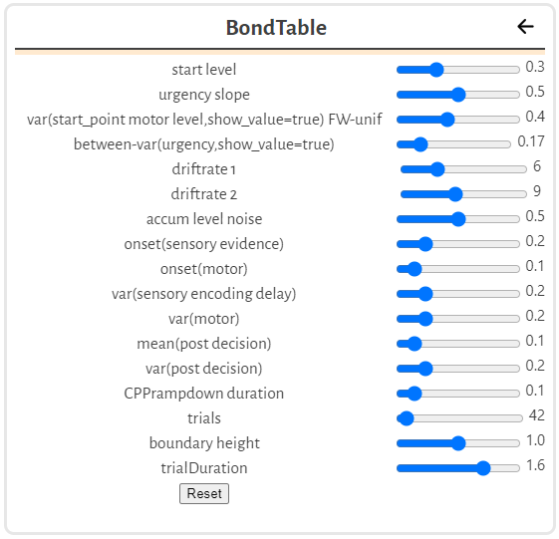
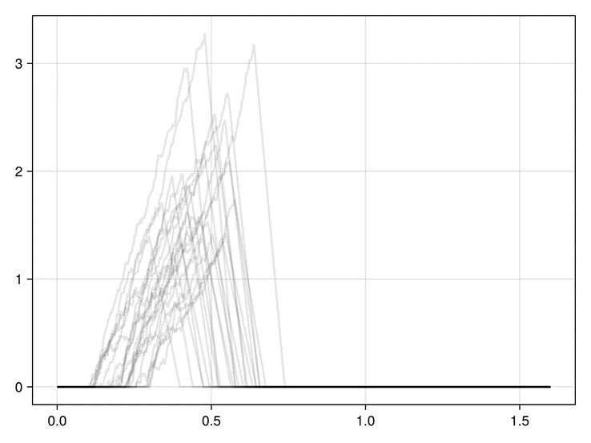
Kelly et. al Model of neural activity in Julia
Reference Paper: Kelly et al. “Neurocomputational mechanisms of prior-informed perceptual decision-making in humans” 2021 [2]
With Matlab Code for SSM to ERP Simulation
Rough translation from Matlab Code to Julia
Own illustration based on Kelly et al. Code converted to Julia
Own illustration based on Kelly et al. Code converted to Julia

Slide 6
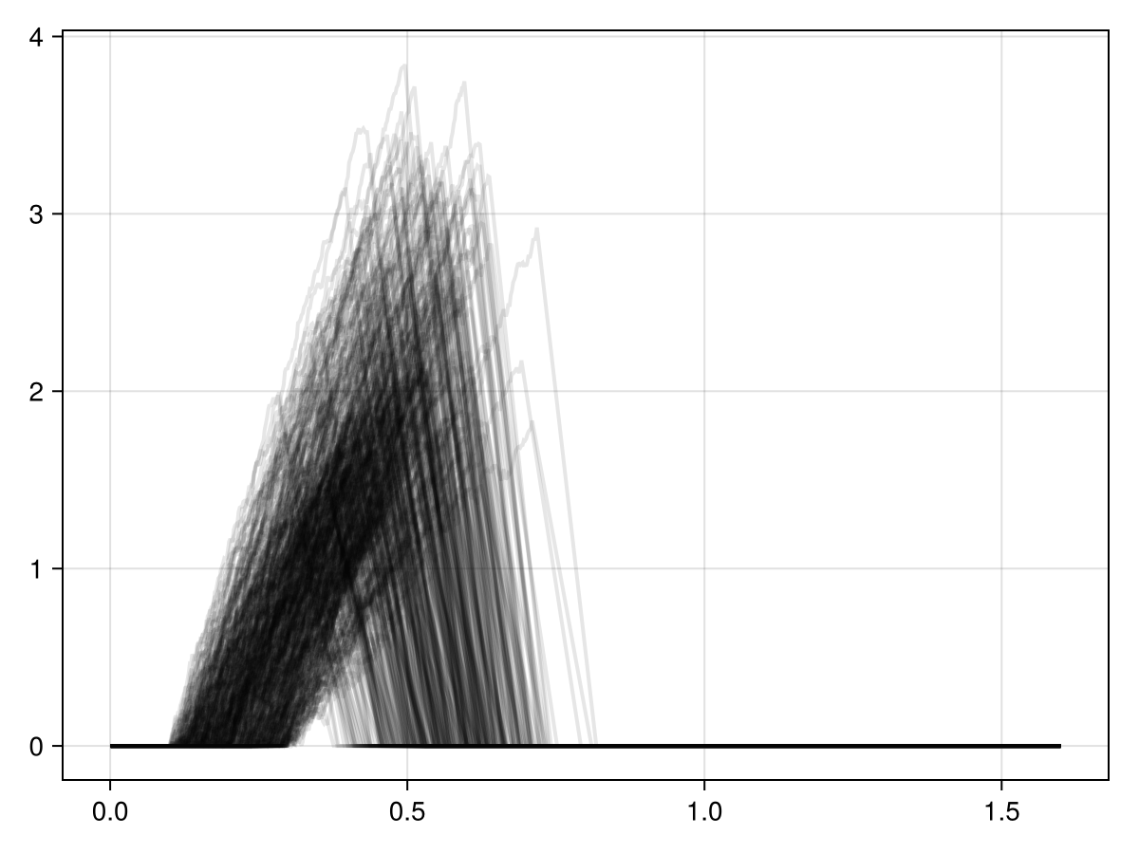
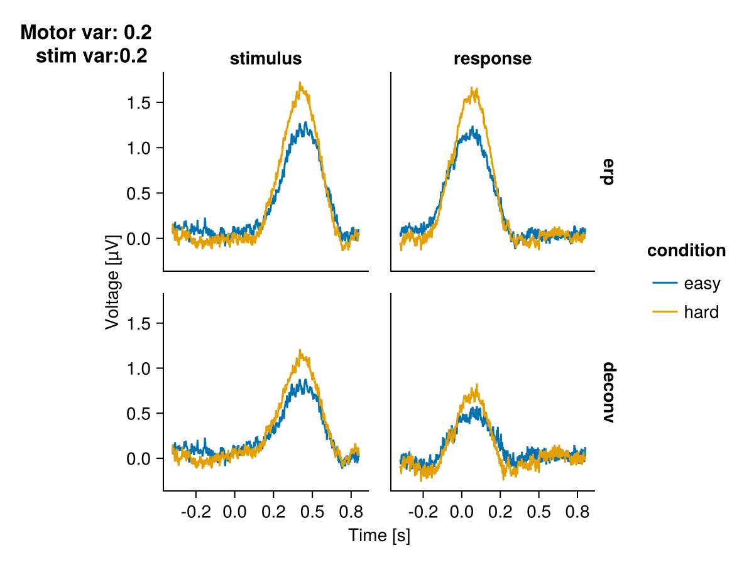
Kelly et. al Model of neural activity in Julia
Own illustration based on Kelly et al. Code converted to Julia
Own illustration based on Kelly et al. Code converted to Julia
Notes:
Single trial evidence signal

Slide 7
Goals
Theoretical Description of Sequential Sampling Models (SSMs)
For example the drift-diffusion model (DDM) and the linear ballistic accumulator (LBA)
Reimplementation of the Kelly Model [2]
Integration into UnfoldSIM [3]
Comparison of Models
systematic comparison of different SSMs by varying key parameters
Identify potential indicators of the neural mechanisms behind evidence accumulation

Slide 8
Schedule
Timeline between 15.10. until 15.04.
Proposal Phase
Basic Literature Search and Theoretical Model Description
Programming of Simulations
Simulation and Comparison of Models
Review and Presentation
Writing the Thesis is a constant process

Slide 9
Literature
[1]: Redmond G. Connell and Simon P. Kelly. Neurophysiology of human perceptual decision making. Annual Review of Neuroscience, 44(Volume 44, 2021):495–516, 2021.
[2]: Simon Kelly, Elaine Corbett, and Redmond O’Connell. Neurocomputational mechanisms of prior-informed perceptual decision-making in humans. Nature Human Behaviour, 5:1 15, 04 2021.
[3]: https://github.com/unfoldtoolbox/UnfoldSim.jl

Slide 10
Questions?
PS. if you want more information, you can ask me for my proposal

