Slide 1
Working with Matrices
Przemysław Szufel
https://szufel.pl/

Slide 2
Working with matrices in Julia
Matrices are indexed from 1 (as in Matlab or R)
Vectors are are vertical (not horizontal as in numpy)
Built-in support for views using the @view macro
Pass-by-sharing (changes in matrices and vectors inside functions will be seen outside of functions)
Matrix size is fixed, vectors can be increased using push!, append!, and resize!
Performance notes:
Index range checking is enabled by default - can be disabled with the @inbounds macro
The order of physical data in memory - column-major-order (C++ or Python use row-major)
For small matrices, the same performance as for scalars can be achieved using the StaticArrays.jl library

Slide 3
Increase efficiency by avoiding allocations and materializations
Reshaping data (reshape, transpose, permutedims)
Create views with @view macro
Full support for sparse arrays
SparseArrays.jl
Other packages make it possible to avoid data materialization
BlockArrays.jl
BandedMatrices.jl
BlockBandedMatrices.jl

Slide 4
Efficient code in Julia and matrices
Avoid abstract types in data structures (including vectors, matrices…)
Process data from arrays according to their order of representation in memory (columns)
Preallocate result matrices
Use the @. macro for vectorizing multiple operations - this will result in chaining vectorized operations
Use views for array slicing
Know about macros: @inbounds, @fastmath, @simd
https://docs.julialang.org/en/v1/manual/performance-tips/

Slide 5
Use tools for performance monitoring and optimization
Debugger
Profiler
@time
BenchmarkTools.jl and @btime
@code_warntype

Slide 6
Solving optimization problems with Julia
Przemysław Szufel
https://szufel.pl/

Slide 7
Solving optimization problems with Julia
Przemysław Szufel
https://szufel.pl/

Slide 8
Basics…

Slide 9
Linear optimization
using JuMP, HiGHS
m = Model(optimizer_with_attributes(HiGHS.Optimizer))
@variable(m, x₁ >= 0)
@variable(m, x₂ >= 0)
@objective(m, Min, 50x₁ + 70x₂)
@constraint(m, 200x₁ + 2000x₂ >= 9000 )
@constraint(m, 100x₁ + 30x₂ >= 300 )
@constraint(m, 9x₁ + 11x₂ >= 60 )
optimize!(m)
JuMP.value.([x₁,x₂])

Slide 10
Note – how to type indexes in Julia
julia> x
julia> x\_
julia> x\_1
julia> x\_1<TAB>
julia> x₁

Slide 11
... and Integer programming
using JuMP, HiGHS
m = Model(optimizer_with_attributes(HiGHS.Optimizer))
@variable(m, x₁ >= 0, Int)
@variable(m, x₂ >= 0)
@objective(m, Min, 50x₁ + 70x₂)
@constraint(m, 200x₁ + 2000x₂ >= 9000)
@constraint(m, 100x₁ + 30x₂ >= 300)
@constraint(m, 9x₁ + 11x₂ >= 60)
optimize!(m)

Slide 12
How it works - metaprogramming
julia> code = Meta.parse("x=5")
:(x = 5)
julia> dump(code)
Expr
head: Symbol =
args: Array{Any}((2,))
1: Symbol x
2: Int64 5
julia> eval(code)
5
julia> x
5

Slide 13
Macros – hello world...
macro sayhello(name)
return :( println("Hello, ", $name) )
end
julia> macroexpand(Main,:(@sayhello("aa")))
:((Main.println)("Hello, ", "aa"))
julia> @sayhello "world!"
Hello, world!

Slide 14
Macro @variable
julia> @macroexpand @variable(m, x₁ >= 0)
quote
(JuMP.validmodel)(m, :m)
begin
#1###361 = begin
let
#1###361 = (JuMP.constructvariable!)(m, getfield(JuMP, Symbol("#_error#107")){Tuple{Symbol,Expr}}((:m, :(x₁ >= 0))), 0, Inf, :Default, (JuMP.string)(:x₁), NaN)
#1###361
end
end
(JuMP.registervar)(m, :x₁, #1###361)
x₁ = #1###361
end
end

Slide 15
Some of JuMP Solvers (over 40 as of today)
Solver | Julia Package | License | LP | SOCP | MILP | NLP | MINLP | SDP
Artelys Knitro | KNITRO.jl | Comm. |  |  |  | X | X
BARON | BARON.jl | Comm. |  |  |  | X | X
Bonmin | AmplNLWriter.jl | EPL | X |  | X | X | X
 | CoinOptServices.jl
Cbc | Cbc.jl | EPL |  |  | X
Clp | Clp.jl | EPL | X
Couenne | AmplNLWriter.jl | EPL | X |  | X | X | X
 | CoinOptServices.jl
CPLEX | CPLEX.jl | Comm. | X | X | X
ECOS | ECOS.jl | GPL | X | X
FICO Xpress | Xpress.jl | Comm. | X | X | X
HiGHS | HiGHSMathProgInterface | GPL | X |  | X
Gurobi | Gurobi.jl | Comm. | X | X | X
Ipopt | Ipopt.jl | EPL | X |  |  | X
MOSEK | Mosek.jl | Comm. | X | X | X | X |  | X
NLopt | NLopt.jl | LGPL |  |  |  | X
SCS | SCS.jl | MIT | X | X |  |  |  | X

Slide 16
JuMP Transportation of good among branches

Slide 17
Use case scenario
The Subway restaurant chain in Las Vegas has a total of 118 restaurants in different parts of the city.
18 restaurants have adjacent huge product warehouses that keep ingredients cool and fresh, moreover fresh vegetables are delivered only to those warehouses (rather than to every restaurant) daily at 3am.
Subway has signed a contract with a transportation agency and is billed by the multiple of the weight of transported goods and the distance.
Knowing the amount of available stock at each warehouse and the expected demand at each restaurant (measured in kg), the company needs to decide how the goods should be distributed among warehouses.

Slide 18
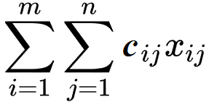
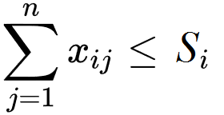
Transportation problem statement
Variables
x_{ij} – number of units transported for i-th supplier to j-th requester
c_{ij} – unit transportation cost between i-th supplier to j-th requester
Cost function C
C =
Constraints: suppliers have maximum capacity S_{i} demand D_{j} must be met

Slide 19
Implementation in JuMP
m = Model(optimizer_with_attributes(HiGHS.Optimizer));
@variable(m, x[i=1:S, j=1:D])
@objective(m, Min, sum( x[i, j]*distance_mx[i, j] for i=1:S, j=1:D))
@constraint(m, x .>= 0)
for j=1:D
@constraint(m, sum( x[i, j] for i=1:S) >= demand[j] )
end
for i=1:S
@constraint(m, sum( x[i, j] for j=1:D) <= supply[i] )
end
optimize!(m)
termination_status(m)

Slide 20
JuMP Travelling salesman problem

Slide 21
Use case scenario
The Subway restaurant chain in Las Vegas has a total of 118 restaurants in different parts of the city.
Company’s manager plans to visit all restaurants during a single day.
What is the optimal order that restaurants should be visited?

Slide 22

Traveling salesman problem (TSP)
Variables:
c_{ft} – cost of travel from “f ” to “t ”
x_{ft} – binary variable indicating 1 when agent travels from “f ” to “t ”
The mathematical problem framing based on: Julia Programming for Operations Research A Primer on Computing, Changhyun Kwon, 2018, see: http://opensourc.es/blog/mip-tsp

Slide 23
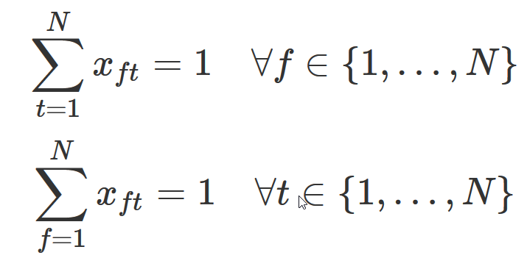
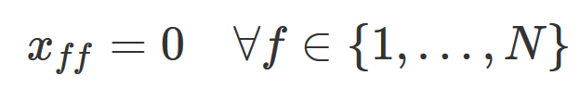

TSP
Variables:
c_{ft} – cost of travel from “f ” to “t ”
x_{ft} – binary variable indicating 1 when agent travels from “f ” to “t ”
Each city visited once
City cannot visit itself
Avoid two-city cycles
Other cycles:
/dynamically add a constraint whenever a cycle occurs/
For more details see: http://opensourc.es/blog/mip-tsp

Slide 24
JuMP implementation
m = Model(optimizer_with_attributes(HiGHS.Optimizer));
@variable(m, x[f=1:N, t=1:N], Bin)
@objective(m, Min, sum( x[i, j]*distance_mx[i,j] for i=1:N,j=1:N))
@constraint(m, notself[i=1:N], x[i, i] == 0)
@constraint(m, oneout[i=1:N], sum(x[i, 1:N]) == 1)
@constraint(m, onein[j=1:N], sum(x[1:N, j]) == 1)
for f=1:N, t=1:N
@constraint(m, x[f, t]+x[t, f] <= 1)
end

Slide 25
Getting a cycle
function getcycle(m, N)
x_val = getvalue(x)
cycle_idx = Vector{Int}()
push!(cycle_idx, 1)
while true
v, idx = findmax(x_val[cycle_idx[end], 1:N])
if idx == cycle_idx[1]
break
else
push!(cycle_idx, idx)
end
end
cycle_idx
end

Slide 26
Adding a constraint...
function solved(m, cycle_idx, N)
println("cycle_idx: ", cycle_idx)
println("Length: ", length(cycle_idx))
if length(cycle_idx) < N
cc = @constraint(m, sum(x[cycle_idx,cycle_idx]) <= length(cycle_idx)-1)
println("added a constraint")
return false
end
return true
end

Slide 27
Iterating over the model
while true
status = solve(m)
println(status)
cycle_idx = getcycle(m, N)
if solved(m, cycle_idx,N)
break;
end
end

Slide 28
Gurobi.jl
Commercial software
Free for academic use
Integrates with JuMP via Gurobi.jl
Supports JuMP Lazy constraints (http://www.juliaopt.org/JuMP.jl/0.18/callbacks.html)

Slide 29
Gurobi callbacks
function getcycle(cb, N)
x_val = callback_value.(Ref(cb), x)
getcycle(x_val)
end
function callbackhandle(cb)
cycle_idx = getcycle(cb, N)
println("Callback! N= $N cycle_idx: ", cycle_idx)
println("Length: ", length(cycle_idx))
if length(cycle_idx) < N
con = @build_constraint(sum(x[cycle_idx,cycle_idx]) <= length(cycle_idx)-1)
MOI.submit(m, MOI.LazyConstraint(cb), con)
println("added a lazy constraint")
end
end
MOI.set(m, MOI.LazyConstraintCallback(), callbackhandle)

Slide 30
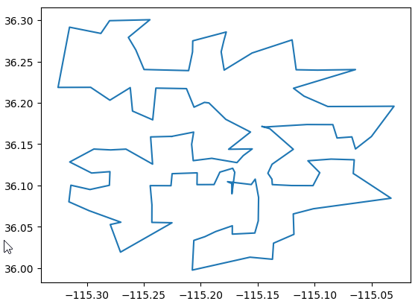
TravelingSalesmanHeuristics.jl
using TravelingSalesmanHeuristics
sol = TravelingSalesmanHeuristics.solve_tsp( distance_mx,quality_factor =100)
More info:
http://evanfields.github.io/TravelingSalesmanHeuristics.jl/latest/heuristics.html

Slide 31
JuMP Non-Linear Programming

Slide 32
Simple scenario
Estimate parameters of a quadratic form
$y\left(x_{i}\right)=x_{i}^{T}\left[\begin{matrix}a & b/2 \\ b/2 & c\end{matrix}\right]x_{i}$, where $x_{i}=\left[\begin{aligned}x_{i}^{1} \\ x_{i}^{2}\end{aligned}\right]$
for a vector of observed values y to minimize the observed error function
$$\sum_{i=1}^{N}{{\left(y\left(x_{i}\right)−y_{i}\right)}^{2}}$$

Slide 33
Nonlinear optimization Julia
m = Model(optimizer_with_attributes(Ipopt.Optimizer));
@variable(m, aa[1:2,1:2])
function errs(aa)
sum((y .- (x * aa ) .* x * [1;1]) .^ 2)
end
@objective(m, Min, errs(aa))
optimize!(m)

Slide 34
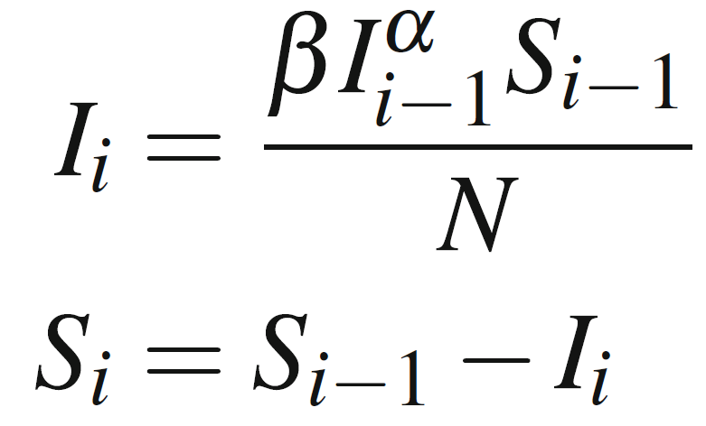
Use case scenario (source: Hart et al, Pyomo-optimization modeling in python, 2017)
Simulate dynamics of disease outbreak in a small community of 300 individuals (e.g. children at school)
Three possible states of a patient:
susceptible (S)
infected (I )
recovered (R)
Infection spread model :
N – population size
α, β – model parameters

Slide 35
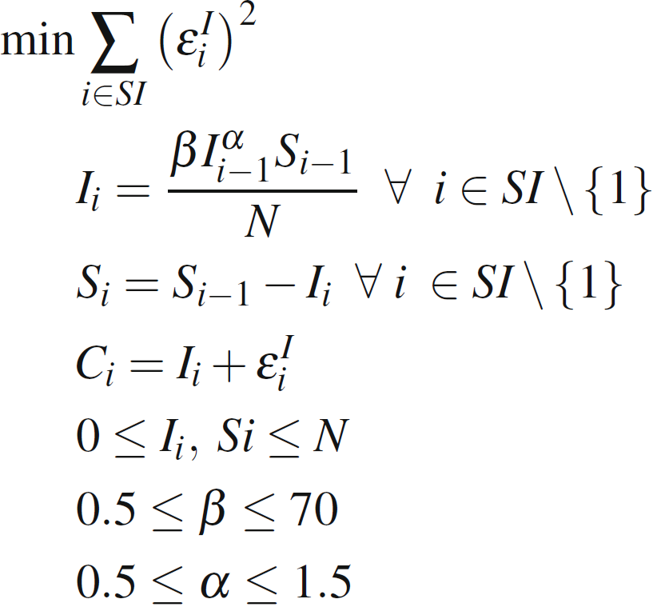
Optimization problem for finding parameters α and β
S - susceptible
I - infected
N – population size
α, β – model parameters
SI - time indices {1,2,3,...}
C_{i} - known input (the actual number of infected patients)

Slide 36
Model implementation in JuMP
Input data (disease dynamics)
obs_cases = vcat(1,2,4,8,15,27,44,58,55,32,12,3,1,zeros(13))

Slide 37
Full model specification in JuMP
m = Model(optimizer_with_attributes(Ipopt.Optimizer));
@variable(m, 0.5 <= α <= 1.5)
@variable(m, 0.05 <= β <= 70)
@variable(m, 0 <= I_[1:SI_max] <= N)
@variable(m, 0 <= S[1:SI_max] <= N)
@variable(m, ε[1:SI_max])
@constraint(m, ε .== I_ .- obs_cases )
@constraint(m, I_[1] == 1)
for i=2:SI_max
@NLconstraint(m, I_[i] == β*(I_[i-1]^α)*S[i-1]/N)
end
@constraint(m, S[1] == N)
for i=2:SI_max
@constraint(m, S[i] == S[i-1]-I_[i])
end
@NLobjective(m, Min, sum(ε[i]^2 for i in 1:SI_max))

Slide 38
JuMP Non-Linear Programming for estimation of model parameters

Slide 39
Simple scenario
Estimate parameters of a quadratic form
$y\left(x_{i}\right)=x_{i}^{T}\left[\begin{matrix}a & b/2 \\ b/2 & c\end{matrix}\right]x_{i}$, where $x_{i}=\left[\begin{aligned}x_{i}^{1} \\ x_{i}^{2}\end{aligned}\right]$
for a vector of observed values y to minimize the observed error function
$$\sum_{i=1}^{N}{{\left(y\left(x_{i}\right)−y_{i}\right)}^{2}}$$

Slide 40
Nonlinear optimization Julia
m = Model(optimizer_with_attributes(Ipopt.Optimizer));
@variable(m, aa[1:2,1:2])
function errs(aa)
sum((y .- (x * aa ) .* x * [1;1]) .^ 2)
end
@objective(m, Min, errs(aa))
optimize!(m)

Slide 41
Use case scenario (source: Hart et al, Pyomo-optimization modeling in python, 2017)
Simulate dynamics of disease outbreak in a small community of 300 individuals (e.g. children at school)
Three possible states of a patient:
susceptible (S)
infected (I )
recovered (R)
Infection spread model :
N – population size
α, β – model parameters

Slide 42
Optimization problem for finding parameters α and β
S - susceptible
I - infected
N – population size
α, β – model parameters
SI - time indices {1,2,3,...}
C_{i} - known input (the actual number of infected patients)

Slide 43
Model implementation in JuMP
Input data (disease dynamics)
obs_cases = vcat(1,2,4,8,15,27,44,58,55,32,12,3,1,zeros(13))

Slide 44
Full model specification in JuMP
m = Model(optimizer_with_attributes(Ipopt.Optimizer));
@variable(m, 0.5 <= α <= 1.5)
@variable(m, 0.05 <= β <= 70)
@variable(m, 0 <= I_[1:SI_max] <= N)
@variable(m, 0 <= S[1:SI_max] <= N)
@variable(m, ε[1:SI_max])
@constraint(m, ε .== I_ .- obs_cases )
@constraint(m, I_[1] == 1)
for i=2:SI_max
@NLconstraint(m, I_[i] == β*(I_[i-1]^α)*S[i-1]/N)
end
@constraint(m, S[1] == N)
for i=2:SI_max
@constraint(m, S[i] == S[i-1]-I_[i])
end
@NLobjective(m, Min, sum(ε[i]^2 for i in 1:SI_max))

