Slide 1
Scaling computations using parallel computing
Przemysław Szufel
https://szufel.pl/

Slide 2
Parallelization options in programming languages
Single instruction, multiple data (SIMD)
Green-threads (co-routines) only where I/O is bottleneck
Multi-threading
Language
Libraries
Multi-processing – many julia processes at the same time
single machine
distributed (cluster)
distributed (cluster) via external tools
GPU computing

Slide 3
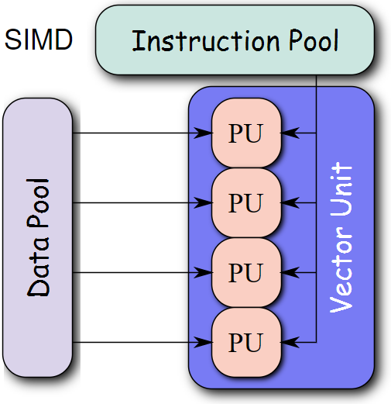
SIMD
Single instruction, multiple data (SIMD) describes computers with multiple processing elements that perform the same operation on multiple data points simultaneously. Such machines exploit data level parallelism, but not concurrency: there are simultaneous (parallel) computations, but only a single process (instruction) at a given moment.
Source: https://en.wikipedia.org/wiki/SIMD

Slide 4
Data level parallelism
#1_dot_simd.jl
function dot1(x, y)
s = 0.0
for i in 1:length(x)
@inbounds s += x[i]*y[i]
end
s
end
function dot2(x, y)
s = 0.0
@simd for i in 1:length(x)
@inbounds s += x[i]*y[i]
end
s
end
Image source: https://en.wikipedia.org/wiki/SIMD

Slide 5
Dot product: output
12.900 μs (0 allocations: 0 bytes)
1.760 μs (0 allocations: 0 bytes)
2.4592981764713477e7
2.4592981764713492e7

Slide 6
Green threading
In computer programming, green threads are threads that are scheduled by a runtime library or virtual machine (VM) instead of natively by the underlying operating system. Green threads emulate multithreaded environments without relying on any native OS capabilities, and they are managed in user space instead of kernel space, enabling them to work in environments that do not have native thread support.
https://en.wikipedia.org/wiki/Green_threads

Slide 7
Green threads in Julia
julia> @time sleep(2)
2.004142 seconds (11 allocations: 320 bytes)
julia> @time @async sleep(2)
0.000128 seconds (27 allocations: 2.250 KiB)
Task (runnable) @0x0000000012c22e10

Slide 8
Green threads - sample
function dojob(i)
val = rand()
sleep(val) # this could be external computations with I/O
i, val
end
result = Vector{Tuple{Int,Float64}}(undef, 8)
@sync for i=1:8
@async x[i] = dojob(i)
end

Slide 9
A simple web server with green threading
server = Sockets.listen(9991)
contt = Ref(true)
while contt[]
sock = Sockets.accept(server)
@async begin
data = readline(sock)
print("Got request:\n", data, "\n")
cmd = split(data, " ")[2][2:end]
println(sock, "\nHTTP/1.1 200 OK\nContent-Type: text/html\n")
contt[] = contt[] && (!occursin("stopme", data))
if contt[]
println(sock, string("<html><body>", cmd, "=", eval(Meta.parse(cmd)), "</body></html>"))
else
println(sock,"<html><body>stopping</body></html>")
end
close(sock)
end
end
println("Server stopped")

Slide 10
Comparison of parallelism types
Threading
Multiprocessing
Distributed computing
Single process (cheap)
Shared memory
Number of threads running simultaneously limited by number of processors
Possible issues with locking and false sharing
Multiple processes
Separate memory
Number of processes running simultaneously limited by cluster size
Possible issues if inter-process communication is needed
Multiple hosts
Multiple processes (single- or multi-threaded)

Slide 11
Julia command line option for parallelism
multi-threading
-t, --threads {N|auto} Enable N threads; "auto" currently sets N to
the number of local CPU threads but this
might change in the future
-p, --procs {N|auto} Integer value N launches N additional local
worker processes
"auto" launches as many workers as the number
of local CPU threads (logical cores)
--machine-file <file> Run processes on hosts listed in <file>
multi-processing
distributed computing

Slide 12
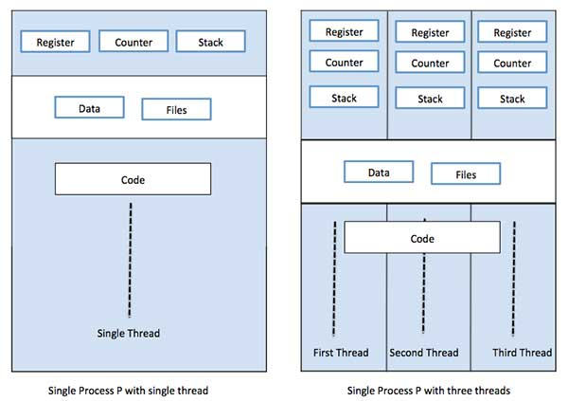
Threading

Slide 13
Simple example – threading
Single threaded
Multithreading
function ssum(x)
r, c = size(x)
y = zeros(c)
for i in 1:c
for j in 1:r
@inbounds y[i] += x[j, i]
end
end
y
end
function tsum(x)
r, c = size(x)
y = zeros(c)
Threads.@threads for i in 1:c
for j in 1:r
@inbounds y[i] += x[j, i]
end
end
y
end

Slide 14
Sum: output
threads: 1
0.721701 seconds (2 allocations: 156.328 KiB)
0.858513 seconds (2 allocations: 156.328 KiB)
0.730469 seconds (60.27 k allocations: 3.834 MiB, 8.09% compilation time)
0.914933 seconds (8 allocations: 156.938 KiB)
threads: 2
0.750043 seconds (2 allocations: 156.328 KiB)
0.882158 seconds (2 allocations: 156.328 KiB)
0.415769 seconds (60.29 k allocations: 3.835 MiB, 14.25% compilation time)
0.341232 seconds (14 allocations: 157.469 KiB)
threads: 4
0.709045 seconds (2 allocations: 156.328 KiB)
0.690816 seconds (2 allocations: 156.328 KiB)
0.261915 seconds (60.32 k allocations: 3.838 MiB, 23.98% compilation time)
0.224480 seconds (24 allocations: 158.484 KiB)
delta is compilation time

Slide 15

Threading: synchronization
Increment $x$ ${10}^{6}$ times using threads:
Atomic operations
SpinLock (busy waiting)
Mutex (OS provided lock)

Slide 16
Locking: output
1 thread
4 threads
Row │ f i value timems
─────┼─────────────────────────────────────────
1 │ f_bad 1 10000000 65.416
2 │ f_bad 2 10000000 47.856
3 │ f_atomic 1 10000000 12.144
4 │ f_atomic 2 10000000 5.9725
5 │ f_spin 1 10000000 116.92
6 │ f_spin 2 10000000 107.22
7 │ f_reentrant 1 10000000 175.71
8 │ f_reentrant 2 10000000 180.96
Row │ f i value timems
─────┼─────────────────────────────────────────
1 │ f_bad 1 2500984 32.145
2 │ f_bad 2 2501422 30.683
3 │ f_atomic 1 10000000 26.352
4 │ f_atomic 2 10000000 18.803
5 │ f_spin 1 10000000 186.86
6 │ f_spin 2 10000000 185.11
7 │ f_reentrant 1 10000000 998.39
8 │ f_reentrant 2 10000000 1003.6

Slide 17
Example – multiprocessing
function s_rand()
n = 10^4
x = 0.0
for i in 1:n
x += sum(rand(10^4))
end
x / n
end
@time s_rand()
@time s_rand()
using Distributed
function p_rand()
n = 10^4
x = @distributed (+) for i in 1:n
sum(rand(10^4))
end
x / n
end
@time p_rand()
@time p_rand()

Slide 18
Rand: output
0.685125 seconds (20.01 k allocations: 763.722 MiB, 16.21% gc time)
0.642642 seconds (20.00 k allocations: 763.702 MiB, 15.37% gc time)
0.927246 seconds (356.68 k allocations: 783.715 MiB, 11.54% gc time, 26.08% compilation time)
0.471032 seconds (20.03 k allocations: 763.704 MiB, 14.47% gc time)

Slide 19
Parallelizing Julia code
@distributed
@spawnat
@everywhere
@async
@sync
fetch()

Slide 20
Typical pattern for distributed computation
using Distributed
addprocs(4); # instead –p
@everywhere include("worker_setup.jl")
function init_worker()
Random.seed!(myid())
end
@sync for wid in workers()
@async fetch(@spawnat wid init_worker())
end

Slide 21
Writing distributed loops
data = @distributed (append!) for (i, j) = vec(collect(Iterators.product(1:4, 1:5)))
a = rand(1:499)
b = rand(1:9)*1000
c = calc(a, b)
DataFrame(;i,j,a,b,c,procid = myid())
end

Slide 22
Typical computation distribution pattern
@everywhere function f()
# do something
return sum(rand(10000))
end
@sync for w in workers()
@async begin
res = @spawnat w f()
values[w-1]=fetch(res)
end
end

Slide 23
Sending data across cluster nodes
@everywhere using ParallelDataTransfer
sendto(workerid, vara = vara)
sendto([workerid1, workerid2], varb = varb)

Slide 24
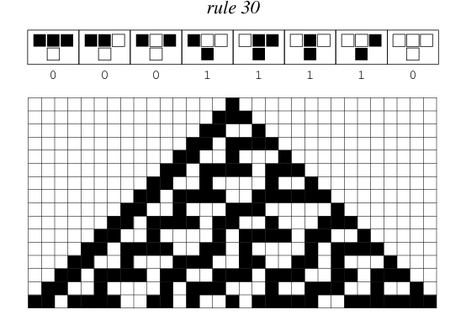

Cellular automaton
Source:
http://mathworld.wolfram.com/Rule30.html

Slide 25
Distributed cellular automaton
Distributing data among worker processes

Slide 26
cellular automaton
using Distributed
@everywhere using ParallelDataTransfer
@everywhere function rule30(ca::Array{Bool})
lastv = ca[1]
for i in 2:(length(ca)-1)
current = ca[i]
ca[i] = xor(lastv, ca[i] || ca[i+1])
lastv = current
end
end

Slide 27
@everywhere function getsetborder()
caa[1] = (@fetchfrom neighbours[1] getcaa[end-1])
caa[end] = (@fetchfrom neighbours[2] getcaa[2])
end

Slide 28
function runca(steps::Int, visualize::Bool)
@sync for w in workers()
@async @fetchfrom w fill!(caa, false)
end
@fetchfrom wks[Int(nwks/2)+1] caa[2]=true
visualize && printsimdist(workers())
for i in 1:steps
@sync for w in workers()
@async @fetchfrom w getsetborder(caa, neighbours)
end
@sync for w in workers()
@async @fetchfrom w rule30(caa)
end
visualize && printsimdist(workers())
end
end

Slide 29
Running the cellular automaton
wks = workers()
nwks = length(wks)
for i in 1:nwks
sendto(wks[i],neighbours = (i==1 ? wks[nwks] : wks[i-1],
i==nwks ? wks[1] : wks[i+1]))
fetch(@defineat wks[i] const caa = zeros(Bool, 15+2));
end
runca(20,true)

Slide 30




A typical „single server in the cloud” configuration
EC2 instance
S3 bucket
Computational
scientist
Local
laptop
Cloud workstation
Linux Ubuntu
Cloud data
storage

Slide 31
Connecting to a cloud instance
Connect to the cloud server
$ ssh -i keyfile.pem ubuntu@ec2-18-218-237-1.us-east-2.compute.amazonaws.com
Copy a local file (note the slash type on Windows)
$ scp -i keyfile.pem c:\temp/local.txt ubuntu@ec2-18-218-237-1.us-east-2.compute.amazonaws.com:/home/ubuntu/
Copy a local folder (note the slash type on Windows)
$ scp -r -i c:\temp\folder ubuntu@ec2-18-218-237-1.us-east-2.compute.amazonaws.com:/home/ubuntu/
Notes:
Mac OSX and Linux: run chmod 600 keyfile.pem before using the keyfile
Windows: The best SSH/SCP for windows is contained within Git: https://git-scm.com/download/win

Slide 32
Typical enviroment
Cluster controller
Machine type: t2.micro (free tier)
Number of machines: 1
Cluster nodes
Machine type: c5.large (Spot Fleet)
Number of machines: 5
You should know how to:
Basic understanding of HTTP protocol
Use console
Use SSH client
All work throughout the workshop will take place in the cloud (no local software except for an SSH client a web browser is required)

Slide 33

What is a computing cluster
A group of computers working towards achieving a common goal.
A computer within a cluster is called a node

Slide 34
Passwordless SSH cluster
Control node
Private key
Enables direct execution of commands on other nodes via command: ssh user@hostname command
Environments such as Gnu R parallel and Julia parallel use this feature to spawn processes on worker nodes
Control node has the private key while each slave node needs to have the public key in the ~/.ssh/authorized_users file
Network connections between nodes should be open
Create a SecurityGroup that allows unlimited connections to itself.
public key
public key
public key
Slave
node
Slave
node
Slave
node

Slide 35
Setting up SSH for passwordless SSH
ssh-keygen -P "" -t rsa -f ~/.ssh/cluster
printf "\nUser ubuntu\nPubKeyAuthentication yes\nStrictHostKeyChecking no\nIdentityFile ~/.ssh/cluster\n" >> ~/.ssh/config
cat ~/.ssh/cluster.pub >> ~/.ssh/authorized_keys
Test configuration:
$ ssh localhost

Slide 36
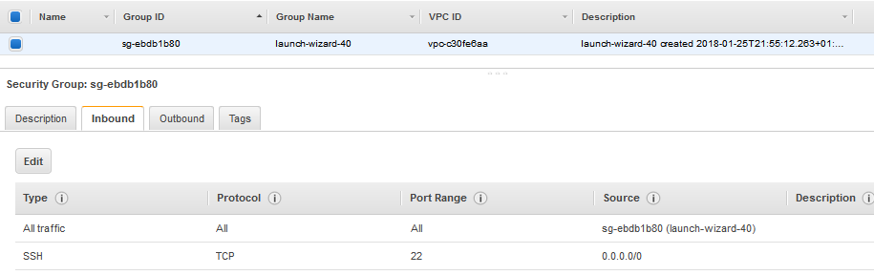
Paswordless SSH cluster
Self-referencing SecurityGroup

Slide 37
Julia cluster specification file and running distributed clusters
$ more machinefile_julia
4*ubuntu@172.31.10.229
4*ubuntu@172.31.11.44
4*ubuntu@172.31.0.243
4*ubuntu@172.31.13.134
4*ubuntu@172.31.14.219
$ julia –machine-file machinefile_julia program.jl
# REQUIRES PASSWORDLESS SSH TO BE CONFIGURED!

Slide 38
Use case scenario: Performance of distributed code in Julia Cray vs AWS

Slide 39
Schelling (1974) segregation model
Agents occupy cells of rectangular space
Two types of agents (e.g. blue and red)
When not happy with their neighbours randomly relocate
☹ Unhappy
(has too few neighbours of the same color)
☺ Happy
(has 5 neighnours of the same color)

Slide 40
Distributed Schelling segregation model
CPU1
CPU3
CPU4
CPU2

Slide 41
Distributed Schelling segregation model
Inner
area
CPU1
CPU3
CPU4
CPU2
Border
area

Slide 42

Distributed simulation architecture
Cray SLURM worker nodes
/or/
AWS Spot fleet instances
within a placement group
Master
node
synchronize
Worker
Worker
Control node
Worker
p2p comm.
Worker

Slide 43
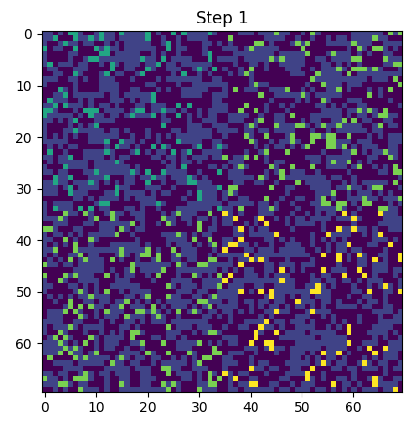
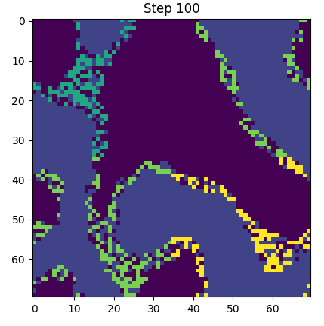
Parallelized Schelling model (2x2)
CPU 1
CPU 2
CPU 3
CPU 4

Slide 44
Parralelizing Julia on Cray with SLURM
julia> using ClusterManagers
julia> addprocs_slurm(200,job_name="my_job", account="GC71-37", time="00:10:00", exename="/lustre/tetyda/home/pszufe/julia/usr/bin/julia")

Slide 45
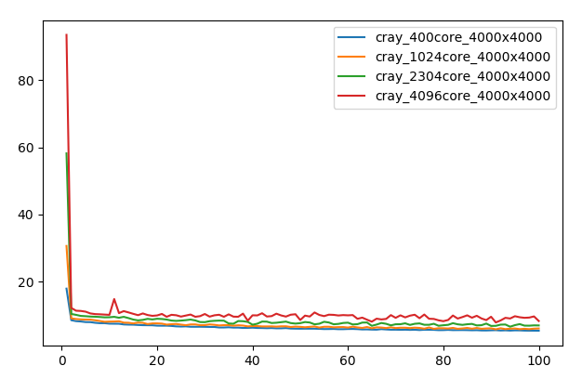
Typical Julia performance pattern ….
Time
to
execute
step
(seconds)
Simulation step

Slide 46
Typical Julia performance pattern ….
Compile time
Time
to
execute
step
(seconds)
Simulation step

Slide 47
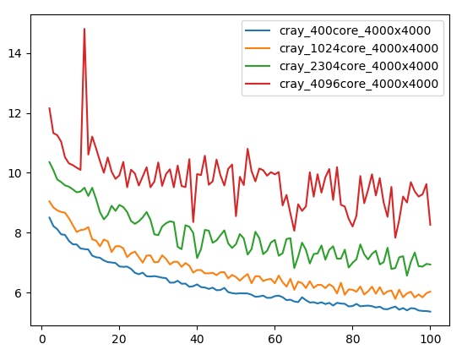
Distributed simulation scalability
Time
to
execute
step
(seconds)
Note:
The first step has been removed
Simulation step

Slide 48
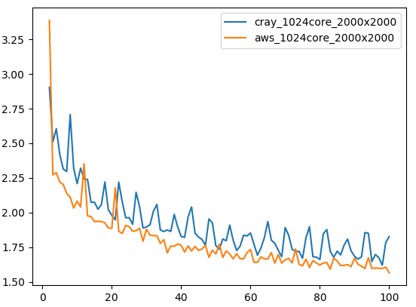
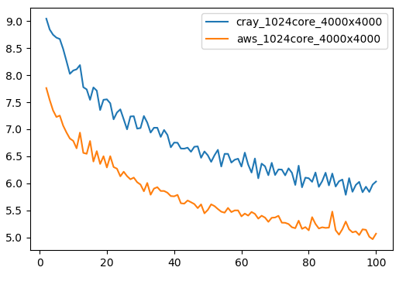
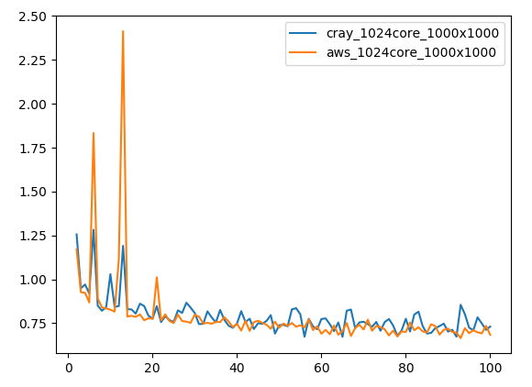
Cray vs AWS Spot Fleet

