Slide 1

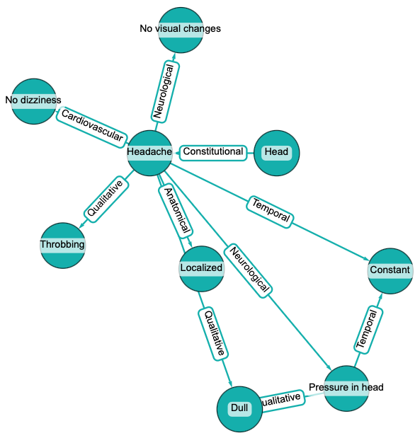
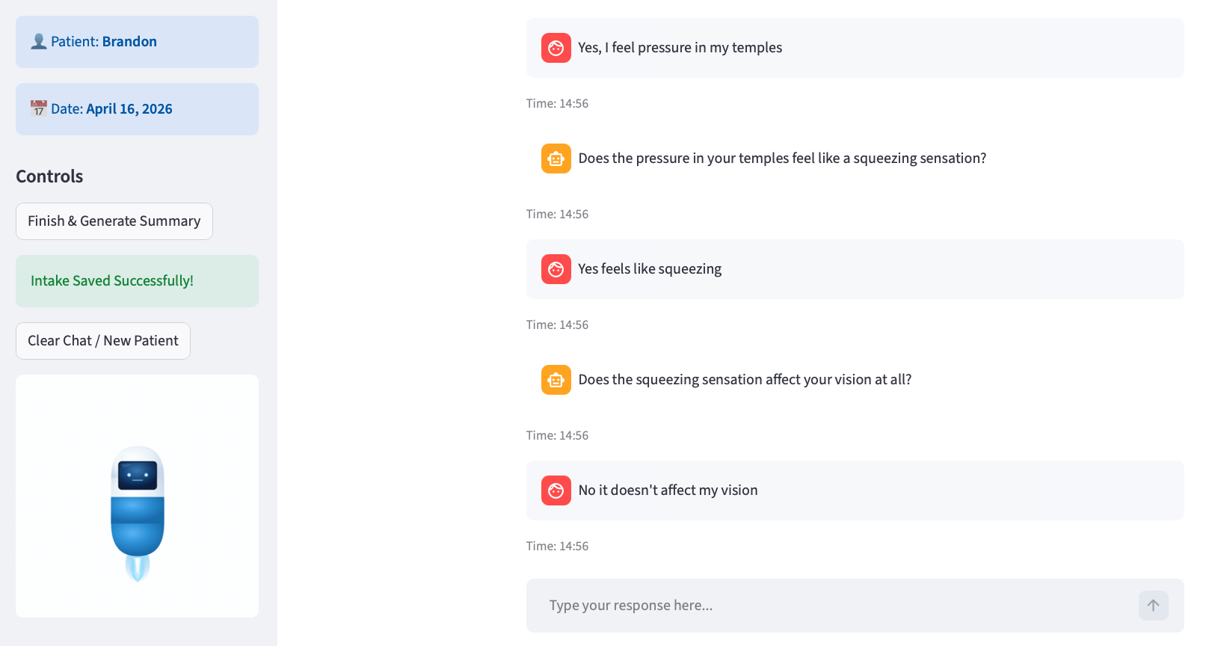
Using Dynamic Knowledge Graphs to Surface Patient Symptoms and Aid Doctors with Diagnosis
Notes:
The dynamic knowledge graph approach has two user interfaces, one that is patient-facing and another that is doctor-facing.
The patient interface (pictured upper right) uses a local LLM to generate questions to ask the patient. As the patient engages with the dialogue, questions and answers are logged in our database. The LLM evaluates patient answers to surface symptom information. After spotting patterns in systems and symptoms, it queries the Unified Medical Language System through its API to find related symptoms. These related symptoms are then used in the questioning process, narrowing down to the specific conditions the patient may be experiencing. The process repeats until UMLS queries have drilled down to the most specific system (example: headache -> frontal headache -> right-sided frontal headache). The conversation ends at this point, a summary is generated and displayed to the patient.
The doctor interface allows for further investigation of the patient dialogue to assist with a diagnosis. Doctors can view the summary, see a visual of the conversation in the form of a knowledge graph, and see the knowledge graphs that were formed throughout the turns of conversation held with the patient to see how the drill down of symptoms was managed. The can also see how symptoms were ranked at different points in the conversation for the LLM to make the choices it did with questioning. Additional notes can be made by the doctor which will be saved in the database for retrieval later.
The major goal of this approach is to make the logic being used for the patient conversation and symptom drill down as transparent as possible to experts who may question the logic an LLM would apply in medical scenarios.

