Slide 1
Permutations and Combinations

Slide 2
Permutations vs. Combinations
Both are ways to count the possibilities
The difference between them is whether order matters or not
Consider a poker hand:
  A♦, 5♥, 7♣, 10♠, K♠
Is that the same hand as:
  K♠, 10♠, 7♣, 5♥, A♦
Does the order the cards are handed out matter?
  If yes, then we are dealing with permutations
  If no, then we are dealing with combinations

Slide 3
Permutations
A permutation is an ordered arrangement of the elements of some set S
  Let S = {a, b, c}
  c, b, a is a permutation of S
  b, c, a is a different permutation of S
An r-permutation is an ordered arrangement of r elements of the set
  A♦, 5♥, 7♣, 10♠, K♠ is a 5-permutation of the set of cards
The notation for the number of r-permutations: P(n,r)
  The poker hand is one of P(52,5) permutations

Slide 4
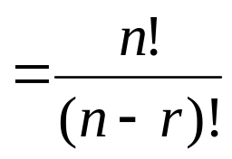
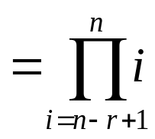
Permutations
Number of poker hands (5 cards):
  P(52,5) = 52*51*50*49*48 = 311,875,200
Number of (initial) blackjack hands (2 cards):
  P(52,2) = 52*51 = 2,652
r-permutation notation: P(n,r)
  The poker hand is one of P(52,5) permutations

Slide 5
r-permutations example
How many ways are there for 5 people in this class to give presentations?
There are 27 students in the class
  P(27,5) = 27*26*25*24*23 = 9,687,600
  Note that the order they go in does matter in this example!

Slide 6
Permutation formula proof
There are n ways to choose the first element
  n-1 ways to choose the second
  n-2 ways to choose the third
  …
  n-r+1 ways to choose the r^{th} element
By the product rule, that gives us:
P(n,r) = n(n-1)(n-2)…(n-r+1)

Slide 7
Permutations vs. r-permutations
r-permutations: Choosing an ordered 5 card hand is P(52,5)
  When people say “permutations”, they almost always mean r-permutations
    But the name can refer to both
Permutations: Choosing an order for all 52 cards is P(52,52) = 52!
  Thus, P(n,n) = n!

Slide 8
Sample question
How many permutations of {a, b, c, d, e, f, g} end with a?
  Note that the set has 7 elements
The last character must be a
  The rest can be in any order
Thus, we want a 6-permutation on the set {b, c, d, e, f, g}
P(6,6) = 6! = 720
Why is it not P(7,6)?

Slide 9
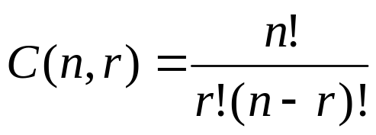
Combinations
What if order doesn’t matter?
In poker, the following two hands are equivalent:
  A♦, 5♥, 7♣, 10♠, K♠
  K♠, 10♠, 7♣, 5♥, A♦
The number of r-combinations of a set with n elements, where n is non-negative and 0≤r≤n is:

Slide 10
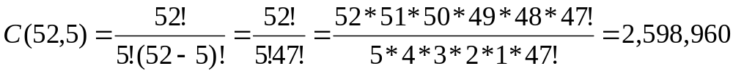
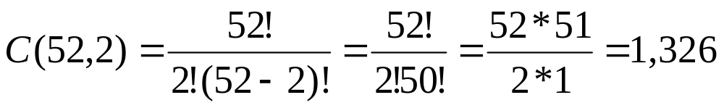
Combinations example
How many different poker hands are there (5 cards)?
How many different (initial) blackjack hands are there?

Slide 11
Combination formula proof
Let C(52,5) be the number of ways to generate unordered poker hands
The number of ordered poker hands is P(52,5) = 311,875,200
The number of ways to order a single poker hand is P(5,5) = 5! = 120
The total number of unordered poker hands is the total number of ordered hands divided by the number of ways to order each hand
Thus, C(52,5) = P(52,5)/P(5,5)

Slide 12
Combination formula proof
Let C(n,r) be the number of ways to generate unordered combinations
The number of ordered combinations (i.e. r-permutations) is P(n,r)
The number of ways to order a single one of those r-permutations P(r,r)
The total number of unordered combinations is the total number of ordered combinations (i.e. r-permutations) divided by the number of ways to order each combination
Thus, C(n,r) = P(n,r)/P(r,r)

Slide 13
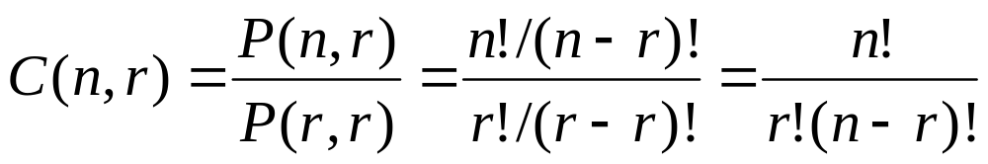
Combination formula proof

Slide 14
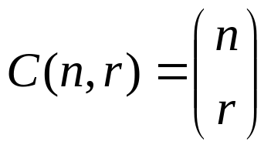
A last note on combinations
An alternative (and more common) way to denote an r-combination:
I’ll use C(n,r) whenever possible, as it is easier to write in PowerPoint

