Slide 1
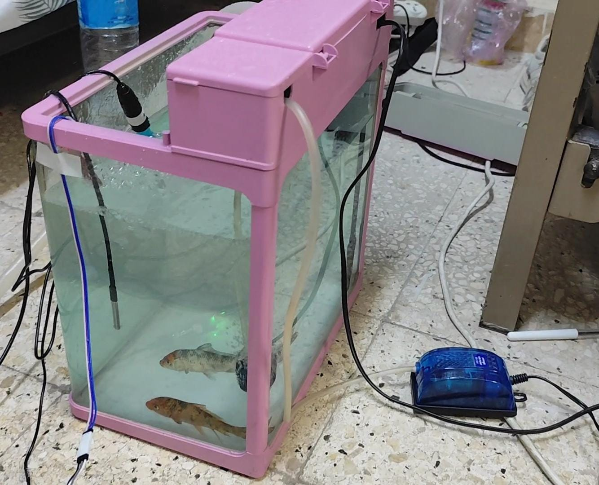
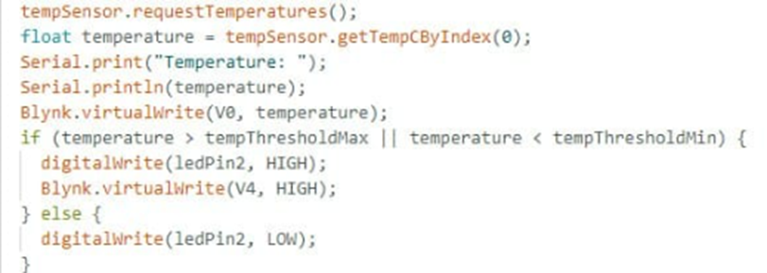
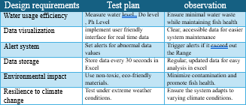
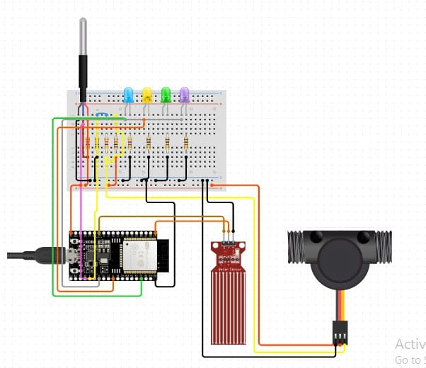
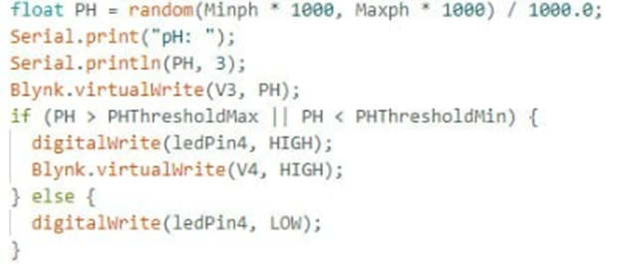
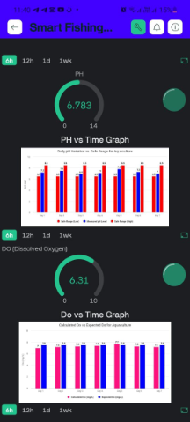
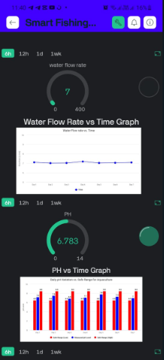
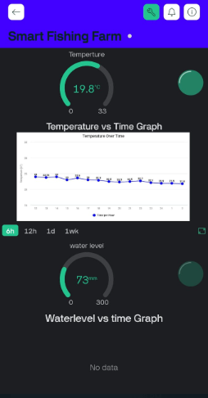
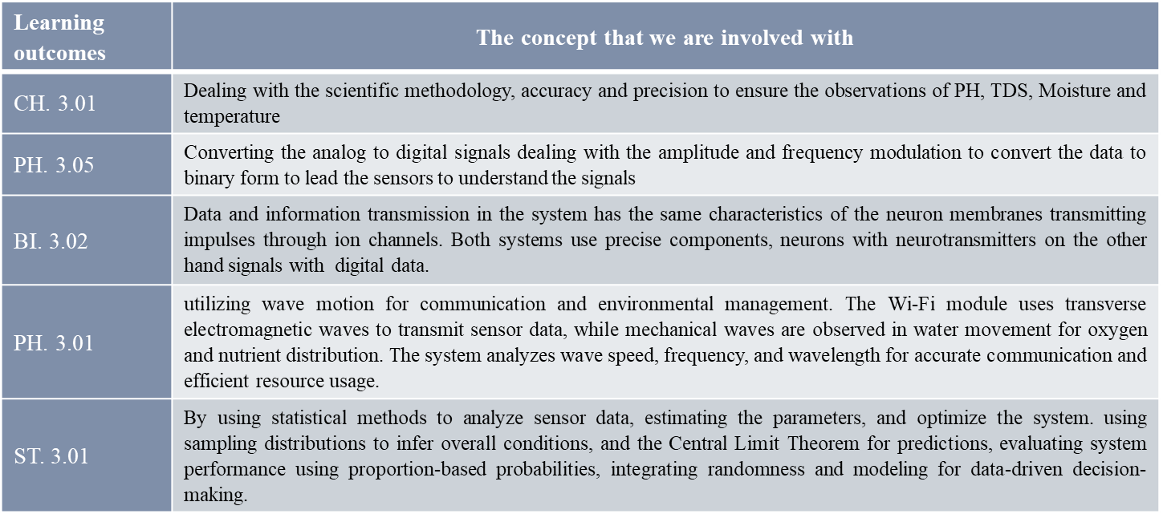
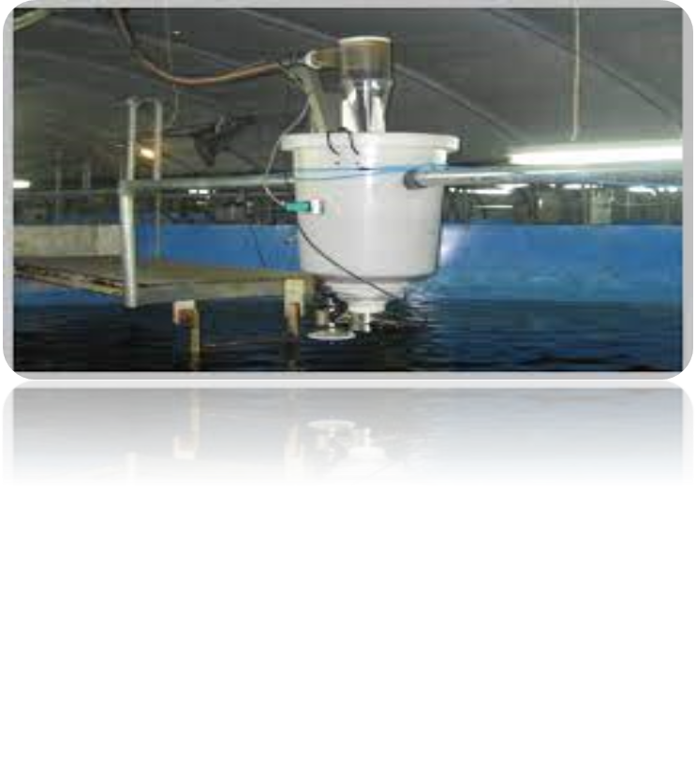

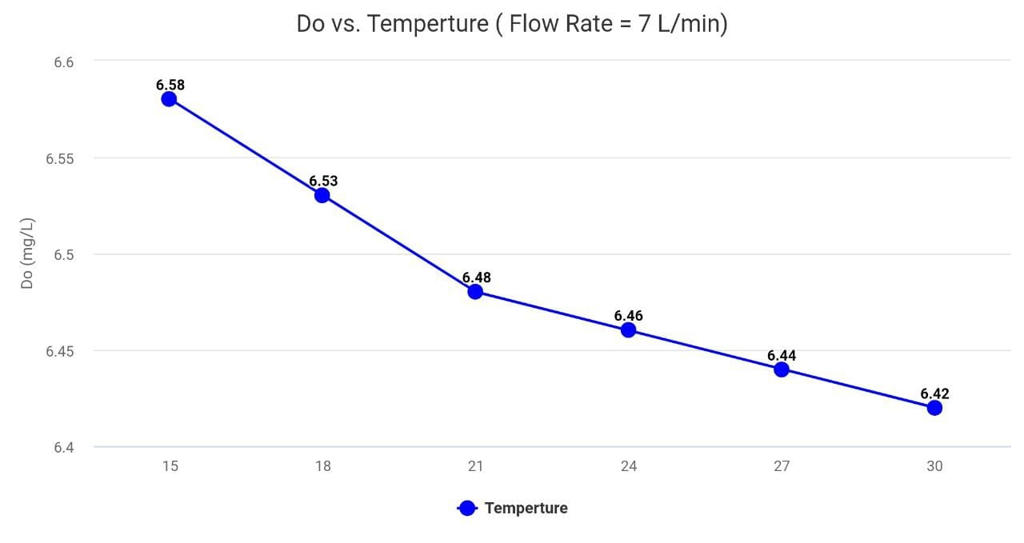
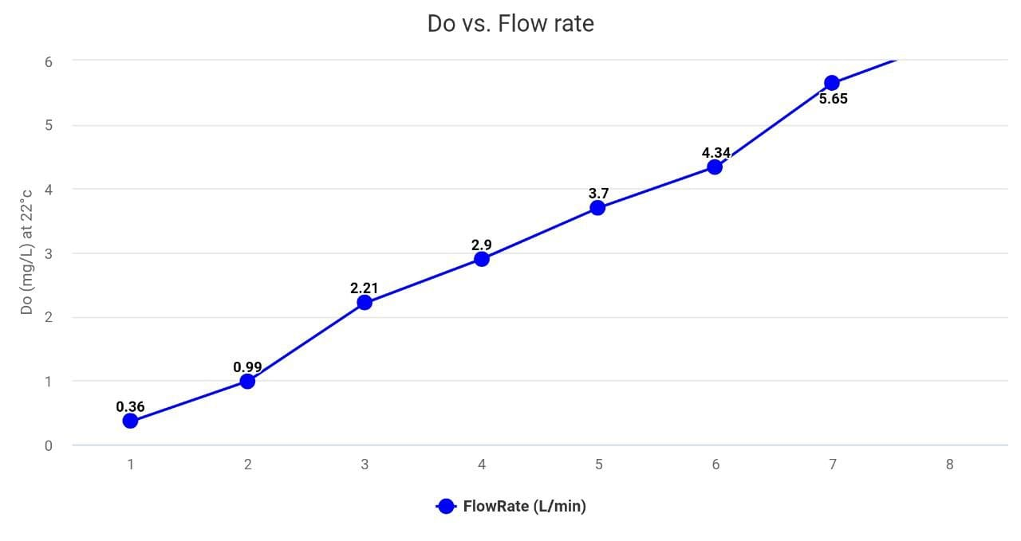
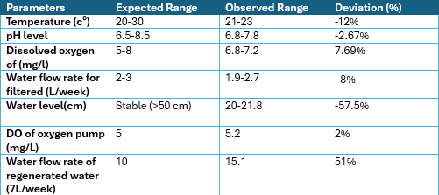
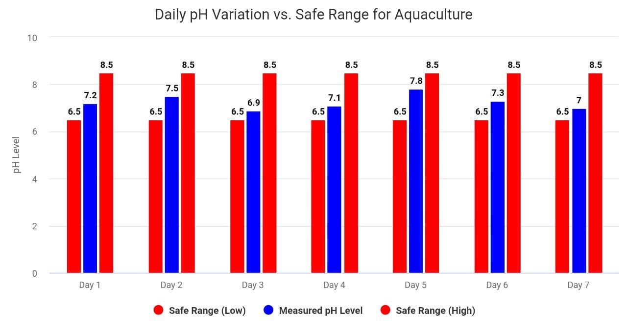
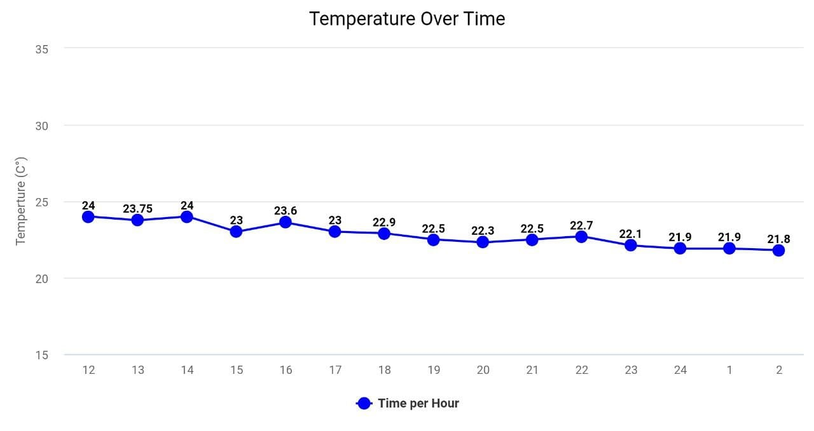
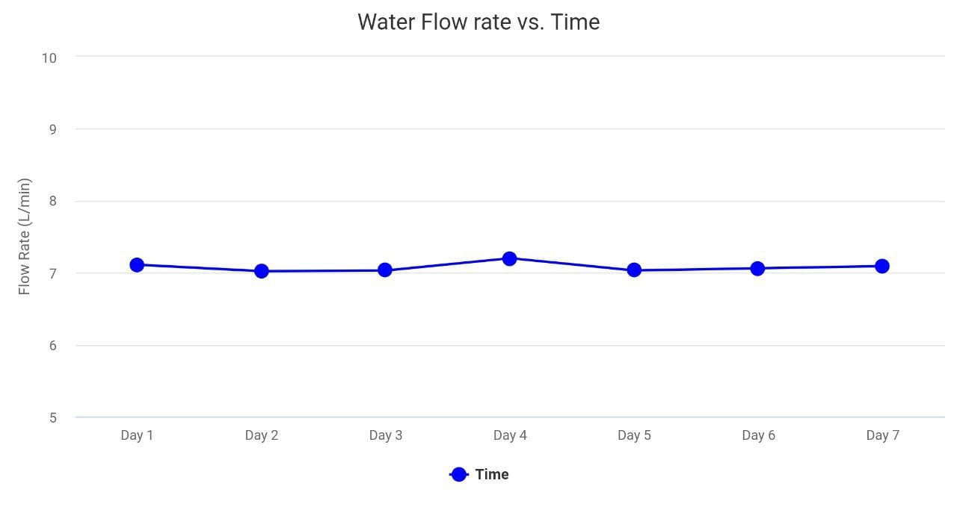
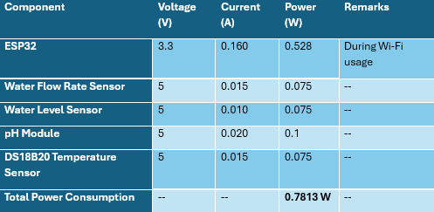
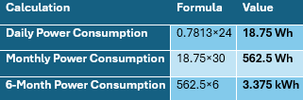

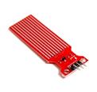
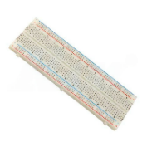

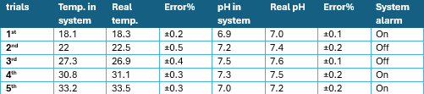
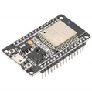
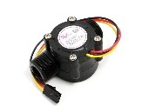
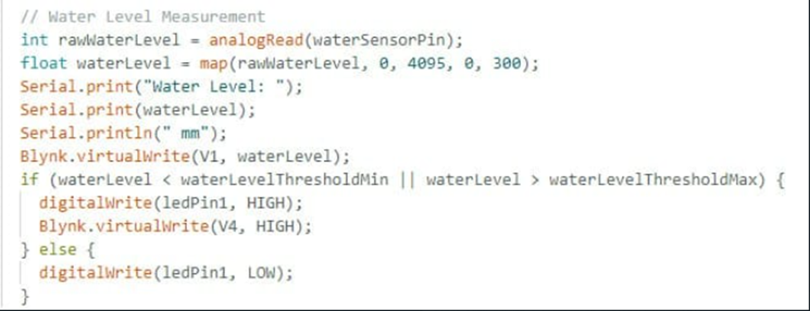
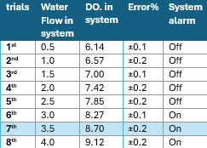
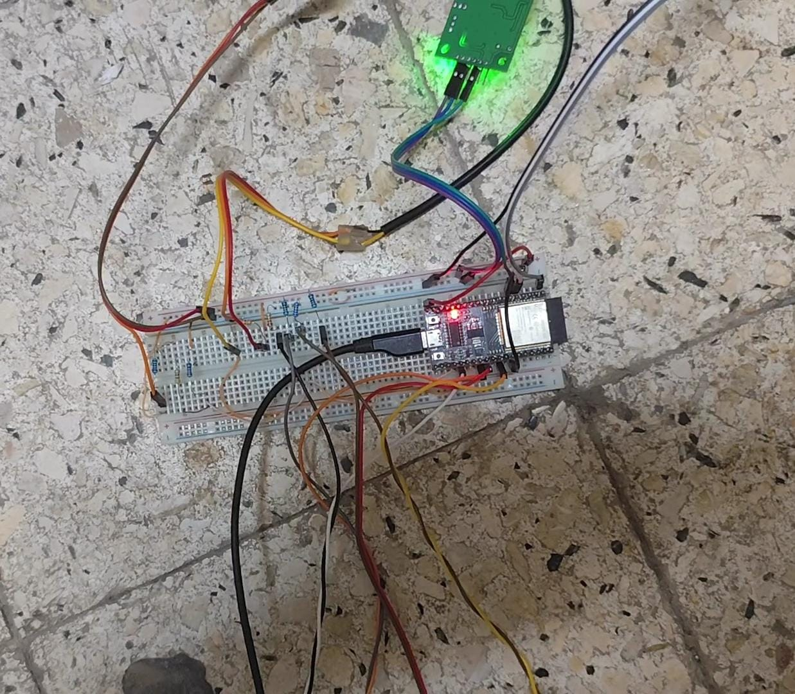
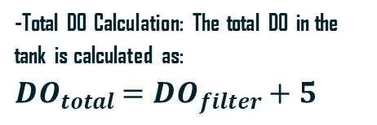
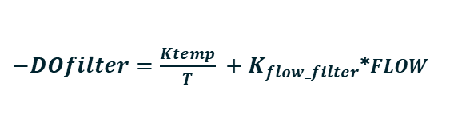
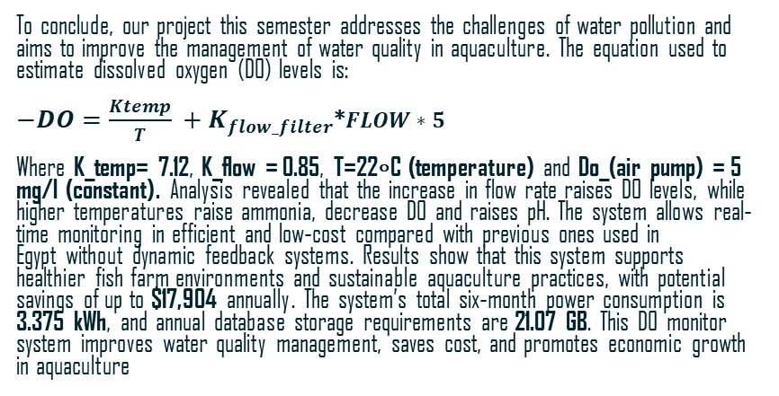
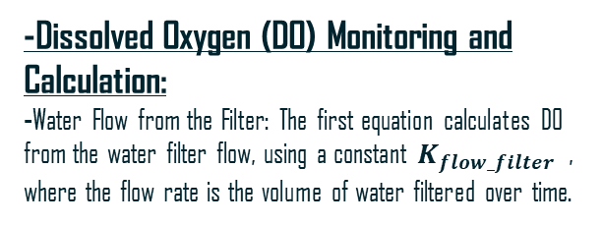
Aquasmart system “ESS”
Abstarct
Results
Learning outcomes
Material& Methods
El-Sadat stem school- grade12- semester1 -schoolyear (2024/2025) -25307
Ahmed Mohamed- Mohammed Amr- Fares Mohammed
Fish Aquarium Construction:
Step 1: A second-hand fish tank was acquired, filled with water, and the fish were added to give as realistic an aquaculture environment as possible.
Step 2: The water filter and oxygen pump were
installed to keep the quality of water good and
create a good environment for the fish.
Step 3: Sensors measuring pH, temperature, and water
level were installed in the aquatic environment to assess
essential water quality indicators shown in fig (3).
Step 4: The flow rate sensor was inserted in the water
filtration device so that the flow rate, a parameter used in
the determination of DO, could be measured.
3-A pH sensor: Tracks water acidity/alkalinity to ensure safe levels Fig (6) -Dashboard:
Using Blynk, real-time sensor data (pH, temperature,
water level, flow rate) is visualized remotely with graphs,
gauges, and notifications as shown in fig (7). Data is logged
into Excel for analysis.
Real-Time Visualization: Custom widgets display data.
Alerts: Push notifications warn of unsafe conditions.
Data Logging: Ensures systematic storage for trends and
analysis.
Table (7) sows how our test plan achieved the design requirements
Aquaculture plays an important role in solving global food problems. To maintain the health and development of aquatic organisms, high-quality water is required. This paper proposes a low-cost IoT-based water quality monitoring system. A microcontroller, the ESP32, collects data from sensors that measure water level, temperature, and flow rate. Dissolved oxygen is calculated using a new equation based on temperature and flow rate, reducing the dependency on expensive DO sensors. Real-time monitoring and notification can be done using the Blynk dashboard, while the data is logged in Excel for further analysis. The tested prototype was effective in monitoring and notifying the key water parameters, thus providing a low-cost method for the maintenance of sustainable aquaculture.
Figure (3)
Figure (5)
Graph (7)
Figure (4)
Figure (6)
Introduction
Great achievements have great results. In this report, we show the outcomes, findings, and achievements of our project as shown in -table (1) which provides the test location, duration, fish stocking density and the water volume. -table (2) provides the observed range and the expected ranges of the parameters of the project. -graph (1) provides variation of pH measurement during a 7 day test, the red color represent the safe range (high, low) of pH -Graph (2) measure temperature over time per hour
-Graph (3) measure water flow rate over time per hour
-Dissolved Oxygen (DO) Monitoring and Calculation: -Water Flow from the Filter: The first equation calculates DO from the water filter flow, using a constant $K_{flow_filter ​}$​, where the flow rate is the volume of water filtered over time.
Water resource management is one of the critical big-picture challenges facing Egypt, particularly aquaculture, which plays a key role in guaranteeing food security and driving economic growth. The maintenance of optimum water quality is an indispensable requirement for the survival and proper productivity of aquatic species. Poor water quality causes reduced yields, higher mortalities, and environmental deterioration, all of which work to threaten the sustainability of the aquaculture sector. Given the limited freshwater resources in Egypt, effective management of water quality is critical to the sustainable future of industry. Previous methods of water quality monitoring have shown some limitations. One such method is the
automatic fish feeding system in Hainan, China,
shown in fig(1) which uses real-time information
on water quality and fish behavior to increase
feeding efficiency. While this system reduces
feed waste and helps improve water quality, the
expensive sensors and complex infrastructure involved make it unfeasible for smaller operations. It also does not consider other important water quality parameters like dissolved oxygen (DO) and pH, which are important for keeping healthy aquatic ecosystems. To bridge these gaps, our project proposes a low-cost, scalable IoT-based water quality monitoring system tailored to the needs of Egypt's aquaculture sector. The system has been designed with the following requirements in mind:
-Water Efficiency: Minimize water usage and waste to improve fish cultivation.
-Data Visualization: Provide clear and accessible data for smallholder farmers, ensuring ease of use and affordability.
-Alert System: Send notifications when abnormal data is detected, enabling quick action..
-Ease of Use: User-friendly features such as remote monitoring and real-time alerts. The system has an ESP32 microcontroller with a built-in pH, temperature, water level, and flow rate sensor. DO is estimated from the novel equation based on temperature and flow rate, minimizing the dependency on costly sensors. The method guarantees the aquaculture water quality management a cost-effective, reliable, and user-friendly solution. Our solution addresses Egypt's grand challenge by providing an accessible and scalable tool for the management of water quality in aquaculture. The following sections present the implementation and testing of the prototype, demonstrating that it is effective in satisfying the design requirements.
$−DOfilter​=\frac{Ktemp}{T}​+K_{flow_filter​}$*$FLOW$
Figure (7)
-DO Calculation from Two Sources of Oxygenation:-Air Flow from the Pump: Through multiple trials, it was observed that the oxygen pump consistently increases DO by 5 mg/L. This increase is treated as a constant.
-Total DO Calculation: The total DO in the tank is calculated as: $${DO}_{total​}={DO}_{filter}​+5$$
- Graph (4,5) show the relation of DO with Temperature and Flow rate
conclusion
Figure (1)
Table (1)
To conclude, our project this semester addresses the challenges of water pollution and aims to improve the management of water quality in aquaculture. The equation used to estimate dissolved oxygen (DO) levels is:
$−DO​=\frac{Ktemp}{T}​+K_{flow_filter​}$*$FLOW∗$ $5$
Where K_temp= 7.12, K_flow = 0.85, T=22∘C (temperature) and Do_(air pump) = 5 mg/l (constant). Analysis revealed that the increase in flow rate raises DO levels, while higher temperatures raise ammonia, decrease DO and raises pH. The system allows real-time monitoring in efficient and low-cost compared with previous ones used in Egypt without dynamic feedback systems. Results show that this system supports healthier fish farm environments and sustainable aquaculture practices, with potential savings of up to $17,904 annually. The system’s total six-month power consumption is 3.375 kWh, and annual database storage requirements are 21.07 GB. This DO monitor system improves water quality management, saves cost, and promotes economic growth in aquaculture
Graph (4)
Graph (5)
Table (2)
Graph (1)
-Yearly Data Transmission Calculation: The total data sent in a year would be approximately 21.07 GB
-total power consumption is calculated in six months is 3.375kWh, by using this rule voltage(v)*current(a) as shown in table (3,4)
recommendation
the following modifications should be done to maintain the efficiency to use this prototype in real life:
- Use a BCP board instead of bread bord to make our system more stability
-Use advanced sensors with higher precision to improve the feasibility of the project and enhance the accuracy of reading
-Add Machin learning which provided by camera module to monitoring fish health and provide information about types of fish on the farm
-Add water flow controller to keep the flow steady and ensure oxygen spreads evenly
- Develop a cloud system for remote monitoring and controlling the system.
Graph (2)
Graph (3)
Analysis
Table (3)
Table (4)
Positive Results: 1-Monitors temperature, pH, DO, and flow rate to ensure optimal fish growth and survival.
2-Reduces contamination, improves fish health, and boosts farm productivity through
continuous monitoring. 3-Cost-effective, scalable, and easy to deploy for farms of all sizes.
4-Real-time monitoring enables proactive decisions, preventing issues and increasing efficiency.
Negative Results:
1. The inaccuracy of the sensors may vary because of environmental changes and may
introduce slightly different measurement readings.
2. The continuous power dependence of the system could be problematic to areas with
unstable electricity; thus, the extra management of power would be needed. Specific Problem: This project is confronting the problem of water quality management in aquatic environments, especially regarding oxygen level, flow rates, and pH imbalance under optimal conditions for fish survival
-test plane:
To work on our project the project was tested to make sure the project meet the design requirements. The first part is Sensor Testing , Integration and warning system
It was necessary to test all sensors of the system for accuracy and proper functioning while connecting them to the Arduino Uno controller. These tests were done to the:
-pH Sensor: Ensures water acidity/alkalinity stays optimal for fish health. -Temperature Sensor: Maintains stable water temperature to prevent fish stress.
Literature citation
Water temp. sensor
Water level sensor
- Food and Agriculture Organization of the United Nations (FAO). (2023). Aquaculture systems and technologies. https://www.fao.org/aquaculture. - Chen, C.-H., Wu, Y.-C., Zhang, J.-X., & Chen, Y.-H. (2022). Iot-based Fish Farm Water Quality Monitoring System. Sensors, 22(17), 6700. https://doi.org/10.3390/s22176700 - Huang, D. Z. (2012). Modeling and simulation of the dissolved oxygen monitoring system in aquaculture. Advanced Materials Research, 605–607, 910–914. https://doi.org/10.4028/www.scientific.net/amr.605-607.910 - Meseguer, J., & Quevedo, J. (2017). Real-time monitoring and control in water systems. Advances in Industrial Control)pp. 1–19).springer. https://doi.org/10.1007/978-3-319-50751-4_1 .-pppppppppppppp9867iK
- United States Environmental Protection Agency (EPA). (2022). Water quality monitoring in aquaculture.https://www.epa.gov/water-quality-monitoring/aquaculture.
PH sensor
This table shows the results of trials to evaluate the system’s temperature and pH measurements. The "Temp. in system" and "pH in system" are the readings from the system, while "Real temp." and "Real pH" represent the actual measured values. The Error% column indicates the deviation between the system and real values. The System alarm column shows when the alarm was triggered, indicating that the readings were outside the optimal range, which occurred in the 1st, 4th, and 5th trials.
Total price: LE
Bread Board
Esp 32
Water flow rate sensor
Egypt Grand Challenges: Advancing Society: This program aligns with Egypt's efforts to advance technology in agriculture, promoting smarter development in the aquaculture industry through innovative, tech-driven solutions. By ensuring optimal water quality, the system supports sustainable freshwater resource management, contributing to both agricultural efficiency and environmental conservation.
Table(5)
System Building:
Step 1: The ESP32 is fixed into a breadboard, with easy connections.
Step 2: The sensors for pH, temperature, water level,
and flow rate were all wired to the ESP32 for the
measurement of water quality parameters shown in fig (2,4).
Step 3: A buzzer and LEDs were implemented to
provide alarm notifications to the users when the
water quality parameters exceeded safe thresholds.
and "Real pH" represent the actual measured values. The Error% column indicates the deviation -Flow Rate Sensor: Monitors water Circulation for adequate oxygen and nutrient distribution. -Dissolved Oxygen (DO) Calculation: DO= (𝐾𝑡𝑒𝑚𝑝/T) + (𝐾𝑓𝑙𝑜𝑤×FLOW) + 5
Further information
-sensors functions :
As water flow increases, DO levels rise. The alarm triggers when DO exceeds 8 mg/L, starting from trial 6. The error percentage shows the accuracy of system readings, highlighting the need for balanced flow.
-mohamed.2522043@stemelsadat.moe.edu.eg
-Ahmed.2522029@stemelsadat.moe.edu.eg
-fares.2522038@stemelsadat.moe.edu.eg
Figure (2)
1-The water level sensor: Water Level Sensor: Monitors water depth to prevent overflow Fig (4)
2-temperature sensor: Measures water temperature for aquatic well-being Fig(5)
Table(6)
Figure (4)

