Slide 1
Last.fm Music Recommendation
Stewart Gibson
EDSP Spring ‘17
5/8/17

Slide 2
Project Objective
Objective: To be able to recommend new artists to users, based on their listening history, through an algorithm that relies on the listening patterns of last.fm users.
Ideally based on a hybrid algorithm that combines user-based collaborative filtering and item similarity recommendations.

Slide 3


Progress through midterm
Had a working program that recommended 30 new artists to a user based on their (hypothetical) listening history.
Relied on UBCF through “recommenderlab” R package.
John likes the Beatles, the Rolling Stones, and Elton John
Susan likes the Beatles, Elton John, and the Beach Boys
Might Susan also like the Rolling Stones?

Slide 4
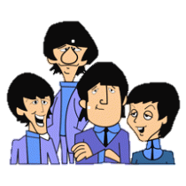
Recent Progress: Artist Similarity
Previous program relied on user similarity.
I have since created a program that identifies artists as being similar based on overlap of users who listen to artist(s).
The Beatles are similar to the Rolling Stones
Susan likes the Beatles, Elton John, and the Beach Boys
Might Susan also like the Rolling Stones?

Slide 5
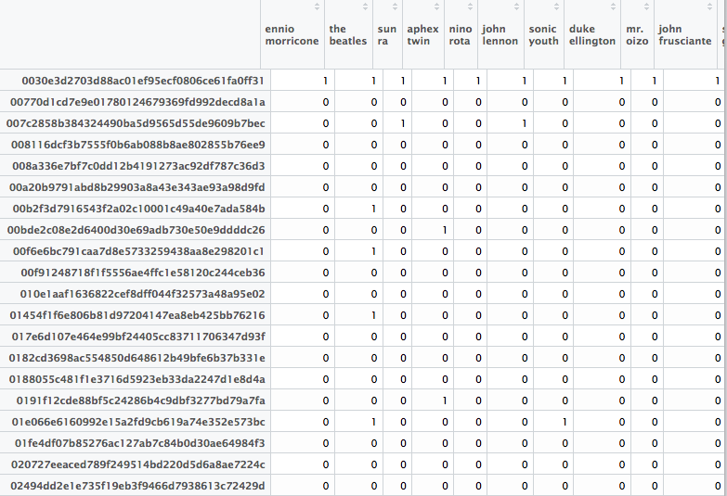
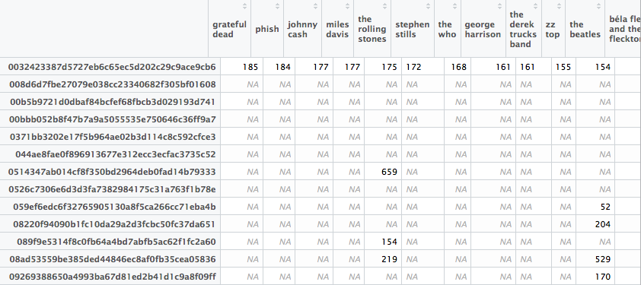
How is this done?
Previously, “utility matrices” listed the number of listens by a user of a particular artists. Now this is coded as a 0/1 binary (0 = user_i hasn’t listened to artist_j, 1 = user_i has listened to artist_j).
Only includes artists with at least 500 listeners.

Slide 6
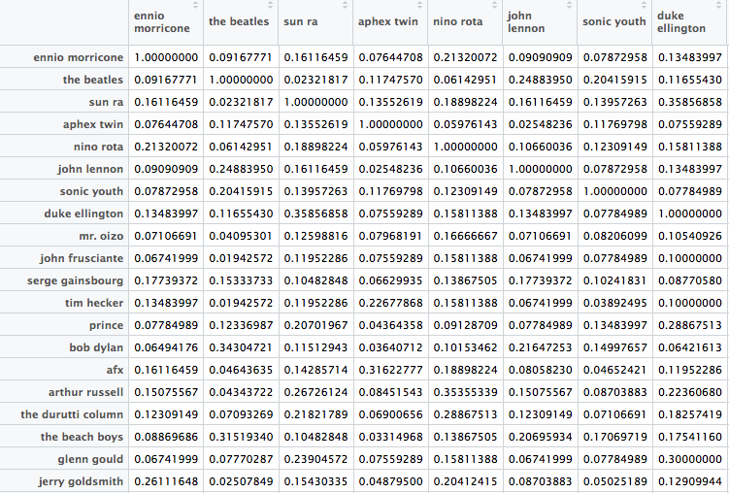
How is this done? (continued)
Create a matrix of cosine similarity measures between artists.
This creates a matrix of 0-1 similarity measures.

Slide 7
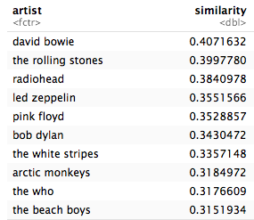
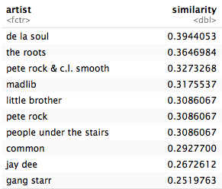
Some Examples
Similar to: The Beatles
Similar to: A Tribe Called Quest

Slide 8
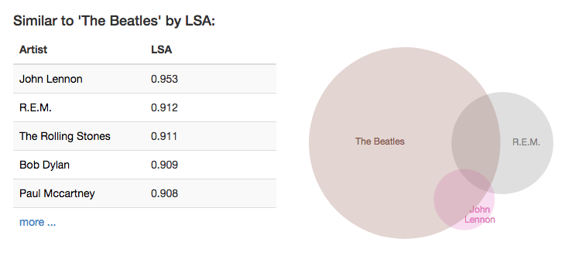
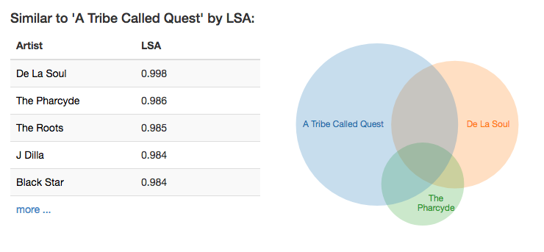
Visualization
I liked a visualization tool provided by Github contributor Ben Frederickson…

Slide 9
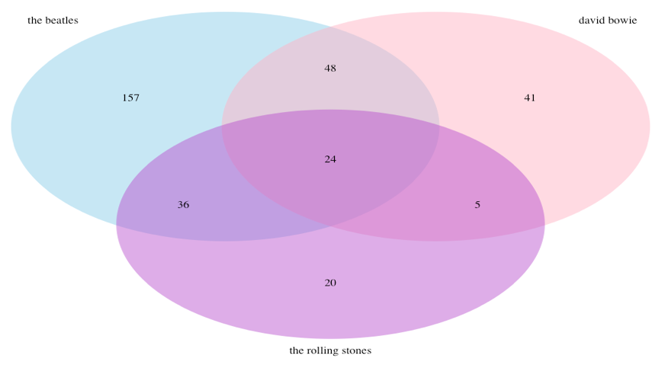
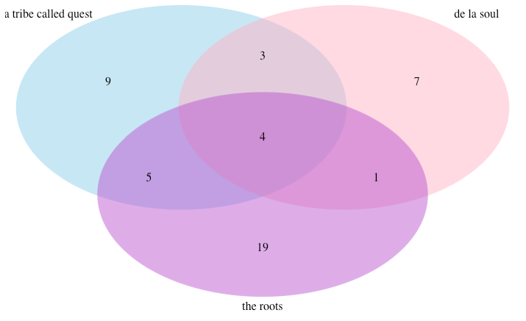
Visualization
…So I decided to do the same using my cosine similarity measures.
Similar to: The Beatles
Similar to: A Tribe Called Quest

Slide 10
Using my Repo
This is functionally where I am at.
One nice thing about my repository, is that an outside user could go in and create a matrix of their listening preferences and create a list of recommended artists (“Interactive recommender.Rmd”) or they could find a short list of artists that are similar to a single artist that they are interested in finding similar music for (“Artist Similarity.Rmd”).

Slide 11
What’s left to do?
As noted in the midterm, the goal was to create a hybrid recommender.
I feel like I have the pieces in place to carry out some iteration of this.

Slide 12
The End

