Slide 1
Music Recommendation Program
Stewart Gibson New York University
March 27, 2017

Slide 2


Introduction
The goal of the program is to recommend music to users based on their past listening history.
The recommendation program relies on user-based collaborative filtering (UBCF). This method identifies users with similar listening preferences and based on the preferences of “neighboring” users recommends new music to the test user.
John likes the Beatles, the Rolling Stones, and Elton John
Susan likes the Beatles, Elton John, and the Beach Boys
Might Susan also like the Rolling Stones?

Slide 3
Recommendation Methodology
Many recommendation engines are content-based recommenders, meaning that they recommend items with similar characteristics or tags (i.e. genre, year, etc.).
Some of the more advanced algorithms rely on a combination of content-based and collaborative filtering recommendation, sometimes referred to as a “hybrid” model.
Collaborative filtering:
Training
Set
Raw
Data
Utility
Matrix
Recs
List
Test
Set

Slide 4
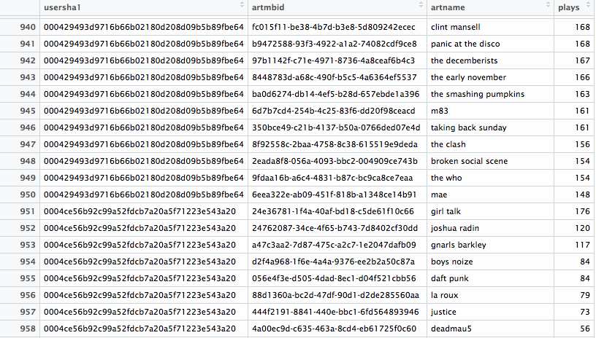
Data: Last.fm Playcounts
Publicly available dataset
# of user-artist combinations: 11,708,729
# of unique users: 334,063
# of unique artists: 215,578

Slide 5
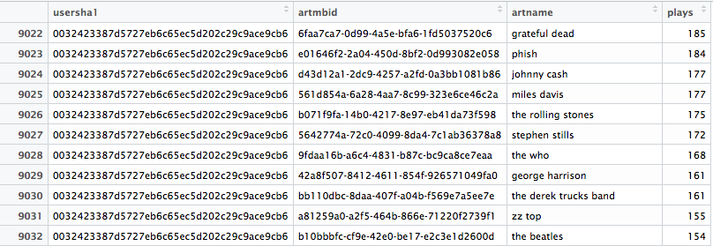
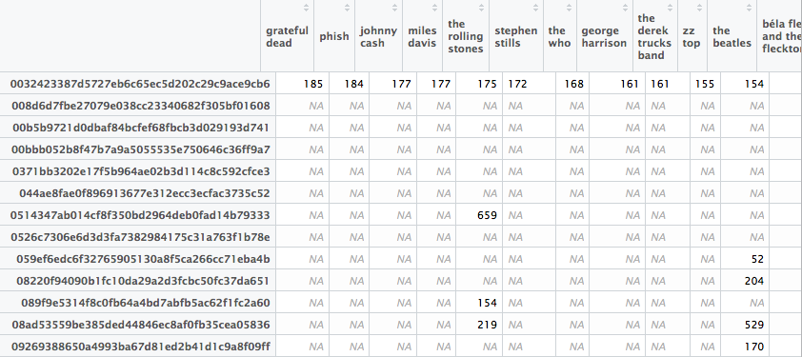
Data: Creating a Utility Matrix
(User ID)
(Artist ID)
(Artist Name)
(Playcount)
Raw Data
(Artist Name)
(User ID)
Utility Matrix

Slide 6
Recommendation Model
Think of a user’s unique musical preference as a row vector of values. <185, 184, 177, 177, 175, 172, 168,…………, NA, NA, NA, NA>
Recommendation program identifies other users with most similar musical preferences (“neighbors”), by finding users with smallest distance from a user.
Variety of similarity/distance measures that are used to determine how similar users are. I use Cosine Distance in my simulation.

Slide 7
Model Simulation
Although a recommendation program that is trained by the full dataset is ideal, there is simply too much data to do so in a timely manner.
My prototype recommends new music based on the preferences of a small 250-user subset of the full dataset, trading accuracy for efficiency.
Using utility matrix, identify users (rows) with similar listening preferences. Project listening preference for new music based on similar users’ listening preferences.

Slide 8
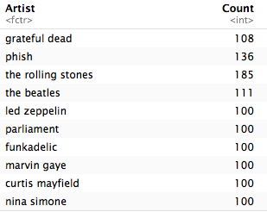
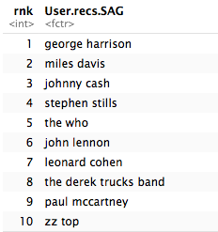
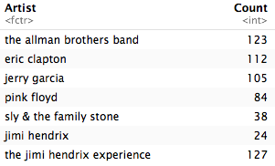
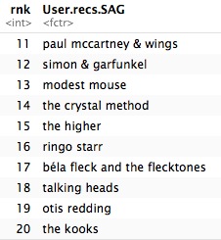
Recommendation Results
Recommendations for a hypothetical user listening history. Recommendations are ranked, seem to be appropriate.
Listening History
Recommendations

Slide 9
Additional Steps
Evaluate the recommendations. There are statistical approaches for evaluating the effectiveness of machine learning models which I plan to implement moving forward.
Experiment with different user-similarity measures, number of nearest neighbors to recommend music from.
Increase the size of training utility matrix. With more users & artists to draw from, the program should be able to offer more appropriate and specific recommendation lists.
Consider implementing a hybrid model.

Slide 10
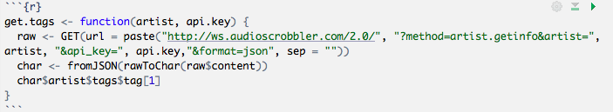
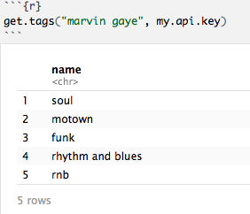
Progress: Content-based Recommendation
I’ve built a function for scraping the “tags” associated with each artist from Last.fm’s API.
I have been able to scrape tags associated with artists in my data.

Slide 11
Goal: Hybrid Model
Item Characteristics: Tags
User Listening History
Recommendation Algorithm
Artists Recommendations

Slide 12
The End

